Slide 1
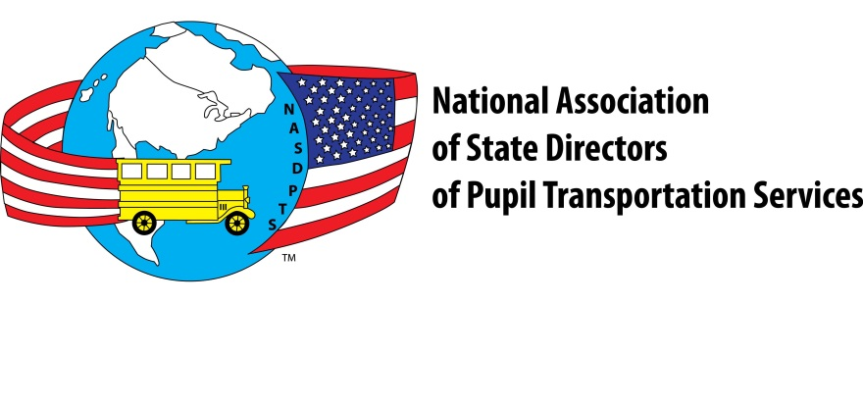
To Belt or Not To Belt?
Presented by Charlie Hood, NASDPTS Executive Director
to Colorado State Pupil Transportation Association
June 23, 2017

Slide 2
School Bus Transportation
Yellow school buses comprise the largest transportation system in the United States – 480,000 buses transporting more than 26 million children each day .

Slide 3
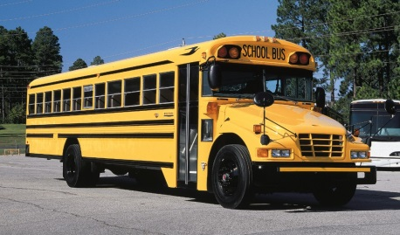
School Bus Safety Facts
School buses are the safest form of transportation for getting children to and from school.
According to ASBC and the National Highway Traffic Safety Administration, students are about 70 times more likely to arrive at school safely if they take the school bus rather than traveling by car.

Slide 4
School Bus Safety Facts
School buses must meet 37 different Federal Motor Vehicle Safety Standards – more than any other vehicle in the nation.
The unique design, color and size, rigorous construction standards of school buses, combined with flashing red lights, cross view mirrors, and crossing and stop sign arms ensure children are protected and secure on and off the bus.

Slide 5
But Can They Be Even Safer?
The National Transportation Safety Board and NASDPTS believe the answer is, “YES.”
In November 2017, NTSB released a video explaining the high level of safety provided by school buses and explaining these three ways of protecting student riders:
Compartmentalization
Compartmentalization plus two-point lap belts
Compartmentalization plus three-point lap/shoulder belts.
“NTSB Presents: School Bus Safety,” can be viewed at https://www.youtube.com/watch?v=ksw67zFnuAE

Slide 6
Accurate Terms are Important!
“Belts” or “Seat Belts” is a meaningless term that can be misconstrued
“Lap Belts” or “2-point Lap Belts” describes a specific design
As does “Lap/shoulder Belts” or “3-point Lap/Shoulder Belts”

Slide 7
What is a “Seat Belt?”
It’s a confusing term. It’s either a “lap belt” or a “lap/shoulder” belt
Two-point lap belts in cars starting in early 1960s
National Transportation Safety Board in 1999 called lap belts “obsolete technology”
Three-point lap/shoulder belts have been required in most vehicles for years
Lap/shoulder have belts proven to be the most effective safety restraint

Slide 8
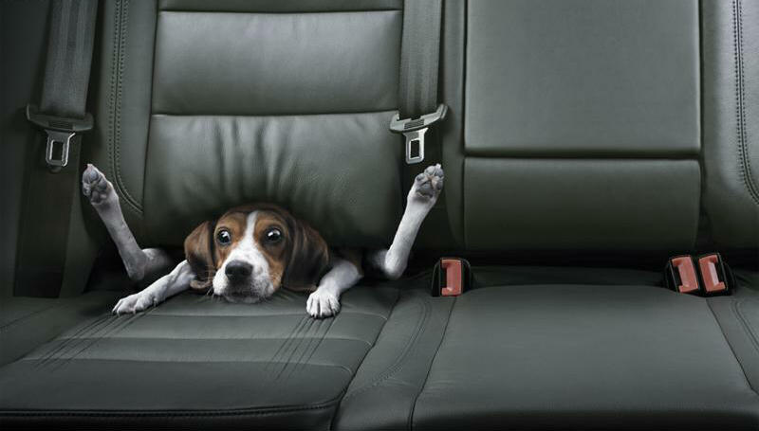

Slide 9
What is “Compartmentalization”
System of passive passenger crash protection required on all large school buses since 1977
Padded seats, spaced closely together
Provides a protective cocoon or “compartment” that retains students in most, but not all, crashes
Padding and designed bending of seat frames absorb crash forces

Slide 10
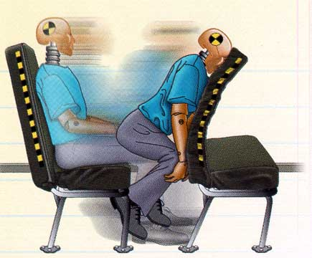
Compartmentalization
Acts like a protective envelope
Seat backs are high,
flexible and
energy-absorbing
Seats are closely spaced
Notes:
Discuss seat construction: high density foam for absorption…top part of seat uses no steel bars to mold seat frame.
To receive the benefits of Compartmentalization children need to be over 48 pounds and six years of age.

Slide 11
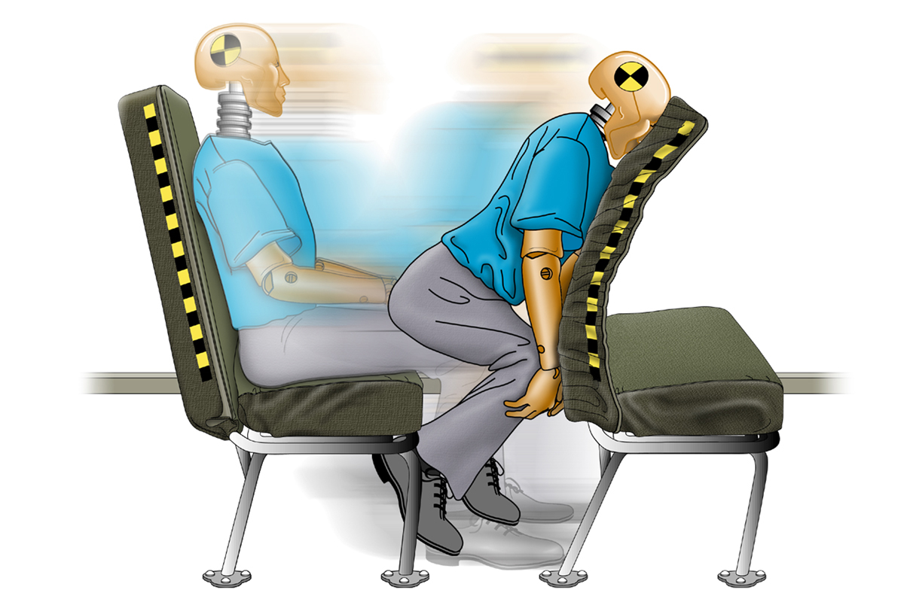

Slide 12
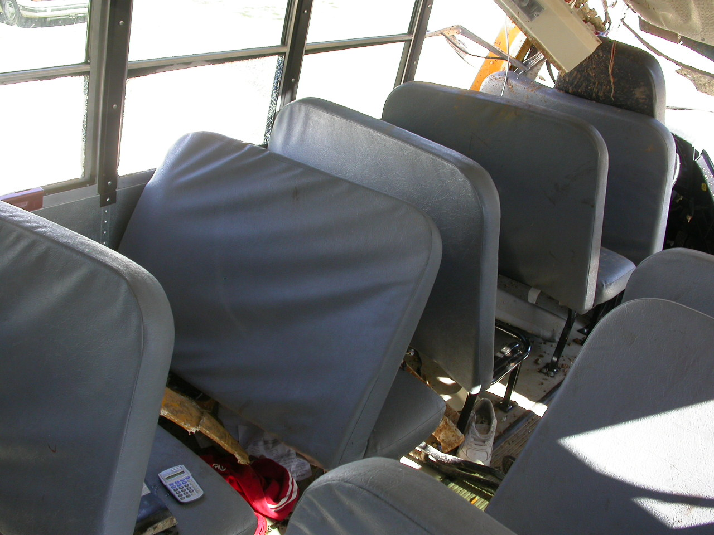
Huntsville Crash November 20, 2006

Slide 13
Does Compartmentalization Work?
Studies by Transport Canada, National Highway Traffic Safety Administration, National Transportation Safety Board confirmed compartmentalization very effective in most types of serious crashes
Students seriously injured or killed are usually directly at the point of intrusion
Students, though, can be ejected in severe rollovers or side impact collisions
Students can impact each other or bus interior

Slide 14
Florida’s Law (s.316.6145)
Requires “Safety belts or…other restraint system…”
Applies to each public school bus purchased after 12/31/2000
Requires students to wear “properly adjusted and fastened safety belt”
Districts and operators are not liable for use, nonuse, or misuse of a belt
Requires 1st priority for elementary grades

Slide 15
How Florida Got Lap Belts
Citizen interest and Florida PTA platform; no one high profile crash or trigger event
Legislative testimony from citizens, FPTA, FAPT, doctors, injured student
NHTSA announced research plan in late 1990s on possible improvements to crash protection in school buses
Section 316.6145, School Bus Safety Restraints, passed in 1999 as final day amendment to unrelated bill (HB 21)

Slide 16
Why Two-point Lap Belts in FL?
Until about 2004 lap belts were only additional restraint system available in large school buses (to comply with s.316.6145, FS)
Nearly all 15K Florida buses now have lap belts
Current three-point lap/shoulder belt systems only available from bus/seat manufacturers since about 2007 without reducing capacity
Until recently significant cost impact of lap/shoulder belts as std. equipment would have required new legislation

Slide 17
States With “Seat Belt” Laws
New York – Lap belts, use not required
New Jersey - Lap belts, use required
California – Lap/shoulder (L/S) belts, use required
Louisiana – few in use, never funded
Florida – Lap belts, use required
Texas- Lap/shoulder belts starting Sept. 1, 2017, unless districts vote to opt out
Nevada- Lap/shoulder belts starting July 1, 2019

Slide 18
New Buses or Retrofits?
All state laws required installation in new buses as of specified dates
Retrofitting is not recommended for several reasons:
Unreasonably high cost
Requires replacing all seat frames usually
Floor structure may not accommodate loads unless installation done per OEM specs
Liability of improper installations
“Convertible” seats may be exception

Slide 19
Implementing Florida’s Bill
Section 1006.25, Florida Statutes, requires State Board of Education to adopt school bus specifications
FAPT and FDOE developed technical specifications for State Board
Specs require one, color-coded lap belt system per passenger in all new buses (2001 and later)
FAPT studied NY, NJ experience and developed “best practices” document
Best practices guides drivers on how to instruct students and enforce belt use

Slide 20
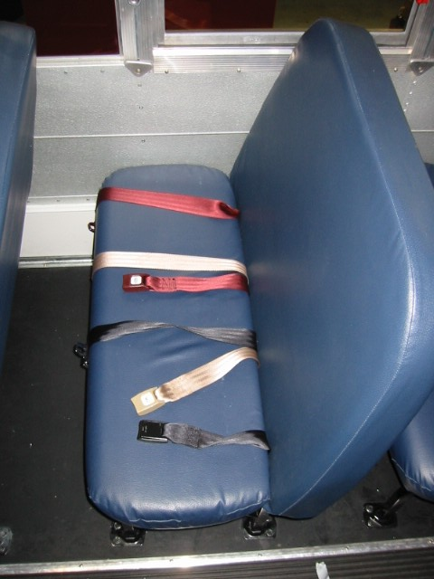

Slide 21
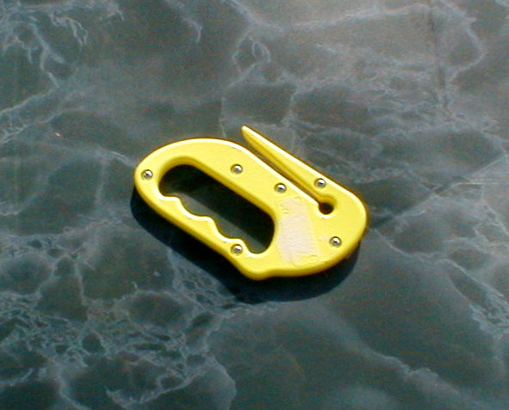
Belt Cutter Required
All Florida buses shall be equipped with a durable webbing cutter that will be mounted in a location accessible only to the driver in an easily detachable manner.
(Rule 6A-3.0121(1), Florida Administrative Code)

Slide 22
Florida Lap Belts (2001-2017):
One serious rollover crash (Milton, FL) where belts very likely saved lives or serious injuries
Usage rates in districts responding to survey: 70% elementary; 35% middle school; 25% high school
Vandalism, maintenance not major concern
Discipline effects positive for elementary
Drivers enforce by verbal instructions

Slide 23
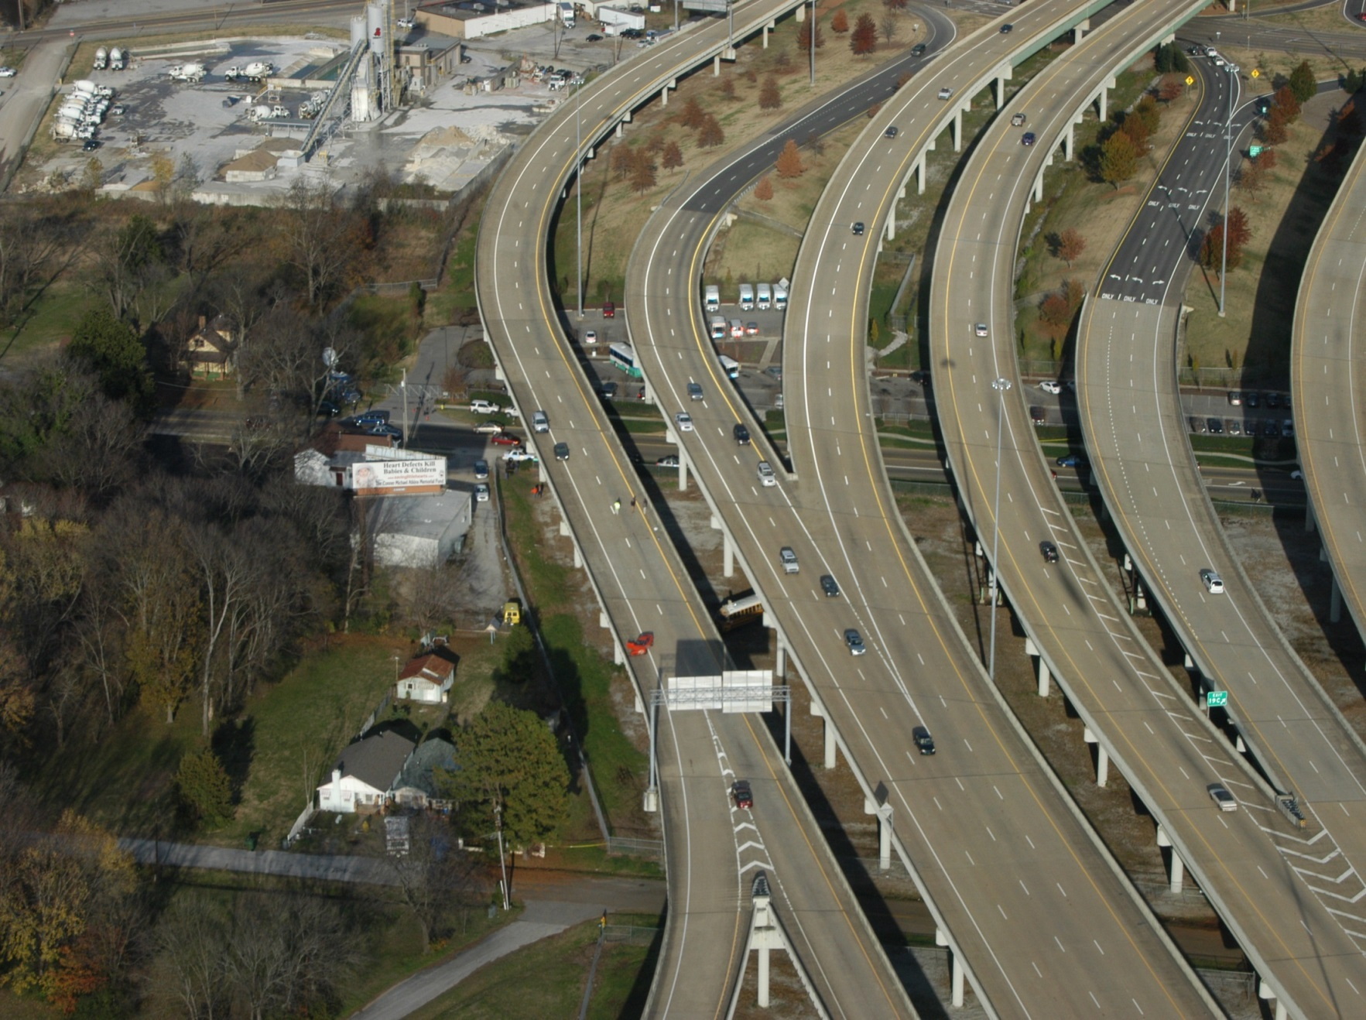
2006 Huntsville, AL Crash

Slide 24
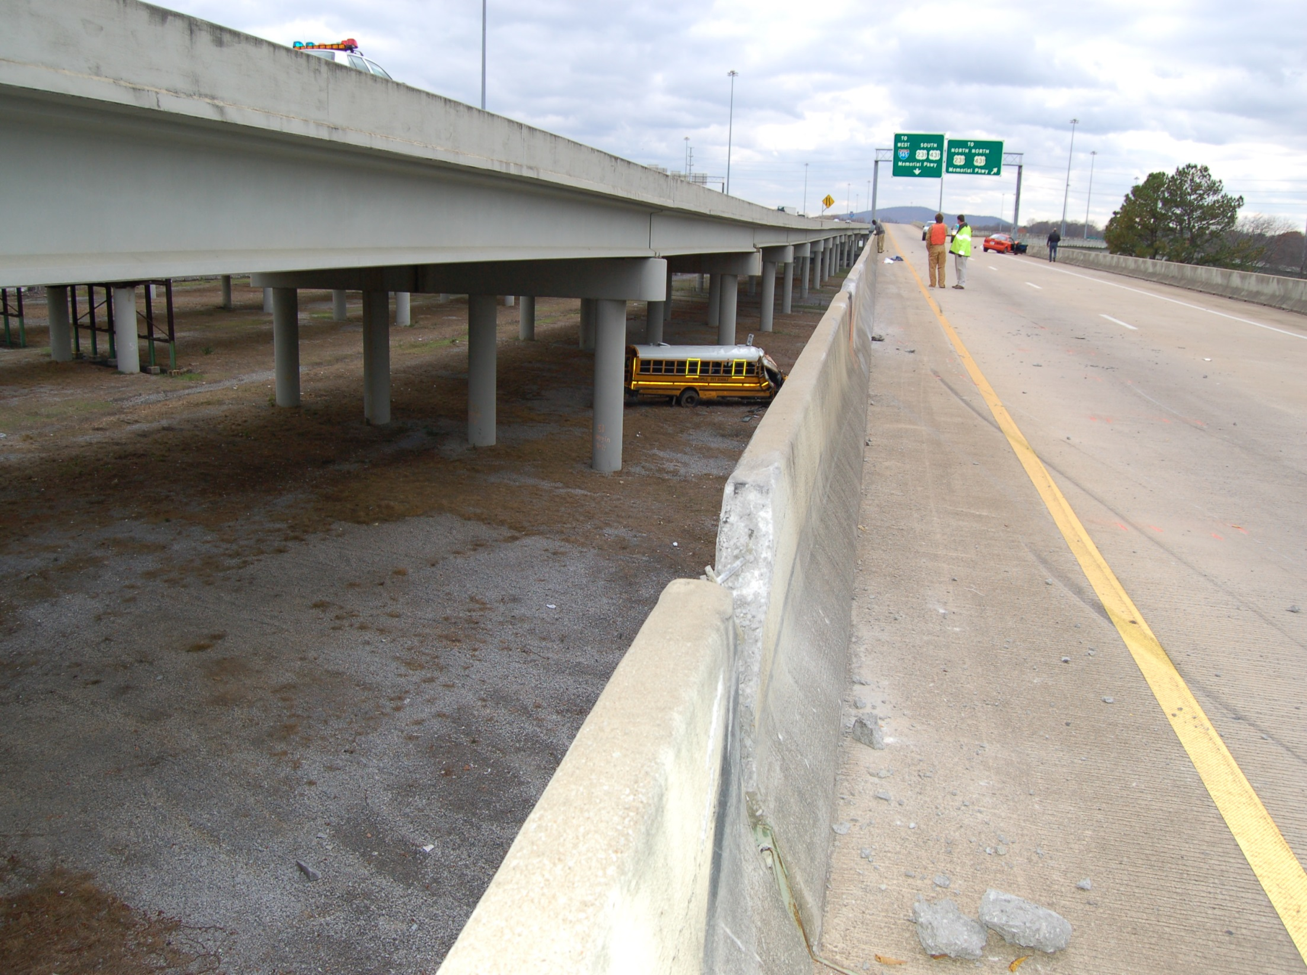
Huntsville Crash November 20, 2006

Slide 25
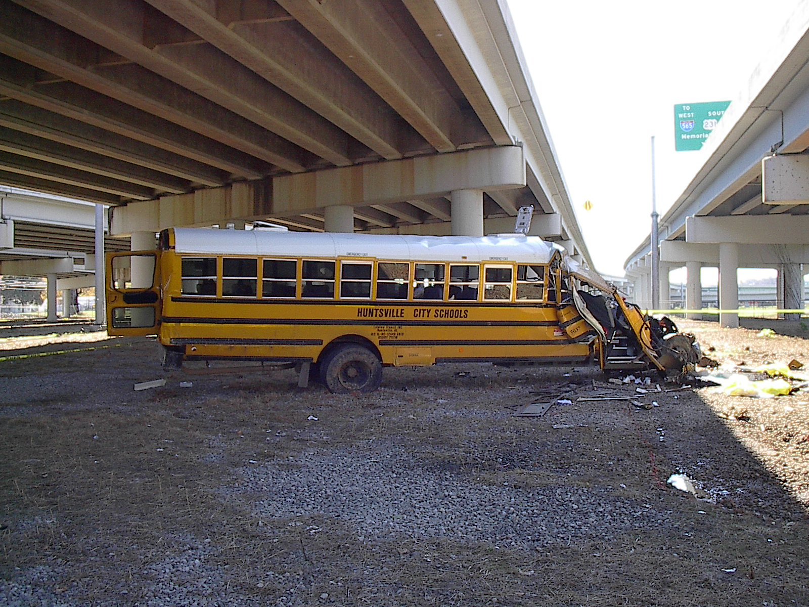
Huntsville Crash November 20, 2006

Slide 26
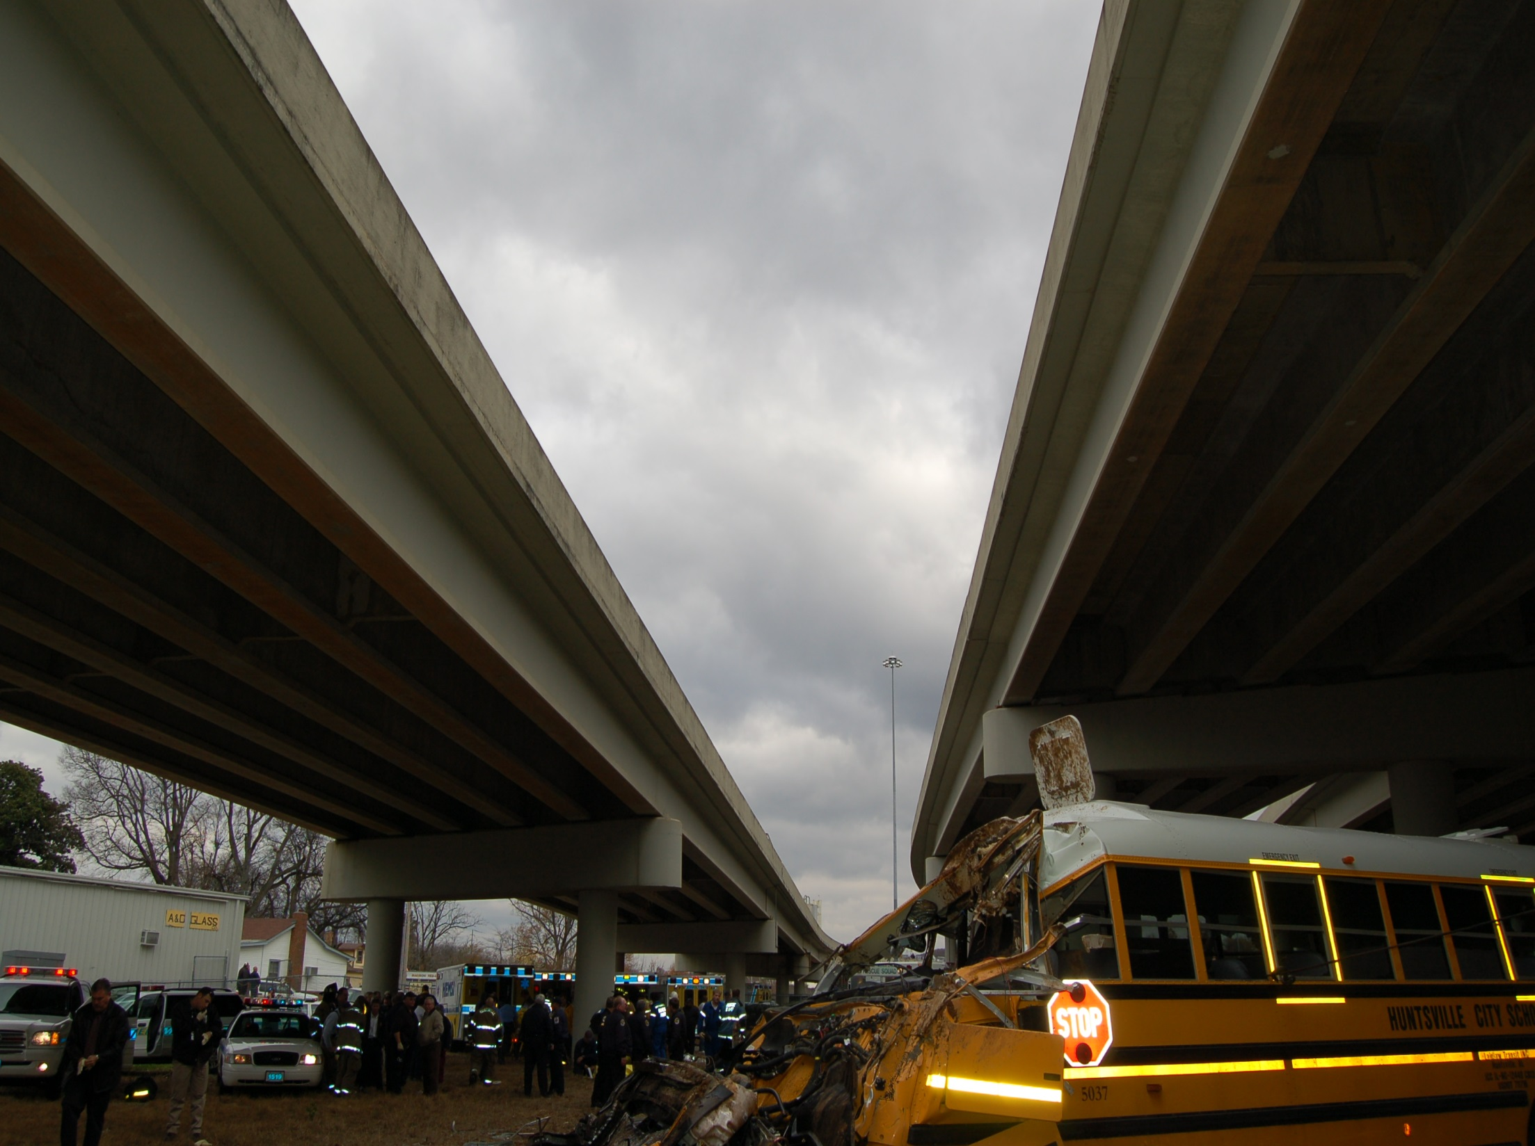
Huntsville Crash November 20, 2006

Slide 27
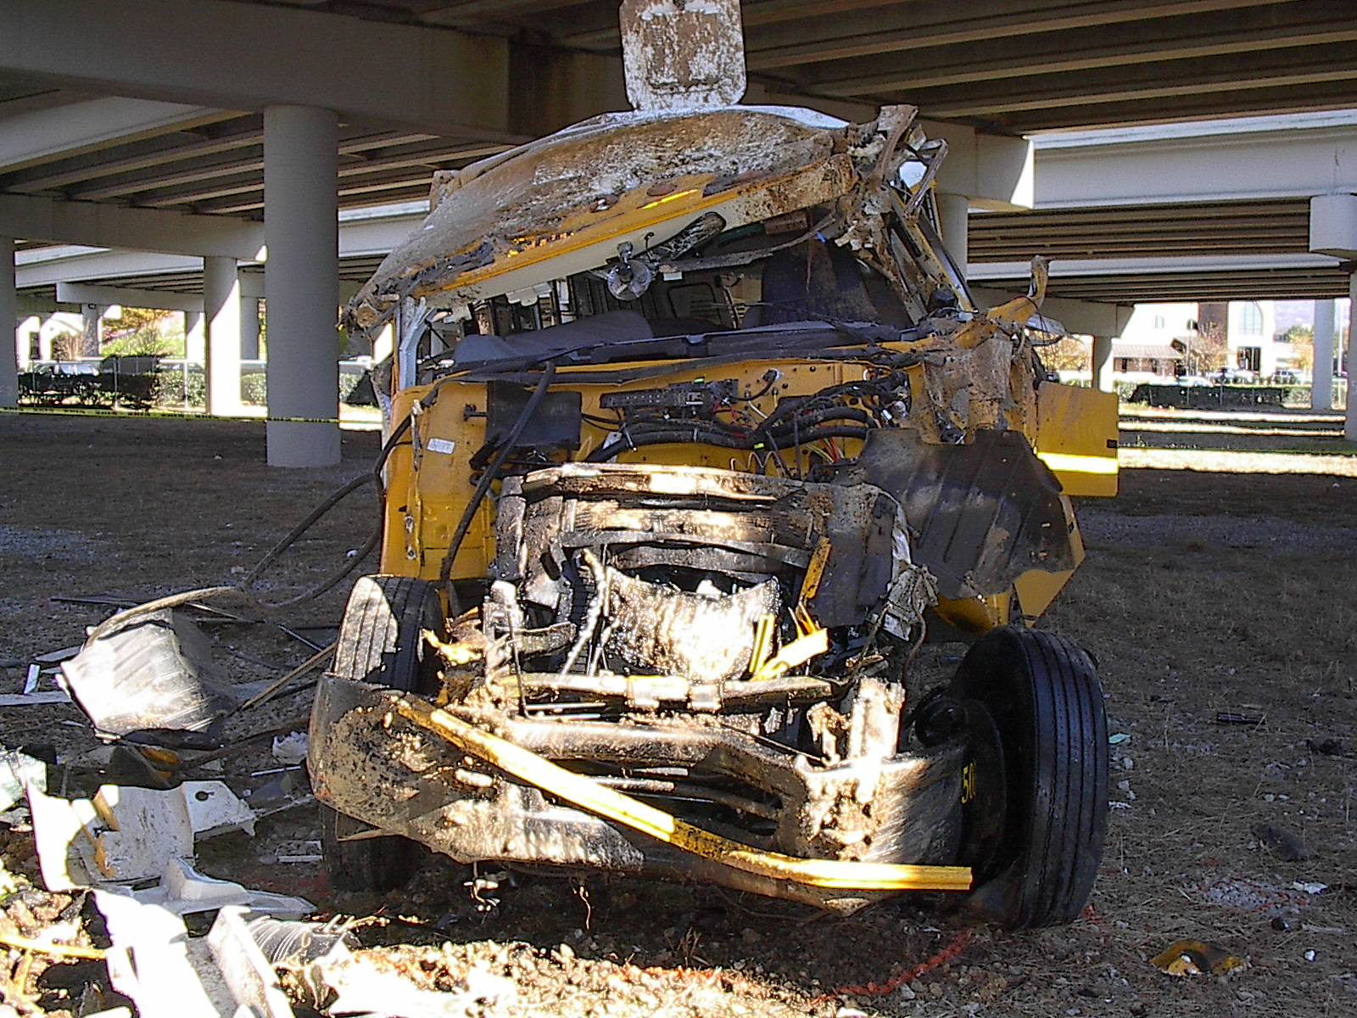
Huntsville Crash November 20, 2006

Slide 28
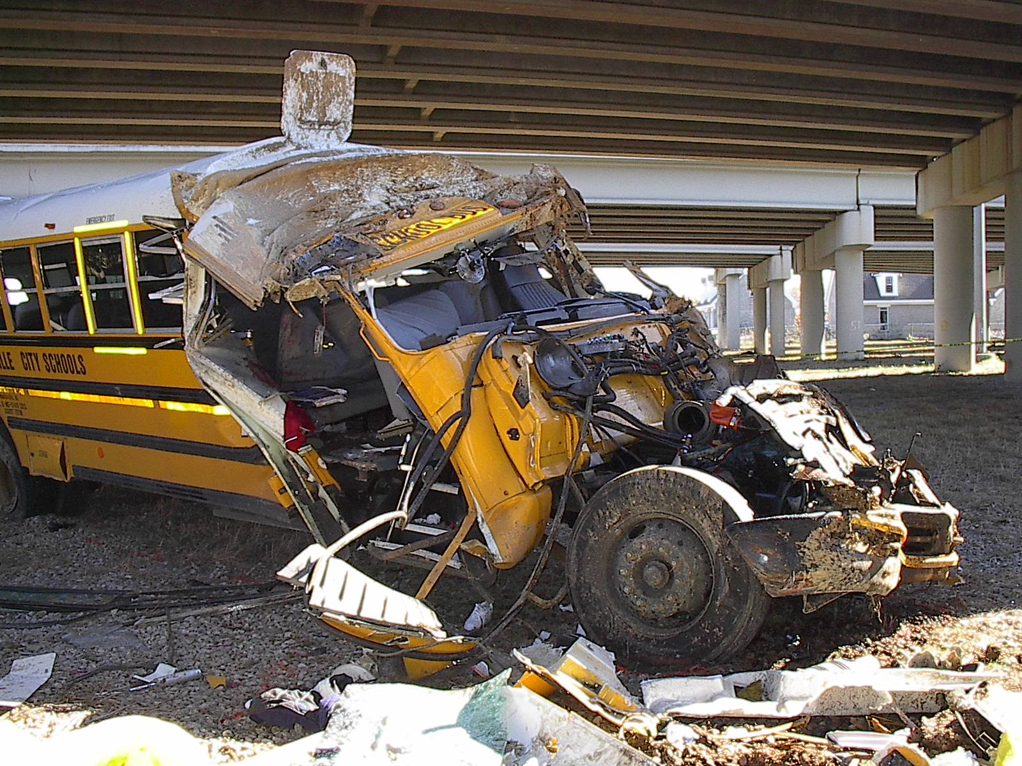
Huntsville Crash November 20, 2006

Slide 29
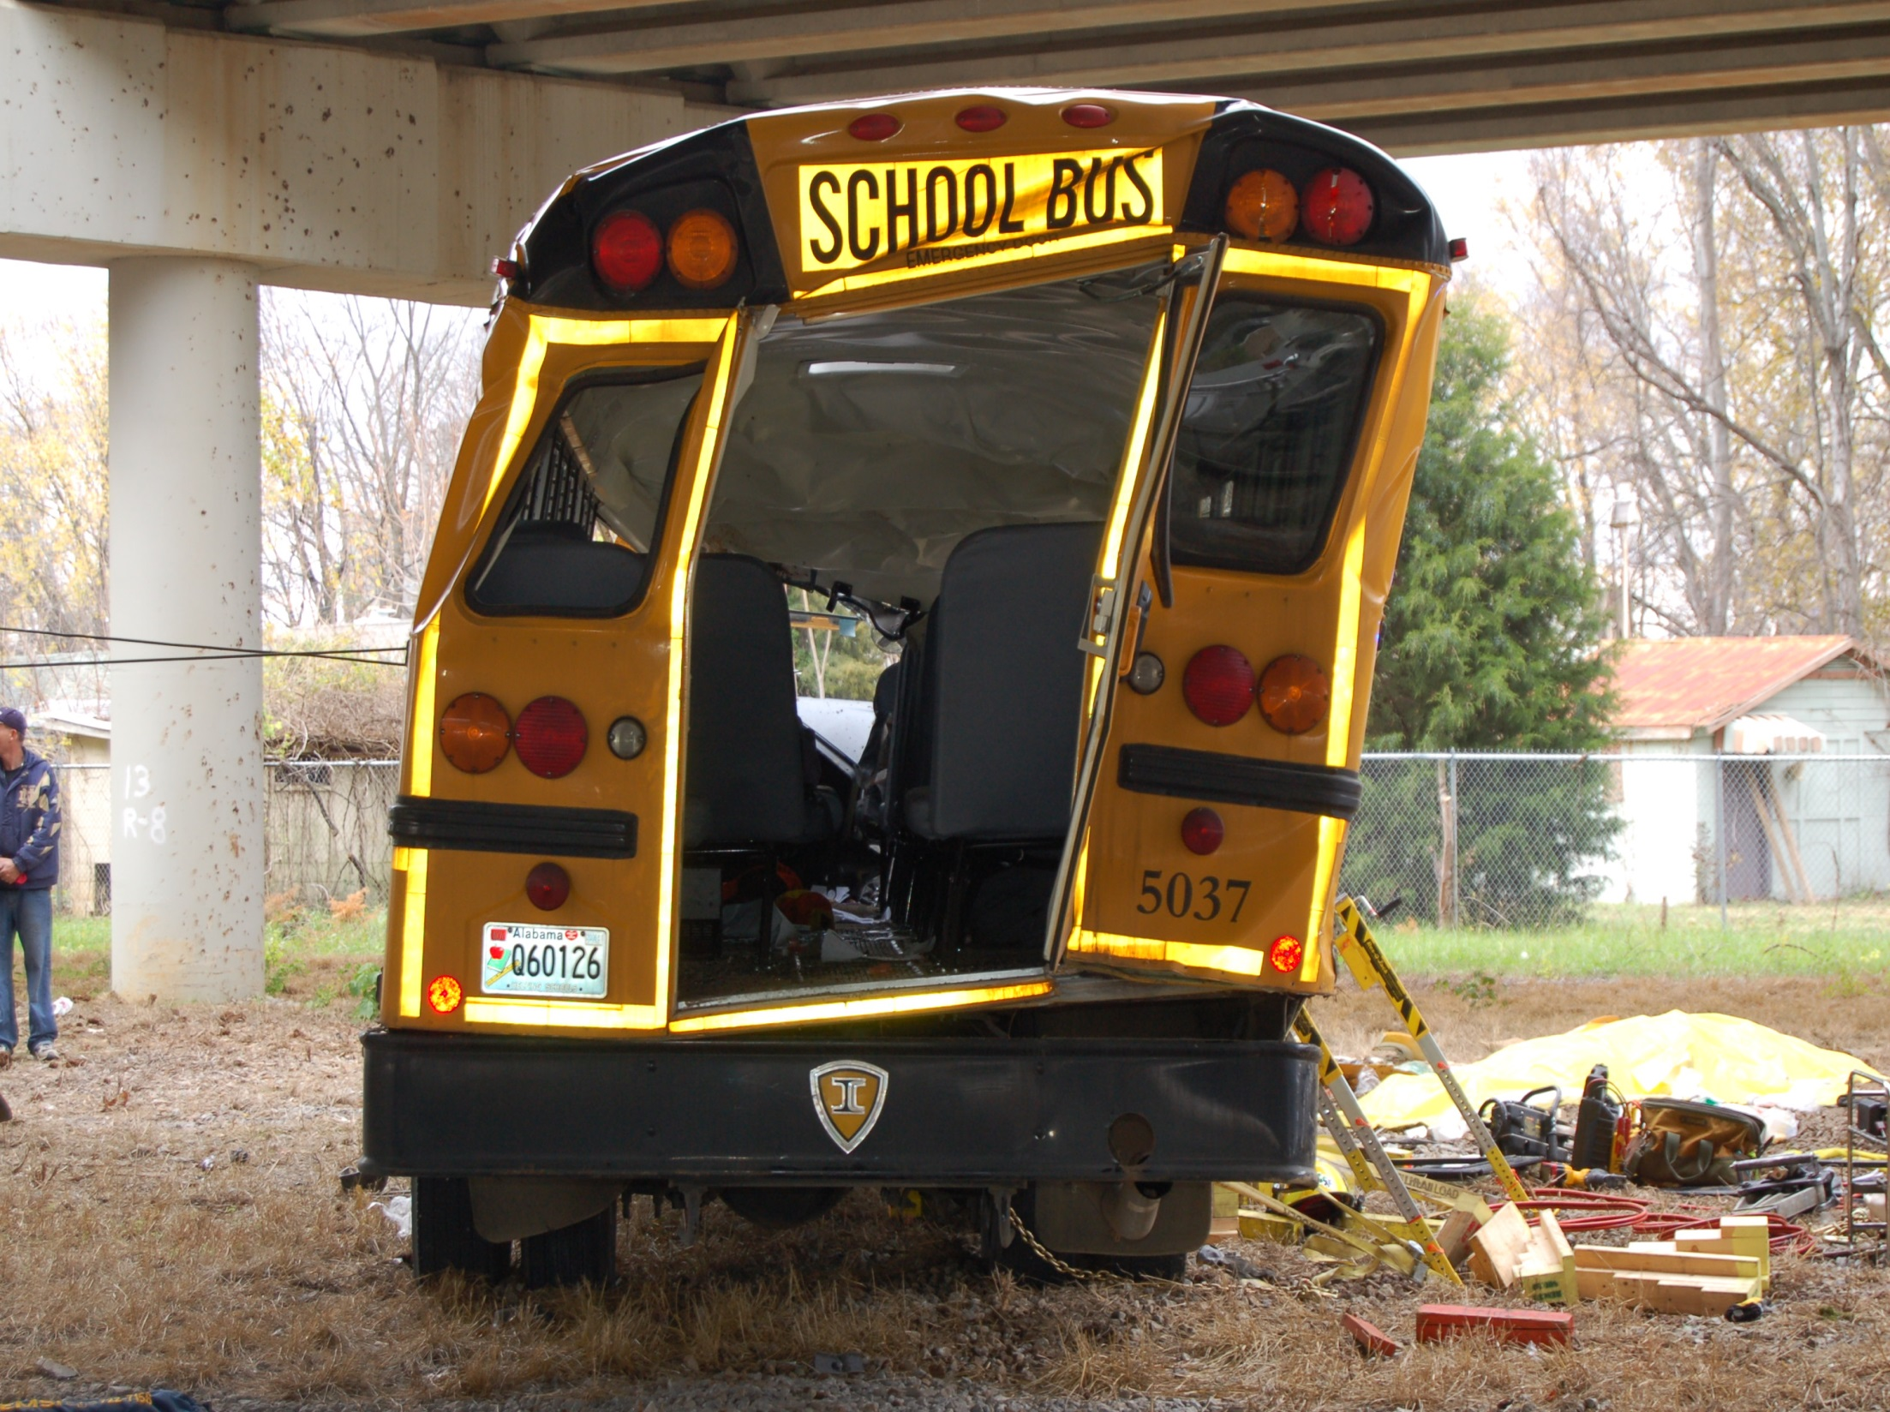
Huntsville Crash November 20, 2006

Slide 30
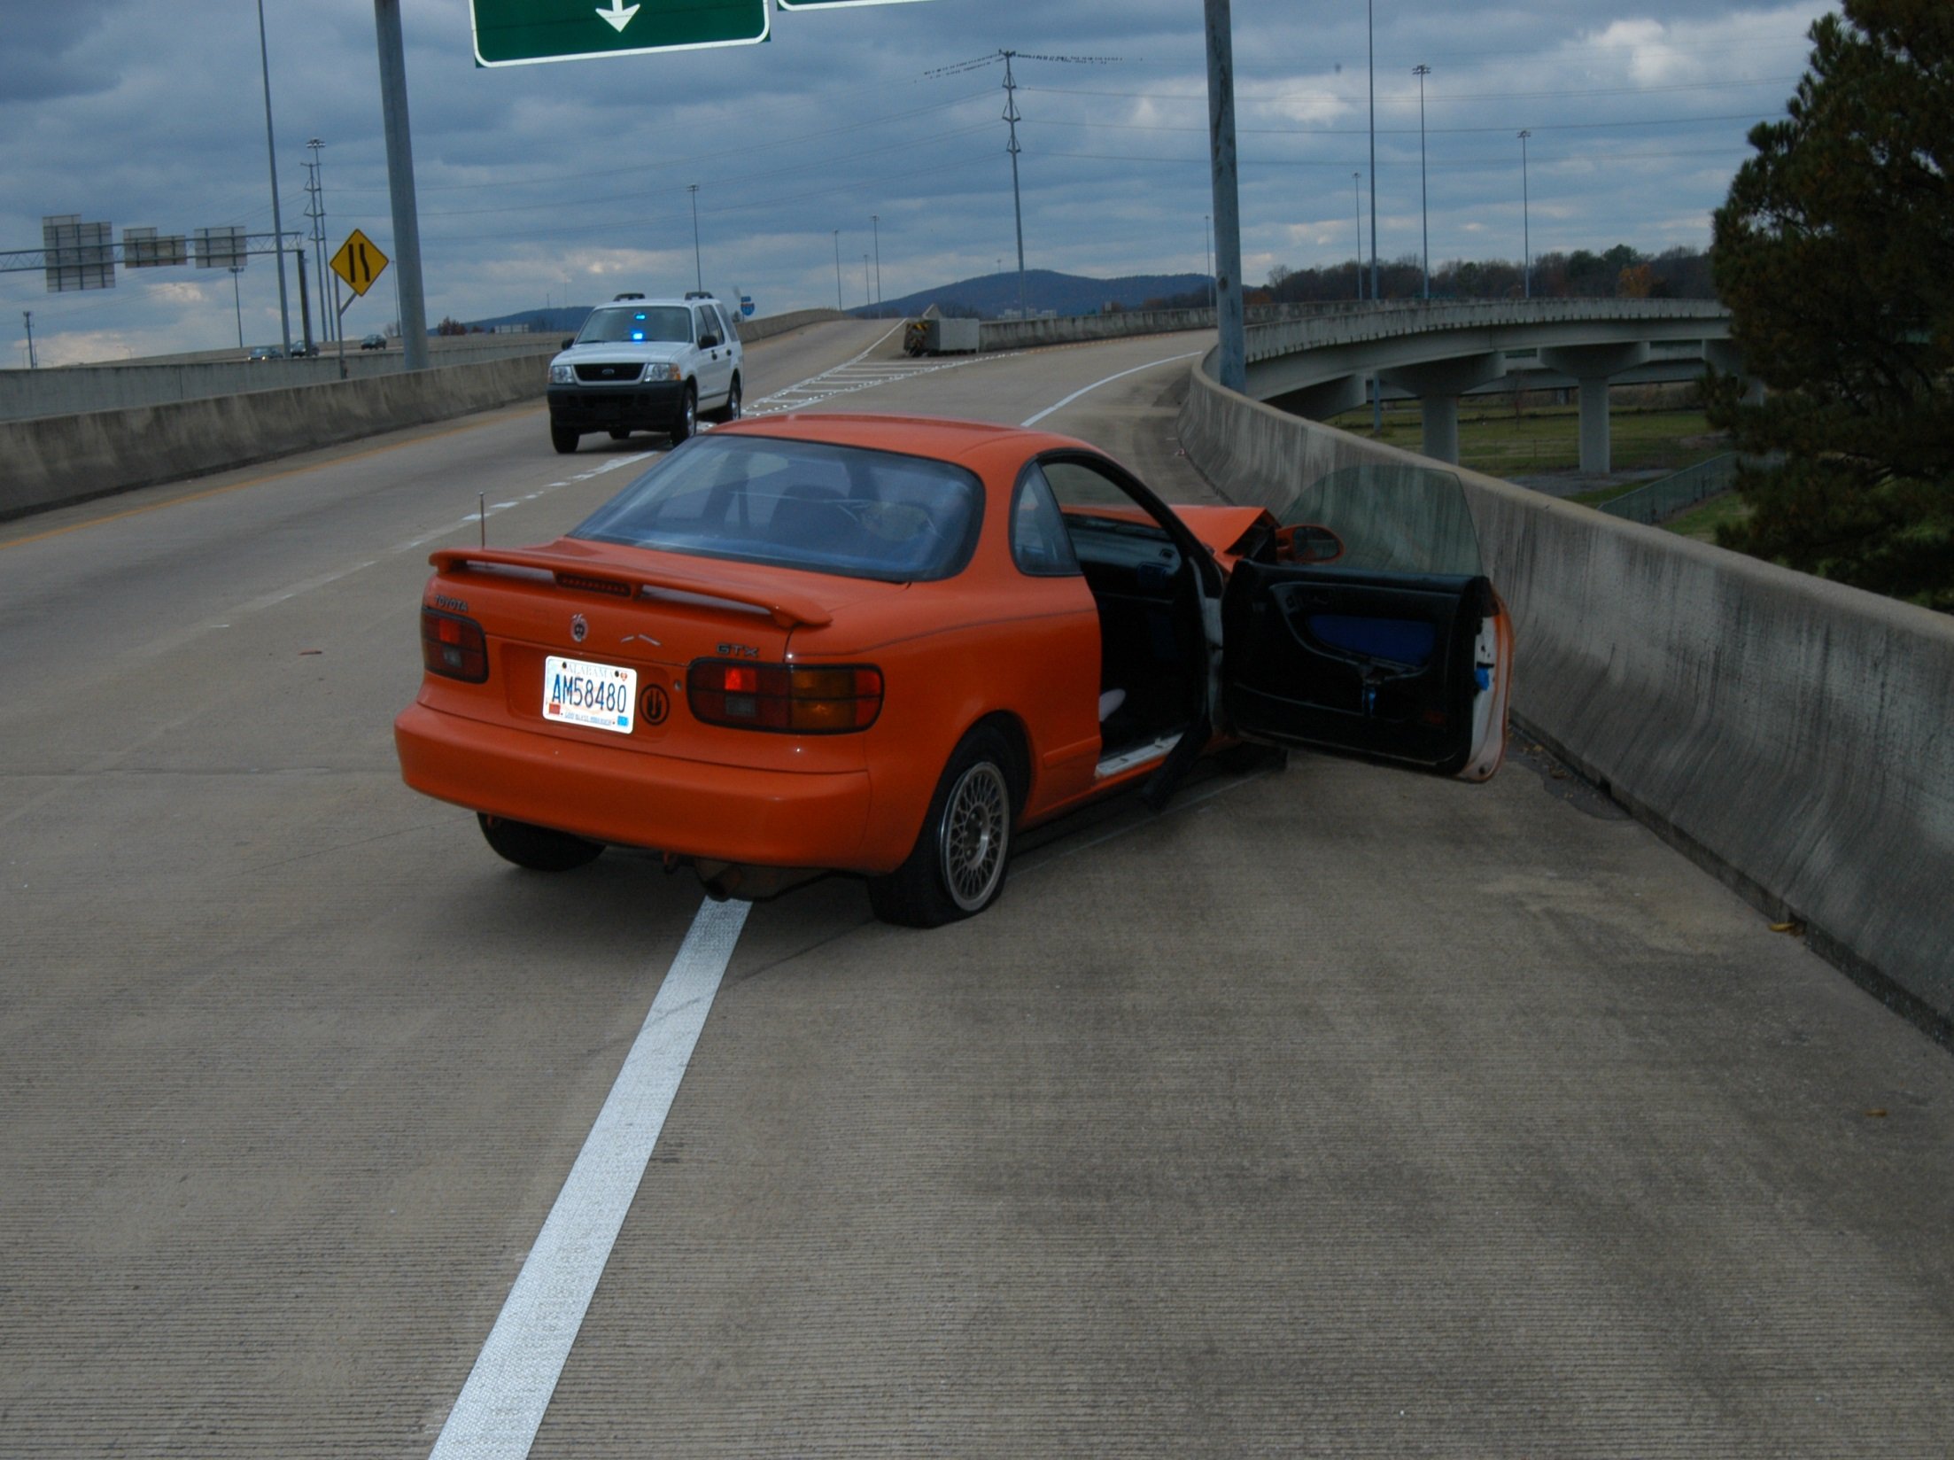
Huntsville Crash November 20, 2006

Slide 31
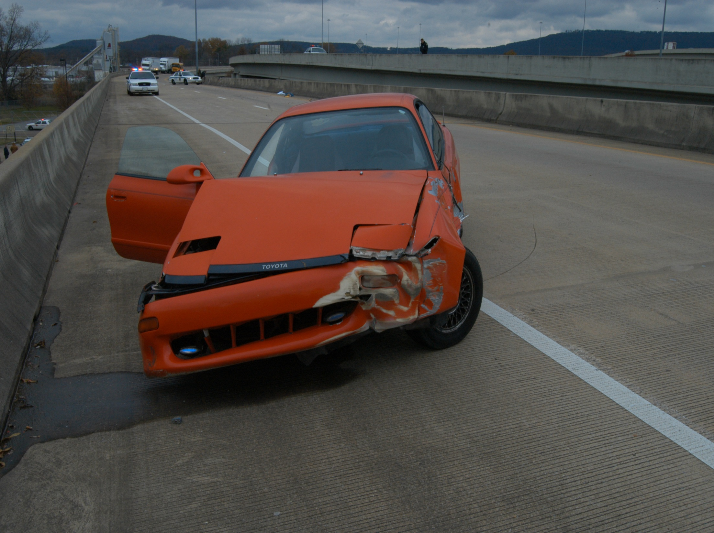
Huntsville Crash November 20, 2006

Slide 32
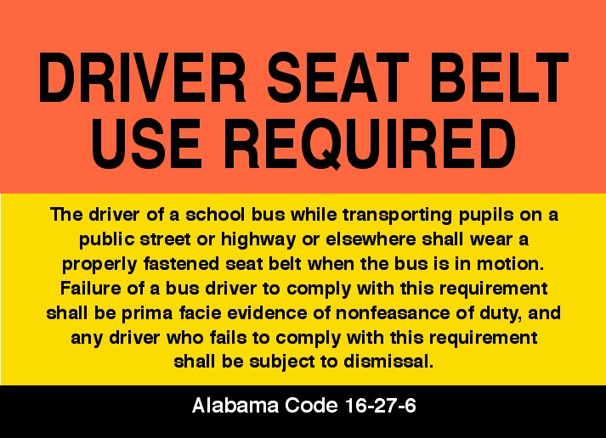

Slide 33
NHTSA Rulemaking
NHTSA held Roundtable on School Bus Seat Belts in DC on July 11, 2007
NHTSA released a Notice of Proposed Rulemaking (NPRM) on Nov. 21, 2007
NASDPTS and others issued public comments on the NPRM

Slide 34
2008-09 NHTSA Final Rule:
Standards for states that continue to require (or newly require) lap belts in large school buses
Automatic self-latching devices for seat bottom cushions when cushions are designed to flip up for cleaning or inspection

Slide 35
NHTSA Final Rule Required:
Lap/shoulder belts in new Type A buses (10,000 Gross Vehicle Weight Rating or less) in three years from final rule
Test procedures and standards
High-back seats in all new buses starting in one year from final rule
Provided guidance and standards for states that voluntarily install lap/shoulder belts in large school buses

Slide 36
Lead Time/Effective Dates
Small bus lap/shoulder belts ~ 3 years
All buses manufactured on or after October 21, 2011
Large bus voluntarily installed belts ~ 3 years
All buses manufactured on or after October 21, 2011
Increased seatback height ~ 1 year
All buses manufactured on or after October 21, 2009
Self-latching bottom cushions ~ 1 year
All buses manufactured on or after October 21, 2009

Slide 37
Passenger Crash Protection

Slide 38
NASDPTS 2014 Position Paper
Position Statement
As an association with a primary leadership role in issues relating to student transportation safety, environmental responsibility, and access to education, NASDPTS fully supports state and local decisions for the installation and use of lap/shoulder belts in school buses. NASDPTS is not advocating that the installation and/or use of lap/shoulder belts be required by state or local jurisdictions without thorough consideration of available resources. NASDPTS believes this decision should be based on state or local need, but also believes lap/shoulder belt equipped seats should be encouraged as an option when considering new bus original equipment specifications. NASDPTS further believes that states and local jurisdictions should require proper usage by all students when belts are available and should provide related notices, training and enforcement.
Position Paper available at http://www.nasdpts.org/Papers/index.html

Slide 39
Key Points--NASDPTS Position
There is still heated debate on this issue
Compartmentalization alone has limits
Capacity issues with L/S belts largely solved
Evacuation may be enhanced due to fewer injuries to lap/shoulder belted students
Students will wear them in today’s world
Lap/shoulder belts keep students in seats and improve behavior; little intentional misuse

Slide 41
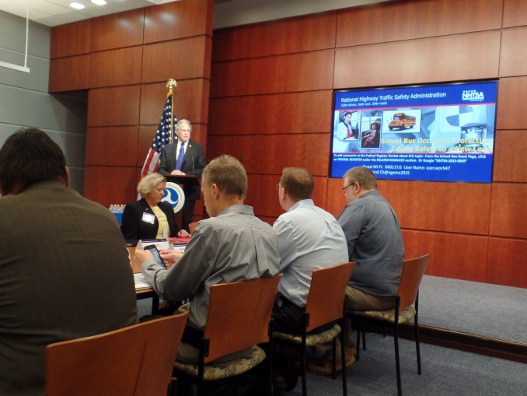
NHTSA Meeting July 23, 2015
Stated purpose, “to address the challenges and barriers that have prevented schools from taking action to install three-point seat belt systems in school buses,” and, “operational challenges, new approaches for funding, seating capacity, training for drivers, parents, and students, and other issues”

Slide 42
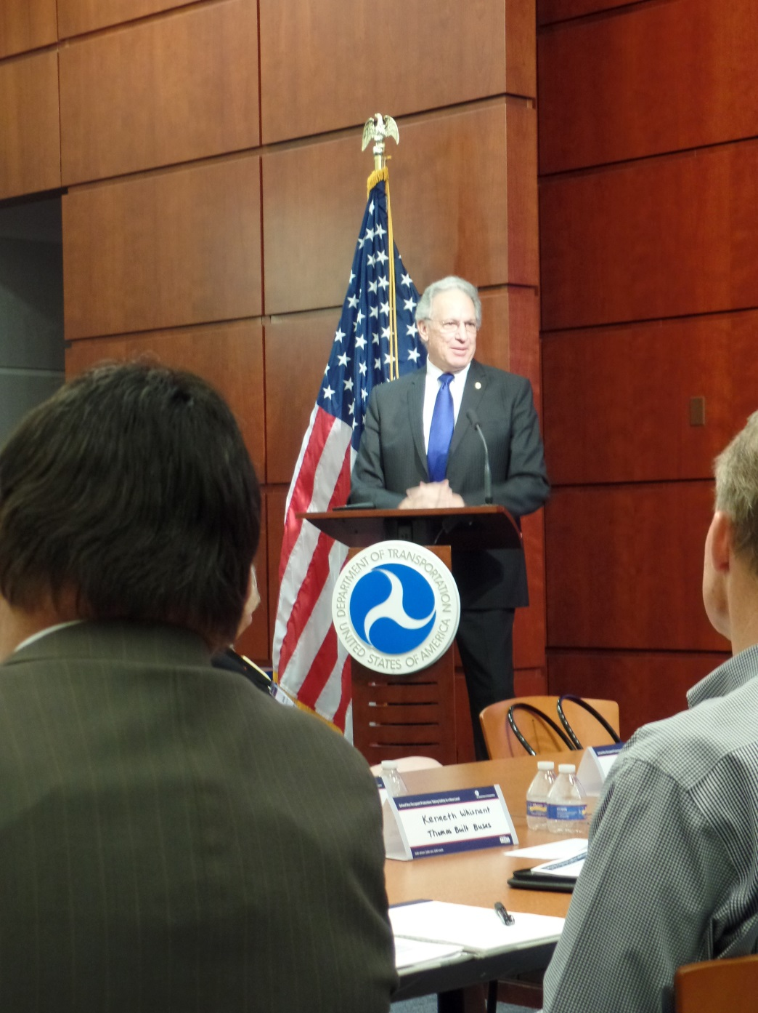
NHTSA Meeting July 23, 2015
NHTSA Administrator, Dr. Mark R. Rosekind opened the meeting
Rosekind: “Our kids are not data points.”

Slide 43
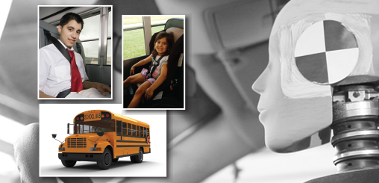
School buses are the safest form of school transportation, but the addition of three-point seat belts could take safety to a new level. NHTSA is holding this meeting to update the current state of knowledge in recent advances in the technology of three-point belt systems, identify operational and policy challenges and solutions, and explore innovative funding approaches that could serve as a catalyst for change.

Slide 44
NHTSA Meeting July 23, 2015
Rosekind and staff cited the outstanding safety record of school buses
4 students killed in school buses annually compared to 419 killed annually in passenger cars over the most recent ten-year period (2003-04 through 2012-13)

Slide 45
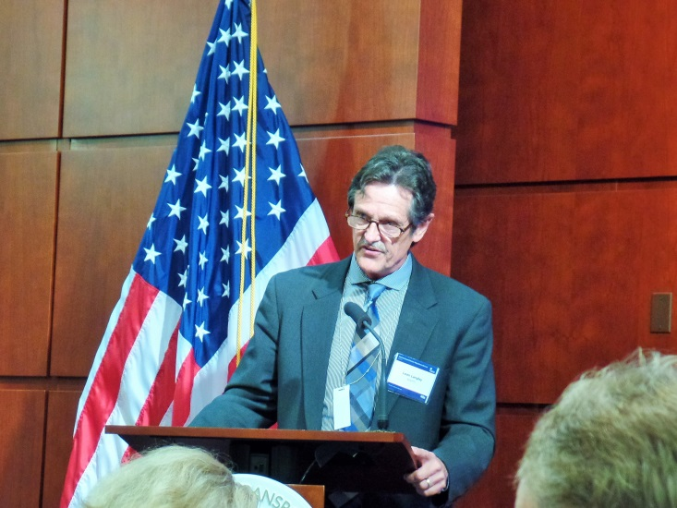
NHTSA Meeting July 23, 2015
Leon Langley, NASDPTS President, Ronna Weber, NSTA Executive Director, and others testified
NTSB’s Kristin Poland outlined findings and safety recommendations from their investigation of two crashes in Chesterfield, NJ, and Port St. Lucie, FL (2012) in which student was killed
Local directors from Indiana (Bob Downin) and Montana (Tom Cohn) cited significantly improved behavior in their buses with lap/shoulder belts

Slide 46
NHTSA Meeting July 23, 2015
Shashi Kuppa, NHTSA Division Chief outlined history of NHTSA rulemaking in 2008 to require lap/shoulder belts in new small buses
Rule also specified required performance of lap/shoulder belt systems when voluntarily installed by states and LEAs
Kuppa reiterated that decision not to mandate was based on their analysis that students may be displaced into other less safe modes due to cost of equipping buses with lap/shoulder belts

Slide 47
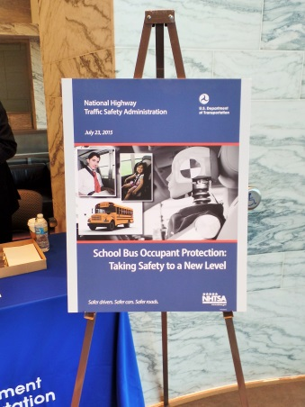
Takeaways
Lap/shoulder belts augment compartmentalization and improve safety and student behavior
Funds for L/S belts without displacing students remain a concern
Agency recognized need to expand support for other school bus safety countermeasures, especially any that would improve the safety of students in the loading zone

Slide 48
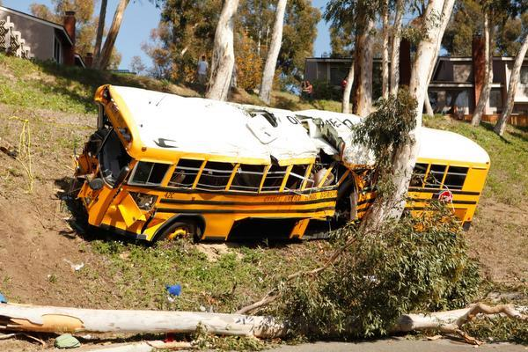
2014 Anaheim, CA Crash
School bus driver ran off road and impacted tree.
NTSB found that injuries would have been greater for students wearing their lap/shoulder belts had they not been in use.

Slide 49
So what’s really new in 2017?
Excerpts from remarks, 11/8/15, by NHTSA Administrator, Dr. Mark R. Rosekind to NASDPTS/NAPT:
“Every child on every school bus shall have a three-point seat belt.”
“NHTSA will use every tool at its disposal.”
“Seat belts save lives, and that includes seat belts on school buses.”

Slide 50
Since NHTSA Position Change:
NHTSA sent letters to governors of the six states with school bus seat belt laws (CA, FL, LA, NJ, NY, and TX).
State and local school district representatives met March 24, 2016, in DC for NHTSA to learn the states’ experiences with various aspects (safety, enforcement of use, usage rates, assigning buses, funding sources, effects on student behavior, etc.).

Slide 51
Since NHTSA Shift
NASDPTS and NSTA attended the March 24th “six-states” meeting as “observers” and informed members of key issues raised
More states have considering legislation (e.g., Maryland, Washington, West Virginia, Connecticut, Tennessee)
IMMI petitioned NHTSA to increase Type A threshold for requiring L/S belts to 14,500 GVWR.
Serious crashes in Baltimore and Chattanooga
NHTSA contractor seeking information from districts on local issues in implementing belts

Slide 52
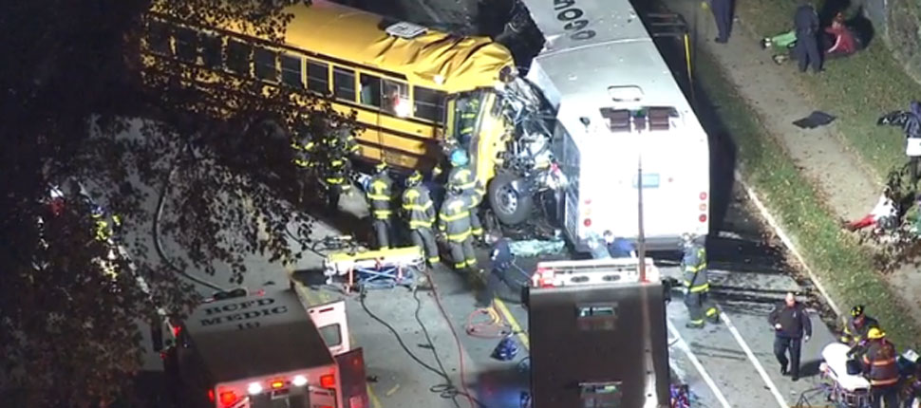
Baltimore and Chattanooga
Baltimore, November 1, 2016- Contracted school bus driver careened into public transit bus, killing six people, including himself

Slide 53
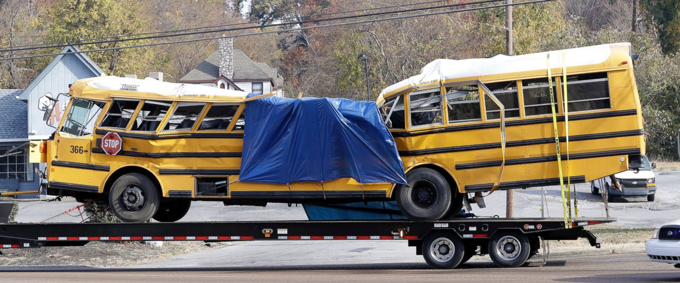
Baltimore and Chattanooga
Chattanooga- 24 year old driver ran off residential road, killing six elementary school students

Slide 54
2017
Over 25 states considered various forms of school bus “belts” legislation
Federal legislation introduced from Congressmen in Tennessee and Florida
Legislation passed in Texas and Nevada
More local jurisdictions deciding to purchase new buses with lap/shoulder belts

Slide 55
Real-World Seat Belt Experiences
Use of Belt Systems
Training?
Compliance?
Impacts on Student Behavior, Vandalism?

Slide 56
Real-World Seat Belt Experiences
Impacts on time
Pre-trip?
Loading / Unloading?
Maintenance?
Evacuation?

Slide 57
Real-World Seat Belt Experiences
Impact on Costs
Acquisition?
Maintenance?
Iowa estimates cost of L/S Belts at less than 5 cents per day per student

Slide 58
Real-World Seat Belt Experiences
Parental Views?
Political Environment?
Driver Liability concerns?

Slide 59
Any Questions?

