Slide 1
New MKV Liaison Orientation
August 20, 2020

Slide 2
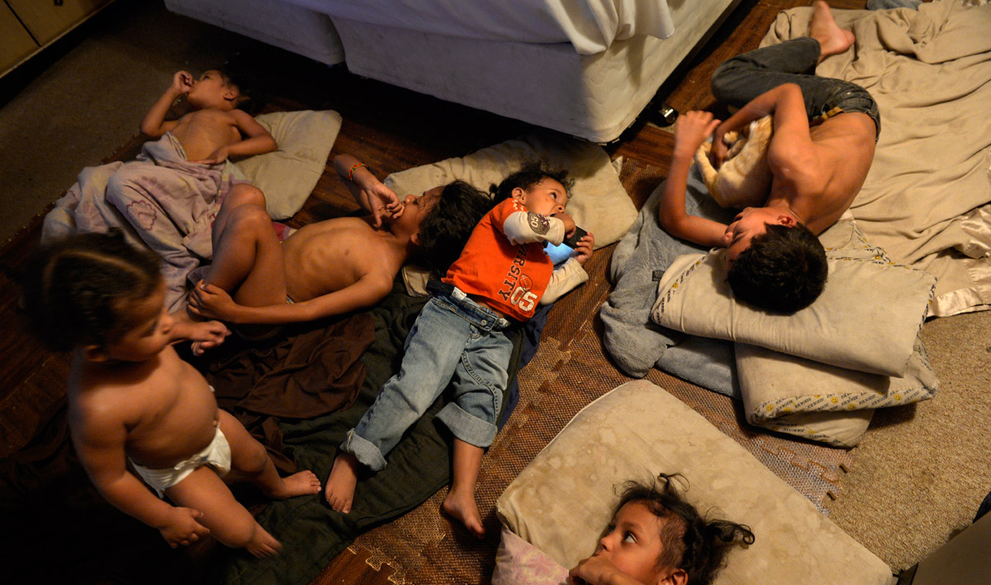
The “Why”

Slide 3
The first 90 days
Understanding the role and responsibilities
Identification
Enrollment
Ongoing support

Slide 4
Where to begin…
What is the McKinney-Vento Homeless Assistance Act?
Subtitle VII-B of The McKinney-Vento Homeless Assistance Act authorizes the federal Education for Homeless Children and Youth (EHCY) Program and is the primary piece of federal legislation related to the education of children and youth experiencing homelessness. It was reauthorized in December 2015 by Title IX, Part A, of the Every Student Succeeds Act (ESSA).

Slide 5
Local Liaison Responsibilities
The McKinney-Vento Act requires every local educational agency to “designate an appropriate staff person” to serve as a McKinney-Vento Homeless Education Liaison.
specialize in legally qualifying students for McKinney-Vento and are responsible for identifying eligible students
expedite enrollment into public school for McKinney-Vento students
provide access to free school meals
make referrals to other school and community resources
inform families and students about transportation services, determining school of origin and mediating disputes.
Liaisons can also serve as one of the primary contacts between McKinney-Vento eligible families and school staff, district personnel, shelter workers, and other service providers.

Slide 6
“Homeless” Definition
What is the definition of “homeless” under the McKinney-Vento Act?
Section 725(2) of the McKinney-Vento Act defines “homeless children and youths” as individuals who lack a fixed, regular, and adequate nighttime residence. The term includes—
Children and youths who are:
sharing the housing of other persons due to loss of housing, economic hardship, or a similar reason (sometimes referred to as “doubled-up”);
living in motels, hotels, trailer parks, or camping grounds due to lack of alternative adequate accommodations;
living in emergency or transitional shelters; or abandoned in hospitals;
Children and youths who have a primary nighttime residence that is a public or private place not designed for, or ordinarily used as, a regular sleeping accommodation for human beings;
Children and youths who are living in cars, parks, public spaces, abandoned buildings, substandard housing, bus or train stations, or similar settings; and
Migratory children who qualify as homeless because they are living in circumstances described above.

Slide 7
What are the educational rights of McKinney-Vento eligible students?
McKinney-Vento eligible students have the right to:
receive a free, appropriate public education;
enroll in school immediately, even if lacking normally required for enrollment, or having missed application or enrollment deadlines during any period of homelessness;
enroll in school and attend classes while the school gathers needed documents;
continue attending the school of origin, or enroll in the local attendance area school if attending the school of origin is not in the best interest of the student or is contrary to the request of the parent, guardian, or unaccompanied youth;
receive transportation to and from the school of origin, if requested by the parent or guardian, or by the local liaison on behalf of an unaccompanied youth; and
receive educational services comparable to those provided to other students, according to each student’s need.

Slide 8
Where to go for help
CDE McKinney-Vento Webpage
National Center for Homeless Education (NCHE)
Liaison Toolkit
Quick Guide to Important Sections of McKinney-Vento Act
Understanding My LEA's Homeless Education Program
National Association for the Education of Homeless Children and Youth (NAEHCY)

Slide 9
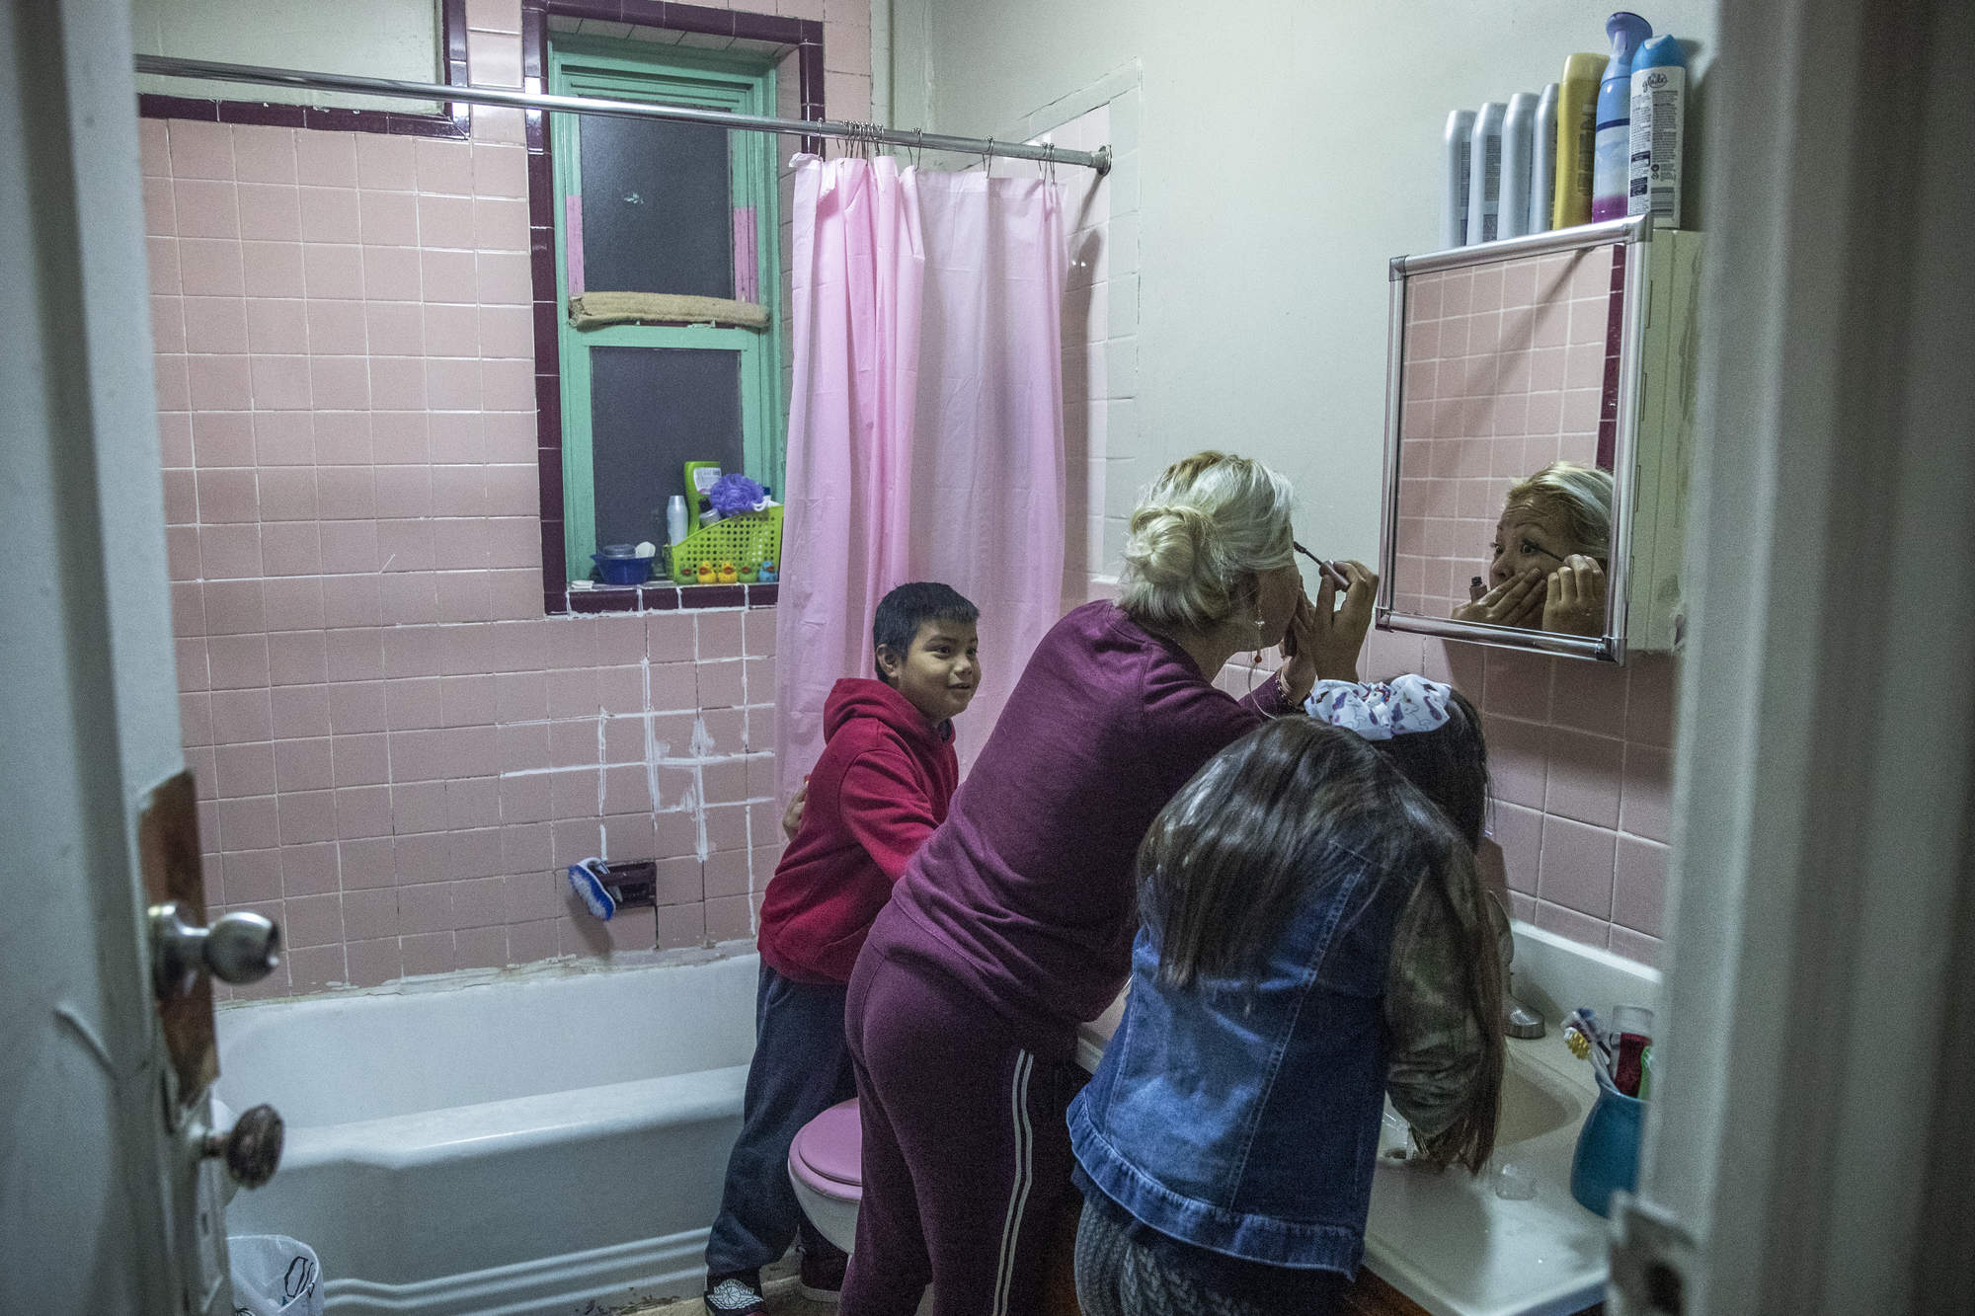
McKinney-Vento Students

Slide 10
Living Doubled-up

Slide 11
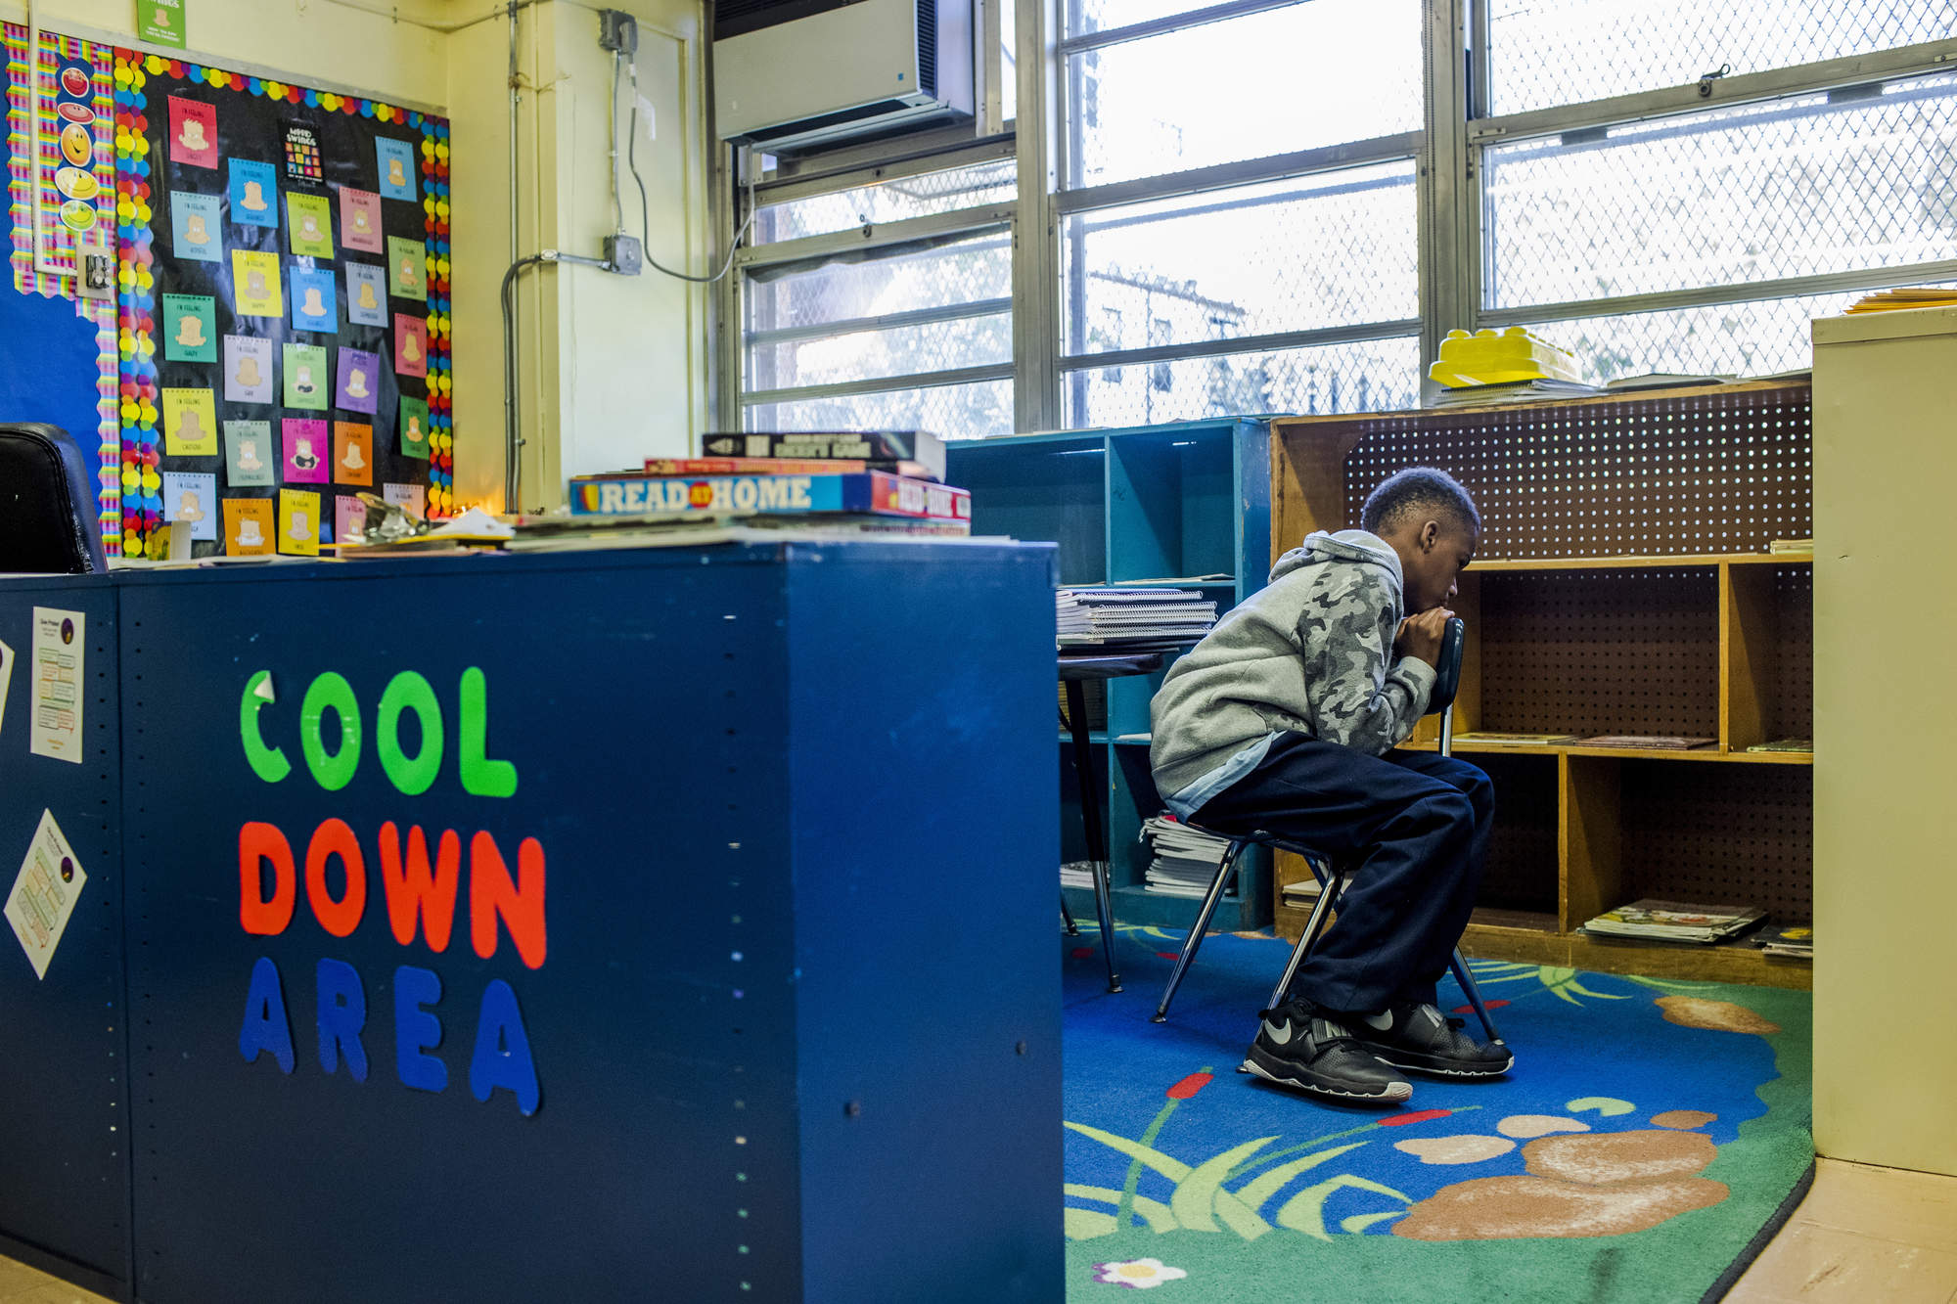

Slide 12
Transportation

Slide 13
Engagement

Slide 14
Empowered

