Slide 1
Child Welfare Education Liaison Spring Webinar
Wednesday, April 10th, 2024

Slide 2
Welcome and Agenda
  Welcome
  State Updates
  ChildFind IEP/504 Plans Presentation

Slide 3
State Updates
Updated summer CWEL directory
Reporting Child Welfare Education Liaison (CWEL) contact information
  Report by August 15th
  Process if you will no longer be the CWEL in your district
  Change of CWEL Request form: https://www.cde.state.co.us/studentsupport/fostercare_index

Slide 4
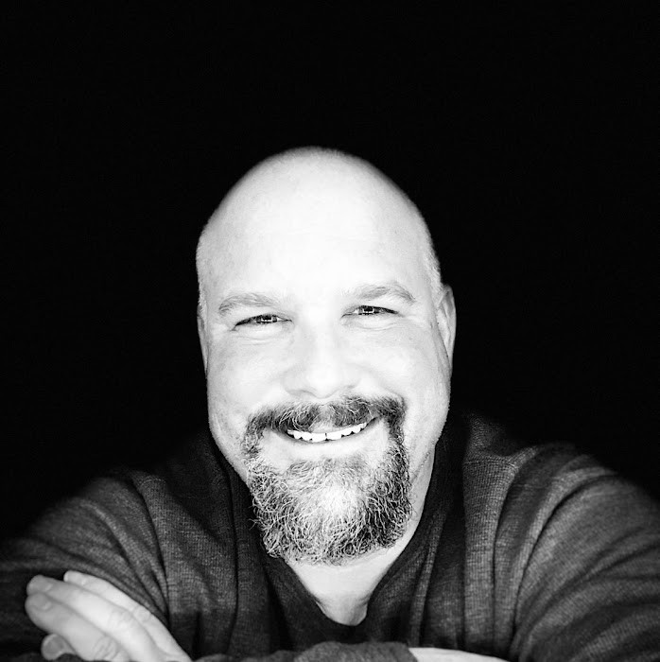
Joining Us Today
Jon Paul Burden, Supervisor
Special Education Director, TA Specialist
Colorado Department of Education

