Slide 1
Steps to Complete the Kindergarten School Readiness Collection
October 10, 2023
1:00-2:00 pm

Slide 2
Steps to Complete the KSR Collection
Overview
Step 1: Verify the Location of the KSR Assessment Data
Step 2: Extract the Data
Step 3: Use the KSR Data to complete the File Template
Step 4: Verify you have Data Pipeline Access
Step 5: Select the Assessment Tool in Data Pipeline
Step 6: Uploading Data to CDE Data Pipeline
Step 7: Resolve any Data Pipeline Errors
Step 8: Submit Data to Data Pipeline
Step 9: Complete the KSR signature form

Slide 3
Step 1: Verify the location of the KSR Assessment Data
Quick background on the KSR Assessment
  Who: All kindergarten students who receive 0.5 FTE funding or greater.
  What: Assess the varying skill levels and knowledge with which students enter kindergarten (C.R.S. 22-7-1002 (2)) and inform individual learning plans for each publicly funded student (C.R.S. 22-7-1014).
    Physical well-being and motor development
    Social and emotional development
    Language and comprehension development
    Cognition
    Literacy
    Math
  Where: All schools that serve kindergarten students who receive 0.5 FTE or greater. This includes charter schools.
  When: Students are assessed in the first 60 days of the school year. The first 60 days should align with each school’s calendar.
  How: The State Board of Education has approved a menu of tools for the KSR Assessments. Link to the list of approved assessments.

Slide 4
Step 1: Verify the location of the KSR Assessment Data (continued)
Local Education Providers (LEPs) can choose any combination of the approved assessment tools to assess the six domains.
LEPs can store their assessment data in the platform of their choosing.
  The data could be stored in one location or across several assessment tools.
If a LEP has a question regarding their assessment tool, the LEP should contact that vendor for technical assistance. The Assessment Choices and School Readiness Plans website provides a link to each vendor.
Depending on the LEP, this step might be completed by a staff member other than the Data Respondent. LEPs are welcome to develop a system that works well for them.
If you have additional questions regarding the assessments or the vendors, please contact Megan Rogers (rogers_m@cde.state.co.us).

Slide 5
Step 2: Extract the data
LEPs will need to access the platform or assessment tool where the data is stored.
The data will need to be exported.
  Note: The final data file that will be uploaded into Data Pipeline will need to be in the .xlsx format. Therefore, exporting the data into a spreadsheet (such as one that can be opened in Excel) will be beneficial.
If you are uncertain how to access or export the LEP’s data, connect with the LEP staff, and the LEP’s chosen vendor(s) for technical assistance.
CDE’s Assessment Choices and School Readiness Plans website provides a contact link to each vendor.
There are going to be two main approaches to this step, depending on how the LEP has decided to store the data.
  Data is located in a single assessment tool or platform. This will likely require only one extraction.
  Data is located in multiple places, depending on the KSR Domain.
    For example, five of the domains were assessed in assessment tool A and stored there. The sixth domain is located in assessment tool B and it is stored there. This will require multiple extractions.
Depending on the LEP, this step might be completed by a staff member other than the Data Respondent. LEPs are welcome to develop a system that works well for them.

Slide 6
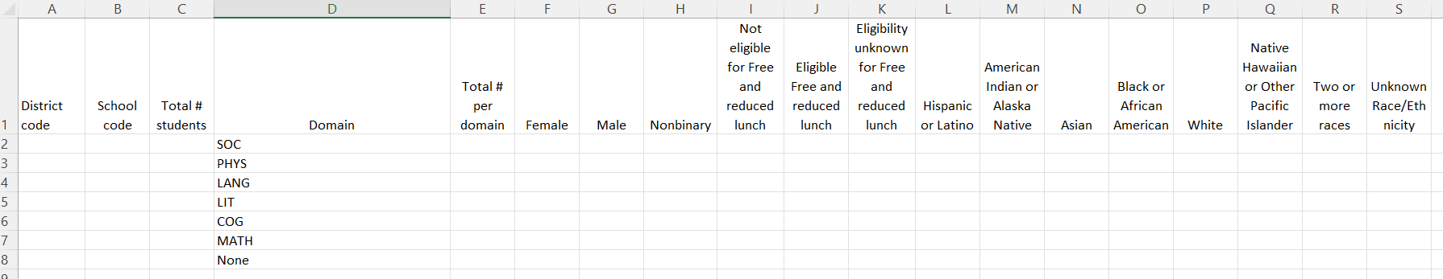
Step 3: Use the KSR Data to complete the File Template
The File Template can be found on the Kindergarten School Readiness Data Collection website.
There are two main approaches to completing the KSR File Template:
  A) Data from one source, and it exists in a single extract: Includes all six domains.
  B) Date from multiple extracts: Different domains contained in different extracts.
Webinar on Wednesday, October 11th (12:00-1:00 pm) will provide instructions for approach A, data is contained in a single extract.
Webinar on Thursday, October 12th (1:00-2:00 pm) will provide instructions for approach B, data is contained in multiple extracts.
Those webinars and Power Point presentations will be posted on the Kindergarten School Readiness Data Collection Website. You will be able to access that information, even if you cannot attend the webinar.
I am also available for technical support. Email me with questions for to set up a time for a phone call or video call. Tanna George, George_t@cde.state.co.us.

Slide 7
Step 3: Use the KSR Data to complete the File Template (continued)
District Code: A unique 4-digit code assigned to each district. It must be formatted as “Text”.
School Code: A unique 4-digit code assigned to each school. It must be formatted as “Text”.
Total # Students: Total number of students included in the KSR Assessment.
Domain: The six domains included in the KSR Assessment.
Total # Per Domain: Total number of assessed students who are meeting or exceeding expectations in that domain.
Gender - Female/Male/Nonbinary: Of the number of students who are meeting or exceeding expectations in that domain, how many are in each gender category?
Free and Reduced Price Lunch Not Eligible/Eligible/ Unknown: Of the number of students who are meeting or exceeding expectations in that domain, how many are in each FRL category?
Race Ethnicity: Of the number of students who are meeting or exceeding expectations in that domain, how many are in each race and ethnicity category?

Slide 8
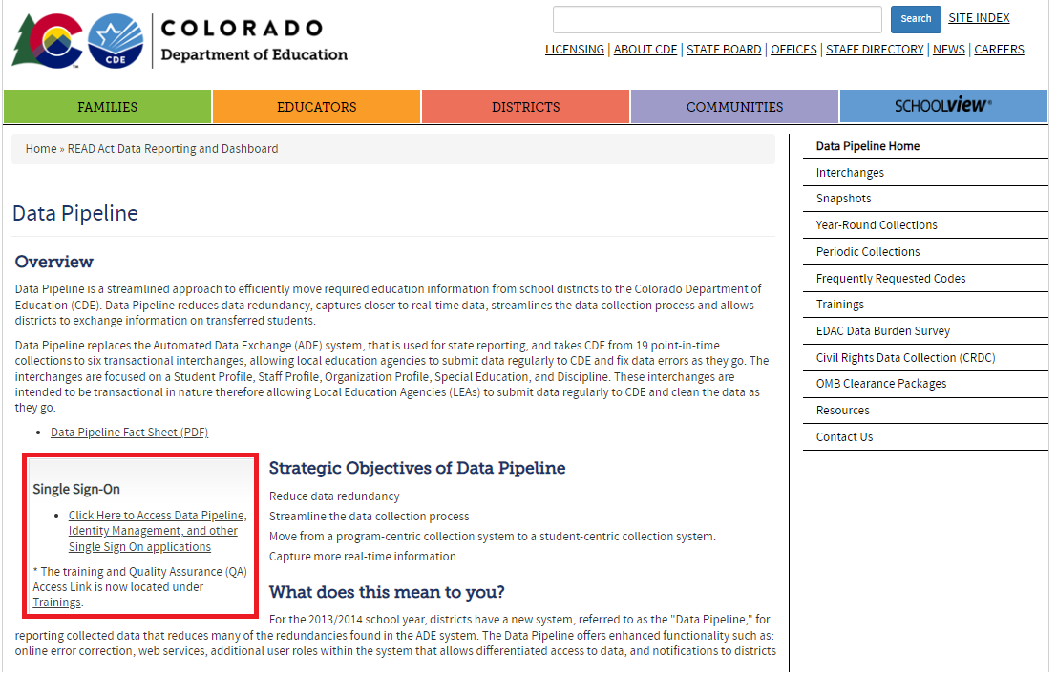
Step 4: Verify you have Data Pipeline Access
Each individual Data Pipeline user must be granted a Data Pipeline login, and access to the KSR Collection within Pipeline.
To login to Data Pipeline.
  Link to Data Pipeline website.
  Click on the “Single Sign-On” link.
  Enter your login credentials.
CDE cannot manage district staff assignments in Data Pipeline.
Each district’s Local Access Manager (LAM) manages their staff’s Pipeline access, and assignment of roles. The LAM is frequently the Superintendent for many smaller districts.

Slide 9
Step 4: Verify you have Data Pipeline Access (continued)
If you do not know the LAM is for your district, this is the link to the LAM inquiry form.
Your LAM can do the following:
    Grant Data Pipeline logins
    Assign a Data Repondent(s) to the KSR Collection within Data Pipeline
    Change staff’s role assignments for each collection.
  Roles:
    Viewer: They can only see the uploaded data for the KSR Collection.
    User: They can view the collection data, upload data, and finalize the data. They cannot submit to CDE within Pipeline.
    Approver: They are the only role that can submit the data to CDE within Data Pipeline. Submitting the data to CDE is a required step of the collection. If you do not have the Approver role, you will need to identify the district staff member with that role.

Slide 10
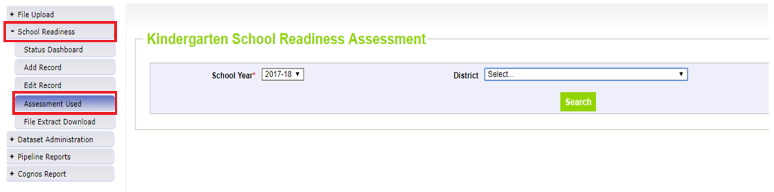
Step 5: Select the Assessment Tool in Data Pipeline
Do you have the following?:
Completed the KSR Data File Template (Steps 1-3)
Data Pipeline access to the KSR Collection, with a User or Approver role (Step 4)
1: Login to Data Pipeline
2: Click on “School Readiness”
3: Click on “Assessment Used”
4: Select the correct “School Year”
5: Select the correct “District”
6: Click “Search”

Slide 11
Step 5: Select the Assessment Tool in Data Pipeline (continued)
Your screen will display a list of every school that is coded to serve kindergarten students in CDE’s system.
Select the main assessment tool used for each school.
Assessment Waivers: Some districts or schools have a waiver from the State Board of Education that grants the school a waiver to use an assessment tool that is not on the SBE approved list. The assessment and collection still needs to be completed, but the waiver recipient can use a different assessment.
Who has assessment tool waivers? Here is a link to the 2023-24 list of SBE approved waivers for Charter Schools. (last updated August 2023)
More information regarding waivers can be found on the Waivers & Policy Guidance website.

Slide 12
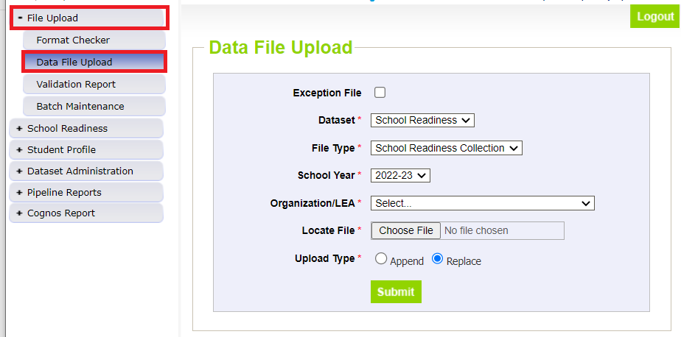
Step 6: Uploading Data to CDE Data Pipeline
Upload your data file into Data Pipeline after the Assessment Tool has been selected (Step 5).
If you reverse this order, it will trigger a Pipeline error, and you will need to start again in the correct order.
The data file for the upload must be saved as an .xlsx file. Any other file type will trigger an upload error in Pipeline.
  Note: In past years, some vendor tools export the report has downloaded into an .txt file- you will need to make sure it is saved as an .xlsx for upload into Pipeline.
Select “File Upload”, then select “Data File Upload” from the left-side menu.

Slide 13
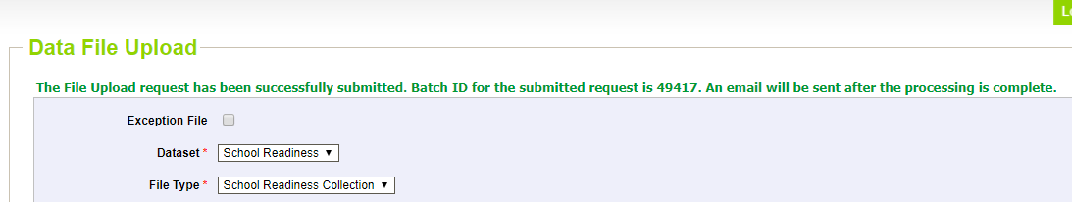
Step 6: Uploading Data to CDE Data Pipeline (continued)
Exception File: Unchecked
File Type: School Readiness Collection
School Year: The current school year
Organization / LEA: Select the correct district
Locate File: Click choose file, and find the completed KSR File Template on your computer.
Upload Type: Replace
Click Submit. The screen will display a success message in green text.

Slide 14
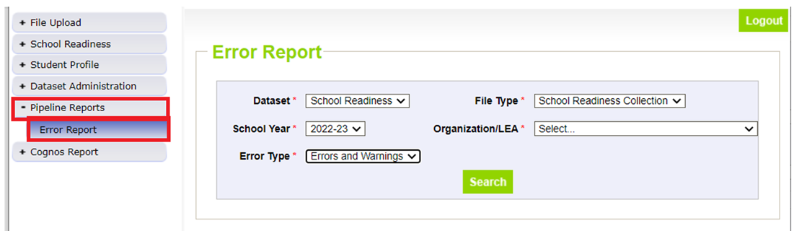
Step 7: Resolve any Data Pipeline Errors
Select “Pipeline Reports”, then select “Error Report”
Dataset: School Readiness
File Type: School Readiness Collection
School Year: The current school year
Organization / LEA: The correct district name
Error Type: Errors and Warnings
  Note: Errors must be resolved before submission. Warnings are important to pay attention to, but they do not need to be resolved before data submission.
Click “Search”

Slide 15
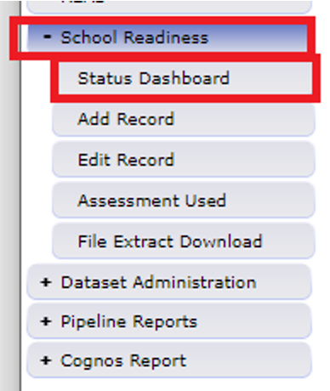
Step 7: Resolve any Data Pipeline Errors (continued)
Fix any errors in the file, and re-upload the data file.
Check the error report again.
Continue this until you reach zero errors.
You can also check the Status Dashboard in Pipeline to see how many errors exist.
Common Errors:
The assessment used must be selected for this school.
  Common Cause: The assessment tool wasn’t selected before the data file was uploaded into Data Pipeline.
  To clear the error, select the assessment tool, and reupload the data file to clear the data.
The district code in the file must match the district code selected for upload.
  Common Cause: In the KSR File Template, the District Code column wasn’t formatted as “Text”.
  To clear the error, open the KSR File Template in Excel, select all of the cells in the “District Code” column, and convert them to text. Save the file, and reupload it into Pipeline.

Slide 16
Step 7: Resolve any Data Pipeline Errors: Common Errors
Common Errors Continued…
This school is noted as being within the district and serving kindergarten. Please report data for this school, even if zero-filled to indicate no kindergarten students presently enrolled.
  Common cause: In the data file upload, the district omitted a school that did not serve any kindergarteners receiving 0.5 FTE or greater in this school year. All schools must be present in the data file, even if they did not serve any kindergarten students.
  To clear the error: The district must fill out the Exception File for the school(s) not serving kindergarteners receiving 0.5 FTE or greater. Email that file to me. I will respond when Data Pipeline is adjusted. Add the previously omitted schools to the data file, with the data filled as zeros. Reupload the amended file into Data Pipeline.
  The Exception File Template is available on the Kindergarten School Readiness Data Collection website.
No kindergartners are reported at this school. If no kindergartners are presently enrolled at a school, please request an exception.
  Common cause: The district has not submitted an Exception File
  To clear the error: The district must fill out the Exception File for the school(s) not serving kindergarteners receiving 0.5 FTE or greater. Email that file to me. I will respond when Data Pipeline is adjusted. Reupload the amended file into Data Pipeline.

Slide 17
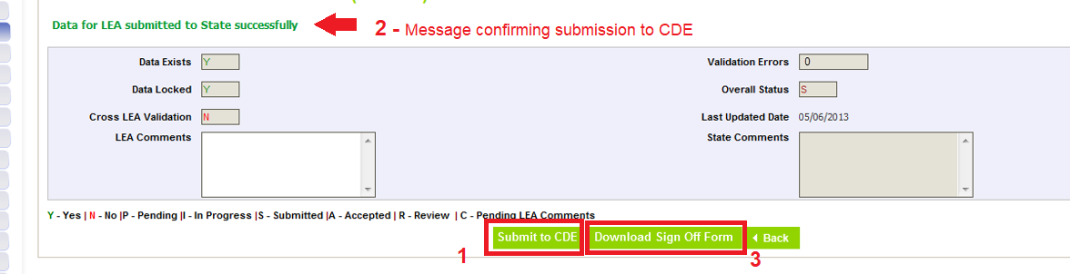
Step 8: Submit Data to Data Pipeline
Data must first be uploaded and error free.
Select “School Readiness”, then select “Status Dashboard” on the left-hand menu.
Click on the “Submit to CDE” button (1)
  If you cannot see this button, it means you do not have the correct Data Pipeline role to submit the data. The “Viewer” and “User” roles cannot submit the data. Only the “Approver” role can submit. Contact your LAM to either gain the Approver role for yourself or identify the staff member with the Approver role.
A message in green text will appear near the top of the screen. It confirms the data was submitted successfully. (2)
Then click on the “Download Sign Off Form (3)

Slide 18
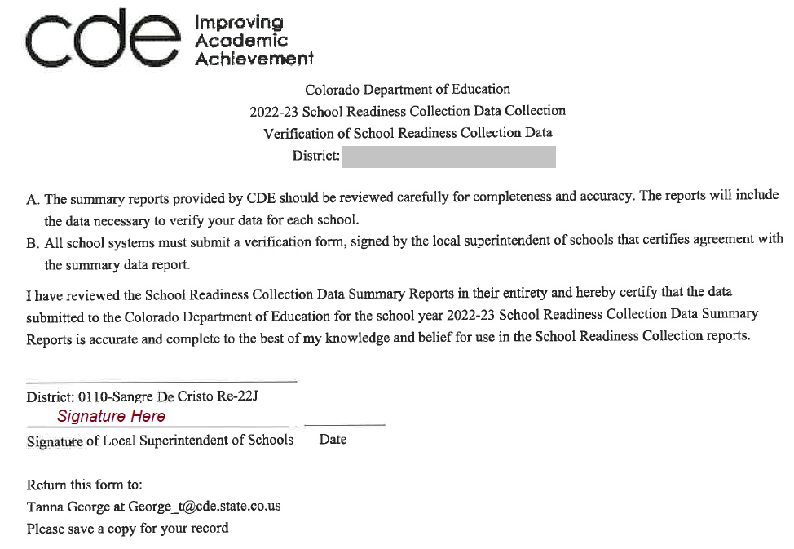
Step 9: Complete the KSR Signature Form
In Step 8, the signature form was download from Data Pipeline.
The file downloads as a pdf.
The file must be signed by the district’s superintendent
CDE accepts both physical and electronic signatures on this form.
The signed form can be emailed to me (george_t@cde.state.co.us)
Congratulations, you are done!

Slide 19
Forms and Files for the Collection
Required
Assessment data files
  What: The student data required to be submitted for the collection.
  Source: The LEP’s chosen assessment tool(s), or district platform(s).
KSR Data File Template
  What: The required file format/layout for a successful Data Pipeline Upload
  Source: KSR Data Collection website
KSR Signature From
  What: Form confirms the superintendent has authorized the data
  Source: Data Pipeline, after the data has been submitted

Slide 20
Forms and Files for the Collection (continued)
Helpful
2023-2024 KSR Collection File Layout and Data Elements (PDF)
  What: It contains descriptions for each data point found in the KSR File Template. If you have further questions about how the data should be entered into the File Template, please contact me.
  Source: KSR Data Collection website
KSR Exception File
  What: This file is only needed when a school is coded to serve kindergarten, but the does not enroll any kindergarteners receiving 0.5 FTE or greater of funding. Fill out the file and email it to me. It will resolve the Pipeline error.
  Source: KSR Data Collection website

Slide 21
Troubleshooting
If data the data is not exporting from the vendor platform, please check the following:
  Have teachers finalized their data?
  Has it been 24 hours since the data were finalized?
  Is the data in the correct checkpoint?
    Examples: Fall, Winter, Spring. The data should be entered in the Fall checkpoint.
    The data cannot be automatically transferred into a different checkpoint by the vendor. The data will need to be manually re-entered by the district.
  Was the data entered in the correct license?
    Sometimes it is difficult to distinguish the preschool and kindergarten licenses from a vendor offering both. Make sure you are logged into the correct license (kindergarten).
    The data cannot be automatically transferred into a different checkpoint by the vendor. The data will need to be manually re-entered by the district.
If none of these work, please contact your vendor directly.

Slide 22
Thank you!
Please reach out to Tanna George, Kindergarten School Readiness Collection Lead, if you have any questions or concerns.
Email: george_t@cde.state.co.us
If you have questions regarding the assessment process for Kindergarten School Readiness, please contact Megan Rogers.
Email: Rogers_M@cde.state.co.us

