Slide 1
KSR Collection: Instructions for Data Exported from Multiple Sources
October 12, 2023
Tanna George
George_t@cde.state.co.us

Slide 2
Agenda
Overview of the Steps to Complete the Collection
Overview of the KSR Assessment
Vendor Platforms/ Assessment Tools
Entry and Storage of KSR Assessment Data
Detailed Walkthrough of Completing the File Template
Calculating the Student Count for the “None” Category
Quick Overview of Remaining Steps to Complete the Collection (with the time remaining).

Slide 3
Steps to Complete the KSR Collection
Detailed Focus
Step 1: Verify the Location of the KSR Assessment Data
Step 2: Extract the Data
Step 3: Use the KSR Data to complete the File Template
Quick Review with the Time Remaining
Step 4: Verify you have Data Pipeline Access
Step 5: Select the Assessment Tool in Data Pipeline
Step 6: Uploading Data to CDE Data Pipeline
Step 7: Resolve any Data Pipeline Errors
Step 8: Submit Data to Data Pipeline
Step 9: Complete the KSR signature form

Slide 4
Overview of Kindergarten School Readiness
Who: All kindergarten students who receive 0.5 FTE funding or greater.
What: Assess the varying skill levels and knowledge with which students enter kindergarten (C.R.S. 22-7-1002 (2)) and inform individual learning plans (C.R.S. 22-7-1014).
  Physical well-being and motor development
  Social and emotional development
  Language and comprehension development
  Cognition
  Literacy
  Math
Where: All schools that serve kindergarten students who receive 0.5 FTE or greater. This includes charter schools.
When: Students are assessed in the first 60 days of the school year. The first 60 days should align with each school’s calendar.
How: The State Board of Education has approved a menu of tools for the KSR Assessments.

Slide 5
KSR Vendor Platforms/ Assessment Tools
KSR Assessment Platforms Authorized by the State Board of Education (2023-24 SY)
  COR for Kindergarten
  Desired Results Developmental Profile for Kindergarten (DRDP-K)
  North Carolina Kindergarten Entry Assessment
  Acadience Math K-6
  Brigance Early Childhood Screens III
  DIAL-4 Developmental Indicators for the Assessment of Learning
  FastBridge earlyMath
  FastBridge earlyReading
  FastBridge SAEBRS
  Istation's Indicators of Progress (ISIP)
  READ Assessment tools
  Teaching Strategies GOLD

Slide 6
Entry and Storage of KSR Assessment Data
The KSR Assessment is required.
  Some charter schools and districts have waivers that been approved by the State Board of Education to use a different assessment.
Local Education Providers (LEPs) can choose any combination of the approved assessment tools to assess the six domains.
LEPs can decide how to enter and store their data in their systems.
If a LEP has a question regarding their assessment tool, the LEP should contact that vendor for technical assistance.
  CDE’s Assessment Choices and School Readiness Plans website provides a link to each vendor.
Depending on the LEP, these steps might be completed by a staff member other than the Data Respondent. LEPs are welcome to develop a system that works well for them.

Slide 7
Single Export vs. Multiple Export
Single source export is possible if all student level assessment and demographic data is stored in one location.
  Each of the six domains - Did they meet or exceed expectations?
  Demographic data
    Gender
    Free and reduced-price lunch
    Race and Ethnicity
Multiple source exports will be required if the student level data is stored in more than one location.
  Most commonly due to using more than one assessment tool.
  Example: Literacy was assessed using FastBridge earlyReading. The other five domains were assessed using Teaching Strategies GOLD.

Slide 8
Troubleshooting the Export
If data the data is not exporting from the vendor platform, please check the following:
  Have teachers finalized their data?
  Has it been 24 hours since the data were finalized?
  Was the data entered in the correct checkpoint?
    Examples: Fall, Winter, Spring. The data should be entered in the Fall checkpoint.
    The data cannot be automatically transferred into a different checkpoint by the vendor. The data will need to be manually re-entered by the district.
  Was the data entered in the correct license?
    Sometimes it is difficult to distinguish the preschool and kindergarten licenses from a vendor offering both options. Make sure you are logged into the correct license (kindergarten).
    The data cannot be automatically transferred into a different checkpoint by the vendor. The data will need to be manually re-entered by the district.
If none of these work, please contact your vendor directly.

Slide 9
Export format
The final data file that will be uploaded into Data Pipeline will need to be in the .xlsx format. Therefore, exporting the data into a spreadsheet (such as one that can be opened in Excel) will be beneficial.
  Note: There is an uncommon file format called “.xlsx (Open)” in most views, it will look like a normal “.xlsx” format, but Data Pipeline will not accept it. Use the “Save As” function to check if the file is saved as just “.xlsx” or “.xlsx (Open)”.
Data Pipeline does not accept file names with special symbols or characters.
  They will trigger an upload error in Data Pipeline.
  Examples: !@#$.%&*_?/
  Spaces in the file name are fine.

Slide 10
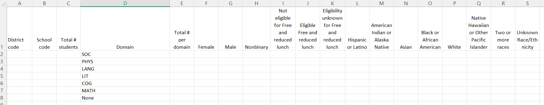
KSR File Template
The File Template can be found on the Kindergarten School Readiness Data Collection website.
Data Elements:
  District Code
  School Code
  Total # students
  Domain
  Total # per domain
  Gender
  Free and Reduced-Price Lunch
  Race and Ethnicity
All participating schools will be included in the final file.

Slide 11
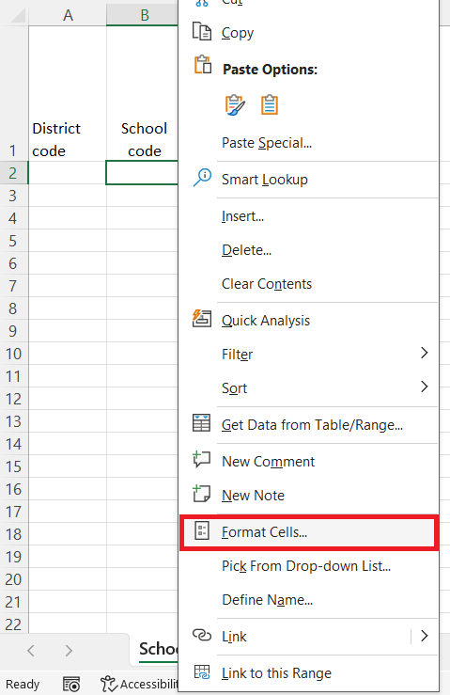
File Template: Columns A and B
District Code and School Code (Columns A and B): A unique 4-digit code is assigned to each district, and to each school.
  Don’t know your codes? Find them on the Data Pipeline Frequently Requested Codes website.
The District and School Code columns must be formatted as “Text” in the final file.
This preserves the leading zeros in the codes.
  Example: 0235
To format as “Text” in Excel.
  Open the file in Excel.
  Find the cell(s) you want to reformat.
  Right click with your mouse on the cell.
  In the new window that pops up, select “Text” form the list of formats, and click “OK”.
  All other numerical cells in the file will be formatted as numbers.

Slide 12
File Template: Columns C, D, and E
100
90
Total # Students (Column C): Total number of students included in the KSR Assessment. This number should be the same as all kindergarteners receiving 0.5 FTE or greater.
Domain (Column D): The abbreviated six domains included in the KSR Assessment.
  Social and emotional development
  Physical well-being and motor development
  Language and comprehension development
  Literacy
  Cognition
  Math
Total # Per Domain (Column E): The total number of assessed students who are meeting or exceeding expectations in that domain.
  Example: Out of the 100 students assessed (Column C), how many met or exceeded expectations in Math? In my example, 90 students met or exceeded expectations in Math (Column E).

Slide 13
File Template: Columns F, G, H (Gender)
90
Female (Column F): Out of the total number of students who met or exceeded expectations in Math, how many are female?
Male (Column G): Same process
Nonbinary (Column H): Same process
Using our Math domain example: If 90 students met or exceeded expectations in Math, then the sum of Female, Male, and Nonbinary should equal 90 (that’s the number in Column E, Total # per Domain)
If no students are identified in a demographic category, enter a zero.

Slide 14
File Template: Columns I, J, K (Free and Reduced Lunch)
90
Not Eligible for Free and Reduced Lunch (Column I): Out of the total number of students who met or exceeded expectations in Math, how many are Not Eligible for Free and Reduced Lunch?
Eligible for Free and Reduced Lunch (Column J): Same process.
Eligibility Unknown for Free and Reduced Lunch (Column K): Same process.
Using our Math domain example: If 90 students met or exceeded expectations in Math, then the sum of Not Eligible, Eligible, and Eligibility Unknown should equal 90 (the number in Column E, Total # per Domain).

Slide 15
File Template: Columns L through S (Race/ Ethnicity)
90
Hispanic or Latino (Column L): Out of the total number of students who met or exceeded expectations in Math, how many are Hispanic or Latino?
All the other Race/Ethnicity Categories (Columns M-S): Same process.
Using our Math domain example: If 90 students met or exceeded expectations in Math, then the sum of all the Race /Ethnicity categories should equal 90 (the number in Column E, Total # per Domain).

Slide 16
File Template:
Demographic Data Reminders
Ensure there is consistency of information across the assessment tools.
  Name, gender, FRL status, Race/ethnicity
If no students qualify for a category, enter a zero. Leaving it blank will trigger an error in Data Pipeline.
This demographic information is also part of the Student October Count collection. It is required for all students, and it will be on file.
The data for each of the six KSR Domains (rows in the Template) can be calculated independently from the other Domains.
  Except the “None” category.

Slide 17
File Template: The None Category
None: Students who did not meet or exceed expectations in any of the six domains.
In a single source export this will be easy to calculate. Some vendors will complete the calculation for the export automatically.
In multi-source exports, this will need to be calculated.

Slide 18
Calculating the None Category
The calculation for “None” will need to be repeated for each school within the district.
There are multiple different methods to identify and count these students. Please use a method that works well for you.
I will provide an example. This example should be possible in most spreadsheet software programs, and it does not use formulas.
  Highlight duplicate cells (students) that appear in every list
  Filter for those highlighted cells
  Count the highlighted cells

Slide 19
Calculating the None Category:
Getting the Data
Complete the exports from all assessment tools.
Use those exports to get the names (or SASIDs) of the students in the “None” category from each export
  Students who did not meet or exceed expectations in any of the domains assessed by that assessment tool.
  Remember this calculation is completed separately for each school.
  How this information is presented can vary between assessment tools.
    Contact the assessment tool vendor for support if needed.
  Consider the possibility of duplicate names within a school.
    Larger schools might consider pulling in another common piece of PII, such as birth date.
Copy and paste the “None” names (or SASIDs) from each export into Excel
  SASIDs will be easiest, due to consistency
    Ensure cells are in the same format (Text vs. Number format, etc.)
  Ensure the names (and birthdates, if used) are in the same format.
    Are the first and last name in the same cell or in two separate cells?
    Are the names in the same order, with the same punctuation? (Last, First / First Last)
    Are the middle names entered consistently in each export?
    Date format is consistent (MM/DD/YYYY, Sept 2, 2018, MM/DD/YY HH:MM)

Slide 20
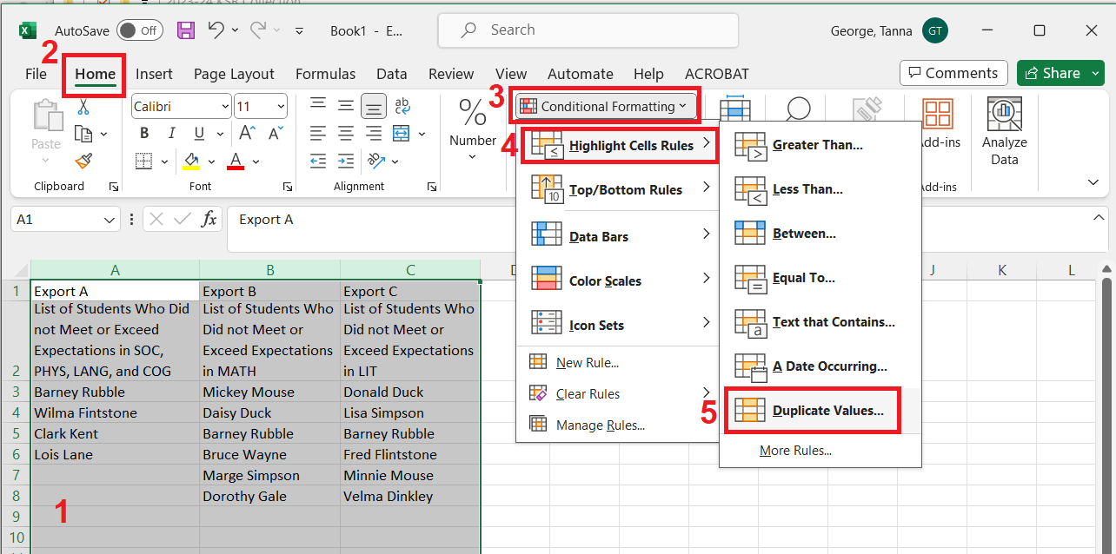
Calculating the None Category:
Identifying the Students in None
Highlight the columns with the student data
Click “Home”
Click on “Conditional Formatting”
Click on “Highlight Cell Rules”
Click on “Duplicate Values

Slide 21
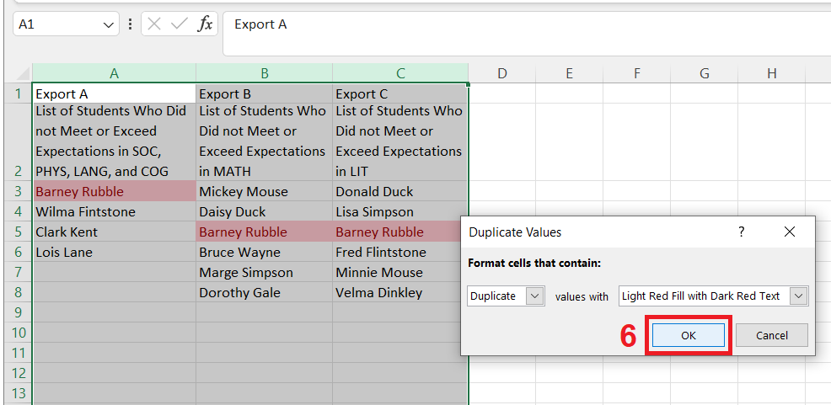
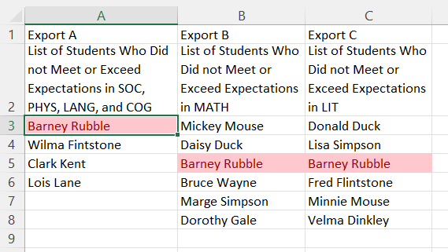
Calculating the None Category:
Identifying the Students in None Continued
6) In the new window, click “OK”.
The children's names that appear in all three export lists now have a red text and a pink cell color.
Possible sources of errors
  Different formatting
  Name order
  Name spelling
  Punctuation
  Duplicate Names
  Extra “spaces”

Slide 22
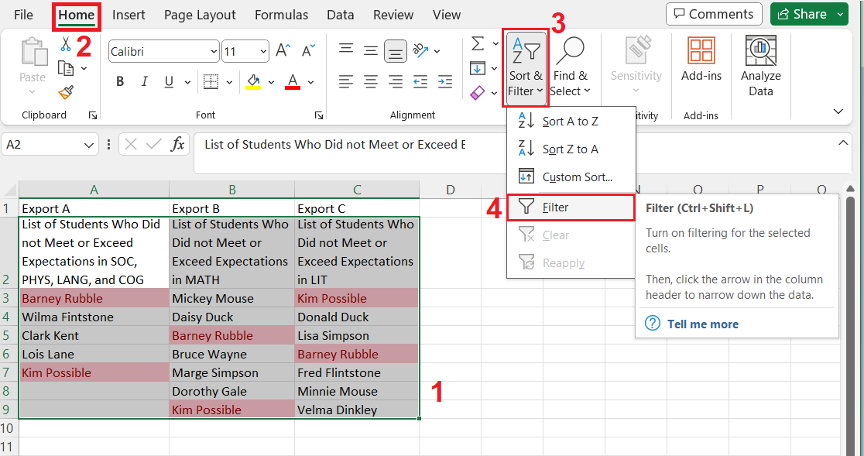
Calculating the None Category:
Filtering the Student List
If the list of names is long, then filtering can be helpful to consolidate the student names.
Highlight student names and the column header.
Click “Home”.
Click “Sort and Filter”.
Click “Filter” from the new menu.

Slide 23
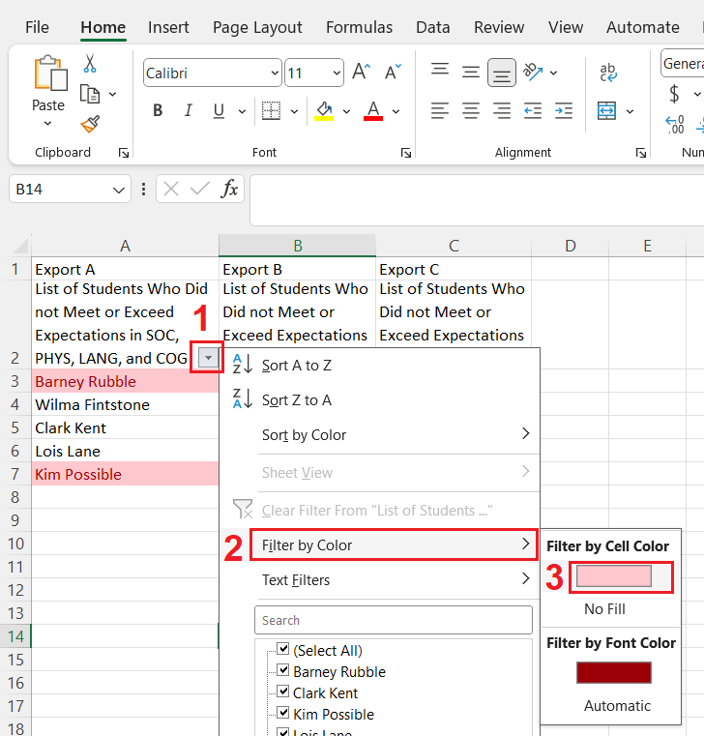
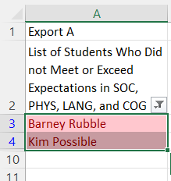
Calculating the None Category:
Filtering the Student List (Continued)
Click on the new menu button in the header cell. It’s the grey square.
Click on “Filter by Color”.
Click on the color box. It is pink in this example.

Slide 24
Calculating the None Category:
Reminders
The “None” category needs to be calculated for each school.
Once the students in the “None” category are identified, you will need their demographic information to complete the rest of the File Template: Gender, FRL status, Race/Ethnicity
I can provide support and answer questions.
  Don’t send student PII over email, especially student names or SASIDs.
  CDE uses Syncplicity for sending files with PII. I can provide instructions for using Syncplicity.

Slide 25
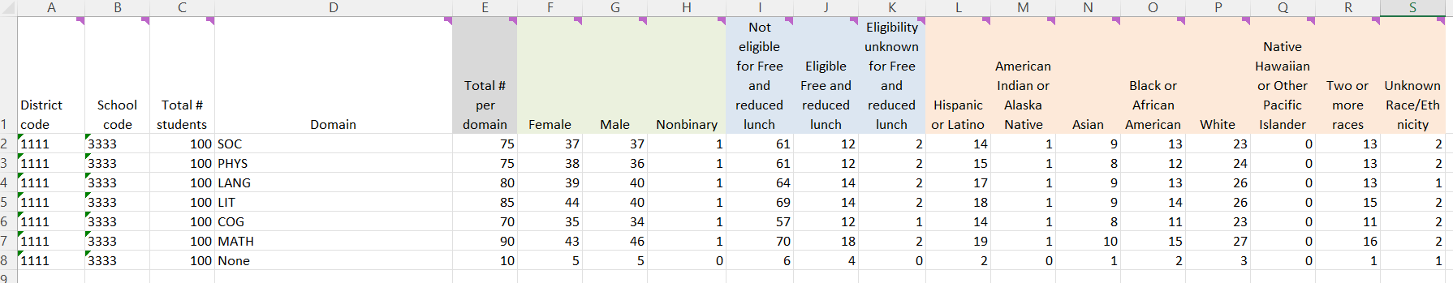
File Template: Example Data
This is an example of completed data from one school. All participating schools will be included in the final file.
In this example, I added the cell colors to the demographic headers to help in visualizing the categories.

Slide 26
Export Format Reminders
The final data file that will be uploaded into Data Pipeline will need to be in the .xlsx format. Therefore, exporting the data into a spreadsheet (such as one that can be opened in Excel) will be beneficial.
  Note: There is an uncommon file format called “.xlsx (Open)” in most views, it will look like a normal “.xlsx” format, but Data Pipeline will not accept it. On my computer it is only visible on the “Save As” screen.
Data Pipeline does not like file names with special symbols or characters
  They will trigger an error in Data Pipeline.
  Examples: !@#$%&*_?/
  Spaces are fine in the file name.

Slide 27
Remaining Steps to Complete the Collection
Completed
Step 1: Verify the Location of the KSR Assessment Data
Step 2: Extract the Data
Step 3: Use the KSR Data to complete the File Template
Up Next
Step 4: Verify you have Data Pipeline Access
Step 5: Select the Assessment Tool in Data Pipeline
Step 6: Uploading Data to CDE Data Pipeline
Step 7: Resolve any Data Pipeline Errors
Step 8: Submit Data to Data Pipeline
Step 9: Complete the KSR signature form

Slide 28
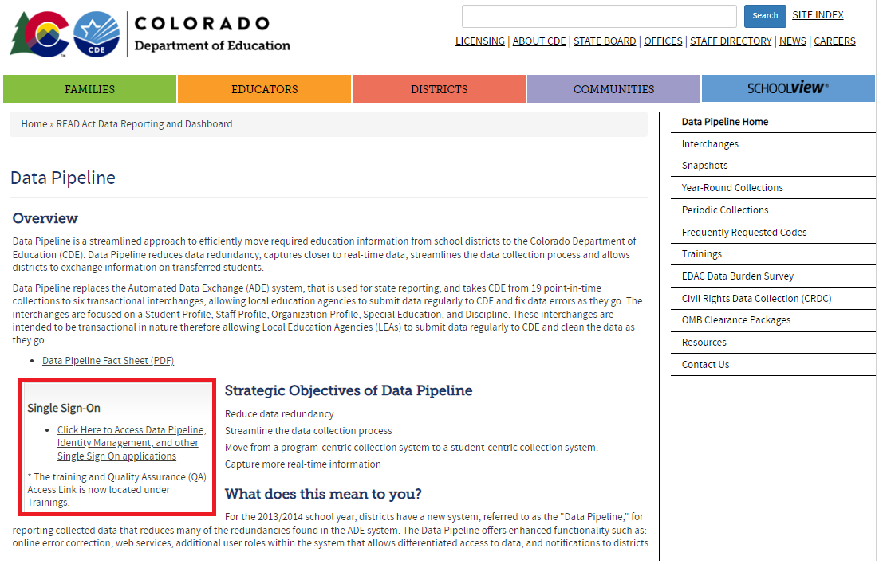
Step 4: Verify you have Data Pipeline Access
Each individual Data Pipeline user must be granted a Data Pipeline login, and access to the KSR Collection within Pipeline.
To login to Data Pipeline.
  Link to Data Pipeline website.
  Click on the “Single Sign-On” link.
  Enter your login credentials.
CDE cannot manage district staff assignments in Data Pipeline.
Each district’s Local Access Manager (LAM) manages their staff’s Pipeline access, and assignment of roles. The LAM is frequently the Superintendent for many smaller districts.

Slide 29
Step 4: Verify you have Data Pipeline Access (continued)
If you do not know the LAM is for your district, this is the link to the LAM inquiry form.
Your LAM can do the following:
    Grant Data Pipeline logins
    Assign a Data Respondent(s) to the KSR Collection within Data Pipeline
    Change staff’s role assignments for each collection.
  Roles:
    Viewer: They can only see the uploaded data for the KSR Collection.
    User: They can view the collection data, upload data, and finalize the data. They cannot submit to CDE within Pipeline.
    Approver: They are the only role that can submit the data to CDE within Data Pipeline. Submitting the data to CDE is a required step of the collection. If you do not have the Approver role, you will need to identify the district staff member with that role.

Slide 30
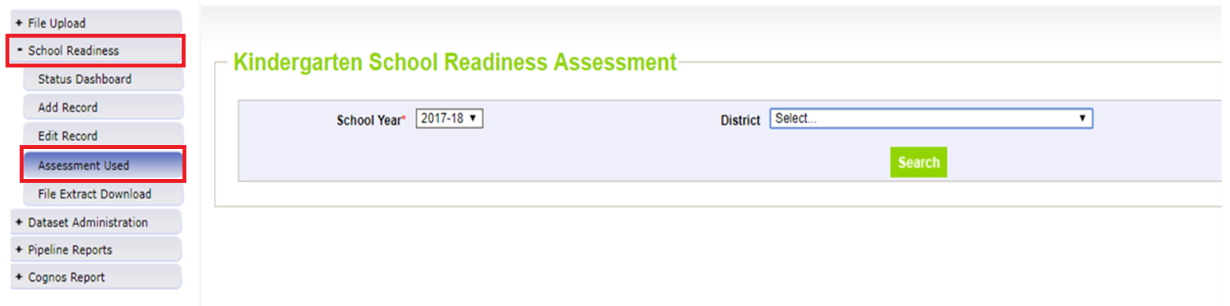
Step 5: Select the Assessment Tool in Data Pipeline
Do you have the following?:
Completed the KSR Data File Template (Steps 1-3)
Data Pipeline access to the KSR Collection, with a User or Approver role (Step 4)
1: Login to Data Pipeline
2: Click on “School Readiness”
3: Click on “Assessment Used”
4: Select the correct “School Year”
5: Select the correct “District”
6: Click “Search”

Slide 31
Step 5: Select the Assessment Tool in Data Pipeline (Continued)
Your screen will display a list of every school that is coded to serve kindergarten students in CDE’s system.
Select the main assessment tool used for each school.
Assessment Waivers: Some districts or schools have a waiver from the State Board of Education that grants the school a waiver to use an assessment tool that is not on the SBE approved list. The assessment and collection still needs to be completed, but the waiver recipient can use a different assessment.
Who has assessment tool waivers? Here is a link to the 2023-24 list of SBE approved waivers for Charter Schools. (last updated August 2023)
More information regarding waivers can be found on the Waivers & Policy Guidance website.

Slide 32
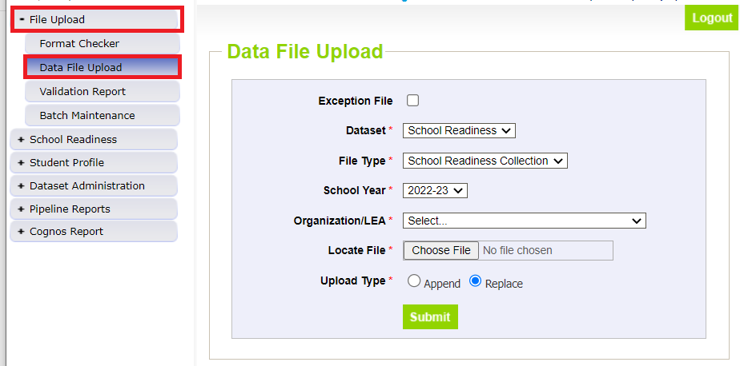
Step 6: Uploading Data to CDE Data Pipeline
Upload your data file into Data Pipeline after the Assessment Tool has been selected (Step 5).
If you reverse this order, it will trigger a Pipeline error, and you will need to start again in the correct order.
The data file for the upload must be saved as an .xlsx file. Any other file type will trigger an upload error in Pipeline.
  Note: In past years, some vendor tools export the report has downloaded into an .txt file- you will need to make sure it is saved as an .xlsx for upload into Pipeline.
Select “File Upload”, then select “Data File Upload” from the left-side menu.

Slide 33
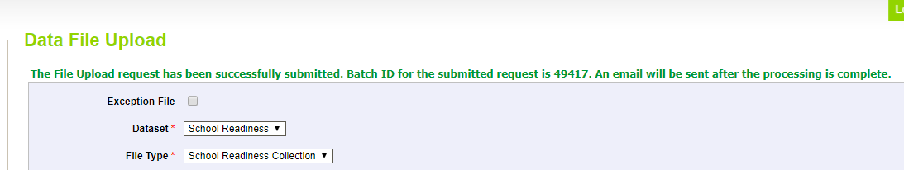
Step 6: Uploading Data to CDE Data Pipeline (Continued)
Exception File: Unchecked
Dataset: School Readiness
File Type: School Readiness Collection
School Year: The current school year
Organization / LEA: Select the correct district
Locate File: Click choose file, and find the completed KSR File Template on your computer.
Upload Type: Replace
Click Submit. The screen will display a success message in green text.

Slide 34
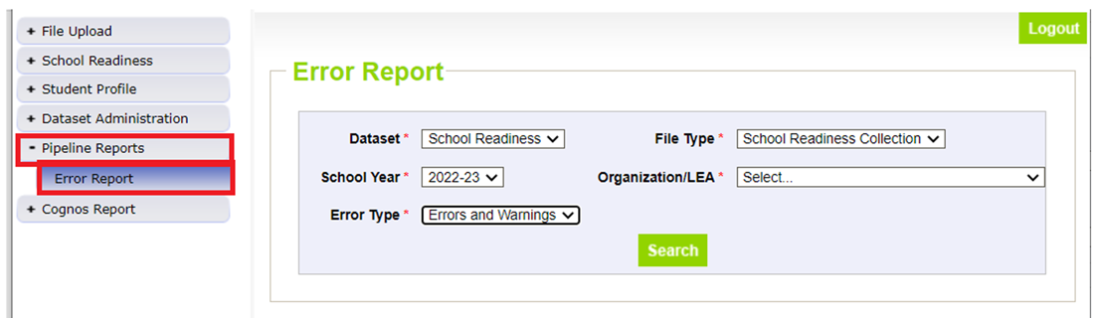
Step 7: Resolve any Data Pipeline Errors
Select “Pipeline Reports”, then select “Error Report”
Dataset: School Readiness
File Type: School Readiness Collection
School Year: The current school year
Organization / LEA: The correct district name
Error Type: Errors and Warnings
  Note: Errors must be resolved before submission. Warnings are important to pay attention to, but they do not need to be resolved before data submission.
Click “Search”

Slide 35
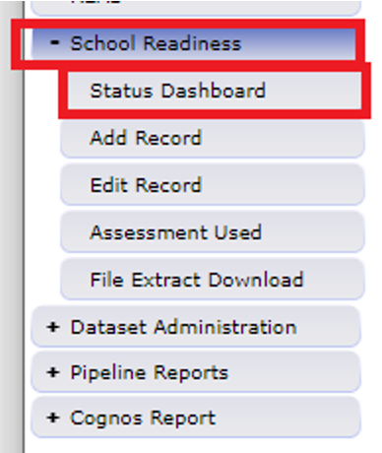
Step 7: Resolve any Data Pipeline Errors (continued)
Fix any errors in the file, and re-upload the data file.
Check the error report again.
Continue this until you reach zero errors.
You can also check the Status Dashboard in Pipeline to see how many errors exist.
Common Errors:
The assessment used must be selected for this school.
  Common Cause: The assessment tool wasn’t selected before the data file was uploaded into Data Pipeline.
  To clear the error, select the assessment tool, and reupload the data file to clear the data.
The district code in the file must match the district code selected for upload.
  Common Cause: In the KSR File Template, the District Code column wasn’t formatted as “Text”.
  To clear the error, open the KSR File Template in Excel, select all of the cells in the “District Code” column, and convert them to text. Save the file, and reupload it into Pipeline.

Slide 36
Step 7: Resolve any Data Pipeline Errors: Common Errors
Common Errors Continued…
This school is noted as being within the district and serving kindergarten. Please report data for this school, even if zero-filled to indicate no kindergarten students presently enrolled.
  Common cause: In the data file upload, the district omitted a school that did not serve any kindergarteners receiving 0.5 FTE or greater in this school year. All schools must be present in the data file, even if they did not serve any kindergarten students.
  To clear the error: The district must fill out the Exception File for the school(s) not serving kindergarteners receiving 0.5 FTE or greater. Email that file to me. I will respond when Data Pipeline is adjusted. Add the previously omitted schools to the data file, with the data filled as zeros. Reupload the amended file into Data Pipeline.
  The Exception File Template is available on the Kindergarten School Readiness Data Collection website.
No kindergartners are reported at this school. If no kindergartners are presently enrolled at a school, please request an exception.
  Common cause: The district has not submitted an Exception File
  To clear the error: The district must fill out the Exception File for the school(s) not serving kindergarteners receiving 0.5 FTE or greater. Email that file to me. I will respond when Data Pipeline is adjusted. Reupload the amended file into Data Pipeline.

Slide 37
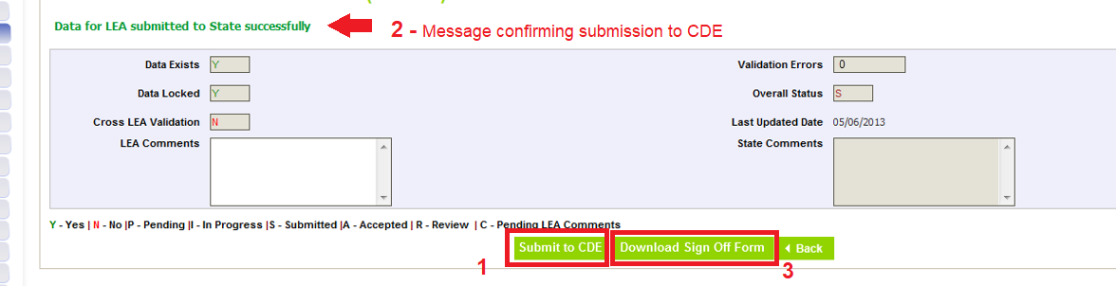
Step 8: Submit Data to Data Pipeline
Data must first be uploaded and error free.
Select “School Readiness”, then select “Status Dashboard” on the left-hand menu.
Click on the “Submit to CDE” button (1)
  If you cannot see this button, it means you do not have the correct Data Pipeline role to submit the data. The “Viewer” and “User” roles cannot submit the data. Only the “Approver” role can submit. Contact your LAM to either gain the Approver role for yourself or identify the staff member with the Approver role.
A message in green text will appear near the top of the screen. It confirms the data was submitted successfully. (2)
Then click on the “Download Sign Off Form (3)

Slide 38
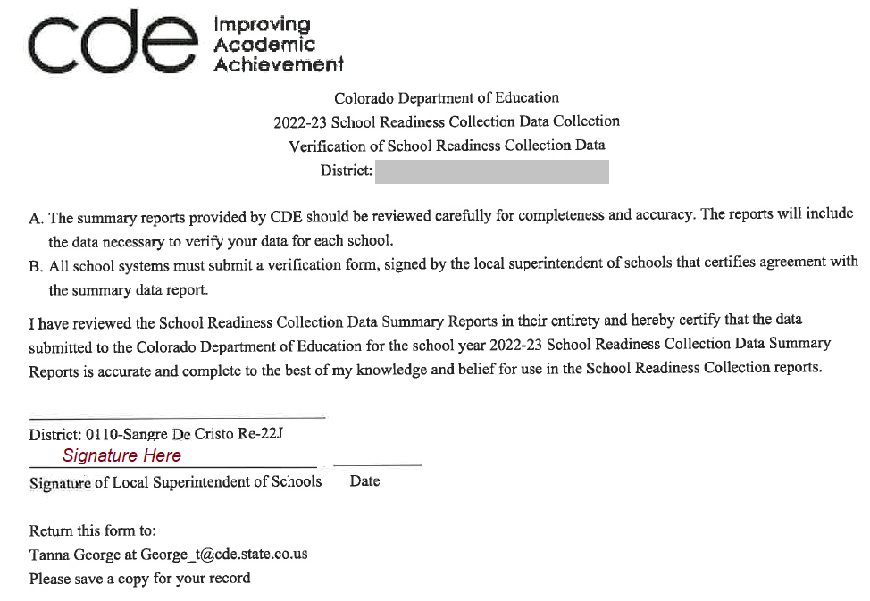
Step 9: Complete the KSR Signature Form
In Step 8, the signature form was download from Data Pipeline.
The file downloads as a pdf.
The file must be signed by the district’s superintendent
CDE accepts both physical and electronic signatures on this form.
The signed form can be emailed to me (george_t@cde.state.co.us)
Congratulations, you are done!

Slide 39
Forms and Files for the Collection
Required
Assessment data files
  What: The student data required to be submitted for the collection.
  Source: The LEP’s chosen assessment tool(s), or district platform(s).
KSR Data File Template
  What: The required file format/layout for a successful Data Pipeline Upload
  Source: KSR Data Collection website
KSR Signature From
  What: Form confirms the superintendent has authorized the data
  Source: Data Pipeline, after the data has been submitted

Slide 40
Forms and Files for the Collection (continued)
Helpful
2023-2024 KSR Collection File Layout and Data Elements (PDF)
  What: It contains descriptions for each data point found in the KSR File Template. If you have further questions about how the data should be entered into the File Template, please contact me.
  Source: KSR Data Collection website
KSR Exception File
  What: This file is only needed when a school is coded to serve kindergarten, but the does not enroll any kindergarteners receiving 0.5 FTE or greater of funding. Fill out the file and email it to me. It will resolve the Pipeline error.
  Source: KSR Data Collection website

Slide 41
Thank you!
Please reach out to Tanna George, Kindergarten School Readiness Collection Lead, if you have any questions or concerns.
Email: george_t@cde.state.co.us
If you have questions regarding the assessment process for Kindergarten School Readiness, please contact Megan Rogers.
Email: Rogers_M@cde.state.co.us

