Slide 1
WBL Program Measurement and Assessment
May 12, 2021
*This meeting will be recorded

Slide 2
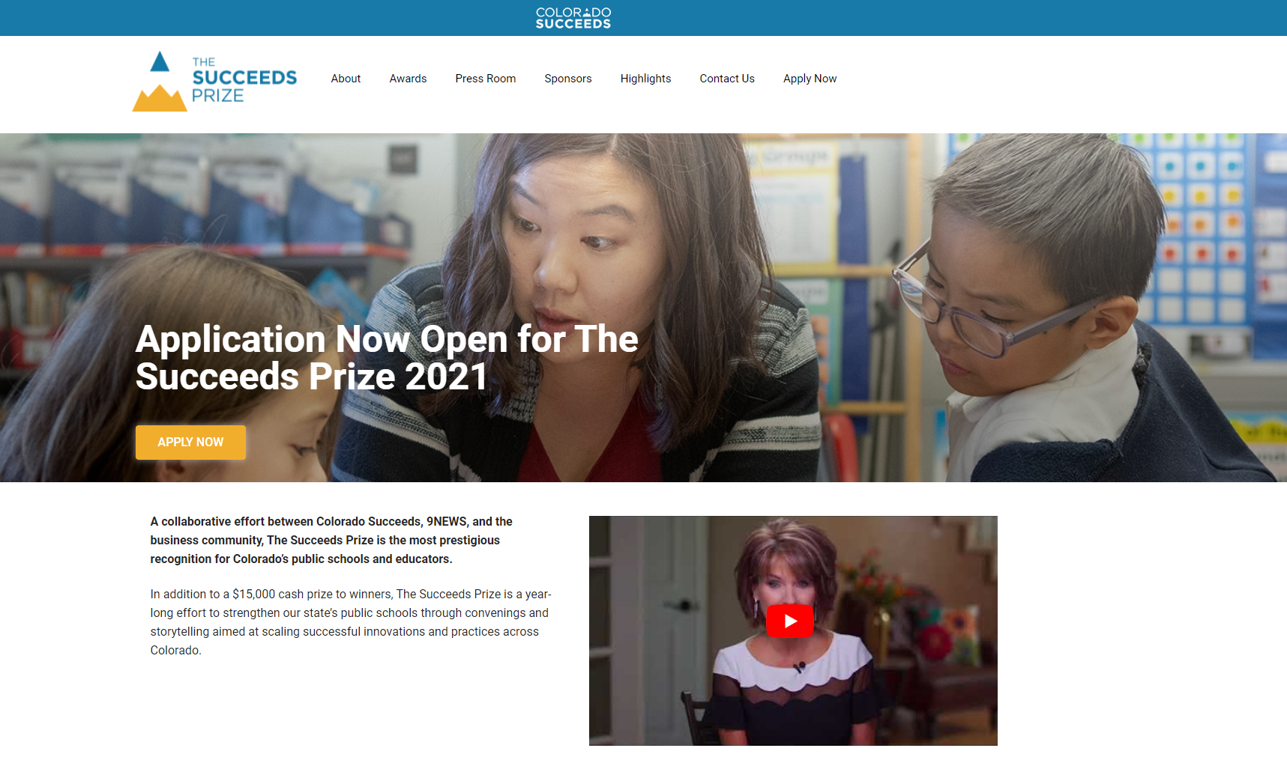
Colorado Succeeds Prize
The Succeeds Prize exists to identify, recognize, and share stories of impact from innovative educators statewide
Notes:
https://coloradosucceeds.org/succeeds-prize/the-succeeds-prize/

Slide 3
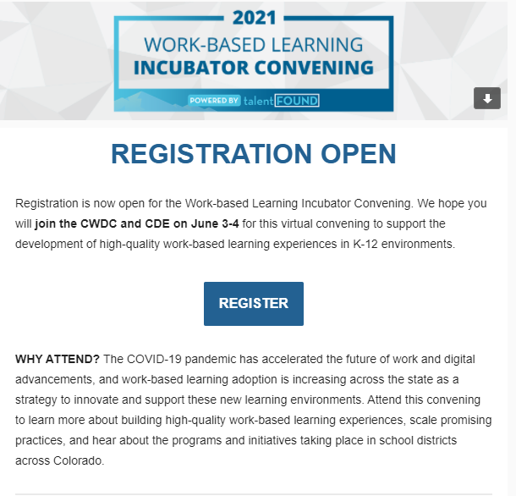
Convening registration
Notes:
https://cwdc.colorado.gov/wbl-incubator-convening

Slide 4
Objective
Participants will learn more about work-based learning program measurement and assessment to increase access, opportunities and effectiveness

Slide 5
Agenda
Measuring Access and Participation
Program Measurement and Assessment in Cherry Creek School District
Measurement and Assessment Overview from CEI
Breakout Groups
Wrap Up

Slide 6
Reviewing Participation Data and Access
Create a learning agenda to ground the work in data
What are you trying to learn and why?
Compare to the bigger picture - school/district
Notes:
What percent enrolled? What percent persist? Demographic breakdown of students in high wage industry sectors?

Slide 7
What types of barriers may exist?
Acceptance into program
The way participation is built
Awareness of opportunities - recruitment
The types of opportunities
The industry - representation
The company/organization culture

Slide 8
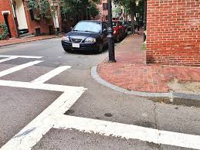
Curb Cut Effect
Notes:
In 1945, disability activism resulted in the installation of curb cuts. Originally designed to make public streets accessible to disabled war vets in wheelchairs, today everyone benefits whether they use a wheelchair, have a disability, or or not -- people with strollers, people carrying lots of packages, etc.

Slide 9
Opportunities
Notes:
https://cue.usc.edu/files/2018/01/2_Ladders_But-the-world-isn-equal.png

Slide 10
Quote
“Guided pathways without equity in the center is simply tracking” - Dr. J. Luke Wood

Slide 11
How can we determine additional barriers?
Notes:
Ask

Slide 12
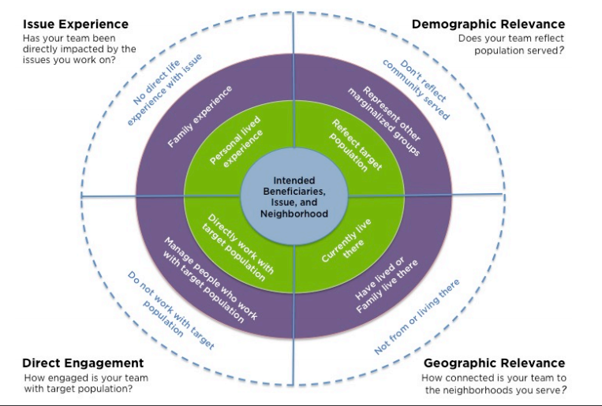
Who is at your table?

Slide 13
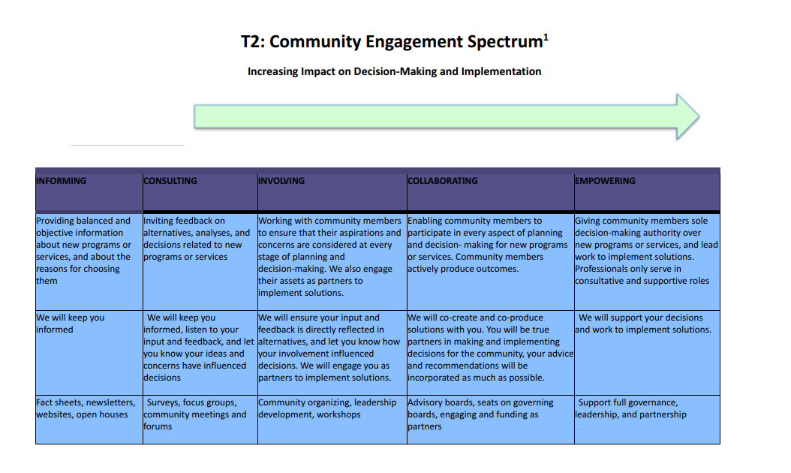
Community engagement spectrum

Slide 14
Ten essential questions for workforce development

Slide 15
Measurement and Assessment - Mike
Current Programs
Executive Internship
Apprenticeships
Careerwise - 9 Pathways
Other - Mikron, NSA
CCSD
Future Educator - Fall 2019
Auto Technician - Fall 2021
Health Technician - Fall 2021

Slide 16
Measurement and Assessment -
Executive Internship
Executive Internship
Overview
1 Semester, 100 Hours, Unpaid, 10 - 15 hours a week
2020 - 2021 Internship
Spring 2020 - 13 Students
Summer 2020 - 22 Students
Fall 2020 - 15 Students
Spring 2021 - 11 Students

Slide 17
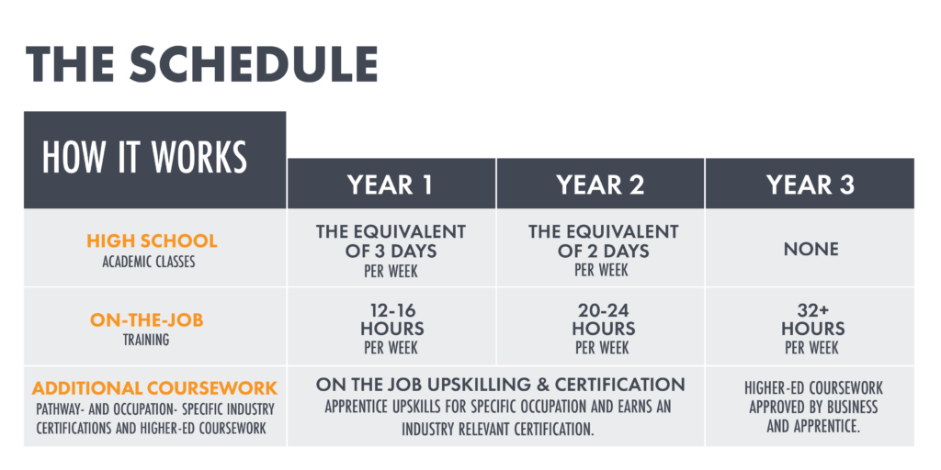
Measurement and Assessment - Apprenticeships
Apprenticeships
Overview
3 Year program
Careerwise
1st Year - 11 Students
2nd Year - 9 Students
FEP - 18 Students
Mikron - 3 Students
NSA - 3 Students

Slide 18
Measurement and Assessment
Measures of Effectiveness
Executive Internship
Access
Placements
School participation
Equity - participation reflects the district

Slide 19
Measurement and Assessment
Measures of Effectiveness
Apprenticeships
Access
Student profiles - 144 Student Profiles
Applications - 86 Applicants, 145 Applications
Students hired - Currently 34 hired apprentices
Continuation from year to year - TBD
Equity - participation reflects the district

Slide 20
Measurement and Assessment
Future Forward
K-8 CTE programming
Industry speakers
Industry tours/events
Continued growth in Internships and Apprenticeships

Slide 21
Resources From Today’s Conversation: tinyurl.com/WBLdata1
In this folder you’ll find:
A Logic Model template
A couple of measurement plan templates/examples
Internship guide
A data use facilitation guide
Notes:
Rachel

Slide 22
Why measure your work?
Why measure your work?
Notes:
Amy
Start with a conversation starter, asking folks to put in the chat why they might consider measuring their work.

Slide 23
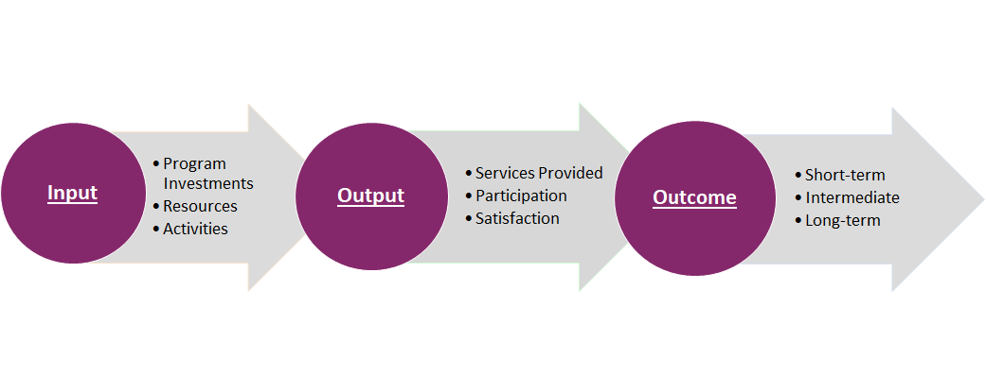
Theory of Action or
Logic Model Approach
Notes:
Amy
Communicate what you’re doing, why, what outcomes you expect to achieve. We’ve done a first draft of something you all can take/leave.
This slide is an orientation to what logic models are, and why we are using. Making our thinking explicit, no assumptions, everyone is on the same page. Easy to focus on the what, this helps us focus on the why of what we’re doing. We can also use this as a communication tool, helps your team have a unified story of what this work is, what your aims are, and how we’ll get there.

Slide 24
Logic Model Approach
Notes:
Amy
Which activities lead to which outcomes
Separating outputs, and outcomes. Parsing out which activities lead to what outputs and outcomes.

Slide 25
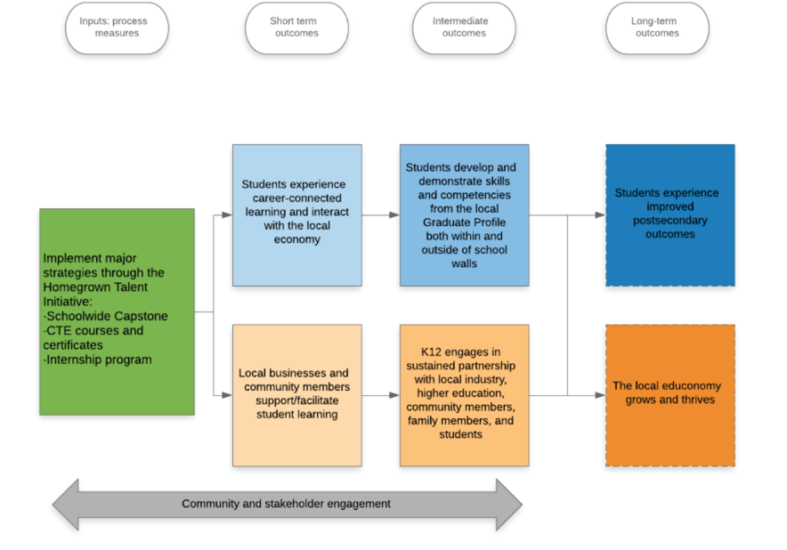
Outcomes graphic
Notes:
Amy
Example logic model to walk through, introduce the idea of short, medium, and long term outcomes

Slide 26
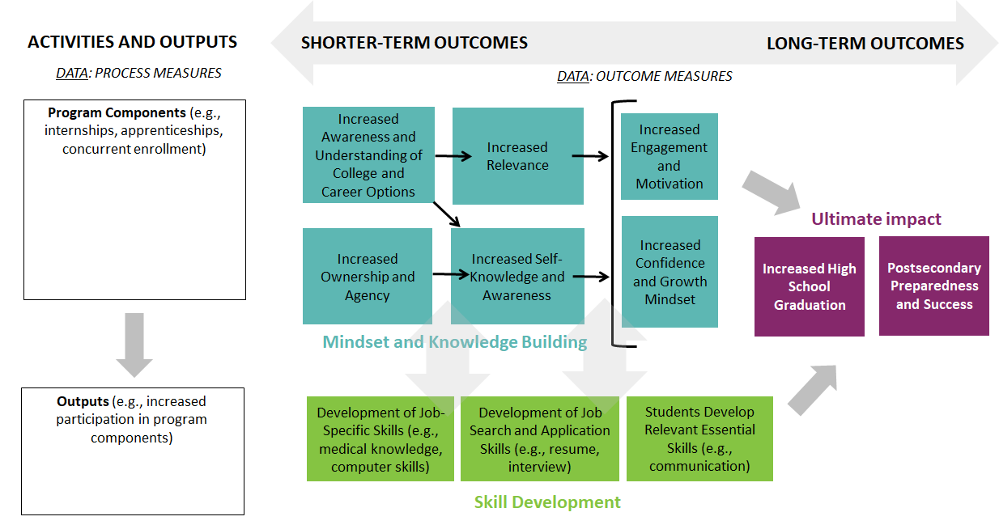
Alternative outcomes graphic
Notes:
Rachel
Another example to share. Note the outputs box and shorter vs. long term outcomes

Slide 27
Output Measures vs.
Outcome Measures
Notes:
Rachel
Introduce outputs vs. outcomes. What is the difference, why does it matter? Look to previous logic model for a visual demonstration if needed.

Slide 28
Creating a Measurement
Plan
Measurement Plans answer the following questions:
WHAT are we going to measure tied to implementation (outputs) and our outcomes? What disaggregations are we going to look at (e.g. race/ethnicity, FRL status).
HOW are we going to collect that data? Are we going to use focus groups? Surveys? Assessments?
WHEN do we collect that data? Is it every week? Month? Semester? Consider what outcomes you may see take place sooner (leading outcomes) rather than later (lagging outcomes).
WHO is responsible for gathering these data?
Let’s look at an example!
Notes:
Rachel
If we’re thinking about outputs, outcomes, we need some actual data to measure those, right? This is where the rubber meets the road and you decide what you want to measure, how you’re going to do it, how often, and who is responsible

Slide 29
Data Collection Tools
Tips for selecting your data collection tools:
Consider how data collection is already embedded into your work-based learning work. Are you collecting stories about students’ internship experience? Are you asking internship providers for feedback? That is data!
Think about how to leverage publicly available data (or data you already have at the district/school levels) such as TLCC, Healthy Kids, or Post-Secondary data.
Consider gaps in your knowledge. Is there an aspect of your work you’ve always wondered about? Follow your gut, more likely than not, you, your team, or students knows how to get that data.
Consider capacity. Data collection, synthesis, and use can take a lot of work. Think about what is realistic for you and your team given your capacity. Short on capacity? Go back to tips one and two.
Notes:
Rachel
Selecting tools: How do you plan to use these data? For example, do you want to use them for program improvement? Recruiting new students? As a way to garner funding?
What type of data is most useful given what you want to learn about?
How will your team analyze and use these data?
Who will collect, analyze, and use these data?
Who will you collect data from, in other words, who is your source? It could be students, teachers, businesses, etc.

Slide 30
Publicly Available Data
A few publicly available data sources to explore:
CDE’s School/District Dashboard
Tip: Check out the yellow Post-Secondary & Workforce Readiness Tab
CDHE’s Post Secondary Access and Success Dashboard
Tip: All tabs are interesting and likely relevant to WBL work, but check out the High School Pathways tab
Teaching and Learning Conditions Colorado Survey (TLCC)
Note: May be less directly related to WBL work, however, the Community Support and Involvement tab may be useful
Office of Civil Rights Data
Note: This data source has data from a few years ago and therefore might feel a little outdated, however, there is a wealth of information on this site!
Notes:
Rachel

Slide 31
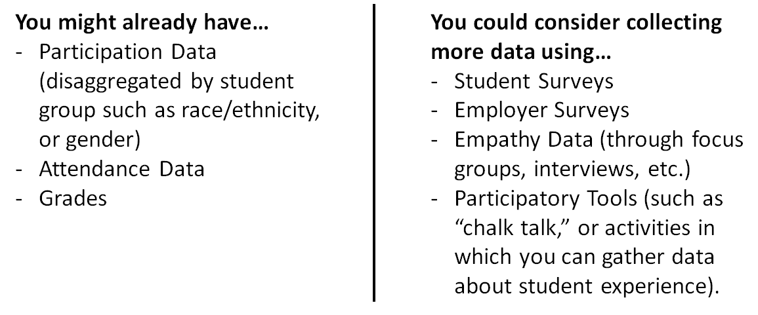
Data You Might Have or
Could Consider Collecting
Notes:
Rachel

Slide 32
Empathy Building
Empathy building is an easy way to collect data from your core user (students!) no matter where you are on your journey to offer students work-based learning opportunities.
This Toolkit has a wealth of resources for those of you wanting to collect qualitative data through empathy building and participatory activities.
Notes:
Amy

Slide 33
Example Outcomes to
Explore
Engagement and Motivation. “I understand why I am engaging in the work I am doing, and I am driven to do my best work to achieve my goals.”
Confidence and Growth Mindset. “I believe I am capable of achieving my goals and that hard work and commitment will result in learning and growth.”
Agency and Ownership.“I have the information I need to make thoughtful choices about what path I choose in learning and life. I believe that the choices I have made are mine and I am responsible to achieve my goals and access the resources I need to be successful.”
Relevant Essential Skill Development. “I am building the skills I need to be successful in work and life.”
Notes:
Amy

Slide 34
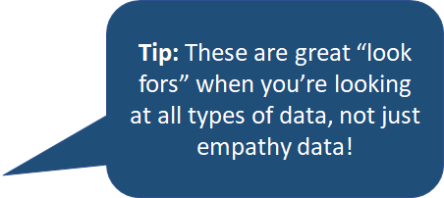
Empathy Building
Engaging with an “end-user” to uncover the deeper need we should be designing our work to meet and/or making sure our work is addressing.
Look for…
Bright spots to enhance!
What are end-users delighted by?
What is most successful now?
Gaps
What is not working?
What is hurting our end-users’ experiences?
Needs
What needs are our end-users expressing that we are not addressing?
Why are the end-users engaging in these learning opportunities?
What barriers do our end-users experience that limit their engagement?
Notes:
Amy

Slide 35
Putting Your Data to Use
Data Use Activity
Notes:
Amy

Slide 36
Questions? Interest in
Discussing Further? Reach out!
Amy Spicer, Senior Director of Implementation, Partnership, and Strategy: aspicer@coloradoedinitiative.org
Rachel Lieurance, Program Lead of Data and Learning: rlieurance@coloradoedinitiative.org
Notes:
Amy/Rachel

Slide 37
Breakout Groups
What questions do you have?
How does what you just heard influence
What did you hear today that you are excited to try?
How are you measuring your programs?
What’s next/how are you using measurements?

Slide 38
Punch Card and Survey
Notes:
https://docs.google.com/forms/d/e/1FAIpQLSct_ZEqj6rLq36wNKFRta1q3_kxXxwlIOONbPxyU5VOCunHaQ/viewform?usp=sf_link

Slide 39
Next Webinar
There isn’t one!!
But come to the convening June 3 and 4!
Notes:
https://www.cde.state.co.us/postsecondary/workbasedlearning

Slide 40
Thank you!
Notes:
https://mailchi.mp/state.co.us/wbl-incubator?e=2a23b764ce

