Slide 1
Increasing Access to WBL for students with disabilities
April 8, 2021
*This meeting will be recorded

Slide 2

Colorado Virtual Career Fair
Notes:
https://youthcareerfair.org/

Slide 3

WBL Incubator Convening Save the Date, June 3-4, 2021
Notes:
https://mailchi.mp/state.co.us/wbl-incubator-convening-save-the-date?e=6ba47d683d

Slide 4
Objective
Participants will learn more about increasing access to work-based learning programs for students with disabilities and hear promising practices from a couple of Colorado school districts

Slide 5



Who we are??
Katie Oliver
  School to Work Initiatives Consultant, Exceptional Student Services, Colorado Department of Education
Cheryl Carver
  Youth Services and Transition Unit Manager, Division of Vocational Rehabilitation
Jennifer Stewart
  Contracted Transition Liaison for Colorado Office of Employment First
Dan Mellemstrand & Lila Downing
  Englewood School District
Joetta Vallejos-Forsyth & Kacy Littleowl
  Ft. Lupton/Keenesburg school districts
Notes:
Promoting interagency coordination and collaboration
Exploring how agencies sequence services at different points in time
Solidifying outcomes agencies can strive for a different points in time
Supporting students with the most significant disabilities move toward employment
Moving toward the same “language”

Slide 6
TODAY’S OUTCOMES
Learn about Employment First
Raise awareness about the importance of community-based employment experiences for young adults
Explore similar models continuums of work-based learning
Discuss internal and external opportunities
Utilizing outside resources to enhance employment experiences
Hearing from local collaborations on increasing access and opportunities for students with disabilities

Slide 7
Importance of Employment
What is Employment First?
A belief & value that all individuals regardless of level of disability are capable of full inclusion and working in Competitive Integrated Employment (CIE).
CIE is the first and preferred outcome, regardless of level of disability in businesses found in the community, with regular compensation, equal advancement and equal interaction with non-disabled co-workers.
Systems Change & Culture Shift efforts in state agency employment-related policies, service delivery practices, and alignment of service funding structures to increase CIE outcomes.
Notes:
Many think that Employment First is a training that you attend or a trend to be aware of – It is so much MORE than that. Employment First is belief and a value……..
https://employmentfirstcolorado.org/youth-families-educators/

Slide 8
Creating a Vision and creating high expectations!
What will you do for fun?
How will you get around?
Where will you sleep?
What will you do during the day?
Notes:
Creating high expectations!
Beginning at the transition from elementary to middle school, discussion about a post secondary goal of integrated employment should occur
At the transition from middle school to high school, discussion about chores at home, work experiences at the high school should occur
During the beginning of high school, families need to have detailed information about benefits, services beyond high school to support their son or daughter on a job in their community

Slide 9

Importance of Employment
For young adults, there is a continuum of experiences to increase awareness, start exploration, and begin to prepare for employment opportunities.
Work- Based learning opportunities can range from job tours, to job shadowing, volunteering to paid work. These opportunities should be expanded into the community beyond the school building.
Work-Based learning experience: an educational approach or instructional methodology that uses the workplace or real work to provide students with the knowledge and skills that will help them connect school experiences to real-life work activities and future career opportunities.
http://www.wintac.org/topic-areas/pre-employment-transition-services/overview/work-based-learning-experiences
Notes:
Work-based learning experiences, may include:
Job Shadowing
Career Mentorship
Career Related Competitions
Informational Interviews
Paid Internships
Non-paid Internships
Practicum
Service Learning
Student-led Enterprises
Simulated Workplace Experience
Paid Work Experience
Non-Paid Work Experience
Volunteering
Workplace Tours/Field Trips
These WBL opportunities can be done in conjunction with private, for-profit, public or nonprofit businesses in your community and/or through web-based resources. In addition, work-based learning requires in-depth engagement of youth with oversight and evaluation of acquired work relevant skills by identified staff. The work based learning experience must be provided in an integrated setting in the community. Where paid WBL experiences are provided, the wages are to be paid at no less than minimum wage.

Slide 10
Importance of Employment
IDEA & WIOA
Individuals with Disabilities Education Act (IDEA)
  Purpose: to prepare students with disabilities for further education, employment, and independent living.
Workforce Innovation and Opportunity Act (WIOA)
  Purpose: increased access to employment, education, training, and support services to assist individuals with disabilities, including those with the most significant disabilities, to succeed in the competitive labor market.
Source: National Technical Assistance Center on Transition

Slide 11
Importance of Employment
How can Work-Based Learning Experiences increase access for students with disabilities??
  Inclusive- for all students
  Starting at age 15 in collaboration with the schools and community (or earlier)
  Variety of supports and challenging experiences
  Programming should be tiered to meet a student where they are at
Notes:
Incorporate self reflection for self-assessment

Slide 12
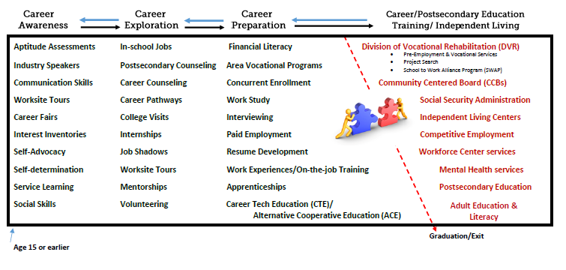
Goal: Continuum of supports, services, information to support young adults toward employment.
Notes:
***Range of Opportunities-

Slide 13
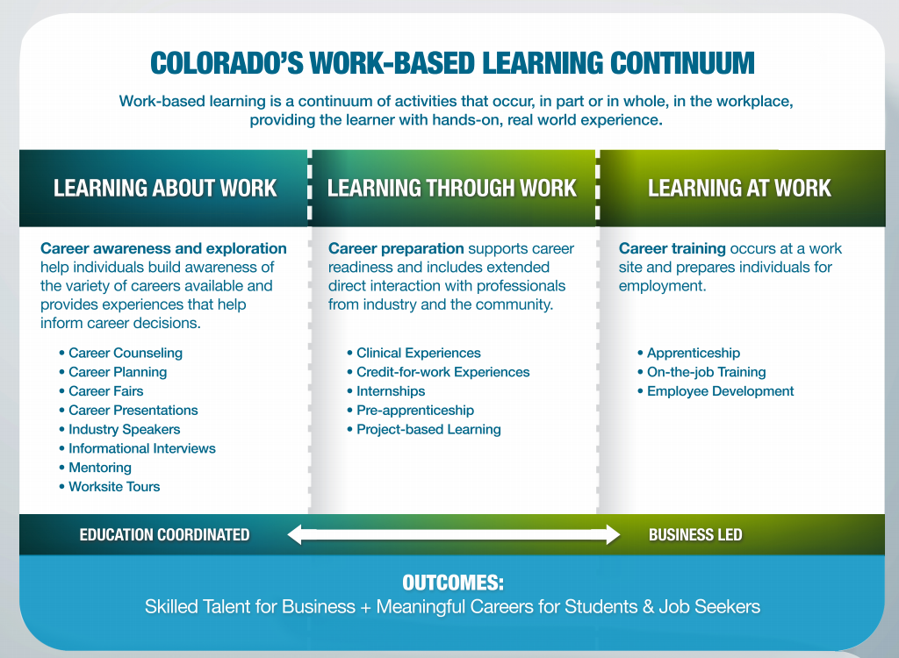
Colorado’s Work-based Learning Continuum
Notes:
Work- Based Learning Experiences: Learn “about”, “through” and “at” work.
Utilize: Workforce Centers
DVR- Pre-employment Transition Services
Schools and Paraeducators

Slide 14

Internal- beyond the classroom
  Custodial
  Transportation
  Clerical
  IT
  Library
  Administration
  Service learning
  Health clinic
  School board
  Concession stands
Notes:
INTERNAL SCHOOL: ACE/CTE partners (sharing information and contacts)
Everything we do must be PURPOSEFUL….Everything can be purposeful if we look for the opportunities which can provide useful information
Different departments
Elective classroom: sewing, typing, metal shop, woodworking, culinary, theater class,
Extra curricular activities: football coach, speech and debate for lawyers wanna -be’s, choreography, running concessions
Student assistant: assess or work-based learning opportunities by allowing the youth to input data/file
Causes/fund raising: sorting, gathering, collating, organizing things like food drive/clothing drives
Custodial staff
Utilize your school boards! (made up of business professionals) –invested in the youth of the district/BOCES
So again, we’re not talking about leaving the district, going out into your community, or investing a lot of time – these are things which should be readily available to you. Think day to day.

Slide 15

External partners and resources
Business organizations
Community based organizations
Disability related organizations
Faith based organizations
Government programs
Health organizations
Service organizations
Youth development programs
Notes:
To utilize for job shadows, bringing the world of work into the schools, work experiences, volunteering.
Examples:
Business: Chamber of Commerce, local business associations (restaurant, manufacturing, IT, etc.)
Community-based: Rotary, Lions Club, Habitat for Humanity, food bank,
Faith based: local church, childcare centers, food banks, housing
Government programs: Social Services, Police, Parks and Rec, Volunteer Programs, Libraries
Health: Hospitals, associations, clinics, retirement and nursing homes (look at auxiliary programs within – example – computer labs in retirement homes, dietary programs, cosmetology, etc)
Youth development: 4-H, Co9to25, Boys and Girls clubs

Slide 16
Division of Vocational Rehabilitation (DVR)
All people with disabilities can choose a career path leading to meaningful employment and independent living
Learn more about DVR here: https://dvr.colorado.gov/
Services are individualized and may include:
Vocational rehabilitation counseling and guidance
Pre-employment Transition Services
Physical and mental restoration services
Training services
Job related services
Specialized services for individuals who are blind, deaf, and deaf-blind
Rehabilitation technology services
Notes:
Tapping into resources

Slide 17
Pre-Employment Transition Services
Job exploration counseling
Counseling for enrollment postsecondary education programs
Workplace readiness training
Instruction in self-advocacy
Work-based learning experiences
Notes:
Cheryl
What is the goal and purpose of Pre-employment transition services?
Readiness!
Preparing them to try, fail, and try again!
Intended to
Incrementally learn skills
Apply and demonstrate those skills
Build a career pathway
Recognizes coordination is essential

Slide 18
Pre-Employment Transition Services
Who are these services for?
Students with disabilities
Ages 15 - 21
Potentially eligible for VR and eligible for VR
In high school or post secondary education
Notes:
Cheryl
younger focus with intention to focus on preparation
Align with ECEA

Slide 19
Pre-Employment Transition Services
Collaboration:
Importance of complimenting student’s IEP services and not duplicating.
Schools and DVR must have strong communication practices to coordinate student’s employment services and progress.
Connect parents to benefits counseling
As the student gets closer to graduation, schedule meetings to determine details of support beyond graduation
Goal is for each student to receive a seamless transition into adulthood
Academics vs. Employment- Not one or the other- BOTH!
Notes:
Cheryl

Slide 20
Pre-Employment
Transition Services
Access to Pre-ETS:
Collaborative partnerships
Consistent referral processes
Cross-system training
Comprehending participant expectations
Pre-ETS are Provided by:
DVR Counselors
Third Party Cooperative Arrangements
  School to Work Alliance Program
Project Search
Private Vendors
  https://www.colorado.gov/pacific/dvr/vendors-providers
Program development through local LEA and DVR partnerships
  Districts can be vendors too!
Notes:
Cheryl
▪Assist with explaining expectations
▫Id if 18+
▫Participation
▫Communication
Examples of district partnership and vendors:
CCB Summer Program
Cherry Creek School District - 18-21 Transition Program (Chronic Mental Illness)
Career Road trips through WFC
Loveland Youth Gardeners
Gleam Car Wash
RMDS
Reverse Job Fair for WBLE
AgrAbility
Jefferson County Transition Boot Camp
•Nothing in WIOA is to be construed as reducing the responsibility of local educational agencies under IDEA to provide or pay for transition services.
•Schools will continue to receive IDEA funds and will continue to provide transition services to their students.
•Under WIOA, the Vocational Rehab Counselor will work with the schools to identify students who are in need of VR services and to facilitate these students' application for VR services.
•Collaboration is the key. WIOA Pre-ETS is designed to supplement, not supplant IDEA, therefore schools and DVR will be working together more than ever before to assure student success in postsecondary outcomes

Slide 21
Increasing access
Ensuring opportunities and services are available are part of the Individual Education Program (IEP).
Create IEP goals and services in partnership with general education to support the student with postsecondary goals
Invite agencies to the table when appropriate to braid blend services.
Tap into internal and external partners to share information, contacts, and resources.
Think outside the box.

Slide 22

Work - based Learning Partners:
Division of Voc Rehab (DVR)
School to Work Alliance Program (SWAP)
Englewood High School (EHS)

Slide 23

Examples
Lila’s Role - attend IEP meetings, connect students to Dan for employment exploration and opportunities, transition interviews (double teaming resulted in more career information), tours, educating parents about different types of programs, reconnecting former students that we hear need the services again
*The Warm Handoff...Academic focus → Career focus → College → Employment → Adult Agencies
Dan’s Role - attend IEP meetings, transition interviews, tours, educating parents about different types of programs, Monday workshops in Transition Program, bringing access to outside agencies (DVR, ADWorks) into the schools,

Slide 24

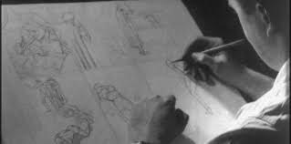
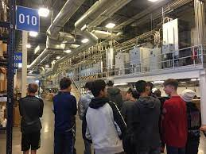
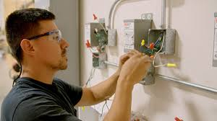
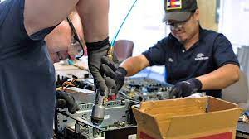

Career Exploration: Career Scope https://vri.org/
Job Shadowing, Work-Site Tours, Informational Interviews & Guest Speakers:
Meadow Gold, 7 Up Snapple, Blue Star Recycler, Union Halls, Brewability, Comic Book Artist, Division of Wildlife - Pepper & Brock
Internships, Apprenticeships, & Competitive Employment:
Englewood Public Schools

Slide 25
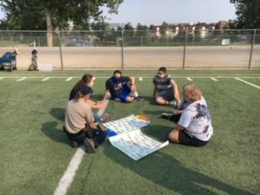
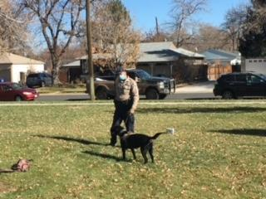
A Glimpse of Possibilities…
Kole - CDot
Tyler - Bayaud Enterprises
Kalena - Denver Health
Miranda - Big Lots
Skylar - Englewood Public Schools
Nicole - Denver Health

Slide 26
Contact information:
Englewood
Lila Downing lila_downing@engschools.net
Dan Mellemstrand
daniel_mellemstrand@engschools.net

Slide 27




Kacy Little Owl
Transition Coordinator
Joetta Vallejos-Forsyth
SWAP Coordinator

Slide 28
Benefits of Collaborating
Employer engagement opportunities
Career research and exploration
Hands-on, work-based learning activities
Student-led business ventures
Administration of student driven transition assessments to facilitate skill-set development IEP goal attainment
Culminate Assessment data for intra agency planning
  SWAP/DVR utilizes data to determine appropriate provision of services and service provider

Slide 29
Providing Work Based Learning Opportunities
Students (examples include but not limited to)
Conduct guided market research
Develop and maintain actionable marketing plan
Research and price compare supplies and materials
Investigate opportunities for socialization training in the community
Learn and practice self-advocacy and self-determination strategies
Develop digital and fiscal literacy skills
Authentic critical thinking and problem solving opportunities

Slide 30
Contact information:
Ft Lupton & Keenesburg
Kacy Littleowl
klittleowl@weld8.org
Joetta Vallejos-Forsyth
jvallejos-forsyth@weld8.org

Slide 31
QUESTIONS?
Katie Oliver, CDE oliver_k@cde.state.co.us
Jennifer Stewart, Office of Employment First
breakingexpectationsllc@gmail.com
Cheryl Carver, DVR
cheryl.carver@state.co.us

Slide 32
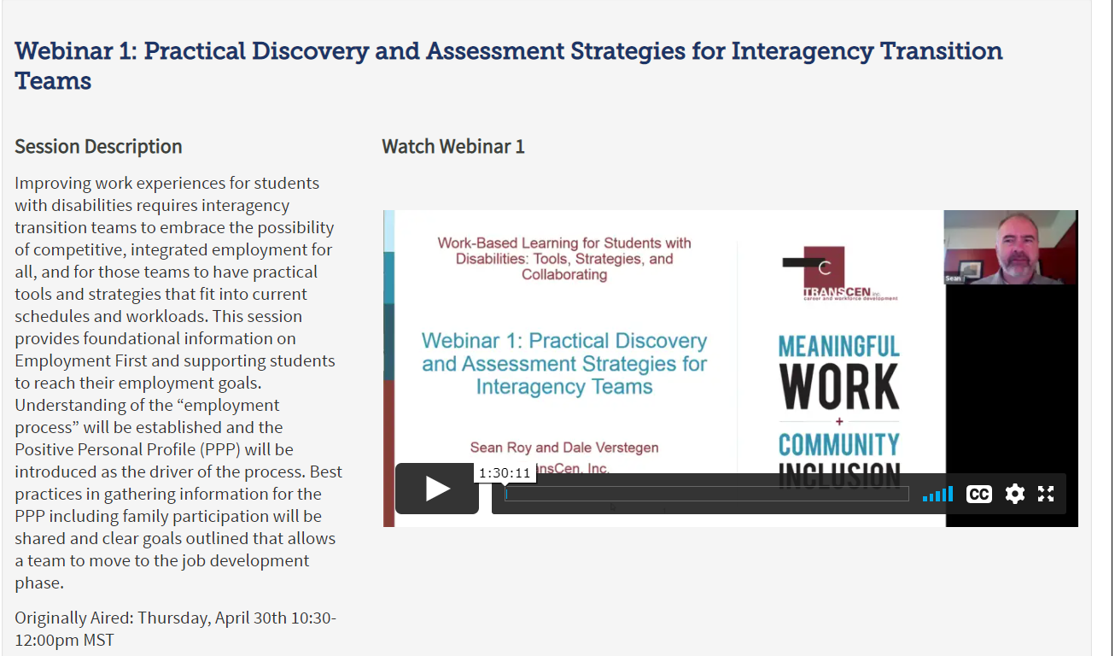
Additional Resources
Notes:
http://www.cde.state.co.us/cdesped/web-series-work-based-learning-for-swd#bonuswebinar

Slide 33
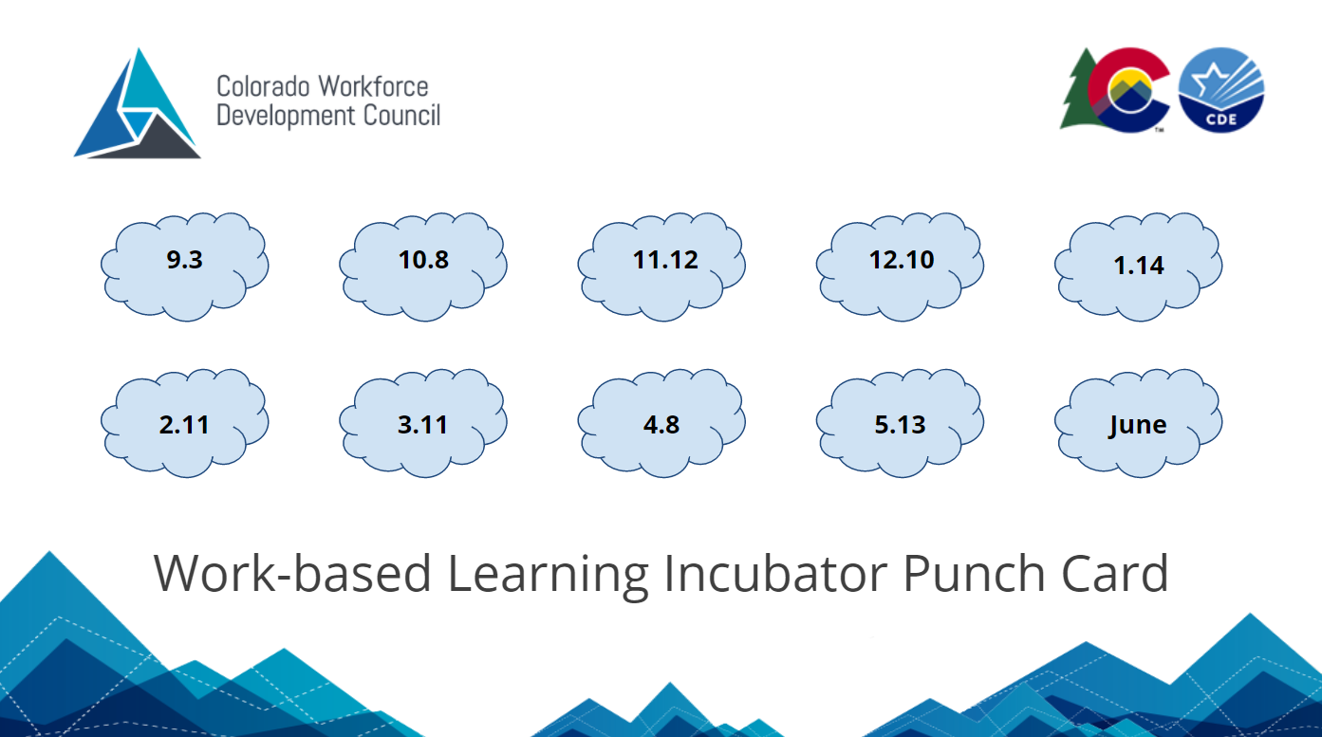
Punch Card and Survey
Notes:
https://docs.google.com/forms/d/e/1FAIpQLSct_ZEqj6rLq36wNKFRta1q3_kxXxwlIOONbPxyU5VOCunHaQ/viewform?usp=sf_link

Slide 34
Next Webinar
Measuring and Assessing Work-based Learning Programs
May 13, 2021 from 2:30 - 4:00
Notes:
https://www.cde.state.co.us/postsecondary/workbasedlearning

Slide 35
Thank you!
Notes:
https://mailchi.mp/state.co.us/wbl-incubator?e=2a23b764ce

