Slide 1
Data Review Through Equity Lens and Increased Access
Work-Based Learning Incubator
November 12, 2020
*This meeting will be recorded

Slide 2
Objectives
Discuss how to analyze programs and data using an equity lens
Leverage Career & Technical Education (CTE) accountability metrics and Individual Career & Academic Planning (ICAP) as a method of becoming an Equity Ambassador
*Wide overview - April Incubator Session will focus on WBL Programming for students with disabilities

Slide 3
WBL Incubator Community of Practice
January - June
5-8 Districts
Application to open Oct 6th and close December 7th
Goal: Build a sustainable work-based learning program utilizing design based thinking strategies
To find more information: https://cwdc.colorado.gov/resources/technical-assistance
Notes:
https://mailchi.mp/state.co.us/wbl-incubator-4046634?e=2a23b764ce

Slide 4
WBL Incubator Webinars
Notes:
https://mailchi.mp/state.co.us/wbl-incubator-4046634?e=2a23b764ce

Slide 5
Talent Equity Agenda
Developed with input from state agencies and stakeholders to address the racial equity gaps seen in Colorado with regards to talent development
Focus Areas
Post-secondary credential attainment
Unemployment
Digital Divide
Career Navigation and Advancement
Equitable Hiring, Promotion and Retention
Notes:
https://cwdc.colorado.gov/talent-equity-agenda

Slide 6
...when race, gender, socioeconomic status, immigration status, zip code, etc., is no longer correlated with one’s outcomes. When everyone has what they need to thrive...

Slide 7
Mentimeter Backchannel
Engage throughout webinar and responses will be posted afterwards as an additional resource

Slide 8
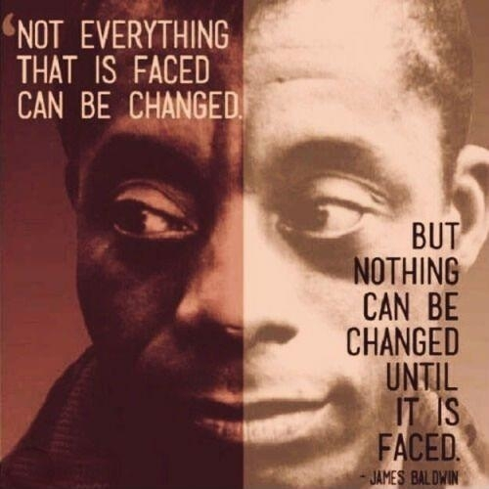
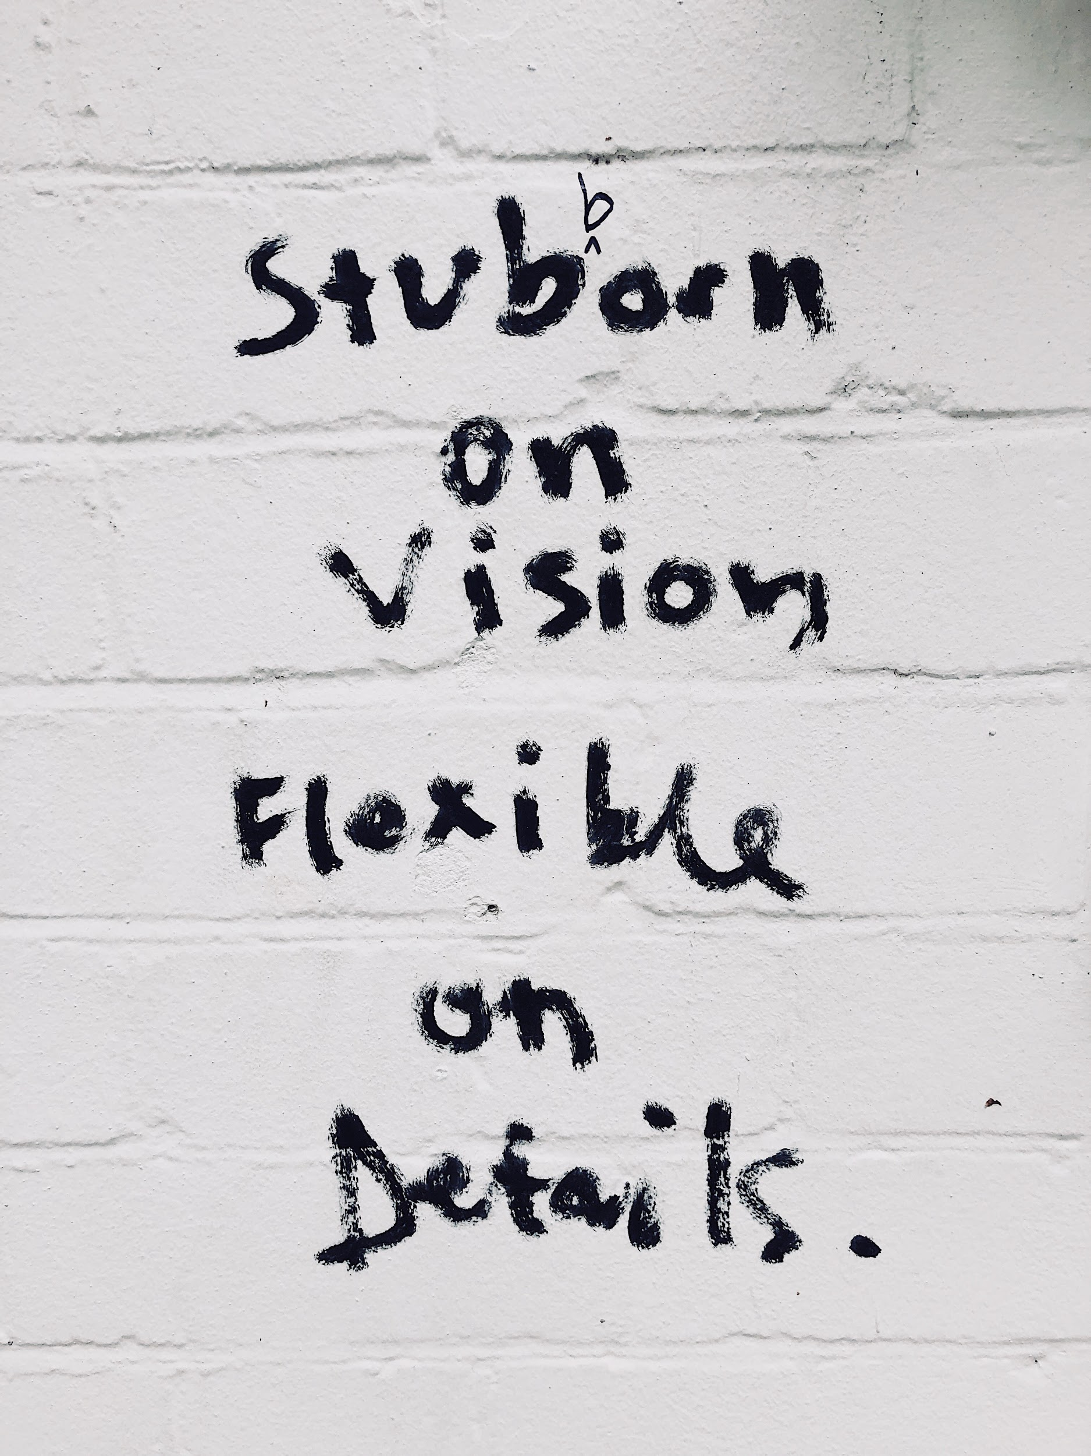
Introductions
Jamie Bassett, she/her
Founder
Prismatic, LLC
prismatic@variedandbrilliant.com
Robert Franklin, II, MPA, he/him
Consultant
MNMR, LLC
mnmrllc@gmail.com
Notes:
45 minutes
5 minutes for questions

Slide 9
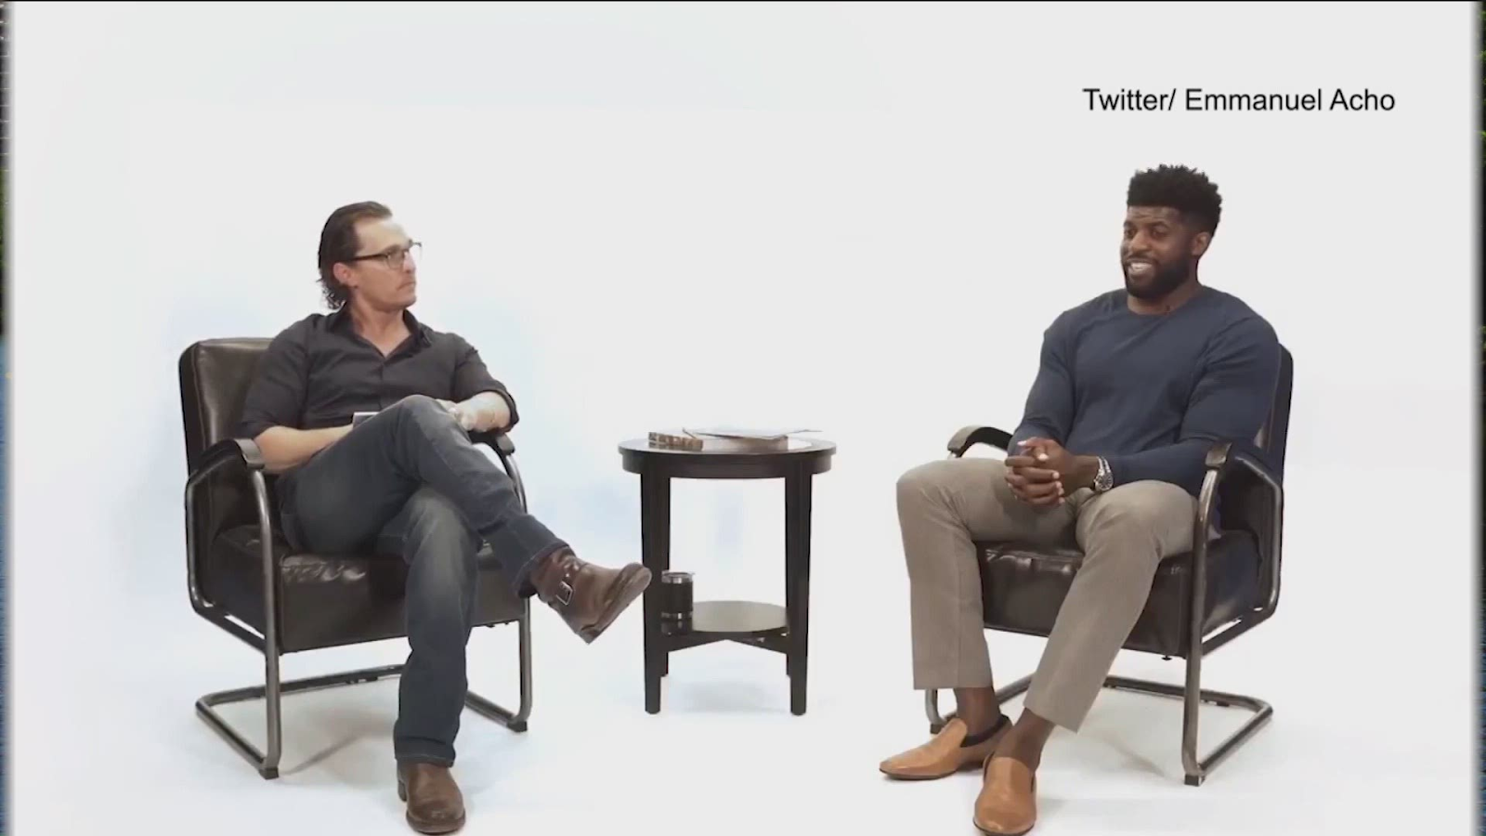
“More is caught than is taught”

Slide 10
Intent and Impact

Slide 11
Consult and Investigate Data

Slide 12
Widening the Frame

Slide 13
Coalition Building
Notes:
45 minutes
5 minutes for questions
(transition to) “Proximity breeds care, distance breeds fear.” - Emmanuel Acho
Qualitative data gathering…”will you help us get better?”
Authentic engagement - less like a customer, more like a partner
Food truck example, sending text messages (cuz I don’t have time to be in the room)

Slide 14
The Journey Ahead
Intent vs. impact
Investigating the data; triangulate the data
Widen the frame and consider identity
Build a coalition

Slide 15
Program Analysis and Development
Kelly Mitchell, Education Consultant
Colorado Workforce Development Council/Department of Education
kelly.mitchell@state.co.us

Slide 16
Principles

Slide 17
Targeted Universalism
Setting universal goals that can be achieved through targeted approaches for segments of the population
Define Universal Goal
Measure Overall Population
Measure Population Segments
Understand Group-Based Factors
Implement Targeted Strategies
Establish a universal goal
Measure how overall population fares relative to universal goal
Measure performance of population segment relative to universal goal
Understand how structures and other factors support or impede group’s progress towards universal goal
Create and implement targeted strategies so each group can achieve universal goals

Slide 18
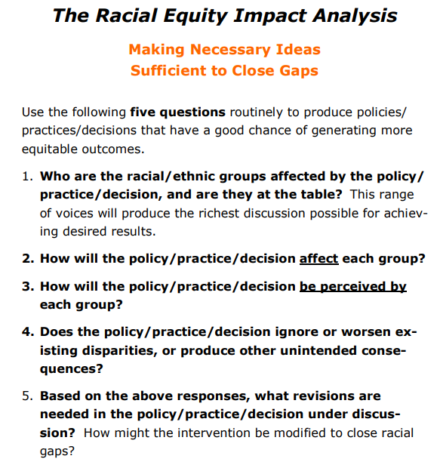

Slide 19
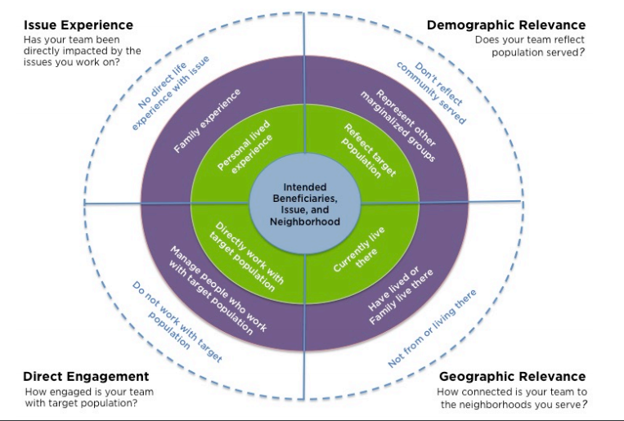
Who is on your team?

Slide 20
“5 Whys” Root Cause Analysis
Ask “why” 3-5 times to move past superficial understandings of the sources of inequity and get to the underlying causes/histories.
Observation:
Why:
Why:
Why:
Why:
Why:
Conclusion:

Slide 21
How to Talk About Race:
Effective Messages for Diverse Audiences
1
2
3
4
Start the message with a value of “big idea” that virtually everyone shares related to the specific issue.
Identify the barriers standing in the way of that big idea
Identify the consequences of those barriers - the results or disparate data
Always identify solutions to the problems early on.

Slide 22
Equity & Inclusion in
CTE Programs
Lauren Jones, CTE Program Director
Special Populations, Counseling and Equity

Slide 23
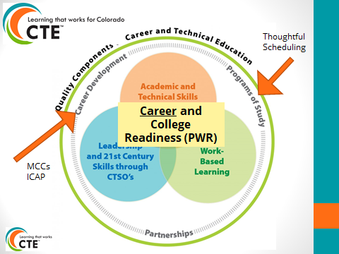
Be an
Equity Minded
Meaningful Career Conversationalist! (MCC)

Slide 24
That’s me!
Leverage the acronym: PoWeR!
Postsecondary Workforce
Readiness

Slide 25
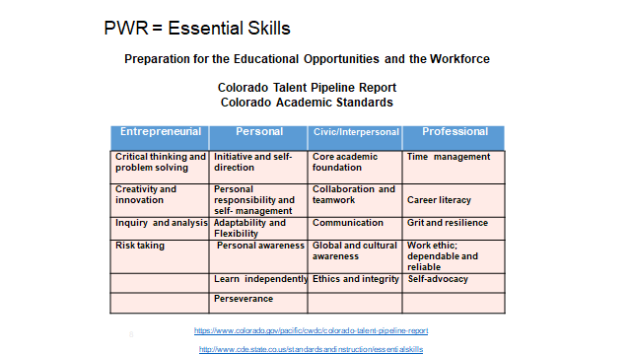
PWR/Essential Skills
It’s what we are looking for in an employee/student/military recruit/gap year participant/mission trip NOT who.
Be cheesy with saying these out loud, using them in text: social learning theory!
We learn by watching others, hearing others, seeing what others do or say or act.

Slide 26
Not the most culturally relevant for CO….example of what not to do, maybe!

Slide 27
Consider your real-world may differ from others’ real-world.
Get comfortable with culturally relevant pedagogy
Notes:
20 minutes presentation
5 minutes questions

Slide 28
Try diving deeper into your data, past the high level reporting requirement and more into the ‘real’ story.

Slide 29
A work in progress.
Share your promising practices!
Let’s do this together.
We may not be there (yet)

Slide 30
CTE accountability!
CTE state office is here to help!
Connect with us and your Program Directors and team:
www.coloradostateplan.com

Slide 31
No cost solution:
Replace ‘ALL’ words with ‘EVERY’ or ‘EACH’ instead!
Check websites, mission and vision statements, marketing materials, etc...

Slide 32
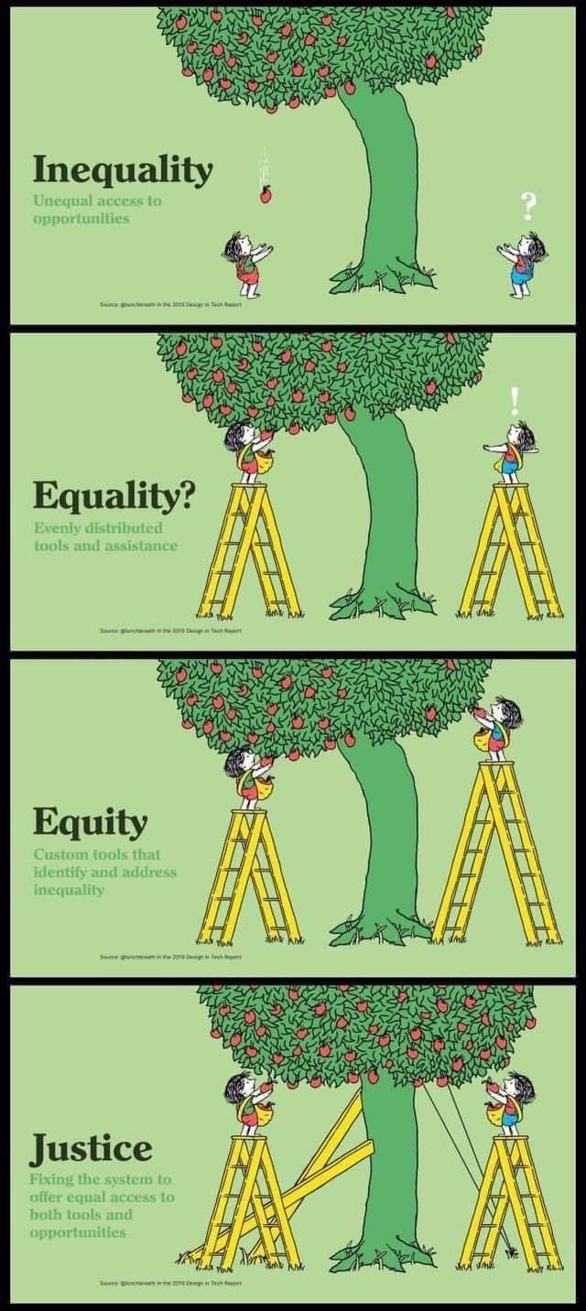
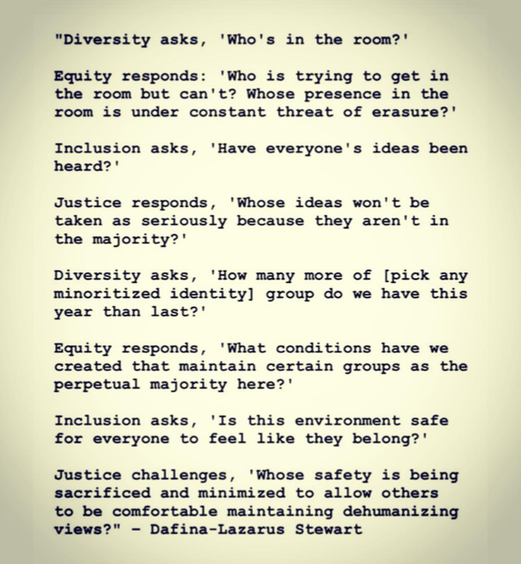
Accomodation on a job site yet no additional supports for time management habits
Same supports for both, still not the answer.
Getting better: differentiated supports to meet EACH individual yet the outcome is still uneven.
Individualized work schedule yet unequal payscale
Provide gas card
Aha! Discover the root cause, apply supports there then watch each individual thrive!

Slide 33
Consider
a
Mnemonic!

Slide 34
CTE Program Assurances
Credentialed Teacher (do our students ‘see themselves’ in their teacher?)
Standards Based Instruction (Scope and Sequence)
Program of Study (thoughtful scheduling & advising)
Student Leadership Integrated (CTSO: CTE Student Organization)
Articulation (pathway development)
Work Based Learning
2-4 year planning (Perkins V Plans w/ local needs assessment)
**Advisory Committees (representation matters)
**Non-Traditional Careers (permission to dive deep into DEI work)

Slide 35
Help your educators & peers check in with bias!

Slide 37
Explore: www.navigatingourway.org

Slide 38
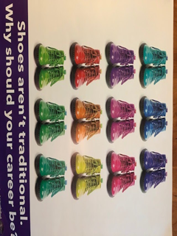
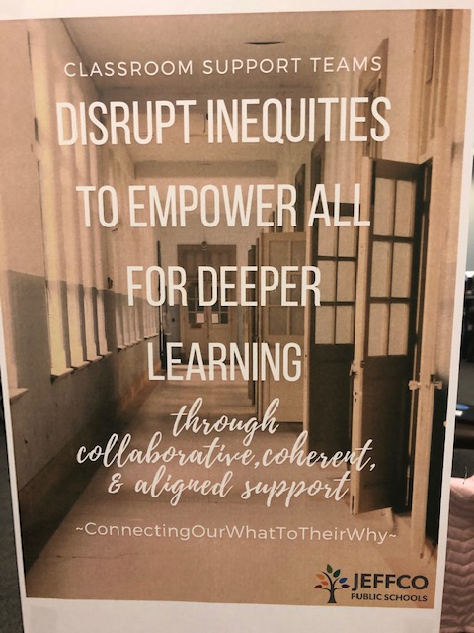
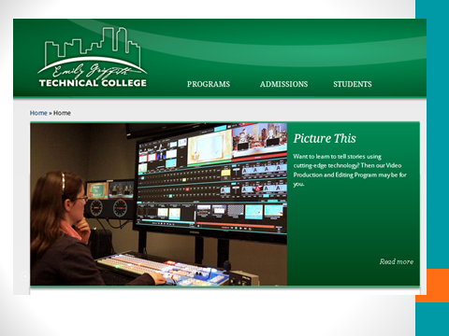
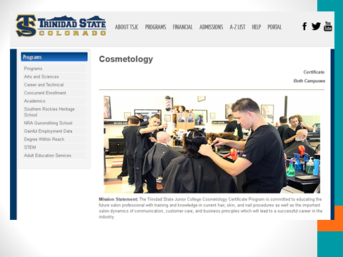

Slide 39
Did you know about Alternative Cooperative Education (ACE) CTE programming?!
Perhaps it is worth exploring!

Slide 40
Individual
Career
Academic
Planning

Slide 41
Equity Minded Career Conversations!

Slide 42
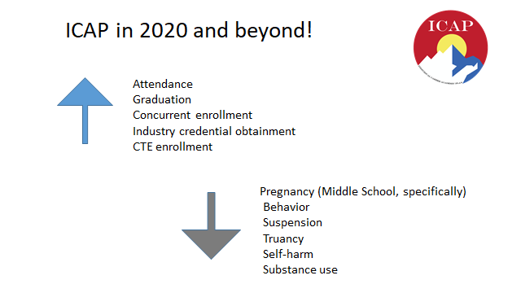
Equity Minded Career Development!

Slide 43
ICAP!
EACH learner!

Slide 44
Let’s Connect!
Lauren Jones (Austin)
CTE Program Director for Special Populations, Counseling, Equity and Middle School
CTE in Colorado/Community College System
lauren.jones@cccs.edu
Equity in CTE: http://coloradostateplan.com/equity-in-cte/
WBL and CTE: http://coloradostateplan.com/educator/work-based-learning/
CTE and ICAP/PWR Playbook: https://www.cde.state.co.us/postsecondary/pwrplaybookwbl & https://www.cde.state.co.us/postsecondary/pwrplaybookcte

Slide 45
Takeaways

Slide 47
Punch Card and Survey
Notes:
https://docs.google.com/forms/d/e/1FAIpQLSeHmnij5BY2GnWwec1nNzgLmD0tD4ihLWq9PUcRXUhBIJfH3g/viewform?usp=sf_link

Slide 48
Thank you!
kelly.mitchell@state.co.us
Notes:
https://mailchi.mp/state.co.us/wbl-incubator?e=2a23b764ce

