Slide 1
Concurrent Enrollment Advisory Board Meeting
October 25, 2018

Slide 2
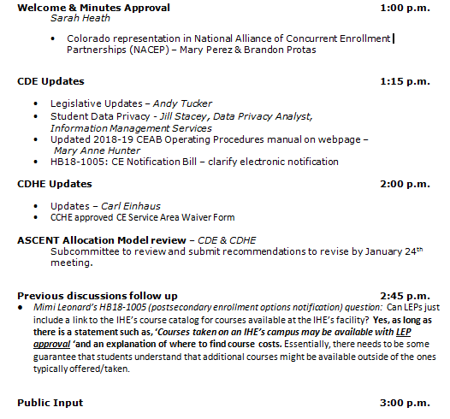
AGENDA

Slide 3
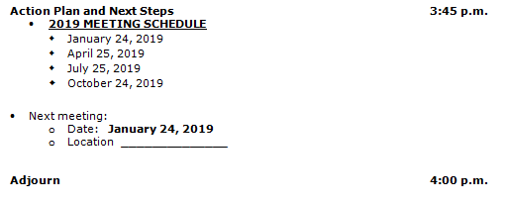
AGENDA

Slide 4
Welcome & Minutes Approval - Sarah Heath
Colorado representation in National Alliance of Concurrent Enrollment Partnerships (NACEP) – Mary Perez & Brandon Protas

Slide 5
CDE Updates
Legislative Updates – Andy Tucker
Student Data Privacy - Jill Stacey, Data Privacy Analyst, Information Management Services
Updated 2018-19 CEAB Operating Procedures manual on webpage – Mary Anne Hunter
HB18-1005: CE Notification Bill – clarify electronic notification – Mary Anne Hunter

Slide 6
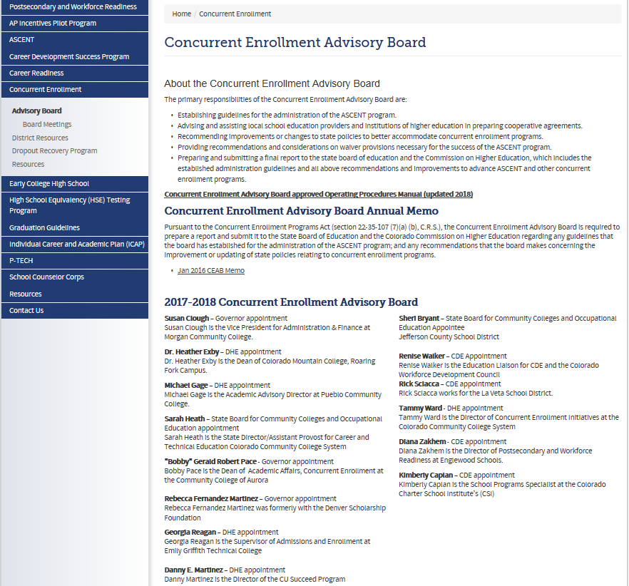
Please check

Slide 7
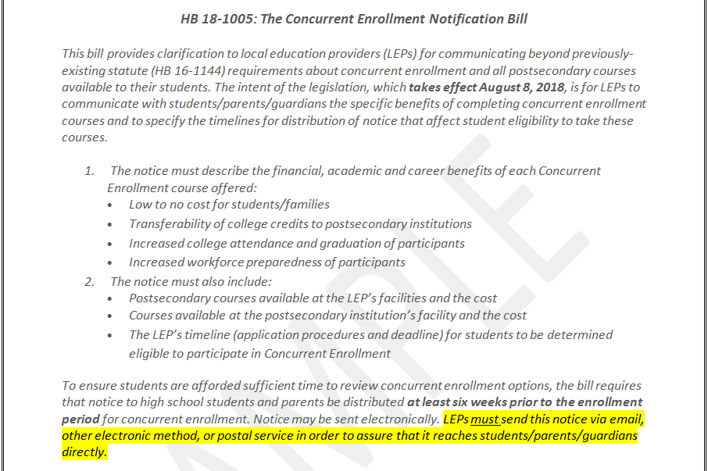
The Concurrent Enrollment Notification Bill HB 18-1005

Slide 8
CDHE Update
Updates – Carl Einhaus
CCHE approved CE Service Area Waiver Form

Slide 9
ASCENT Allocation Model review
Subcommittee to review and submit recommendations to revise by January 24th meeting.

Slide 10
ASCENT Allocation Model
The CEAB developed a system to allocate ASCENT slots to local education providers (LEP) fairly in the case that the number of qualified students exceeds the number of funded slots:
Currently participating LEPs will receive a minimum number of ASCENT slots equal to those utilized by students during the current school year.
New LEPs will receive up to 10 slots for the first year or the number requested if less than 10
If additional spaces are available, half the remaining slots will be distributed via the LEPs free and reduced lunch (FRL) rate as a proration
The other half of remaining slots will be proportionally distributed based on LEP size, to LEPs that did not receive spaces under the FRL distribution
Unused spaces may be returned to the general pool and reallocated to LEPs, based on appeal

Slide 11
Initial Slot Requests (as of May 1, 2018)
ALL REQUESTS
Total ITPs received (districts & charters) | 51
Total slots planned to use in 2018-19 | 951
Total carry-forward slots into 18-19 | 65.5
Adjusted New only slots (- carry-forwards) | 887.5

Slide 12
Modified Allocation Breakdown
CONTINUING PARTICIPANTS (DID PARTICIPATE IN 2017-18)
Total ITPs received (districts & charters) | 35
Total slots planned to use in 2018-19 | 860
Total carry-forward slots into 18-19 | 64.5
Total slots relinquished by 5/16/18 | 56.5
Adjusted New only slots (- CFs & relinquished) | 739
Total slots utilized in 2017-18 | 523
NEW 18-19 PARTICIPANTS (DID NOT PARTICIPATE IN 17-18)
Total ITPs received (districts & charters) | 15
Total new slots requested | 91

Slide 13
Previous discussions follow up
Mimi Leonard’s HB18-1005 (postsecondary enrollment options notification) question: Can LEPs just include a link to the IHE’s course catalog for courses available at the IHE’s facility? Yes, as long as there is a statement such as, ‘Courses taken on an IHE’s campus may be available with LEP approval ‘and an explanation of where to find course costs. Essentially, there needs to be some guarantee that students understand that additional courses might be available outside of the ones typically offered/taken.

Slide 14
Public Input
Action Plan and Next Steps
2019 MEETING SCHEDULE
January 24, 2019
April 25, 2019
July 25, 2019
October 24, 2019

Slide 15
Next meeting:
Date: January 24, 2019
Location ______________
Adjourn

