Slide 1
Concurrent Enrollment Advisory Board Meeting
August 1, 2019

Slide 2
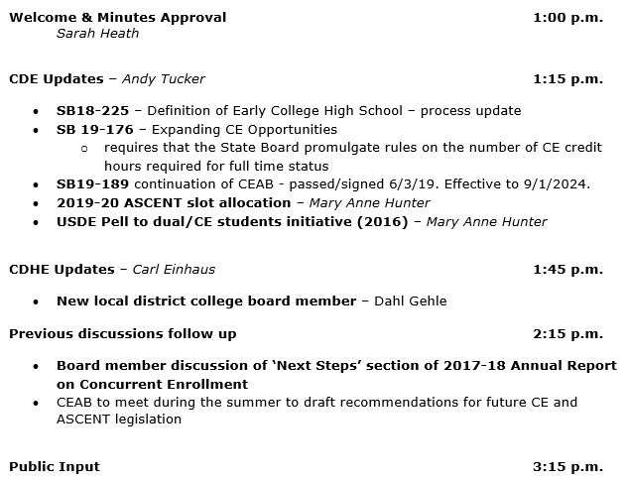
AGENDA

Slide 3
AGENDA

Slide 4
Welcome & Minutes Approval - Sarah Heath

Slide 5
CDE Update
SB18-225 – Definition of Early College High School – process update
SB 19-176 – Expanding CE Opportunities
requires that the State Board promulgate rules on the number of CE credit hours required for full time status
SB19-189 continuation of CEAB - passed/signed 6/3/19. Effective to 9/1/2024.
2019-20 ASCENT slot allocation – Mary Anne Hunter
USDE Pell to dual/CE students initiative (2016) – Mary Anne Hunter

Slide 6
Funding/Documentation Requirements
ASCENT Cooperative Agreement
For the corresponding school year between the district and the IHE
Enrollment
Student must be enrolled with the district as of the pupil enrollment count date

Slide 7
Funding/Documentation Requirements
Attendance
Beginning w/2019-20 districts/charter schools will no longer be required to provide attendance verification for postsecondary courses taken off-site at the IHE
Section 22-54-103(10)(h) (as amended by SB 19 -176)
(I) For the 2019-20 budget year and each budget year thereafter, with regard to a pupil who is simultaneously enrolled in a district or institute charter school and in one or more postsecondary courses, a district or institute charter school must submit evidence of:
Enrollment in the district or institute charter school and evidence, as provided in state board rule, of attendance for any secondary courses the pupil is enrolled in; and
Enrollment in one or more postsecondary courses, by submitting evidence, as described in state board rule, only of the district’s or institute charter school’s nonrefundable obligation to pay the student share of tuition for the postsecondary course on behalf of the pupil.
(II) The state board by rule shall specify the number of secondary and postsecondary course credit hours that constitute full-time and part-time membership.

Slide 8
Attendance Verification
Starting with 19/20, IHE attendance is no longer required for postsecondary courses. In these cases, the district will need to show that:
The student was enrolled with the district as of the pupil enrollment count date
The student had a schedule as of the pupil enrollment count date that lists the courses the student was scheduled to take and complete during the semester of the pupil enrollment count date
The District paid its nonrefundable obligation of the student share of tuition directly to the IHE
Verification as to the number of credits for which the district paid (to determine funding level eligibility)
3-11 credits = part-time
12+ credits = full-time
The District had a cooperative agreement with the IHE

Slide 9
Question from the Field
What if an instructor cancels class during the 11 day count period?
What if an instructor does not take daily attendance?
What if our student does not get completed attendance forms submitted to the district shortly after the 11 day count period?
No longer relevant as attendance verification is not required for postsecondary courses taken off-site at the IHE.

Slide 10
2019-20 ASCENT slot allocation data
 | 19-20 | 18-19 | 19-20 Difference
Total ITPs submitted | 59 | 51 | 8
New participating LEPs | 11 | 17 | -6
Charter schools (separate requests) | 13
BOCES | 1 | 1 | 0
Total new slots requested | 854.5 | 952 | -97.5
Total carry forwards from 18-19 | 61.5 | 62.5 | -1
Total slots available for 19-20 (new allocations + 18-19 carry forwards) | 561.5 | 562.5
Rural | 11 | 11 | 0
Small Rural | 13 | 15 | -2
Total | 24 | 26 | -2
% of total | 41% | 51% | -10%
NEW Participating LEPs
Rural | 3 | 6 | -3
Small Rural | 5 | 8 | -3

Slide 11
DHE UPDATE
New local district college board member – Dahl Gehle

Slide 12
Previous discussions follow up
Board member discussion of ‘Next Steps’ section of 2017-18 Annual Report on Concurrent Enrollment

Slide 13
Suggestions for Improving Concurrent Enrollment
To achieve universal access to Concurrent Enrollment in the state and to maximize its impact, CDHE, CDE, institutions of higher education, and LEPs should:
Leverage Open Education Resources and similar approaches to minimize costs to families;
Streamline the administrative processes for institutions and districts adopting Concurrent Enrollment;
Provide opportunities for high school teachers to earn the necessary qualifications to teach Concurrent Enrollment courses, particularly in rural areas;
Create greater access to Concurrent Enrollment via diverse delivery models;
Communicate clearly how Concurrent Enrollment impacts a student’s financial aid status;
Provide opportunities to receive stackable credentials in high school;
Ensure Concurrent Enrollment courses carry through to a postsecondary education by counting successful credits toward a program of study or approved CTE program;
Explore ways to improve access by first better understanding barriers for students to enroll;
Improve transparency for student and families through clear branding and public, statewide information about Concurrent Enrollment offerings, associated costs, transferability and applicability; and
Offer Supplemental Academic Instruction (corequisite remediation) opportunities through Concurrent Enrollment.

Slide 14
Previous discussions follow up
CEAB to meet during the summer to draft recommendations for future CE and ASCENT legislation

Slide 15
Public Input
Action Plan and Next Steps
Next meeting:
Date: October 24, 2019
Location ______________
Adjourn

