Slide 1



Presented by: BLANCA TREJO
www.ColoradoASSET.com

Slide 2
What we will cover:
Story of Jose
Brief History of the ASSET Campaign
ASSET Implementation
What is ASSET?
Who Qualifies?
Difference between DACA and ASSET
I'm Eligible! Now What?
  Apply to College
  Communicate
  COF
Financial Aid
Affected Institutions
Next Steps

Slide 3

The Story of Jose

Slide 4
The History of the ASSET Campaign

Slide 5
Higher Education Access Alliance
Formed 2006-7
  Member and Grant Funded
10 Steering Committee members plus numerous individuals and organizations.
Key role in 5 of the 8 pieces of legislation until final approval of SB 13-033 (AKA Colorado ASSET) on April 29th 2013.
Scheduled to meet periodically for updates on Implementation.
Statewide coalition dedicated to promoting affordable access to higher education for all Colorado high school graduates.

Slide 6
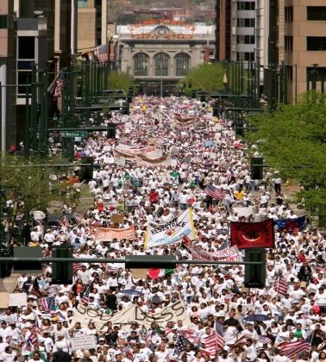
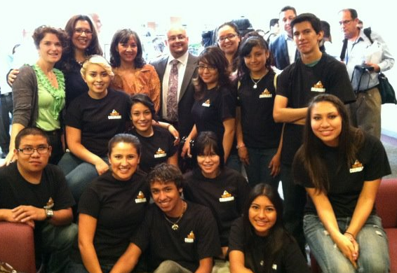
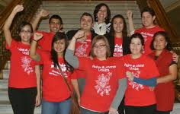
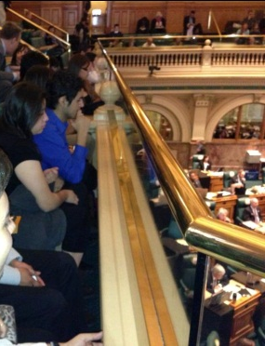
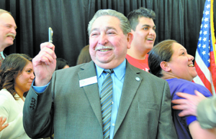
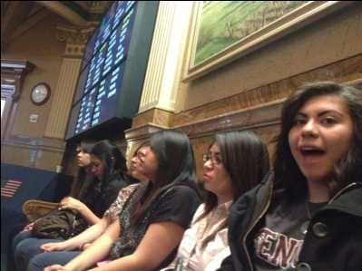
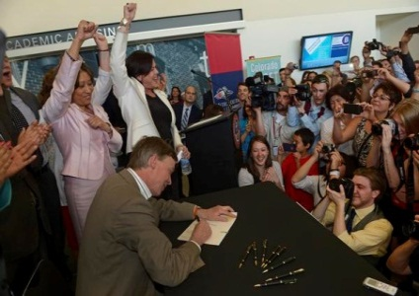
HB06S– 1023 passed during a special session making in-state tuition for undocumented students illegal
Denver Immigration Marches
Public Demonstrations
Walk-in at Auraria Campus
250 people march to Senator Salazar’s Office
Participation on the Governors P-20 Council on Education
Mock Graduation and Press Conferences
Research:
  What has been tried in Colorado?
  What is our current political context?
  How were other states successful?
  Who were the key allies?
The Higher Education Access Alliance was formed
2008 Publication of “Tuition Equity Legislation: Investing in Colorado High School Graduates through equal opportunity to Postsecondary Education”
Metro State University of Denver’s Board of Directors votes to allow undocumented students to pay an “unsubsidized” rate of tuition
Deferred Action for Childhood Arrivals (DACA) is announced through Obama Administration
First Keeping
the
DREAM Alive Conference
Prior to 1997 Colorado offered In-state Tuition to undocumented students
2003
2003
2004
2005
2006
2007
2008
2009
2010
2011
2012
2013
2013
SB12-015 - Bill passes in the Senate dies in House Committee
“In-State” legislation introduced for the first time (HB03-1178) - Bill failed
SB08– 079 - Bill failed
SB09-170 - Bill failed
COLORADO ASSET PASSES
SB13-033 passes in the Senate and House, Governor Hickenlooper signs the bill on April 29. 2013
HB 04-1132—Bill failed
Colorado ASSET Introduced SB10-126 -Bill Failed
HB05– 1124 - Bill failed

Slide 7
Implementation
Statewide implementation outreach
College In Colorado, with partner organizations, are coordinating and conducting:
  K-12 and Higher Ed counselor trainings
  Higher Ed institution assistance with implementing new tuition rate
  Student outreach and information sessions
  Community information meetings (incl. Spanish)
  Informational website, promotional materials and social media outreach
  Resources for DACA applications

Slide 8
2013-2014 Estimated cost for a Full-time Student (15 Credits per Semester) for One Year
School | Residency Tuition and Fees, Students Share | Resident tuition and fees | Non-resident tuition and fees
Colorado Mountain College | $2,130 | $3,300 | $9,420
Aims Community College | $2, 711 | $3,662 | $13,446
Community College of Denver | $3,734 | $5,654 | $14,858
Adams State | $7,450 | $9,370 | $18,082
Metro State University of Denver | $7,723 | $9,643 | $19,816
CSU Pueblo | $7,327 | $9,247 | $17,649
Western State | $7,343 | $9,263 | $17,944
Fort Lewis College | $4,306 | $5,654 | $17,762
Colorado Mesa | $7,206 | $9,126 | $17,945
University of Northern Colorado | $7,166 | $11,006 | $18,710
University of Colorado- Co Springs | $9,847 | $11,767 | $19,765
Colorado State University | $9,313 | $11,233 | $25,166
University of Colorado – Boulder | $10,240 | $12,160 | $32,008
School of Mines | $16,485 | $18,405 | $32,415

Slide 9
Who qualifies for ASSET?

Slide 10
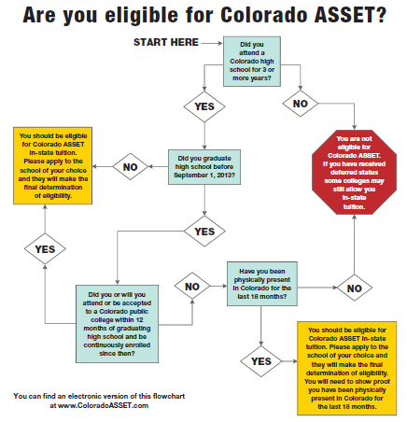
Are you eligible?
Visit our website
www.coloradoasset.com
for an interactive chart for an initial screening to determine if you are eligible.

Slide 11
Current high school students - Graduated on or after Sept. 1, 2013
  Attended Colorado high school for three years;
    As long as a student attended six academic terms from three separate academic years—and then graduated or received a GED—the student would satisfy the high school requirement. (CDHE FAQ document);
    ASCENT is considered part of a student’s high school program and may be counted toward the three-year academic residency requirement
  Graduated or earned GED; and
  Be admitted (not enrolled) to a college within twelve months of graduating.

Slide 12
Students who have already graduated-
Graduated before September 1, 2013
  Attended Colorado high school for three years:
  Graduated or earned GED;
  Be admitted to a Colorado state-funded college; and
  Demonstrate you have been physically present in Colorado for the last 18 months prior to enrollment.

Slide 13
How can a student document they have been physically present in Colorado for the past 18 months?
Below are some examples but ultimately it is up to the school to determine what they will accept:
Rent receipts, utility bills, receipts or letters from companies showing the dates during which you received service;
Employment records or, if you are self employed, letters from banks and other firms with whom you have done business);
School records from the schools that you have attended in the United States, showing the name(s) of the schools and periods of school attendance;
Military records
Hospital or medical records concerning treatment or hospitalization, showing the name of the medical facility or physician and the date(s) of the treatment or hospitalization;
Official records from a religious entity in the United States confirming your participation in a religious ceremony, rite, or passage (e.g., baptism, first communion, wedding);
Money order receipts for money sent in or out of the country; dated bank transactions; U.S. Social Security card; automobile license receipts, title, vehicle registration, etc.; deeds, mortgages, rental agreements; tax receipts; insurance policies; receipts; postmarked letters.

Slide 14
DACA students

Slide 15
What is Deferred Action for Childhood Arrivals (DACA)?
On June 15th, 2012 the Obama Administration announced DACA as an expansion of Prosecutorial Discretion.
An immediate halt to deportation for DREAMers who meet qualifications, apply and are accepted.
Opportunity to apply for legal work authorization for 2 years.
  A valid Social Security Number to be used for Work Purposes ONLY
US Customs and Immigration Services will grant DACA for a period of 2 years; at the end of the 2 years, the person can apply for a renewal.
Source: United We DREAM
July 2012

Slide 16
DACA students
Undocumented students who attended high school in Colorado for FEWER than three years, regardless of the time they have been physically present in the state, are not eligible to qualify for in-state tuition classification under ASSET.
Students who have been granted DACA status MAY BE eligible under existing in-state tuition criteria depending on individual institution practices.
  If a student can provide documentation that he or she resides in Colorado and has acceptable evidence of domicile, such as a valid driver’s licensure and/or social security number, the student MAY qualify for in-state tuition under existing tuition classification laws and policies.

Slide 17
I’m eligible now what?

Slide 18
First step - Apply
FIRST STEP: APPLY AND GET ACCEPTED TO THE PUBLIC COLLEGE YOU WISH TO ATTEND!
A list of eligible schools and their website addresses are located at
www.coloradoasset.com/colleges
Visit the school’s website and make yourself familiar with their deadlines and qualifications
Go through that college’s application process

Slide 19

Start with a College In Colorado Profile

Slide 20
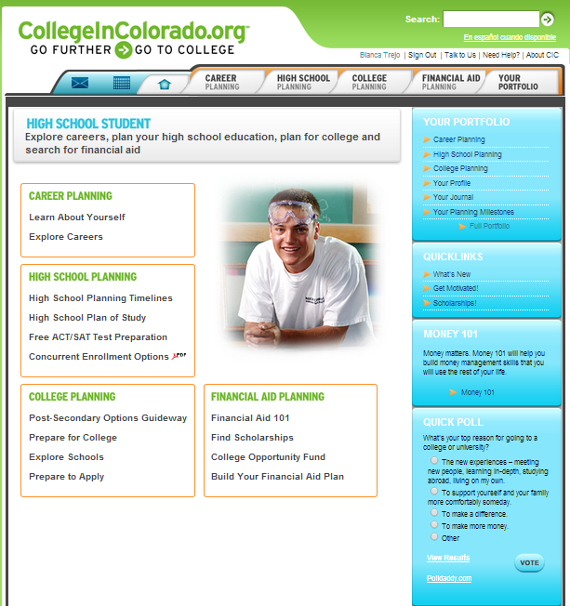
Your College In Colorado Profile can help you Plan, Attend and Pay for College.

Slide 21

Second step – submit your paperwork
The college is the ultimate decider on if you are eligible for ASSET
Make sure to respond to any follow up emails for additional information quickly
Failure to provide all required information could result in an out-of-state classification and higher tuition
Professional Image
  Create a PROFESSIONAL email account
(ex. Blanca_trejo@gmail.com, b.trejo@hotmail.com)
  Check professional email account DAILY
  PROFESSIONAL voicemail message
Photo: miggslives

Slide 22





Third Step: Apply for the College Opportinity Fund (COF)
$64 per credit hour at 2 or 4 year public institutions in Colorado = approx. $1536 a year with 12 credits (full time)
$32 per credit for students Pell Grant eligible – for private non-profits in Colorado (Universidad de Denver, Regis University y Colorado Christian University)
For residents of Colorado studying up to a Bachelors degree
Paid directly to the institution
https://cof.college-assist.org/

Slide 23
2013-2014 Estimated cost for a Full-time Student (15 Credits per Semester) for One Year
School | Residency Tuition and Fees, Students Share | Resident tuition and fees | Non-resident tuition and fees
Colorado Mountain College | $2,130 | $3,300 | $9,420
Aims Community College | $2, 711 | $3,662 | $13,446
Community College of Denver | $3,734 | $5,654 | $14,858
Adams State | $7,450 | $9,370 | $18,082
Metro State University of Denver | $7,723 | $9,643 | $19,816
CSU Pueblo | $7,327 | $9,247 | $17,649
Western State | $7,343 | $9,263 | $17,944
Fort Lewis College | $4,306 | $5,654 | $17,762
Colorado Mesa | $7,206 | $9,126 | $17,945
University of Northern Colorado | $7,166 | $11,006 | $18,710
University of Colorado- Co Springs | $9,847 | $11,767 | $19,765
Colorado State University | $9,313 | $11,233 | $25,166
University of Colorado – Boulder | $10,240 | $12,160 | $32,008
School of Mines | $16,485 | $18,405 | $32,415
With COF
Without COF

Slide 24
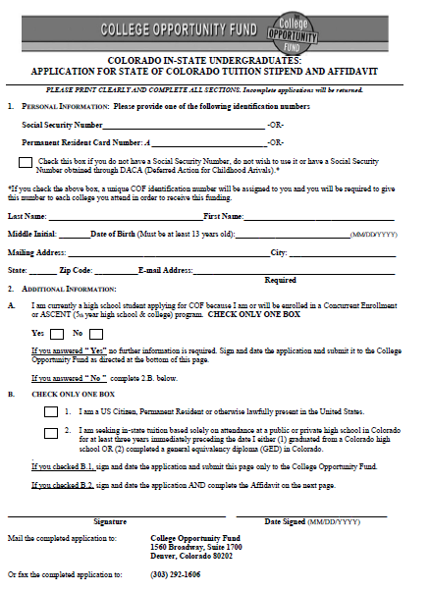
Paper Application Page #1
Students with a Deferred Action (DACA) Social Security number should NOT use it.

Slide 25
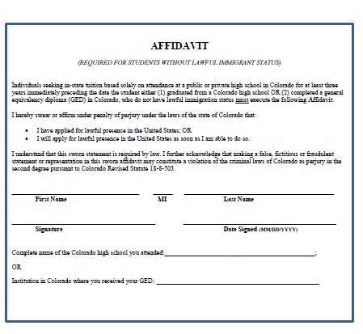
Paper Application Page #2

Slide 26
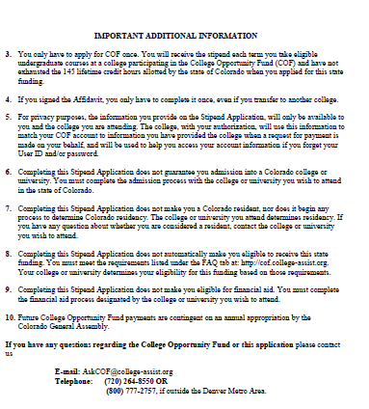
Paper Application Page #3
If you have questions regarding your COF Application, contact College ASSIST
Email:
askCOF@college-assist.org
Phone: (720) 264-8550
OR
(800) 777-2757
(if outside the Denver Metro Area)

Slide 27
Financial Aid

Slide 28
2013-2014 Estimated cost for a Full-time Student (15 Credits per Semester) for One Year
School | Residency Tuition and Fees, Students Share | Resident tuition and fees | Non-resident tuition and fees
Colorado Mountain College | $2,130 | $3,300 | $9,420
Aims Community College | $2, 711 | $3,662 | $13,446
Community College of Denver | $3,734 | $5,654 | $14,858
Adams State | $7,450 | $9,370 | $18,082
Metro State University of Denver | $7,723 | $9,643 | $19,816
CSU Pueblo | $7,327 | $9,247 | $17,649
Western State | $7,343 | $9,263 | $17,944
Fort Lewis College | $4,306 | $5,654 | $17,762
Colorado Mesa | $7,206 | $9,126 | $17,945
University of Northern Colorado | $7,166 | $11,006 | $18,710
University of Colorado- Co Springs | $9,847 | $11,767 | $19,765
Colorado State University | $9,313 | $11,233 | $25,166
University of Colorado – Boulder | $10,240 | $12,160 | $32,008
School of Mines | $16,485 | $18,405 | $32,415

Slide 29
Financial aid
ASSET students are not eligible for federal or state funded financial aid:
  FAFSA (Free Application for Federal Student Aid)
  Pell Grants
  Work Study
  State Merit Aid, Loans, or scholarships
  Federal Merit Aid, Loans or scholarships
ASSET does not make a student eligible for other benefits offered by the state or federal government.

Slide 30
Private or institutional financial aid
ASSET students are eligible to apply for and be awarded:
  Scholarships and other financial aid that is generated from each individual school’s funds or private beneficiaries donating money to individual schools where being a resident of the US or Colorado is not required.
  Hourly-paid jobs created by individual institutions (not work-study)

Slide 31
Scholarships
  * Foundational/non-profit/corporate and other Non Governmental scholarships may be willing and able to award ASSET and DACA students funds.
  Each scholarship has their own requirements.
  For more information on Scholarships for DACA/DREAM and ASSET students please visit
www.collegeincolorado.org
http://www.du.edu/cme/kda-resources.html

Slide 32




SCHOLARSHIPs
Search for/Inquire about scholarships through:
High School: Counseling/Post-Grad office, school website
(including Naviance if available), teachers, coaches, advisors
College(s) you are interested in attending (admissions. financial aid offices, academic depts, foundations)
Local/regional/national businesses
Religious & ethnicity-based organizations,
civic organizations & foundations
Parent & student employers
Networking: Facebook, Twitter, social gatherings
Internet www.collegeincolorado.org , www.fastweb.com
www.finaid.org, www.scholarships.com
SEARCHING FOR SCHOLARSHIPS

Slide 33
What schools participate in asset?

Slide 34
4 year schools
  Adams State University—Alamosa
  Colorado Mesa University—Grand Junction
  Colorado School of Mines—Golden
  Colorado State University—Fort Collins, Pueblo, Global Online
  Fort Lewis College—Durango
  Metro State University—Denver
  University of Colorado—Boulder, Denver, Colorado Springs
  University of Northern Colorado—Greeley
  Western State University—Gunnison

Slide 35
2 year schools
  Aims Community College—Greeley, Loveland, Fort Lupton
  Arapahoe Community College—Littleton
  Colorado Mountain College—Aspen, Buena Vista, Breckenridge, Dillon, Carbondale, Edwards, Glenwood Springs, Rifle, Leadville
  Colorado Northwestern Community College—Rangely
  Community College of Aurora--Aurora
  Community College of Denver--Denver
  Front Range Community College—Westminster
  Lamar Community College --Lamar
  Morgan Community College –Fort Morgan
  Northeastern Junior College --Sterling
  Otero Junior College—La Junta
  Pikes Peak Community College—Colorado Springs
  Pueblo Community College—Pueblo
  Red Rocks Community College—Lakewood
  Trinidad State Junior College--Trinidad

Slide 36
Technical schools
    Delta-Montrose Technical College--Montrose
    Emily Griffith Technical College—Denver
    Pickens Technical College--Aurora

Slide 37
Next Steps

Slide 38
NEXT Steps
Continued training for High School and Higher Ed.
Continue coordination with Higher Ed institutions.
Support High Schools with FAFSA/Financial Aid Nights.
Q&A Hotline in English and Spanish to field student/parent questions.
Continue sharing best practices and resources across the state.

Slide 39

Blanca.Trejo@cic.state.co.us
Blanca E. Trejo
Outreach and Access Coordinator- Statewide Parent Engagement and ASSET Education
Cell: 720-227-2072
Information about DACA:
Together Colorado, United We DREAM, PICO National Network, www.togethercolorado.org, www.unitedwedream.org, www.piconetwork.org,

