Slide 1
Cohort 1 - Year 2 Kickoff
Office of Learning Supports
September 2017

Slide 2
Video (transition)
Be Like Mike
https://www.youtube.com/watch?v=5D11e424M_Q
Monday morning…here we go…

Slide 3
Objectives (on agenda)
Cultivate common language from CDE regarding MTSS implementation.
Contribute to collegial conversations & build individual & collective capacity.
Identify opportunities and action planning for 2017-2018.
http://www.cde.state.co.us/mtss/ co-spdg-cohort1y2-fall2017kickoff

Slide 4
Expectations
Notes:
Click each to animate: These are some expectations for our day (some examples for others, perhaps)…we can agree each category could be adapted somewhat, but hopefully, these feel reasonable for major actions of the day.
When in your MLTs, you have defined norms/agreements that have been guiding you (outside of these). But basically (overall), we are seeking: Communication, Collaboration, and Respect.

Slide 5
CDE OLS Staff
Director Scott Ross
Specialists
Lynne DeSousa
Jason Harlacher
Andrew Schaper
Sam Swauger
Adam Collins
Carole Pandorf
Sean Taylor
Kim Watchorn
Diane Barranco, Program Assistant
Implementation Consultants
Katy Goebel
Rebecca Knighton
Sheree Wheeler
Megan Rogers
Sara Widiger
Jill Youngren
Milcah Hawk
Matt Klausmeier
Kelly Ratliff
Robyn Shank
Erin Ax

Slide 6
Self-Identify by Team
Adams 14 School District | Adams Arapahoe 27J School District (APS) | Bayfield 10 JT-R School District
Charter School Institute (CSI) | Colorado Springs District 11 | Delta County School District
Douglas County School District | Durango School District 9-R | Englewood Schools
Gunnison Watershed School District | Hinsdale County School District RE-1 | Mesa 51 School District
Norwood R2-J School District | Ouray School District R-1 | Ridgway R-1 School District
San Juan BOCES | South Routt RE-3 School District | Thompson R2-J School District
Weld RE-3J School District | Widefield School District 3 | Wray RD-2 School District
http://www.cde.state.co.us/mtss/co-mtss-spdg-grantees
Notes:
Highlighted districts are here today! When your team is called out, please self-identify (shout out…or stand up…or wave).

Slide 7
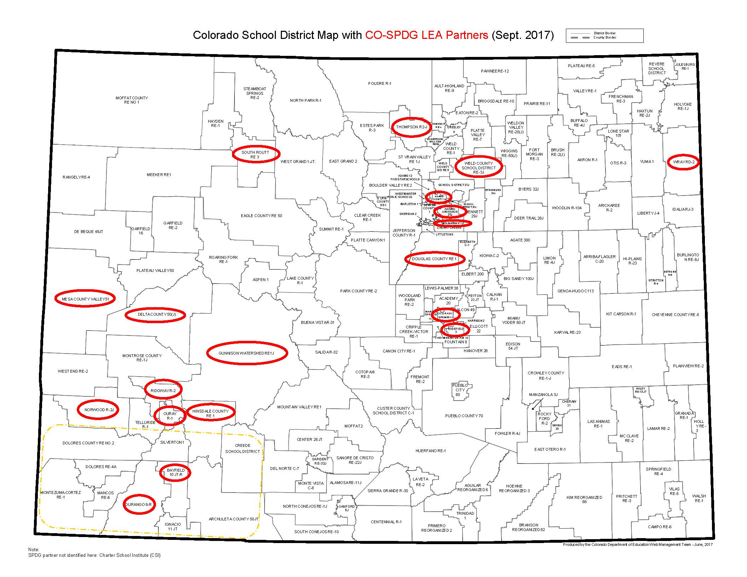
http://www.cde.state.co.us/mtss/co-mtss-spdg-grantees

Slide 8
Video (welcome)
25 Reasons to be Thankful
https://www.youtube.com/watch?v=yA5Qpt1JRE4
And we are thankful for all of you…
What are you thankful for today?

Slide 9
Celebrations
Consider the successes within your district…
What are you proud of? What has worked or is working? What would you like to share?
Dialogue as a team, and identify at least 1-3 shareable “Celebrations” related to you & MTSS.
Create a poster by capturing ideas on chart paper using only pictures (no words).

Slide 10
Pre-Learning
Narrated recording: Focus on capacity development (including Implementation Science)
Tool: Colorado Evidence-Based Personnel Development Rubric
Self-Analysis of LEA status on MLT Self-Assessment…THANKS to all completed!
http://files.eric.ed.gov/fulltext/ED565253.pdf

Slide 11
CO-MTSS State Personnel Development Grant (SPDG)
Goal 1
Increase state leadership capacity for CO-MTSS by improving the professional learning, technical assistance, data-based problem solving, initiative alignment, capacity building, funding, visibility, political support, and policy of CDE.
Goal 2
Increase regional and district capacity for CO-MTSS through effective leadership, planning, and the provision of professional development and technical assistance.
Goal 3
Increase preschool-12, school-level capacity for CO-MTSS through team-driven shared leadership, data-based problem solving, family school, and community partnering, and a layered continuum of evidence-based practices.
Goal 4
Support teacher effectiveness through district and regional systems of professional development and technical assistance.
Goal 5
Increase family, school, and community partnering around CO-MTSS through specific
activities and engagement.

Slide 12
CO-MTSS Project Activities & Timeline
Goal 2: Regional and District Capacity, Implementation Science
MLT Self Assessment, Initiative Inventory, PD Planning, Communication Planning, Action Planning, P-3 within CO-MTSS, FSCP, content based PD and TA
Goal 3: School Capacity and High Quality Personnel Development
BLT Self Assessment, Short Cycle Action Planning, content based PD & TA
Year 1
Year 2
Year 3
Year 4

Slide 13
MLT Implementation
Action Planning
Initiative
Inventory
MLT Self
Assessment
Communication Planning
Selection
Family, School,
and Community Partnering
P-3 within CO-MTSS
Personnel Development
Planning

Slide 14
Active Implementation Stages
Identify
Plan
Get Started
Get Better
Exploration
Installation
Initial Implementation
Full Implementation
Assess need;
Examine fit and feasibility
Assure resources;
Develop supports
Initiate practice; use data to improve supports
Practice is consistent; positive outcomes

Slide 15
Using MLT Dashboards
Andrew Schaper

Slide 16
Section Overview & Objection
Learning Objective: Learn how to access and navigate dashboard, as well as where to enter data
Overview:
The dashboard & its fit within an implementation framework
Access
Navigation
Basic layout of dashboard worksheet
Basic layout of measure worksheets
That annoying feature about hyperlinks…
Where to enter MLT Self-Assessment data

Slide 17
Dashboard Access
In the main folder of your MLT Google Folder (named Dashboard_LEANAME)
Only MLT Lead(s) and TA Providers have access at this point
Others can gain access – work with TA providers and email Andrew Schaper (schaper_a@cde.state.co.us)

Slide 18
Dashboard Navigation

Slide 19
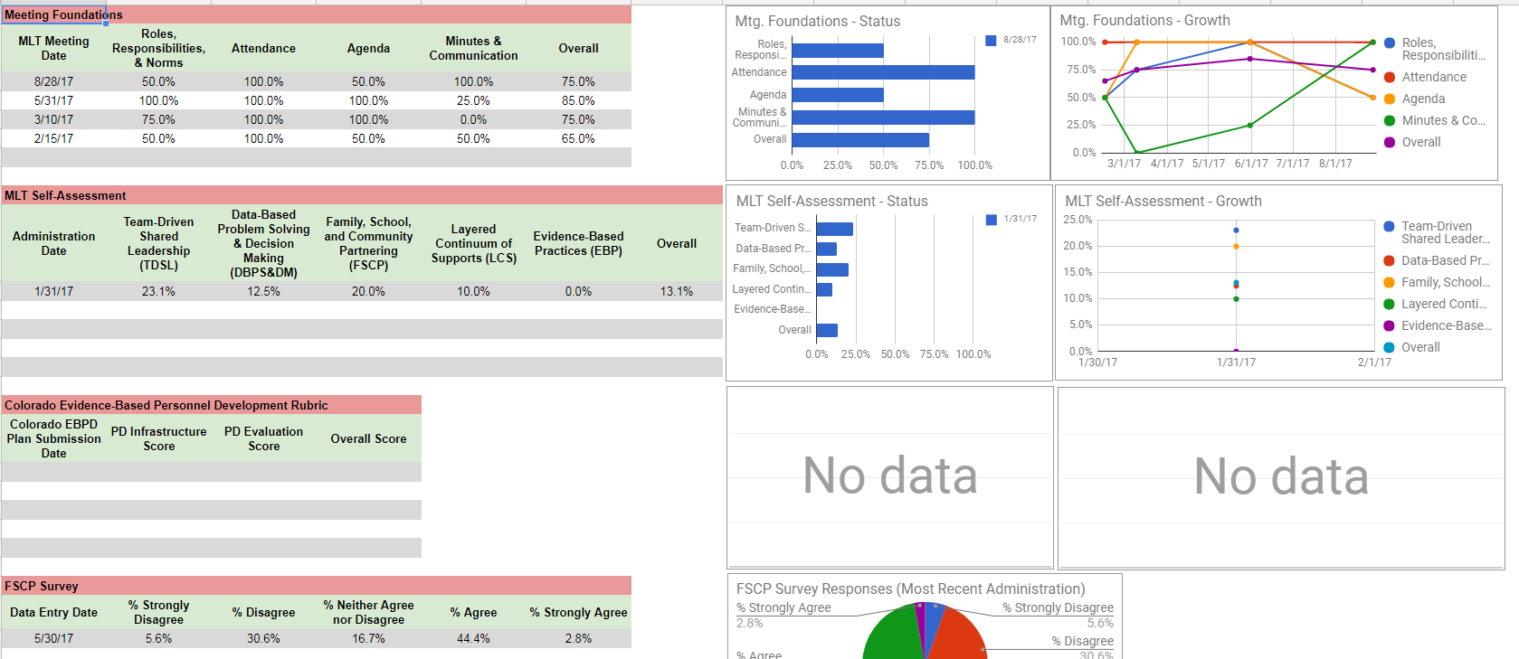
Basic Layout of the Dashboard Worksheet

Slide 20
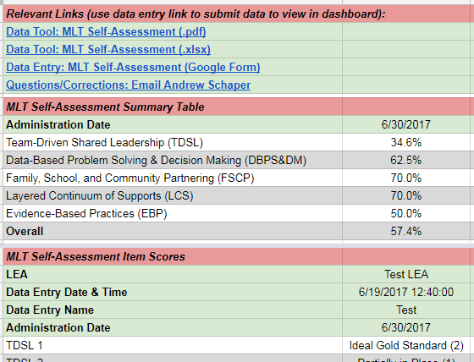
Measure Worksheet Layout

Slide 21
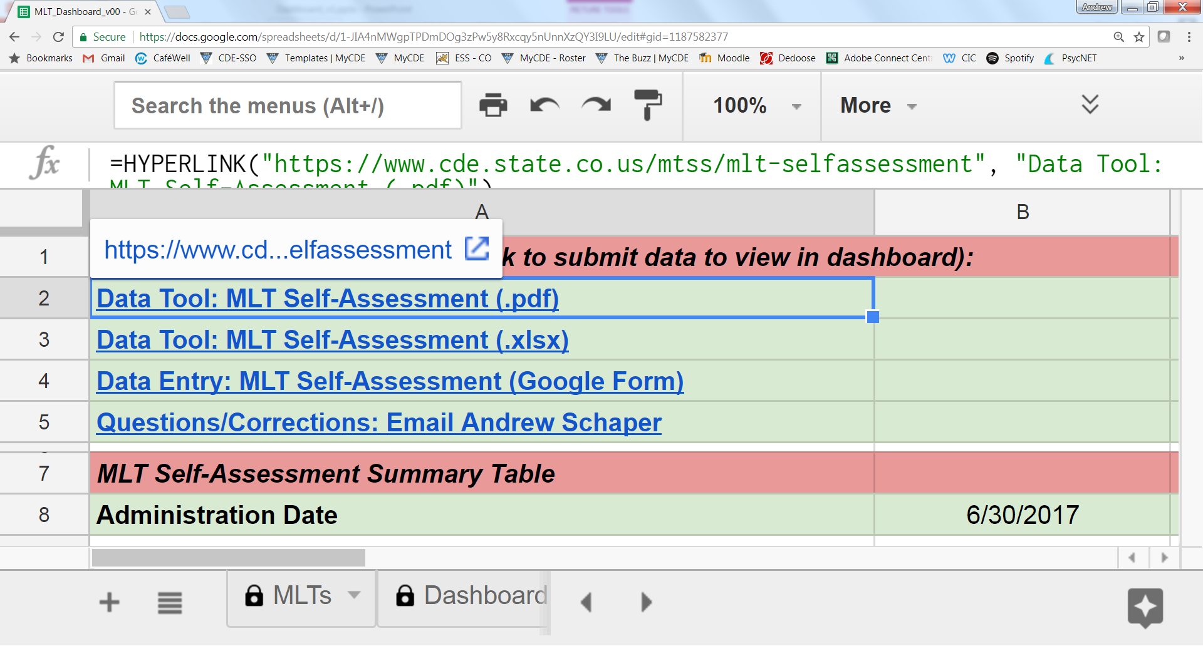
That annoying thing about hyperlinks…

Slide 22
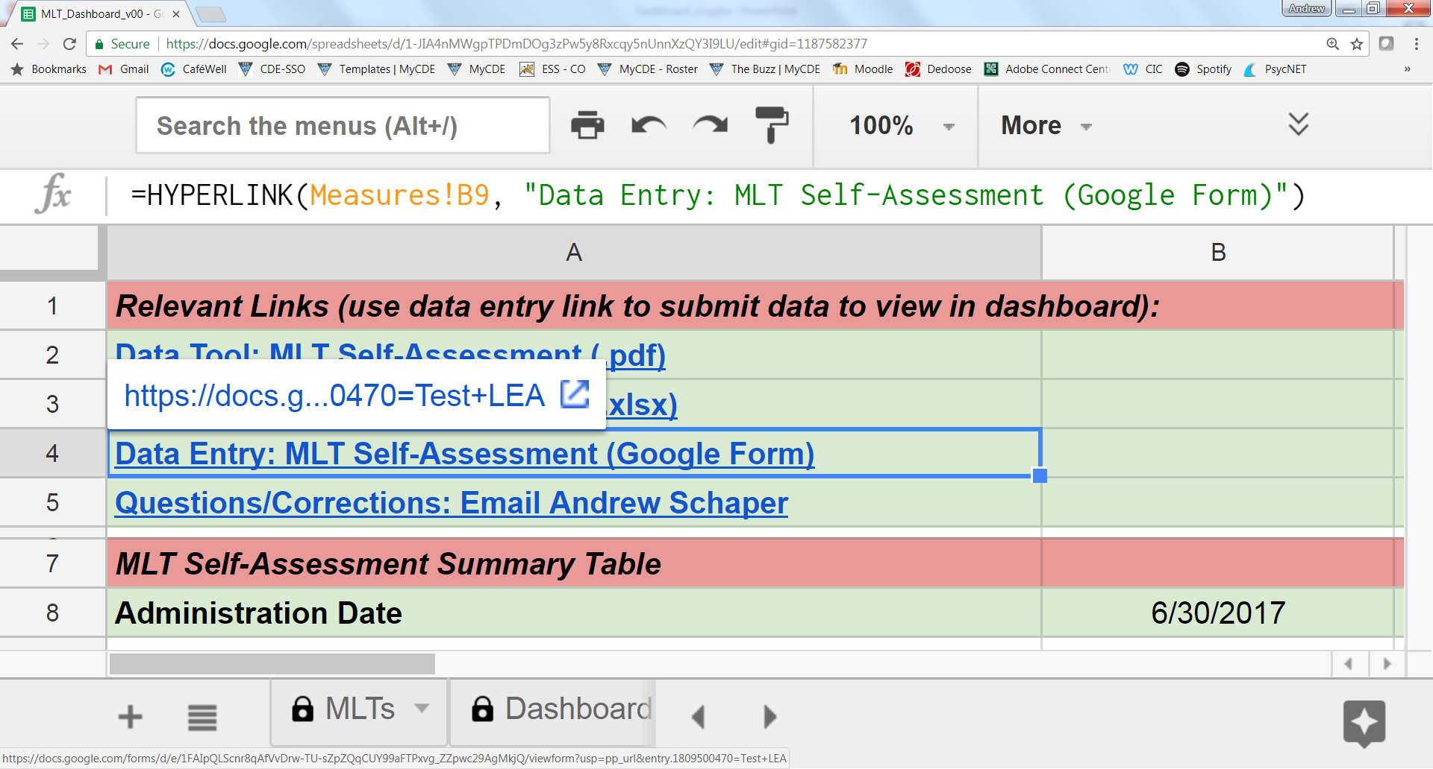
Where to enter MLT Self-Assessment Data

Slide 23
Yearly MLT-SA Review

Slide 24
MLT Self-Assessment Completion
Ensure roles are secured (e.g., Facilitator, Note-Taker) and Norms are clarified (e.g., set-aside rule if significant deliberation on a single item).
Consider your personal scores across all items.
As an MLT, proceed through 5 Components to come to Consensus as a team for each of the 35 items.
Use MLT-initiated decision rules; if dissension exists, discuss to resolve for score entry.
Capture evidence & supports (documentation) and comments or notes – as available and as needed.
Enter agreed upon scores within the Dashboard.
Time-Permitting: Compare/analyze against initial score (winter 2017). Consider possible priorities.

Slide 25
Integrated Learning and Networking (round tables)

Slide 26
Integrated Learning and Networking: Special Topics (round table conversations)
Handout 1: (small slip of paper, 1 per person)
Guiding questions and sentence starters are included below. If helpful, chart paper will be available. Also, a CDE staffer will be nearby, for support, and will give a 5-minute remaining time check, at which time, he/she will collect major takeaways and questions for CDE.
Why is this an area of interest for you? What do you hope to learn from others?
How could your MLT explore/investigate/ implement this area?
What are your primary celebrations/considerations/concerns related to this area?
What support(s) do you think you need?
What questions do you have?
Other inquiries?
Handout: 3-2-1 Personal Reflection (1 per person)
Write Down

Slide 27
Integrated Learning & Networking: Topics
Massard Room
(this room)
Communication Planning
Preschool – Third (P3)
Data-Based Problem-Solving & Decision-Making
Adult learning/PD planning
Layered Continuum of Supports
San Juan Room
(next door)
Team-Driven Shared Leadership
Evidence-Based Practices
Action Planning

Slide 28
Lunch Break
Return Time – 12:30
Breakout Sessions:
P-3 Early Childhood Representative: San Juan Room
FSCP Family/Community Representative: San Juan Room
Evidence-Based Approaches & Layered Supports for Social Emotional and Behavioral Health – Massard Room
PLEASE go to your respective break-out when you return.

Slide 29
Breakouts
Adam Collins - Evidence-Based Approaches & Layered Supports for Social Emotional and Behavioral Health – Massard Room
Emily Kielmayer – P-3
Carole Pandorf – Family School Community Partnering

Slide 30
MLT to the BLT and
Colorado Evidence-Based Personnel Development

Slide 31
Predictions & Implications
“Just Do It…” (FrameWorks Institute, 2015)

Slide 32
Research Synthesis of Adult Learning Studiesª
Research synthesis of studies of accelerated learning, coaching, guided design, and just-in-time training
58 randomized control design studies
2,095 experimental group participants and 2,213 control or comparison group participants
Combination of studies in university and non-university settings
Learner outcomes included learner knowledge, skills, attitudes, and self-efficacy beliefs
The influence of the adult learning methods on the learner outcomes was estimated by weighted Cohen’s d effect sizes for the differences on the post test scores for the intervention vs. nonintervention group participants
ª Dunst, C.J., Trivette, C.M., & Hamby, D.W. (2010). Meta-analysis of the effectiveness of four adult learning methods and strategies. International Journal of Continuing Education and Lifelong Learning, 3(1), 91-112.

Slide 33
Most Effective Adult Learning Method Practices
Characteristic | Practice | Mean Effect Size
Introduction | Out-of-class learner activities/self-instruction | 0.64
 | Classroom/workshop presentations | 0.63
 | Pre-class learner exercises | 0.54
Illustration | Trainer role playing/simulations | 0.55
 | Learner-informed input | 0.53
Practicing | Real-life learner application | 0.94
 | Real-life learner application/role playing | 0.86
Evaluation | Self assessment of strengths/weaknesses | 0.94
Reflection | Identify performance improvement goals | 1.27
 | Journaling/behavior suggestions | 0.82
Mastery | Standards-based assessment | 0.86

Slide 35
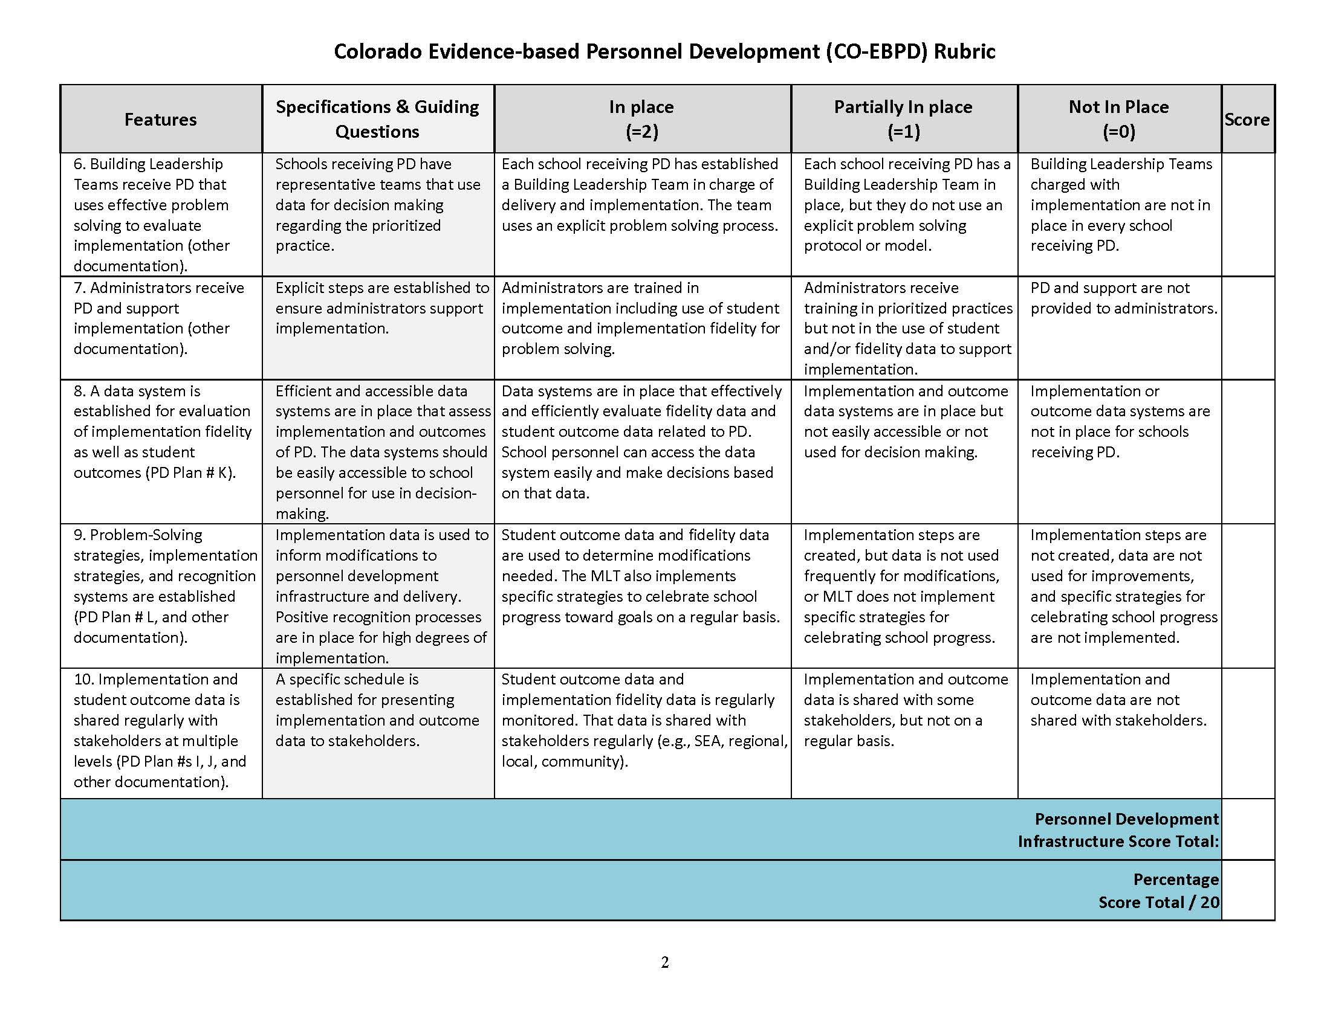

Slide 36
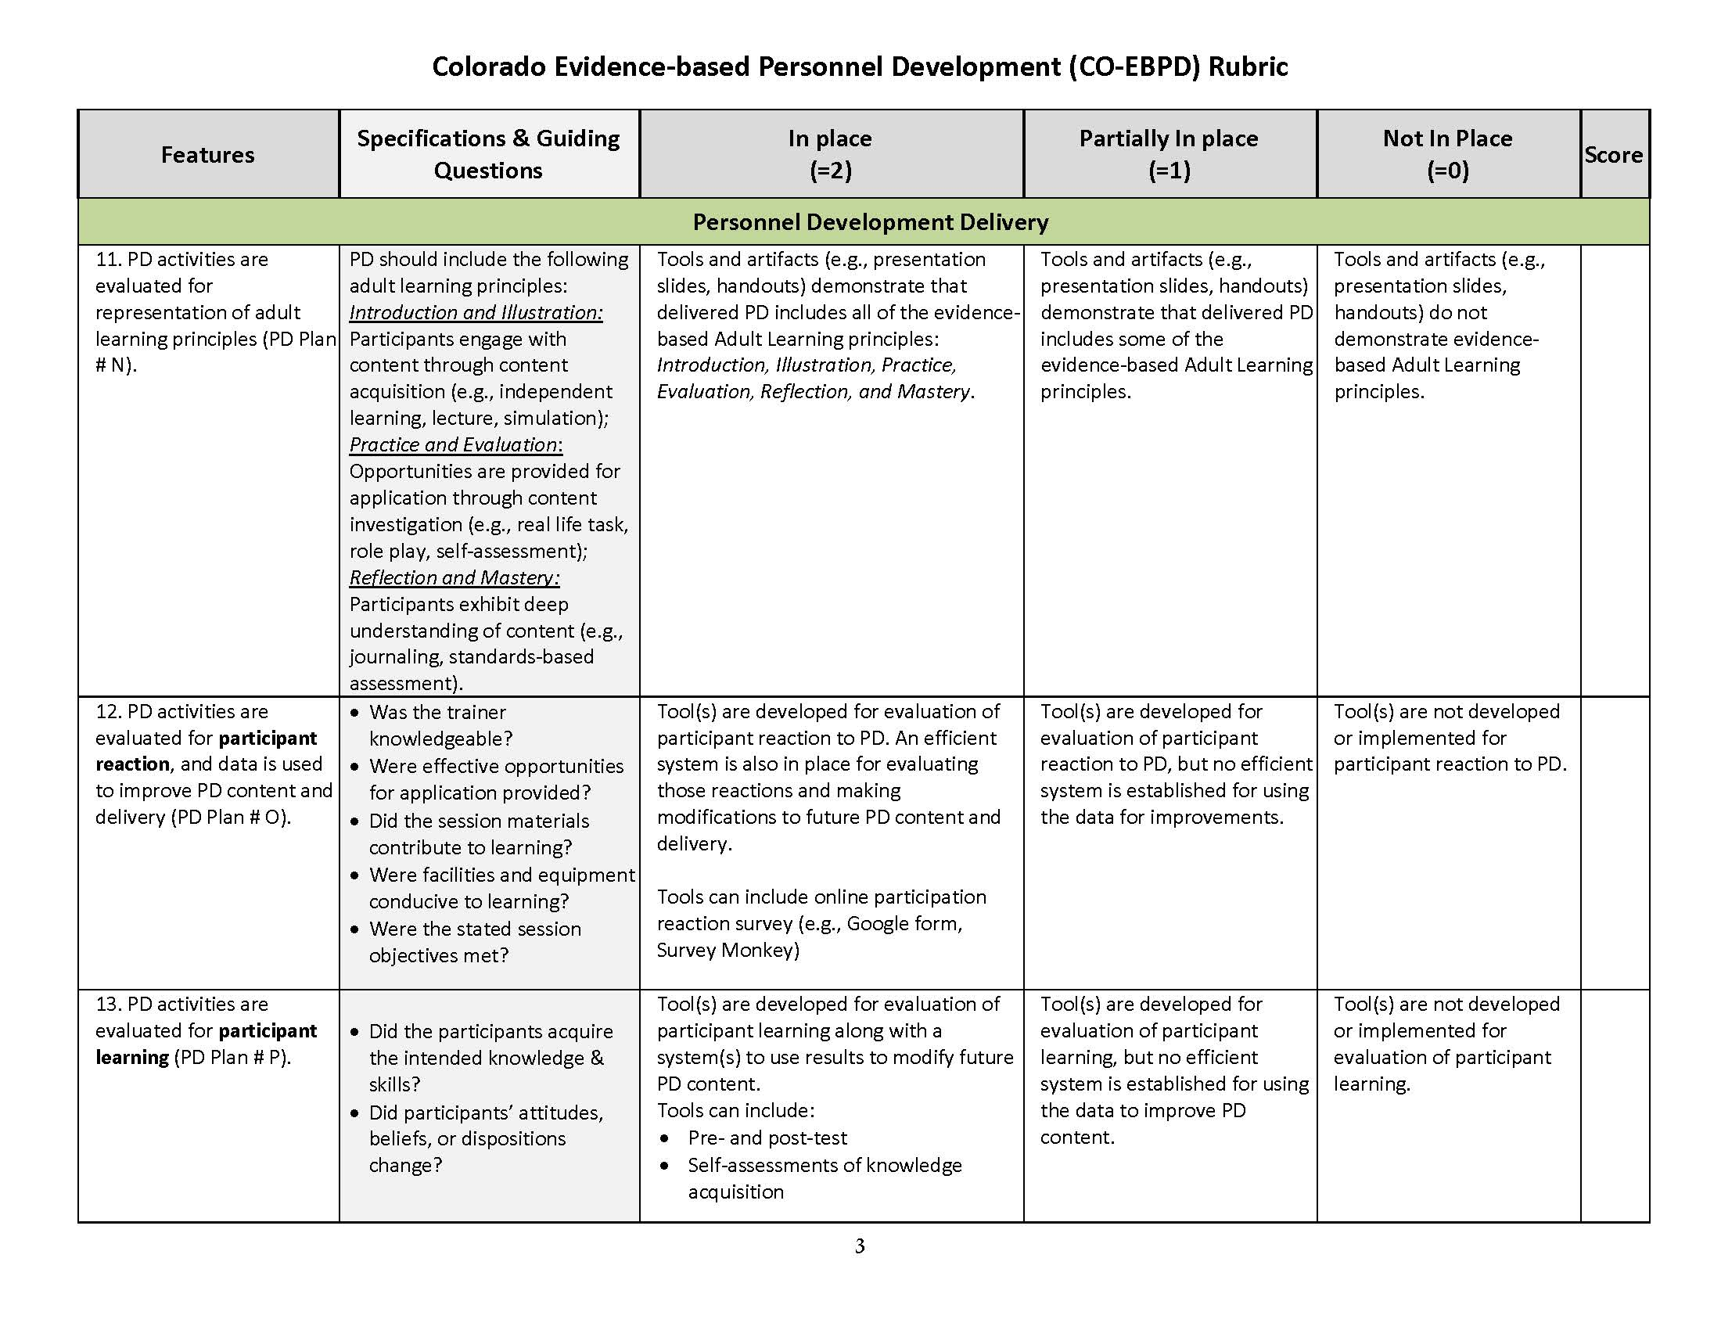

Slide 37
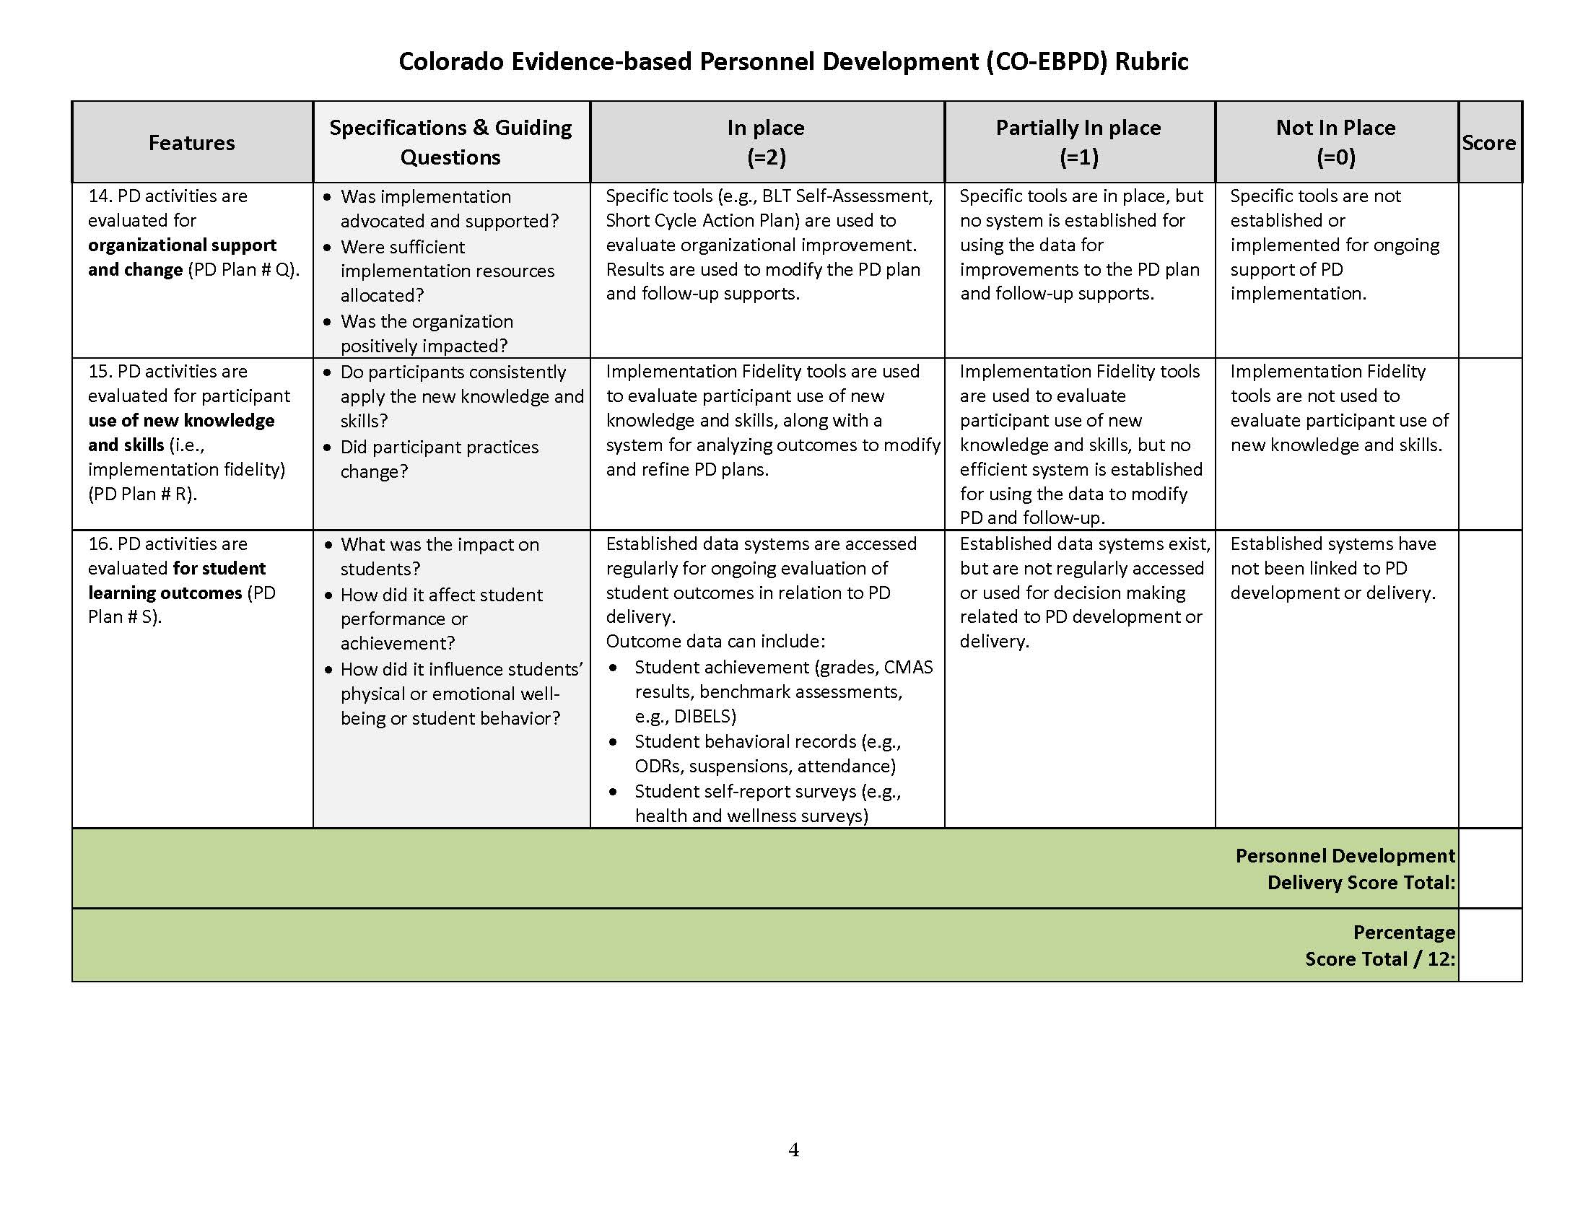

Slide 38
Personnel Development
Activity:
Review the PD Rubric with teammates
Consider current PD your district/BOCES provides and how you might score that PD with the Rubric
Now consider PD through CO-MTSS. Who needs CO-MTSS training/TA? What should they know? When?

Slide 39
Action Planning

Slide 40
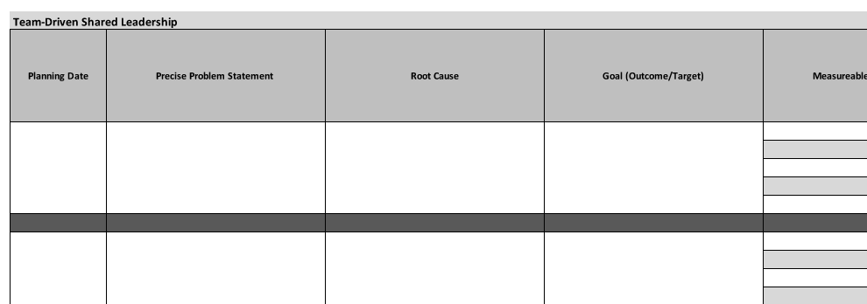
Action Planning Tool

Slide 41
Objectives Review – Fist to Five
Cultivate common language from CDE regarding MTSS implementation.
Contribute to collegial conversations & build individual & collective capacity.
Identify opportunities and action planning for 2017-2018.

Slide 42
FOR ALL YOU DO. YOU are the ones that are getting this work done.

Slide 43
This CDE guidance document is meant for clarification, is not legally binding, and is not to be confused with legal advice. This guidance reflects CDE’s recommendations, but Local Education Agencies (LEAs) and Administrative Units (AUs) may have developed their own policies or procedures that differ from those described herein. Be sure to refer to your local AU’s policies and procedures through local leadership (e.g., Directors of Special Education, Title I Coordinators, superintendents). If you are seeking legal advice, please contact your legal counsel.
Note that the contents of this presentation and corresponding handouts were developed under a grant from the U.S. Department of Education. However, the content does not necessarily represent the policy of the U.S. Department of Education, and you should not assume endorsement by the federal government.
Notes:
Key Points:
This slide notes the funding source for this work.

