Slide 1
Supporting Students through Intentional Decision-Making Practices
Oct. 3, 2017
Office of Learning Supports
Kim Watchorn: watchorn_k@cde.state.co.us

Slide 2

This CDE guidance document is meant for clarification, is not legally binding, and is not to be confused with legal advice. This guidance reflects CDE’s recommendations, but Local Education Agencies (LEAs) and Administrative Units (AUs) may have developed their own policies or procedures that differ from those described herein. Be sure to refer to your local AU’s policies and procedures through local leadership (e.g., Directors of Special Education, Title I Coordinators, superintendents). If you are seeking legal advice, please contact your legal counsel.
Note that the contents of this presentation and corresponding handouts were developed under a grant from the U.S. Department of Education. However, the content does not necessarily represent the policy of the U.S. Department of Education, and you should not assume endorsement by the federal government.
Notes:
Key Points:
This slide notes the funding source for this work.

Slide 3
Acknowledgements
Multiple offices/units within the Colorado Department of Education (CDE)
Frank Porter Graham Child Development Institute, Mary Ruth Coleman
Iowa Department of Education, David Tilly
Michigan’s Integrated Behavior and Learning Supports Initiative (MiBLSi), Steve Goodman
National Association of School Psychologists (NASP), Stacy Skalski
National Implementation Research Network (NIRN), Caryn Ward
National Technical Assistance Center on PBIS (OSEP), Rob Horner
and George Sugai
RtI Action Network
RtI Innovations (Annual Conference)
State Implementation Scaling up Evidence-Based Practices Center (SISEP), Karen Blase & Dean Fixsen
University of South Florida, George Batsche
University of North Carolina at Charlotte, Bob Algozzine & Kate Algozzine
University of Oregon, Kent McIntosh, Steve Newton, & Anne Todd
Utah Multi-Tiered System of Supports (UMTSS)
Notes:
We like to acknowledge all of those who have contributed to our thinking and this work.
Our information has a strong research base with expertise from varied national partners.
This is a list of many researchers and contributors to our work. Our work has greatly benefitted from their contributions.

Slide 4
Learning Session Outcomes
Participants will…
Reflect on the Multi-Tiered System of Supports (MTSS) framework
Focus on one of the five MTSS Essential Components: DBPSDM (including problem solving across tiers)
Consider acceptable variations, adaptations to concepts, and potential (personal/system) applications

Slide 5
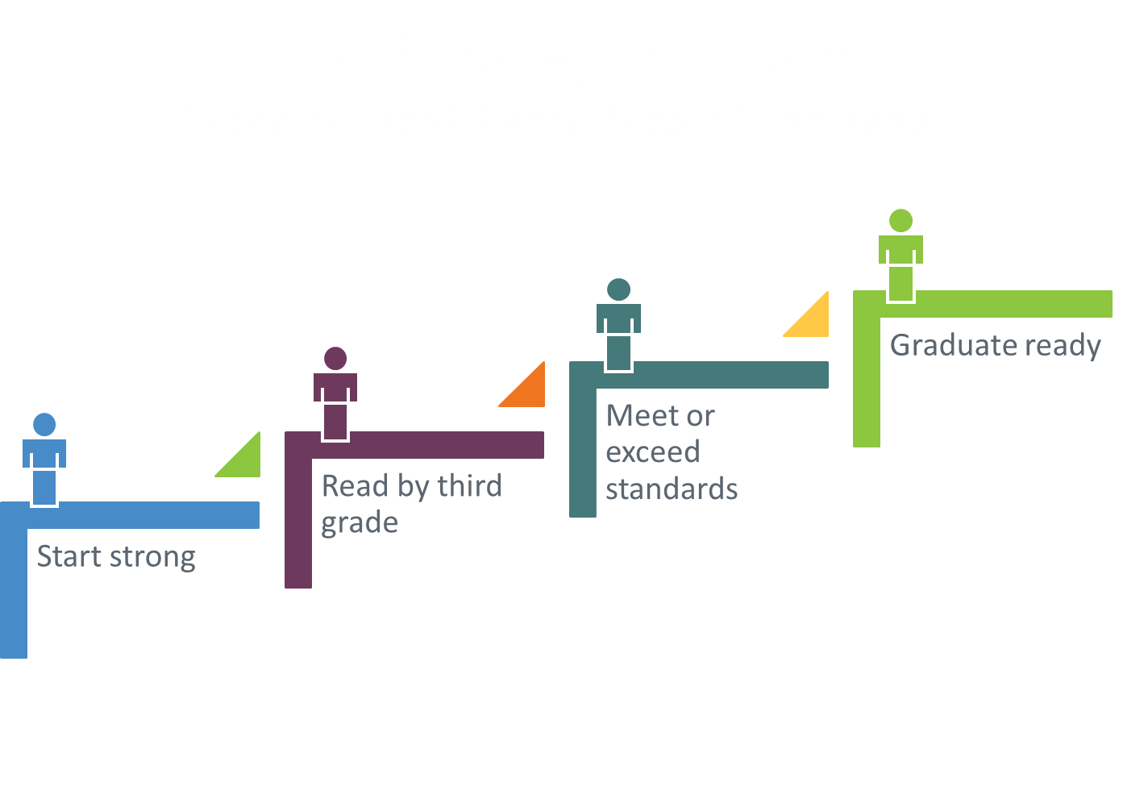
Notes:
Focus on “every”. We aren’t saying “all” here, as we want to ensure every means “each and every” – so that we measurably support every student – sometimes, the generalization of “all” diminishes the focus on “every.”
Then there was also the notion that if a student didn’t meet the criteria of a program and didn’t fit into a specific category or group, then the student didn’t receive supports (to be successful)
It’s every student…Not, every student except…. “students with disabilities”, “students who are English Learners,” “students in large schools or small schools or urban schools or rural schools or facilities schools”, students of every race and socioeconomic level.

Slide 6
Common Language and Common Understanding
Language reveals belief;
belief informs action;
action is visible in the behavior of adults
…which is what we are trying to
change or shape to support students.
Notes:
Common Language alone is not enough; we need to have Common Understanding.

Slide 7







MTSS and Essential Components
Team-Driven Shared Leadership
Family, School, and
Community Partnering
Data-Based
Problem Solving and
Decision-Making
Layered Continuum
of Supports
Evidence-Based
Practices
Notes:
CO-MTSS is a prevention-based framework of team-driven, data-based problem solving for improving the outcomes of every student through family, school, and community partnering and a layered continuum of evidence-based practices applied at the classroom, school, district, region, and state level.
The Mountain graphic = note the dynamic nature and the ‘blurred lines’, not finite division between the colors (fluidity is represented).
You’ll notice the color-coded icons throughout the content (correlating different Components with connected content).
Kim has said, we often “start at 12 o’clock”, or the “Team-Driven Shared Leadership” component.

Slide 8

Team-based Shared Leadership
Family, School, and Community Partnering
Data-Based Problem Solving
MTSS
Evidence-based Practices
Layered Continuum of Supports
Every student, every staff member… and every family and every school setting
academic & behavior supports
Imp. Sci.
“Every Ed” – Gen. Ed., Spec. Ed., Gifted Ed., CLD, ESEA
Notes:
We can also visualize this “MTSS system” idea in an overarching umbrella. Within the overall system, MTSS consists of six components including shared leadership, family, school, community partnering, data based problem solving and decision making, universal screening and progress monitoring, evidence based instruction, intervention and assessment practices and a layered continuum. Academic, behavior and any other supports are all housed under this one system or umbrella.
Language of “every ed” has been used across systems framework literature for many years. (author reference: Judy Elliott)

Slide 9
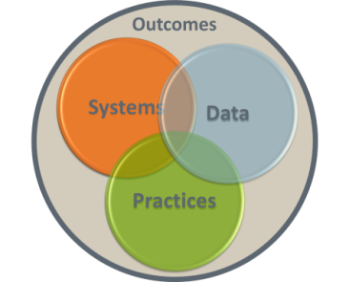
MTSS = Organizational Framework
General Education
+ Special Education
[it really is “every ed”…]
Academic + Behavioral Supports
Response to Intervention (RtI)
+ Positive Behavioral
Interventions and Supports (PBIS)
School-wide Systems
+ Individual Systems
Multiple Funding Streams
Merging Data, Practices,
and Systems
Notes:
See how it is “both/and”; we are not forgetting individual systems when we speak school-wide;
We do attend to school-wide, to have biggest impact first.
Connect to what’s worked; don’t disregard historical success. This is not “something new,” excluding what has been of benefit.
Reminder: Value add…if something isn’t bringing value to your system, why are you adopting/integrating it?
Speak to the “Circles” specifically…we need these integrated/overlapping to contribute to those outcomes, the outer circle, which is our constant vision/focus;
note the circles have origin in the PBIS TA Center (as “integrated elements”)

Slide 10
Systems Thinking
Systems thinking
is an approach to
organizational
improvement based on
awareness of the whole, the part,
and the interactions between the two.
Image: MS ClipArt
Notes:
We start with Systems thinking. It’s about the whole & parts. (“the global & the granular”)
(integrity of both, each sub-system & the entire system, and how they relate)
Example analogy (revisited): Jobs (roles/tasks) expected in a RESTAURANT (which has systems that function), what different jobs people do (anticipate ‘water is needed on the table’ = preventative approach)

Slide 11

One System…
(with sub-systems & supports)
Notes:
Note the “s” usage here. (what is plural & what isn’t, notable for CO)
Systems thinking – MTSS is “one system” - it is about symbiotic relationships. We’re thinking about how individual elements contribute to the whole and compose that larger entity. We’re also thinking about how that whole system supports each of its disparate parts. For the organization to improve, the focus cannot be either one or the other. How might that concept translate or compare to other systems you have seen (small or large) that are successful or that have faltered?
Analogy: The human body is one system with many “systems” within it (skeletal, circulatory, etc.); so, too, MTSS focuses on the “one system” with multiple systems – and Essential Components – that lead to its effective functioning.

Slide 12
Focus on the System
To get to “all”,
we must pay attention to “every”.
We must pay attention
to the “system” first, and then,
we move to small groups and individuals.
-Dave Tilly
Notes:
PREVENTION Reinforcement: IN Schools…sometimes, we try to “case by case”, and if we have MANY cases and only address one student per week…will we ever manage every case. We learned we need to attend to the system first…it’s more efficient AND more effective. And we reach more people. Students…with supports – and ADULTS with capacity-building, every stakeholder gaining confidence and COMPETENCE to do their roles well!
Slide notes:
This quotation from Dave Tilly summarizes what we have been highlighting.
It is most efficient and effective to be thinking about how we support the system and then can provide additional supports. Focus first on the universal. We say “every” (each and every student) to ensure we don’t mean “most.” Sometimes, when people say “all,” they imply “most” – not attending fully to the needs of ‘every’.
If we are intentional and develop an organized way of addressing every students’ needs, we are more likely to impact more students positively and improve student outcomes.

Slide 13

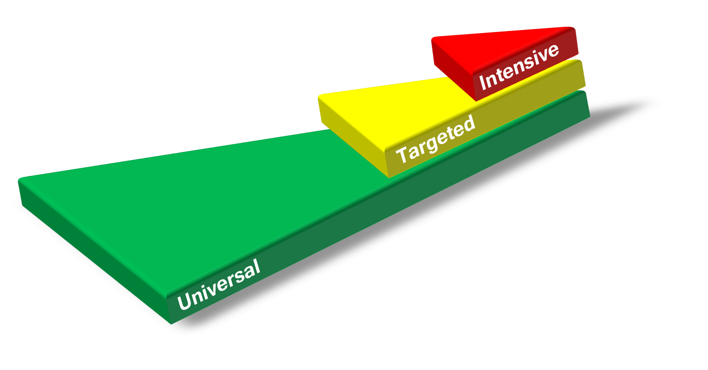
Prevention-Based: The Aim is to eliminate Barriers BEFORE they are shaped
Preventative approach applied across all tiers
Identify who needs support as early as
possible; Implement supports
when needed; and Determine if
those supports are effective
Prevent development of
new problems
Reduce the number of
existing challenges
Reduce the intensity
and complexity
of needed supports
Notes:
EMPHASIZE PREVENTION INITIAL: (e.g. diet/exercise IS primary action for everyone all…UNIVERSAL EVIDENCE-BASED PRACTICE); “prevention” = preventing from not reaching “potential”; preventing obstacles impeding student/stakeholder progress
Click for animation:
Note: Also…Prevention “across the tiers”, not universal alone; thus, the bulleted points and layered graphic. Describe Tiered Logic here, if desired. (reference connection to everyone gets, some may need & get, a few need more…maybe include “blanket analogy”, if helpful)
We also believe in “asset” or “strengths” based thinking across the tiers and application levels (of problem solving and decision-making)

Slide 14



MTSS Makes it Possible
ALP
UIP
READ
IEP
ICAP
ILP
CAS
SR
HS
ELDGs
Notes:
Thinking of connecting the dots…
It’s not that MTSS is another thing “on the plate”…maybe, instead, it is the plate. (not another ‘thing on the plate’)
It is the “work” – if a well-articulated, well-designed MTSS is in place, you will have a system that is efficient, effective, durable, and sustainable. You will have the capacity to implement legislative priorities and additional initiatives.
It truly is a ‘framework’ that holds all those elements in as the “big picture.” Another analogy to consider is to think of MTSS as “a frame” (holding in all the legislative priorities and efforts we need to include).

Slide 15
Discussion: Turn and Talk
?
Now…
  How could you contribute to systems conversations…What are your assets/strengths?
  Are there any differences between what is perceived as MTSS (how it’s been shared here) and what you have seen/heard?
Notes:
POSSIBLE ACTIVITY
Mention resource: Initiative Inventory (2 page handout) – Technical Guide file in TOOLKIT

Slide 16
Formula for Success
What
How
Where
Effective Interventions
Effective Implementation Methods
Enabling Contexts
EBPs (Academic, Behavior,
FSCP Supports)
Systems, protocols, teams
Supportive Infrastructure
& Culture
Why
Desired
Outcomes
Adapted from 2012 Dean Fixsen and Karen Blase,
National Implementation Research Network
Notes:
For “WHERE”: Supportive infrastructure …also all people on the same page, so the culture feels positive.

Slide 17


Colorado MTSS PROBLEM SOLVING PROCESS
Reflect on your process.
Where are your strengths? Where are your challenges?
Step 1—Define the problem
What is the problem?
Step 4—Evaluate
Is it working?
Step 2—Problem Analysis
Why is it occurring?
Step 3—Plan Implementation
What are we going to do about it?
Reflect on your process. Where (within the process) do you
spend most of your time? For whom is this process applied?
Notes:
Here’s the Problem Solving Process – with each step defined.
Question prompts may be useful as people are reflecting. (provide the prompts for people to consider their engagement)
We say it’s a 4-step process, but “step 0” is having effective teaming in place and having Data to define the problem.
We advise that deliberation in steps 1-2 will help make sure that you have come up with the “right” (likely to eliminate) strategy in steps 3.
Don’t forget to EVALUATE both fidelity (‘did we say we’d do what we intended’) and outcomes (performance/results).

Slide 18

What do we need?
A clear model with steps for
problem solving routine
Access to the right information
at the right time
in the right format
A formal/predictable process
that a group of people
can use to build and
implement solutions
Notes:
This could be the biggest ‘takeaway’ slide for PS.
To use data for progress monitoring and for decision making we need to engage in problem solving that provides access to the right type of current data, a system/process for using those data, and strategies for using those during the problem solving process.
Middle bullet: If we are in a conversation, are we sure we have what we need to begin.

Slide 19

Data-Based
Efficient collection and use of data (all
domains; all levels).
Teams are informed by data and make decisions based on available information.
Protocol(s) for effective analysis of data is/are established.
Notes:
“data-driven” = data drive the decisions within the framework, according to processes and protocols;
data do not “drive” the personnel; that’s why we say, “data-based”, the people are informed by data,
but the TEAM makes the decision (‘drives’ what will be done)

Slide 20
Collaborative Inquiry
The ongoing investigation into how to continuously improve student learning for more and more students, guided by the following simple questions:
  How are we doing?
  What are we doing well? How can we amplify our successes?
  Who isn’t learning? Who aren’t we serving? What aren’t they learning?
  What can we do to improve? To deepen our knowledge of our content and how to teach it?
  How do we know if it works?
  What do we do if they don’t learn?
From Nancy Love: Using Data to Improve
Learning for All: A Collaborative Inquiry Approach
(ch. 1 “Building a High-Performing Data Culture”, p. 3)

Slide 21
Continuum of Teaming Implementation for Problem Solving
Teaming is ineffective.
A process for Problem Solving is not in place.
Meetings are
not regularly-scheduled.
Meeting flow and progression are determined at meeting time.
Decisions and discussions are owned by (a) certain individual(s).
Documentation is inconsistent if present.
Effective teaming practices and the Problem Solving Process are used across tiers.
Fully-developed meeting structures are known by all stakeholders.
Responsibilities and roles are clear.
Agreements are followed; protocols exist for dissension and consensus.
Documentation is efficient and accurate.
Select a Percentage that represents your level of implementation
0%
10%
20%
30%
40%
50%
60%
70%
80%
90%
100%
0%
10%
20%
30%
40%
50%
60%
70%
80%
90%
100%
Notes:
Activity: Self-identify … do you have the foundational elements of teaming in place; where would you attribute your school’s implementation of effective teaming?
Possible way to deliver: Do this as “dot voting” on big chart paper on the wall.

Slide 22
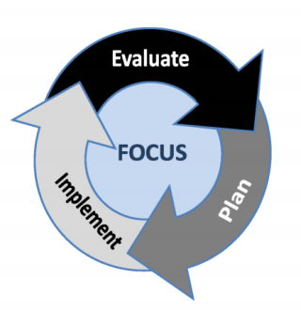
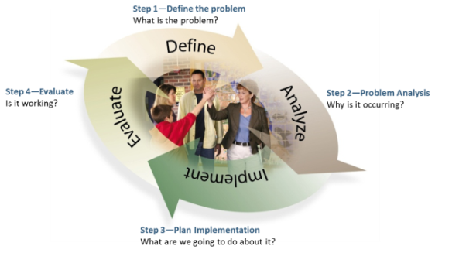
CO MTSS Problem Solving Process (systems)
Teams represent the educational setting; families are partners at all levels of problem solving.
Identify gaps in system-wide processes in need of improvement and monitor progress toward system-wide goals.
UIP
Notes:
UIP = continuous improvement
Note the alignment between PSP & UIP
Use a systematic, problem solving process
Identify gaps in system-wide processes in need of improvement
Monitor progress toward system-wide goals (i.e., implementation benchmarks)

Slide 23
Questions Teams Asks
 | Schoolwide | Student
Imple-mentation | Systems-Implementation: Who is on each team? When/where do the teams meet? What supports and interventions are available? What personnel development is provided (to individuals; to teams)? Is fidelity of use at least 90%? | Student-Implementation: What determines if a student should receive Tier 2 or 3 supports? What is the process? What documentation is needed? Who is responsible?
Impact | Systems-Impact: Are at least 80% of students successful with Tier 1 supports alone? Is there a maximum of 10-15% of the student population who need Tier 2 or 3 supports? Are at least 80% of students receiving Tier 2 and 3 supports successful? | Student-Impact: Which students need additional supports or interventions? What support or intervention does the student need? What progress is the student making? What is the success of students with this level of support?
Attention-seeking here…You can’t just live here. Must do all...
Notes:
When you consider systems and student along with implementation and impact, it creates a matrix. Questions that you ask/data to gather for each cell.

Slide 24
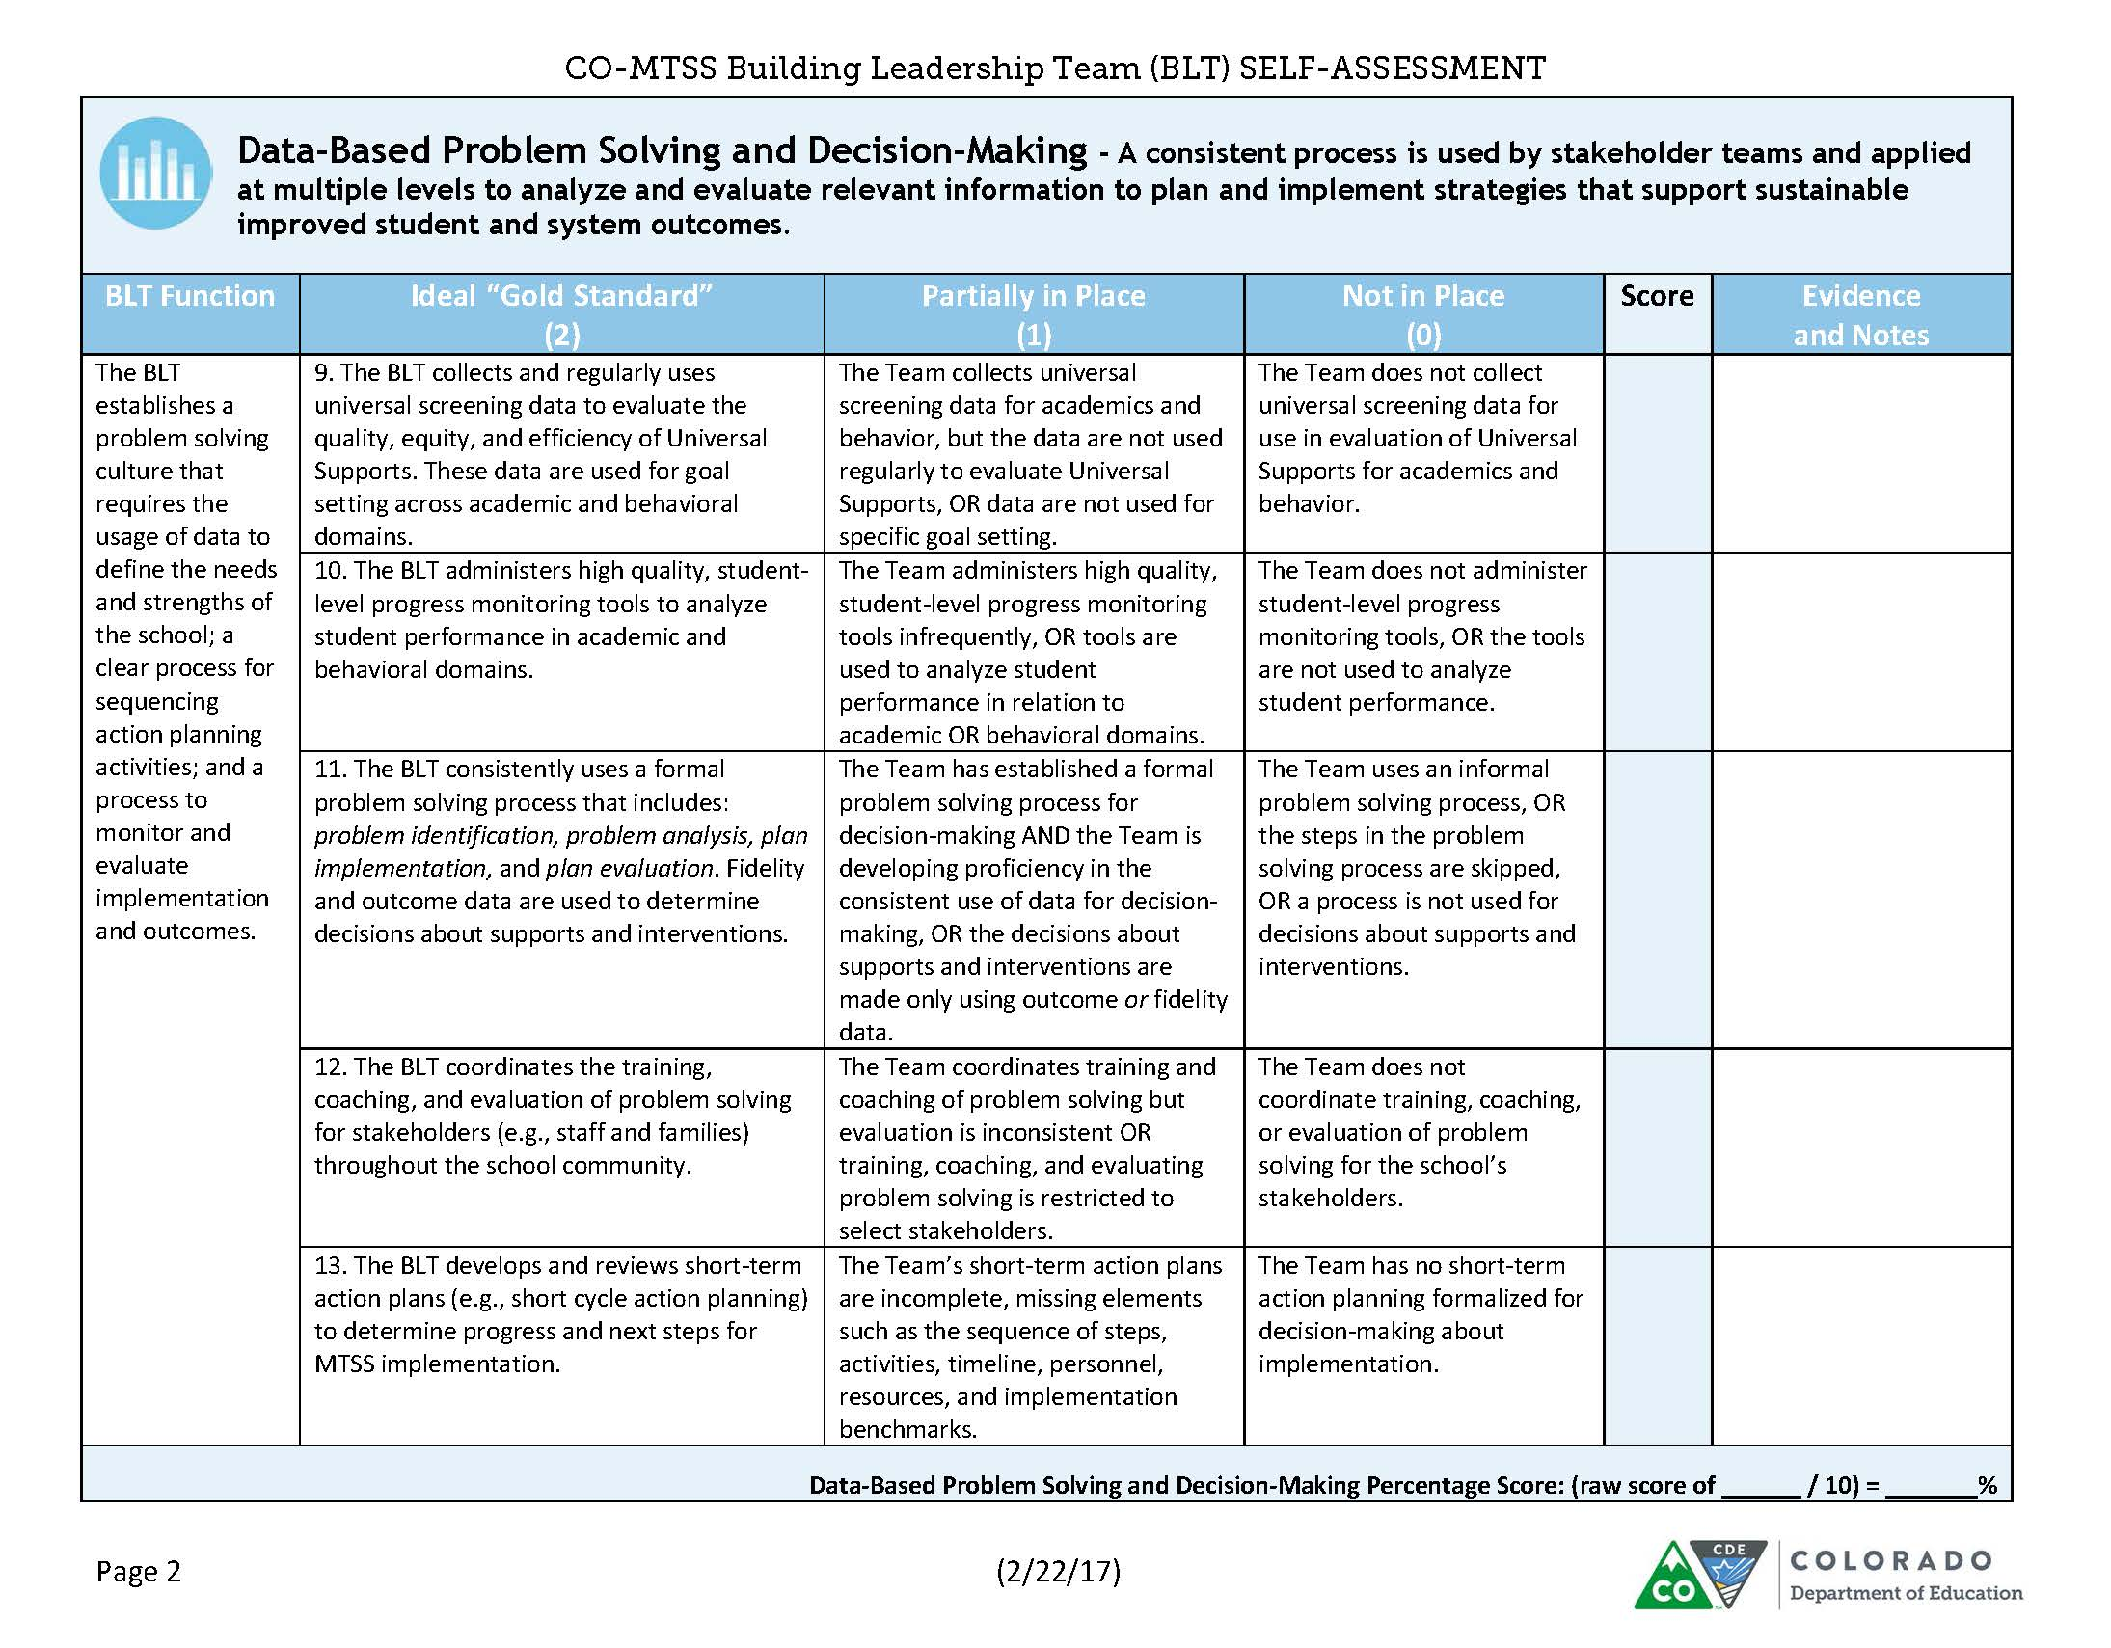
Notes:
Data-Based Problem Solving and Decision-Making (DBPSDM) component

Slide 25
Improving Decision-Making via Problem Solving
Problem
Problem
Problem
Solving
Solution
Solution
Action Planning & Evaluation
Information & Data
Adapted from Rob Horner
Notes:
It’s not just “problem > solution” track.
We need “problem solving” to begin.
It is a ‘recursive’ process, as we note data and how to respond.

Slide 26
Problem Solving: Levels of Application
Problem solving can be applied to the student, classroom, building, district, and system levels, such as:
  Student: academic and/or behavior issues
  Classroom: discipline, returning homework
  Grade Level: low academic skill performance
  Building: bullying, attendance
  District: over-/under-representation
  SYSTEM: problem common to students
  in building/program
Notes:
These are Levels at which Problem Solving can occur and is also a good reminder that Problem Solving is not just for individual students.
Prompt: If you have teams who are doing PS, think about “what are the levels of application” that your teams are doing for PS.
LEVEL of implementation does NOT equal “level” as in Tier 1, 2, or 3;
These multiple LEVELs of application allow us to see how we can be thinking of this conversation in contexts that aren’t reserved for Individualized Student discussions.

Slide 27
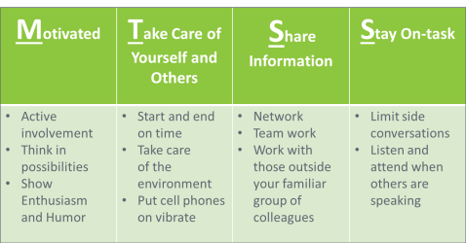

Practices for Teams
Schedules, Agendas,& Norms
Function/Purpose
Roles/Responsibilities
Membership: Invest in Shared Leadership
Meeting Protocols (e.g., Meeting Minutes;
Consensus and Dissension; Evaluation)
Use a systematic, problem solving process
Identify gaps in system-wide processes in need of improvement
Use data-based decision making
Monitor progress toward system-wide goals
Implement evidence-based instruction and intervention
Notes:
Intentionally creating the stage to conduct problem solving can lead to effective decision making which in turn can facilitate positive student outcomes.
So, paying attention to team membership or ‘having the right people at the table’ to discuss the issue, people understanding their role and function in the specific setting for effective problem solving to occur, having formalized processes to conduct the work and framing the business of the work within acceptable norms (or how we treat each other when we work together are all critical to the success of effective problem solving.
Can you recognize these practices within your setting? If not, why not?
Remember that these effective practices, implemented well, lead to EFFICIENCY…and time is always a commodity to preserve.
Examples of decisions based on data:
Use data from universal screening to prevent problems from starting or getting worse
Use data from progress monitoring to guide daily instruction

Slide 28
Considerations when looking at (school) data
Purposes: What is the assessment intended to measure?
What does it “do” or measure?
Uses: How do educators use the instrument? Are “groups” determined as a result? May it lead to further diagnostics?
Methods: How are scores collected and reported? What are the “metrics” (i.e. scale score, percentage), and what are the increments of difference? “Is this a comparison against a criterion or in comparison to peers?” What does administration look like? What is the frequency?
Targets: What are the “best hopes”? What are the expectations? Are there “benchmarks”?
Implications: What decisions or changes may be made to Curriculum, Instruction, or Environment?
Notes:
These are possible questions to consider. If not these, which/what??? How are you making sure you know intent of data collected/analyzed?
Also, in a bigger sense, what “counts” as “data”? Has that been operationalized? (qualitative/quantitative measures, etc.) Just tools? Experiences?

Slide 29
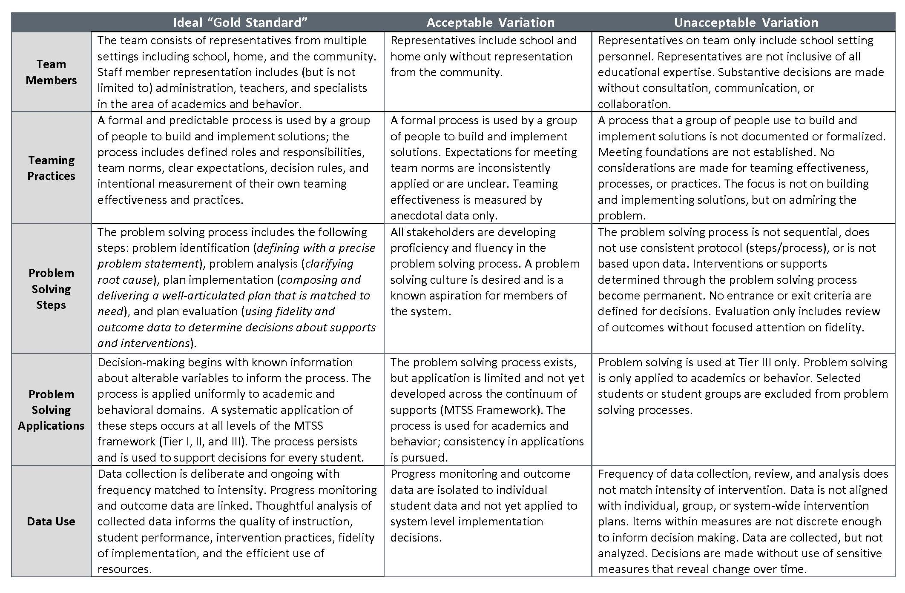
Practice Profile

Slide 30
Why? | Define the problem with Data (ensure: right time, right information, right format) and Analyze to the Root Cause
Try! | Implement: Identify plan elements - e.g., who’s responsible, timeline, resources, set short/long- term targets and desired outcomes and “just do it” (work the plan according to defined elements)
Track... | Evaluate the change in “real time” Progress Monitor - How will you know “as you go”?
Check +/- | Evaluate the change after plan completion for Impact Performance: Did we get the results we wanted? (yes/no) If no, do we need to consider fidelity? Do we need to consider re-entering problem solving or another intervention? Process: Did we do the plan as intended? Fidelity? (yes/no) If no, consider which variations caused the results (good/bad) and determine if to re-enter problem solving.

Slide 31
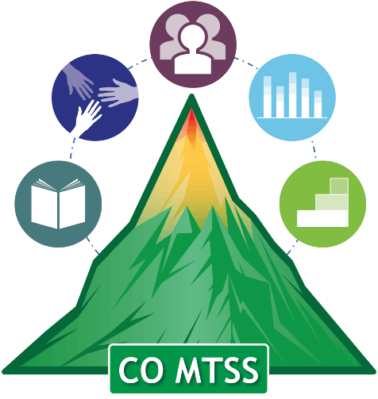

Step 1 for Implementation
What is the Gap between Desired Outcome and Actual Performance?
Precise Problem Statement
  Precise statements include specification information on:
  -What is the problem?
  -How often is the problem happening?
  -Where is the problem happening?
  -Who is engaged in the problem?
  -When is the problem most likely to occur?

Slide 32
Step 2: A Shift in Thinking
What about the interaction of the curriculum, instruction, learners, and learning environment should be altered so that the student(s) will learn?
What about the student is causing a problem?
STOP
Instead
This shift alters everything else!
Adapted from Batsche and Elliott materials (citing Ken Howell)
Notes:
A major conceptual shift. This puts the problem in the context of alterable variables and moves it outside of the student. When the focus of team meetings is on the discovery of instructional changes that will enable learning, the content of the meeting is quite different from one focused on the discovery of a disability.
Allowing time for discussion of this slide can bring about significant “aha”s.
*Remember our MTSS approach where we are focusing on what we can do or what supports (i.e. instructional changes) we can put in place (RtI triangle) to help the student be successful. This is a major conceptual shift. This puts the problem in the context of alterable variables and moves it outside of the student
FSCP Ideas:
Use of out-of-school time is considered a major factor in the achievement gap; and can be altered with family and community partnering; coordinated before and after-school programs, summer learning, homework support, technology access – and their interaction with the other variables can be influential

Slide 33
Most Common Functions of Behavior
To Obtain/ Get :
Peer attention
Adult attention
Desired activity
Desired object/ items
Sensory stimulation: auditory, tactile, etc.
To Avoid/ Escape:
Difficult Task
Boring Task
Easy Task
Physical demand
Non-preferred activity
Peer
Staff
Reprimands
Adapted from Sheldon Loman and Chris Borgmeier “Practical FBA”
Notes:
These are the most common functions of behavior. All functions of behavior can be put under two specific categories – either Get or Avoid.

Slide 34
What exactly IS a trauma-sensitive school?
All staff understand the prevalence and impact of trauma of their students and themselves.
School strives for physical, emotional, social, academic safety for all.
The school addresses holistic student needs.
The school is inclusive and connects students to the community instead of excluding them.
The school staff work collaboratively to support students.
School leaders adapt services and supports based on contemporary needs of students.
Notes:
The focus of Trauma Informed Care is in the recognition, understanding, and responsiveness to trauma with explicit efforts made in restoring emotional safety, building healthy relationships, and creating positive opportunities where students can practice self-regulation strategies and prosocial skills.

Slide 35
What can you “alter” within your system? What is within your control? (consider: adult/child)
Curriculum
Environment
Instruction
Notes:
These are the “alterable variables”.
Remember that we can apply these to our learning experiences for adults and for children. (all learners)

Slide 36
Step 3
Core Features (If you were to walk into a school, can you determine if the practice is in place?)
For whom is the practice intended?
Who should use the practice?
How is it to be delivered?
What are the expected outcomes?
Is there peer-reviewed research supporting the effectiveness of the practice? How convincing? (Provide references)
How is fidelity measured? (Data source, method and frequency)
How is impact measured? (Data source, method and frequency)
What is the simplest thing that can be done that has the greatest impact?
Always matching support to need!

Slide 37
Feature | Description
Explicit instruction of expectations/skills | Teach the student exactly what is expected using examples and non-examples to illustrate desired behaviors (consider avoidance of “appropriateness”). Typically: Define behaviors, role play, and cite feedback for initial and ongoing implementation.
Structured prompts for behaviors | This might include reminders of expected behaviors, visuals, or cues on a point card.
Opportunities to practice the skills | Skill practice should be embedded throughout the school day and across [relevant] environments (and not just in an isolated instructional/skills group setting).
Frequent feedback to the student | Students should receive positive and corrective feedback at regular intervals throughout the school day on the expectations or skills being targeted (usually at least once per period or subject area). Feedback should be consistent and specific and focus on positive interactions.
Mechanism to fade support | This often involves reducing the number of times the student is prompted or receives feedback about a skill. It can also involve increasing the interval between delivery of acknowledgements (“positive referrals”) associated with success.
Communication with students’ families | Outreach to parents/families (e.g., brief notes home , daily or weekly ; phone calls, emails, post card mailers or other quick, culturally-relevant communication forms). Considerations: Content & Confidentiality & Two-way options
Adapted from CDE PBIS presentations
Notes:
The features are the salient things you’d see ... What does it look like?

Slide 38
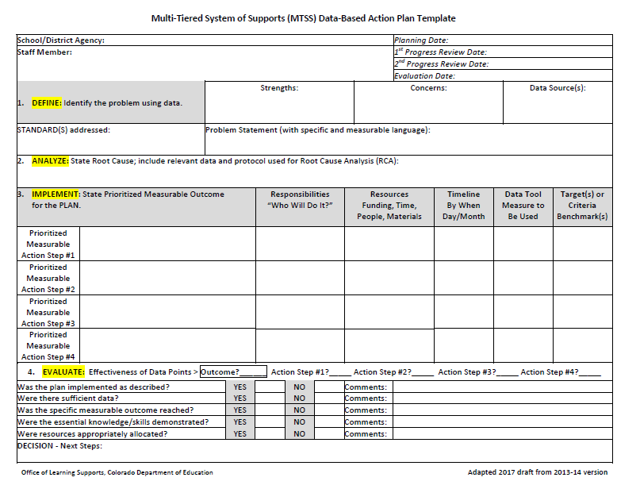

Slide 39
Step 4: Guiding Questions
Was the system support or intervention successful?
Does the plan require more time and monitoring or modification?
Was the system support or intervention implemented with fidelity?
Was the outcome met according to set criteria?
Do we have the resources to sustain these supports?
Do we need to go back to previous steps?
Celebrate progress!

Slide 40
Responses to Data: What is the impact?
(Consider fidelity & outcomes)
Done without fidelity and no growth:
restart/enter with implementation as it was planned; consider barriers to implementing [Ask: How can we reduce, eliminate, navigate barriers?]
Done without fidelity and growth: change the plan/document to reflect “what is done and
working” = assess variables; “what variations are
occurring that are resulting in gains”
Done with fidelity and no/low growth: re-enter problem solving &/or change intervention (consider changes in intensity level)
Done with fidelity and growth: continue support and/or plan to “fade” or “graduate” (celebrate progress/exit)
Notes:
Here are some potential options for you.
Listed here are 4 responses to data. It is important to look at both fidelity and outcomes.

Slide 41
Resources
CDE ESSU: IEP Resources: http://www.cde.state.co.us/cdesped/
iep_resources
National Center on Intensive Interventions (NCII): http://www.intensiveintervention.org/
Substance Abuse and Mental Health Services Administration (SAMHSA), National Registry of Evidence-Based Programs and Practices (NREPP): https://www.samhsa.gov/nrepp

Slide 42

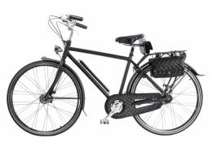
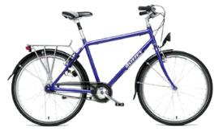
Which Bike do you Like?
Adapted from original slide from: U.S. Department of Education (Family Engagement)
Notes:
See how there are “essentials” (every bike has a seat, handlebars, tires) > those are the “components” needed (just as in our framework), but each can be “customized” for need/fit/context.
*This framework consideration originated from discussion on FSCP, but you can see the same needs within MTSS implementation.

Slide 43
What are you personally “planning” to impact?
See Action Planning Handout:
What would you like to see “in place”? (Pick any duration)
30 Days
60 Days
90 Days
Notes:
(variation as handout)

Slide 44

For more information:
http://www.cde.state.co.us/mtss
Materials online:
http://www.cde.state.co.us/mtss/adultlearningopportunities

