Slide 1
Virtual Winter Regional Network Meeting
Federal Programs and Supports Unit
2023

Slide 2

CDE Introductions
Nazie Mohajeri-Nelson: Executive Director
Laura Meushaw: Program Implementation Supervisor and ESEA Title I Coordinator
Christina Adeboye Sullivan: Program Implementation Coordinator
Evita Byrd: ESEA Title I Specialist
Rachel Echsner: ESEA Title I and II Specialist
Rachel Temple: ESEA Title III Specialist
Shannon Wilson: ESEA Title V Specialist and ESSER Grants Administration Coordinator

Slide 3
Objectives and Agenda
Objectives:
Understand important updates from FPSU, including the 23-24 Consolidated Application
Know the steps to plan for and implement activities that respond to student needs using federal funds
Build knowledge of allowable uses of federal funds
Identify evidence-based interventions to meet student needs
Reflect on past programming and plan for future activities using federal funds
Agenda:
Updates from FPSU
  Transition Year Application
  Due Dates & Timelines
  Free and Reduced Lunch Count Update
  Comprehensive Support and Improvement - Year 4
  CDE Monitoring
Planning Cycle
  Guidance & Examples for Each Step
Resources
Questions

Slide 4
Meeting Norms and Logistics
Take advantage of the time to collaborate with your own team members and colleagues from other LEAs.
Ask Questions! Feel free to ask questions throughout the presentation. We will also pause after each section for questions.
Share your experiences and learn from your colleagues.
Use the work time to reflect on your current practices and plan for next school year. You can do this individually or collaboratively.
Let us know if there are other topics or questions you want to discuss while here or on upcoming office hours.

Slide 5

Who is here?
Type in the chat:
Name
District or BOCES
Position
How long have you been working with federal programs?

Slide 6
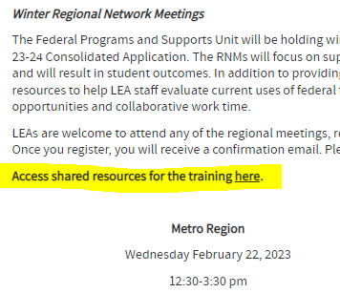
Accessing Meeting Resources
Slides and resources for this meeting can be found on the Regional Network Meeting website:
https://drive.google.com/drive/folders/12ahe6K1-wg_tP9E9elkMnG-0KDuTBlRi
Resources in folder:
  Slidedeck
  Allowability guiding questions
  Note Catcher
Copy slides and resources into your own drive to edit and take notes

Slide 7
Updates

Slide 8
2023-2024 Consolidated Application
(Transition Year)
The transition application will
Look like a Year 1 application
Majority of questions will be the same as last year
LEAs can use narrative responses from prior years, compose a new response, or use a “canned” comment
Include all budget sections and some required narratives
Only October Count 2022 will be prepopulated; LEAs may use other data sources as necessary (i.e., CEP, TANF, Medicaid)
Available beginning of April

Slide 9
2023-2024 Consolidated Application (Transition Year)
Module A - all sections
Cross Program
  3.3. Consultation with stakeholders in developing proposed activities with Title III funding (only appears if the LEA has a Title III allocation)
  4.1. Describe outreach to parents and families of English Learners on their involvement in the academic progress of their students
Title I, Part A
  2 - Discuss support for Homeless students
  5 - 5.5: Address any gaps identified through the Equitable Distribution of Teachers data. For more information visit CDE's Equitable Distribution of Teachers webpage. Note: only appears if the LEA has medium to large gaps.
  Budget
Title I Targeted Support and Improvement
  All questions required if LEA has schools identified as Targeted and/or Additional Targeted Support and Improvement

Slide 10
2023-2024 Consolidated Application
(Transition Year)
Title ID (will only appear if the LEA has delinquent facilities)
  2.2 Describe formal agreements between the LEA and correctional facilities or alternative school programs
  3.1 Describe how participating schools facilitate successful transition
  Budget
Title II, Part A (narrative will only appear if the LEA has CS, ATS, and/or TS schools)
  Complete table describing the prioritization of Title II funds to support CS, ATS, and/or TS schools
  Budget
Title III (narrative will only appear if the LEA receives a Title III allocation)
  Complete the tables to describe how professional development is funded
  Budget
Title IV
  Narratives will not be required and will be hidden
  Budget

Slide 11
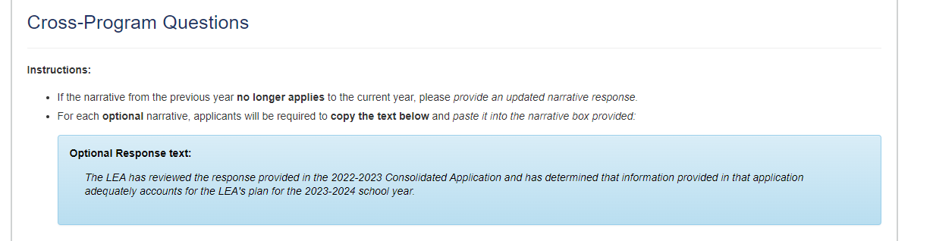
2023-2024 Application Instructions
For each optional narrative, applicants will be required to copy the text below and paste it into the narrative box provided. If the narrative from the previous year no longer applies to the current year, please provide an updated narrative response.
- Optional
APPLICATION SCREENSHOT

Slide 12
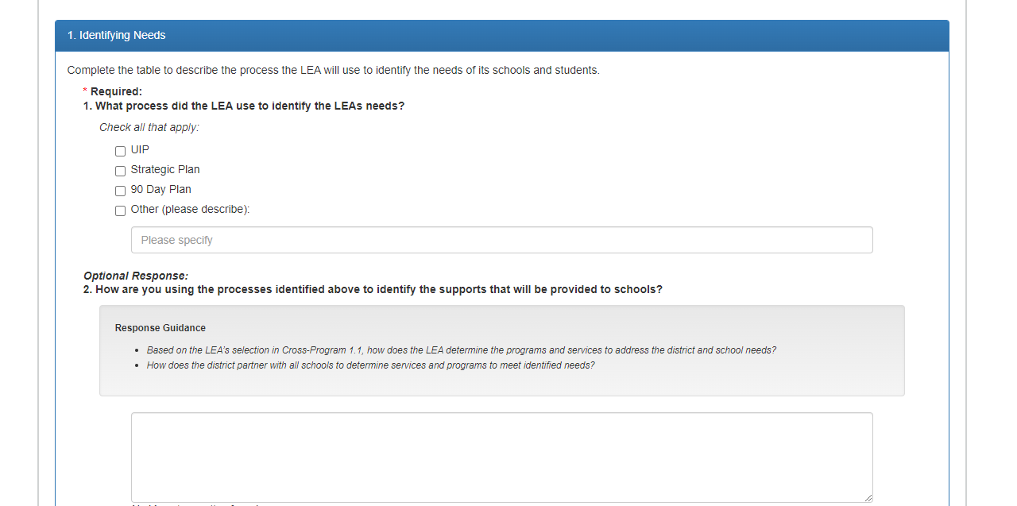
2023-2024 Application Required vs. Optional
All questions will either indicate whether a question is required or optional:
- Optional
APPLICATION SCREENSHOT

Slide 13
Due Dates & Timelines
Activity | Due Date
Preliminary Allocations Available (anticipated increase/decline) | End of March
2023-2024 Online Application Available | April
Consolidated Application “How To” Training | April/May
Non-Public School Consultation Forms and School Improvement Retention of Funds Form | May 31
Approval and Transmittal Form, BOCES Member District ARAC Form and Native American Education Tribal Consultation Form - Submit to the Consolidatedapplications@cde.state.co.us (as applicable) | June 30
Online Application | June 30

Slide 14
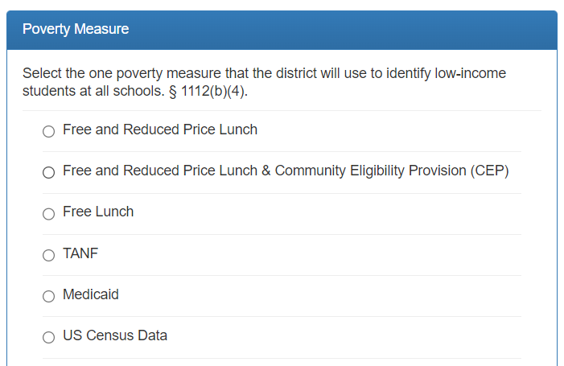
Poverty Measure Update
For 2023-2024,
Only the 2022-2023 poverty data
Same poverty measure options as prior years and afforded by the law
2022 October Count will be the only data source for FRL pre-populated into the system
Resources:
Department of Education, Within-District Allocation Guidance (Feb. 2022)
Healthy Meals for All information

Slide 15
Comprehensive Support and Improvement (CS) UIP Review Feedback Update
CS UIPs reviewed:
CS Year 4
Dual Identification State/Federal
Schools in districts monitored during 22-23
CS UIPs not reviewed:
Any plan not listed in above categories
Any approved CS plan from a previous year
Feedback available: Now available in UIP system
What happens next:
LEAs review and address feedback provided by CDE
CS Year 4: Address feedback and resubmit incorporating revisions from feedback before April 28, 2023 for review this school year
All others: Incorporate feedback when plan is submitted next school year (23-24)
If plan was not selected for review this year: Option to request a review; LEA agrees to address feedback when plan is submitted next school year (23-24); contact Tammy Giessinger or Karen Bixler
Resources for CS UIPs
CS Identification website
CS UIP Trainings and Planning Requirements
Resource Inequities Requirements Evidence-Based Interventions (EBI) Requirements
Karen Bixler: bixler_k@cde.state.co.us
Tammy Giessinger: Giessinger_T@cde.state.co.us

Slide 16
CS Year 4 Update
The Every Student Succeeds Act (ESSA) requires that each state that accepts funds under ESSA have a plan approved by the U.S. Department of Education (ED) for taking more rigorous action for schools that have been identified for Comprehensive Support and Improvement (CS) for four or more years.
Timeframe | Activities
August | After accountability notification letters about SPFs and ESSA identifications are sent, CDE will Develop and share a CS-Y4+ ESSA School Profile that outlines the services awarded through EASI so far Continue discussing with district options for EASI support if not previously engaged.
October | Review the school’s CS UIP for ESSA approval, if not already approved.
Feb/March | Convene schools for a preliminary CS-Y4 meeting.
Late spring | Convene schools for a co-planning meeting to identify evidence-based strategies to continue and which ones need to be changed in the UIP by the next October submittal.

Slide 17
CDE Monitoring Status Update
Completed
Most reports for 21-22 monitoring cycle have been finalized
Analyzing common monitoring findings from 21-22
PARs
Policies and Procedures
Schoolwide Plans
CS UIP Approvals
Upcoming
Reaching out to LEAs if more information is needed than what was provided on the self-assessments
Desk reviews and onsite visits of selected LEAs
Drafting and finalizing reports for 22-23 monitoring cycle
Happening Now
Self-Assessment Submissions from LEAs who were granted extensions
CDE Team reviewing submitted self-assessments
Planning TA based on 21-22 monitoring findings

Slide 18
Questions?

Slide 19
Planning Cycle
Purpose: To create a Consolidated Application that is driven by student needs and will result in improved student outcomes

Slide 20
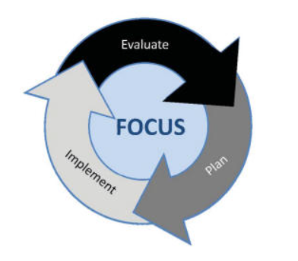
Continuous Improvement Cycle
We will present a continuous improvement cycle for Federal Programs based on the Unified Improvement Plan continuous cycle
Overall cycle:
  Evaluate performance by gathering, analyzing, and interpreting data
  Plan strategies based on data, root cause analysis, and evidence-based strategies
  Implement planned strategies
  Throughout the process, focus attention on student needs

Slide 21
Planning Cycle for Federal Funds
Conduct CNA and identify local needs
Monitor implementation and effectiveness of programming
Consider potential evidence-based strategies to address needs
Adjust implementation based on actual data
Implement plan to address needs
Use guiding questions to determine allowability and appropriate funding source
Finalize Plan

Slide 22
Planning Cycle for Federal Funds
Conduct CNA and identify local needs
Monitor implementation and effectiveness of programming
Consider potential evidence-based strategies to address needs
Adjust implementation based on actual data
Implement plan to address needs
Use guiding questions to determine allowability and appropriate funding source
Finalize Plan

Slide 23
Internally Monitor Implementation and Effectiveness of Programming
Internal Monitoring
LEAs should monitor the implementation and effectiveness of the activities funded with federal funds to:
Ensure that programs are being implemented with fidelity
Make program adjustments to meet the needs of students, based on data
Determine if activities are resulting in improved student performance
Ensure that statutory requirements are being met, including any recommendations or corrective actions identified through prior monitoring processes
Answer questions about the value of the program and the investments being made.
CDE Monitoring
CDE formally monitors LEAs to ensure compliance with statutory requirements
LEA’s internal monitoring is key to success when being monitored by CDE
CDE’s monitoring process begins with an LEA self-assessment where LEAs will describe their internal monitoring process

Slide 24

Program Self Reflection
In a breakout room, share out:
What is one program your district is funding with this year’s Cons App?
  Is the program having the desired outcome?
  Is it supporting the student needs it was intended to address?
  What evidence is available that demonstrates effective implementation?

Slide 25
Planning Cycle for Federal Funds
Conduct CNA and identify local needs
Monitor implementation and effectiveness of programming
Consider potential evidence-based strategies to address needs
Adjust implementation based on actual data
Implement plan to address needs
Use guiding questions to determine allowability and appropriate funding source
Finalize Plan

Slide 26
Conduct Comprehensive Needs Assessment and Identify Local Needs
What is the
Comprehensive Needs Assessment?
How is the CNA related to
ESEA Programs?
Title I, Part A
Title I, Part C
Title II, Part A
Title IV, Part A
A CNA is a process that is used to identify needs and performance challenges in a school or district, determine their root causes, and set priorities for future action.
Many ESEA Programs require LEAs to conduct a CNA annually to identify needs and connect performance challenges to the purposes of various ESEA programs.
How can CNA data inform planning for ESEA programs?
How can CNA data inform local
ESEA program evaluation?
The CNA is a source for several data points including data related to performance challenges, root causes, and actions to address those challenges.
Schools and districts can use data associated with the challenges and actions chosen to address those challenges to evaluate the program.

Slide 27

Stakeholders
Consulting with stakeholders is an essential part of the planning, implementation, and evaluation processes.
Stakeholders may include:
District and School leaders
Teachers
Students
Families
Community organizations that serve students
How are stakeholders engaged in the process of determining the needs of the LEA, creating an ESEA Plan, and developing proposed activities for Title funding?

Slide 28
Planning Cycle in Action: Conduct Comprehensive Needs Assessment and Identify Local Needs
EXAMPLE
An example district has collected data from various sources to identify their needs.
Comprehensive Needs Assessment
Low Math Scores
Stakeholder Input
Local Data
Based on the data collected, this district has identified the need to address below-grade-level math scores. They identified one root cause as teachers lacking strategies for effectively teaching number sense.

Slide 29

Jamboard Activity
Question 1: What data sources does your LEA use to determine needs? Try to think beyond testing data.
Question 2: What are some of the needs that your LEA has identified? What may be the root causes of those needs?
Add your own thoughts to the jamboard and read and respond to your colleagues’ thoughts.

Slide 30
Planning Cycle for Federal Funds
Conduct CNA and identify local needs
Monitor implementation and effectiveness of programming
Consider potential evidence-based strategies to address needs
Adjust implementation based on actual data
Implement plan to address needs
Use guiding questions to determine allowability and appropriate funding source
Finalize Plan

Slide 31
Consider or Reconsider Potential Evidence-Based Strategies to Address Need
Guiding Question: What evidence-based strategies can be used to address the identified needs?
LEAs should use Evidence-Based Strategies because:
The Every Student Succeeds Act (ESSA) requires that evidence-based strategies be incorporated into improvement plans
Using available solutions and interventions decreases the effort needed to “reinvent the wheel” and increases chances of success.
Note: For schools and districts that will continue to implement evidence-based strategies, the school/district will want to monitor the implementation and effectiveness of any strategy to ensure desired outcomes.

Slide 32
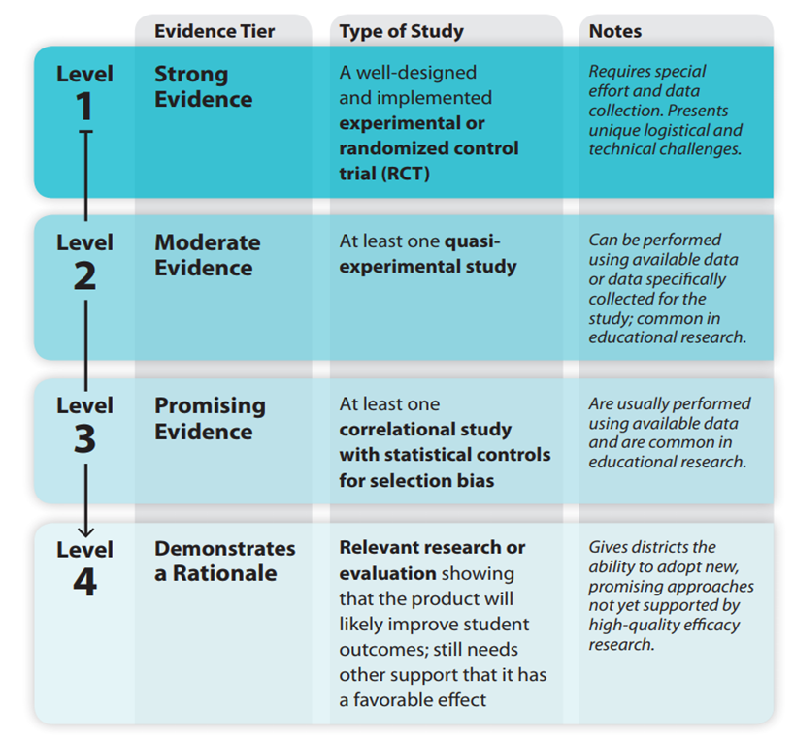
ESSA Levels of Evidence

Slide 33
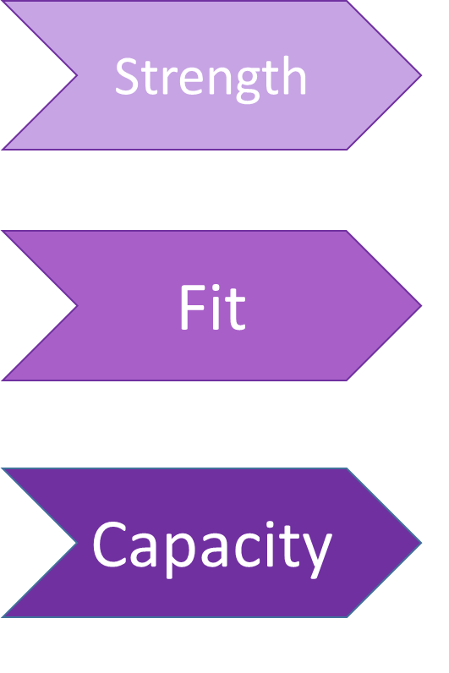
Additional Questions When Selecting A Strategy
Is the strategy clearly defined and supported by high quality research?
Does the strategy address needs and root causes and align to staff and competencies?
Is there leadership support, resources, and necessary time for implementation?

Slide 34
Resources for Finding EBIs
CDE Major Improvement Strategies Guides
  Attendance Strategy Guide 2.0
  Coaching Strategy Guide 2.0
  Data Driven Instruction Strategy Guide 2.0
  Family-School-Community Partnerships (FSCP) Strategy Guide 2.0
  High Dosage Tutoring Strategy Guide 2.0
  Professional Learning Communities (PLC) Strategy Guide 2.0
  Trauma-Informed Education Strategy Guide 2.0
What Works Clearinghouse from USDE
Best Practices Clearinghouse from USDE
Root Cause Analysis Information

Slide 35
Planning Cycle in Action: Consider Potential Evidence-Based Strategies to Address Need
The example district has brainstormed ideas to meet the need for more effective math strategies:
EXAMPLE
Proposed Intervention | Strength | Fit | Capacity
Hire a math interventionist at the lowest performing schools | X | X
Hire instructional coaches at lowest performing schools | X | X | X
Host a family engagement pizza night to teach families helpful math strategies to use at home |  |  | X

Slide 36

10 Minute Break

Slide 37
Planning Cycle for Federal Funds
Conduct CNA and identify local needs
Monitor implementation and effectiveness of programming
Consider potential evidence-based strategies to address needs
Adjust implementation based on actual data
Implement plan to address needs
Use guiding questions to determine allowability and appropriate funding source
Finalize Plan

Slide 38
Use Guiding Questions to Determine Allowability and Appropriate Funding Source
The following slides include guiding questions to determine allowability for:
Title I: Improving the Academic Achievement of the Disadvantaged
Title II: High Quality Teachers and Principals
Title III: Supports for English Learners
Title IV: Student Support and Academic Enrichment
Title V: Rural Education Achievement Program
These guiding questions can be used to determine the appropriate funding source for a proposed program and guide internal monitoring.

Slide 39

Overarching Guiding Questions for Allowability
These guiding question will help your LEA determine allowability under ESSA Titles I through V:
Is there a clear, identifiable connection between this use of funds and a need identified on your Comprehensive Needs Assessment?
  When applicable, does this use of funds address the reasons for a school’s ESEA school improvement identification or a resource inequity?
Does this use of funds strengthen the academic program at your school through evidence-based instructional methods and strategies?
Is this use of funds supplemental to the strategies and methods available to the LEA through non-federal funds?
Is this use of funds reasonable and necessary?

Slide 40
Title I Allowability -
Targeted Assistance Program
Purpose: To provide resources to LEAs to ensure that all children have a fair, equitable, and significant opportunity to obtain a high-quality education and close educational achievement gaps. Funds target low achieving students only.
Guiding Questions: Will this use of funds…
Address the needs of students at risk of not meeting State academic standards?
Increase the amount of quality learning time for Title I students?
Provide an enriched or accelerated curriculum contributing to a well-rounded education for Title I students?
Allowable Examples:
Teaching assistant or interventionist salary
Extended learning opportunities (i.e., tutoring, summer school)
Intervention materials or software
Monitoring Considerations:
Identification of students for participation
Minimizing removal from regular classroom
Title I Annual Meeting
Parent’s right to know teacher qualifications
Annual report to the public
Parent and family engagement
Equitable distribution of teachers (EDT)
Targeted assistance program evaluation

Slide 41
Title I Allowability - Schoolwide Program
Purpose: To upgrade the entire educational program in a Title I school in order to improve the achievement of the lowest-achieving students so that all children have a fair, equitable, and significant opportunity to obtain a high-quality education and close educational achievement gaps.
Guiding Questions: Will this use of funds…
Address the needs of all students in the school, particularly students at risk of not meeting State academic standards?
Increase the amount of quality learning time for students?
Provide an enriched or accelerated curriculum contributing to a well-rounded education?
Allowable Examples:
Instructional coach salary
Parent and family engagement
Classroom books aligned with READ Act
Supplies for hands-on learning
Monitoring Considerations:
Comprehensive Schoolwide Plan
Title I Annual Meeting
Parent’s right to know teacher qualifications
Annual report to the public
Parent and family engagement
Equitable distribution of teachers (EDT)
Schoolwide program evaluation

Slide 42
Title II Allowability
Purpose: Improve the quality and effectiveness of educators, increase the number of educators who are effective in improving student academic achievement in schools, and provide low-income and minority students greater access to effective educators which would lead to increased student academic achievement consistent with the challenging State academic standards.
Guiding Questions: Will this use of funds…
address the learning needs of all students, including children with disabilities, English learners, and gifted and talented students?
help recruit and retain qualified teachers, principals and other school leaders?
contribute to a system of professional growth and improvement for educators?
offer opportunities to develop teacher and principal leadership?
prioritize schools implementing targeted, additional targeted or comprehensive support and improvement activities, and among those schools, have the highest percentage of children identified as low income?
improve the equitable access to effective, qualified, and experienced teachers for any low-income and or/minority students enrolled in schools assisted by Title I, Part A funds?
Allowable Examples:
Providing high-quality, personalized professional development that is evidence-based.
Developing and implementing initiatives to assist in recruiting, hiring, and retaining effective teachers, recruiting qualified individuals from other fields to become teachers, principals, or other school leaders.
Developing or improving a rigorous, transparent, and fair evaluation and support system for teachers, principals or other school leaders.
Monitoring Considerations:
Funds are directly connected to needs of students that have been identified through a comprehensive needs assessment with consideration to content areas, grade levels, and student populations.

Slide 43
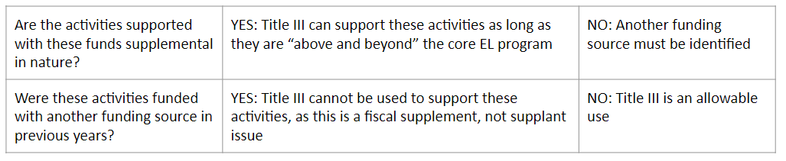


Title III Allowability
Purpose: Title III is a supplemental grant under the ESEA that is designed to improve and enhance the education of English learners (ELs) in becoming proficient in English, as well as meeting the Colorado Academic Content standards. The Title III Immigrant Set-Aside grant resides within this program and provides opportunities for LEAs to enhance the instructional opportunities for immigrant students and their families.
Helpful Guidance:
Non-Allowable Examples:
WIDA Screener, ACCESS 2.0: LEAs cannot use Title III to purchase these materials, train teachers, or provide FTE/subs/release time to administer assessments.
Required FTE or resources for ELD or core content programming
Using Title III to pay for ELs to participate in an activity paid for with local funds for other students.
Translation/interpretation: Communication regarding the student’s academic successes/challenges or health and safety needs to be translated using general funds (Small Bite video coming soon)
Monitoring Considerations:
Procedures for identification and redesignation of English Learners
Parent and family engagement
Annual English language proficiency assessment
Demonstration of how funds are used for supplemental activities

Slide 44
Title III Allowability Cont.
Allowable Examples:
Supplementary educational programs that work to increase English language proficiency and academic achievement of English learners Multilingual Learners.
Providing effective supplemental language instruction educational programs that meet the needs of of ELs/MLLs including early childhood programs that demonstrate success in increasing English language proficiency and student academic achievement.
Providing professional development that is sustained, intensive, collaborative, job-embedded, data-driven, and classroom-focused.
Tutorials and supplemental materials (including home language) for ELs/MLLs.
Promoting parent, family, and community engagement through community participation programs, family literacy services and parent outreach and training activities to ELs/MLLs and their families.
Upgrading EL/MLL programs’ objectives and effective instruction strategies.
Improving the instruction programs for ELs/MLLs by identifying, acquiring, and upgrading curricula, instructional materials, educational software, and assessment procedures.
Early college high school or dual enrollment programs for ELs/MLLs.
Improving instruction, including the provision of educational technology, for all EL/MLL subgroups.

Slide 45
Title IV Allowability
Purpose: To improve students’ academic achievement by increasing the capacity of States, local educational agencies (LEAs), schools, and local communities to provide all students with access to a well-rounded education, improve school conditions for student learning, and improve the use of technology in order to improve the academic achievement and digital literacy of all students.
Guiding Questions: Will this use of funds…
address a need in one of the three content areas?
  Well-Rounded Education
  Safe and Healthy Students
  Effective Use of Technology
strengthen the academic program of the school?
prioritize schools that have the highest percentages or numbers of low-income students or that are identified for targeted or comprehensive support?
Allowable Examples:
STEM programs
Music and art programs
School-based mental health services
Drug and violence prevention activities
Improving school dropout and reentry programs
Blended learning
Professional development for the use of technology
Monitoring Considerations:
Alignment of activities to content areas
Content-area distribution requirements
Program evaluation
Demonstration of how funds are used for supplemental activities

Slide 46
Title V Allowability
Purpose: To address the needs of rural school districts that may lack the resources needed to compete effectively for Federal competitive grants and receive formula grant allocations in amounts too small to be effective in meeting their intended purpose.
Title V funds can be used for any of the following:
Activities authorized under Title I, Part A (Improving Basic Programs Operated by Local Education Agencies)
Activities authorized under Title II, Part A (Supporting Effective Instruction)
Activities authorized under Title III (Language Instruction for English Learners and Immigrant Students)
Activities authorized under Title IV, Part A (Student Support and Academic Enrichment)
Parental and family engagement activities
Allowable Examples:
Paying for .5 FTE of an instructional coach that is .5 funded through Title I
Sending an additional number of staff to a professional development funded through Title II
Hiring a part-time Art teacher to support Well-Rounded Education
Monitoring Considerations:
Alignment to allowable use under identified Title program
Demonstration of how funds are used for supplemental activities
Note: Title V includes two grants, SRSA (application released from USDE in ~Feb.) and RLIS (added to ConsApp in ~August)

Slide 47
Reasonable and Necessary
Activities funded with ESEA funds must be reasonable and necessary.
All expenditures should be addressing an identified need generated from the Comprehensive Needs Assessment.
Regulations require that a prudent person would believe that the expense is reasonable and a cost-effective way to do business/meet the need. Oftentimes, paying fair market value for an item/activity in an area is considered a reasonable expense.
To demonstrate the reasonableness of an expense, include:
  Cost comparisons from various vendors or websites
  Cost comparisons to same items purchased in previous years
  Cost comparisons to similar expenses within the geographic area (e.g., salaries for similar positions within the district or region)
  Cost comparison to same item purchased/funded through non-federal funds
  Research conducted on various vendors/providers
  Written LEA policies/protocols for determining cost-effectiveness

Slide 48

Planning Cycle in Action: Use Guiding Questions to Determine Allowability and Appropriate Funding Source
Using the guiding questions for each Title, the example district has determined the following allowability for their proposed programs:
Hire a math interventionist at the lowest performing school
  Allowable under Title I, Part A
Hire instructional coaches
  Allowable under Title I, Part A or Title II, Part A
Host a family engagement pizza night to teach families helpful math strategies to use at home
  If the district chose this program, they would be required to pay for dinner with non-federal funds
EXAMPLE

Slide 49
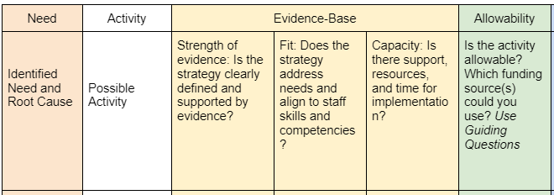
Planning for Federal Funds: Note Catcher
Planning resource to help LEAs and schools consider possible activities for federal funding
Use this tool to brainstorm additional activities at the district level or share it with school leaders
Access the guiding questions resource from the shared folder
Make a copy of note catcher document from the shared folder
Today’s goal: Fill out one row with a potential activity idea

Slide 50

Activity/Work Time
Consider activities you may want to add/continue in your 22-23 ConsApp in order to respond to LEA needs.
Join a breakout room relevant to the activity you chose.
Fill out the YELLOW and GREEN sections of the note catcher to consider whether this activity meets requirements, will work in your local context, and is allowable.
Share out in your group: What is one activity that you are considering? How well does it fit your LEA needs? What funding source(s) will you use?
Topics:
Staffing
Curriculum & Technology
Extended Learning Time
Social and Emotional
Professional Development

Slide 51
Planning Cycle for Federal Funds
Conduct CNA and identify local needs
Monitor implementation and effectiveness of programming
Consider potential evidence-based strategies to address needs
Adjust implementation based on actual data
Implement plan to address needs
Use guiding questions to determine allowability and appropriate funding source
Finalize plan

Slide 52

Make a Plan Using Evidence-Based Strategies
The plan should:
Be based on the LEA’s CNA (e.g., UIP, 90 Day Plan, Strategic plan, S-CAP, other)
Utilize evidence-based strategies and interventions
Include allowable, reasonable, and necessary activities
Include an evaluative measure(s) for the effectiveness of how the LEA implements the activities
Include an evaluative measure(s) for the effectiveness of the activities on improving the academic achievement of students
Consider any barriers for specific populations (gender, race, national origin, color, disability, or age) and make a plan to support these groups– You will use this to create your GEPA statement in the Consolidated Application

Slide 53
Planning Cycle in Action: Make a Plan Using Evidence-Based Strategies
After determining allowability and the EBI Level through assessing the strength, fit and capacity of their proposed programs, the example district has decided to hire instructional coaches to help implement effective math strategies.
EXAMPLE
Interventionists
Allowable
Evidence-Based
Instructional
Coaches
Meets Needs

Slide 54
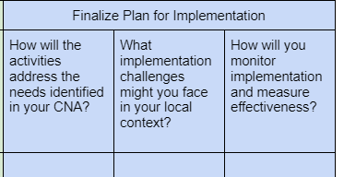
Activity
Work Time
Return to your breakout room
Reflect on the plan for your LEA and local context by filling out the BLUE boxes on the note catcher.
  How will the activities address the needs identified in your CNA?
  What implementation challenges might you face in your local context and what would be necessary to overcome those challenges?
  How and when will you measure the effectiveness of implementing the activities and the effectiveness of activities on student outcomes?
Topics:
Staffing
Curriculum & Technology
Extended Learning Time
Social and Emotional
Professional Development

Slide 55
Planning Cycle for Federal Funds
Conduct CNA and identify local needs
Monitor implementation and effectiveness of programming
Consider potential evidence-based strategies to address needs
Adjust implementation based on actual data
Implement plan to address needs
Use guiding questions to determine allowability and appropriate funding source
Finalize Plan

Slide 56
Planning Cycle in Action: Implement Plan to Address Needs
EXAMPLE
The example district has hired an instructional coach to focus on math for each of their elementary schools using Title I, Part A funds.
New Strategies
Data Cycles
Improved Scores
The Instructional Coach will partner with teachers to conduct data cycles around math achievement and student growth during teacher’s mid-day plan time.
The Instructional Coaches will work with teachers to plan for and implement new, more effective math strategies.
As a result of consistent implementation and data monitoring, math scores at the school and in the district will improve.

Slide 57
Planning Cycle for Federal Funds
Conduct CNA and identify local needs
Monitor implementation and effectiveness of programming
Consider potential evidence-based strategies to address needs
Adjust implementation based on actual data
Implement plan to address needs
Use guiding questions to determine allowability and appropriate funding source
Finalize Plan

Slide 58

Monitor Implementation and Adjust
LEAs must internally progress monitor Title activities, and make mid-course adjustments as necessary*, to:
Ensure that programs are being implemented with fidelity
Make program adjustments to meet the needs of students, based on data
Determine if activities are resulting in improved student performance
Ensure that statutory requirements are being met, including any recommendations or corrective actions identified through prior monitoring processes
Answer questions about the value of the program and the investments being made.
*Changes to plans over the course of the year for any ESEA-funded activities may require a Post Award Revision submission approval before changes can be made/implemented

Slide 59
Program Evaluation Resource
CDE co-developed 6 program evaluation training modules with Marzano Research.
Module Topics:
Logic Models and Evaluation Questions
Assessing the Availability and Quality of Existing Data
Identifying and Developing Data Collection Instruments
Coding, Cleaning, and Analyzing Data
Interpreting and Presenting Findings

Slide 60
Planning Cycle in Action: Monitor Implementation and Adjust
EXAMPLE
LEA Monitoring Findings:
Due to staffing and substitute shortages, the example district has been utilizing their instructional coaches to cover classrooms several days a week.
Because of this, the instructional coaches have not been able to implement consistent data cycles.
Implementation Adjustments:
The district decided to adjust their plan so the coach can meet with teachers before/after school so their data cycles will not be interrupted by an unexpected need for classroom coverage.
The district will consider a plan to recruit and retain substitutes.
The district will limit the number of days per week instructional coaches can cover classes.

Slide 61

Activity
On slides 3-5 of the jamboard, reflect on your learning from today.
Stoplight: Thinking about the 2023-2024 Consolidated Application, my LEA will…
Start:
Continue:
Stop:

Slide 62
Questions?

Slide 63
Resources
The Launchpad- Includes intros and resources for each Title program and a Year at a Glance
Federal Programs Monitoring Website - Includes CDE monitoring schedules and monitoring self-assessments
CDE Unified Improvement Planning Website
Consolidated Application Website- Include trainings and resources for completing the Cons App
6 program evaluation training modules
CDE Major Improvement Strategies Guides

Slide 64
New Resource: Small Bites
Small Bites - Short recorded videos on topics related to Federal Funding
Schoolwide Programming
Using Title III for translation/interpretation services (coming soon!)
Immigrant Set Aside
More small bites and link to come!

Slide 65

Survey
Please give us feedback on what you liked and how we can improve our regional network meetings in the future.

Slide 66
CDE Contacts
Emails: Lastname_Firstinitial@cde.state.co.us
Federal Programs & Supports (ESEA/ESSER Program Supports) | School Finance & Operations (Fiscal and Systems Supports)
Nazie Mohajeri-Nelson, Executive Director of Federal Programs & Supports Unit Program Specialists Program Implementation Supervisor: Laura Meushaw Program Monitoring Supervisor: Tammy Giessinger Program Effectiveness Supervisor: Tina Negley Program Implementation Coordinator: Christina Adeboye Sullivan ESEA Programs Specialists and ESEA Regional Contacts (assigned by district) Title I: Laura Meushaw, Evita Byrd, Rachel Echsner Title II: Karen Bixler, Rachel Echsner Title III: Rachel Temple Title IV: Tammy Giessinger, Nathan Hickman Title V: Shannon Wilson ESSER Program Specialists Kristin Crumley Jonathan Schelke Kim Boylan Shannon Wilson ESEA and ESSER Data and Reporting Specialists Tina Negley Mary Shen Mackenzie Owens Melissa Chaffin | Fiscal Specialists Jennifer Austin, Director of Grants Fiscal Management ESEA Robert Hawkins, Grants Fiscal Analyst Steven Kaleda, Grants Fiscal Analyst ESSER Fiscal Specialist Steven Kaleda Grants Fiscal Analyst ESSER Monitoring Bill Parsley, ESSER Fiscal Monitoring Supervisor Hilery Morris, ESSER Fiscal Monitoring Kristina Jones, Federal Fiscal Monitoring and Reporting Specialist Werner Hagemann, ESSER Fiscal Monitoring Specialist Application Systems Specialists DeLilah Collins, Director of Grants Program Administration Online Applications Systems Technical Support Michelle Prael

Slide 67
Common Acronyms
FPSU- Federal Programs and Supports Unit
FRL- Free and Reduced Lunch
LEA- Local Educational Agency
RLIS- Rural, Low Income Schools (Title V Grant)
RNM - Regional Networking Meeting
SRSA- Small Rural Schools Achievement (Title V Grant)
TA- Technical Assistance
UIP- Unified Improvement Plan
CNA- Comprehensive Needs Assessment
ConsApp- Consolidated Application for federal programs funding
CSUIP- Comprehensive Support and Improvement UIP
EBI- Evidence-Based Intervention
EL- English Learner
ESEA- Elementary and Secondary Education Act
ESSA- Every Student Succeeds Act

