Slide 1
Targeted (TS) and
Additional Targeted (ATS)
Support and Improvement
Planning Requirements
Colorado Department of Education
Federal Programs and Supports Unit

Slide 2
Topics Included in Today’s Training
Overview of Methods and Criteria for Identification of Targeted (TS) & Additional Targeted (ATS) Support and Improvement
Addressing TS/ATS in the Consolidated Application
Improvement Plan Requirements for Schools Identified for TS/ATS
Supports and Funding
Resources and Contacts for Support

Slide 3
ESSA Identification Overview:
Targeted (TS) and Additional Targeted (ATS) Support and Improvement
Notes:
Brief overview

Slide 4
ESSA Identification of TS/ATS
Any state that accepts funds under the federal legislation called the Elementary and Secondary Education Act (ESEA), reauthorized as the Every Student Succeeds Act (ESSA), must identify schools for support and improvement based on overall performance of the school (Comprehensive Support and Improvement), and performance of disaggregated groups (Targeted or Additional Targeted Support and Improvement).
ESSA draws more focused attention to the performance of each historically underserved student population, including students with disabilities [in Colorado, students with an individualized education program (IEP)], English learners, economically disadvantaged students (in Colorado, students who qualified for free or reduced meals), and students from major racial/ethnic groups.
Notes:
Add CS and reference other CS trainings

Slide 5
ESSA Identification of TS/ATS
All public schools enrolling students in grades Kindergarten (K) through twelfth grade may be identified, including schools that only enroll students in grades K-2.
Colorado’s identification process occurs annually.
The number of years that a school remains in the TS/ATS category is determined by the district.
  ATS schools that have been re-identified for the same student group for four years will transition into the Comprehensive Support and Improvement (CS), formerly ATS category.
Colorado publicly posts lists of schools identified for support and improvement, separately for each year of identification, on CDE’s ESSA Methods and Criteria for Identification of Schools for Support and Improvement webpage. (https://www.cde.state.co.us/fedprograms/essa_csi_tsi)
.

Slide 6
ESSA Identification of Schools for
Targeted Support and Improvement (TS)
ESSA Definition: Any schools with at least one consistently underperforming disaggregated group.
  Student Groups included in the identification methodology
    English learners
    Students with disabilities
    Economically disadvantaged students
    Students from each Major Racial/Ethnic Group
  Sub-indicators included for each of the student groups listed above
    English language arts achievement and growth, math achievement and growth, science achievement, graduation rate (for high schools), ELP growth and percent on-track to attain fluency (for English learners), and dropout rate (for high schools)
Colorado’s Method:
  Schools are identified for Target Support and Improvement (TS) if
    They have enough students in a student group to earn a rating on at least 3 sub-indicators (for additional information please see the ESSA Identification methodology document, reference table 2) for any student group at any grade span (i.e., elementary, middle, or high school)
    They earn a does not meet expectations (DNM) on at least 3 sub-indicators for any disaggregated groups at each grade span (elementary, middle, or high)
  Schools will not be identified or re-identified in subsequent years if they earn a rating above DNM (i.e., approaching, meets, exceeds) on at least one sub-indicator for a given student group would not be identified based on the performance of that student group.
  Length of Identification: Established by LEA
  Exit Criteria: Established by LEA

Slide 7
ESSA Identification of Schools for
Additional Targeted Support and Improvement (ATS)
ESSA Definition: Schools identified for ATS are a subset of TS schools with at least one disaggregated group that, on its own, meets the criteria for the CS-Lowest Performing 5%.
Colorado’s Method:
  The same data (sub-indicators), student groups, and years of data from the TS analyses are used for the Additional Targeted Support and Improvement school (ATS) analyses.
  Schools that have enough students in a disaggregated group to earn a rating on all sub-indicators, for all grade-spans served by that school (elementary, middle, high), and earned DNM on all sub-indicators at all grade spans, are identified as ATS.
Identification: Annually
Transition to Comprehensive Support (CS): ATS schools that receive Title I funds and continue to earn DNM on all indicators, for the same student group(s) that resulted in the school’s identification as ATS, for 3 consecutive years will be transitioned to CS-Chronically Low Performing Student Group(s).
Notes:
Discuss DNM and address identification in the school profile

Slide 8
Additional Information - TS/ATS Identification
For more information about TS/ATS identification, please visit Colorado’s ESSA Methods and Criteria for Identification of Schools for Support and Improvement Webpage (http://www.cde.state.co.us/fedprograms/essa_csi_tsi)
For questions about ESSA Identification, please contact
  Tina Negley, Program Effectiveness Supervisor
  Nazie Mohajeri-Nelson, Executive Director of the Federal Programs & Supports Unit

Slide 9
Addressing TS/ATS in the Consolidated Application

Slide 10
Consolidated Application
The following areas will need to be addressed in the Consolidated Application for TS/ATS identified schools.
Process for reviewing, approving and monitoring of TS/ATS plans
How the LEA will annually exit schools no longer meeting the state’s identification criteria for TS/ATS (using state’s exit criteria or have established other exit criteria).
Federal funds can be used to support improvement strategies identified in plan.
Notes:
Reiterate Cons App requirement and availability of federal funding

Slide 11
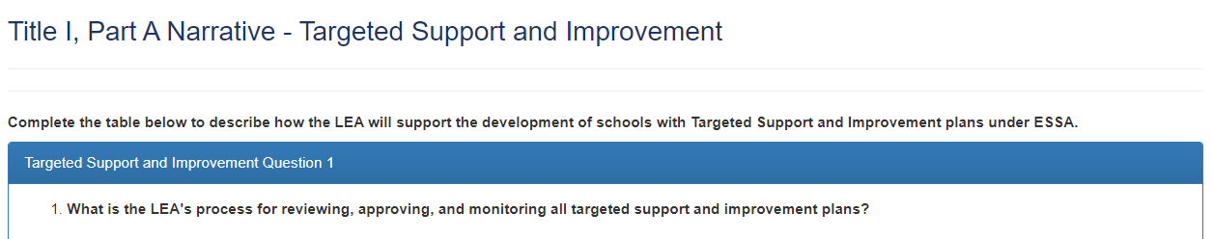
Consolidated Application: TS/ATS
The LEA is responsible for reviewing, approving, and monitoring the improvement plans for schools identified for Targeted (TS) and Additional Targeted (ATS) Support and Improvement.
For ATS plans, the LEA needs to address how they will support the school’s ATS identification and describe a process in supporting the identified resource inequities. This question is being added starting with the 23-24 application.
A description of the LEA’s process is collected in the Consolidated Application.

Slide 12
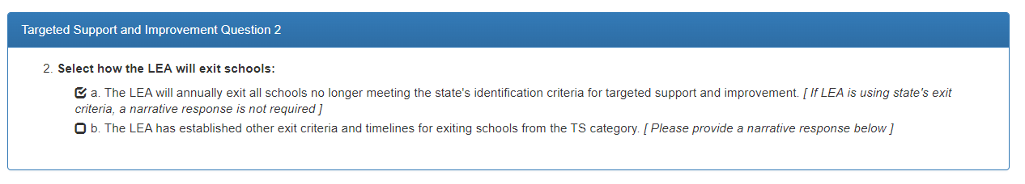
Consolidated Application: TS/ATS
The LEA may establish their own criteria and timelines for exiting schools identified for Targeted (TS) and Additional Targeted (ATS) Support and Improvement or use the criteria established by CDE.

Slide 13
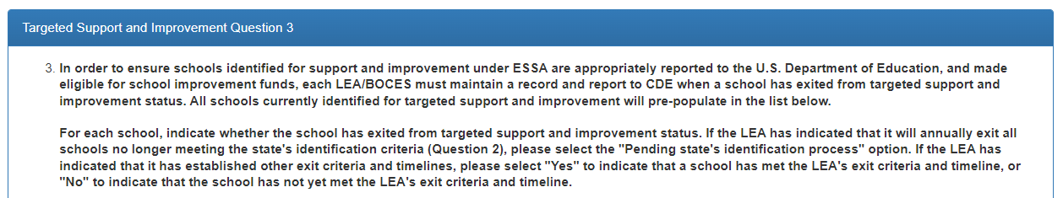
Consolidated Application: TS/ATS
The LEA will report to CDE which schools are exited through the Consolidated Application.

Slide 14
ESSA Improvement Planning Requirements for Schools Identified for TS/ATS

Slide 15
Improvement Planning for TS/ATS
Any schools identified for support and improvement under ESSA must develop and implement an improvement plan that addresses the reason(s) the school was identified.
For each category of identification, there are specific improvement planning requirements. For example, ATS schools must identify and address any resource inequities within a plan.
For additional information about the improvement planning requirements, please visit the CDE webpage. (https://www.cde.state.co.us/fedprograms/essaplanningrequirements)

Slide 16
ESSA Planning Requirements for TS/ATS
Plan must be developed with stakeholders.
Plan is informed by student performance against state-determined long-term goals on each accountability indicator in ESSA.
Plan includes evidence-based interventions.
Plan addresses resource inequities (ATS).
Only the LEA approves plan prior to implementation (does not need to be submitted to CDE).
LEA reviews and monitors plan, upon submission and implementation.

Slide 17
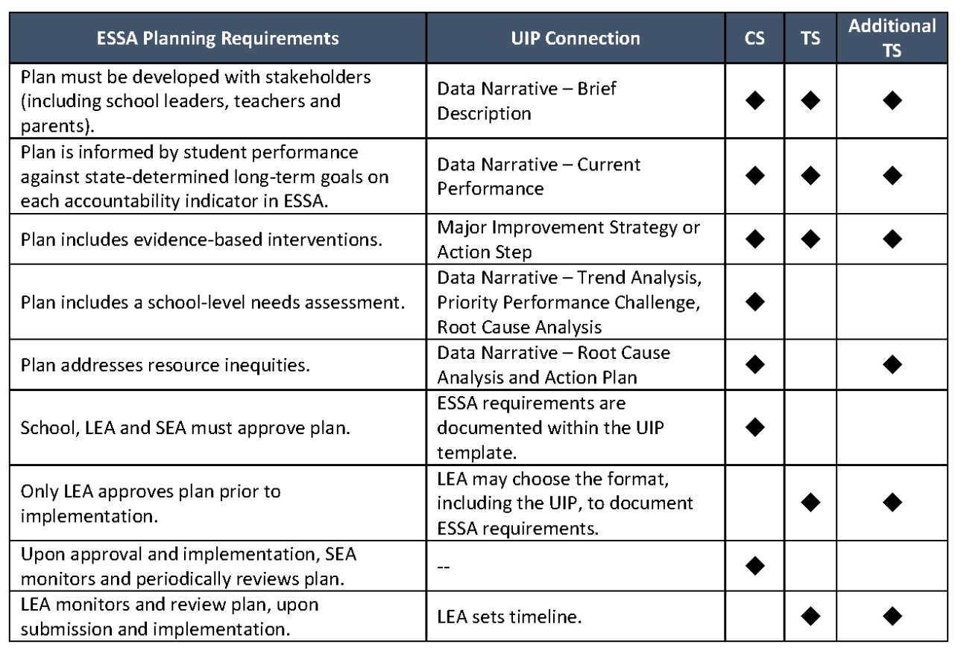
ESSA Planning Requirements- Crosswalk if using UIP

Slide 18
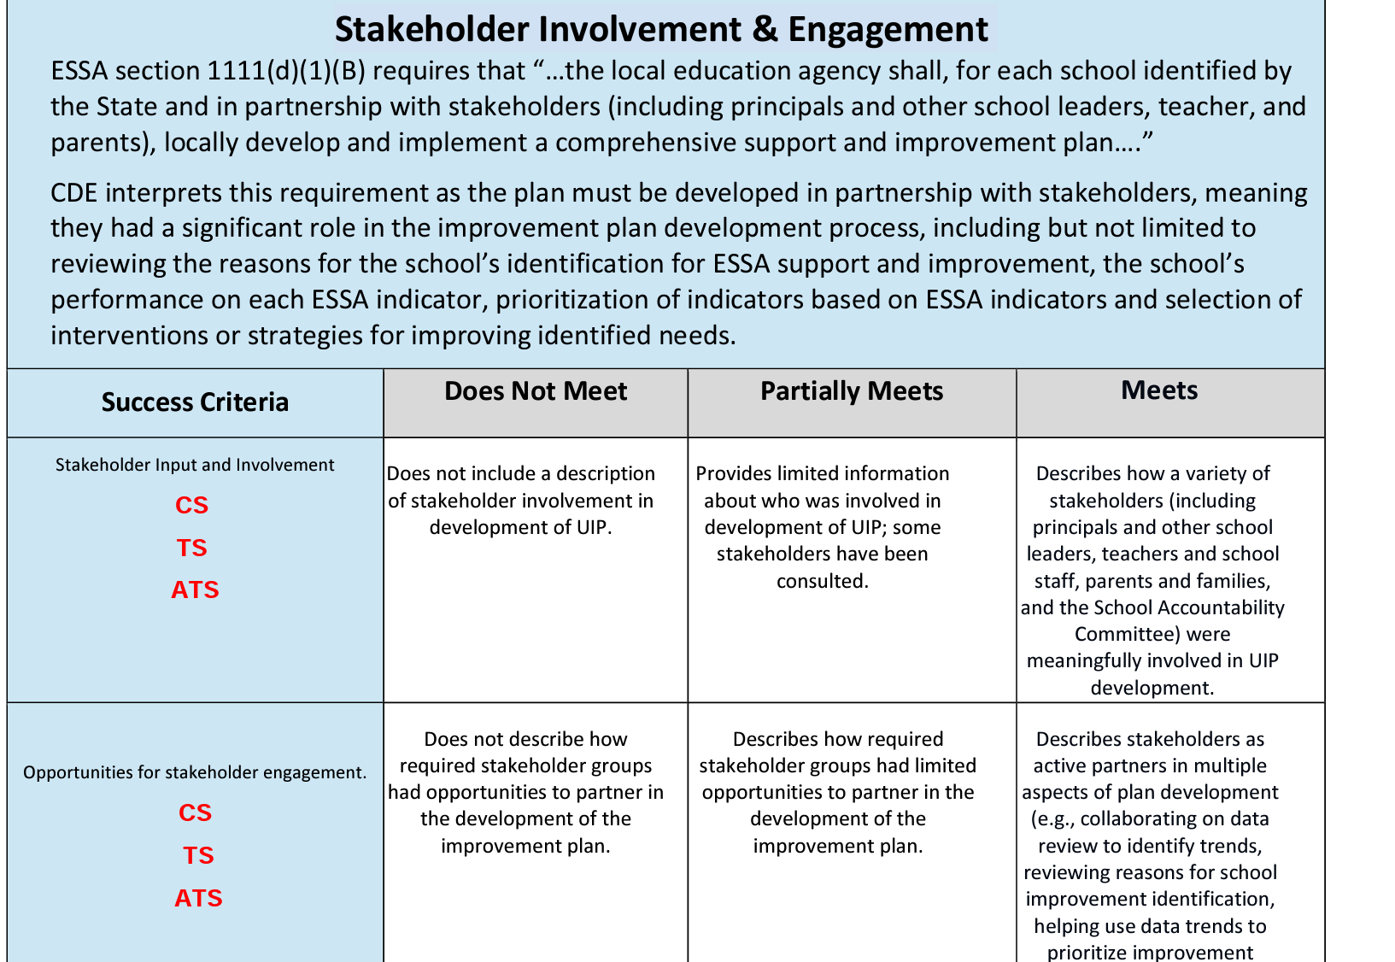
TS/ATS: ESSA Improvement Plan Rubric
LEAs have the option to create their own document, however, Colorado’s UIP provides a convenient mechanism for capturing the specific ESSA requirements as it aligns well with required plan components. The ESSA Improvement Plan Rubric includes TS/ ATS requirements and success criteria.
Notes:
Speak to CS and refer to other trainings

Slide 19
Unified Improvement Planning - Typical Cycle
January- March
April-June
July-September
October-December
ACCESS Testing
State Assessment Window
State Assessment Initial Data Release
State Growth Data and Frameworks Released
Graduation Data Release
ESSA Identifications Released
Accountability and Assessment
MOY READ Assessment
EOY READ Assessment
October Count
SBE/Accountability Clock Hearings
BOY READ Assessment
Request to Reconsider
Improvement Plan Implementation
January - June
September - December
Implement UIP and Adjust Based on IB, Interim Measures
Implement UIP and Adjust Based on IB, Interim Measures
April
July/August
Current Year data analysis, adjust PPCs and targets
Adjust Data Analysis based on State Data
Submit UIP by October 17th
UIP Process
May
March
Solidify current year data analysis, PPCs, Root Causes, MIS
August/September
Reflect on current year, recent local data. Highlight potential Priority Performance Challenges
June
Confirm draft plan with rating and identification release, share with stakeholders. Build detailed action plan.
Draft Implementation Benchmarks and Interim Measures
March
May
June- August
September-December
Related School Leadership Moves
Refine budget and hiring vision to support improvement efforts
Make purchases related to improvement efforts (e.g. curriculum)
Plan teacher induction, including improvement efforts
Closely monitor implementation and keep stakeholders informed
Stakeholder Engagement
Progress Monitoring
Input on initial data, PPCs and targets
Input on Root Causes and MIS
Input on Finalized UIP
Progress Monitoring
Progress Monitoring
Notes:
Just as an example of UIP planning

Slide 20
Stakeholder
Involvement and Engagement
Notes:
Kathryn

Slide 21
Stakeholder Identification
Stakeholder groups that must be involved are:
Principals and other school leaders
Teachers and school staff
Parents and families
School Accountability Committee (made up of members listed above)
Other groups that are best practice but not required to add are:
Non-teaching staff
Community partners
Students
Notes:
SAC- needs to include the members listed

Slide 22
Stakeholder Identification
This could look like:
We strive to include our full school community but ensure we have representation of Principals and other school leaders, Teachers, and Parents. We will refer to this group as our SAC.
Another Example from a current school plan:
The Leadership Team consisted of the following positions within the building:
•Administrative Team (Principal, Assistant Principal)
•Instructional Coach
•Learning Specialist
•Classified Staff
•Parents
•Specialist
•One Teacher per Grade Level
•Gifted and Talented Coordinator
Notes:
Karen Actual example from plan

Slide 23
Reason for Identification: TS/ ATS
ESSA requires that identified schools develop and implement an improvement plan that addresses the reasons for the school’s identification and will result in improvement of student outcomes. Stakeholders were made aware of the identification.

Slide 24
Stakeholder Involvement Throughout
Meaningful involvement throughout the process for stakeholder involvement
  Review performance on ESSA indicators, including reason(s) for ESSA identification and stakeholders were made aware of TS/ATS identification
  Give input on strategies or interventions to be used in meeting identified needs related to TS/ATS identification, collaborating about data, reviewing identified trends, and prioritizing improvement strategies
  Continuous involvement
Notes:
Reiterate stakeholders were made aware of identification

Slide 25
Stakeholder Involvement Throughout
This could look like:
Additionally, our SAC is involved in our review of the ESSA indicators especially the indicators that are related to our identification, Targeted Support, Students Eligible for Free and Reduced Meals. They gave input about our major improvement strategies and evidence based interventions during our school kick-off gathering. In addition, we have put a scheduled review of the TS plan during our quarterly SAC meetings. 3.5.
Additionally, our ____________ is involved in our review of the ESSA indicators especially the indicators that are related to our identification. They gave input about our _________________ during ____________. In addition, we have put a scheduled review of the CS plan during __________meeting ________ times a year.
Notes:
Karen emphasize that this cannot be one and done or an event that happens 1-2 times per year. There needs to be sufficient opportunity for ongoing involvement and input.

Slide 26
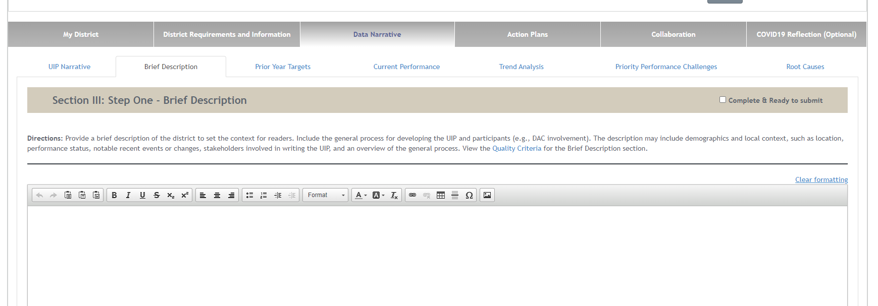
Where to Enter in the UIP-Brief Description Tab

Slide 27
Plan is Informed by Current Performance

Slide 28
Current Performance
For TS/ATS identification:
Plan is informed by student performance relative to local, state and federal metrics and expectations that align to the specific school identification.
The performance described needs to include only the student groups aligned to the school’s TS/ATS identification.
Performance trend data for students groups that align to to the school’s TS/ATS identification must be addressed.

Slide 29
Where to Enter in the UIP: Current Performance Tab

Slide 30
Resource Inequities

Slide 31
ATS Plans: Resource Inequities
Resource inequities must be considered and prioritized during the planning process for ATS plans.
Reflection and identification of resource allocation and any inequities that may have contributed to the ATS identification must be considered and addressed as a part of the ATS plan.
The inequities addressed within a plan must be actionable.
As part of the resource allocation review, it might be necessary to consider school-level budgets.
Notes:
Emphasize where to put it in various sections

Slide 32
ATS Planning: Identifying Possible Resource Inequities
The following list demonstrates examples of possible key resources that should be considered as a part of a plan that could relate to possible resource inequities. This list represents a few examples and is not exhaustive of all possible resource inequities a school may experience.
Instructional Time
Early Intervention
Teacher Quality
School Leadership Quality
Family Involvement and Engagement
School Funding
Facilities
Rigorous Content/ Courses
Comparability in State and Local Services

Slide 33
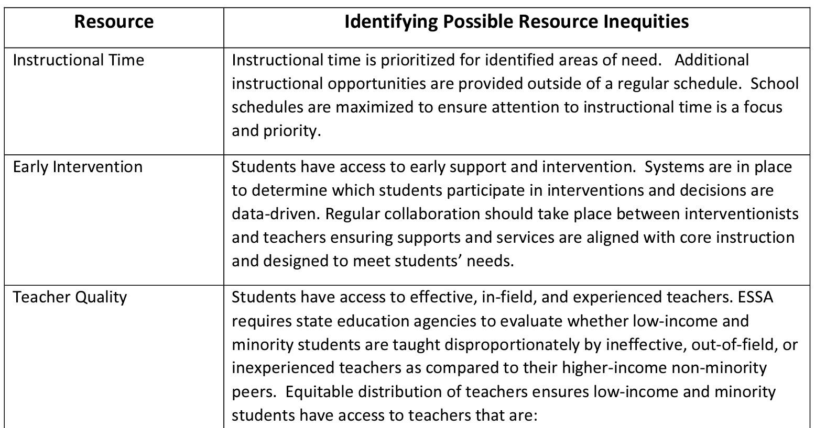
ATS: Resource Inequities
Refer to the ESSA Support and Improvement Plan Rubric (toward the bottom of the document) for additional information about considerations of possible resource inequities for ATS planning.

Slide 34
Prioritize Priority Performance Challenges

Slide 35
Prioritization of Priority Performance Challenge
The plan clearly and explicitly prioritizes, aligns at least one priority performance challenge to the indicator triggering TS/ATS identification. ATS Plans address resource inequities as a part of the prioritization of a priority performance challenge.
This could look like:
One of our areas of highest need related to our ESSA TS Identification of Lowest 5%, Students Eligible for Free and Reduced meals is math achievement.
Rationale:
Our priority challenge that addresses this need is teachers do not have sufficient training to analyze math data to inform mathematics instruction specifically related to students eligible for free and reduced meals. This is necessary to improve teachers’ understanding of data-driven instructional practices to improve achievement in the area of mathematics specifically for our students eligible for free and reduced meals.
Based on our ESSA identification of ________, one of our areas of highest need is _________. Our priority challenge that addresses this need is _________________________________. This is necessary to ______________________.

Slide 36
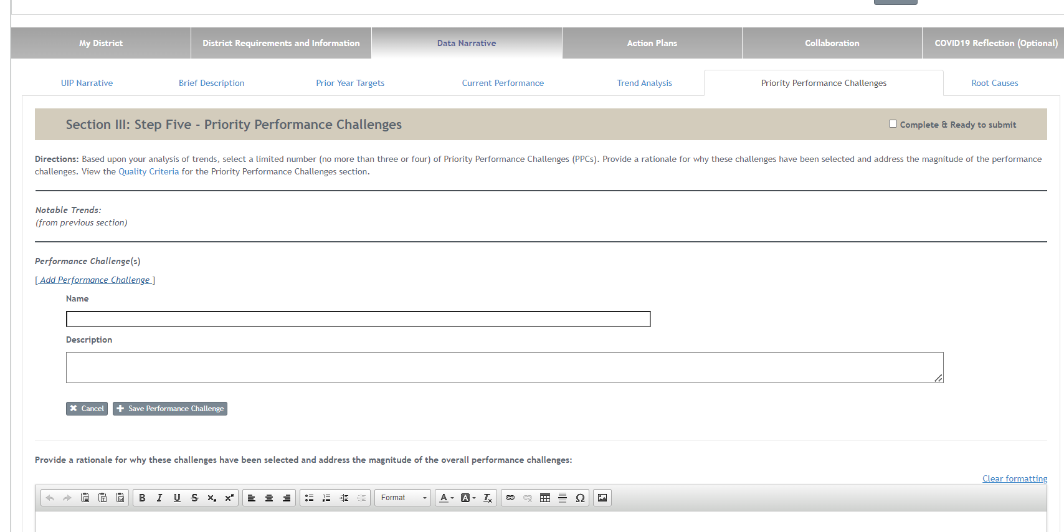
Where to Enter in the UIP: Priority Performance Challenges
Notes:
Ein

Slide 37
Major Improvement Strategies

Slide 38
Major Improvement Strategies (MIS)
At least one MIS must fulfill the following criteria. This can be done with each MIS, but this is not required.
Provides clear rationale that includes at least one intervention and/or strategy that is clearly and explicitly aligned with the reason for ESSA TS/ATS identification.
Includes an evidence-based intervention (EBI). Provides a short description of what has been found in research regarding the success of the selected intervention and/or strategy as aligned to the school’s identification.
Describes the contextual fit for the implementation of the selected intervention and/or strategy aligned to the reason for ESSA TS/ATS identification
Note: ATS Plans address resource inequities as a part of a MIS.
Notes:
Elaborate about EBI

Slide 39
Major Improvement Strategies Example
This could look like:
Based on our ESSA identification of Targeted Support: Students Eligible for Free and Reduced Meals, our chosen priority improvement challenge is lack of teacher training in using data to inform instruction. Our major improvement strategy we have chosen that addresses this need is having staff work through the National Board for Professional Teaching Standards (NBPTS) Certification. NBPTS Certification has rigorous PD that allows teachers to learn to effectively use data with a hands-on approach using their own student data. This intervention has been shown to be effective in improving teacher data usage by research that can be found here https://ies.ed.gov/ncee/wwc/study/67272. This strategy was chosen for this challenge because we struggle to higher experienced teachers and in conjunction of allowing them to work with data, this program will help our new teachers and and less experienced staff gain a deeper knowledge and understanding of the connection between standards-based teaching, using data, and results.
Based on our ESSA identification of ________, our chosen priority improvement challenge is _________. Our major improvement strategy we have chosen that addresses this need is _________________________________. _____________________________(Program name) _____________________________( what it provides) . This intervention has been shown to be effective in improving /mitigating ____________________ by research that can be found here_______________________. This strategy was chosen for this challenge because _____________________________.

Slide 40
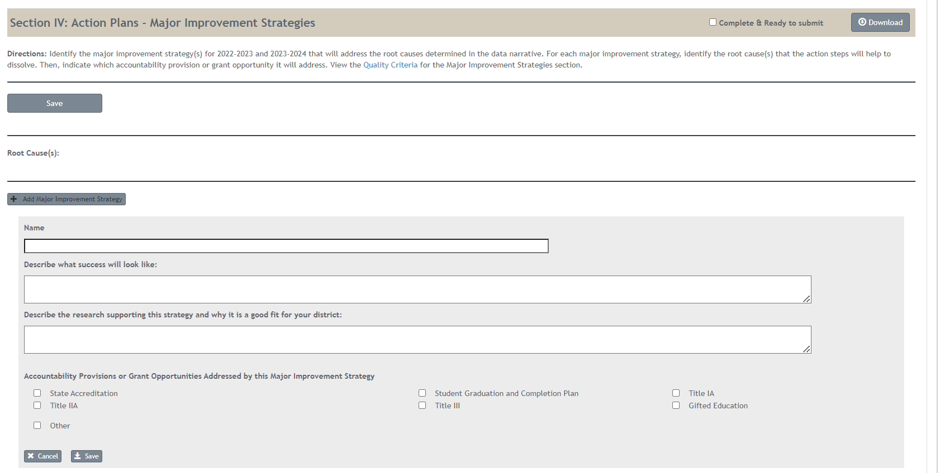
Where to Enter in the UIP
EBI screenshot

Slide 41
Action Planning and Monitoring

Slide 42
Action Planning and Monitoring of TS/ATS Plans
Plans must include the following:
Quality of Target: Identifies ambitious, attainable targets that align to the priority performance challenge and reason for TS/ATS identification.
Interim Measures: Specifies interim measures that are aligned to an annual target and assess the impact of the major improvement strategies (MIS) on student outcomes multiple times a year.
Quality of Implementation Benchmarks: Provides implementation benchmarks that enable staff to determine whether the strategy is occurring in an effective manner and articulates a plan if adjustments are needed.
Monitoring of Implementation: Shares a monitoring plan for tracking implementation efforts.
Evaluating Impact: Provides and evaluation plan for assessing the impact of intervention(s).
Modification of Interventions or Strategies: Shares a process using evaluation results to make adjustments and modifications.
Resource Inequities: Must be considered and addressed as a part of ATS action planning and monitoring of plan.

Slide 43
Monitoring - Implementation Benchmarks
Shares a monitoring plan for tracking implementation and for determining if the selected intervention and/or strategy aligned to the reason for ESSA identification and is being implemented with fidelity.
This could look like:
We will monitor the implementation _____________ in our _________________.
We will monitor the implementation monthly in our PLC meetings.

Slide 44
Evaluation: Action Steps
Provides an evaluation plan for assessing the impact of the selected intervention and/or strategy. Includes a timeline and methods for determining if the school’s performance has increased on the ESSA indicator(s) that resulted in the school’s identification.
This may look like:
We will assess the impact of the intervention at our monthly meeting where we will look at student data to assess if the scores are reflecting growth for our students eligible for free and reduced meals. Additionally, we will assess if any specific skills identified for additional instruction informed by data demonstrated improvement after the reteach related to this specific student group.
We will assess the impact of the intervention at our __________ meeting we will look ______________(what you will look at to see if the intervention is effective).

Slide 45
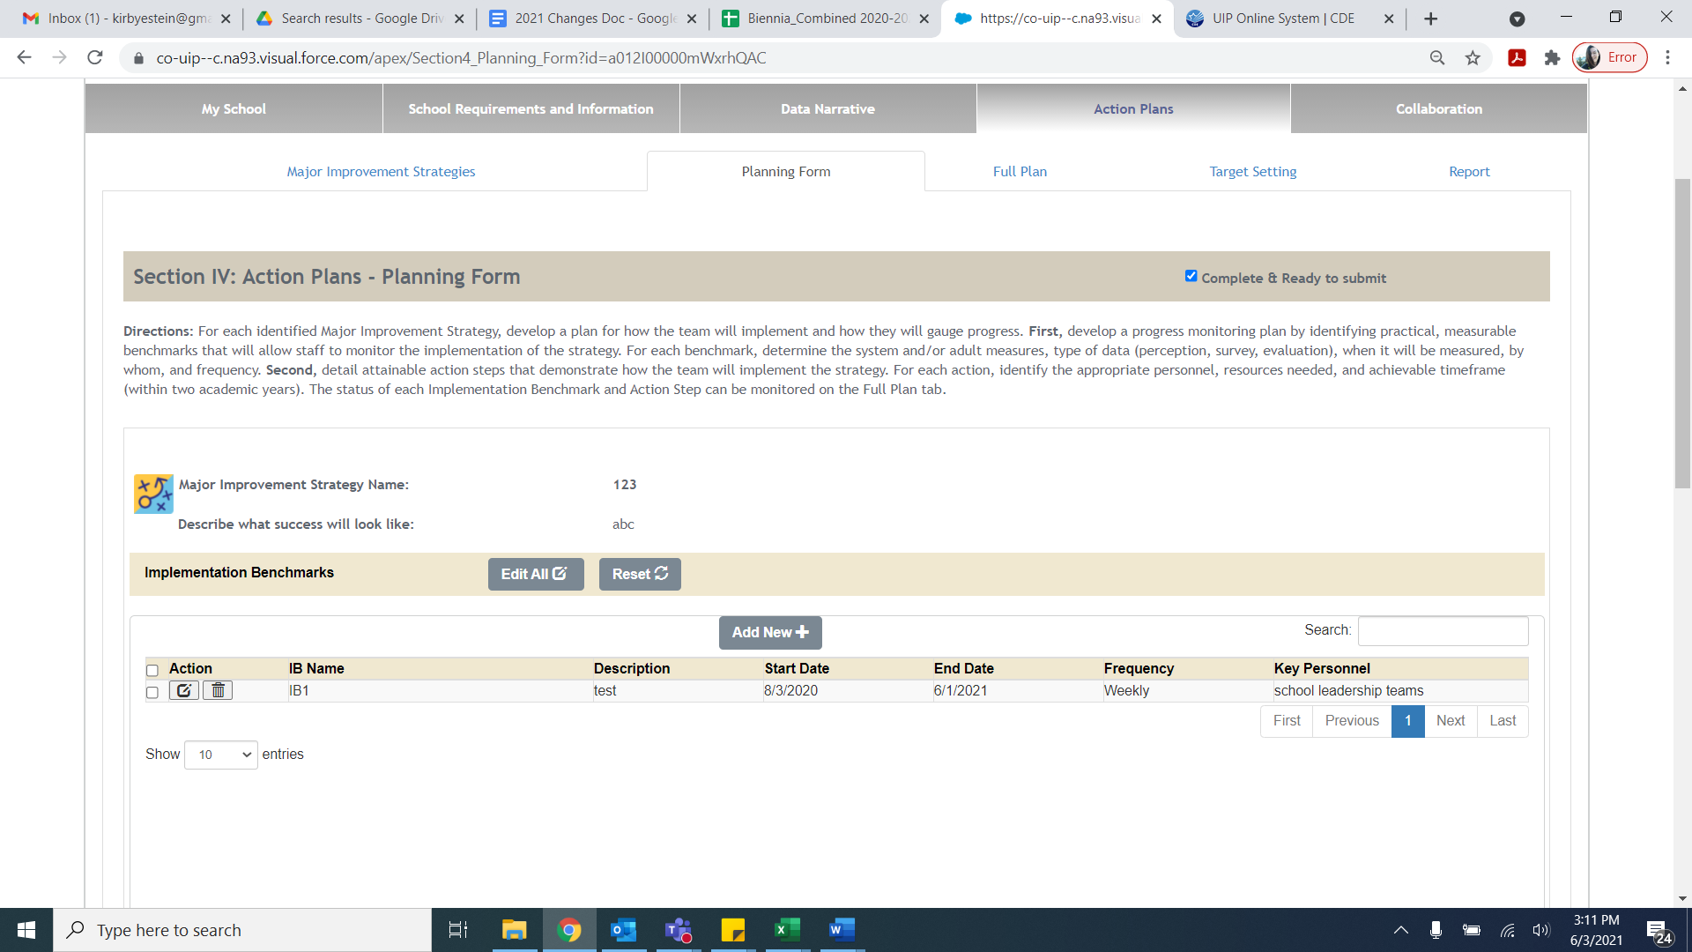
Where in the UIP

Slide 46
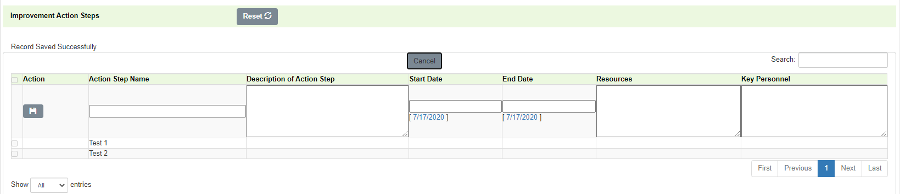
Where in the UIP

Slide 47
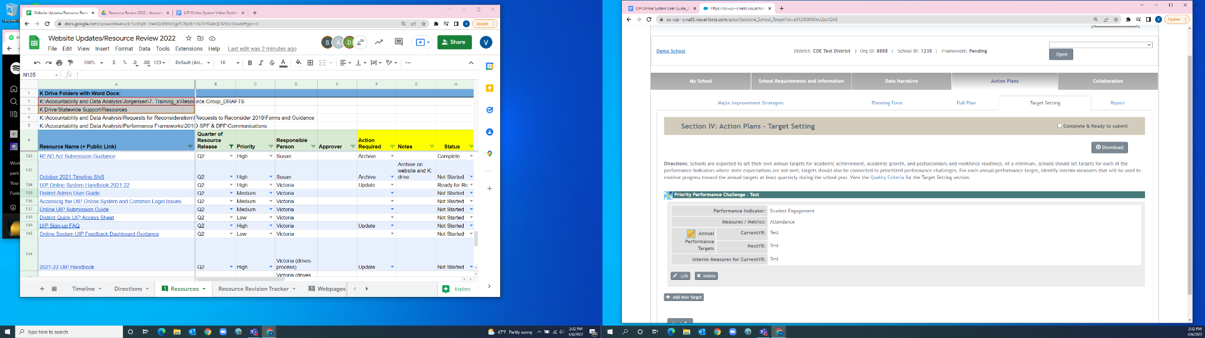
Where in the UIP

Slide 48
Monitoring and Approval of
TS/ATS Plans

Slide 49
Approval and Monitoring of TS/ATS Plans
LEAs are responsible for approving and monitoring TS/ATS plans.
For TS/ATS identified schools, the LEA, or district, will monitor the implementation of the plan to ensure the school is addressing the reasons for ESSA identification.
LEAs determine the number of years a school can be identified for targeted support and improvement before taking additional action. LEAs are responsible for determining what that additional action should be.
Transition to Comprehensive Support and Improvement: School identified for ATS that receive Title I funds and continue to earn does not meet on all indicators, for the same students group(s) that resulted in the school’s identification for ATS, for 3 consecutive years will be transitioned to Comprehensive Support-Chronically Low Performing Student Group(s).

Slide 50
Supports and Funding

Slide 51
Empowering Action for School Improvement (EASI Grant)
ESSA Application for School Improvement (EASI)
Schools identified for support and improvement under ESSA are eligible for supports, services, and grant opportunities for Title I School Improvement funds.
For more information on that process, please visit the ESSA Application for School Improvement page.

Slide 52
Resources

Slide 53

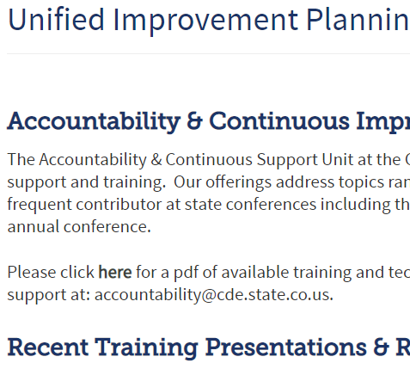
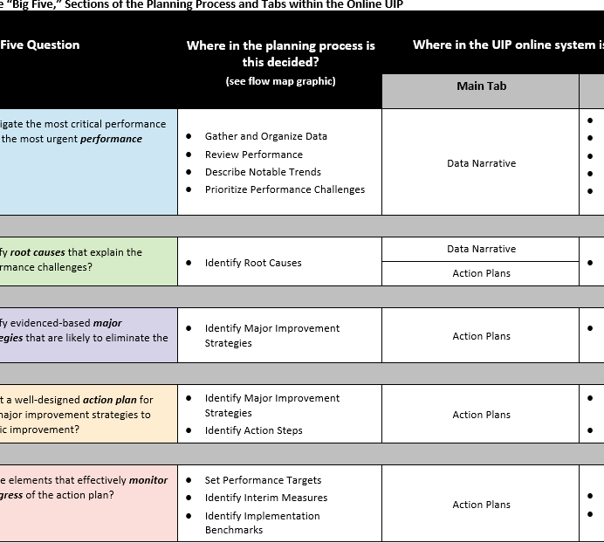
Planning Resources
UIP 101
The UIP 101 video series provides an introduction to the elements of the school UIP and the UIP online system.
https://www.cde.state.co.us/uip/uip101
UIP Training Page
This page hosts a variety of training and technical assistance, both past and present.
https://www.cde.state.co.us/uip/uip_training
Other Resources
Implementation Benchmarks Guidance Document
Data Analysis for Small Student Populations
UIP School QC Rubric- (DOC)

Slide 54
Resources: Websites Related to TS/ATS
ESSA Identification: https://www.cde.state.co.us/fedprograms/essa_csi_tsi
ESSA Planning and Improvement Requirements: https://www.cde.state.co.us/fedprograms/essaplanningrequirements
Evidence-Based Interventions Requirements: https://www.cde.state.co.us/fedprograms/evidence_based_interventions
Resource Inequities Requirements: https://www.cde.state.co.us/fedprograms/resource_inequities_planning_requirements
ESSA Planning and Improvement Rubric: https://www.cde.state.co.us/fedprograms/essa_support_and_improvement_pan_rubric_cs-ts-ats
Note: Federal Programs and Supports Unit Contacts are listed on each webpage above.
ESEA Regional Contacts
Notes:
Review Contacts are listed on page

Slide 55
Contacts
Karen Bixler
bixler_k@cde.state.co.us
(720) 357-4864
Tammy Giessinger
giessinger_t@cde.state.co.us
(720) 827-5291

