Slide 1
ESEA Title IV, Part A
Overview April 2024

Slide 2

Contents
Purpose of Title IV, Part A
How to plan funds
Budget requirements
Reporting requirements

Slide 3
Purpose
The purpose of Title IV, Part A is to improve academic achievement by increasing the capacity of states, LEAs, schools, and communities to:
Provide all students with access to a well-rounded education;
Improve school conditions for student learning;
Improve the use of technology in order to improve the academic achievement and digital literacy of all students.

Slide 4
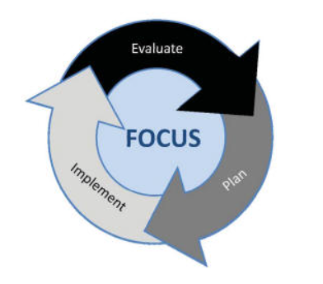
Planning Cycle
Conduct CNA and identify local needs
Monitor implementation and effectiveness of programming
Consider potential evidence-based strategies to address needs
Adjust implementation based on actual data
Implement plan to address needs
Use guiding questions to determine allowability and appropriate funding source
Finalize Plan

Slide 5
Comprehensive Needs Assessment
A comprehensive needs assessment (CNA) must be completed once every three years for LEAs receiving $30,000 or more. LEAs may use the UIP or other CNA to inform Title IV, Part A planning.
Proposed Title IV, Part A activities should be clearly connected to the needs identified in the district or school CNA.
Activities supported with Title IV, Part A funds must be planned in consultation with parents, teachers, principals and other relevant stakeholders. LEAs must engage in continued consultation with stakeholders to improve supported activities.

Slide 6
Distribution of Funds
LEAs can allocate funds directly to a school or fund a program that supports all schools.
The LEA has discretion in how funds are distributed to schools but must prioritize:
  Schools with the greatest need
  Schools with the highest poverty percentages or numbers of children counted in the Title I, Part A calculation
  Schools identified as Comprehensive (CS), Targeted (TS), or Additional Targeted (ATS) Support and Improvement
  Schools identified as a persistently dangerous public elementary school or secondary school

Slide 7
Equitable Services
The Consolidated Application will automatically calculate the LEAs per pupil allocation (PPA) which will help guide LEAs in non-public school consultation meetings.
Title IV, Part A Non-Regulatory Guidance
LEAs must also consult with private school officials to identify the needs of eligible private school students and teachers consistent with the requirements in section 8501 of the ESEA.
ESEA 8501c
To ensure timely and meaningful consultation, a State educational agency, local educational agency, educational service agency, consortium of those agencies, or entity shall consult with appropriate private school officials. Such agency and private school officials shall both have the goal of reaching agreement on how to provide equitable and effective programs for eligible private school children.
* More information about the consultation process can be found on CDE’s Equitable Services Website.

Slide 8
Consider Evidence-Based Strategies
What evidence-based strategies can be used to address the identified needs?
LEAs should use evidence-based strategies because:
  The Every Student Succeeds Act (ESSA) requires that evidence-based strategies be incorporated into improvement plans.
  Using available solutions and interventions decreases the effort needed to “reinvent the wheel” and increases chances of success.
Consider reporting requirements when defining overall objectives and outcomes for each content category in the ESEA Consolidated Application.
*More information is available on CDE’s Evidence-Based Interventions webpage.

Slide 9
Allowable Uses of Funds
Category | Allowable Uses of Funds
Well-Rounded Education | STEM programs Music and art programs Foreign language offerings The opportunity to earn credits from institutions of higher learning Reimbursing low-income students to cover the costs of accelerated learning examination fees Environmental education Programs and activities that promote volunteerism and community involvement
Safe and Healthy Students | School-based mental health services Drug and violence prevention activities that are evidence-based Integrating health and safety practices into school or athletic programs Nutritional education and physical education activities Bullying and harassment prevention Activities that improve instructional practices for developing relationship-building skills Prevention of teen and dating violence, stalking, domestic abuse, and sexual violence and harassment Establishing or improving school dropout and reentry programs Training school personnel in effective practices related to the above

Slide 10
Allowable Uses of Funds - Continued
Category | Allowable Uses of Funds
Effective Use of Technology | Developing or using effective or innovative strategies for the delivery of specialized or rigorous academic courses through the use of technology Carrying out blended learning activities (must include ongoing professional development for teachers) Providing professional development on the use of technology to enable teachers to increase student achievement in STEM areas Providing students in rural, remote, and underserved areas with the resources to take advantage of high-quality digital learning experiences Providing educators, school leaders, and administrators with the professional learning tools, devices, content and resources to: Personalize learning Discover, adapt, and share relevant high-quality educational resources Use technology effectively in the classroom Implement and support school and districtwide approaches for using technology to inform instruction, support teacher collaboration, and personalize learning
Allowable Uses Planning Tool

Slide 11
Determining Allowability
Is the activity aligned to a need identified in the district’s or school’s needs assessment?
Does the activity align to one of the content areas and activity categories under Title IV, Part A (Well-Rounded Education, Safe and Healthy Students, or Effective Use of Technology)?
Will the activity support improving students’ academic achievement?
Is the cost of the activity reasonable?

Slide 12
Unallowable Activities
Construction (major building construction, structural alterations to buildings, building maintenance, and repairs)
Food (may be permissible if reasonable/necessary to meet intent/purpose of program)
Gift cards or incentives/prizes of monetary value (should be nominal in value and educational in nature)
Non-educational games, devices, and field trips
Social/entertainment events
Costs associated with purchase of firearms, storage and training

Slide 13
Supplement, Not Supplant (SNS)
Supplanting is presumed if any of the following is true, according to federal fiscal guidance (2 CFR Part 200, Appendix XI):
A district uses federal funds to provide services that are required under other federal, state, or local laws.
A district uses federal funds to provide services that the district provided with non-federal funds in the prior year.
A district uses federal funds to provide services that the district would otherwise provide without federal funds.
*These presumptions are rebuttable if the LEA can demonstrate that it would not have provided the services in question with non-Federal funds had the Federal funds not been available. (2 CFR Part 200)

Slide 14
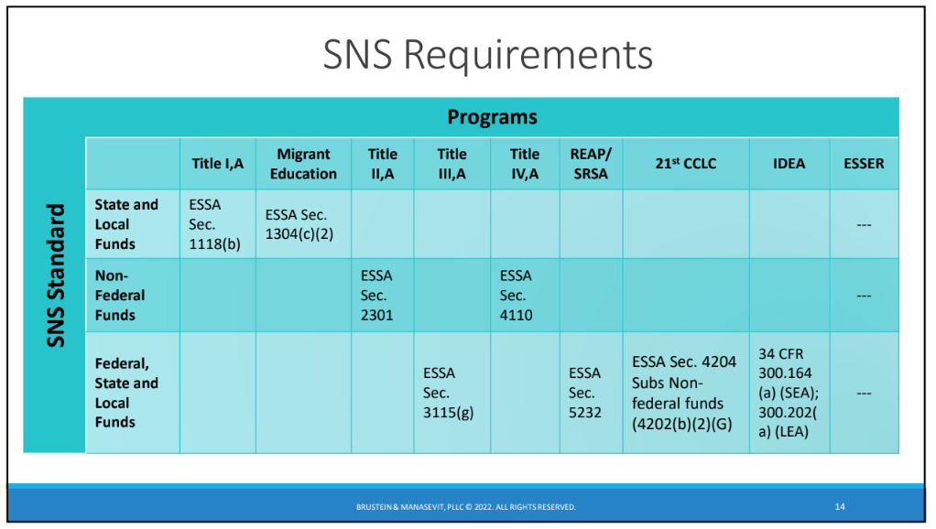
SNS Graphic

Slide 15
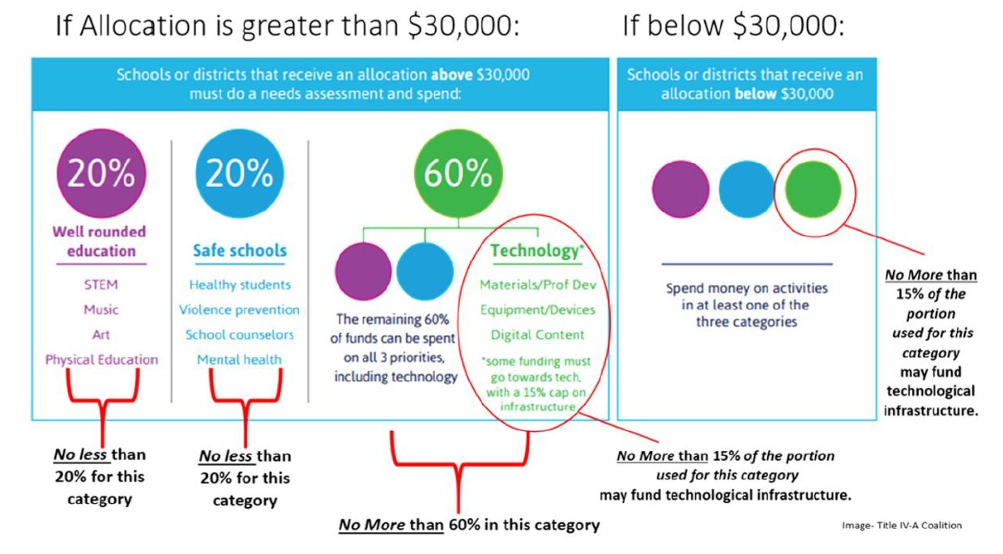
Budget Requirements
Note: Percentages apply to the Federal Fiscal Year of award.

Slide 16
Implement and Monitor Plan
Implement the finalized plan.
Monitor the effectiveness of the plan.
Adjust activities and/or implementation, as needed, and submit a Post-Award Revision (PAR) for changes to activities.
The Program Evaluation Trainings series, developed by CDE and the Regional Educational Laboratory (REL Central), is a helpful resource for program evaluation.

Slide 17
Public Reporting
States must report the following, by content category (Well-Rounded Education, Safe and Healthy Students, Use of Technology) for all LEAs who accept a Title IV allocation:
Number of LEAs that spent Title IV, Part A funds
How much LEAs spent
The effectiveness of each LEA’s objectives
*Note: Reporting is by federal fiscal year, not academic school year.

Slide 18
Reporting Program Effectiveness
All LEAs that receive a Title IV, Part A allocation must also report progress toward meeting objectives and outcomes described in the application.
LEAs can report objectives and outcomes for each activity, group of activities, content area.
LEAs must report on each objective and outcome in the application.
LEAs have to report the degree of their progress to meet objectives.

Slide 19
Now You Know
Conduct CNA and identify local needs
Purpose of Title IV, Part A
How to plan funds
Budget requirements
Reporting requirements
Monitor implementation and effectiveness of programming
Consider potential evidence-based strategies to address needs
Adjust implementation based on actual data
Implement plan to address needs
Use guiding questions to determine allowability and appropriate funding source
Finalize Plan

Slide 20
Questions?
Contact your ESEA Regional Contact

