Slide 1
Program Evaluation Training
January 2020
Notes:
Hi everyone, this is Tina Negley with the Colorado Department of Education, Unit of Federal Programs Administration, Office of ESEA Programs. I’m here with my colleagues Rachel Matson. We are also joined by Josh from Marzano Research at REL Central.

Slide 2
Program Evaluation Module 3
Overview
REL Central and CDE
Notes:
This webinar will cover Module 3 of the Program Evaluation Training series. Modules 1 and 2 were recorded and can be accessed by visiting the Program Evaluation webpage of the Data, Accountability, Reporting, and Evaluation (DARE) team. If you do not have access to the handouts, please contact Michelle or Rachel. Josh will be introducing REL.

Slide 3
Notes:
REL Central is one of 10 Regional Educational Labs across the country provided by IES through the U.S. Department of Education. The mission is to provide applied research and technical support for education stakeholders in the region. REL Central serves 7 states: Colorado, Kansas, Missouri, Nebraska, North and South Dakota, and Wyoming. REL Central has been collaborating with CDE on this project in trying to create and deliver these Program Evaluation modules. REL Central is working on an online toolkit based on some of this work, which will hopefully be available in another year or so once it’s gone through full development and approval.

Slide 4
Introductions
REL Central Team
Josh Stewart, Jeanette Joyce, David Yanoski, Mckenzie Haines, Doug Gagnon
CDE Team
Nazanin Mohajeri-Nelson, Ph.D.
  Director, ESEA Office
Tina Negley
  Coordinator, Data, Accountability, Reporting and Evaluation Team
Mary Shen
  Research Analyst
Notes:
From CDE, we have other staff who have also been involved in the partnership with REL over the last couple years, including Nazanin Mohajeri-Nelson, the Director of the ESEA Programs Office, and Mary Shen, who is also part of the DARE team. The individuals listed under both REL Central and CDE are available for additional, more customized technical assistance after you complete the modules. You are encouraged to contact any of the team members listed.

Slide 5
Program Evaluation:
Overall Training Goals, Purpose, and Process
Notes:
We’ll get started with the overall purpose of program evaluation and why we are providing these trainings.

Slide 6
Overall Goals of Program Evaluation Training
Develop understanding of the evaluation process and cycle.
Build capacity to effectively implement quality evaluation.
Form a common language to facilitate evaluation.
Identify how program evaluation can apply to small scale, targeted interventions.
Notes:
One of the reasons we are currently providing these trainings is because ESSA has emphasized and highlighted the need for identification and selection of evidence-based interventions. As those interventions are implemented at the local level, there is a requirement to collect a body of evidence that demonstrates the effectiveness of those evidence-based interventions as they’re implemented in your local context. What that translates to is a need to do program evaluation on a scale that is suitable to the size of the program being implemented at the local level. The larger the program and the more ESEA funds that are being used to support the program, the greater the need to have a body of evidence at the local level demonstrating that these programs have resulted in the intended outcomes. The purpose of these Program Evaluation trainings is to prepare districts in building that local body of evidence that demonstrates the effectiveness of the program.
Another reason these trainings are currently being provided is because, beginning with the 2020-21 school year, we are going to begin collecting evidence of local program evaluations through our monitoring of ESEA programs. All of the Titles, Titles I through V, have a requirement for conducting program evaluation and using evidence-based interventions. Because of that requirement, that is being rolled into our monitoring process to look at the local evaluations that are being conducted.
In order to have that understanding of the evaluation process and the cycle and what capacity is needed in order to conduct a local program evaluation, we’re providing these trainings. The trainings are also designed to form a common language to facilitate evaluation and to identify how program evaluation can apply to small scale projects, all the way up to larger scale projects. Again, the scale of the program evaluation should be aligned to the scale, and the time, effort, and resources being invested in the program.

Slide 7
What is Evaluation?
Evaluation
  Involves collecting and analyzing information about a program’s activities, characteristics, and outcomes
  Answer questions specific to local context
  Iterative process
Purpose
  Make informed judgements about a program
  Inform programming decisions
  Tool to inform continuous improvement
Notes:
So what is a program evaluation? An evaluation is a process that involves collecting and analyzing information about a program’s activities, characteristics, and outcomes. It answers specific questions to how things are working and what outcomes are being achieved as a result of an intervention being implemented at the local context. As a note, when we mention interventions throughout these modules, that is inclusive of any practices, strategies, or activities that are funded with ESEA funds. Evaluations happen in an iterative process and we are hoping that individuals participating in these modules will select 1 or 2 activities to go through the full development of the logic model and evaluation plan, and implementation of that evaluation plan. As you build those practices and build capacity at the local level, then those practices can be applied to other interventions throughout the district, especially those supported through ESEA funds.
The purpose of evaluations are to make informed judgements about how well a program is meeting the needs that have been identified through a comprehensive needs assessment, and to ensure that programmatic decisions are based in that needs assessment and to ensure that interventions are being implemented as designed and approved and are producing the intended results. Evaluation is a tool for informing continuous improvement, so as we talk about program evaluation moving forward, especially at the local context, it’s really important to frame it as a process to look for what’s working so we can scale up those efforts, and continue to make modifications to what’s not working, so we can achieve the desired outcomes.

Slide 8
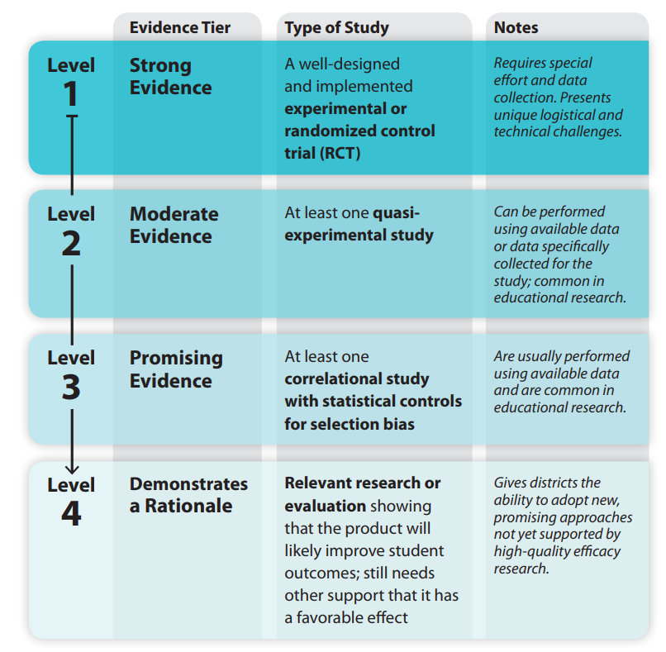
Defining ESSA Levels of Evidence
See Handout A for more information
Notes:
As mentioned earlier, one of the driving forces behind providing Program Evaluation Trainings is the required ESSA levels of evidence that are called upon when selecting and implementing evidence-based interventions. There are 4 different levels of evidence that are explained in ESSA, and all states and districts that accept ESEA funds, including Titles I, II, III, IV, or V, as well as Title I 1003 or school improvement funds, are required to have a demonstration of the level of evidence that is in support of the interventions that are being funded with these funds. The 4 levels range from 1 being the strongest level of evidence that is based on a well-designed and implemented experimental or randomized control trial, which is a practice that requires special effort and data collection. When you are looking at the research base behind an intervention, what you are looking for is that there is a certain level of rigor in studying whether that intervention has worked in other contexts. There are resources that are available for looking at the level of strength for existing programs and interventions and we have an entire webinar training series and website that explain these levels and how to search the resources that are available to look at the evidence base behind the interventions you are considering at the local level. If you navigate to the CDE website and enter Evidence-Based Interventions in the search bar, you’ll find the link to where those webinars are stored. The second level is moderate evidence, which means there was at least one quasi-experimental study that was used in looking at the effectiveness of that intervention. Level 3 is looking for at least one correlational study, which means that two variables are related to each other, either positively or negatively. When there is a correlational study that demonstrates the relationship between two variables, that is considered a promising level of evidence. For school improvement funds or Title I section 1003 funds that are awarded through EASI, there is a requirement for any interventions that are funded to meet levels 1 through 3. For Consolidated Application funding, formula funds under Titles I through V, however, interventions can meet any of the levels, including level 4. Level 4 indicates there was relevant research or evaluation, whether nationally or at the local level, showing that the intervention will likely improve student outcomes, but there is still a need for other supports that is has a favorable effect and there needs to be a plan for evaluating that impact to collect and build that body of evidence as you’re developing and implementing any promising practices that are based on a theory or research that demonstrates a rationale.

Slide 9
The Program Evaluation Cycle
Part 1: Logic Model
Part 6: Dissemination
Part 2: Evaluation Questions
Part 5: Data Preparation and Analysis
Part 3: Data Sources
Part 4: Data Collection Tools
Adapted from: http://toolkit.pellinstitute.org/.
Notes:
The training modules for program evaluation are designed to follow a typical program evaluation cycle, which typically happens with development of a logic model, development of evaluation questions, development and identification of data sources, development and identification of data tools that are necessary for conducting the program evaluation, identification of the data preparation strategies and analyses to be used to answer the evaluation questions, and then, once you have the results, determining how best to disseminate and communicate those findings to your stakeholders. Each one of these buckets are a separate training module that has been developed by REL in partnership with CDE and are being provided through webinars.

Slide 10
Part 3: Data Sources
Notes:
With that, we are going to get started with this module, which is focused on identifying appropriate data sources for use in your program evaluation…

Slide 11
The Program Evaluation Cycle: Part 3
Part 1: Logic Model
Part 6: Dissemination
Part 2: Evaluation Questions
Part 5: Data Preparation and Analysis
Part 3: Data Sources
Part 4: Data Collection Tools
Adapted from: http://toolkit.pellinstitute.org/.
Notes:
which falls into the third bucket in the evaluation cycle.

Slide 12
Goals for Part 3
Discuss sources and types of data.
Discuss data quality considerations.
Identify available data and needs for additional data.
Notes:
The goals for this module are to discuss sources and types of data that may be used in your evaluation, to discuss data quality considerations which should inform the inclusion or exclusion of data sources in your evaluation, and to identify what data is currently available and whether there is a need to collect additional data. This module also includes activities and exercises that you can engage in. Once you have started these activities, and you have questions or want to brainstorm or receive additional technical assistance, you can reach out to our REL partners or our CDE team.

Slide 13
Data Sources
I don’t have the resources to collect new data; can I use what I have?
Existing data can be an excellent source of information if they are complete and accurate.
Let’s discuss what data is available without additional collection!
Examples of Existing Data
School records
Lesson plans
Meeting minutes
Public datasets
State/district assessments
Office of Data, Analysis, Research & Evaluation Administration on Children, Youth & Families. (2016). Qualitative research methods in program evaluation: Considerations for federal staff. Available from: https://www.acf.hhs.gov/sites/default/files/acyf/qualitative_research_methods_in_program_evaluation.pdf
Notes:
Once you have developed a logic model and evaluation questions, you need to identify what data sources are needed in order to answer your evaluation questions. You might be concerned that you don’t have the resources necessary to collect new data and are wondering whether you can utilize existing data. Some examples of existing data you may have access to within your district include state and/or local assessment data, meeting minutes, and school records such as student attendance. You may also have access to public datasets. Existing data can be an excellent source of information if they are complete and accurate.

Slide 14
Types: Quantitative and Qualitative
Quantitative | Qualitative
Numeric Answers How many? How much? and How frequently? Surveys, assessments, observations | Non-numeric Answers Why? and How? Interviews, focus groups, document review, observations Often can be “quantified”
See Handout H for more information
1. Giancola, S. P. (2014). Evaluation matters: Getting the information you need from your evaluation. Available from: https://www2.ed.gov/about/offices/list/oese/sst/evaluationmatters.pdf
2. Office of Data, Analysis, Research & Evaluation Administration on Children, Youth & Families. (2016). Qualitative research methods in program evaluation: Considerations for federal staff. Available from: https://www.acf.hhs.gov/sites/default/files/acyf/qualitative_research_methods_in_program_evaluation.pdf
Notes:
Data can be classified into two broad categories, quantitative data and qualitative data. Quantitative data are measures of values or counts, expressed as numbers, which answer questions such as how many, how much, and how frequently. Assessment results are a common source of quantitative data. Survey data is also typically quantitative, utilizing ratings, Likert scales, and multiple-choice questions to gather input. Observation data may be quantitative, such as when evaluation rubrics are used. On the other hand, qualitative data are non-numeric and focused on categorical variables that describe qualities or characteristics, and answer questions such as why and how. Interviews, focus groups, and document reviews are common sources of qualitative data. Observation data may also be qualitative in nature, if it includes, for example, descriptions of the activities being observed. Open-ended survey questions can also be considered sources of qualitative data. Qualitative data can often be quantified, such as by counting the frequency of responses. Handout H provides additional examples of quantitative and qualitative data.

Slide 15
Data Types
Should I use quantitative data, qualitative data, or both?
It depends on the goals of the evaluation and the research questions.
The availability of resources and time are also important.
Both quantitative and qualitative methods have advantages and disadvantages and often complement each other.
Type | Advantages | Disadvantages
Quantitative | Cost effective Accessible for analyses Generalizable Objective | Limited in scope Can be of poor quality Not context sensitive
Qualitative | Brings to light relationships and phenomenon that might have been missed More representative of reality | Complex to analyze More subjective
Adapted from: http://dx.doi.org/10.5539/jel.v6n1p102
Notes:
When considering potential data sources, one question often asked is whether you should use quantitative data, qualitative data, or both. The answer to that question depends on the goals of the evaluation and on the evaluation questions. The availability of resources and time are also important when determining what data types to use. Conducting interviews and focus groups, for instance, can be time consuming and require additional resources such as the development of interview protocols and the availability of multiple staff. Both quantitative and qualitative methods have advantages and disadvantages and can often be used in conjunction to complement each other. For example, if you obtain data quantitatively, you might want to contextualize or situate it with qualitative data.
One advantage of quantitative data is that it is typically more cost effective as it requires fewer resources to obtain. The numeric nature of quantitative data also means that data analysis is less time consuming. Quantitative findings are often generalizable to a larger population and are more objective than qualitative findings. Disadvantages of quantitative data, however, are that it can be limited in scope as it does not ascertain deeper underlying meanings and explanations, it can be of poor quality, and it is not context sensitive (taking a snapshot, measuring variables at a specific moment in time).
Qualitative data, on the other hand, has the advantage of bringing to light relationships and phenomenon that might have been missed with quantitative data alone, and may be considered more representative of reality as it produces detailed descriptions of participants’ feelings, opinions, and experiences. Disadvantages of qualitative data, however, are that it is more subjective, and that it can be more complex and time consuming to analyze.

Slide 16
Evaluation Matrix
A planning tool that details the methods and procedures that will be used to address each evaluation question.
EVALUATION QUESTION | DATA SOURCES | DATA COLLECTION TOOLS | DATA COLLECTION TIME FRAME | ANALYSIS METHOD
To what extent did the teacher training in new reading strategies improve students’ attitudes toward reading? | Collect new data using a survey instrument. | 5-item Likert response scale measuring students’ attitudes towards learning. | Survey administered twice – prior to teacher training and after the training. | Attitude scores are aggregated into means, which are then subtracted from each other.
Office of Data, Analysis, Research & Evaluation Administration on Children, Youth & Families. (2016). Qualitative research methods in program evaluation: Considerations for federal staff. Available from: https://www.acf.hhs.gov/sites/default/files/acyf/qualitative_research_methods_in_program_evaluation.pdf
Notes:
Now we’d like to introduce the evaluation matrix, which can be found on Handout I, which is a planning tool that details the methods and procedures that will be used to address each evaluation question. This module mainly focuses on identifying what data sources could be used to answer your evaluation questions, but participants will also be asked to consider data collection tools and time frames. Data collection tools will be covered in further detail during module 4, and module 5 will focus on analysis methods that can be used to address each evaluation question.

Slide 17
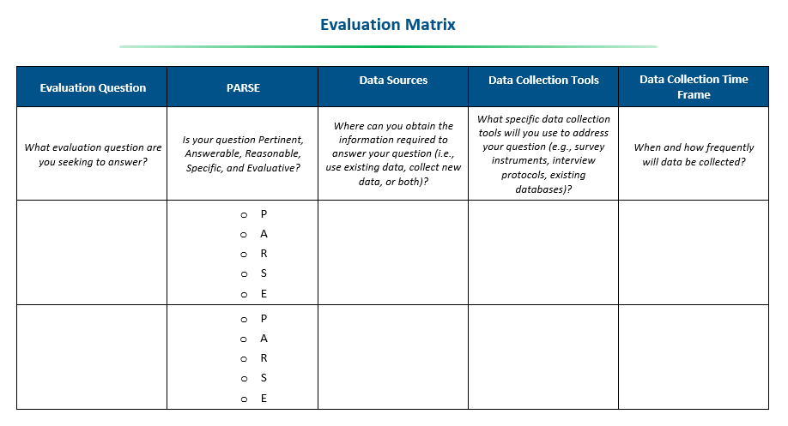

Activity to Assess Data Sources
Using Handout I, develop an Evaluation Matrix to describe potential data sources, collection tools, and time-frame for each evaluation question.
Activity!
Notes:
At this time, we’d like to pause the recording and invite you, if you haven’t already accessed the handouts, to open Handout I, review the information provided, reflecting on how you’d use the handout when beginning initial development of your evaluation matrix. The handout is structured such that evaluation questions you identified during module 2 should be entered into the first column of the matrix, one evaluation question per row. The second column should be used to apply the PARSEC model to each evaluation question, identifying whether each question is pertinent or meaningful, whether each question is answerable based on data capacity and constraints, whether each question is reasonable and linked to program objectives, whether each question is specific and aligned to logic model components, and whether each question is evaluative and able to inform program adjustments. All evaluation questions should then be considered in combination with each other, to determine whether the evaluation questions are complete and thoroughly address the objectives of the program evaluation. More information about the PARSEC model can be found in the recording of Modules 1 and 2 posted online. Column three should be used to identify potential data sources that could be used to answer to each evaluation question, which can include existing or new data sources. The fourth column should be used to identify data collection tools that could be used to collect the data, such as survey instruments or interview protocols. The final column should identify the data collection time frame, clarifying when and how frequently the data will be collected. For example, will local assessment data be collected once annually, at the end of the school year, or will it be collected quarterly throughout the year? How frequently will surveys be administered and at what point during the school year?
We will pause the recording and give everyone 5 minutes to review Handout I and ask any questions you may have.

Slide 18
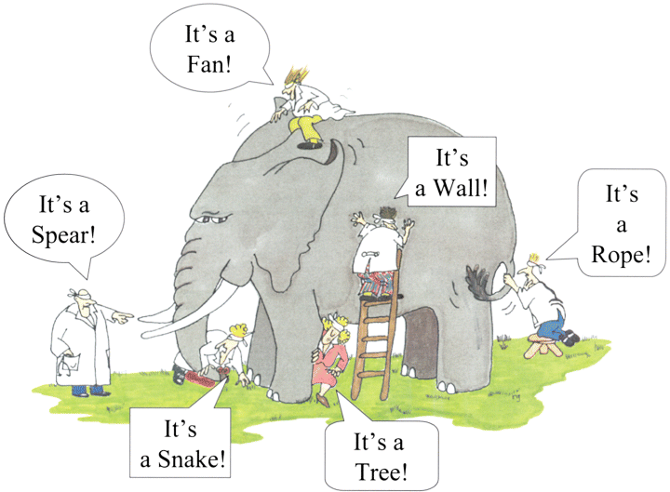
Elephant Graphic
Notes:
This image demonstrates how different data sources tell different parts of the story and depicts how an incomplete data set could result in inaccurate results or interpretations. Using a variety of high-quality data sources, and including different perspectives, can provide a more accurate and complete picture.

Slide 19
Elements of High-Quality Data
Validity
See Handout J for more information
Completeness
Reliability
Data Quality
Integrity
Timeliness
Precision
1. Brown, W., Stouffer, R., & Hardee, K. (2007). Data quality assurance tool for program level indicators. Chapel Hill, NC: MEASURE/Evaluation Project. Available from https://www.measureevaluation.org/resources/publications/ms-07-19
2. Radhakrishna, R., Tobin, D., Brennan, M., & Thomson, J. (2012). Ensuring data quality in extension Research and evaluation studies. Journal of Extension, 50(3), n3. Available from https://www.joe.org/joe/2012june/pdf/JOE_v50_3tt1.pdf
Notes:
Once you have identified potential data sources to address your evaluation questions, it is important to evaluate each source to ensure it meets the elements of high-quality data. This pertains if you are developing a new instrument, such as a survey, or if you are using an established instrument, such as a local assessment.
The first element of high-quality data is validity, which looks at the extent to which the data are actually measuring what they are intended to measure. If you purchase a scale to measure your body weight, for example, but the scale instead provides your blood pressure, it would not be a valid measure of your weight.
The second element is reliability, or the extent to which an instrument yields consistent results. Going back to the scale you purchased, if it gives you a different weight every time you step on it, even though your body weight has not changed, it would not be a reliable measure.
The third element is timeliness, thinking about when data are available. Will data sources be available on time to complete an evaluation. For example, data from a local assessment administered in the spring may not be shared until the fall, and therefore wouldn’t be available for use in analyses conducted over the summer. Timeliness also refers to whether data are up to date. Using Census data from 10 years ago, for example, might not be best source for school demographics.
The fourth element is precision, which means that the data have sufficient detail. If we’re interested in whether an intervention increases students’ performance on a specific grade-level expectation, for example, then an overall proficiency level on an end of unit exam might not provide as much detail as an overall scale score or a subscale score.
The fifth element is integrity, or the assurance that data are free from tampering, entry errors, and political or personal bias.
The last element is completeness, thinking about whether the data collected are sufficient to address all of your evaluation questions. Completeness also includes a consideration of missing data. If an intervention was administered at 6 schools within the district, but you only collected survey data at one of the schools, that would not be a complete data source and could limit the generalizability of results.
Handout J provides additional definitions and examples for each of the elements of high-quality data.

Slide 20

Considering Data Quality
People who perceive that data quality is poor are unlikely to trust the findings.
There is no “one size fits all” approach to data quality.
3 steps to improving data quality:
  Evaluate data quality subjectively and objectively.
  Identify the source of any difference in findings.
  Take action to improve quality.
Pipino, L. L., Lee, Y. W., & Wang, R. Y. (2002). Data quality assessment. Communications of the ACM, 45(4), 211-218.
Notes:
So why is it important to consider all elements of data quality? If your stakeholders perceive that the data quality is poor then they will be unlikely to trust the findings of the evaluation. Therefore, it’s important to include your stakeholders throughout the evaluation process to ensure they’ve had an opportunity to provide feedback and input regarding the data sources that will be used. There is not a “one size fits all” approach to ensuring data quality and ensuring the appropriate data sources are included, it is an ongoing effort requiring multiple perspectives.
There are three different steps that can be taken to improve data quality. First, evaluate data quality both subjectively and objectively. Subjectively means walking through data sources as a team, and making sure everyone is on the same page and has a shared understanding of what data is being collected and why. Objectively involves looking at specific measures of an instrument’s validity and reliability.
The next step is to identify the source of any differences in findings. For example, if teachers participated in a professional learning opportunity, and a survey reveals that all teachers are implementing the strategies learned on a regular basis, but that finding is not corroborated by classroom observations, it would be good to reflect on the quality of those data sources and determine whether they should be included in the evaluation.
Lastly, action should be taken to improve data quality, which will be described in more detail in module 4. For example, if you have developed a survey, but discover that the right questions are not being asked or discover that the phrasing of questions might have created a bias in the results, then it would be important to revisit the data quality components and make adjustments to the instrument prior to administering it to the larger population.

Slide 21
Review Evaluation Matrices
Referring to Handout I, what refinements could you and your team make to the:
  Data sources you planned to use?
  Timeline you included in your matrix?
Activity!
Notes:
At this time, we’d like to pause the recording again and invite you to again open Handout I and reflect on how the data quality elements discussed could be used to make refinements to your evaluation matrix, especially thinking about the data sources you planned to use and the data collection timelines proposed. We will pause the recording and give everyone 5 minutes to review Handouts I and J and ask any questions you may have.

Slide 22
ESEA Office
ESEA Office | Position | Phone | E-mail
Nazie Mohajeri-Nelson | Director of ESEA Office | 303-866-6205 | Mohajeri-nelson_n@cde.state.co.us
DeLilah Collins | Asst. Director of ESEA Office | 303-866-6850 | Collins_d@cde.state.co.us
DARE Team | Expertise | Phone | Email
Tina Negley | ESSA Accountability, Program Evaluation, and Reporting | 303-866-5243 | negley_t@cde.state.co.us
Alan Shimmin | ESEA Reporting and Data Collections | 303-866-6209 | shimmin_a@cde.state.co.us
Mary Shen | ESEA Program Evaluation, Research, and Accountability | 303-866-4571 | shen_m@cde.state.co.us
Notes:
That concludes our Program Evaluation training module on Data Sources. We again encourage you to reach out to the REL team or our CDE team for additional technical assistance. Thank you all for attending! At this time we’ll end our recording and open up the phone lines for any questions you may have.

