Slide 1

Leveraging Computer Programs and Applications to Meet Educational Needs

Slide 2

Leveraging Computer Programs and Applications to Meet Educational Needs
A computer program is a set of instructions that can be executed on a computer. An application is software that directly helps a user perform tasks. The two intersect, but are not synonymous. A program with a user-interface is an application, but many programs are not applications.
https://stackoverflow.com/questions/4431819/what-are-the-differences-between-a-program-and-an-application#:~:text=A%20computer%20program%20is%20a,many%20programs%20are%20not%20applications.

Slide 3

Leveraging Computer Programs and Applications to Meet Educational Needs
What (specifically) do your Students and Teachers need?
How do you know what (specifically) your Students and Teachers need?
Forms?
Forums?

Slide 4

Leveraging Computer Programs and Applications to Meet Educational Needs

Slide 5


Leveraging Computer Programs and Applications to Meet Educational Needs
The resources are abundant!

Slide 6
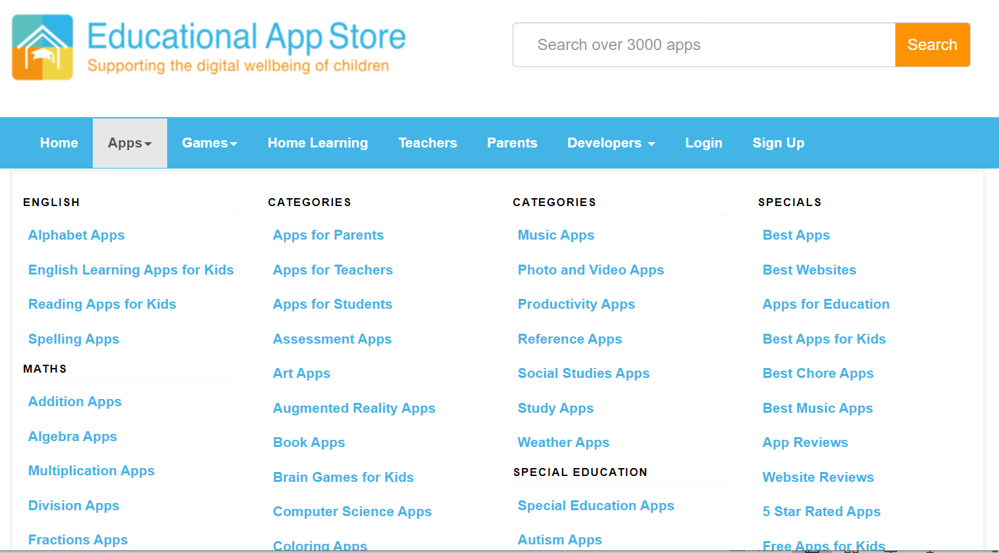
Leveraging Computer Programs and Applications to Meet Educational Needs
The resources are abundant!
https://www.educationalappstore.com/app-lists/best-apps-for-schools
CDE does not promote specific online resources.

Slide 7
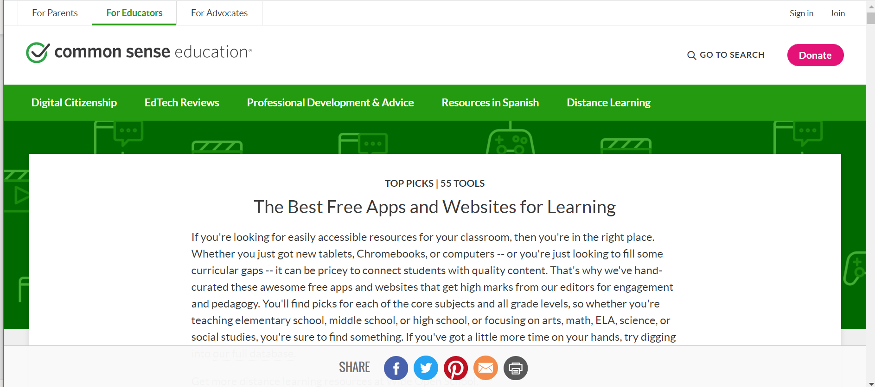
Leveraging Computer Programs and Applications to Meet Educational Needs
The resources are abundant!
https://www.commonsense.org/education/top-picks/the-best-free-apps-and-websites-for-learning
CDE does not promote specific online resources.

Slide 8

Leveraging Computer Programs and Applications to Meet Educational Needs
The resources are abundant!
https://www.teachthought.com/technology/38-best-elementary-learning-apps-for-students/
CDE does not promote specific online resources.

Slide 9

Leveraging Computer Programs and Applications to Meet Educational Needs
The resources are abundant!
https://www.weareteachers.com/best-free-apps-for-students/
CDE does not promote specific online resources.

Slide 10

Leveraging Computer Programs and Applications to Meet Educational Needs
The resources are abundant!
Maybe, too abundant!
Having too many choices is often as bad as having too few!

Slide 11
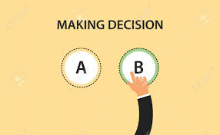
Leveraging Computer Programs and Applications to Meet Educational Needs
Pick ONE Primary Resource (designate a preferred listing) from which to browse Educational Apps for Consideration. Encourage Staff to review the listing for their Educational Application needs.
Let someone else do the initial vetting!

Slide 12

Leveraging Computer Programs and Applications to Meet Educational Needs
If Staff or Students want to use an Application not on the Preferred List, be clear, that it will be evaluated like all other Applications, for suitability, prior to use.

Slide 13

Leveraging Computer Programs and Applications to Meet Educational Needs
Have a dedicated Team and a standard, agreed upon process (check list) for evaluating Apps for use to ensure a consistent appraisal.
Is it Educational?
Who else is using it?
Is it recommended?
How is it rated?
Are we following the Student Data Transparency and Security Act?
What can we glean from their Privacy Policy? 5W2H

Slide 14

Leveraging Computer Programs and Applications to Meet Educational Needs
Ultimately, the
assessment weighs risk and reward.

Slide 15
Leveraging Computer Programs and Applications to Meet Educational Needs
Is the App being considered designed for Educational Use?
In a new study in Psychological Science in the Public Interest, Kathy Hirsh-Pasek of Temple University and colleagues offer a way to evaluate current and future educational apps. Building on decades of work on the “Science of Learning” about how children learn best, they identify four pillars that make for an educational app: “Apps designed to promote active, engaged, meaningful, and socially interactive learning,” the researchers write, “within the context of a supported learning goal are considered educational.”
https://www.cogneurosociety.org/ed_apps_kaufman_may15/#:~:text=Building%20on%20decades%20of%20work,a%20supported%20learning%20goal%20are

Slide 16
Leveraging Computer Programs and Applications to Meet Educational Needs
The four main “pillars of learning,” according to Kathy Hirsh-Pasek of Temple University and Colleagues
Active, “minds-on” learning takes place when children experience learning as a collaborative process and are able to actively build understanding.
For apps, this means that some kind of cognitive activity should be required; physical actions alone, such as activating basic touch-screen functions or moving the device, are not enough. Control is a key factor: The app needs to allow children to proceed at their own pace. Socially interactive learning is based on a collaborative learning experience, and is particularly successful when learning a language. Naturally, responsitivity is limited in apps. However, they offer various possibilities for social interaction: They can allow multiple users to work on a learning process together, for example, or they can facilitate mediated interactions or parasocial relationships with on-screen characters.
https://bold.expert/what-makes-an-app-educational/

Slide 17
Leveraging Computer Programs and Applications to Meet Educational Needs
The four main “pillars of learning,” according to Kathy Hirsh-Pasek of Temple University and Colleagues
2. Engaged learning is strongly linked to a low level of distraction. Individuals who are truly engaged in learning will develop a state of “flow” (intrinsic motivation).
Fancy features in an app may disrupt one’s cognitive processing capacity because they interrupt the narrative. What supports engagement and concentration is contingent interaction – e.g. when an app responds immediately to an action taken by the child. Rewards (extrinsic motivation) can be helpful but should not be overdone. https://bold.expert/what-makes-an-app-educational/

Slide 18
Leveraging Computer Programs and Applications to Meet Educational Needs
Is the App being considered designed for Educational Use?
3. Meaningful learning takes place when information is embedded into a meaningful context. Learners need to be able to connect experiences and use them to build their own model. While memorizing a huge set of unconnected facts (rote learning) can serve as a basis for meaningful learning, it is inefficient without a conceptual framework.
An app can promote meaningful learning by interacting with content that is connected to children’s lives instead of just conveying isolated facts.
https://bold.expert/what-makes-an-app-educational/

Slide 19
Leveraging Computer Programs and Applications to Meet Educational Needs
Is the App being considered designed for Educational Use?
4. Socially interactive learning is based on a collaborative learning experience, and is particularly successful when learning a language.
Naturally, responsitivity is limited in apps. However, they offer various possibilities for social interaction: They can allow multiple users to work on a learning process together, for example, or they can facilitate mediated interactions or parasocial relationships with on-screen characters.
https://bold.expert/what-makes-an-app-educational/

Slide 20
Leveraging Computer Programs and Applications to Meet Educational Needs
Are other Local Education Providers Using the App?
Each Local Education Provider shall post on its website, to the extent practicable, a list of the School Service On-Demand Providers that the Local Education Provider or an employee of the Local Education Provider uses for School Services. At a minimum, the Local Education Providers shall update the list of School Service On-Demand Providers at the beginning and mid-point of each school year. The Local Education Provider, upon the request of a Parent, shall assist the parent in obtaining the Data Privacy Policy of a School Service On-Demand Provider that the Local Education Provider or an employee of the Local Education Provider uses.
Local Education Providers Obligations under the Student Data Transparency and Security Act (HB 16-1423; C.R.S. 22-16-101 et. seq) https://www.cde.state.co.us/dataprivacyandsecurity-2

Slide 21
Leveraging Computer Programs and Applications to Meet Educational Needs
How is the App Rated? Look for Reviews.
User reviews. Sometimes it takes a village to figure out which apps are right for our kids. If you're on the fence, see what other parents -- and even kids -- are saying. Although our user community's ratings are based on personal opinion rather than developmental guidelines, they do rate apps using the same tools our editors do, with icons to flag areas of concern, stars to signal overall quality, and a target age to help you decide.
https://www.commonsensemedia.org/about-us/our-mission/about-our-ratings/apps

Slide 22
Leveraging Computer Programs and Applications to Meet Educational Needs
Privacy Policy
Privacy and safety. For kids under 13, COPPA rules are designed to protect personal information. But whether an app is collecting personal information about kids or adults isn't always obvious. Some developers (not enough) offer short, sweet privacy policies written in plain language. But more often, you'll feel like you need a law degree to decipher the legalese.

Slide 23
Leveraging Computer Programs and Applications to Meet Educational Needs
Privacy Policy - Continued
Aggregate data collection can be good -- it can even help developers improve their products. It's what happens to your information that's key. Will it be sold to marketers who then will target you? Can you have your personal information removed from the developer's records? There also are issues related to kids' safety to consider: Can they interact with others? Are location details collected and revealed? How easy is it to delete your account and remove any or all data?
https://www.commonsensemedia.org/about-us/our-mission/about-our-ratings/apps

Slide 24
Leveraging Computer Programs and Applications to Meet Educational Needs
Evaluating a Privacy Policy - 5W1H
Who – Who (or what) is providing the personal information that is collected?
  How – How is the personal information collected?
What – What personal information is collected by the App?
When – When, or how long is the personal information that is collected retained? When is the personal information that is collected deleted?
Where – Where is the personal information that is collected stored?
Why – Why does the personal information collected need to be collected? What is the purpose? Functionality?
  2. How – How will the personal information collected be used?

Slide 25
Leveraging Computer Programs and Applications to Meet Educational Needs
Do Staff and Students Know What is Expected of Them?
What is the Acceptable Use Policy?
What is the School/District’s Data Privacy Policy?
Do we have a process for vetting Apps?
Are we following the Student Data Transparency and Security Act?
Is our process for vetting Apps being followed?

Slide 26
Leveraging Computer Programs and Applications to Meet Educational Needs
My Questions for You
Has this time/information been helpful?
Do you feel you are supported/have the resources to be successful in App vetting?
Has the concentration on App vetting increased with COVID/Remote Learning? Why? Who is the pressure coming from?
What insecurities do you have around App vetting?
Has anything that has been shared today increase your confidence around App vetting?
What keeps you up at night?
What solutions seem evasive?
How can CDE help?

Slide 27

Leveraging Computer Programs and Applications to Meet Educational Needs
Your Questions for Me

