Slide 1
Multilingual Learners State of the State
School Year 2023-2024

Slide 2
Introduction
Multilingual Learners (MLs) are students who are linguistically diverse and identified as having a level of English language proficiency that requires language scaffolds to achieve standards in grade-level content in English.
Federal reporting for multilingual learners typically refers to students with non-English proficiency (NEP) or limited English proficiency (LEP).
Colorado also includes students monitored for two years following redesignation as fluent English proficient (FEP Monitor Year 1 or 2) when analyzing the performance of multilingual learners.
When possible, data are disaggregated separately by language proficiency level.
Colorado also includes data for former multilingual learners – students who have exited from an English language development (ELD) program after demonstrating English language proficiency and grade-level proficiency in reading, writing, and other content areas. This includes students within two years of exiting an ELD program (FEP Exit Year 1 or 2) and students identified as former English language learners (FELL).
For comparison purposes, tables and figures include data on all Colorado students, as well as data for students not identified as multilingual learners.
Notes:
PHLOTE refers to students with a primary home language other than English.

Slide 3
Multilingual Learners (MLs) in Colorado

Slide 4
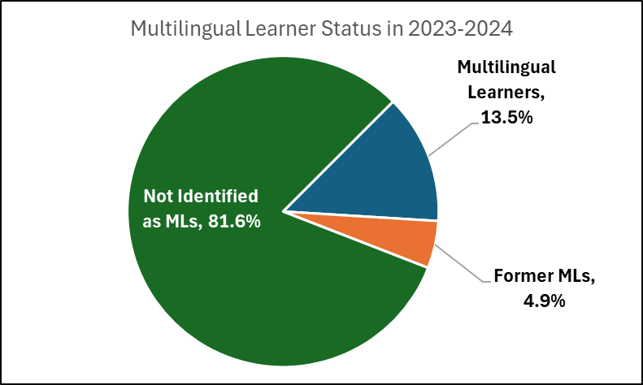
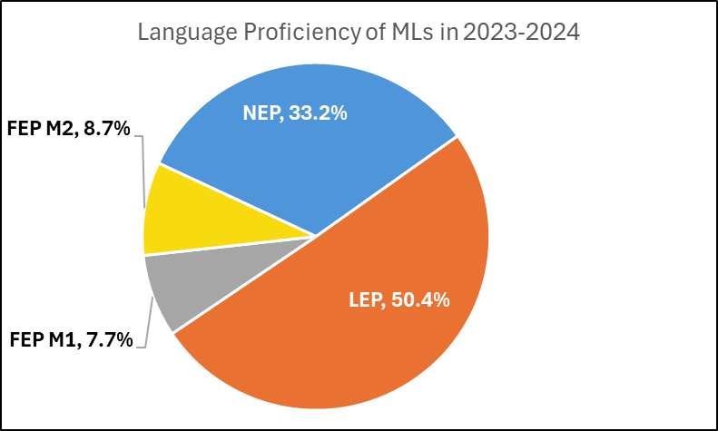
Total Number of Multilingual Learners (MLs) in Grades K-12 in Colorado
School Year | NEP (Non-English Proficient) | LEP (Limited English Proficient) | FEP M1 (Fluent English Proficient Monitor Year 1) | FEP M2 (Fluent English Proficient Monitor Year 2) | Total MLs (NEP, LEP, FEP M1/M2) | Former MLs | All K-12 Students
2019-2020 | 29,147 | 67,390 | 14,200 | 12,239 | 122,976 | 42,030 | 878,798
2020-2021 | 23,960 | 66,262 | 11,255 | 12,340 | 113,817 | 44,910 | 856,783
2021-2022 | 36,093 | 55,867 | 7,701 | 9,900 | 109,561 | 46,351 | 855,623
2022-2023 | 34,921 | 56,658 | 11,398 | 6,803 | 109,780 | 45,411 | 851,059
2023-2024 | 38,036 | 57,671 | 8,827 | 9,948 | 114,482 | 41,813 | 849,404
Updated by Federal Programs and Supports Unit (July 2024); Data Source: 2019-2020 through 2023-2024 Student October, pupil attendance codes 01 through 08.

Slide 5
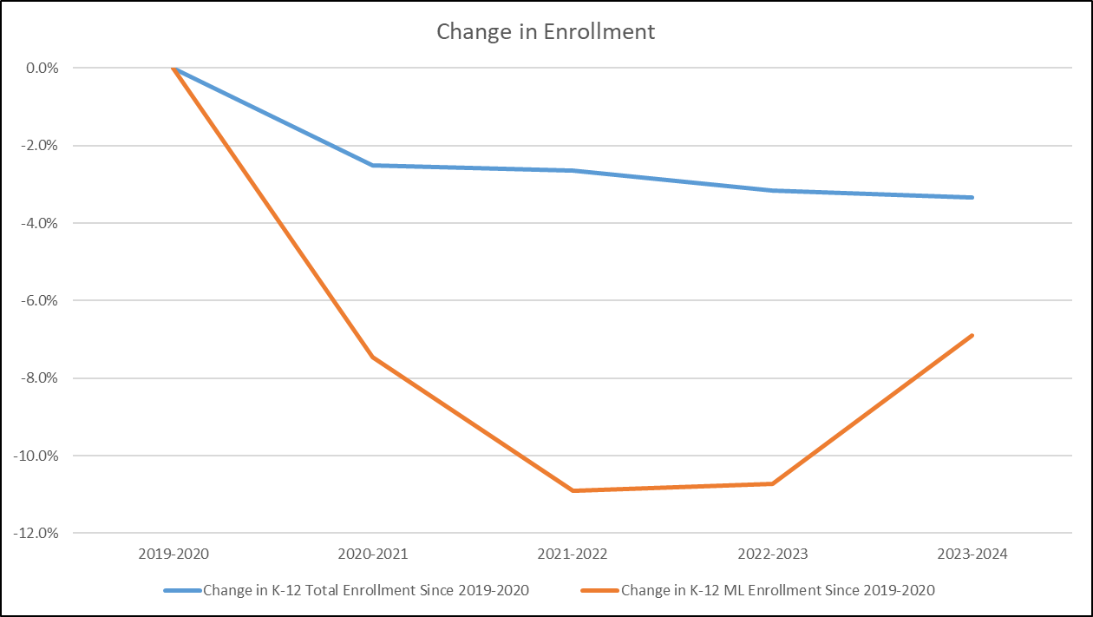
K-12 ML Percentage Change Since 2019-2020
Total K-12 enrollment decreased 3.3% from 2019-2020 to 2023-2024
ML K-12 enrollment decreased 6.9% from 2019-2020 to 2023-2024
Updated by Federal Programs and Supports Unit (April 2024); Data Source: 2019-2020 through 2023-2024 Student October, pupil attendance codes 01 through 08. ML = NEP, LEP, FEP Monitor Year 1 and 2 only.

Slide 6
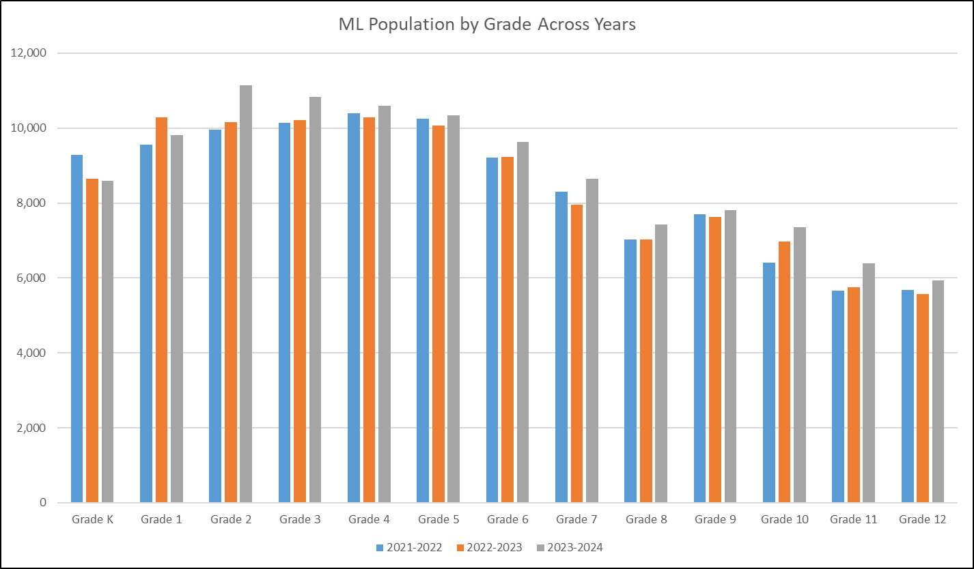
K-12 ML Population by Grade
Updated by Federal Programs and Supports Unit (April 2024); Data Source: 2021-2022 through 2023-2024 Student October, pupil attendance codes 01 through 08. ML = NEP, LEP, FEP Monitor Year 1 and 2 only.

Slide 7
Location and Context

Slide 8
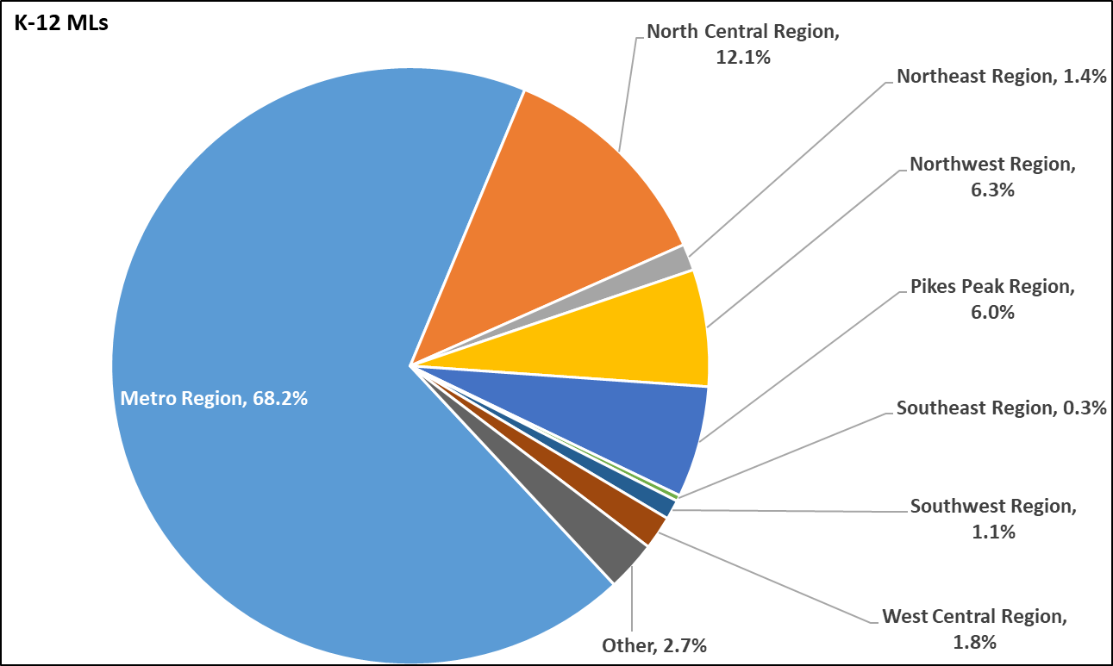
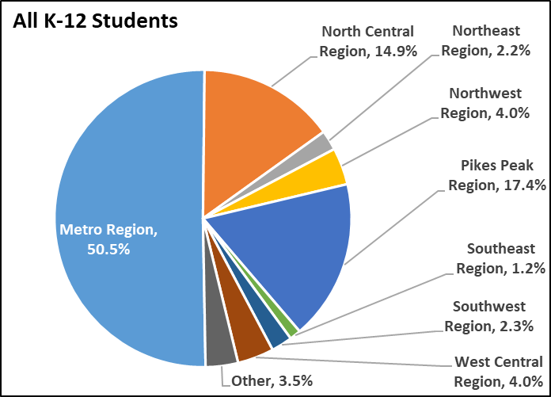
K-12 ML Geographic Distribution by Region
Updated by Federal Programs and Supports Unit (April 2024); Data Source: 2023-2024 Student October, pupil attendance codes 01 through 08. ML = NEP, LEP, FEP Monitor Year 1 and 2 only. “Other” includes Charter School Institute, Detention Centers, and Education reEnvisioned BOCES.

Slide 9
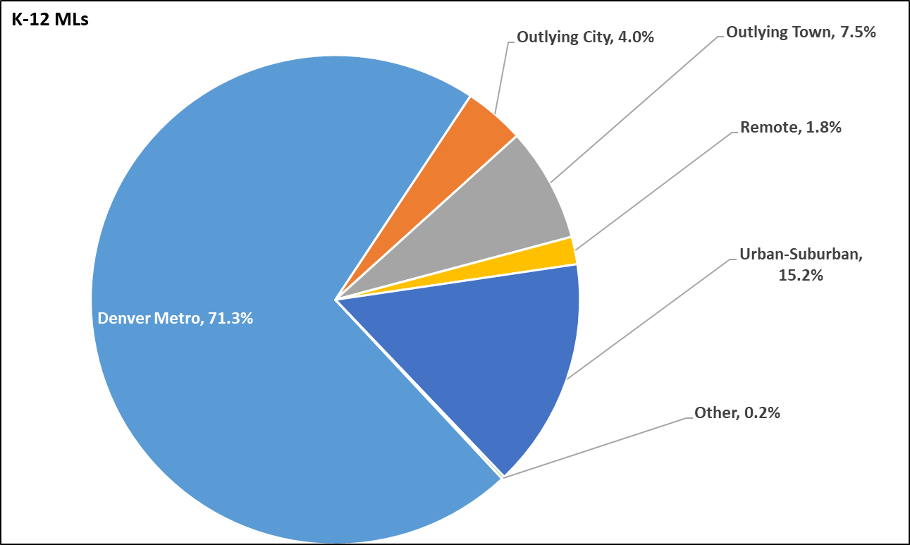
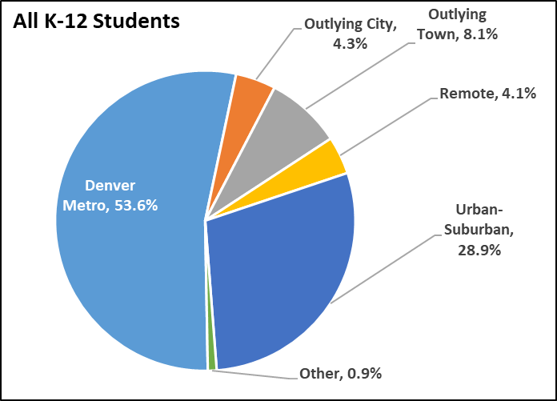
K-12 ML Geographic Distribution by Setting
Updated by Federal Programs and Supports Unit (April 2024); Data Source: 2023-2024 Student October, pupil attendance codes 01 through 08. ML = NEP, LEP, FEP Monitor Year 1 and 2 only. “Other” includes Detention Centers and BOCES. “Urban-Suburban” reflects population center over 30,000 residents outside of Denver Metro Area. “Outlying City” reflects population center of 7,000 to 30,000 residents. “Outlying Town” reflects population center of 1,000 to 7,000 residents. “Remote” reflects population center of less than 1,000 residents.

Slide 10
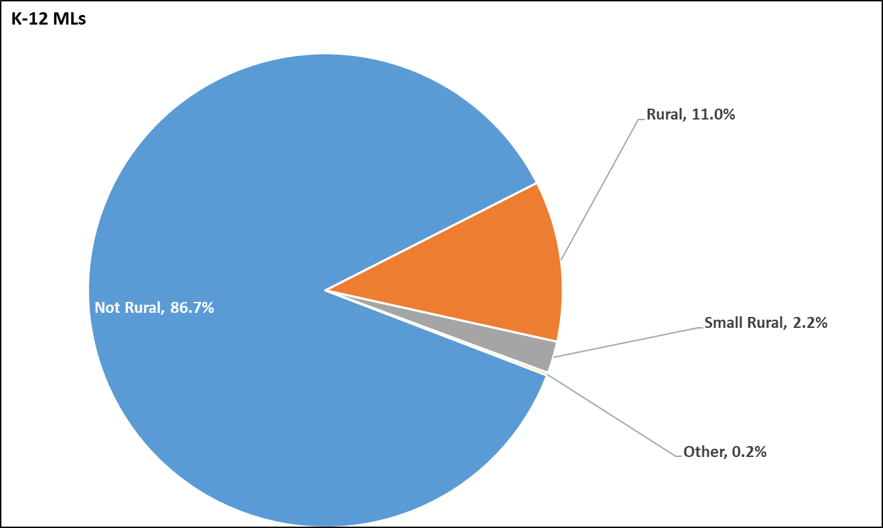
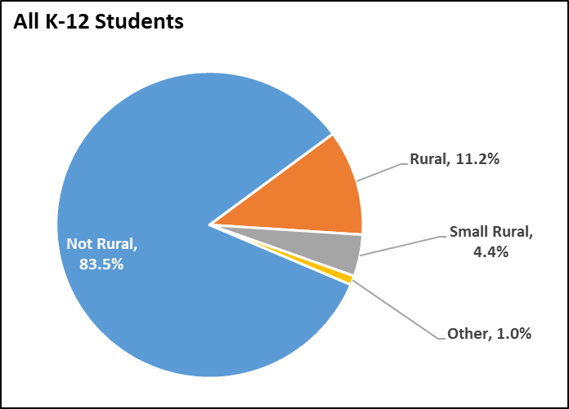
K-12 ML Geographic Distribution by Rural Status
Updated by Federal Programs and Supports Unit (April 2024); Data Source: 2023-2024 Student October, pupil attendance codes 01 through 08. ML = NEP, LEP, FEP Monitor Year 1 and 2 only. “Other” includes Colorado School for the Deaf and Blind, Detention Centers, and BOCES. Rural status obtained from the Rural and Small Rural Designation List.

Slide 11
Top 10 Districts by Number of K-12 MLs
District Code | District Name | All K-12 Students | K-12 MLs | Percent ML
0880 | Denver County 1 | 83,387 | 26,494 | 31.8%
0180 | Adams-Arapahoe 28J | 37,522 | 16,335 | 43.5%
0130 | Cherry Creek 5 | 50,680 | 7,591 | 15.0%
0020 | Adams 12 Five Star Schools | 34,054 | 5,810 | 17.1%
3120 | Greeley 6 | 22,322 | 4,804 | 21.5%
1420 | Jefferson County R-1 | 73,590 | 4,733 | 6.4%
0470 | St Vrain Valley RE1J | 31,226 | 3,595 | 11.5%
0040 | School District 27J | 22,313 | 3,587 | 16.1%
0900 | Douglas County Re 1 | 60,361 | 3,058 | 5.1%
8001 | Charter School Institute | 22,653 | 2,925 | 12.9%
Updated by Federal Programs and Supports Unit (April 2024); Data Source: 2023-2024 Student October, pupil attendance codes 01 through 08. ML = NEP, LEP, FEP Monitor Year 1 and 2 only. Excludes Detention Centers.

Slide 12
Top 10 Districts by Percent of K-12 MLs
District Code | District Name | All K-12 Students | K-12 MLs | Percent ML
0030 | Adams County 14 | 5,112 | 2,425 | 47.4%
0180 | Adams-Arapahoe 28J | 37,522 | 16,335 | 43.5%
0010 | Mapleton 1 | 6,521 | 2,419 | 37.1%
2810 | Center 26 JT | 569 | 207 | 36.4%
0123 | Sheridan 2 | 941 | 331 | 35.2%
0880 | Denver County 1 | 83,387 | 26,494 | 31.8%
0070 | Westminster Public Schools | 7,139 | 2,243 | 31.4%
2670 | Holly RE-3 | 246 | 77 | 31.3%
1510 | Lake County R-1 | 889 | 278 | 31.3%
1180 | Roaring Fork RE-1 | 5,607 | 1,722 | 30.7%
Updated by Federal Programs and Supports Unit (April 2024); Data Source: 2023-2024 Student October, pupil attendance codes 01 through 08. ML = NEP, LEP, FEP Monitor Year 1 and 2 only. Excludes Detention Centers.

Slide 13
Characteristics

Slide 14
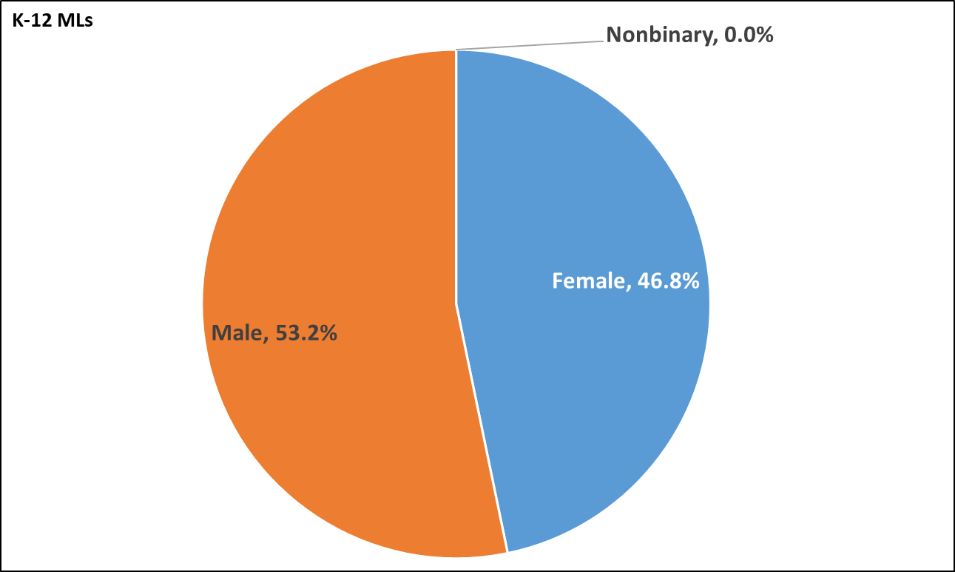
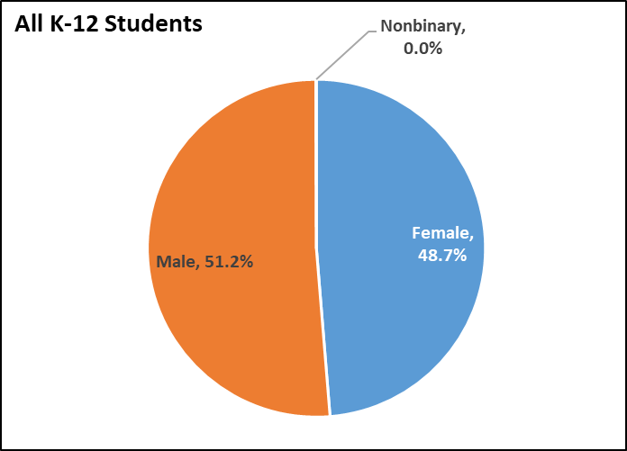
K-12 MLs by Gender
Updated by Federal Programs and Supports Unit (April 2024); Data Source: 2023-2024 Student October, pupil attendance codes 01 through 08. ML = NEP, LEP, FEP Monitor Year 1 and 2 only.

Slide 15
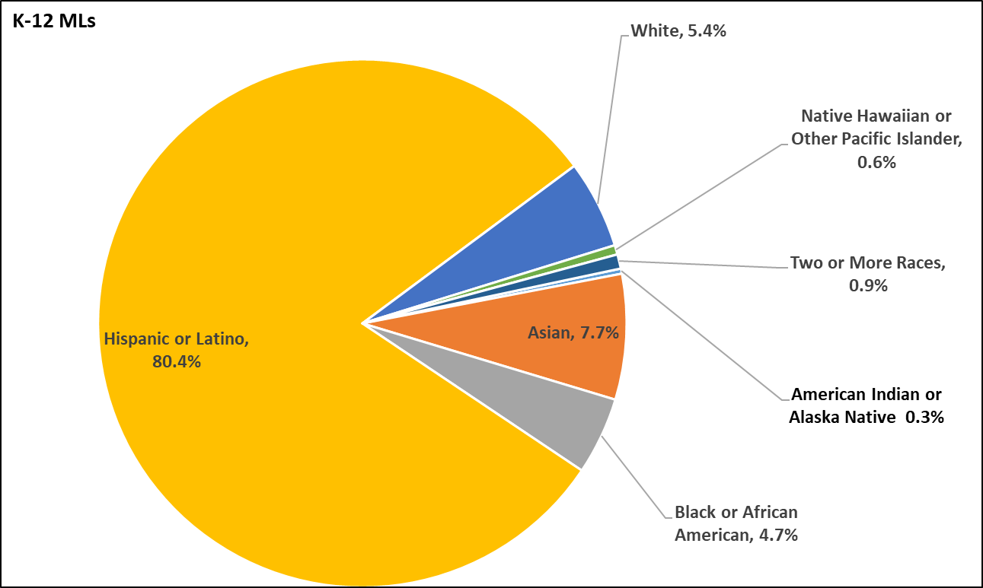
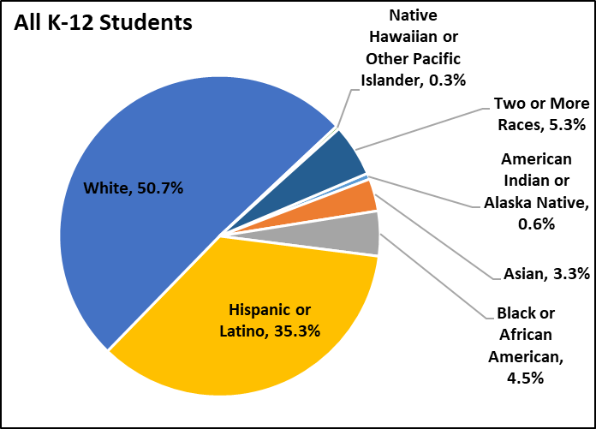
K-12 MLs by Race/Ethnicity
Updated by Federal Programs and Supports Unit (April 2024); Data Source: 2023-2024 Student October, pupil attendance codes 01 through 08. ML = NEP, LEP, FEP Monitor Year 1 and 2 only.

Slide 16
Top 20 Home Languages Spoken by K-12 MLs
Language | K-12 MLs | Percent of MLs
Spanish | 92,602 | 80.9%
Arabic | 2,147 | 1.9%
Vietnamese | 1,469 | 1.3%
Russian | 1,408 | 1.2%
Amharic | 1,361 | 1.2%
Chinese, Mandarin | 1,059 | 0.9%
Nepali | 828 | 0.7%
Dari, Zoroastrian | 770 | 0.7%
Somali | 721 | 0.6%
French | 720 | 0.6%
Farsi, Eastern | 582 | 0.5%
Tigrigna | 479 | 0.4%
Pashto, Central | 457 | 0.4%
Korean | 447 | 0.4%
Burmese | 429 | 0.4%
Telugu | 379 | 0.3%
Chuukese | 370 | 0.3%
Swahili | 363 | 0.3%
Portuguese | 344 | 0.3%
Hindi | 324 | 0.3%
Updated by Federal Programs and Supports Unit (April 2024); Data Source: 2023-2024 Student October, pupil attendance codes 01 through 08. ML = NEP, LEP, FEP Monitor Year 1 and 2 only.

Slide 17
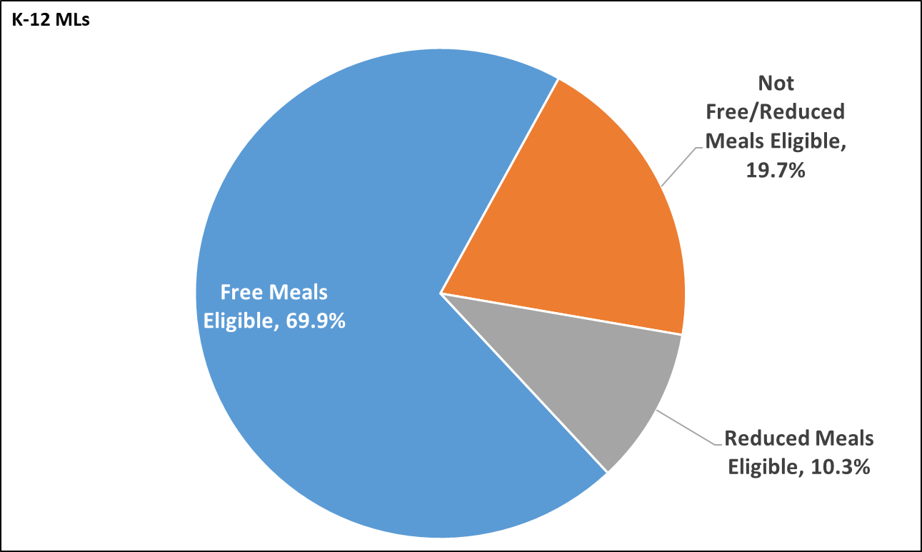
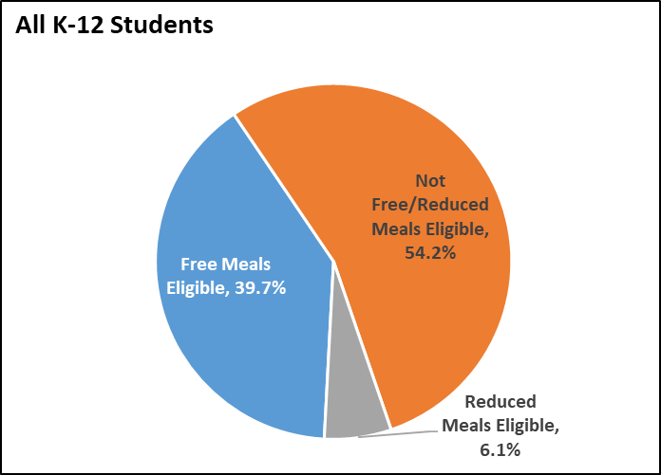
K-12 MLs by Free/Reduced Meal Eligibility
Updated by Federal Programs and Supports Unit (April 2024); Data Source: 2023-2024 Student October, pupil attendance codes 01 through 08. ML = NEP, LEP, FEP Monitor Year 1 and 2 only.

Slide 18
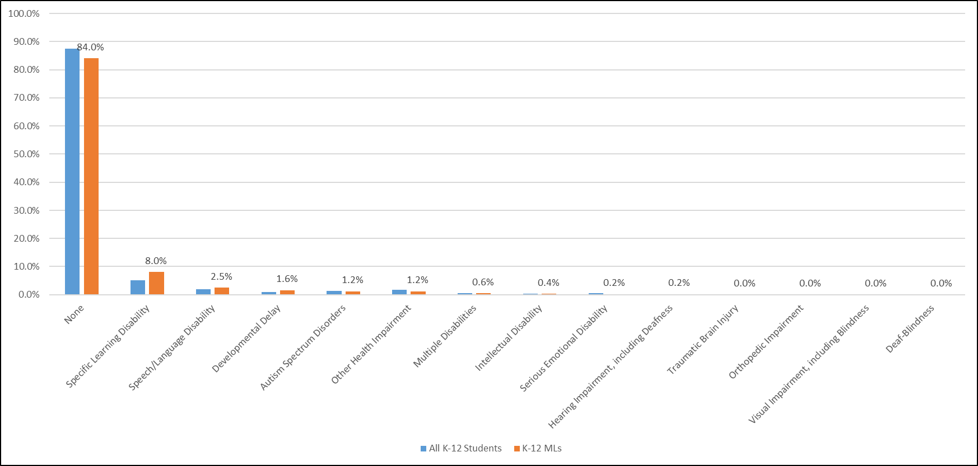
K-12 MLs by Disability Type
Updated by Federal Programs and Supports Unit (April 2024); Data Source: 2023-2024 Student October, pupil attendance codes 01 through 08. ML = NEP, LEP, FEP Monitor Year 1 and 2 only.

Slide 19
’23-’24 CO Total K-12 Students With and Without Individualized Education Programs (IEPs)
Updated by the ESSU’s Office of Special Education. Data Sources: CDE IDEA Child Count for 2023-2024 and 2023-2024 Student October, pupil attendance codes 01 through 08.
Notes:
In School year 2023 and 2024 in Colorado there were 881,464 students of those, 114,482 were multilingual learners, and 776,982 were non-multilingual learners. Of Multilingual Learners, 15.53% were identified with disabilities. Of Non MLs, 11.8% were identified with disabilities.

Slide 20
’23-’24 CO K-12 Dually Identified Students [Multilingual Learners(MLs) Individualized Education Programs(IEPs)]
Updated by the ESSU’s Office of Special Education. Data Sources: CDE IDEA Child Count for 2023-2024 and the Office of Special Education Fast Facts
Notes:
For the 2023-2024 School year, 84% of Colorado K-12 students with disabilities were not Multilingual learners while 16% were multilingual learners. For the 2021 School year, 88% of US K-12 students with disabilities were not Multilingual learners while 12% were multilingual learners

Slide 21
’23-24 CO K-12 Students with IEPs with Specific Learning Disabilities or All Other Disabilities
Updated by the ESSU’s Office of Special Education. Data Sources: CDE IDEA Child Count for 2023-2024 ’24 and the National Center for Education Statistics and the Office of Special Education Fast Facts
Notes:
Due to a lag in data collection, we only have national data for 2021 where we find that 32% of students with IEPs in the US were identified with a Specific Learning Disability. For comparison, In Colorado last year, we found that just over 40% of our students with disabilities were identified with SLD. Nationally nearly 45% of MLs with disabilities were identified with SLD. When we review the data for Multilingual learners in Colorado, we find that more than 50% of dually identified learners fall under the category of SLD last year.
With what degree of certainty have we ruled out the exclusionary factors for SLD such as English language proficiency or lack of appropriate instruction?
How have we ruled out cultural differences as a determinative factor?
What about socioeconomic status?
If many of these students do in fact have a disability and we have ruled out these exclusionary factors, how confident are we that SLD is the most accurate category for identification?

Slide 22
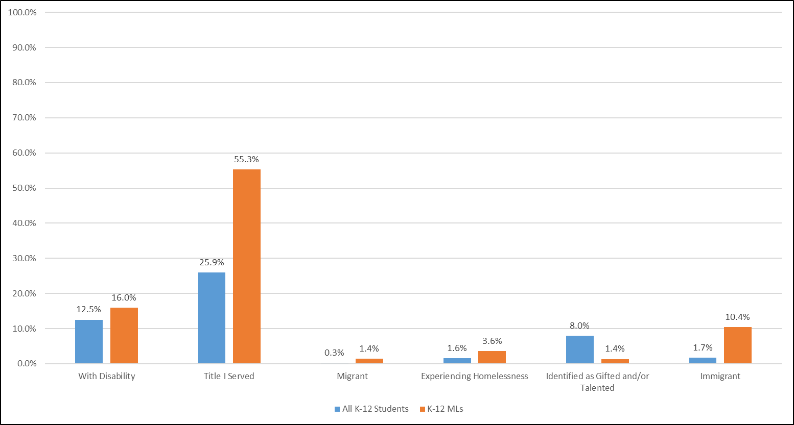
K-12 MLs by Other Programs
Updated by Federal Programs and Supports Unit (April 2024); Data Source: 2023-2024 Student October, pupil attendance codes 01 through 08. ML = NEP, LEP, FEP Monitor Year 1 and 2 only.

Slide 23
Academic Achievement

Slide 24
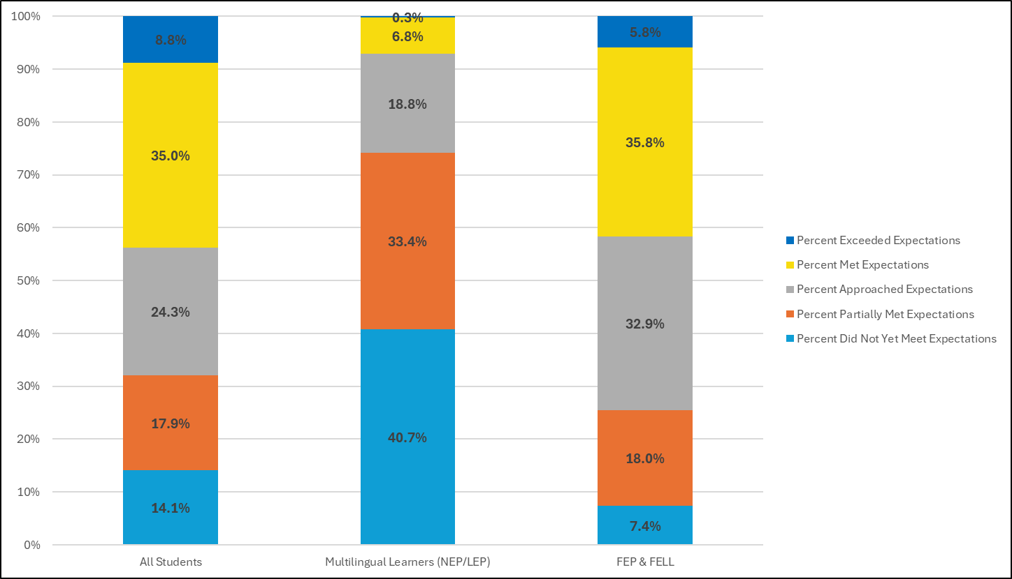
CMAS English Language Arts Results
All Students Participation Rate = 88.8%
ML Participation Rate = 88.0%
FEP & FELL Participation Rate = 92.4%
Updated by Federal Programs and Supports Unit (July 2024); Data Source: 2022-2023 CMAS English Language Arts. ML = NEP and LEP only. FEP = Fluent English Proficient (Monitor Year 1 & 2, Exit Year 1 & 2) and FELL = Former Multilingual Learners.

Slide 25
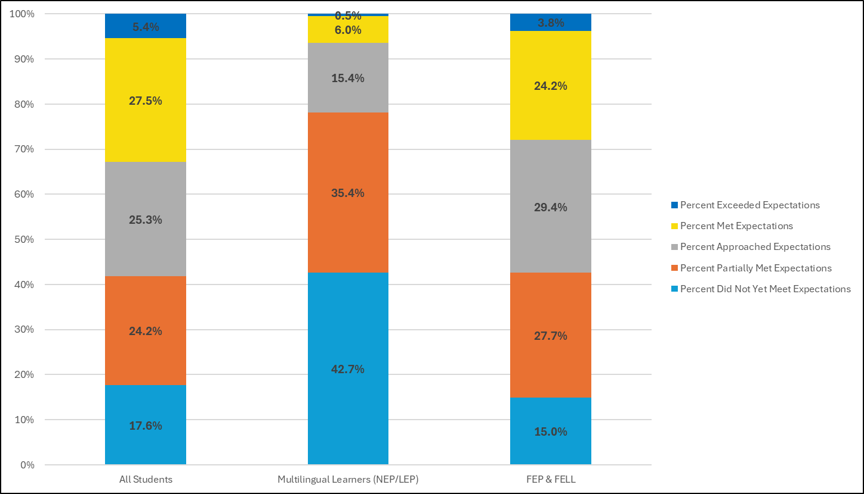
CMAS Math Results
All Students Participation Rate = 89.2%
ML Participation Rate = 91.9%
FEP & FELL Participation Rate = 92.4%
Updated by Federal Programs and Supports Unit (July 2024); Data Source: 2022-2023 CMAS Mathematics. ML = NEP and LEP only. FEP = Fluent English Proficient (Monitor Year 1 & 2, Exit Year 1 & 2) and FELL = Former Multilingual Learners.

Slide 26
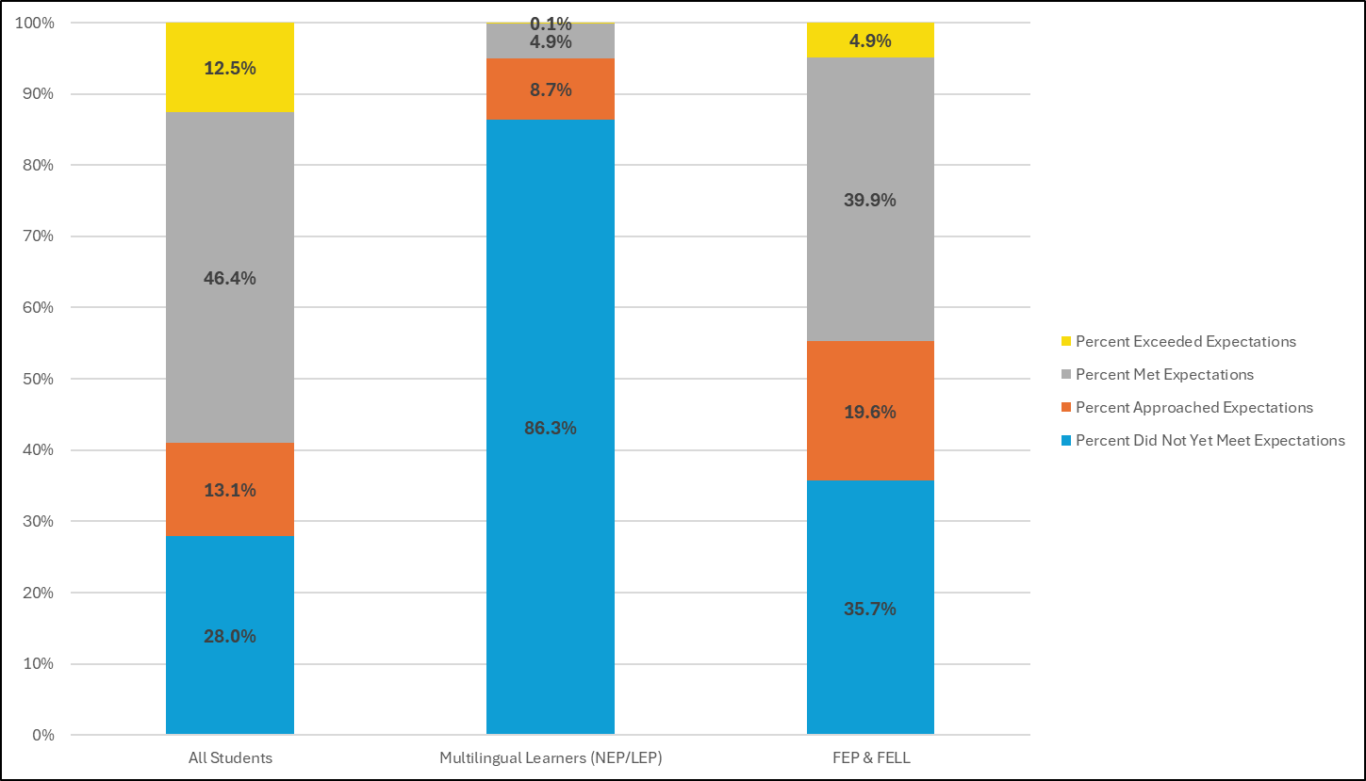
SAT Evidence-Based Reading and Writing Results
All Students Participation Rate = 86.6%
ML Participation Rate = 78.1%
FEP & FELL Participation Rate = 90.9%
Updated by Federal Programs and Supports Unit (July 2024); Data Source: 2022-2023 SAT Evidence-Based Reading and Writing. ML = NEP and LEP only. FEP = Fluent English Proficient (Monitor Year 1 & 2, Exit Year 1 & 2) and FELL = Former Multilingual Learners.

Slide 27
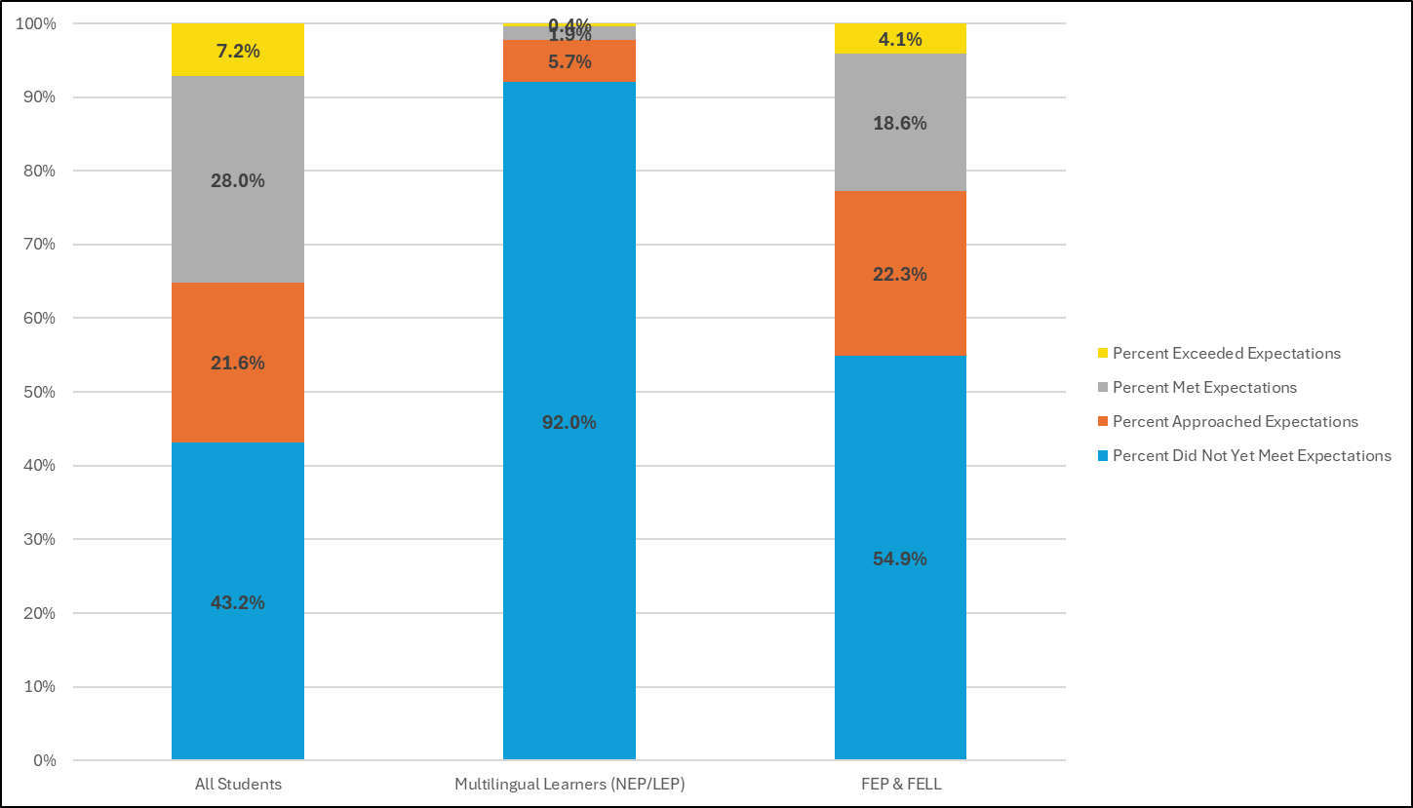
SAT Math Results
All Students Participation Rate = 86.6%
ML Participation Rate = 78.2%
FEP & FELL Participation Rate = 90.9%
Updated by Federal Programs and Supports Unit (July 2024); Data Source: 2022-2023 SAT Mathematics. ML = NEP and LEP only. FEP = Fluent English Proficient (Monitor Year 1 & 2, Exit Year 1 & 2) and FELL = Former Multilingual Learners.

Slide 28
English Language Proficiency Assessments

Slide 29
Performance on ACCESS
Category | Level 1 | Level 2 | Level 3 | Level 4 | Levels 5 & 6
Number MLs | 17,570 | 19,152 | 34,685 | 15,125 | 2,401
Percent MLs | 19.8% | 21.5% | 39.0% | 17.0% | 2.7%
Updated by Federal Programs and Supports Unit (July 2024); Data Source: 2022-2023 ACCESS for ELLs Assessment. ML = NEP and LEP only.

Slide 30
Students Eligible for Redesignation Based on ACCESS Performance
Category | Eligible for Redesignation
Number MLs | 11,896
Percent MLs | 13.4%
Updated by Federal Programs and Supports Unit (July 2024); Data Source: 2022-2023 ACCESS for ELLs Assessment. ML = NEP and LEP only.

Slide 31
Graduation and Dropout Rates

Slide 32
Graduation Rates
4-Year
Student Group | Number (N) of Students in Graduation Base | Number (N) of Graduates | Graduation Rate (%)
All Students | 68,356 | 56,284 | 82.3%
Multilingual Learners | 8,633 | 5,991 | 69.4%
7-Year
Student Group | Number (N) of Students in Graduation Base | Number (N) of Graduates | Graduation Rate (%)
All Students | 66,676 | 58,121 | 87.2%
Multilingual Learners | 9,089 | 7,165 | 78.8%
Updated by Federal Programs and Supports Unit (April 2024); Data Source: 2021-2022 Graduation Rates. ML = NEP, LEP, FEP Monitor Year 1 and 2 only.

Slide 33
Dropout Rates
Student Group | Total Pupil Count | Total Dropouts | Total Dropout Rate
All Students | 476,226 | 10,524 | 2.2%
Multilingual Learners | 48,384 | 2,111 | 4.4%
Updated by Federal Programs and Supports Unit (April 2024); Data Source: 2021-2022 Dropout Rates Grades 7-12. ML = NEP, LEP, FEP Monitor Year 1 and 2 only.

Slide 34
National Assessment of Educational Progress (NAEP)

Slide 35
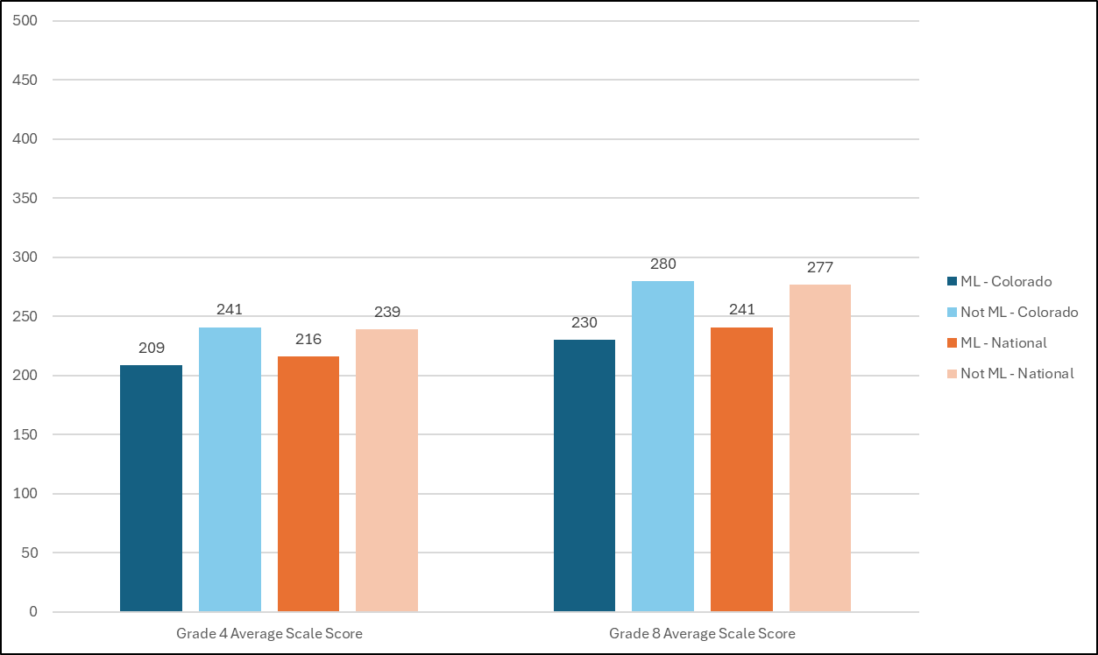
Average scale scores on NAEP Math Assessment
Updated by Federal Programs and Supports Unit (April 2024); Data Source: 2022 National Assessment of Educational Progress (NAEP) in Math. ML = NEP and LEP only.

Slide 36
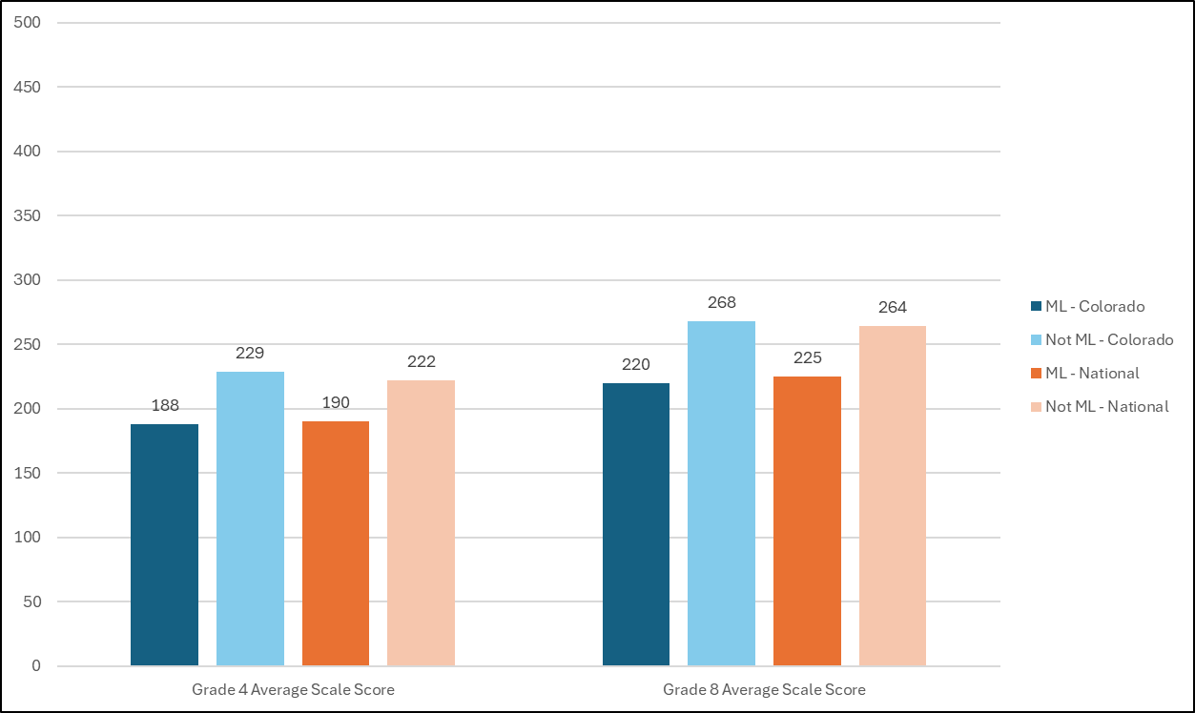
Average scale scores on NAEP Reading Assessment
Updated by Federal Programs and Supports Unit (April 2024); Data Source: 2022 National Assessment of Educational Progress (NAEP) in Reading. ML = NEP and LEP only.

Slide 37
READ Act

Slide 38
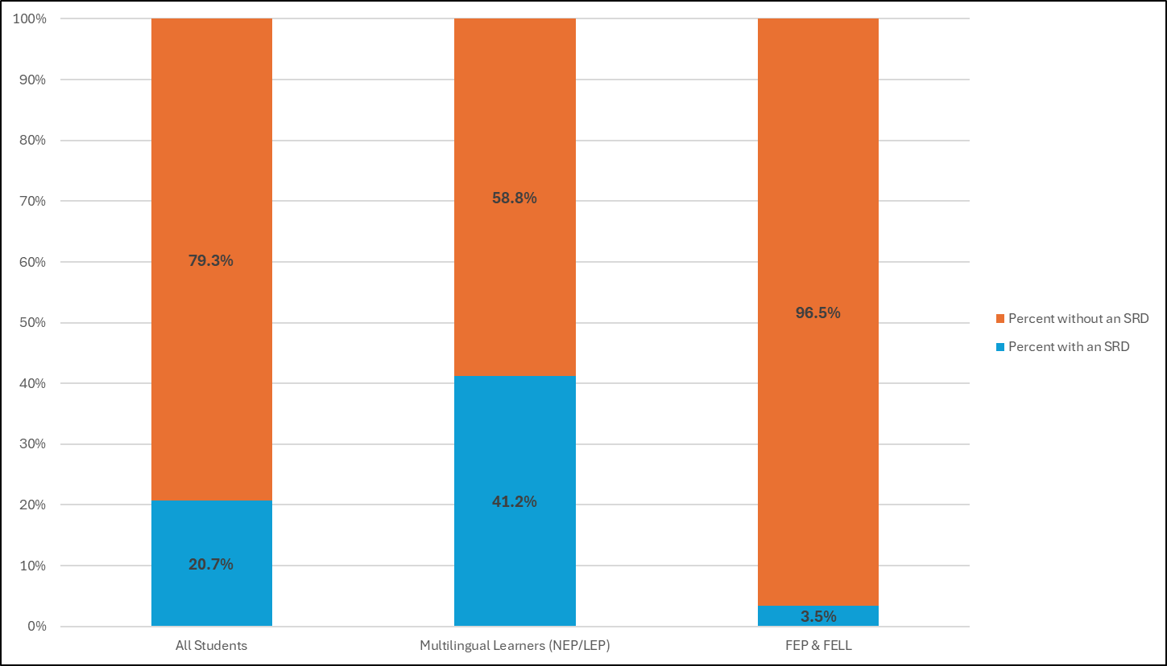
READ Act Results
Updated by Federal Programs and Supports Unit (July 2024); Data Source: 2022-2023 READ Act Assessment. ML = NEP and LEP only. FEP & FELL = Fluent English Proficient (Monitor Year 1 & 2, Exit Year 1 & 2) and Former Multilingual Learners.

