Slide 1





ESSA School Improvement Spoke Committee
September 23, 2016
Committee Co-Leads: Brad Bylsma, Lisa Medler, Peter Sherman
1

Slide 2
ESSA School Improvement Spoke Committee
Agenda for Today
10:00
Welcome, goals for the day, framing Committee updates
Guiding principles and theory of action Current state supports and interventions School support scenarios
Lunch
State Plan discussion and recording of ideas Next steps and topics
10:20
10:40
11:00
11:45
12:15
1:30
2

Slide 3
ESSA School Improvement Spoke Committee
Guiding Thoughts
Let’s do what we know will be best for students.
Let’s make your engagement on this committee as tangible, clear, and productive as possible.
We want your input and representation. We also strive to be as transparent as possible about what is possible and negotiable vs. what may be less-negotiable.
We welcome individuals who are interested in specific aspects of this work to engage with us deeper in between spoke committee meetings.
3

Slide 4
Decision Points for School Improvement and Support
SEA supports for identified schools
Identify and define “evidence-based” interventions
Allocation of School Improvement resources
4

Slide 5
ESSA School Improvement Spoke Committee
Guiding Questions
What are our current (and recent past) supports offered by CDE (specifically for districts and schools in Priority Improvement or Turnaround)?
What has worked and what has not worked in our previous efforts to turnaround low-performing systems? How do we know?
What theory of action should we follow in designing our systems of support to have the biggest impact on low-performing systems?
What criteria should we consider and apply for CDE systems of supports to low- performing districts and schools?
Where are we negotiable and non-negotiable in what supports we offer? Why?
What funding is necessary in order to provide these systems of support?
5

Slide 6
ESSA School Improvement Spoke Committee
Questions to answer (for next time)
How should CDE allocate funds to LEAs?
How can we utilize the funding levers through competitive and/or formula funding to prioritize actions and evidence-based practice for low-performing schools?
What performance goals and/or criteria can we set to determine either awarding of funds or retention of funds to LEAs?
6

Slide 7
Guiding Principles and a Theory of Action
7

Slide 8
Guiding Principles (or a theory of action) for School Improvement work
We will build district capacity to support low-performing schools and ensure students success, IF we…
Focus work with district staff and leadership with some direct support for schools;
Create a deep pool of school and district leaders that specialize in addressing low- performing systems;
Focus on results, rather than inputs that do not yield high value;
Differentiate our support based on district/school need and willingness to engage;
Offer a variety of strategies and tools matched to district/school need (e.g., performance management tool, autonomy and flexibility); and
Continuously evaluate the impact of our support systems and adjust practices rapidly when needed.
8

Slide 9
Guiding Principles (or a theory of action
We will build district capacity to support low-performing schools and ensure students success, IF we…
Some direct school support
School and district leadership
Focus on results
Differentiate our support
Variety of strategies and tools
Evaluate the impact of our support
TO DO
In table groups, discuss these guiding principles and consider what you would add, revise, remove.
Write your notes on the handout.
Be prepared to share out one thought.
9

Slide 10
Current CDE Supports and Interventions
and the ESSA context
10

Slide 11
Current State of CDE Supports Federal 1003 grants
1003 Grants
  Generate an eligibility list based on lowest achieving schools (priority schools) and schools with achievement gaps (focus schools)
  Flag for Priority Improvement/Turnaround SPF
  Close overlap between lowest achieving and SPF, but not exact
  Further along the clock does not affect priority school status
  Some PI/T schools are not Title I schools, thus not eligible for 1003 grants
Awarding a grant
  Eligible schools are able to apply for competitive grant programs
  CDE runs a competitive grant process

Slide 12




Current 1003-funded Programs
Grant Name | Award Size | # of awards annually | Duration | Targeted Schools | Key Features
TIG | >$200,000/yr per school | 4-6 | 5 years (3 years in 2016) | Priority Schools | District involvement Light CDE engagement Some required PD
Turnaround Network | $65,000/yr | 8-12 | 3 years | Priority Improvement/Turnaro und (does not need to be Title I to participate) | District involvement High CDE engagement CDE PD required Concurrent turnaround leadership program
Connect for Success | $65,000/yr |  | 2.5 years | Focus schools | District involvement Some required PD
Pathways Planning | $100,000/yr |  | 1 year | Districts | District grant CDE engagement required
Diagnostic Review & Improvement Planning | $50,000/yr |  | 1 year |  | Light CDE engagement
Reading Ignite | $75,000- $125,000 |  | 2 years

Slide 13
Other Turnaround-Targeted Programs
School Turnaround Leaders Development Program
  State funded
  Identifies Turnaround Leadership providers
  Provides grants to districts and schools for individuals to attend these programs
Targeted Support from CDE
  UIP
  MTSS
  Literacy
  Federal programs funds coordination
  Accountability clock supports
13

Slide 14

Differences under ESSA
14

Slide 15

State Leverage Points for School Improvement
From CCSSO (Council of Chief State School Officers)
School identification for Comprehensive and
Targeted Support and Improvement
Distribution and use of Title I school improvement funds
SEA approval and monitoring of support and improvement plans
Coordination with other federal Title programs and SEA/LEA initiatives

Slide 16
Eligibility for support services
Eligibility for Support Services:
ALL Priority Improvement/Turnaround; Comprehensive/Targeted; Priority/Focus All are eligible for supports.
Some are eligible for funding.
$ Grants and funding available
Funding may be issued by formula and/or competitions
Rigorous criteria exist to issue, maintain, renew funding
MOU agreement about results and impact
General Support
Accountability
Must earn rating off of the accountability clock.
Differentiated monitoring for performance using agreed-upon metrics.
Same recommendation process for State Board.
Intensive Support
District consultation Planning support Cons. App
Specialized Support
District systems consultation
Diagnostics Pathway planning Leadership training
Pathway consultation: Innovation, Management, Zone development
Expectations and technical assistance provided and differentiated for:
Improvement Planning
Performance Management
Leadership training
16

Slide 17
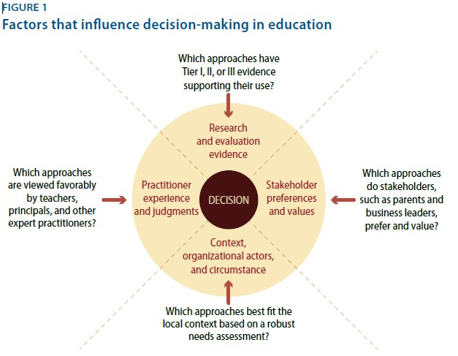
Decision Criteria for Selecting Interventions
From CCSSO (Council of Chief State School Officers)
https://www.amer icanprogress.org/ issues/education/ report/2016/08/3 1/143223/better- evidence-better- choices-better- schools/
Source: Better Evidence, Better Choices, Better Schools: State Supports for Evidence-Based School
Improvement and the Every Student Succeeds Act. Fleischman, Scott, and Sargrad. Center for American Progress.

Slide 18
Mock School Scenarios
Goal:
To look at 4 representative fictional schools and consider what supports they have received, what they might need, and CDE’s role in their
improvement.
18

Slide 19
School Scenarios
Platte River Elementary School
Sage Middle School
Columbia Elementary School
Plateau High School
19

Slide 20
Key questions for groups to consider
Listen about each of the four school scenarios.
Choose which of the scenarios is most relevant/interesting to you – go to that table.
TO DO
Read the details about your scenario, discuss and document your thoughts on the graphic organizer.
Strengths?
Weaknesses?
Considerations for the CO ESSA plan?
20

Slide 21
Working Lunch
21

Slide 22
State Plan Outline
Goal: to capture each group’s best thinking in what will become the outline of the plan.

Slide 23
Proposed State Plan Template
Group 1 (Evidence Based Interventions) -- Alisa and Sarah
Group 2 (System Flow and Timeline) -- Lisa
Group 3 (Improvement Planning) -- Lisa
Group 4 (Data Use and Monitoring) -- Brad
Group 5 (System of Supports from SEA) -- Peter and Lindsey
TO DO
Choose one of these groups/topics and join that group. Read, discuss, and document your ideas.
Goal: to capture each group’s best thinking in what will become the outline of the plan.

Slide 24

District Instructional Costs - Estimated Percentages (for discussion purposes only)
100
80
60
40
20
0
State and Local
Title I

Slide 25
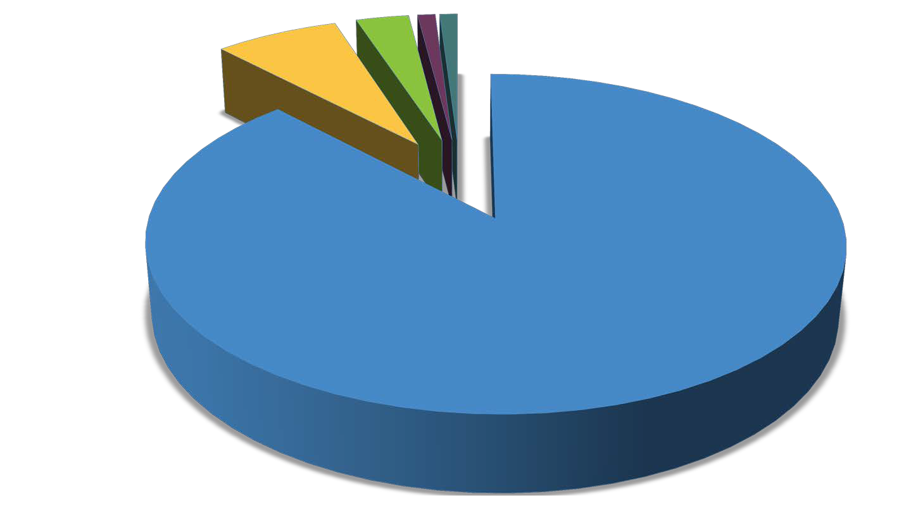
ESSA Title I Funds ~ $150M Annually (Estimates only)
Distibution to districts 132M 3% Dir Serv (Optional) 4.5M Delinquent Alloc. 1.5M
7% SI Funds (Required)10.5M State Admin 1.5M

Slide 26

Title I School Improvement Set-Aside
7 % Must be set aside to support schools identified for ESEA School Improvement.
Eligibility for access to set aside
  Lowest 5% of Title I schools in the state
  High Schools with grad rate less than 67%
  Schools with underperforming Subgroups
Estimated ~ $10,500,000
95% of set-aside must go to LEAs with identified schools
SEA must
  Prioritize LEAs with large numbers of identified schools
  Take into account the geographic diversity of the LEAs in the state
Decision Points
  Award funds by formula?
  Award funds competitively (as under NCLB)?
  Hybrid (formula and competitive)?
  Should SEA retain funds to provide direct services?

Slide 27
Next Steps
Next meeting in October
  October 14 OR October 18?
Funding discussion
React to written draft

