Slide 1
CDE Office Hours
August 26, 2021

Slide 2
CDE Team Introductions!
ESSER/ESEA
Nazie Mohajeri-Nelson, Director of ESEA Office (mohajeri-nelson_n@cde.state.co.us)
DeLilah Collins, Assistant Director of ESEA Office (collins_d@cde.state.co.us)
Kristin Crumley, ESSER Monitoring & Reporting Specialist (Crumley_k@cde.state.co.us)
ESEA Regional Contacts assigned to your district
Fiscal Experts
Jennifer Okes, Chief Operating Officer (okes_j@cde.state.co.us)
Kate Bartlett, Executive Director of School District Operations (Bartlett_k@cde.state.co.us)
Jennifer Austin, Director of Grants Fiscal Management (Austin_j@cde.state.co.us)
Robert Hawkins, Grants Fiscal Analyst (Hawkins_s@cde.state.co.us)
Steven Kaleda, Grants Fiscal Analyst (Kaleda_s@cde.state.co.us)

Slide 3
ESSER Office Hours
Topics
Updates and Reminders
ARP ESSER III LEA Plan Requirements
Narrative Question
Notes:
Nazie

Slide 4
Updates

Slide 5
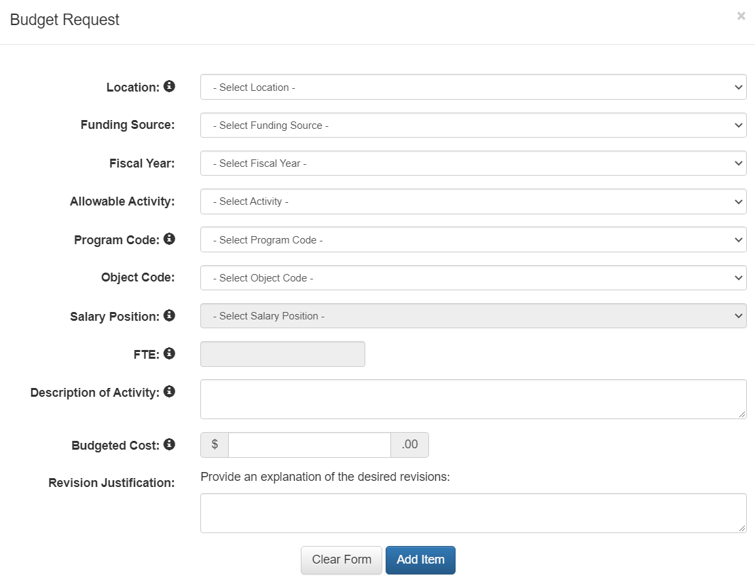
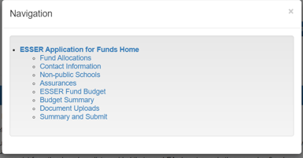
Updates
ESSER I Carryover Application - PAR
  LEAs will manage carryover funds through the Post Award Revision process
    Only edit the ESSER Fund Budget page
    For all lines that have been changed, complete the Revision Justification text box
    Do not remove budget line items, zero out the amount, add a new budget line item and explain the change in the Revision Justification text box

Slide 6
Updates
ARP – HCY II (Formula Allocation)
  Dana Scott, Office of Student Support
  Taking application to EDAC on September 3rd for approval
  Hoping to release applications, allocations, and additional information week of September 6th
  LEAs will be able to apply as soon as the application is announced in the SCOOP and via emails to McKinney-Vento Liaisons
Using ESSER funds for construction that is necessary to respond to, prepare for, or prevent the spread of COVID-19 is allowable. However, proceed with caution! There are numerous statutory and regulatory requirements that pertain to using federal funds for construction. It is the LEA’s responsibility to ensure that all requirements are met.
  Construction Guidance being posted on our Resources and Technical Assistance webpage.
Notes:
Nazie

Slide 7
LEA Plan Requirements

Slide 8
ARP ESSER III – Additional Requirements
ARP ESSER III has three additional requirements that were not in ESSER I or II
Set Aside for Evidence-Based Interventions [Collected in the ARP ESSER III Budget (Funding Code)]
  A minimum of 20% set aside to provide evidence-based interventions to address the academic impact of lost instructional time (or impact of the pandemic)
  Evidence-based interventions (ESSA Section 8101(21)(A)] – EBI Explanation and Resources
    Summer Learning Programs
    Summer Enrichment Programs
    Extended Day/School Year
    Comprehensive afterschool programs
Safe Return/Remain In-Person Plan [Provide the URL in the ARP ESSER III Application Assurances]
  Mitigation strategies to ensure safety and health of students and staff
  Posted on LEA website within 30 days of award
  Must be updated at least every 6 months
LEA Use of Funds Plan [Collected in the ARP ESSER III Application]
  Use of at least 20% set aside [Full Budget OR Narrative Question]
  Use of at most 80% [Full Budget OR Narrative Question]
  Ensuring that evidence-based interventions are addressing the academic, social, emotional, and mental health needs of students [Narrative Question]

Slide 9
Develop Plan with Key Stakeholders
Provide an opportunity for meaningful stakeholder engagement
Students
Families
School and district administrators (including special education administrators)
Teachers, principals, school leaders, other educators, school staff, and their unions
Where applicable
  Tribes
  Civil rights organizations (including disability rights organizations)
  Stakeholders representing interests of children with disabilities, English language learners, children experiencing homelessness, children and youth in foster care, migratory children, children who are incarcerated, and other underserved populations.
Does the LEA Plan need Board approval?
It depends on local policies, practices, and procedures.

Slide 10
Plan Requirements
Translate relevant materials and obtain the services of interpreters, as needed, to engage English learners and families with limited English proficiency.
Plan must be made available for the public the opportunity to provide input on the development of the plan.
Take comments into account when developing the plan.
Post plan on the LEA website.

Slide 11
Narrative Question 1

Slide 12
ARP ESSER III – Additional Requirements
ARP ESSER III has three additional requirements that were not in ESSER I or II
Set Aside for Evidence-Based Interventions [Collected in the ARP ESSER III Budget (Funding Code)]
  A minimum of 20% set aside to provide evidence-based interventions to address the academic impact of lost instructional time (or impact of the pandemic)
  Evidence-based interventions (ESSA Section 8101(21)(A)] – EBI Explanation and Resources
    Summer Learning Programs
    Summer Enrichment Programs
    Extended Day/School Year
    Comprehensive afterschool programs
Safe Return/Remain In-Person Plan [Provide the URL in the ARP ESSER III Application Assurances]
  Mitigation strategies to ensure safety and health of students and staff
  Posted on LEA website within 30 days of award
  Must be updated at least every 6 months
LEA Use of Funds Plan [Collected in the ARP ESSER III Application]
  Use of at least 20% set aside [Full Budget OR Narrative Question]
  Use of at most 80% [Full Budget OR Narrative Question]
  Ensuring that evidence-based interventions are addressing the academic, social, emotional, and mental health needs of students [Narrative Question]

Slide 13
Prompt
•ARP ESSER III – Required Narrative Question
•How the LEA will ensure that the interventions it implements, including but not limited to the interventions under section 2001(e)(1) of the ARP Act to address the academic impact of lost instructional time, will respond to the academic, social, emotional, and mental health needs of all students, and particularly those students disproportionately impacted by the COVID-19 pandemic, including students from low-income families, students of color, English learners, children with disabilities, students experiencing homelessness, children and youth in foster care, and migratory students?

Slide 14
Explain how the LEA knows:
In what ways have students been impacted by lost instructional time (the pandemic)?
Have any student groups been disproportionately impacted? If so, which ones?
How were the evidence-based interventions selected to respond to identified academic, social, emotional, and mental health needs and any identified disproportionate impact?
How will we measure the success of the interventions on students’ academic, social, emotional, and mental health needs?

Slide 15
In what ways have students been impacted by lost instructional time (the pandemic)?
Academic
  Examples: drop in reading scores, graduation rates
Social, Emotional, Mental Health
  Examples: attendance, office referrals, increased needs for counseling services
AND how do you know? What data did you utilize when determining these impacts?
Examples: Assessment data, office referral data, student absences data, surveys (parent, staff, student), mental health program participation

Slide 16
2. Have any student groups been disproportionately impacted? If so, which ones?
Building from guiding question 1:
Disaggregate data on academic, social, emotional, and mental health needs for all student groups.
Identify which student groups experienced disproportionate impact; consider the needs of any of the following populations enrolled in your LEA and served by your schools
  Students from low-income families
  Students of color
  English learners
  Children with disabilities
  Students experiencing homelessness
  Children and youth in foster care
  Migratory students

Slide 17
3. How were the evidence-based interventions selected to respond to identified academic, social, emotional, and mental health needs and any identified disproportionate impact?
Explain the priorities the LEA identified based on data sources.
  This should be a high-level overview of the priorities, not a list of every intervention in the budget.
  Examples: Increasing access to mental health needs, literacy instruction, math instruction, re-engaging students, reducing chronic absenteeism
These priorities should be aligned with and reflected in the LEA budget line items.

Slide 18
4. How will we measure the success of the interventions on students’ academic, social, emotional, and mental health needs?
Describe the data sources the LEA will use to measure the impact of the response to identified student needs.
  Examples:
    Identified Priority: Increased literacy instruction
      Impact measured by changes in assessment scores (i.e. district or state assessments)
    Identified Priority: Student Behavior
      Impact measured by changes in number of office referrals
    Identified Priority: Student Mental Health Needs
      Impact measured by changes in pre- and post- parent, student, and staff survey results; changes in mental health program participation

Slide 19
Narrative Example
•Exemplary Education Agency has analyzed [insert your LEA data]. Based on data results, EEA has determined that all students experienced [insert identified student needs].
•Data has been disaggregated for the groups listed in this question. Data shows [insert student needs] for [insert identified student groups] compared to the general student population.
•In selecting our evidence-based interventions, we focused on research-based approaches to address [insert high level priorities based on students needs] in order to respond to the identified student academic, social, emotional, and mental health needs. These interventions are detailed in the budget.
•EEA schools will be [insert methods for measuring impact of interventions] in order to measure the impact of our interventions on students’ academic, social, and behavioral needs.
1. In what ways have students been impacted by lost instructional time (the pandemic)?
2. Have any student groups been disproportionately impacted? If so, which ones?
3. How were the evidence-based interventions selected to respond to identified A.S.E.M. needs and any identified disproportionate impact?
4. How will we measure the success of the interventions on students’ academic, social, emotional, and mental health needs?

Slide 20
Narrative Example
• Exemplary Education Agency has analyzed interim reading and math scores, attendance data, and parent, staff, and student surveys. Based on data results, EEA has determined that all students experienced a drop in reading scores and an increased need for mental health services.
•Data has been disaggregated for the groups listed in this question. Data shows a greater academic decline for students of color, English learners, and students with disabilities compared to the general student population.
•In selecting our evidence-based interventions, we focused on research-based approaches to address the increased need for literacy instruction and need for access to mental health services in order to respond to the identified student academic, social, emotional, and mental health needs. These interventions are detailed in the budget.
•EEA schools will be conducting quarterly progress monitoring through the district reading assessment and annually analyzing beginning- and end-of-year parent, student, and staff mental health surveys in order to measure the impact of our interventions on students’ academic, social, and behavioral needs.
1. In what ways have students been impacted by lost instructional time (the pandemic)?
2. Have any student groups been disproportionately impacted? If so, which ones?
3. How were the evidence-based interventions selected to respond to identified A.S.E.M. needs and any identified disproportionate impact?
4. How will we measure the success of the interventions on students’ academic, social, emotional, and mental health needs?

Slide 21
Questions?

Slide 22
CDE Team Introductions!
ESSER/ESEA
Nazie Mohajeri-Nelson, Director of ESEA Office (mohajeri-nelson_n@cde.state.co.us)
DeLilah Collins, Assistant Director of ESEA Office (collins_d@cde.state.co.us)
Kristin Crumley, ESSER Monitoring & Reporting Specialist (Crumley_k@cde.state.co.us)
ESEA Regional Contacts assigned to your district
Fiscal Experts
Jennifer Okes, Chief Operating Officer (okes_j@cde.state.co.us)
Kate Bartlett, Executive Director of School District Operations (Bartlett_k@cde.state.co.us)
Jennifer Austin, Director of Grants Fiscal Management (Austin_j@cde.state.co.us)
Robert Hawkins, Grants Fiscal Analyst (Hawkins_s@cde.state.co.us)
Steven Kaleda, Grants Fiscal Analyst (Kaleda_s@cde.state.co.us)

