Slide 1
CDE Office Hours
November 30, 2023

Slide 2
ESSER Office Hours
Topics
Updates and Reminders
  School District Review Program
  ESSER Reporting Requirements
  EASI Deadline
  BruMan Training
Title IV CSPR Outreach
SCG Round II
Evaluating Effectiveness of ELD Programs
ESSA Identifications

Slide 3
Updates and Reminders

Slide 4
Submitting Boundary Changes
All requests to update school district boundaries should be submitted to Tina Negley (negley_t@cde.state.co.us).
Training Provided on October 12, 2023 | PowerPoint | Recording
  Districts are encouraged to submit changes as soon as possible. All annotated screenshots must be submitted no later than December 1st to ensure the information is successfully uploaded in the Geographic Update Partnership Software (GUPS) by the deadline.
  Note that the Census Bureau generally does not accept boundary changes of less than 30 feet when the correction does not affect housing. In remote areas with sparse population, the Census Bureau considers a difference of 60-75 feet to not be significant if housing units are not present.

Slide 5
ESSER Reporting Survey Deadline Extended
The deadline for all three FY 22-23 ESSER surveys was extended to December 1, 2023.
Please reach out if you need another extension. Otherwise all reports must be submitted tomorrow! To request an extension, email Mackenzie Owens, Tina Negley, or Nazie
LEA Participation in ESSER Activities Survey (submitted via Syncplicity).
  All LEAs, including AUs, BOCES, etc., must submit.
Re-engaging Students Survey (Google form)
  All LEAs who received an ESSER 90% allocation (districts) must submit.
School-Level Allocation Survey (Google form)
  All LEAs who received an ESSER 90% allocation (districts) and allocated funds to schools in their ESSER applications during FY 22-23 must submit.
Our reporting website contains the surveys and helpful resources for completing them. Annotated and example versions of the participation survey templates are now available.

Slide 6
Empowering Action for School Improvement (EASI)
LEAs with schools identified for support and improvement under state or federal accountability can apply for grants through the Empowering Action for School Improvement (EASI) grant.
Applications are due on Wednesday, December 6, 2023, by 11:59 pm.
General Application Questions:
Laura Meushaw
  720-728-9023 | Send an email to Laura
Lindsay Cox
  720-990-7851 | Send an email to Lindsay

Slide 7
Upcoming BruMan Training
Virtual BruMan Training
Please mark your calendars and join us for a training being provided by Julia Martin of the BruMan Group national law firm. This training will take the place of our regular Office Hours.
Date: Thursday, January 25, 2024
Time: 1:00-2:30
Topics: SNS and transitioning from ESSER to ESEA and/or IDEA.
If you have specific questions that you would like for Julia to address, please email those to Nazie by January 1st.
In-Person BruMan Training
We would also like to schedule an in-person training on the Uniform Grant Guidance, which should be revised in January, 2024. A date and location has not yet been determined. We would like to gauge interested in attending. Please complete this very brief Google Form to let us know if you would be interested in attending an in-person training if scheduled.

Slide 8
Title IV CSPR Outreach

Slide 9
22-23 Title IV-A Content Area Expenditures
Title IV-A Content Area Expenditures required by United States Department of Education
Expenditures reported in Annual Financial Reports (AFR)
Email to LEAs sent 11/28/23
As AFRs are closed, please send expenditures to hickman_n@cde.state.co.us by 12/15/23 in the following format:
LEA Name:
LEA Number:
Well Rounded Education: $
Safe and Healthy Students: $
Effective Use of Technology: $

Slide 10
SCG Round II

Slide 11
Stronger Connections Grant, Round 2 Funding
SCG Rd. 2 Applications are due 12/15/23!!
Allowable uses:
Drug and violence prevention activities that are evidence-based
School-based mental health services
Integrating health and safety practices into school or athletic programs
Nutritional education and physical education activities
Implementation of schoolwide positive behavioral interventions and supports
Bullying and harassment prevention
Establishing or improving school dropout and reentry programs
Crisis management and conflict resolution techniques
School-based violence prevention strategies
Reducing exclusionary disciplinary practices
Establishing partnerships within the community to provide resources and support for schools
Strengthening relationships between schools and communities
Grant amounts up to $150,000
All LEAs are eligible to apply with High-Need LEAs given priority points within the application

Slide 12
Evaluating the Effectiveness of a
District's ELD Program

Slide 13

Joint Guidance: U.S. Department of Education and the U.S. Department of Justice
State education agencies (SEAs), public school districts, and public schools have a legal obligation to ensure that multilingual learners can participate meaningfully and equally in educational programs.
Additionally, there are legal obligations towards limited English proficient (LEP) parents.
4-page document

Slide 14
10 Topics
Identifying and Assessing All Potential ML Students ✅
Providing Language Assistance to ML Students
Staffing and Supporting an ELD Program
Providing Meaningful Access to All Curricular and Extracurricular Programs
Avoiding Unnecessary Segregation of ML Students
Evaluating ML Students for Special Education and Providing Dual Services
Meeting the Needs of Students Who Opt Out of ELD Programs or Particular Services
Monitoring and Exiting EL Students from ELD Programs and Services
Evaluating the Effectiveness of a District’s ELD Program
Ensuring Meaningful Communication with Limited English Proficient Parents

Slide 15
Acronyms
ELL = English Language Learner
EL = English Learner
ML = Multilingual Learner
ELD = English Language Development
DOJ = Department of Justice
ELP = English Language Proficiency
ELPA = English Language Proficiency Act
ESEA = Elementary and Secondary Education Act
ESSA = Every Student Succeeds Act
HLS = Home Language Survey
LEP = Limited English Proficient
LIEP = Language Instruction Educational Program
NEP = Non-English Proficient
OCR = Office of Civil Rights

Slide 16
9. Evaluating the Effectiveness of a District’s ELD Program
ELD programs must be reasonably calculated to enable ML students to attain English proficiency and meaningful participation in the standard educational program comparable to their never-ML peers.
School districts must monitor and compare, over time, the academic performance of ML students in the program and those who exited the program, relative to that of their never-ML peers.
School districts must evaluate ML programs over time using accurate data to assess the educational performance of current and former ML students in a comprehensive and reliable way, and must timely modify their programs when needed.

Slide 17


Chapter 9: Department of Education’s English Learner Toolkit

Slide 18

Chapter 9: Overview
Successful ELD programs must, at a minimum, be designed to enable ML students to attain both English proficiency and parity of participation in the standard instructional program, comparable to their never-ML peers, within a reasonable period of time.

Slide 19
Meaningful ML Evaluations
Meaningful ML evaluations include longitudinal data that compares the performance of current MLs, former MLs, and never-MLs in the LEA’s standard instructional program over time. Longitudinal data is especially important in evaluating the success of each ML program, given the ever-changing nature of the ML student population.
Comprehensive longitudinal monitoring and evaluation will help LEAs and schools determine if MLs are:
(1) meeting college- and career-ready standards;
(2) participating in, and performing comparably to their never-ML peers in, the standard instructional program;
(3) accessing the same curricular and extracurricular opportunities as their never-ML peers; and
(4) exiting ELD programs at appropriate rates (Hill, 2012).
If evaluations show that ELD programs are not effective,
the LEA must make appropriate programmatic changes.

Slide 20
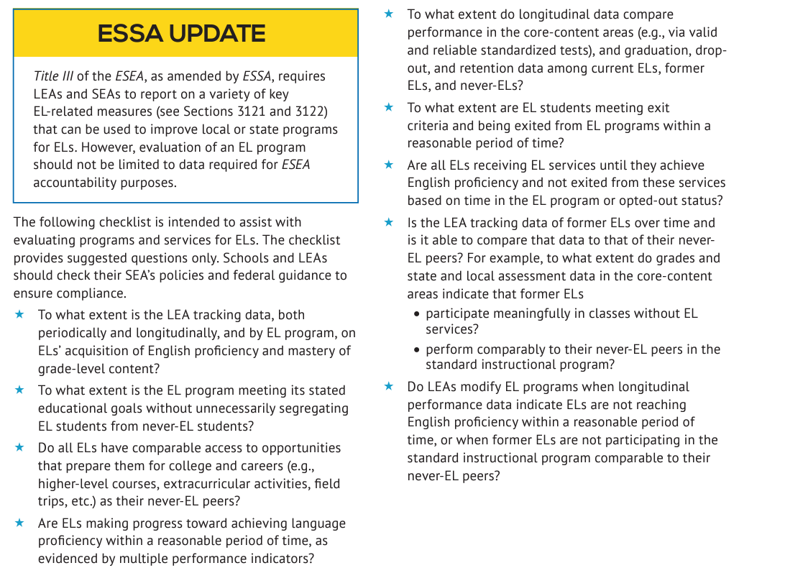
Checklist for Evaluating Programs and Services for English Learners

Slide 21




Chapter 9 Tools

Slide 22
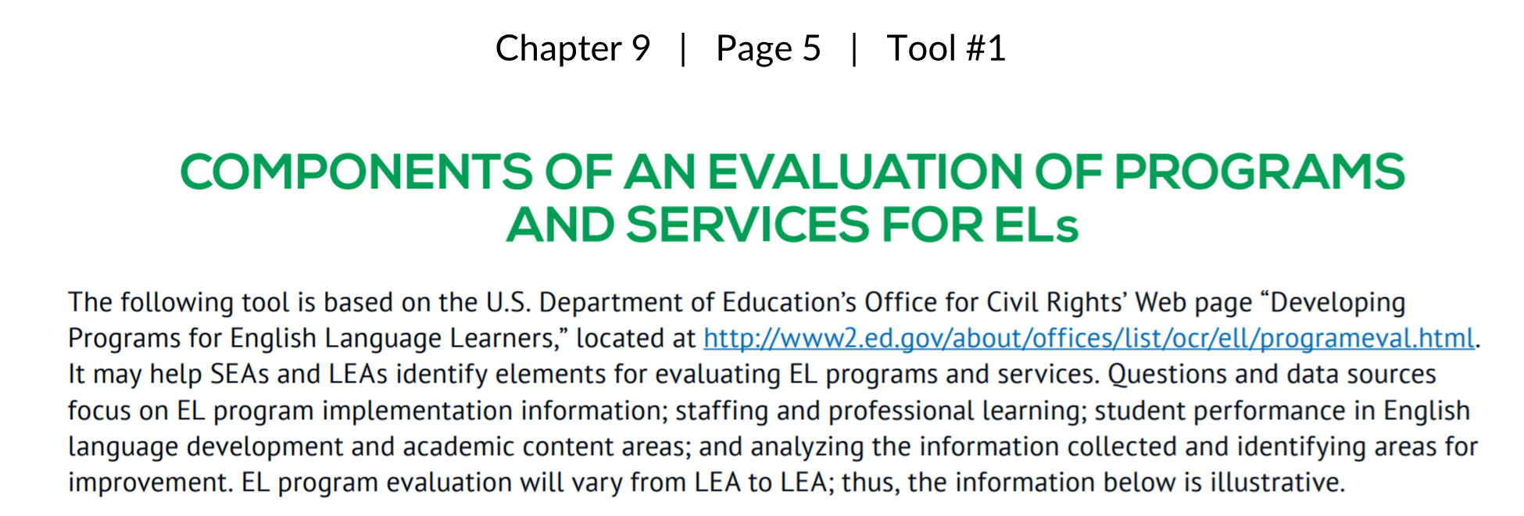
Featured Tool

Slide 23
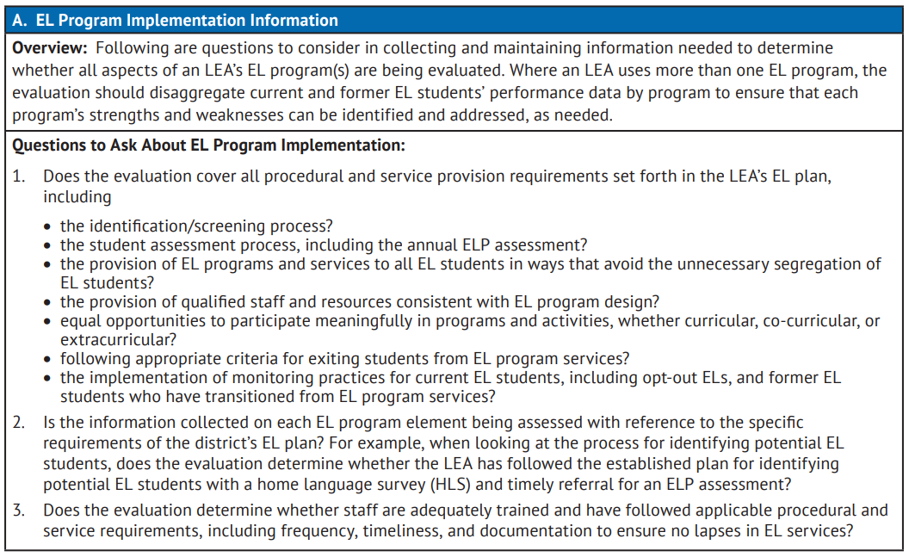
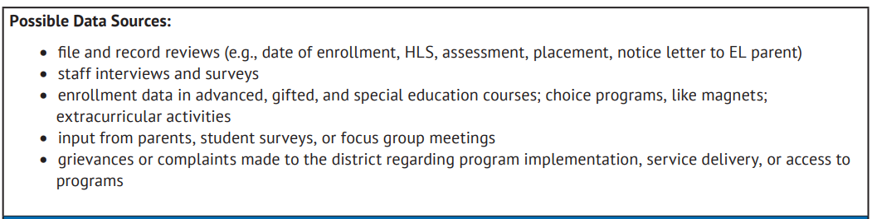
A. EL Program Implementation Information

Slide 24
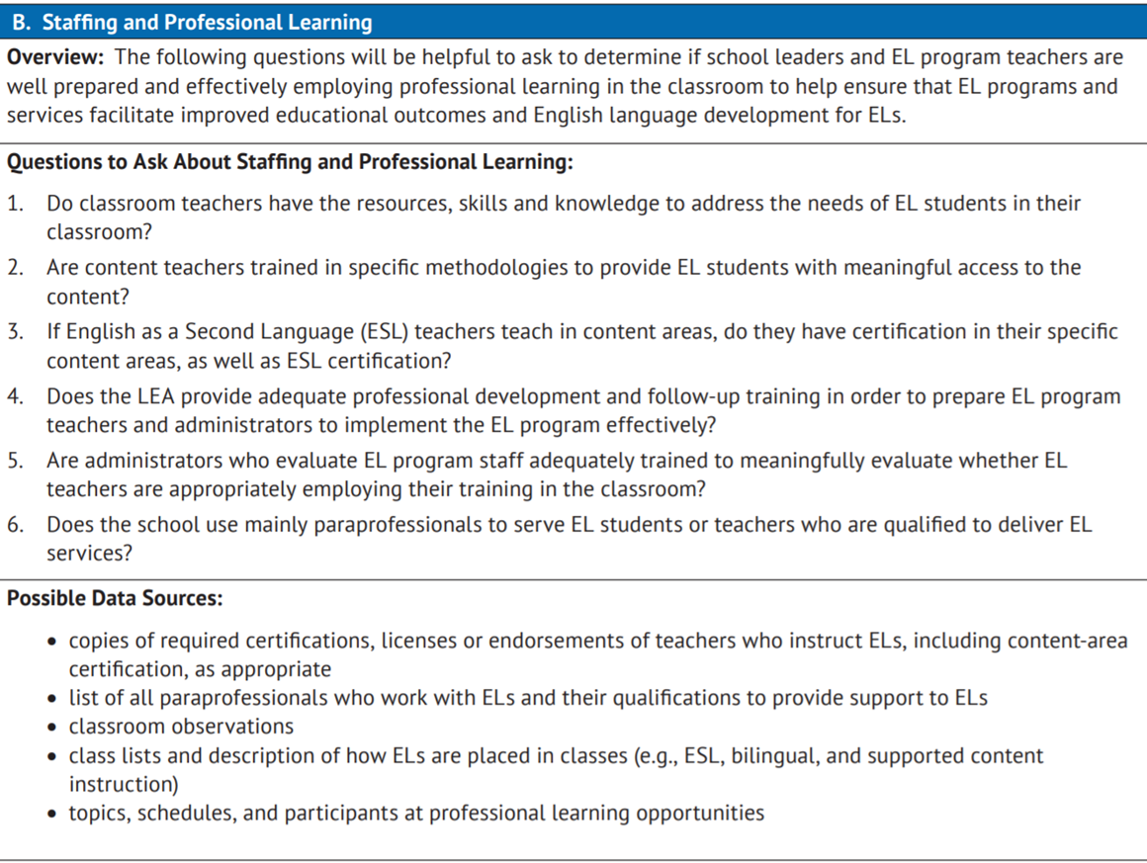
B. Staffing and Professional Learning

Slide 25
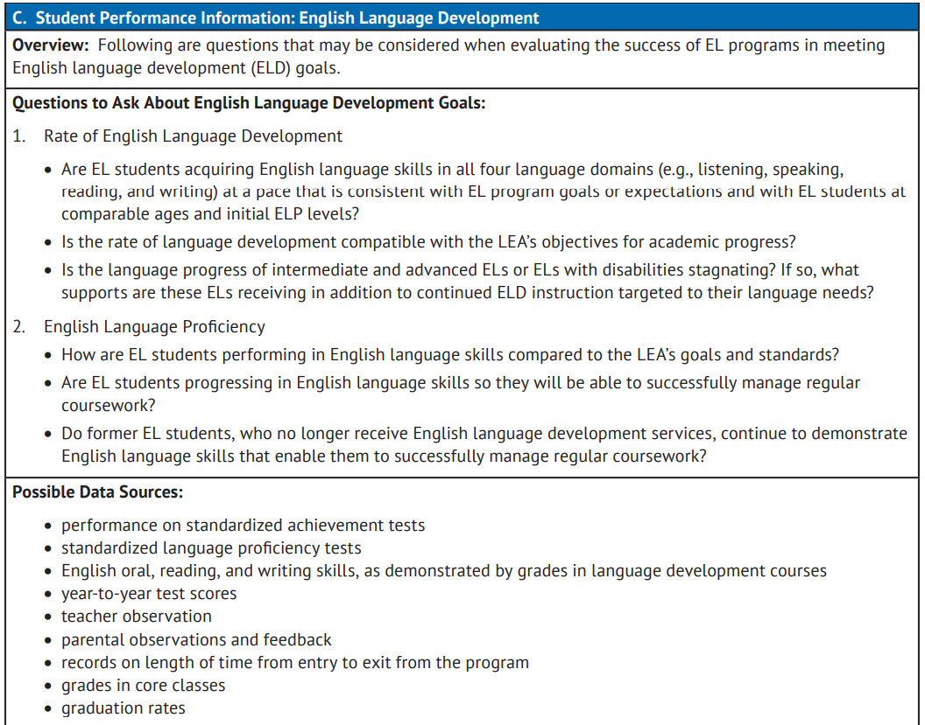
C. Student Performance Information: English Language Development

Slide 26
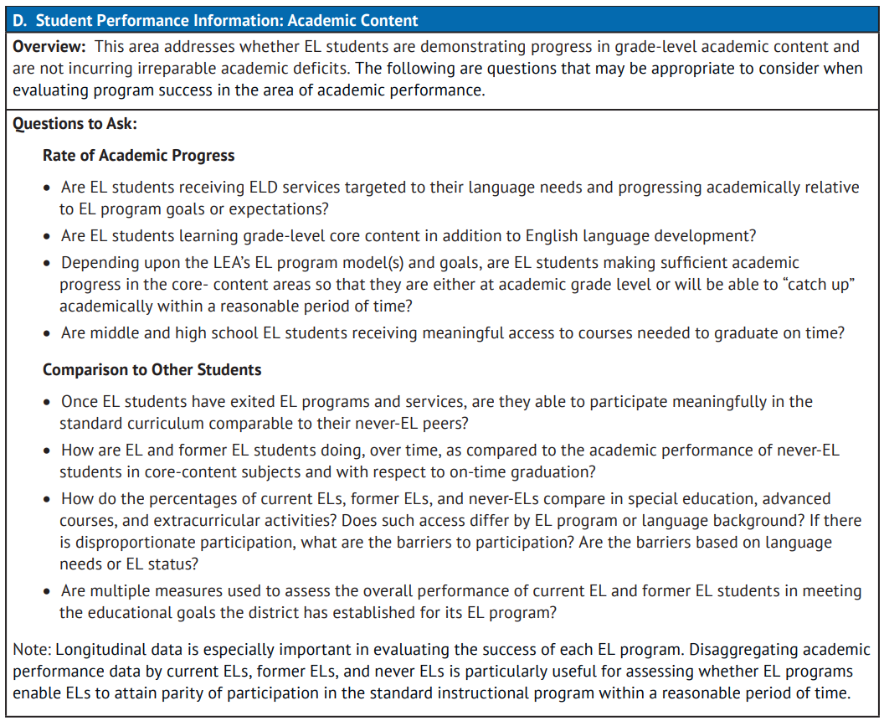
D. Student Performance Information: Academic Content

Slide 27

Stay tuned!
The EL Data Dig Tool will be getting updated soon to include the impact of pandemic on availability of state assessments and other updates! Stay tuned for the rollout!
EL Data Dig

Slide 28
Office of Culturally and Linguistically Diverse Education
English Language Development (ELD) Review (District Level)
The Office of Office of Culturally and Linguistically Diverse Education (CLDE) offers a district-wide review of English language development program(s). The results and recommendations from the ELD Program Review will provide a framework to guide a district in establishing and/or improving upon the overall ELD programming at the district level system that supports and is inclusive of the unique academic, linguistic, and social-emotional needs of Multilingual learners. An additional pathway of ELD programing support is through the EASI Language Partnership. This is a grant funded opportunity through the Exploration Supports Route and eligibility is based on school/district performance.
The foundation used for this initial review is Castaneda v. Pickard (1981), the landmark court case that established a three-prong approach to determine ELD quality programming with the Office for Civil Rights laws and Department of Justice court orders.
The three-prong approach is as follows:
Theory – educationally sound and research-based;
Practice – effective implementation (transforming theory into practice with fidelity) with adequate resources and personnel; and
Results – Analysis of information, program evaluation, modification, and plan for improvement.
For additional information, please contact Alice Collins or Morgan Cox.

Slide 29
Reminder: Invitation to Attend and Extend to Your Colleagues
The CDE Culturally and Linguistically Diverse Education (CLDE) Office is hosting an OCR training on December 7th.
OCR will address ELD Plan components based in large part off of their 2015 Dear Colleague Letter.
Please share with any colleagues who might be interested in learning more about the topics discussed today.
CLDE Office Hours: https://www.cde.state.co.us/cde_english/webinars

Slide 30
RESOURCES
US Dept of Ed & Us Dept of Justice: Ensuring English Learner Students Can Participate Meaningfully and Equally in Educational Programs
EL Toolkit: Chapter 9 - Tools And Resources For Evaluating The Effectiveness of a District’s EL Program
CDE: CLDE English Language Development (ELD) Review (District Level)
U.S. Department of Education’s Office for Civil Rights’ Web page “Developing Programs for English Language Learners”

Slide 31

English Learner Family Toolkit Webinar
To celebrate the publication of the updated English Learner (EL) Family Toolkit and the release of the EL Family Toolkit App, the Office of English Language Acquisition (OELA) is hosting a series of webinars to introduce and showcase these resources.
In this introductory event, the presenters will review all six chapters of the toolkit and the available languages (English, Spanish, Chinese, and Arabic); discuss the implications and potential uses of the information and resources in each chapter; recommend ways and best practices for sharing these resources with EL families; and demonstrate the features of the EL Family Toolkit mobile app.
Presenters include:
Montserrat Garibay, Assistant Deputy Secretary & Director, OELA
Melissa Castillo, Senior Advisor, OELA ﻿
Beatriz Ceja, Deputy Assistant Secretary, OELA

Slide 32
ESSA Identification of Schools for
Support and Improvement

Slide 33
Methodology

Slide 34
Approved Changes to ESSA State Plan
In January 2023, CDE submitted a plan amendment to the U.S. Department of Education to revise its ESSA identification methodology to address the impact of the pandemic. The proposed changes were approved by the USDE on June 22, 2023, for implementation beginning with the Fall 2023 ESSA identifications.
Revised targets for the ELP on-track to attaining fluency metric.
Revisions to the School Quality and Student Success (SQSS) indicator.
  Removal of science achievement.
  Continued use of chronic absenteeism rates (as opposed to a reduction metric) and exclusion of excused absences.
Resumed use of three years of aggregate data, even if some of the data was from prior to the pandemic.
Revisions to the CS – Lowest 5% methodology to stabilize counts around 5 percent.
  Each year, determine whether additional schools must be identified.
  Any school performing below a school previously identified for CS – Lowest 5% that remains in the lowest 5% will be added to the list, regardless of the number of schools identified.

Slide 35
ESSA Indicators
Academic Achievement
  ELA and Math mean scale scores
Academic Progress (Growth)
  ELA and Math median growth percentiles
Progress in Achieving English Language Proficiency (ELP)
  ACCESS median growth percentiles
  Percent on-track to attaining proficiency
School Quality or Student Success
  Chronic absenteeism rate, unexcused absences only (elementary/middle)
  Dropout rate (high)
Graduation Rates
  4-year adjusted cohort rate
  7-year adjusted cohort rate
When necessary, the following indicators are also used to differentiate among lowest performing Alternative Education Campuses (AECs), in addition to the other indicators listed to the left
  Attendance rate
  Truancy rate

Slide 36
ESSA Student Groups
All students
English learners
Students with disabilities
Students experiencing poverty
Students from each racial/ethnic group, separately
  Aggregated Non-White group - Any non-White students from racial/ethnic groups that do not meet the minimum number of students to be reported on their own will be combined into one group for accountability purposes

Slide 37
Identification of Schools
Annual identification of schools for Support and Improvement under ESSA:
Comprehensive Support and Improvement (CS)
  CS - Lowest 5%
    Title I schools with the lowest total percentage points earned
  CS - Low Graduation Rate
    All public high schools with 4-year and 7-year graduation rates below 67 percent for three consecutive years
  CS - Former ATS
    Title I schools identified for Additional Targeted Support for four consecutive years for the same student group will be moved to this category
Targeted Support and Improvement (TS)
  TS
    Schools with at least one consistently underperforming student group
  Additional Targeted Support (ATS)
    Subset of TS schools with at least one disaggregated group that, on its own, meets the criteria for CS - Lowest 5%
Possible to be identified due to participation only

Slide 38
ESSA Identification Categories
Under ESSA, districts may have schools identified in the following categories:
CS – Lowest 5%
  On Watch (previously HOLD) - School no longer meets identification criteria, but has not yet exited CS status (CS is a multi-year designation)
  Due to Participation Only - School met identification criteria as a result of participation-adjusted calculations
CS - Low Graduation Rate
  On Watch (previously HOLD) - School no longer meets identification criteria, but has not yet exited CS status (CS is a multi-year designation)
CS - Former ATS
  No schools identified for this category currently
Targeted Support (TS)
  2018-19/2022-23 - Not Exited by District - School no longer meets identification criteria, but was not exited by district
  Due to Participation Only - School met identification criteria as a result of participation-adjusted calculations
Additional Targeted Support (ATS)
  2018-19/2022-23 - Not Exited by District - School no longer meets identification criteria, but was not exited by district
  Due to Participation Only - School met identification criteria as a result of participation-adjusted calculations

Slide 39
Fall 2023 ESSA Identification Results

Slide 40
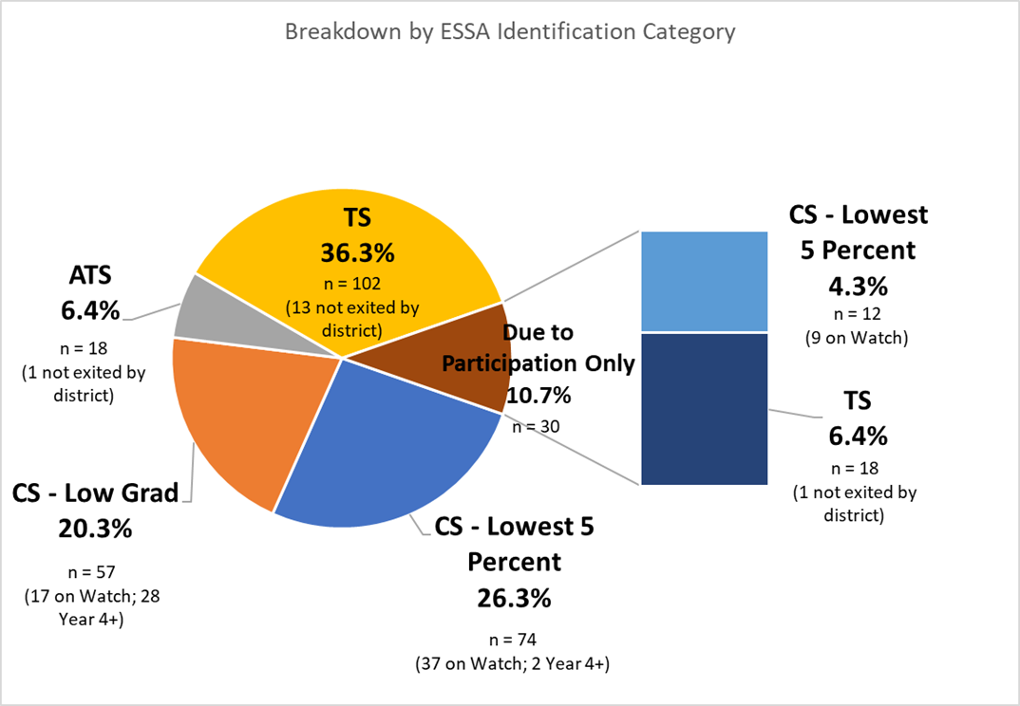
Overview of Fall 2023 ESSA Identification
281 schools currently identified for support and improvement under ESSA (not including K-2)
29 newly identified schools

Slide 41
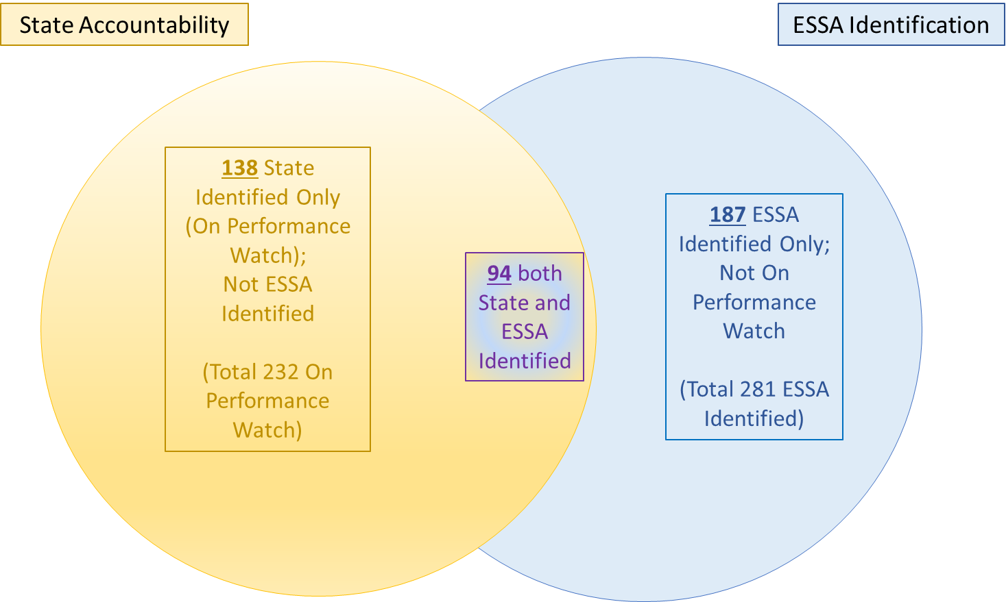


Fall 2023 Schools Eligible for EASI Supports

Slide 42
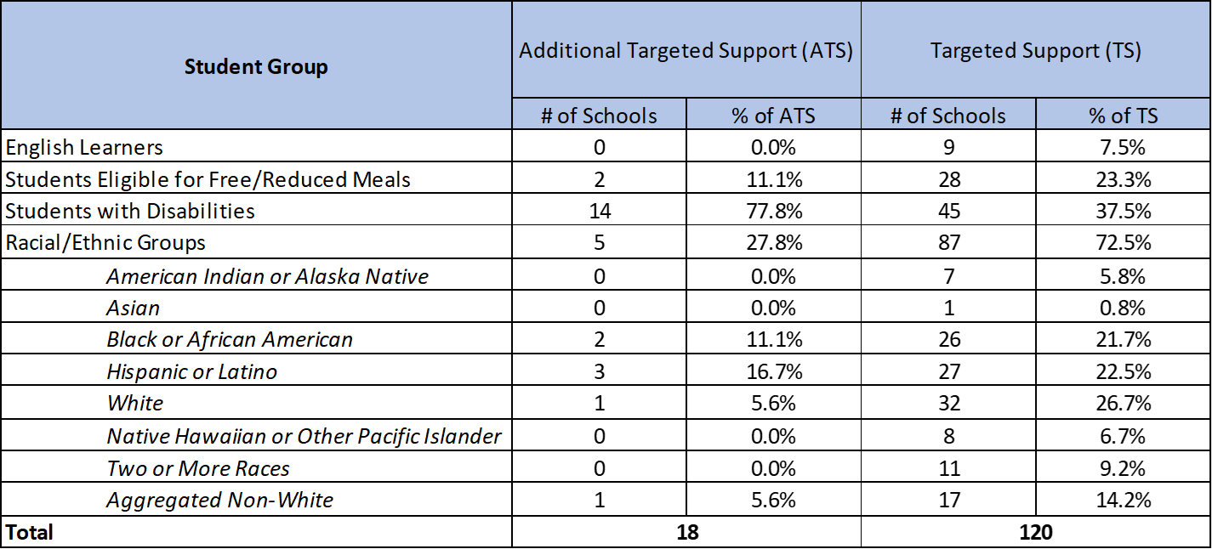
Schools Identified for Targeted Support
*Note: Schools can be identified for more than one student group; therefore, counts may not add up to total.

Slide 43
ESSA School Profiles
Shared via Syncplicity with:
Superintendents
District Accountability Contacts
Authorized Representatives in Consolidated Application
The above individuals can also request access for additional school and/or district personnel by sending an email to Yazmine Patino (patino_y@cde.state.co.us).

Slide 44
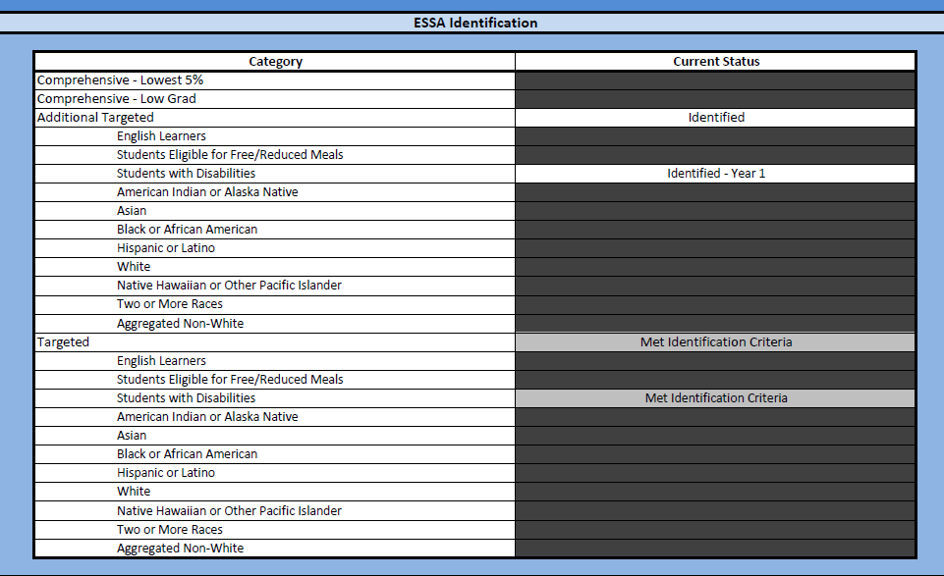
Profiles - Overall Identification

Slide 45
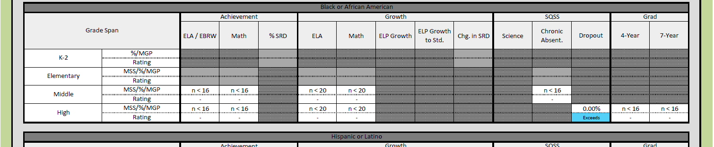
Profiles - Data

Slide 46
Additional Information
For more information, please visit Colorado’s ESSA Methods and Criteria for Identification of Schools for Support and Improvement Webpage (http://www.cde.state.co.us/fedprograms/essa_csi_tsi)
For additional information regarding the methodology, criteria, or data used to identify schools for support and improvement under ESSA, please contact:
  Tina Negley
    Supervisor, Program Effectiveness Office
    720-766-2793
    negley_t@cde.state.co.us
  Mary Shen
    ESEA Research Analyst
    720-766-8723
    shen_m@cde.state.co.us
  Nazie Mohajeri-Nelson
    Executive Director, Federal Programs and Supports Unit
    720-626-3895
    mohajeri-nelson_n@cde.state.co.us

Slide 47
Upcoming Meetings

Slide 48

Looking Ahead…
Any requests for topics or questions?
Upcoming Office Hours:
  December 14
* Please note, due to the OCR Training on 12/7 and winter break, December office hours will be held once on December 14.

Slide 49
CDE Contacts!
Emails: Lastname_Firstinitial@cde.state.co.us (e.g., Smith_a@cde.state.co.us)
Federal Programs & Supports (ESEA/ESSER Program Supports) | School Finance & Operations (Fiscal and Systems Supports)
Nazie Mohajeri-Nelson, Executive Director of Federal Programs & Supports Unit Program Specialists Program Implementation Supervisor: Laura Meushaw Program Implementation Coordinator: Christina Adeboye Sullivan Program Monitoring Supervisor: Tammy Giessinger ESEA/ESSER Monitoring Coordinator: Kristin Crumley Program Effectiveness Supervisor: Tina Negley Program Evaluation & Research Coordinator: Mary Shen ESEA Programs Specialists and ESEA Regional Contacts (assigned by district) Title I: Laura Meushaw, Evita Byrd, Rachel Echsner, Kim Boylan Title II: Rachel Echsner, Sue Miller-Curley Title III: Rachel Temple, Kim Boylan Title IV & Stronger Connections Grant: Nathan Hickman, Evita Byrd Title V: Christina Adeboye-Sullivan, Rachel Echsner ESSER Program Specialists Jonathan Schelke Kim Boylan Kriselda Craven ESEA and ESSER Data and Reporting Specialists Mackenzie Owens (ESSER) Melissa Chaffin (ESEA) Jerry Ring (ESEA) | Amy Carman, Executive Director of School District Operations Unit Fiscal Specialists Jennifer Austin, Director of Grants Fiscal Management ESEA Robert Hawkins, Grants Fiscal Analyst Steven Kaleda, Grants Fiscal Analyst ESSER Fiscal Specialist Steven Kaleda Grants Fiscal Analyst ESSER Monitoring Hilery Morris, ESSER Fiscal Monitoring Kristina Jones, Federal Fiscal Monitoring and Reporting Specialist Werner Hagemann, ESSER Fiscal Monitoring Specialist Application Systems Specialists DeLilah Collins, Director of Grants Program Administration Online Applications Systems Technical Support Michelle Prael

