Slide 1
Office Hours
10.13.22

Slide 2
ESSER Office Hours
Topics
Updates and Reminders
Fall RNMs
Monitoring Overview
Notes:
Nazie

Slide 3
Updates and Reminders
Notes:
Nazie

Slide 4
Fall Regional Network Meeting
We are offering virtual and in-person training opportunities in the fall. The training is structured as three one-hour sessions. LEA staff may attend for the full time or for the sessions that are relevant to them.
Session 1
New LEA staff orientation
CDE staff will give an overview of the programs administered by the Unit of Federal Programs and Supports and provide helpful tools and resources to support new staff who work on these programs. LEA staff will have time to meet their Regional Contacts from CDE and network with LEA staff in their region.
Target Audience: LEA staff who are new to administering Title I-A, I-D, II-A, III, IV-A, or V-B or ESSER programs
Session 2
Post Award Revision Training
CDE staff will provide training on when and how LEAs should submit Post Award Revision in their ESEA Consolidated Application or ESSER applications. There will be time for LEA staff to work on Post Award Revisions with CDE staff available to answer questions.
Target Audience: LEA staff who complete the Consolidated Application or ESSER applications or who administer federal programs
Session 3
Monitoring Work Group
CDE staff will provide an overview of the 22-23 monitoring process, including the new self-assessment tools. Then, LEA staff will have time to work on completing the self-assessment and preparing documents for review with CDE staff present to support and answer questions.
Target Audience: Staff members from LEAs who are being monitored for ESEA or ESSER during the 22-23 school year.
Notes:
Shannon

Slide 5
Fall RNM Dates and Locations
Northwest and West Central- Montrose
Tuesday, October 18, 9:00-12:00
Montrose School District Board Room
Register HERE
Pikes Peak Region- Colorado Springs
Tuesday, October 25, 12:30-3:30
District 49 Creekside Success Center Peak View Hall
Register HERE
Northeast and North Central- Fort Morgan
Thursday, November 10, 9:30-12:30
Fort Morgan Public Library
Register HERE
Northwest and West Central- Steamboat Springs
Wednesday, October 19, 9:00-12:00
Alpine Bank Conference Room
Register HERE
Metro Region- Denver
Thursday, October 27, 9:00-12:00
Colorado Talking Book Library
Register HERE
VIRTUAL
Tuesday, November 15, 9:00-12:00
Zoom
Register HERE
Southwest Region- Alamosa
Thursday, October 20, 12:30-3:30
San Luis Valley BOCES
Register HERE
Southeast Region- Lamar
Tuesday, November 8, 12:30-3:30
Southeastern BOCES
Register HERE
Note:
LEAs may attend at any location, regardless of region

Slide 6
Monitoring Overview

Slide 7
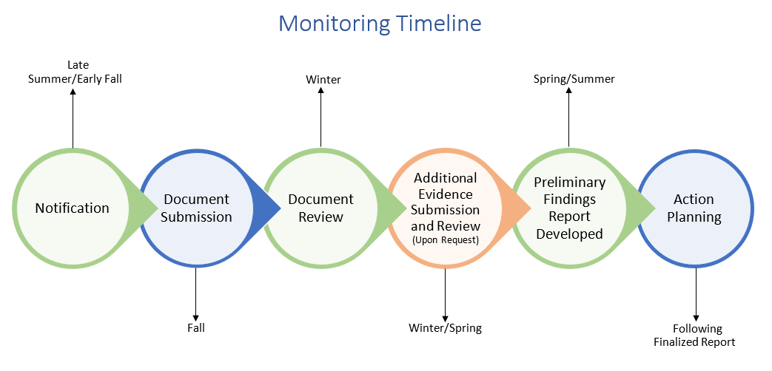
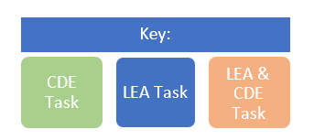
Monitoring Overview
Monitoring formalizes the integral relationship between CDE and Colorado LEAs in implementing effective programs using Federal funds.
Monitoring is implemented from a programmatic and fiscal perspective and meant to accomplish the following objectives:
Focus on What Matters
Reduce Burden on LEAs
Improve Communication with LEAs
Differentiate and Customize Support for LEAs
Ensure Basic Requirements Are Met

Slide 8

Purpose of Monitoring
ESEA Program Intent
ESSER Program Intent
Purpose of Monitoring
To ensure all students, particularly underserved students, have equitable access to a high-quality education
To respond to, prepare for, or prevent the spread of COVID-19 and address the impact on education
To ensure that federal funds are used appropriately to implement programs that meet the intent of each program

Slide 9
CDE’s Monitoring Process Includes…
Application Reviews
Other (i.e. Beeline, Scoop, email communications, etc.)
Federal Programs Monitoring
Training and Technical Assistance
Evidence Submission and Review
Self-Assessment

Slide 10
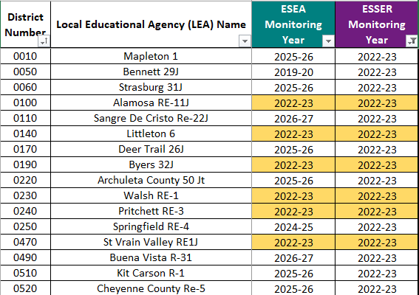
Monitoring Schedule
Monitoring Schedule (right) for ESEA and ESSER is located on our Monitoring Website.
Diagram (below) shows number of LEAs being monitored in 22-23
82 Total
62 ESSER-Only
20 ESEA and ESSER
82 Total LEAs being Monitored
82 ESSER
20 ESEA
Notes:
Districts have received their notification which indicates whether they are being ESEA and ESSER monitored.

Slide 11
ESEA vs ESSER Monitoring
How ESEA and ESSER Monitoring are Similar
Conducted by CDE fiscal and program teams
3-tiered approach based on risk assessment
Same process and protocols
Use of data and documentation that CDE already collects to minimize LEA burden
Iterative process to allow multiple opportunities to demonstrate compliance
Fiscal compliance measured against Uniform Grant Guidance, EDGAR
How ESSER Monitoring is Different
Must complete all monitoring prior to 9/30/24 (within the ESSER III performance period)
Additional, separate indicators
ESSER III
Maintenance of Equity
20% Set Aside
LEA ARP-ESSER III Use of Funds Plan
Safe Return to In-Person Instruction Plan
Includes ESSER State Reserve Funds

Slide 12
Monitoring Goal: Reduce Burden on LEAs
21-22 Key Reflections
Need better differentiation between Tier I and Tier II
Risk levels can vary between fiscal and program
Need to improve processes to provide meaningful feedback in a timely manner
Moving Forward
Will rely more on self-assessments
Will reduce evidence submission and review
Will continue to identify areas for additional training and technical assistance based on common recommendations (best practices) and corrective actions (required by statute/guidance)

Slide 13
Most Common Action Items from 21-22 Fiscal Monitoring
Document the policies/procedures
Our focus is less on which is policy and which is procedure - is the overall process documented?
Ensure review of Sam.gov for suspension and debarment when required
Should include a section speaking to emergencies
Helpful resource for documenting the process here
Budget - to - Actual variations
The expenses posted in the GL do not coincide with the activities approved in the original application
Ensure the LEA is using a PAR for any decisions to spend money in a different activity or an amount greater than 10% of original
Proper use of Chart of Accounts (most common variance is at object code)
Compliant time and effort documentation
Compliant equipment/real property tracking mechanisms
Notes:
Note that policies/procedures are reviewed and transactions are tested against them (need to follow your procedures). Emergency procedures can fold into allowability as one example.

Slide 14
Monitoring Tiers
All LEAs that accept ESEA and ESSER funds will participate in monitoring during a multi-year cycle established by CDE.
Monitoring provides a basic level of oversight to ensure compliance with standard procedures required of all LEAs operating ESEA and ESSER programs.
A limited number of LEAs will be selected for Tier II and Tier III monitoring each year based on a set of selection criteria developed by CDE.
Monitoring activities are conducted primarily through a desk review. Onsite monitoring activities may occur during Tier III monitoring.

Slide 15
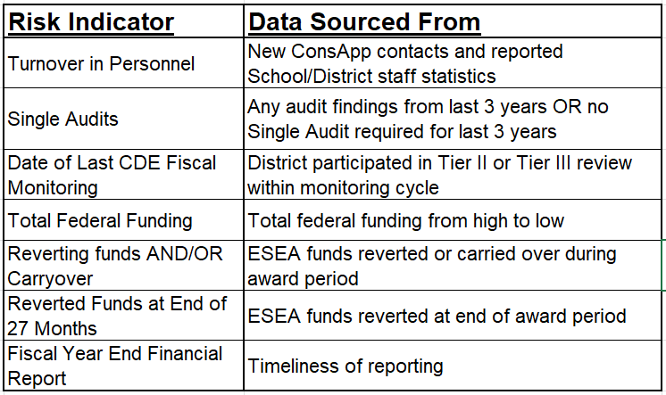
Risk Assessment - Fiscal Indicators
Data comes from multiple sources
Broken out into three levels of risk
Please reach out for specifics on your LEA
Notes:
ESEA reversion rates applicable for ESSER only as internal control measures
All indicators used as a guide not as a gotcha - quantifiable method for setting tiers and establishing rotation (everyone gets a turn)

Slide 16
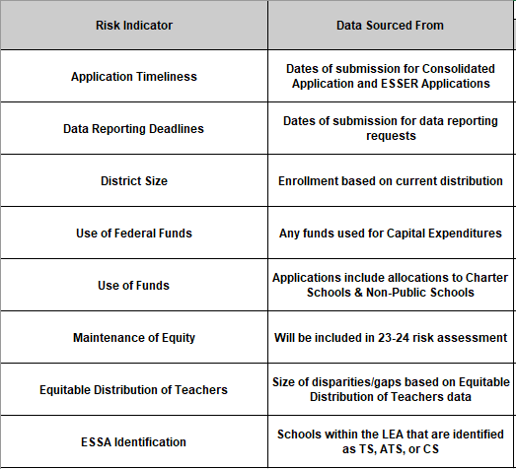
Risk Assessment - Program Indicators
Data comes from multiple sources
We use most recently available data
Rank risk from low to high for each indicator

Slide 17
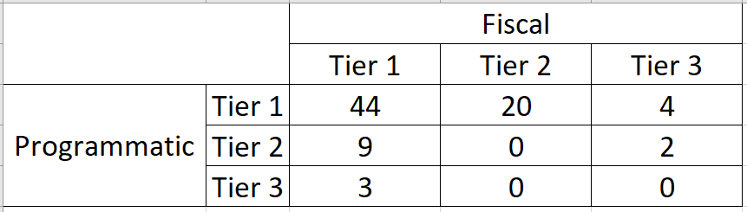
Using the Risk Assessment to Assign Tiers
Beginning with the 2022-2023 year, tier levels are assigned separately for program and fiscal monitoring based on the results of the risk assessment.
Multiple tier combinations are possible
For example, an LEA could be tier 2 for program and tier 1 for fiscal, OR
An LEA could be tier 1 for program and tier 3 for fiscal
Other combinations are possible, based specifically on risk assessment results

Slide 18
Program Monitoring Tiers
Tier I
Tier II
Tier III
Program Monitoring: The LEA will complete and submit the Program Monitoring Self-Assessment (PMSA). If further action is needed, a follow-up call will be scheduled between the LEA and CDE to discuss next steps. If no further action is needed, CDE will notify the LEA by email that the program monitoring process has concluded.
Program Monitoring: In addition to Tier I components, Tier II may include requests for additional information or submission of evidence. LEAs will use Syncplicity to submit any additional documentation. CDE will provide a written report to summarize any recommendations, corrective actions, or next steps identified through the program monitoring process.
Program Monitoring: In addition to Tier I and II components, CDE will work with LEAs to identify additional program requirements and site visit dates to review implementation practices. In Tier III monitoring, the LEA will have an opportunity to co-develop the monitoring plans and help determine which indicators would be helpful and relevant.

Slide 19
What are the Fiscal tiers?
All LEAs identified for monitoring will complete the FSA.
Tier I
Tier II
Tier III
Initial Notification Letter Request: The LEA will complete and submit the Fiscal Self-Assessment (FSA). If further action is needed, CDE will send an email or schedule a follow-up call between the LEA and CDE. If no further action is needed, CDE will notify the LEA by email that the fiscal monitoring process has concluded.
Initial Notification Letter Request: In addition to Tier I components, LEAs will need to submit as part of the initial document submission:
Detailed general ledgers
A list of employees paid with ESEA/ESSER
Links to board policies
Documents that outline the procedures for ESEA/ESSER transactions if the LEA incurred expenditures related to those processes during the period under monitoring:
Procurement
Time and Effort (Payroll)
Capital Property and Equipment
Construction
Initial Notification Letter Request: The initial document submission requirements are the same as Tier II.
The difference in Tier III will come during follow-up sample transaction requests. Typically this will involve a larger sample than Tier II.
All LEAs identified as Tier II or III will receive a follow-up request for sample transactions.
All documents, including FSA, submitted to Syncplicity.
Notes:
GLs would be for any ESSER (and ESEA if that is part of the scope) for which there was activity during the period under monitoring (includes any of the State reserve awards)

Slide 20
Next Steps
RNMs
PMSA
FSA
Regional Network Meetings
Program Monitoring Self-Assessment
Fiscal
Self-Assessment
Overview of Self-Assessments
Coming in Early November
Coming in Early November

Slide 21
CDE Monitoring Team Contact Information
ESEA Monitoring Team
Tammy Giessinger
720-827-5291 (c)
giessinger_t@cde.state.co.us
Nathan Hickman
720-833-8194 (c)
hickman_n@cde.state.co.us
Karen Bixler
720-827-5291 (c)
bixler_k@cde.state.co.us
Grants Fiscal Team
Bill Parsley
303-910-5163 (c)
parsley_b@cde.state.co.us
Hilery Morris
720-471-4877 (c)
morris_h@cde.state.co.us
Kristina Jones
720-601-0031 (c)
jones_kristina@cde.state.co.us
Werner Hagemann
720-262-0870 (c)
hagemann_w@cde.state.co.us
ESSER Monitoring Team
Kristin Crumley
720-660-1369 (c)
crumley_k@cde.state.co.us
Jonathan Schelke
720-388-0842 (c)
schelke_j@cde.state.co.us
Kim Boylan
720-354-7031 (c)
boylan_k@cde.state.co.us
Notes:
Michelle

