Slide 1
CDE ESEA and ESSER Office Hours
October 10, 2024

Slide 2
ESEA/ESSER Office Hours
Topics:
Reminders
ESEA Foundations Training

Slide 3
ESEA Reminders and Updates
Notes:
Nazie

Slide 4
Reminders
Notifications were sent to LEAs with ESSA identified schools. Please notify the schools of the identification and share the ESSA profiles shared with you via Syncplicity.
  Visit the ESSA Identification Website to see list of CS and TS Schools for 2024-2025.
  Notifications sent to Superintendents, DAC, Authorized Representatives
  Improvement plans that address the reason for identification
  September 26, 2024 Office Hours
Cons App Reminders
  Carryover uploaded into applications
    Submit PAR, if at final

Slide 5
Updates
Final Allocations from U.S. Department of Education
Potential for at least one more round
Will be uploaded into GAINs in December-ish depending on any other revisions
  Will require Post Award Revision submissions, even for small awards
  We will provide training and updates at that time about required revisions
Reminder that CDE will share official allocations
  Spreadsheets shared by other organizations do not factor in the State Level set asides (7% for Title I School Improvements) and administrative funds

Slide 6
October 2024
ESEA Foundations Training
Federal Programs and Supports Unit
Notes:
Rachel E

Slide 7
Purpose
The purpose of this training is to provide an orientation for LEA staff who are new to managing federal funds or would like a refresher on ESEA programs.
After this training, district staff will:
Have knowledge of ESEA program intentions and requirements.
Know where to access resources for ESEA programs.
Know who to contact with questions about ESEA programs.
Notes:
Rachel E

Slide 8
ESEA Foundations Training
Agenda
Time: | Content
1:30 - 1:40 pm | Introducing the Federal Programs and Supports Unit
1:40 - 1:55 pm | Responsibilities Under ESEA
1:55 - 2:40 pm | Program Overviews (Title I, Part A; Title I, Part D; Title II)
2:40 - 2:45 pm | Break
2:45 - 3:30 pm | Program Overviews (Title III, Title IV, Title V, Non-Public Schools)
3:30 - 3:35 pm | Program Monitoring
3:30 - 3:40 pm | Website Tour
3:40 - 4:00 pm | Regional Networking
Notes:
Rachel E

Slide 9
Federal Programs and Supports Unit
Notes:
Rachel E

Slide 10
What We Do
The Federal Programs and Supports Unit (FPSU) administers programs and distributes funds under the Elementary and Secondary Education Act (ESEA), most recently reauthorized as the Every Student Succeeds Act (ESSA), and the Elementary and Secondary School Emergency Relief (ESSER) Program. FPSU oversees Title I School Improvement through Empowering Action for School Improvement (EASI) grants, as well as other Federal formula and competitive grants and awards.
Notes:
Rachel E

Slide 11
Purpose of Federal Programs and Supports Unit
Administer Federally-funded programs that support historically underserved students and establishes standards, indicators, and protocols for assessing local programs and systems.
Strengthen the field's capacity to implement higher quality programs and systems supported and funded by ESEA/ESSA and ESSER.
Ensure that grant applications, application and program review protocols, and approval criteria reflect quality program standards, maximize efficiency, and improve program design and implementation in ways that optimize student outcomes.
Ensure Federal programs and funds are leveraged effectively to design and implement local programs in support of historically underserved students using evidence-based strategies and promising practices including those of Colorado's High Achieving Schools (HAS).
Notes:
Rachel E

Slide 12
Structure of Federal Programs and Supports Offices
Oversees ESSA and ESSER implementation to ensure program, activity, and service implementation meets the program intent, improves student outcomes, and complies with Federal legislation and regulations.
Supports the identification of effective uses of ESSA and ESSER funds and how best to leverage them to meet students' needs.
Ensures that local plans and applications for funds meet program intent and are designed to improve student outcomes.
Program Monitoring
Program Implementation
Ensure quality education for historically underserved students
Evaluates the effectiveness of ESEA programs
Fulfills Federal academic accountability and data reporting requirements.
Collects, manages, and analyzes data to inform funding decisions and program quality.
Evaluates program impact and identifies and disseminates best implementation practices.
Program Effectiveness
Notes:
Rachel E

Slide 13
ESSA Funding Overview
Colorado Receives ~ $245 million in ESEA Funds
  Title I, Part A: ~$136,000,000
  Title II, Part A: ~$26,000,000
  Title III, Part A: ~$11,000,000
  Title IV, Part A: ~$13,000,000
  Title V, Part B: ~$460,000
CDE reserves no more than 5% for administration and oversight of the programs
  CDE requests for permission to retain additional funds for school improvement efforts
Funding period ~ generally 27 months to obligate funds
ESSA provides some flexibilities and opportunities to meet program requirements:
  Flexibility in the use of funds
  Consolidation of funds
  Rural flexibilities
  Reducing the requirements for districts that have less than 1,000 students
ESSA Allocations
Notes:
Rachel E
Link Allocations page
Colorado Receives ~ $XXX in ESEA Funds
CDE reserves no more than 5% for administration and oversight of the programs
CDE requests for permission to retain additional funds for School Improvement Efforts
Funding period ~ generally 27 months to obligate funds
ESSA provides many flexibilities and opportunities to meet program requirements:
The flexibility in the use of funds through transfer abilities
There is an opportunity to consolidated funds with other formula funding
Rural flexibilities through the Alternative Uses of Funds Authority which will be discussed further in this presentation
Reduce the requirement for districts that have less than 1,000 students or only one school per grade span

Slide 14
Local Education Agency (LEA) Roles in the Every Student Succeeds Act (ESSA)
Notes:
Laura Present
Make sure you talk about when we use ESEA and when we use ESSA

Slide 15
LEA Roles and Responsibilities Under ESEA
For ESEA formula funds (Includes Titles IA, ID, IIA, IIIA, IV, and V)
Conduct a needs assessment to identify and prioritize schools and student needs
Develop an ESEA plan to address identified needs (every 3 years; submitted via Consolidated Application)
  Stakeholder engagement in reviewing needs assessment, identifying priorities, and developing plans
Annually develop and submit an application for funds (Consolidated Application)
  Ensure funds are supplemental to state and local funds
  Ensure equitable distribution of state and local funds
  Grant Award Letter (GAL)
Implement program as approved and in a manner that improves school outcomes
Provide oversight of grants distributed to schools
Revise and update application for funds if necessary (Post-Award Revisions)
Develop and track local processes for grant administration and meeting ESEA requirements
Provide oversight, monitor school use of funds and evaluate effectiveness of programs
Develop and disseminate school and LEA report cards (or reference CDE’s LEA report cards)
Meet monitoring and reporting requirements
Notes:
Laura present
The consolidated application includes each districts allocation from formula grants based on eligibility. These grants include TIA, ID, IIA, IIIA, IV, and V. Please note that IC has a separate application and is not included in the Consolidated Application.
Each district receiving funds under ESEA must complete a needs assessment that identifies and prioritizes school and student needs.
All stakeholder groups must be included in conducting a needs assessment, identifying priorities to use ESEA funds for support and developing the plan on uses of funds
As part of the LEA Grant cycle mentioned previously, Colorado uses the Consolidated Application as the LEA Plan.
It is the districts responsibility to implement the program, provide oversight to schools participating or receiving funds under each program and ensure that the funds are being used for evidence based programs.
The district is required to publicly post LEA Report Cards. CDE conducts the analysis on district performance and posts each district’s report card on the CDE website in which districts can reference their report card through CDE.

Slide 16
LEA Role: Conducting a Needs Assessment
A comprehensive needs assessment (CNA) is a process that is used to identify needs and performance challenges in a school or district, determine their root causes, and set priorities for future action.
Schools and districts should use the CNA to inform improvement planning and budgeting. In order to justify the use of ESEA funds, there must be a demonstrated need identified in the CNA. The CNA should identify performance challenges that encompass, or make connections to, the purposes of the various ESEA programs.
Learn more on the Comprehensive Needs Assessment Webpage.
Notes:
Laura present

Slide 17
LEA Role: Stakeholder Engagement
Stakeholders are required to be meaningfully engaged in reviewing relevant data and assisting with development of the ESEA Plan (Consolidated Application).
What’s the difference between involvement and engagement?
Involvement. . . | Engagement. . .
Focuses on individual responsibility. | Focuses on collective responsibility and partnership.
Engages in one-way communication with families. | Engages in two-way communication with families.
Concentrates on programming, not people. | Concentrates on collaborative practices.
Creates transactional relationships. | Creates transformative relationships.
Notes:
Laura present

Slide 18

Stakeholder Engagement Resources
School and District Accountability Committees (SACs & DACs)
Promising Practices for Family, School, Community Partnerships
National Standards for Family School Partnerships
Parent and Family Engagement Policy Examples
Quick Brief on Family Engagement in Every Student Succeeds Act
Parent and Family Engagement Provisions in the Every Student Succeeds Act
Notes:
Laura present

Slide 19
LEA Role: Develop and Submit an ESEA Plan
Under the ESSA, state educational agencies (SEAs) are required to collect local education agency (LEA) plans that address the requirements of the law, as well as descriptions of the activities the LEA will implement with its Title I, II, III, IV and V allocations. To meet this requirement, the Colorado Department of Education (CDE) has developed, with stakeholder input, the consolidated application organized around five core elements:
A comprehensive needs assessment;
Meaningful, ongoing consultation with parents, teachers and other community members;
The identification of students in need of additional support;
Delivery and progress monitoring of evidenced-based student supports; and
Evaluation of programs and activities funded by the ESSA.
Notes:
Laura present

Slide 20
LEA Role: Implementation of Approved Programs
Implement programs as approved in the application. If program or activity has changed, submit a Post-Award Revision! Keep documentation of implementation for Federal Programs monitoring.
Provide oversight of grants distributed to schools.
Develop and track local processes for grant administration and meeting ESEA requirements.
Provide oversight, monitor school use of funds and evaluate effectiveness of programs.
Meet federal accountability (e.g., Comparability, Equitable Distribution of Teachers) and reporting requirements (LEA public reporting).
Support any identified schools with improvement planning.
Notes:
Laura present

Slide 21
LEA Role: Monitoring of Implementation
Ensure relevant stakeholders within the LEA are aware of all requirements associated with federal funds
Review internal processes to stay in compliance with applicable program and fiscal requirements
Maintain documentation of compliance (written procedures, artifacts, etc.)
Notes:
Laura present

Slide 22

LEA Plan: Post-Award Revisions (PAR)
When an activity or line item within the Consolidated Application changes, LEAs must submit a Post-Award Revision (PAR) to document the change.
Changes include removing or adding activities, updating FTE, updating actual activity, or updating amount. Please note that amount updates are not necessary if under a 10% change; however, many LEAs choose to update amounts no matter the change so that the application aligns with the LEA’s own books/records.
Notes:
Laura present

Slide 23

LEA Role: Program Evaluation
The LEA must have a process and must collect data to inform decisions to modify, continue or terminate ESEA-funded programs, including a process for reviewing, approving and monitoring improvement plans for Targeted Support and Additional Targeted Support and Improvement schools.
LEAs must support schools when making decisions about effectiveness of ESEA programs at the school.
Ongoing evaluation and consultation should be conducted throughout the year to ensure effective supports and services to staff and students.
Notes:
Laura present
What is the LEA's process for reviewing, approving, and monitoring improvement plans from Targeted Support and Improvement (TS), including plans from schools identified for Additional Targeted Support and Improvement (ATS)?

Slide 24
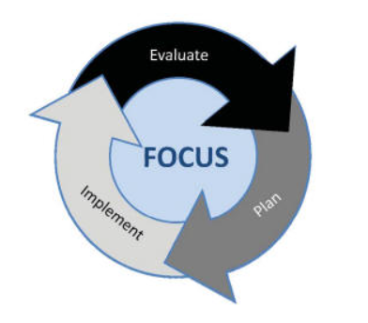
Planning Cycle for Federal Funds
Conduct CNA and identify local needs
Monitor implementation and effectiveness of programming
Consider potential evidence-based strategies to address needs
Adjust implementation based on actual data
Implement plan to address needs
Use guiding questions to determine allowability and appropriate funding source
Finalize Plan
Notes:
Laura present
Discuss the LEA’s responsibilities throughout each step of the cycle.
Here you will see that we have built upon that process of evaluating, planning, and implementing to show how this works in federal programs. This expanded cycle should provide you a step by step cycle that you can use to evaluate, plan for, and implement programs using federal funds. For the rest of today’s training, we will be walking you through the steps in this cycle.

Slide 25
Title I, Part A:
Improving the Academic Achievement of the Disadvantaged
Notes:
Evita

Slide 26
Title I, Part A: Improving the Academic Achievement of the Disadvantaged
Purpose: To ensure that all children have a fair, equitable, and significant opportunity to obtain a high-quality education and close educational achievement gaps
Title I, Part A is intended to support LEAs in:
Improving teaching by promoting effective instruction for at-risk children and for enriched and accelerated programs;
Encouraging school-based improvement planning;
Establishing accountability based on results;
Promoting meaningful parent and family engagement;
Coordinating with health and social services agencies;
Focusing resources on the schools with the highest percentage of students living in poverty.
Notes:
Evita present
Title I, Part A is intended to support LEAs in:
Providing high quality academic support to students at risk of not meeting state standards
Improving teaching by promoting effective instruction for at-risk children and for enriched and accelerated programs;
Expanding eligibility of schools for schoolwide programs that serve all children;
Establishing and requiring the use of school-based improvement planning based on a needs assessment
Establishing accountability based on results;
Promoting meaningful stakeholder engagement that involves a variety of stakeholders, including parents and families;
Coordinating with health and social services agencies;
Focusing resources on the schools with the highest percentage of students living in poverty.
Addressing any disparities that result in low-income and minority students being taught at disproportionate rates by ineffective, inexperienced, or out-of-field teachers.

Slide 27
Title I, Part A: Eligibility
Which schools are eligible to receive Title I funds from districts?
Highest-poverty schools are served in rank order; all schools above 75% poverty must be served first.
*Districts with less than 1,000 students enrolled are exempt from rank order requirements.
Which districts are eligible to receive Title I funds from the State?
CDE receives ESEA funds from USDE and disseminates this formula grant to districts based on census data.
Which students are eligible to receive Title I services from schools?
Students who are at risk of not meeting state academic standards, regardless of income, qualify for Title I services and supports.
Notes:
Evita present
Add note on flexibilities for districts less than 1,000. Include the different groups of students who are eligible for Title I.
An LEA must serve the highest-poverty schools first, allocating equal or higher per-child amounts to schools with higher poverty rates than to schools that are lower on the poverty scale.
All schools above 75% poverty must be served first.
Rank Order requirements do not apply to LEAs with less than 1,000 students and only one school per grade span, who have the flexibility to serve any schools regardless of poverty.
For more information and resources related to serving schools with Title I funds click here.

Slide 28
Title I, Part A: Programmatic Summary
Targeted Assistance Programs
Designed to provide extra educational assistance beyond the regular classroom to at-risk students, identified as having the greatest need for special assistance.
Eligible students are those identified by the school as not meeting academic standards. Requires tracking and reporting supports and serves at the student level.
Funds may only be used to meet the needs of eligible and served Title I students.
Progress of eligible children must be reviewed on an ongoing basis and the program should be adjusted as necessary.
Schoolwide Programs
Comprehensive reform strategy designed to upgrade the entire educational program in order to improve the achievement of the lowest-achieving students.
● Use the school’s comprehensive needs assessment to drive the use of funds ● Regularly monitor and revise the schoolwide plan, as necessary, based on student needs
Funds may be used to upgrade the educational program of the entire school, with particular attention to providing services to students identified as at-risk
Does not need to identify particular students as eligible, which expands eligibility students who may participate in Title I services
Option for schools with a minimum of 40% poverty, or the school has applied for a waiver.
Notes:
Evita present
This chart is just a summary of the key components we discussed, for you to consider side by side. Note the charts are not exactly a one to one comparison across them but rather key components.

Slide 29
Title I, Part A: School Improvement
Schools identified for improvement can apply for additional support through the EASI grant.
Methods and Criteria for Identification
Federal statute requires states that accept ESSA funds to identify schools for Comprehensive or Targeted Support and Improvement as follows:
Comprehensive Support and Improvement (CS)
Lowest performing 5% of Title I schools
High schools with low graduation rates (67% or lower)
Chronically low performing student groups (former ATS that did not meet exit criteria)
Targeted and Additional Targeted Support and Improvement (TS and ATS)
TS: Any schools with at least one consistently underperforming disaggregated group
ATS: A subset of TS schools with at least one disaggregated student group that, on its own, meets the criteria for the CS-Lowest Performing 5%
Notes:
Evita present
Districts have been notified of any schools on improvement for 24-25. Definitions. For schools that are identified there’s a grant opportunity EASI. There are also planning requirements for each identification- link to that page https://www.cde.state.co.us/fedprograms/essaplanningrequirements There will be upcoming trainings.

Slide 30
Reporting Requirements [Section 1111(h)]
Title I requires that LEAs post on their website specific data elements about the performance of schools.
The required data elements are listed on CDE’s ESSA Local Reports website.
CDE meets this reporting requirement on behalf of LEAs, who can link to the CDE website OR create their own.

Slide 31
Title I, Part A: Resources
General Title I, Part A
Title I, Part A: Improving the Academic Achievement of the Disadvantaged
Additional Fiscal Resources
ESSA Allocations and Fiscal Files
Supplement, Not Supplant Guidance
Comparability
Maintenance of Effort Requirements
Student Supports
Schoolwide Programs
Targeted Assistance Programs
Foster Student Program
Homeless Education Program (McKinney-Vento)
School Improvement
ESSA Improvement Planning Requirements
Methods for Identification and Exit Criteria for ESSA Support and Improvement
Notes:
Evita present
Update with most current resources

Slide 32
Title I, Part D: Prevention and Intervention Programs for Children and Youth who are Neglected, Delinquent, or At-Risk
Notes:
Nathan 10 min to present Title ID

Slide 33
Purpose
Title I, Part D: Prevention and Intervention Programs for Children and Youth who are Neglected, Delinquent, or At-Risk
Purpose:
Improve educational services for children and youth who are neglected (N) or delinquent (D)
Provide services to children and youth who are N or D so that they can successfully transition from institutionalization to further education or employment
Prevent youth from dropping out of school and provide youth who have dropped out and youth returning from correctional facilities with a support system to ensure their continued education.
Notes:
Nathan
These are the three tenets of TIPD and ultimately how we assess uses of funds.
Purpose:
The purpose of Title I, Part D is to Improve educational services for children and youth who are neglected (N) or delinquent (D) so that they have the opportunity to meet challenging State academic content and achievement standards;
Provide children and youth who are N or D services so that they can successfully transition from institutionalization to further education or employment; and
to prevent youth from dropping out of school. As well as make sure those who have dropped out and those returning from a correctional facility receive a support system that ensures they continued education.
Please be sure to take a look at the Title I, Part D homepage for more information and resources!

Slide 34
Title I, Part D: Subparts
Subpart 1: State Agencies
  Provides funding to support the education of youth in state-operated institutions
  Must spend 15-30% on transition services
Subpart 2: Local Educational Agencies
  Aids local education agencies (LEAs) that work with local facilities that serve adjudicated youth
  Needs to have a formal agreement between the facility and the LEA
Subpart 3: Evaluation
  Requires that both Subpart 1 and Subpart 2 recipients evaluate the programs that they implement
  Annually evaluate the program and disaggregate data on participation by gender, race, ethnicity, and age; and
  Use evaluation data to plan and improve subsequent programs for participating children and youth.
Notes:
Nathan
This program contains three subparts. Subpart 1 is funding to support the education of youth in state operated institutions. The state agency is responsible in providing a free public education to the children and youth in their eligible facilities.. So sometimes the Division of Youth Services might have a facility under them but they don’t provide the free education, the LEA does and then those facilities could be eligible to receive funding through the LEA. Subpart 1 contains a requirement that the State Agency must spend at least 15% and more than 30% on transition services and it is subject to Supplement Not Supplant where funds must only be used to provide additional services, staff, programs, or materials that are not provided with State or local resources absent federal funds; federal funds cannot pay for resources that would otherwise be purchased with State and/or local funds. State Agencies can also upgrade the entire educational effort by moving to an institution-wide project which is like schoolwide program.
Subpart 2 is what most of the state consists of and a little more flexible than Subpart 1. It provides assistance to school districts that work with local facilities that serve adjudicated youth. Unlike subpart 1, Subpart 2 doesn’t have a requirement when it comes to how much should be spent on transition services but should consider putting a good amount towards it. The Subpart 2 recipients also need a formal agreement with the LEA and the facility.
Finally Subpart 3 is requiring both Subpart 1 and Subpart 2 recipients to evaluate the program they implement and using that information to plan and improve the program for the future.

Slide 35
Title I, Part D: Counting versus Serving Students
Annual Count is required for both Subpart 1 and Subpart 2
  Collected in late fall
  Generates funding for the next year
Counting Versus Serving
  Students can be counted when they are have children in locally operated correctional facilities that meet the definition of delinquent, are between 5 and 17 years old, and reside in the facility for one day within the 30-day count window.
  Students can be served with Title I, Part D funds if they live in a local delinquent institution, are eligible for Title I, Part A, Title I, Part C or are identified as at risk, and are 21 years of age or younger.
All facilities served with Title I, Part D funds, must report in the Consolidated State Performance Report (CSPR)
  Collected late fall to early winter
  Reports on outcomes from the previous year
If you have a facility within your district that you think should be counted in the Annual Count, please reach out to Nathan Hickman or Melissa Chaffin.
Notes:
Nathan
All Subparts must complete an annual count of eligible students. We just recently sent out the Annual Count to both the State Agency and the eligible local educational agencies. The annual count is collected in December and generates the funding for the next year. There are three parts to determining eligibility - we must determine which State Agencies and LEAs are eligible for the program, then the facilities within the State Agency and LEA and then which kids to actually count in the Annual Count Collection. It is important to note that both subparts include different requirements for counting.
A big part of Title I, Part D is the counting versus serving piece. As you can see, Subpart 1 and Subpart 2 are counting children based on different criteria. The same goes for when they serve facilities with this funding. The children that were included in the count might not necessarily be the ones to receive the services. Kids are constantly moving in and out of facilities and it is important to serve your facilities with the greatest need.
So if you think you might have a facility within your district that probably should be included in the annual count, please reach out to Alan Shimmin or myself
Again, the criteria for who is served differs between the two subparts. One thing to keep in mind when it comes to serving students is that any facility that receives Title I, Part D must report students that directly benefited from the program in the Consolidated State Performance Report or CSPR. The CSPR collection aid in the on-going evaluations of all Title I programs statewide. The data collected is analyzed and reported back to ED to inform programming decisions. This was recently just completed by our facilities.

Slide 36
Title I, Part D: Allowable Uses for Subpart 2- LEAs
Special programs to meet the unique academic needs of participating children and youth, including vocational and technical education, special education, career counseling, curriculum-based youth entrepreneurship education, and assistance in securing student loans or grants for postsecondary education
Programs providing mentoring and peer mediation
Programs that serve children and youth returning to local schools from correctional facilities, to assist in the transition of such children and youth to the school environment and help them remain in school in order to complete their education
Dropout prevention programs which serve at-risk children and youth, including pregnant and parenting teens, children and youth who have come in contact with the juvenile justice system, children and youth at least 1 year behind their expected grade level, migrant youth, immigrant youth, students with limited English proficiency, and gang members
The coordination of health and social services for such individuals if there is a likelihood that the provision of such services, including day care, drug and alcohol counseling, and mental health services, will improve the likelihood such individuals will complete their education
Notes:
Nathan

Slide 37
Title I, Part D: Resources
Title I, Part D Homepage
National Technical Assistance Center (NDTAC)
TIPD Statute
Notes:
Laura, Evita, Kim, Rachel Update
Update with most current resources

Slide 38
Title II, Part A: Preparing, Training, and Recruiting High-Quality Teachers, Principals and other School Leaders
Notes:
Rachel E. 10 min or less to present Title II

Slide 39
Title II, Part A: High Quality Teachers and Leaders
Purpose:
Title II, Part A of the Every Student Succeeds Act (ESSA) is intended to:
Increase student academic achievement consistent with challenging State academic standards,
Improve the quality and effectiveness of educators, increase the number of educators who are effective in improving student academic achievement in schools, and provide low-income and minority students greater access to effective educators.
All activities supported with Title II, Part A funds shall address the learning needs of all students including children with disabilities, English learners, and gifted and talented students.
Title II activities should be aligned to the district comprehensive needs assessment.
Notes:
Rachel E.

Slide 40
Title II, Part A: Spectrum of Allowability
Funds CAN be used to support:
Teacher leadership activities
Principal training for strong evaluation and support systems
Professional development that is sustained, collaborative, data-driven, and classroom-focused
Instructional coaches
Implementing a teacher pipeline program, with intentional, systemic recruitment and preparation
Class size reduction (CSR)
Funds MAY be used depending on LEA identified needs:
District-level curriculum coaches
Non-state required induction activities
Strategic recruitment/ retention
PD for staff wellness and student SEL
Funds CANNOT be used to:
Purchase curriculum (for student learning)
Pay for principal training not focused on supporting instructional/school improvement
One-off trainings (1 day, workshop), trainings that do not align to school/LEA CNA
Purchase and/or implement student assessments
Hire paraprofessionals
Allowable
Not Allowable
Notes:
Rachel E.
Title II, Part A Funds can be used to support:
Teacher leadership activities (mentorship, coaching, leading trainings, stipends, subs to cover classroom)
Principal training for strong evaluation, e.g., observation and instructional feedback
Professional development that is sustained, collaborative, data-driven, and classroom-focused
Instructional coaches (e.g., portion of assistant principal or teacher leader salary that focuses on improving teacher instruction)
Implementing a teacher pipeline program, with intentional, systemic recruitment and preparation (e.g., career pathway from para to teacher)
Title II, Part A Funds CANNOT be used to:
Purchase curriculum (for student learning)
Pay for principal training not focused on supporting instructional improvement
One-off trainings (1 day, workshop), trainings that do not align to school/LEA CAN
Purchase and/or implement student assessments
Pay for more paraprofessionals

Slide 41
Common use of Title II, Part A Funds: Ensuring Equitable Distribution of Teachers
The Elementary and Secondary Education Act (ESEA) requires state education agencies (SEAs) to evaluate annually whether low-income and minority students are taught disproportionately by ineffective, out-of-field, or inexperienced teachers compared to their higher-income, non-minority peers and requires local education agencies (LEAS) to submit plans addressing any such disparities.
Title II, Part A funds can be used to address Equitable Distribution of Teachers (EDT) gaps.
Notes:
Rachel E.

Slide 42
Title II, Part A: Resources
Title II, Part A Webpage
Educator Qualification Requirements Under ESSA Webpage
EDT Webpage

Slide 43
5 Minute Break

Slide 44
Title III, Part A: Language Instruction for English Learners and Immigrant Students
Notes:
Kim

Slide 45
Title III, Part A: Purposes
Purpose:
Ensure ELs/MLs and Immigrant children and youth attain English proficiency and develop high levels of academic achievement
Assist all EL/MLs in meeting Colorado Academic Standards (CAS)
Establish, implement, and sustain effective English language development (ELD) programs designed to assist in teaching ELs/MLs
Develop and enhance the capacity of teachers, principals and other school and district leaders to provide effective instructional programs for ELs/MLs
Promote parental, family, and community participation in ELD programs
Notes:
Kim
CDE refers to English Learners as “ELs/MLs” Multilingual Learners. You will see the reference to MLs more frequently.

Slide 46
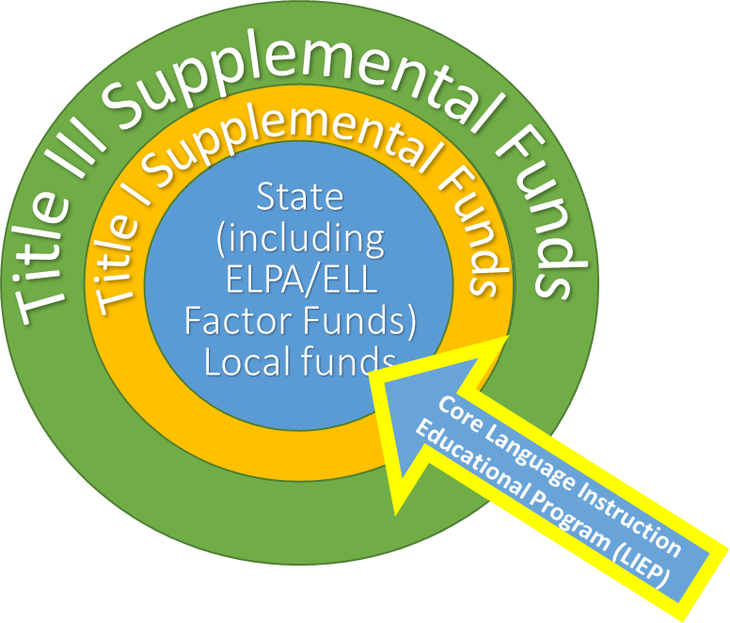
Title III, Part A: Programming
ELD Core
Programming
According to USDE, a core program is a set of instructional services and curricula designed to help ELs/MLs acquire English proficiency and meet high academic standards. The core program is composed of characteristics, principles, and practices that have been developed based on theory and research and serves as a blueprint for which the schools within the district (LEA) follow.
Notes:
Kim - Title III is supplemental, above and beyond ELPA and ELL Factor funds - core programming cannot be paid from Title III. Title III is a supplemental grant under the ESEA that is designed to improve and enhance the education of ELs/MLs in becoming proficient in English, as well as meeting the Colorado Academic Standards.

Slide 47
Title III, Part A: Requirements
Required activities include:
ELD programs that have successfully demonstrated increasing English language proficiency and academic achievement
Providing effective professional development to all staff that relates directly to the instruction of ELs/MLs that support their linguistic, academic, and social-emotional challenges and opportunities of ELs/MLs
Providing and implementing other effective activities and strategies that enhance or supplement ELD programs for ELs/MLs, which must include parent, family, and community engagement activities, but may also include strategies that coordinate and align related programs
Notes:
Kim - As a grant recipient, there are strings attached to federal money. This is where the narrative questions come into play as we are required to collect this data per statute. LEAs are required to provide activities that are effective, that enhance and supplement programs. We ask for this information in the narrative questions and follow-up with monitoring support.

Slide 48
Title III, Part A: Allowable Activities
Funds may be used to support (must supplement core programming):
  Upgrading ELD program objectives and effective instructional activities
  Improving ELD programs for ELs by identifying, acquiring, and upgrading curricula, instructional materials, educational software and technology, and assessment procedures that improve content and language acquisition
  Providing community participation programs, family literacy services, and parent outreach and training activities to EL/ML students and their families
  Providing tutoring and intensified instruction for EL/ML students
  Offering early college high school or dual/concurrent enrollment programs or courses designed to help ELs achieve in postsecondary education
  Developing and implementing effective preschool, elementary or secondary school ELD programs that are coordinated with other relevant programs and services.
  Improving the instruction for EL/ML students, including EL/ML students with a disability or identified as gifted in a specific area
Funds CANNOT be used to support:
WIDA Screener, or ACCESS 2.0
    ELPA requires LEAs to identify, provide services, and annually evaluate ELs.
    LEAs cannot use Title III funds to purchase these materials, train teachers, or provide FTE/subs/release time to administer assessments.
Core ELD Programming
    Curricular resources for ELD or content blocks
      ELD Resources - EL Achieve, Pearson Language Central, National Geographic Edge, Reach, Inside the USA
      READ Act Assessment and approved programming
    FTE for ELD or content areas
OCR requirements
Notes:
Kim - Title III, Part A Funds may be used to support ELD programming by: upgrading curricula, materials, software/technology, assessment procedures, tutoring, dual/concurrent enrollment, support EL/ML students with disabilities, and help support community participation programs, family literacy, and parent outreach. Title III funds CANNOT be used for the WIDA Screener or ACCESS 2.0, which are used to evaluate English proficiency, core English Language Development programming or resources, READ Act assessments, or anything related to OCR (Office of Civil Rights) requirements.

Slide 49
Title III, Part A: Supports & Resources
Title I USDE: Non-Regulatory Guidance- English Learners and Title III Program
Title I USDE: ESSA Webinar Audio Recording on Non-Regulatory Guidance
Title I USDE: Title III Guidance – English Learners
English Learner Professional Development Requirements for educators
Culturally and Linguistically Diverse Education
Title III Resources
Notes:
Kim - here are some links to resources specific to serving ELs/MLs with Title funds.

Slide 50
Title III, Immigrant Set-Aside
Notes:
Kim - CDE reserves 5% of its Title III allocation for the Title III Immigrant Set-Aside (ISA) grant.

Slide 51
Purpose
Title III, Immigrant Set-Aside
Purpose
The Title III Immigrant Set-Aside grant is designed to support school districts that have experienced a significant increase in immigrant students over the past two years. This program provides enhanced instructional and supplemental support opportunities for immigrant students and their families.
Immigrant subgrants provide cultural and social supports for students and their families newly arrived in U.S. schools.
LEAs must be careful to ensure that Immigrant supports are not language-focused but rather are focused on cultural and social adjustment to U.S. schools.
Notes:
Kim -

Slide 52
Title III, Immigrant Set-Aside Definitions: Newcomer Toolkit
Immigrant Children and Youth (Title III)
“Immigrant children and youth are those who
(A) are aged 3 through 21;
(B) were not born in any of the United States; and
(C) have not been attending one or more schools in any one or more states for more than 3 full academic years” (ESEA, Section 3201(5)).
Newcomer Student
For purposes of this toolkit, the term newcomer student refers to K-12 students born outside the United States who have arrived in the United States in the last three years and who also are still learning English. This designation is temporary.
Important: The term “immigrant” as used in Title III is NOT related to an individual’s legal status.
Notes:
Kim
https://ncela.ed.gov/educator-support/toolkits/newcomer-toolkit The Federal definition of immigrant is on the left, the Newcomer Tookit resource utilizes “newcomer” in the same capacity. In some districts, these terms are synonymous, please check for your district’s definitions and in what capacity the term “newcomer” is used. Also, please keep in mind that the term “immigrant” as used in Title III is NOT related to an individual’s legal status.

Slide 53
Title III, Immigrant Set-Aside: Use of Funds
Allowable Activities Focused on Immigrant Children and Youth
Family literacy, parent outreach, and training activities to help parents to participate actively in their children’s education.
Support for personnel, including teacher aides, specifically trained to serve immigrant children.
Tutoring, mentoring, and academic or career counseling.
Identification and acquisition of supplemental curricular materials, and educational software and technologies.
Basic instruction services directly attributable to their enrollment; classroom supplies, costs of transportation, etc.
Other instructional services to assist immigrant students: civics education, introduction to educational system, etc.
Activities coordinated with community-based organizations, institutes of higher education, and private sector entities to assist parents by offering comprehensive services.
Notes:
Kim - here are some allowable activities with Immigrant Set-Aside funds. We’ve seen many of these activities in the Consolidated Application - such as, tutoring before and after school, family literacy activities, and parent university to help them acclimate to life in the U.S. Please remember that only children and their families formally identified as immigrant students and families can participate.

Slide 54
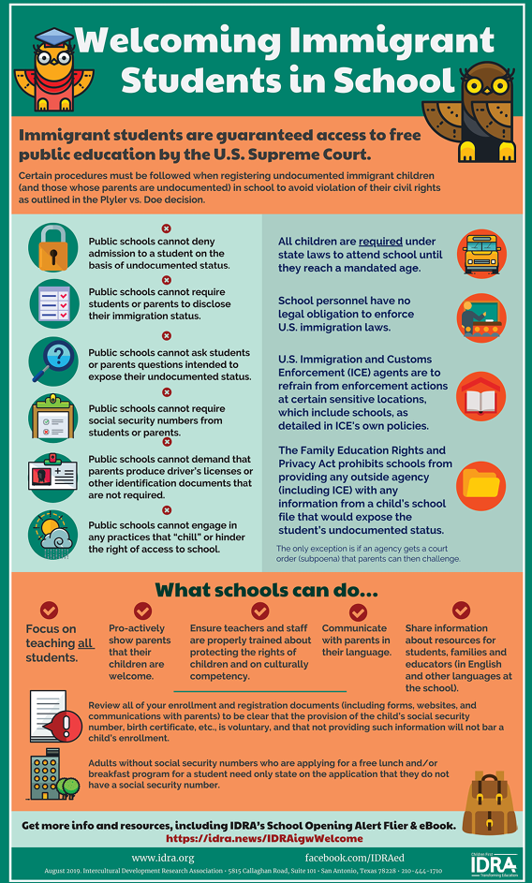
Title III, Immigrant Set-Aside: Resources
CDE: Title III, Immigrant Set-Aside Webpage
CDE: Title III, Immigrant Set-Aside Small Bite:
Recording
Slides
How to Create an Immigrant Liaison Position at Your School
U.S. Department of Education Fact Sheet: Educational Services for Immigrant Children and Those Recently Arrived to the United States
Welcoming Immigrant Students in School
Notes:
Kim - here are some valuable resources in using Title III, Immigrant Set-Aside funds, and how to welcome immigrant students and their families to your school and district. And now I’ll turn it over to my colleague, Evita Byrd to discuss Title IV, Part A.

Slide 55
Title IV, Part A: Student Support and Academic Enrichment Grants
Notes:
Nathan and Evita Update and condense TIV slides. 15 min to present Title IV

Slide 56
Purpose
Title IV, Part A: Student Support and Academic Enrichment Grants
Purpose:
To improve academic achievement by increasing the capacity of states, LEAs, schools, and communities to:
  Provide all students with access to a well-rounded education;
  Improve school conditions for student learning; and
  Improve the use of technology in order to improve the academic achievement and digital literacy of all students.
Notes:
Evita
As with other Title programs, activities must be planned in consultation with parents, teachers, principals and other relevant stakeholders.
LEAs that receive a Title IV, Part A allocation must provide equitable services to children in eligible non-public schools.

Slide 57
Title IV, Part A: Content Categories
Well Rounded Education
STEM, Arts, Health and Physical Education, Computer Science, CTE, Gifted Services, World Languages, career and college support, social emotional learning, and more.
Safe and Healthy Students
Mental health services, violence prevention, positive behavioral intervention system (PBIS), counseling, trauma-informed practice, school climate and safety, and more.
Effective Use of Technology
Professional development, instructional support, blended and personalized learning, staff certification in digital classroom services and products, hardware* or software*, and more.
*Note: LEAs may not spend more than 15% of Effective Use of Technology funding on devices, equipment, software applications, platforms, digital instructional resources and/or other one-time IT purchases.
Notes:
Evita

Slide 58
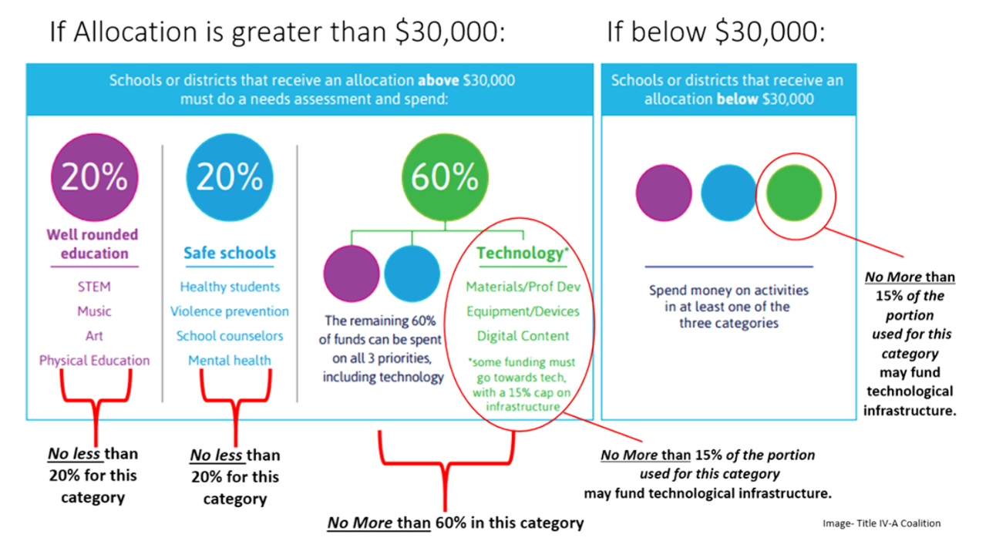
Title IV, Part A: Allocation Distribution
Notes:
Evita
Under $30,000
Must use no less than 20% of funds to support one or more activities under
Well-Rounded Educational Opportunities
Safe and Healthy Students
Effective Use of Technology
$30,000 or more
Must conduct a CNA every 3 years
Must use at least 20% on well-rounded educational opportunities
Must use at least 20% on school conditions for student learning
Must use a portion to support access to personalized learning experiences supported by technology

Slide 59
Title IV, Part A: Prioritization of Funds
The LEA has discretion in how funds are distributed to schools, but must prioritize:
Schools with the greatest need, or
Schools with the highest percentages or numbers of children counted in the Title I, Part A calculation, or
Schools identified for Comprehensive (CS) or Targeted Support (TS) and Improvement, or
Schools identified as persistently dangerous public elementary school or secondary school.
The LEA’s comprehensive needs assessment can include an assessment of Title IV related needs but the LEA will be required to provide a description of how Title IV funds specifically were prioritized.
Notes:
Nathan

Slide 60
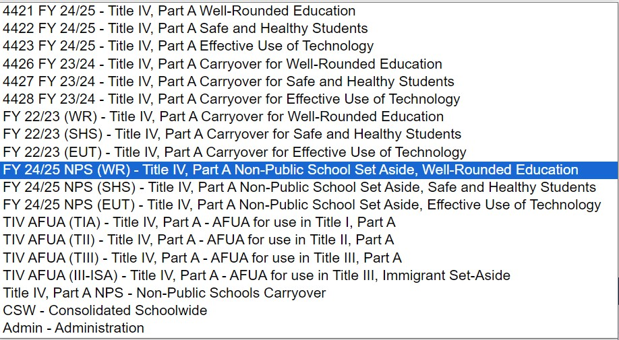
Title IV, Part A: Grant Codes Update
Notes:
Nathan
The additional Title IV, Part A categorical grant codes will be added for use in budgeting Title IV funds in the 2021-2022 Consolidated Application.
Districts will continue to draw down all Title IV, Part A funds using grant code 4424. The categorical codes have been added for internal use in tracking expenditures.
There is not a separate code for tracking Alternative Use of Funds Authority (AUFA) or transfers since those expenditures would support another program and would not need to be recorded and reported categorically for Title IV reporting.

Slide 61
Title IV, Part A: Additional Resources
Title IV, Part A Webpage
T4PA Center
National Center on Safe Supportive Learning Environments
Federal School Safety Clearinghouse
Colorado School Safety Resource Center
Office of Educational Technology
Notes:
Nathan

Slide 62
Title V: Rural Education Achievement Program
Notes:
Kristin 10 min to present Title V

Slide 63
Title V, Part B: Rural Education Initiative
Purpose:
To address the unique needs of rural school districts that frequently lack personnel and resources needed to compete effectively for federal competitive grants
To support LEAs that receive formula grant allocations in amounts too small to be effective in meeting their intended purposes
Rural Education Achievement Program (REAP) is comprised of two formula grant programs:
The Rural, Low-Income School (RLIS) grant program
*Included in the Consolidated Application
The Small, Rural School Achievement (SRSA) grant program
  *SRSA funds are awarded and distributed directly by the USDE to LEAs
Notes:
Kristin

Slide 64
Title V, Part B: Eligibility
Master Eligibility Spreadsheet
RLIS
20 percent or more of children aged 5 to 17 served by the LEA must be from families with incomes below the poverty line and;
All schools served by the LEA must have a locale code of 6, 7, or 8 (assigned by the U.S. Department of Education’s National Center for Education Statistics).
RLIS is the only Title V grant that is managed through the Consolidated Application.
SRSA
Average daily attendance (ADA) at all of the schools served by the LEA is fewer than 600 OR each county in which a school served by the LEA is located has a total population density of fewer than 10 persons per square mile and;
All of the schools served by the LEA are designated with a school locale code of 41, 42, or 43, as determined by the secretary of education OR the secretary of education has determined, based on a demonstration by the LEA and concurrence of the SEA, that the LEA is located in an area defined as rural by the state.​
Dual Eligibility
  Dual-Eligible LEAs must choose one grant under which to receive funds each fiscal year
  By submitting an SRSA application to USDE, LEAs are submitting their intent to accept SRSA funds and will not receive an RLIS grant from CDE
Notes:
Kristin

Slide 65
Title V, Part B: Allowable Activities
Title V, Part B funds for both RLIS and SRSA programs can be used to support activities authorized under ESEA, as follows:
RLIS
SRSA
Title I, Part A
Title I, Part A
Title II, Part A
Title II, Part A
Title III, Part A
Title III, Part A
Title IV, Part A
Title IV, Part A
Parent and Family Activities
Title IV, Part B
Notes:
Kristin

Slide 66
Title V, Part B: Resources
Title V, Part B and Rural Resources
Rural, Low-Income School Program
Small, Rural School Achievement Program
Notes:
Kristin

Slide 67
Equitable Services to Non-Public Schools
Notes:
Kristin 5 min to present Equitable Services

Slide 68
Information
Equitable Services to Non-Public Schools
ESSA underscores the opportunities for students attending non-public schools to receive the benefits of Title programs
SEA is required to designate an Ombudsman to help ensure equity for private school children, teachers, and other educational personnel including monitoring and supporting the requirements of providing equitable services.
LEAs must reach an agreement on the equitable services through timely, meaningful, ongoing communication with the non-public schools in regard to the needs and the services that will be provided.
Title I, Part A Proportionate Share: Expenditures for equitable services to eligible non-public school children, teachers and other educational personnel, and families must be equal to the proportion of funds allocation to participating public school attendance areas based on the number of low-income students who reside in those attendance areas and attend non-public schools (equitable services resources follow the student).
Title VIII Equitable Services: Titles I, Part C, II, III & IV – funds are typically allocated to non-public schools on an equal per-pupil basis (using total enrollment) to participating schools and only apply to non-public schools within the geographical boundaries of the LEA.
Notes:
Kristin
Title II – Take into account all students in schools that agreed to participate
Title III – take into account the number and educational needs of the children to be served.

Slide 69
Equitable Services Big Ideas
Students in Non-Public Schools drive funds too.
Supplement, not supplant still applies, therefore equitable services cannot meet general needs of students in NPS. However, if something is required of the LEA and not of the NPS, it may be allocable to federal funds for NPS and not for the LEA.
As with LEAs, professional development provided to NPS must be part of a sustained, comprehensive PD plan.
The LEA must maintain control of the funds, as well as being responsible for the design, implementation, and measuring academic impact of equitable services. (cannot only be provision of materials)
Notes:
Kristin

Slide 70
Equitable Services: Resources
Title I, Part A of the Elementary and Secondary Education Act Within District Allocations 2022
Title I, Part A of the Elementary and Secondary Education Act Equitable Services Non-Regulatory Guidance 2023
Title VIII, Part F of the Elementary and Secondary Education Act Equitable Services Non-Regulatory Guidance 2023
CDE Equitable Services Webpage
CDE Non-Public Schools Webpage
USDE Office of Non-Public Education
Notes:
Kristin

Slide 71
Program Monitoring
Notes:
Kristin

Slide 72
Federal Programs Monitoring
Purpose: CDE has designed the monitoring system to accomplish the following objectives:
Focus on What Matters by ensuring LEAs are making progress toward increased student achievement and improved quality of instruction for all students through effective implementation of Federal programs;
Reduce Burden on LEAs by combining and streamlining monitoring protocols for federally-funded programs and prioritizing LEAs selected to participate in the process based on a set of performance, fiscal, programmatic, and administrative selection criteria;
Improve Communication with LEAs by strengthening their constructive partnerships with CDE through continuous feedback and assessment of the CDE monitoring resources, process, and system;
Differentiate and Customize Support for LEAs by using the monitoring system to identify technical assistance to support LEA needs as well as areas in which LEAs are making progress or implementing exemplary programs, and can serve as a model or resource for other LEAs; and
Ensure Basic Requirements Are Met by reviewing program and fiscal requirements, to safeguard public funds from waste, fraud, and abuse.
Notes:
Kristin

Slide 73
Federal Programs Monitoring: Timeline
All LEAs are monitored for federal programs in a multi-year cycle. The current cycle’s schedule can be viewed by downloading the Monitoring Schedule (XLSX).
The next multi-year cycle will begin in 2027-2028.
While the LEA isn’t monitored every year, the LEA is responsible for tracking implementation information and keeping applicable artifacts to prepare for monitoring submissions during their monitoring year.
Notes:
Kristin

Slide 74
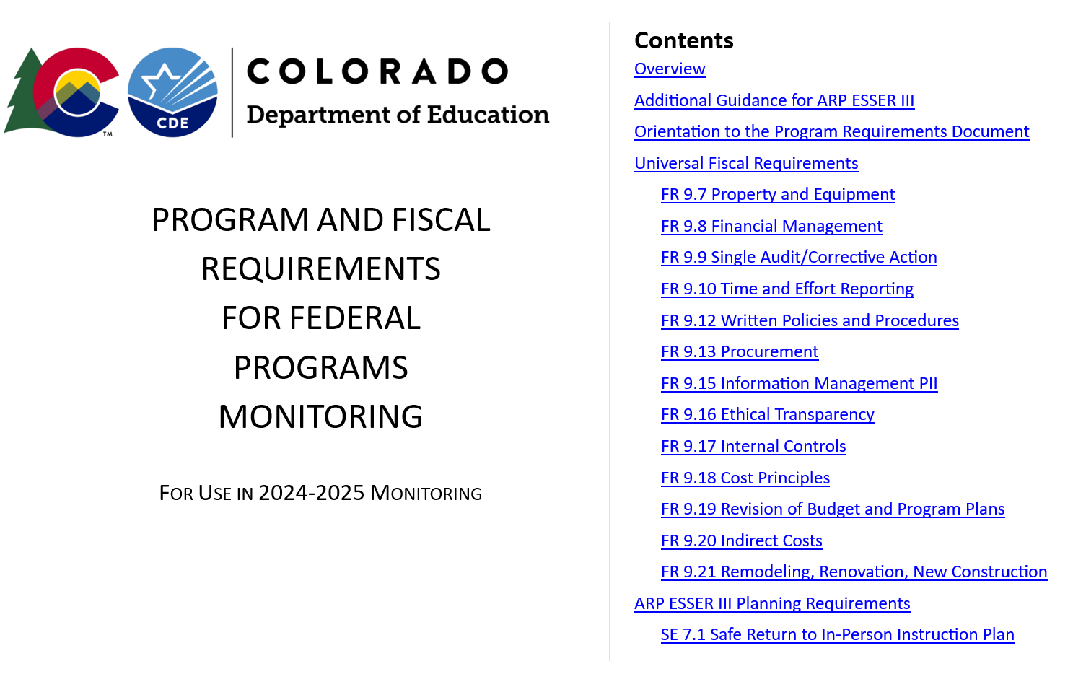
Program Requirements
The Program Requirements Document for use in 2024-2025 shares the formal monitoring requirements for federal programs. LEAs can use the document as guide for progress monitoring throughout the year.
Notes:
Kristin
LEAs are responsible for progress monitoring program and fiscal requirements throughout each fiscal year. These requirements are found in the Program and Fiscal Requirements for Federal Programs Monitoring document, shown here. Ensuring that the LEA is meeting these requirements and maintaining documentation showing this compliance will not only benefit students in the way the funds are intended, but will also prepare the LEA for being monitored by the Federal Programs and Supports Unit.

Slide 75
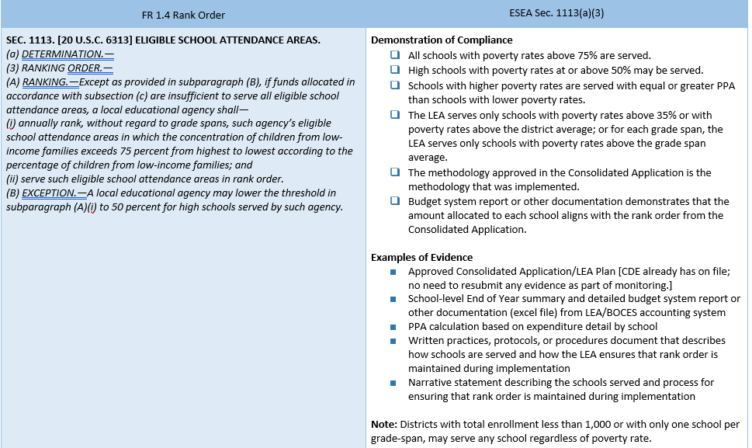
Program Requirements Cont.
The left column of the Program Requirements document references the indicator number and name, and statutory and regulatory citations that delineates the requirement(s).
The right column of the Program Requirements document provides Demonstration of Compliance checklist, and Examples of Evidence LEAs may provide to demonstrate compliance.
Notes:
Kristin
Throughout the Program Requirements document, you’ll see that it is arranged in columns. The left column references the indicator numbers and names (in this case, it’s ID 9.9 Implementation of Funds - GEPA), and the statutory and regulatory citations that delineates the requirements. The right column provides the Demonstration of Compliance checklist, followed by Examples of Evidence that LEAs may provide to demonstrate compliance. The LEA should consider these requirements when working with federal funds.

Slide 76
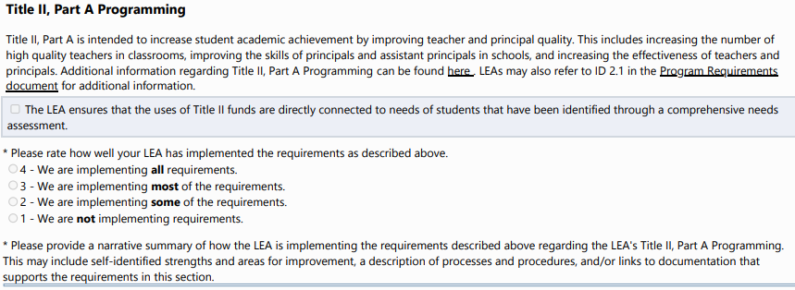
Program Monitoring Self-Assessment
The Program Monitoring Self-Assessment (PMSA) is available for LEAs to self-assess implementation to identify compliance and areas for improvement.
Notes:
Kristin

Slide 77
Program Monitoring: Resources
Federal Programs Monitoring Webpage
Federal Programs Monitoring Requirements (DOC)
ESEA Program Monitoring Self-Assessment 2024-2025 (PDF)
ESEA PMSA Process Guide for GAINS (PDF)
Notes:
Kristin

Slide 78
Website Tour & Networking
Notes:
Rachel E

Slide 79
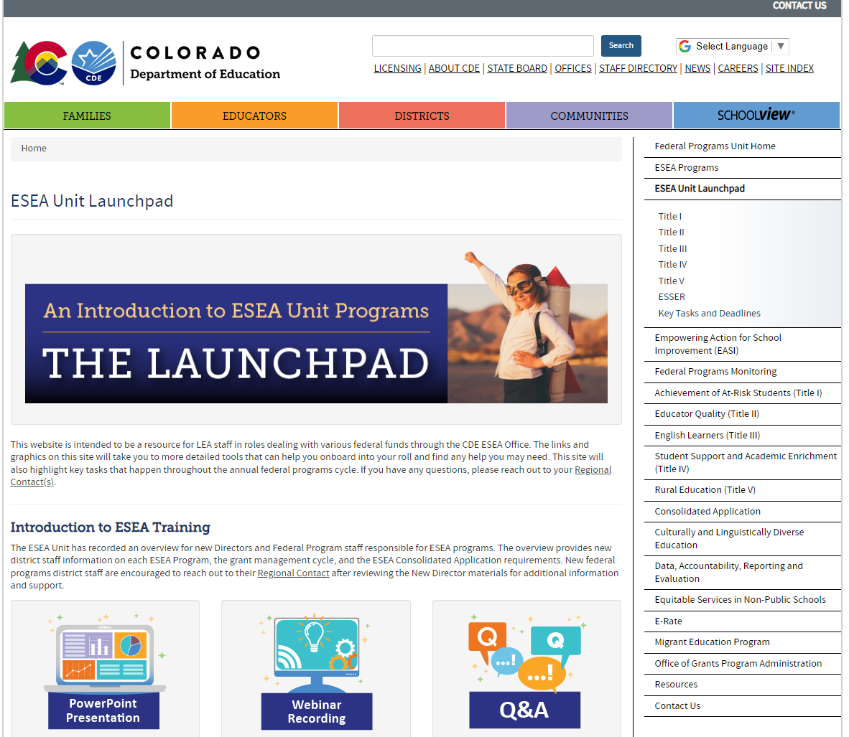
Website Tour
Federal Programs and Supports Unit Homepage
Federal Programs Launchpad
Notes:
Rachel E
During website tour, show people,
The launchpad homepage
Click on Title I
Show the sections including
Overview
key terms and concepts
Eligibility
allowable uses of funds
stakeholder engagement
key tasks and deadlines.

Slide 80
Regional Networking Time
Breakout rooms by region:
Room 1: North Central and Northeast Regions
  Evita Byrd, Nathan Hickman and Kristin Crumley
Room 2: Northwest and West Central Regions
  Kim Boylan and Rachel Temple
Room 3: Pikes Peak Region
  Tammy Giessinger, Laura Meushaw, Sue Miller-Curley
Room 4: Southeast and Southwest Regions
  Christina Adeboye Sullivan and Rachel Echsner
Room 5: Metro
  Nazie Mohajeri-Nelson and CDE Staff
Regional Contacts Webpage
Discussion:
Share your name, district and role.
What are some needs that federal programs support in your district?
What do you hope to learn more about regarding Federal Programs?
Notes:
Rachel E

Slide 81
CDE Contacts
Emails: Lastname_Firstinitial@cde.state.co.us (e.g., Smith_a@cde.state.co.us)
Federal Programs & Supports (ESEA/ESSER Program Supports) | School Finance & Operations (Fiscal and Systems Supports)
Nazie Mohajeri-Nelson, Executive Director of Federal Programs & Supports Unit Program Specialists Program Implementation Supervisor: Laura Meushaw Program Implementation Coordinator: Christina Adeboye Sullivan Program Monitoring Supervisor: Tammy Giessinger ESEA/ESSER Monitoring Coordinator: Kristin Crumley Program Effectiveness Supervisor: Tina Negley Program Evaluation & Research Coordinator: Anna Rowan ESEA Programs Specialists and ESEA Regional Contacts (assigned by district) Title I: Laura Meushaw, Evita Byrd, Rachel Echsner, Kim Boylan Title II: Rachel Echsner, Sue Miller-Curley Title III: Rachel Temple, Kim Boylan Title IV & Stronger Connections Grant: Nathan Hickman, Evita Byrd Title V: Christina Adeboye-Sullivan, Rachel Echsner, Kristin Crumley Non-Public Schools: Christina Adeboye-Sullivan, Kristin Crumley ESSER Program Specialists Kim Boylan Kriselda Craven ESEA and ESSER Data and Reporting Specialists Melissa Chaffin (ESEA) Jerry Ring (ESEA) Anna Rowan (ESEA) Nadine Penn (ESSER) | Sheldon Rosenkrance, Chief District Operations Officer Fiscal Specialists Jennifer Austin, Director of Grants Fiscal Management ESEA Robert Hawkins, Grants Fiscal Analyst Steven Kaleda, Grants Fiscal Analyst ESSER Fiscal Specialist Steven Kaleda Grants Fiscal Analyst ESSER Monitoring Bill Parsley, ESSER Fiscal Monitoring Supervisor Hilery Morris, ESSER Fiscal Monitoring Kristina Jones, Federal Fiscal Monitoring and Reporting Specialist Werner Hagemann, ESSER Fiscal Monitoring Specialist Application Systems Specialists DeLilah Collins, Director of Grants Program Administration Online Applications Systems Technical Support Jessica Hollingshead Michelle Prael Indian Education Coordinator Georgina Owen
Notes:
Rachel E

Slide 82
Thank You!
Notes:
Rachel E

