Slide 1
CDE ESEA and ESSER Office Hours
September 26, 2024

Slide 2
ESEA/ESSER Office Hours
Topics:
Reminders
Overview of ESSA Identification Methodology and Categories
UIP Requirements for ESSA Identified Schools and Resources Overview
Four Week Notification Requirements Pertaining to Educator Qualifications

Slide 3
ESEA Reminders and Updates

Slide 4
Reminders ~ ESSER III
ESSER III obligation deadline - Monday!!!!
Obligation Timetable ~ §76.707
Cannot pay salaries after 9/30/24
Final Request for Reimbursement ~ Grants Fiscal Website
ESSER Request for Funds Form is still in Formsite
Countdown to Closeout
Liquidation Extension Requests due October 15, 2024
Requires approval by U.S. Department of Education
Only allowable for costs that are fully and properly obligated by 9/30/24
Must have a justification (cannot be ‘need more time’)
See ESSER III Website for information on Liquidation Extensions
Submission Form
August 29 Office Hours had a training on Liquidation Extensions

Slide 5
ESEA Foundations Training
October 10, 2024 from 1:30-4:00 PM
The Federal Programs and Supports Unit will host an “ESEA Foundations” training. Federal programs directors and district staff who are new to managing federal funds are welcome to attend. The training will provide information on each ESEA program and will highlight a variety of tools and resources for understanding and meeting the ESEA requirements. Time will be reserved during the training for networking within regions. Register here.
Notes:
Rachel E.

Slide 6
ESSA Identification
Notes:
Nazie

Slide 7
Overview
Every state that accepts funds under the Every Student Succeeds Act (ESSA), the most recent reauthorization of the Elementary and Secondary Education Act (ESEA) must have a process for identifying schools for support and improvement that is approved by the U.S. Department of Education
Must include all public schools in methodology for identification, including Alternative Education Campuses (AECs) and schools with Grade K-2 only
The State (CDE) must notify the districts of their schools that have been identified for ESSA support and improvement
Districts must notify schools and support them in the development of an improvement plan that meets ESSA requirements

Slide 8
Status Update: ESSA State Plan (FYI)
Our original plan was approved in May 2018.
Each time we revise methodology, we must seek approval from US Department of Education
We have amended our methodology a couple of times so far to address the impact of the pandemic on assessment availability
In August 2024, we amended it again to account for new SAT cut-scores from the test becoming digital
We will be amending plan again this year - more to come on that later! Some changes are noted in orange

Slide 9
ESSA State Plan: Prior Amendments (FYI)
June 2023
Revised targets for the ELP on-track to attaining fluency metric.
Revisions to the School Quality and Student Success (SQSS) indicator.
Removal of science achievement.
Continued use of chronic absenteeism rates (as opposed to a reduction metric) and exclusion of excused absences.
Resumed use of three years of aggregate data, even if some of the data was from prior to the pandemic.
Revisions to the CS – Lowest 5% methodology to stabilize counts around 5 percent.
Each year, determine whether additional schools must be identified.
Any school performing below a school previously identified for CS – Lowest 5% that remains in the lowest 5% will be added to the list, regardless of the number of schools identified.
May 2022 - Amended to plan to address impact of not having 2020 assessments and alternating grades in 2021
2020-2021 - Paused ESSA Identification due to the pandemic (no identification in fall 2021)
Notes:
Every state that accepts funds under ESSA must have an approved methodology for methodology for meaningfully differentiating the performance of and identifying schools for support and improvement. Colorado’s methodology was initially approved by the U.S. Department of Education in 2018 as part of its ESSA State Plan. Colorado first identified schools in the fall of the 2017-18 school year, and continued to annually identify schools in the 2018-19 and 2019-20 school years. Due to the extraordinary circumstances created by the COVID-19 pandemic, Colorado received a waiver from accountability and school identification requirements for the 2020-21 and 2021-22 school years.
Colorado resumed school identification in Fall 2022 under a short-term addendum, and then in January 2023, CDE submitted an amendment to revise its ESSA identification methodology to address the impact of the pandemic. The proposed changes were approved by the U. S. Department of Education in June 2023, and implemented beginning with the Fall 2023 identifications. Colorado’s amendment included the following changes:
Revised targets for the English language proficiency on-track to attaining fluency metric, to better align with the performance framework cut scores.
Revisions to the School Quality and Student Success, or SQSS, indicator. Specifically, science achievement was removed for all grades, and chronic absenteeism rates, as opposed to a reduction metric, continues to be used for elementary and middle grade spans. The revised chronic absenteeism metric is based on unexcused absences only.
The amendment also involves resuming the use of three years of aggregate data, even if some of the data was from prior to the pandemic.
And the amendment includes revision to the Comprehensive Support and Improvement – Lowest 5 Percent methodology.

Slide 10
ESSA Identification Update
Districts with identified schools (except K-2 schools) received notifications from Dr. Haniford (CDE) by September 13, 2024!
Sent to Superintendent, Title I Contact (if provided in GAINS), Authorized Representative, and District Accountability Contact
One week later sent to the Local Board
Includes
Outline of changes in state and federal (ESSA) accountability
Resources and grants (EASI) available for identified schools
Improvement planning requirements
Link to a Data Dashboard
ESSA School Profiles are shared with districts via Syncplicity
In the near future, the list of all ESSA identified schools will be posted on the CDE ESSA Identification website

Slide 11
Indicators Used in School Identification Methodology
K-2 Only Schools
READ Act Data is used for the Academic Achievement and Growth indicator
Alternative Education Campus (AECs)
When necessary, the following indicators are also used to differentiate among lowest performing AECs, in addition to the other indicators listed to the left
Attendance rate
Truancy rate
Academic Achievement
English Language Arts (ELA) and Math mean scale scores
Academic Progress (Growth)
ELA and Math median growth percentiles
Progress in Achieving English Language Proficiency (ELP)
ACCESS median growth percentiles
Percent on-track to attaining proficiency
School Quality or Student Success
Chronic absenteeism rate, unexcused absences only (elementary/middle)
Dropout rate (high)
Graduation Rates (will change beginning in 2025)
4-year adjusted cohort rate
7-year adjusted cohort rate
Notes:
This slide provides a brief overview of the five indicators used in the ESSA Identification process.
Colorado utilizes mean scale scores on the CMAS, COALT, and SAT assessments, in both English language arts and math, for the Academic Achievement indicator. Please note that this includes students in grades 3-8 and grade 11.
Median growth percentiles for the CMAS and SAT English language arts and math assessments are utilized for the Academic Progress indicator, for students in grades 4-8 and grade 11.
The Progress in Achieving English Language Proficiency Indicator is based on median growth percentiles from the ACCESS assessment, as well as the percentage of English learners that are on-track to attaining fluency within a six-year timeline.
The School Quality or Student Success Indicator, often referred to as the SQSS indicator, consists of two measures. Chronic absenteeism rates for elementary and middle schools only. And dropout rates for high schools only.
The last indicator, Graduation Rates, includes both 4-year and 7-year graduation rates.
Please note the box on the right, which outlines identification criteria for alternative education campuses or AECs. Colorado is required to include all schools in the ESSA identification process and use a consistent identification process across all schools. When necessary, Colorado utilizes attendance and truancy rates in addition to the other indicators, to further differentiate among the lowest performing AECs.

Slide 12
Student Groups Included in Identification Methodology
ESSA includes review of schools based on performance of:
All students
Multilingual/English learners (ML/EL)
Students with disabilities
Students experiencing poverty
Students from each racial/ethnic group, separately
Aggregated Non-White group - Any non-White students from racial/ethnic groups that do not meet the minimum number of students to be reported on their own will be combined into one group for accountability purposes
Notes:
ESSA requires that states look at the performance of individual student groups in addition to the performance of all students. The following student groups are included in the ESSA identification process: English learners, students with disabilities, students experiencing poverty, and students from each racial or ethnic group. In addition, in order to maximize the number of students that can be included in the accountability process, Colorado has developed an “Aggregated Non-White group”. Any non-White students from racial or ethnic groups that do not meet the minimum number of students to be reported on their own, will be combined into one Aggregated Non-White group for accountability purposes.

Slide 13
Identification Categories
K-2 Schools will be identified based on READ Act data later in October and LEAs will be notified at a later date.
Annual identification of schools for Support and Improvement under ESSA:
Comprehensive Support and Improvement (CS) ~ 3 Year Designation
CS - Lowest 5%
Title I schools with the lowest total percentage points earned
CS - Low Graduation Rate
All public high schools with 4-year and 7-year graduation rates below 67 percent for three consecutive years
CS - Former ATS
Title I schools identified for Additional Targeted Support for four consecutive years for the same student group will be moved to this category
Targeted Support and Improvement (TS) ~ 1 Year Designation
TS
Schools with at least one consistently underperforming student group
Additional Targeted Support (ATS)
Subset of TS schools with at least one disaggregated group that, on its own, meets the criteria for CS - Lowest 5%
Second Phase:
Adjusted Achievement Scores for over 5% non- participation.
~
Possible to be identified due to participation only
Notes:
Colorado annually identifies schools for support and improvement. Schools can be identified based on one of two categories: Comprehensive Support and Improvement, or CS, and Targeted Support and Improvement, or TS.
Within Comprehensive Support and Improvement, there are three sub-categories: CS – Lowest 5 Percent, CS – Low Graduation Rate, and CS – Former ATS.
The CS – Lowest 5 Percent category includes Title I schools with the lowest total percentage points earned, based on a composite scores calculated from the 5 indicators mentioned on the previous slide.
The CS – Low Graduation category includes all public high schools, including AECs, with 4-year AND 7-year graduation rates below 67 percent for three consecutive years.
The CS – Former ATS category includes Title I schools that have been identified for Additional Targeted Support and Improvement for four consecutive years for the same student group.
Within Targeted Support and Improvement, there are two sub-categories: Targeted Support (TS) and Additional Targeted Support (ATS).
The Targeted Support category includes schools with at least one consistently underperforming student group.
The Additional Targeted Support category is a subset of TS and includes schools with at least one disaggregated group that, on its own, meets the criteria for CS – Lowest 5 percent.
Please keep in mind that it is possible for a school to be identified for CS or TS based on participation only. Under ESSA, schools are required to assess at least 95 percent of students on the state assessments. Non-participants, including parent excusals, in excess of 5 percent must be counted as non-proficient and assigned the lowest possible scale score on the missed assessment. Colorado identifies schools for support and improvement based on actual mean scale scores first, then runs a second round of identifications based on participation-adjusted mean scale scores.

Slide 14
Exiting Identification
CS - Lowest 5%, 3 year designation, can exit when
Has not been re-identified for 3 consecutive years
Has a higher performance (percentage points earned) than the year of identification
CS - Low Grad Rate, 3 year designation, can exit when
Has not been re-identified for 3 consecutive years
No longer has 3 consecutive years of Graduation rate below 67% on either the 4- or 7- year rates
TS or ATS - exit criteria and timeline is established by the district

Slide 15
Identification Categories in 2024-2025
Under ESSA, districts may have schools identified in the following categories:
Comprehensive Support and Improvement (CS) – Lowest 5%
On Watch - School no longer meets identification criteria, but has not yet exited CS status
Due to Participation Only - School met identification criteria as a result of participation-adjusted calculations
Comprehensive Support and Improvement (CS) - Low Graduation Rate
On Watch - School no longer meets identification criteria, but has not yet exited CS status
Targeted Support (TS)
2018-19, 2022-23, or 2023-24 - Not Exited by District - School no longer meets identification criteria, but was not exited by district
Due to Participation Only - School met identification criteria as a result of participation-adjusted calculations
Additional Targeted Support (ATS)
2018-19, 2022-23, or 2023-24 - Not Exited by District - School no longer meets identification criteria, but was not exited by district
Due to Participation Only - School met identification criteria as a result of participation-adjusted calculations
Notes:
This slide provides a high-level overview of the various flags that may be included as part of a school’s identification.
Within CS – Lowest 5 percent:
A school can be flagged as On Watch, which indicates the school no longer meets identification criteria, but has not yet exited CS status, which is a multi-year identification. Please note this was previously labeled as Hold, but we have transitioned to On Watch to better align with the categories used for the Performance Frameworks.
A school can also be flagged as Due to Participation Only, if the school meets identification criteria as a result of participation-adjusted calculations only.
Within CS – Low Graduation rate:
A school can be flagged as On Watch, as previously described.
We do not currently have any schools identified for CS – Former ATS.
Within TS and ATS:
A school can be flagged as Not Exited by District, which indicates the school no longer meets identification criteria, but was not exited by the district. Districts are responsible for establishing exit criteria and timelines for TS as part of their Consolidated Application and are responsible for notifying CDE when each school has exited. If a school was not exited by the district, the designation will indicate the year of the original identification.
A school can also be flagged as Due to Participation Only, if the school meets identification criteria as a result of participation-adjusted calculations only.

Slide 16
Fall 2024 ESSA Identification Results
Notes:
Now that we’ve provided a high-level overview of the ESSA Identification process, we will walk through the Fall 2024 ESSA Identification Results.

Slide 17
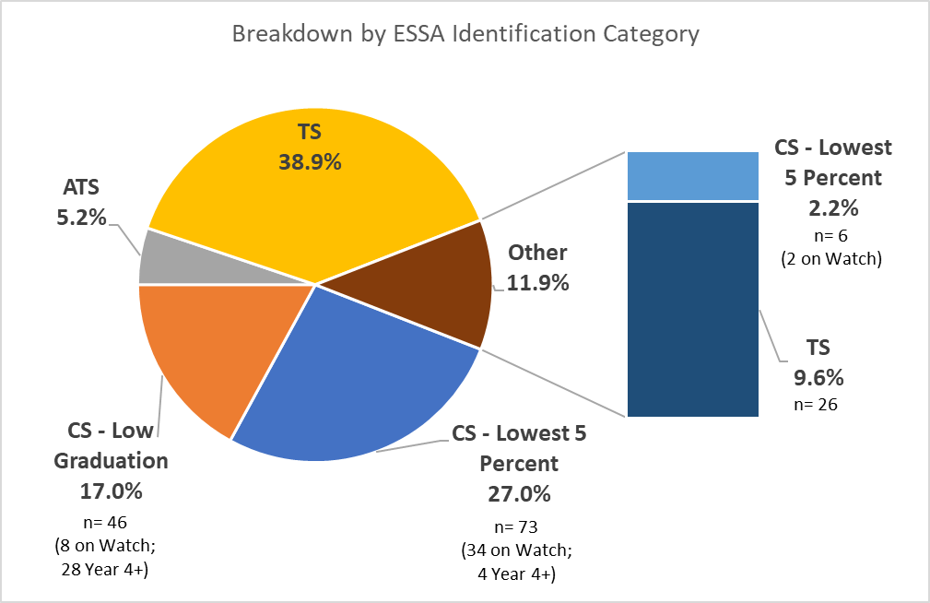
Overview of Fall 2024 ESSA Identification
270 schools currently identified for support and improvement under ESSA (not including K-2)
25 newly identified schools
32 schools are identified due to participation (“Other”)
Largest number of schools are identified based on performance of student group(s) - TS/ATS
23 CS schools met exit criteria
Notes:
Currently, we have 270 schools identified for support and improvement under ESSA, not including K-2 schools for which calculations are in the process of being run.
There are 25 newly identified schools this year. The largest number of schools fall into the TS category, with 105 schools, of which 7 were not exited by the district. There are 14 schools in the ATS category, 2 of which were not exited by the district. There are 46 schools in the CS – Low Graduation Rate category, with 8 on watch and 28 currently identified for their fourth or more year. And there are 73 schools in the CS – Lowest 5 percent category, with 34 on watch and 4 currently identified for their fourth or more year.
There are an additional 32 schools that were identified due to participation only, of which 6 are in the CS – Lowest 5 percent category and 26 are in the TS category.

Slide 18
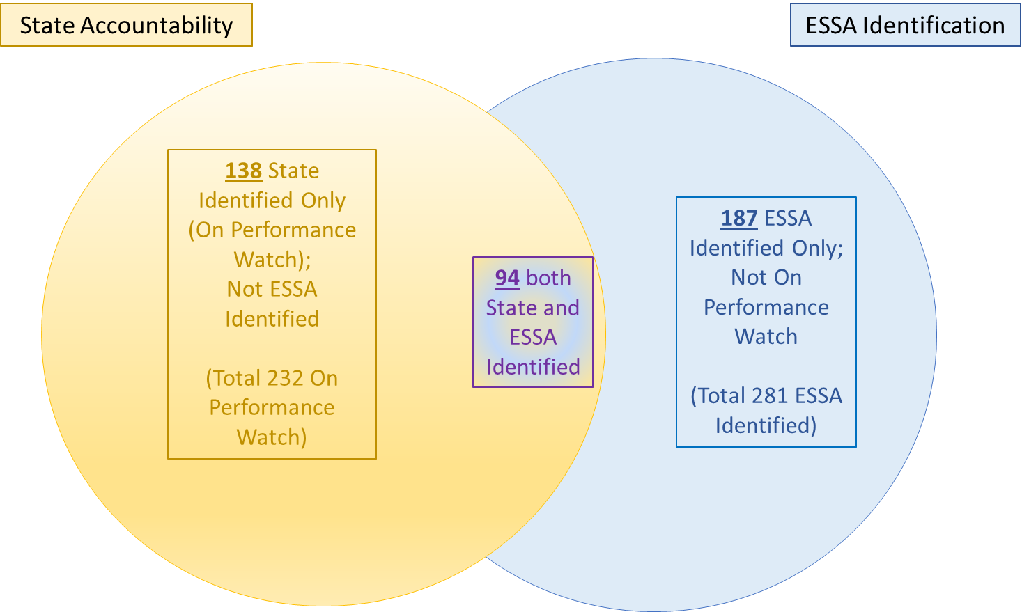
Fall 2024 Schools Eligible for EASI Supports
384 total
114 State Identified Only (On Performance Watch);
Not ESSA Identified
(Total 196 On Performance Watch)
188 ESSA Identified Only; Not On Performance Watch
(Total 270 ESSA Identified)
82 both State and ESSA Identified
Notes:
This slide shows the overlap between the School Performance Framework ratings and ESSA identifications. Please note these numbers are based on preliminary SPF ratings and do not reflect the request to reconsider process. There are a total of 196 schools on Performance Watch based on the Fall 2024 SPF preliminary ratings. Of those, 114 schools are state identified only, not ESSA identified. There are a total of 270 schools identified under ESSA. Of those, 188 are ESSA identified only, not on Performance Watch. There are a total of 82 schools that both state and ESSA identified.

Slide 19
Schools Identified for Targeted Support
*Note: Schools can be identified for more than one student group; therefore, counts may not add up to total.
Student Group | Additional Targeted Support # of Schools | Additional Targeted Support % of ATS | Targeted Support # of Schools | Targeted Support % of TS
Students Eligible for Free/Reduced Meals | 3 | 21% | 33 | 25%
Students with Disabilities | 10 | 71% | 38 | 29%
Multilingual Learners | 0 | 0% | 14 | 11%
Racial/Ethnic Groups | 6 | 43% | 101 | 77%
American Indian or Alaska Native | 0 | 0% | 6 | 5%
Asian | 0 | 0% | 0 | 0%
Black or African American | 1 | 7% | 40 | 31%
Hispanic or Latino | 2 | 14% | 26 | 20%
White | 4 | 29% | 16 | 12%
Native Hawaiian or Other Pacific Islander | 0 | 0% | 12 | 9%
Two or More Races | 0 | 0% | 16 | 12%
Aggregated Non-White | 1 | 7% | 19 | 15%
Total | 14 |  | 131
Notes:
This slide provides an overall of the specific student groups associated with schools identified for Targeted Support and Improvement. Please note that schools can be identified for more than one student groups, therefore the counts may not add up to the total.
Of the 14 schools identified for ATS, 3 were identified based on the performance of students eligible for free/reduced meals, 10 were identified based on the performance of students with disabilities, and 6 were identified based on the performance of specific racial/ethnic groups.
Of the 131 schools identified for TS, 14 were identified based on the performance of multilingual learners, 33 were identified based on the performance of students eligible for free/reduced meals, 38 were identified based on the performance of students with disabilities, and 101 were identified based on the performance of specific racial/ethnic groups.

Slide 20
Reminder: ESSA School Profiles
Shared via Syncplicity with:
Superintendents
District Accountability Contacts
Authorized Representatives in Consolidated Application
The above individuals can also request access for additional school and/or district personnel by sending an email to Yazmine Patino (patino_y@cde.state.co.us).
Notes:
ESSA School Profiles were created for every school identified for support and improvement under ESSA. Profiles were shared via Syncplicity with superintendents, district accountability contacts, and authorized representatives from the Consolidated Application. Authorized individuals can request access for additional school and/or district personnel by sending an email to Yazmine Patino.

Slide 21
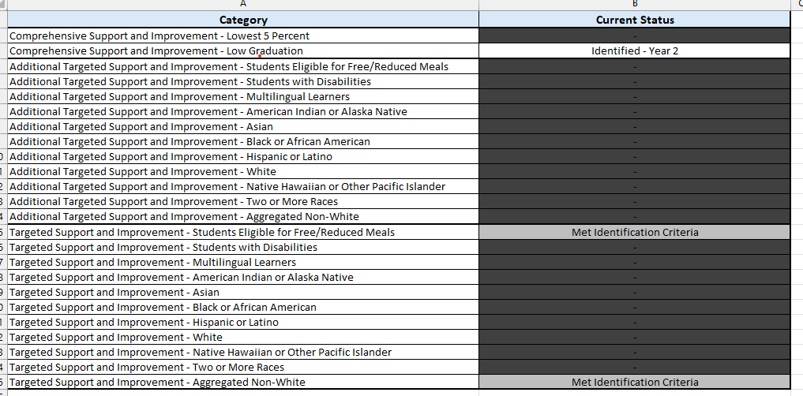
Sample Profile

Slide 22
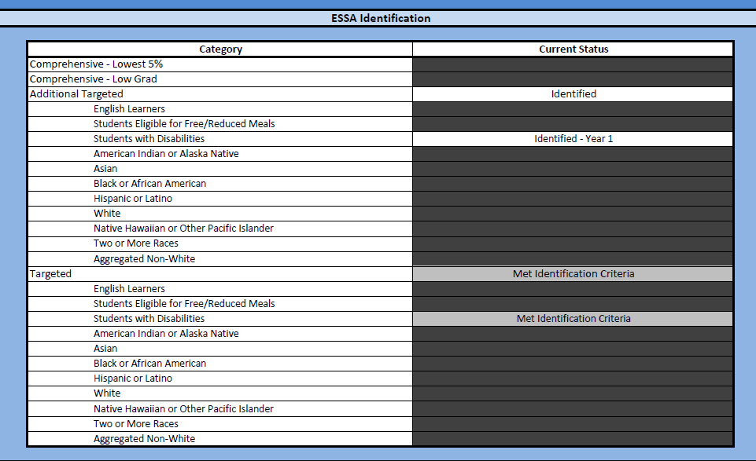
Profiles - Overall Identification
Notes:
The ESSA School Profiles start with an overview section, outlined in blue, which includes the schools ESSA identification status. A few things to note in this section:
More than one identification category may be noted, if a school meets identification criteria for multiple categories. Schools are only identified for a single category, however, based on prioritization of the categories in the order listed. In this example, you’ll see the school met identification criteria for both ATS and TS. The ATS identification was prioritized, which is why the status indicates Identified. The TS identification was not prioritized, which is why the status indicates met identification criteria and the information is greyed out.
For CS and ATS designations, the profiles include the consecutive year of identification. In this example, the school is in Year 1 of ATS identification.
For ATS and TS designations, the profiles indicate the specific student groups for which schools were identified. In this example, students with disabilities.
Designations may also indicate On Watch, Due to Participation Only, or Not Exited by District as applicable.

Slide 23
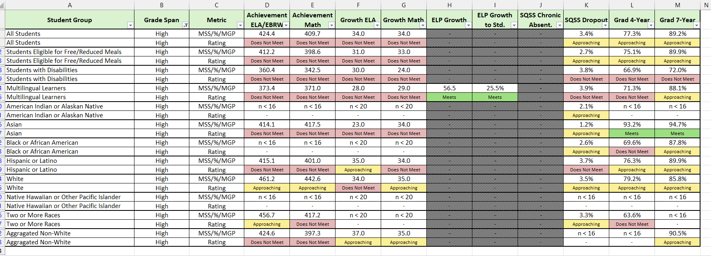
Profiles - Data
Notes:
The next section of the ESSA School Profiles, outlined in green, includes specific performance data for each student group for each ESSA indicator.:
The student group is noted at the top of each section. In this example, Black or African American students.
If an indicator or grade span does not apply, the information will be greyed out.
If the minimum number of students for a given indicator was not met, the profiles will display n < 16 or n < 20 as applicable, as noted in this screenshot.
Otherwise, the profiles will display the specific rating, for example, the mean scale score, median growth percentile, or percentage, and the associated rating. In this example, the dropout rate is 0%, which earns an Exceeds rating.
If a school was identified due to participation only, their profile will include their actual mean scale scores, as well as their participation-adjusted mean scale scores.

Slide 24
Additional Information
For more information, please visit Colorado’s ESSA Methods and Criteria for Identification of Schools for Support and Improvement Webpage (http://www.cde.state.co.us/fedprograms/essa_csi_tsi)
For additional information regarding the methodology, criteria, or data used to identify schools for support and improvement under ESSA, please contact:
Tina Negley
Supervisor, Program Effectiveness Office
720-766-2793
negley_t@cde.state.co.us
Anna Rowan
ESEA Research Analyst
720-215-7456
rowan_a@cde.state.co.us
Nazie Mohajeri-Nelson
Executive Director, Federal Programs and Supports Unit
720-626-3895
mohajeri-nelson_n@cde.state.co.us
Notes:
For more information, you can visit CDE’s ESSA Methods and Criteria for Identification of Schools for Support and Improvement webpage. CDE will be updating this webpage within the next couple weeks to include a list of schools identified for support and improvement in Fall 2024, and to provide additional resources regarding the methodology.
For any additional questions regarding the methodology, criteria, or data used to identify schools for support and improvement under ESSA, you can contact myself, Mary Shen, or Nazie.
Thank you!

Slide 25
School Improvement Planning: ESSA-Identified Schools
TS, ATS, CS
Notes:
Welcome and my name is Sue Miller-Curley and I am an ESEA Monitoring and Title II Specialist. I am here today to provide guidance and resources for you to support your ESSA-identified schools.

Slide 26
Outcomes:
Understand the LEA role in implementing ESSA requirements for school improvement planning for CS, TS and ATS schools.
Utilize planning resources to support school leaders in developing their UIP.

Slide 27
Acronyms - ESSA School Improvement
TS - Targeted Support
ATS - Additional Targeted Support
CS - Comprehensive Support
UIP - Unified Improvement Plan

Slide 28
Unified Improvement Plan: Multiple Purposes
CDE has developed both a process and template to support schools and districts in their performance management efforts.
A mechanism for triggering additional supports through CDE (especially for schools on the accountability clock.
A system to align improvement planning requirements for state and federal accountability into a single plan.
Alignment
Support
A common format for schools and districts to document improvement planning efforts. Schools/districts on the accountability clock must demonstrate a coherent plan for dramatic change and adjustments over time. Reviews conducted by CDE and State Review Panel.
A statewide strategy to promote improvement planning based on best practice, including use of state and local data and engagement in a continuous improvement cycle.
Best Practice
Documentation
Transparency
A process for including multiple voices, including staff, families and community representatives. Plans are posted publicly.
Notes:
Calling your attention to the upper right, the Unified Improvement Plan in Colorado serves as the school improvement planning instrument in which schools meet state and federal accountability requirements.

Slide 29
Review: LEA Role in Supporting ESSA Identified Schools
ESSA Identifications:
Targeted Support (TS)
Additional Targeted Support (ATS)
Comprehensive Support (CS)
ALL plans must be reviewed and approved at the LEA Level.
In addition, the state is required to review and approve CS Plans.
(Methods for Identification and Exit Criteria for ESSA Support and Improvement Webpage)
Notes:
LEAs are required to review and approve plans for TS and ATS schools, as well as CS schools. The state is also required to review and approve plans for CS Schools.

Slide 30
Steps and Resources: School Improvement Planning
1. Which schools have been identified?
2. What are the requirements in the UIP for CS, TS, and ATS schools?
3. How can I support school leaders with their planning?
4. Anything else that I need to know?

Slide 31
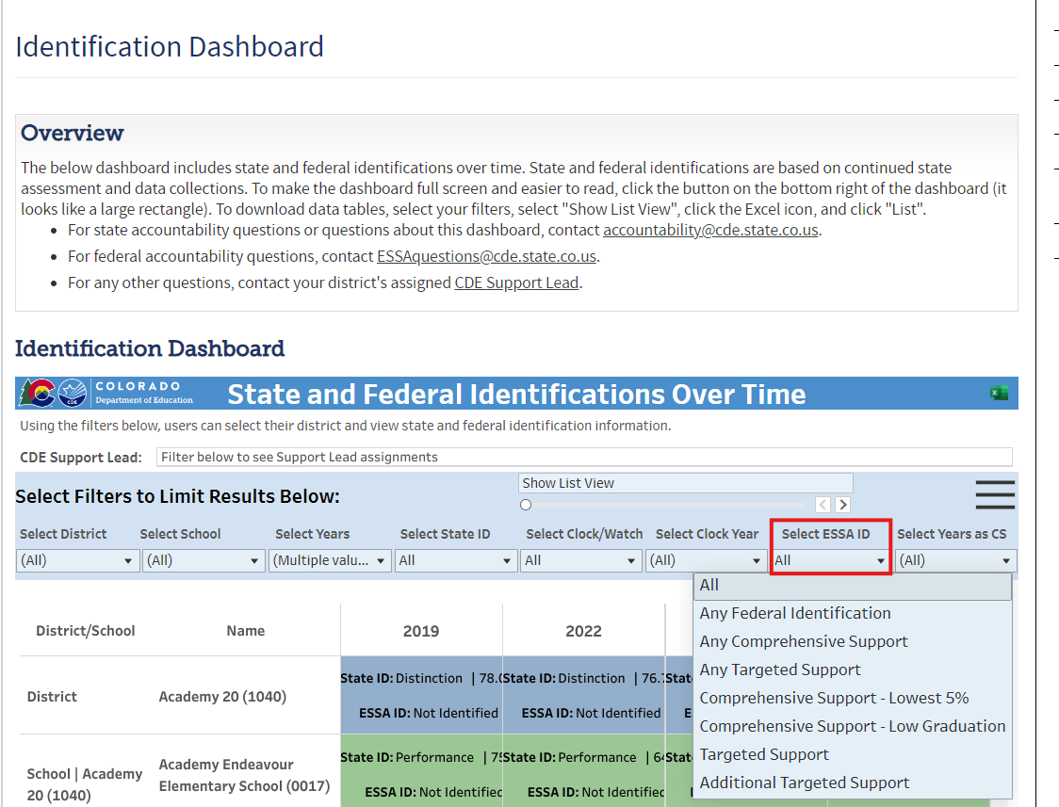
1. Which schools have been identified?
Identification Dashboard
Notes:
The one-stop shop is the identification dashboard. For ESSA identification, see the drop-down. You can view all schools ESSA identified, or select by CS, TS, and ATS. For in-depth information, view school profiles in Syncplicity.

Slide 32
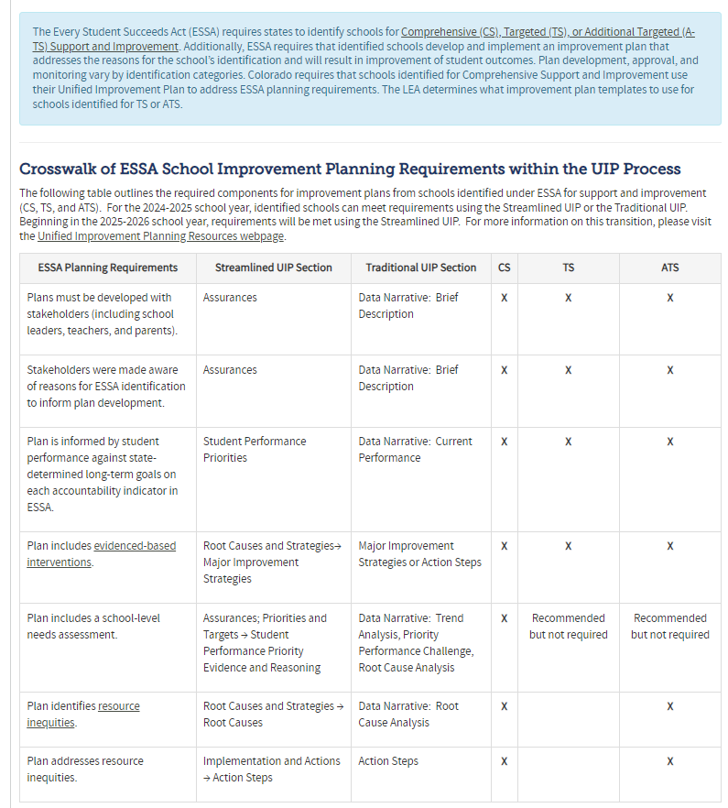
2. What are the requirements in the UIP for CS, TS, and ATS schools?
ESSA Improvement Planning Requirements Webpage
Schools may use the Traditional UIP OR Streamlined UIP to meet ESSA Requirements when submitting the 2024-2025 UIP.
Beginning in 2025-2026 only the Streamlined UIP will be available.
Notes:
This spring, Erin Loften from our School Improvement Team joined us to roll out the streamlined UIP. We have developed resources so schools can use either template to meet the requirements. This website provides information on the requirements for CS, TS, and ATS schools using either template.

Slide 33
3. How can I support school leaders with their planning?
UIP Webpage
Quality Criteria:
This resource provides guidance for all schools.
Quality Criteria Rubric - ESSA Identified Schools:
This resource supports planning with all ESSA-identified schools. LEAs can use this tool for reviewing CS, TS and ATS school. The state will use this tool for reviewing and approving CS-Identified UIPs.
Notes:
On the UIP page, you will find resources for both the traditional template and the streamlined template. In this slide I am highlighting the new, colorful resources for the streamlined UIP. We feel these resources are much clearer and supportive of guiding districts and school leaders in meeting requirements. (demonstrate)

Slide 34
4. Anything else that I need to know?
UIPs are due on October 15th.
Newly identified schools may choose to submit by January 15th to have additional planning time.
For assistance with navigating the UIP tool, email uiphelp@cde.state.co.us
As always, your Regional Contacts are here to support!

Slide 35
Resources:
Identification Dashboard
Unified Improvement Planning: Quality Criteria Rubrics
ESSA Planning Requirements
ESSA School Profiles from Syncplicity
*Resource Inequities: CDE Website for Resource Inequities
*For CS and ATS Identified Schools

Slide 36
Four Week Notification Letter
Notes:
Rachel E.

Slide 37
Four Week Notification Letters
Four Week Notification Letter for Teachers Who Do Not Meet State Certification Requirements
ESSA requires districts to notify families at a Title I school if their student has been assigned to or has been taught for at least four weeks by a teacher who does not meet applicable state certification or licensure requirements at the grade level and subject area in which the teacher has been assigned.
The letter can be modified based on each teacher’s circumstance.
Note for substitute authorizations: Since Colorado substitute authorizations are not specific to a grade level and/or subject, they do not meet the ESSA licensure requirement. Parents of students must receive notification after being taught by staff holding only a substitute authorization for at least 4 consecutive weeks.
Note for charter schools & authorizers: This notification requirement applies even if a Title I charter school has a State Board waiver for teacher licensure requirements.
More information and a template notification letter can be found on the Educator Qualification Requirements Under ESSA webpage.

Slide 38
Upcoming Meetings

Slide 39
Looking Ahead…
Any requests for topics or questions?
Upcoming Office Hours
October 10
ESEA Foundations Training
October 24

Slide 40
CDE Contacts!
Emails: Lastname_Firstinitial@cde.state.co.us (e.g., Smith_a@cde.state.co.us)
Federal Programs & Supports (ESEA/ESSER Program Supports) | School Finance & Operations (Fiscal and Systems Supports)
Nazie Mohajeri-Nelson, Executive Director of Federal Programs & Supports Unit Program Specialists Program Implementation Supervisor: Laura Meushaw Program Implementation Coordinator: Christina Adeboye Sullivan Program Monitoring Supervisor: Tammy Giessinger ESEA/ESSER Monitoring Coordinator: Kristin Crumley Program Effectiveness Supervisor: Tina Negley Program Evaluation & Research Coordinator: Anna Rowan Strategic Recovery Office (ESSER State Reserve): Matt Koziol ESEA Programs Specialists and ESEA Regional Contacts (assigned by district) Title I: Laura Meushaw, Evita Byrd, Rachel Echsner, Kim Boylan Title II: Rachel Echsner, Sue Miller-Curley Title III: Rachel Temple, Kim Boylan Title IV & Stronger Connections Grant: Nathan Hickman, Evita Byrd Title V: Christina Adeboye-Sullivan, Rachel Echsner ESSER Program Specialists Jonathan Schelke Kriselda Craven Nadine Penn ESEA and ESSER Data and Reporting Specialists Melissa Chaffin (ESEA) Jerry Ring (ESEA) Anna Rowan (ESEA) | Vacant, Executive Director of School District Operations Unit Fiscal Specialists Jennifer Austin, Director of Grants Fiscal Management ESEA Robert Hawkins, Grants Fiscal Analyst Steven Kaleda, Grants Fiscal Analyst ESSER Fiscal Specialist Steven Kaleda Grants Fiscal Analyst ESSER Monitoring Bill Parsley, ESSER Fiscal Monitoring Supervisor Hilery Morris, ESSER Fiscal Monitoring Kristina Jones, Federal Fiscal Monitoring and Reporting Specialist Werner Hagemann, ESSER Fiscal Monitoring Specialist Application Systems Specialists DeLilah Collins, Director of Grants Program Administration Online Applications Systems Technical Support Jessica Hollingshead Michelle Prael

