Slide 1
CDE Office Hours
September 1, 2022

Slide 2
ESSER Office Hours
Topics
Updates and Reminders
Consolidated Application Updates
Upcoming ESSER Deadlines
Upcoming CS Training Opportunities
Learning Cohorts Initiative
ESSER Reporting Requirements
ESEA AFR
Office Hours Survey
Notes:
Nazie

Slide 3
Updates, Reminders, and Clarifications
Notes:
Nazie

Slide 4
Consolidated Application Updates
22-23 Consolidated Application
Once your application is returned to you, please look over, address any feedback and resubmit to CDE.
Be sure to look at all sections of the application to view comments.
If you would like to check the status of your application or have any questions, please reach out to your Regional Contact.
Notes:
Kathryn

Slide 5
Upcoming ESSER Deadlines
Important Dates
ESSER III Supplemental budgets due - September 2
Deadline to spend ESSER I Funds - September 30 ~ Statutory Deadline! No Extensions Possible!
Deadline to submit Request for Funds forms for ESSER I funds - October 31
If you have not done so already, please submit your Use of Funds plan ASAP through this form; you can check if you have submitted yours on this site
Resources
ESSER launchpad page- includes deadlines and resources
ESSER I distribution report
Request for funds webpage
ESSER Lead Reviewer list - CDE staff to contact with questions on ESSER applications
Notes:
Shannon

Slide 6
Upcoming Trainings
Comprehensive Support and Improvement Training (CS-)UIP #2: School Level
This training will be a workshop model based on identification type with a drilled-down look at the requirements for each type of CS school. CDE staff will be available to assist with any questions and help work to get the plans to meet requirements. This training is designed for currently identified schools!
Target Audience: Principals or the individuals writing the school-level plans, as well as the district personnel responsible for supporting development of, review, and approval of the school UIPs
Related training held on August 2, 2022 provided an overview of the Unified Improvement Planning for currently identified Comprehensive Support schools and the identification process: Recording and Powerpoint
Contact Kathryn Wisner, wisner_k@cde.state.co.us or
Karen Bixler, bixler_k@cde.state.co.us with questions about the training.
Notes:
Karen

Slide 7
Comprehensive Support and Improvement Plans Training (CS-UIP):
Currently Identified Schools by Specific Identification Type
Session focus: Schools Identified for Lowest 5% Elementary/ Secondary
Date: Thursday, Sept 8, 2022
Time: 8am-11am
Register HERE
Session focus: Schools Identified for Lowest 5% Elementary K-2
Date: Thursday, Sept 8, 2022
Time: 12pm-3pm
Register HERE
Notes:
Karen

Slide 8
Learning Cohorts Initiative
School Quality and Supports Division
Notes:
Adrienne Cruz, Andy Swanson

Slide 9

What is a Learning Cohort?
A learning cohort is a CDE-led, ESSER funded collaborative that consists of a community of practitioners from schools and districts across Colorado who are actively engaged in improving student outcomes. They join together for virtual and in-person convenings to share ideas, give one another feedback, and observe "bright spot" schools across the state, all with the goal of continuous improvement.

Slide 10



Why do we need Learning Cohorts?

Slide 11
Who are Learning Cohorts for?
All educators across the state of Colorado are eligible to
participate in Learning Cohorts at no cost.
Past and current
participants include district leaders, school leaders,
teachers, teacher leaders, and Superintendents.

Slide 12
Learning Cohorts
2021-22

Slide 13
2021-22 Learning Cohorts
Learning Cohort | Leads & Collaborators
AEC - Alternative Education Campus Leaders | Johann Liljengren, Andy Swanson
HS Grading - Grading for Equity | Lauren Hesse, Andy Swanson
Online School Leaders | Susan Barrett, Johann Liljengren, Renee Martinez, Rachel Matson, Andy Swanson
Supporting Multilingual Learners | Susan Barrett, Morgan Cox, Rebekah Ottenbreit, Andy Swanson, Lindsay Swanton

Slide 14
Participants
Cohort | # of Schools/Districts
OVERALL | 57 schools from 40 unique LEAs
AEC | 25 schools from 24 districts
HS Grading | 72 participants from 12 districts
Online Schools | 13 schools
Supporting ELs | 7 districts

Slide 15
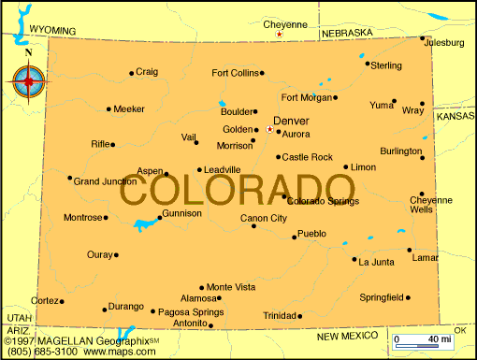
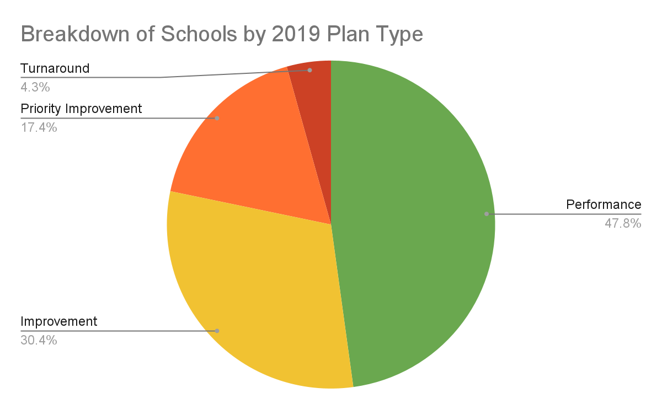
Participants
57% of schools were either state or federally identified

Slide 16
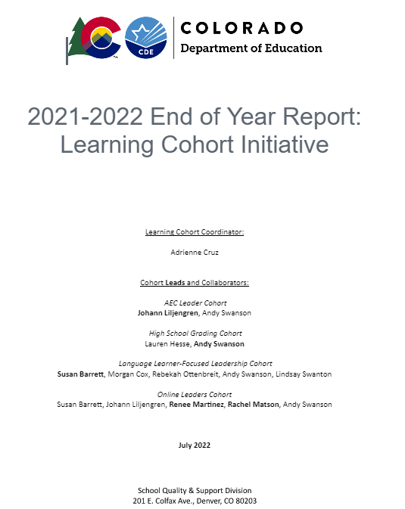
2021-22 Learning Cohorts - Last Year’s Success
Participation
Cohort Experience
Connections
Knowledge
Student Outcomes
Bright Spot Visits
Image size = 4” x 4.62”
Notes:
https://docs.google.com/document/d/1fXTkfWgBqH2REVkfXeKReqldFjR4YiBUU-m78JWLfgI/edit
57 schools from over 40 unique LEA’s participated in Learning Cohorts
Feedback from the cohort experience showed participants valued hearing from other school leaders, gained knowledge to reform grading practices, and had support in identifying and making progress in student outcome goals
‘Bright spot’ visits at schools got positive feedback as well

Slide 17
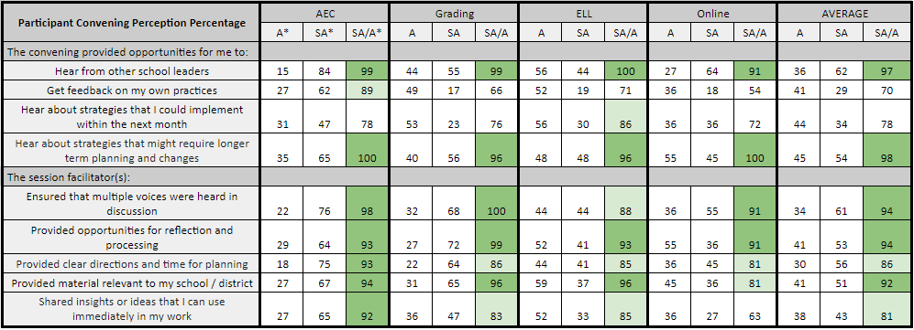
Participant Perception
*A = % Agree, SA = % Strongly Agree, A/SA = Combined % of Agree, Strongly Agree

Slide 18
Evaluation: Convenings (Leader Perception Survey Data)
Highlights
5/9 questions had over 90% favorable responses
Hear from other leaders
Hear about strategies that might require longer term planning and changes
Ensured that multiple voices were heard in discussion
Provided opportunities for reflection and processing
Provided material relevant to my school / district
Areas for Growth
2/9 questions had 70-80% favorable responses
Get feedback on my own practices
Hear about strategies that I could implement within the next month
Just over 80%
Shared insights or ideas that I can use immediately in my work

Slide 19
Learning Cohorts
2022-23

Slide 20

Theory of Action
Theory of Action
If schools and district leaders have…
Opportunities to reflect, plan, practice, and receive feedback with peers and
Opportunities to learn about or observe best practices in a similar setting and
School and district structures to support implementation work
Then…
Implementation will be stronger and
Outcomes will improve

Slide 21
Three Kinds of Learning Cohorts
01
Uses an outside provider to support learning content
Host convenings for shared learning
More logistics and 1:1 check-in’s involved
Learning Series Cohort
02
Focuses on a particular topic (usually accompanied by a text, research-based practice, etc.)
Mix of convenings and 1:1’s
Bright Spot Visits allow participants to see practical use
Topical Learning Cohort
03
Focuses on a particular type of school or role
Typically brings leaders together to have thought partners
Bright Spot Visits highlight work in the field
School-type/Role-
type Learning Cohort

Slide 22
Current Cohorts - Fall 2022
Cohort Name | Type of Cohort | Lead + Team
District Strategic Planning, External Partnerships | Learning Series | Lindsey, Carol
Unfinished Instruction, UnBoundEd Standards Institute Launch | Learning Series | Andy, Adrienne
Year 2: Alternative Education Campus Leaders | School-type | Johann
Year 2: Online School Leaders | School-type | Alison Smith, Renee
Year 2: 6-12 Grading Practices, Grading for Equity | Topical | Andy, Lauren H
More to come in Spring 2023!

Slide 23


Q and A
Notes:
https://drive.google.com/file/d/1d9TDqFOjhY0GuQdMOj_TZx4rWUW4iNmO/view?usp=sharing

Slide 24
ESSER Reporting Requirements
Notes:
Mackenzie

Slide 25
ESSER Data Reporting
The U.S. Department of Education (USDE) has been authorized by Congress to collect data from all ESSER I, II, and III (and other ESSER award) grantees, including but not limited to the uses and impact of funds.
CDE is able to use the ESSER I, II, and III applications to provide the vast majority of the requested data (809 data elements total) on behalf of our LEAs for 22-23, with the exception of the following data points:
How students with poor attendance or participation have been re-engaged; and
How school level allocations were determined.
LEA and school-level participation in ESSER activities (question 4.b1 on the reporting form)
All other data elements required for the 2022-2023 school year and beyond can be reported based on the online applications.
CDE has previously sent out surveys on the first two data elements. The surveys will continue to be sent out yearly to collect data. A new data collection instrument will be sent out for the third data point.
Please ensure you are appropriately tracking activities funded with ESSER so that you are able to meet the reporting requirements. We will update you when data collection instruments will be sent out.

Slide 26
Reporting Question
How did this LEA use ESSER (ESSER I, ESSER II and/or ARP ESSER) funds to support learning recovery or acceleration for student groups who were disproportionately impacted by the COVID-19 pandemic?
Evidence-based summer learning or summer enrichment programs
Evidence-based afterschool programs
Extended instructional time (including extended school day, week, or year)
Evidence-based high dosage tutoring
Early childhood education program expansion or enhancement
Full-service community schools
Purchasing educational technology

Slide 27
Summer Learning, Afterschool Programs, and High Dosage Tutoring
If the LEA used ESSER funds for evidence-based summer learning or summer enrichment programs, evidence-based afterschool programs, or evidence-based high dosage tutoring, please answer the following questions:
Is this program available to all students? Y/N
If no, indicate the number of students this program serves at full capacity
Total unique headcount of students that participated in this activity
Indicate the number of eligible students within each of the student groups on the following slide, and the number of eligible students from that student group that participated in this activity
Eligible refers to students within the student group who meet eligibility criteria for participation, such as belonging to the appropriate grade for the activity.

Slide 28
Student Groups
For question 4 on the previous slide, report on the # of eligible students participating, and the # of enrolled eligible students at the LEA in the group:
Students with one or more disabilities
Low-income students
English learners
Students in foster care
Migratory students
Students experiencing homelessness
American Indian or Alaska Native
Asian
Black or African American
Hispanic/Latino
Native Hawaiian or other Pacific Islander
White
Two or more races
Other student subpopulation (please specify)

Slide 29
Extended Instructional Time
If the LEA implemented extended instructional time, please answer the following questions:
Is extended instructional time in place at all schools within the LEA? Y/N
If yes, you do not need to answer the following questions
If no, indicate the unique headcount of students enrolled in schools within the LEA with mandatory extended instructional time
Indicate the number students from each student group enrolled in schools with extended instructional time

Slide 30
Early Childhood Education Program Expansion or Enhancement
If the LEA implemented early childhood education program expansion or enhancement, please answer the following questions:
Did this LEA expand or enhance its early childhood program? Mark Y/N to each below.
Expand Y/N
Enhance Y/N
If programs were expanded, then:
How many additional students or slots were funded with ESSER I, ESSER II or ARP ESSER in the most recent school year? Please include students or slots that were fully and partially funded with ESSER I, ESSER II, or ARP ESSER funds.
Total unique headcount of students enrolled in an early childhood education program within the LEA
Indicate the number of students from each student group enrolled in an early childhood education program within the LEA

Slide 31
Full-Service Community Schools
If the LEA implemented full-service community schools, please answer the following questions:
How many new or additional full-service community schools were launched using these funds in this LEA?
How many current full-service community schools received additional services and/or support using these funds?
What is the total enrollment in full-service community schools supported with ESSER funds within this LEA?

Slide 32
Purchasing Educational Technology
If the LEA purchased educational technology, please answer the following questions:
Was educational technology purchased for all students? Y/N
If no, indicate the number of students for whom educational technology was purchased ________
Indicate the number of eligible students within each of the following student groups, and
The number of eligible students from that student group that received or were directly supported by the educational technology

Slide 33
All ESSER Funds
Please keep in mind that these questions will need to be answered for any ESSER funds received (ESSER I, II, and III and supplemental funds, as well as other ESSER State Reserve grants such as the Broadband and 21st CCLC grants).

Slide 34
ESEA Annual Financial Report (AFR)
Notes:
Michelle, DeLilah, Robert

Slide 35
Consolidated Application Annual Financial Report (AFR)
The Annual Financial Report will be collected through the 2021-2022 Consolidated Application, similar to last year.
If you haven’t accessed the 2021-2022 Consolidated Application before, please be sure to reach out to your Local Access Manager or LAM to gain access to the “CONSAPP” as it is through the Identity Management System.
If you don’t know who your LAM is, you can fill out the Access Assistance Form to get in touch with the right individual.

Slide 36
Consolidated Application Annual Financial Report (AFR) Walkthrough
The 21-22 Consolidated Application Annual Financial Report is due September 30, 2022
Please be sure to report all expenditure that occurred between July 1, 2021 to June 30, 2022

Slide 37
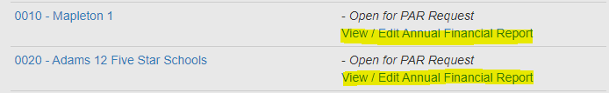
Key Reminders for the AFR
Please do NOT submit a revision to your 21-22 application!!

Slide 38
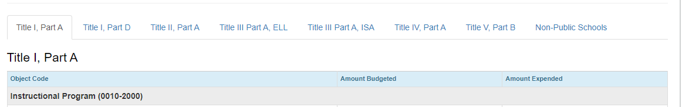
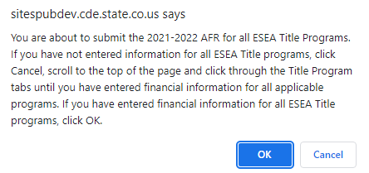

Key Reminders for the AFR
Please do NOT hit submit until you are done with all the tabs at the top!

Slide 39
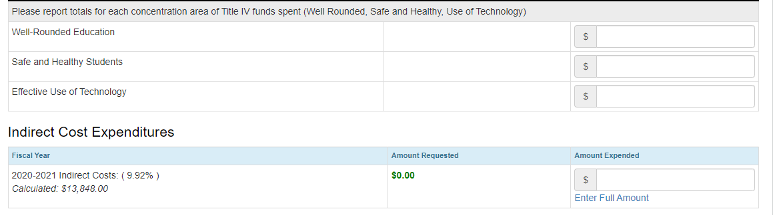
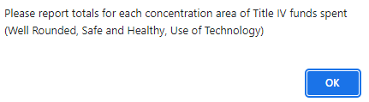
Key Reminders for the AFR
If you expended any Title IV, Part A funds, do not forget to input the amount you expended in each content area. This has to be reported to the US Department of Education, regardless of allocation size.
This report should include ANY funds spent during the fiscal year including carryover.

Slide 40
Contact Us!
If you have questions regarding the AFR, please contact the Grants Fiscal Office:
Steven Kaleda Kaleda_S@cde.state.co.us
Robert Hawkins Hawkins_R@cde.state.co.us
If you have questions regarding the system, please contact the Grants Program Administration Office:
Michelle Prael Prael_M@cde.state.co.us
DeLilah Collins Collins_D@cde.state.co.us

Slide 41
Office Hours Survey
Notes:
Shannon

Slide 42
Office Hours Feedback
To help us ensure that we are meeting your needs, please complete the Fall Office Hours feedback survey.
Survey should take less than 5 minutes to complete

Slide 43
Upcoming Meetings

Slide 44

Any Requests for Upcoming Topics or Questions!
Upcoming Office Hours
September 15
September 29

Slide 45
CDE Contacts!
Emails: Lastname_Firstinitial@cde.state.co.us
(e.g., Smith_a@cde.state.co.us)
Federal Programs & Supports (ESEA/ESSER Program Supports) | School Finance & Operations (Fiscal and Systems Supports)
Nazie Mohajeri-Nelson, Federal Programs & Supports Unit ESEA Programs Specialists and ESEA Regional Contacts (assigned by district) Title I: Laura Meushaw, Kathryn Wisner, Evita Byrd, Nathan Hickman Title II: Karen Bixler Title III: Kathryn Wisner, Rachel Temple Title IV: Tammy Giessinger, Nathan Hickman Title V: TBD ESEA and ESSER: Shannon Wilson ESSER Program Monitoring Specialists Kristin Crumley Jonathan Schelke Kim Boylan ESEA and ESSER Data and Reporting Specialists Tina Negley Mary Shen Mackenzie Owens | Kate Bartlett, Executive Director of School District Operations Unit Fiscal Specialists Jennifer Austin, Director of Grants Fiscal Management ESEA Robert Hawkins, Grants Fiscal Analyst Steven Kaleda, Grants Fiscal Analyst ESSER Fiscal Specialist Steven Kaleda Grants Fiscal Analyst ESSER Monitoring Bill Parsley, ESSER Fiscal Monitoring Supervisor Hilery Morris, ESSER Fiscal Monitoring Kristina Jones, Federal Fiscal Monitoring and Reporting Specialist Application Systems Specialists DeLilah Collins, Director of Grants Program Administration Online Applications Systems Technical Support Michelle Prael

