Slide 1
CDE Office Hours
August 17, 2023

Slide 2
ESSER Office Hours
Topics
Updates and Reminders
Upcoming ESSER Deadlines
Consolidated Application Updates
Request for Funds
Requirements of Federally Funded Construction
Notes:
Laura

Slide 3
Updates and Reminders

Slide 4
ESSER Deadlines
Important Dates
ESSER II funds must be spent on or before September 30, 2023
ESSER II Request for Funds are due by November 1, 2023
Resources
ESSER Launchpad page- includes deadlines and resources
Request for Funds webpage
ESSER Lead Reviewer list- CDE staff to contact with questions

Slide 5

Consolidated Application Updates
Thank you for submitting your LEA’s 2023-24 Consolidated Application! Many districts have already received preliminary feedback; please submit revisions as soon as possible!
CDE’s goal for final approval for applications is 9/30/23.
If you would like to check the status of your application or have any questions, please reach out to your Regional Contact(s).
Notes:
Laura/Rachel E?

Slide 6
Request for Funds
Notes:
Tammy/Steven

Slide 7
Expiring Funds
ESEA FY22 and ESSER II funds are expiring at the end of September.
LEAs will need to complete and submit the Request for Funds Authorized Representative Designation form before requesting funds from CDE.
Program / Funding Stream | Obligation Due Date | Request for Funds Form
ESEA FY22 | September 30, 2023 | November 15, 2023
ESEA FY23 | September 30, 2024 | TBD
ESSER II | September 30, 2023 | November 15, 2023
ESSER III | September 30, 2024 | TBD

Slide 8
Federally-Funded Construction
Requirements
Notes:
Kristin, Bill, Kriselda

Slide 9
Pre-Approval Process
Capital Expenditures or Capital Construction must receive prior written approval/pre-approval.
Caution against starting new construction projects
If the LEA proceeds with a construction request, or has a non-construction capital expenditure request, the LEA must get Pre-Approval from CDE by following this process:
LEA submits complete budget line item in ESSER application including:
Description of purchase or project
Beginning date (if applicable)
Completion date (if applicable)
CDE reviewers ask any follow-up questions then approve line item, if approvable.
Approval of line item is considered prior written approval.
Notes:
CDE’s prior written approval process consists of a fully fleshed-out budget line item that includes a description of the project, date project began/is to begin, and projected completion date, submitted as part of the ESSER II or III application. It is strongly discouraged to begin new construction projects at this point due to the risk of projects not being completed by the end of the award period. LEAs have the responsibility to ensure that completed projects comply with all the applicable regulations.

Slide 10
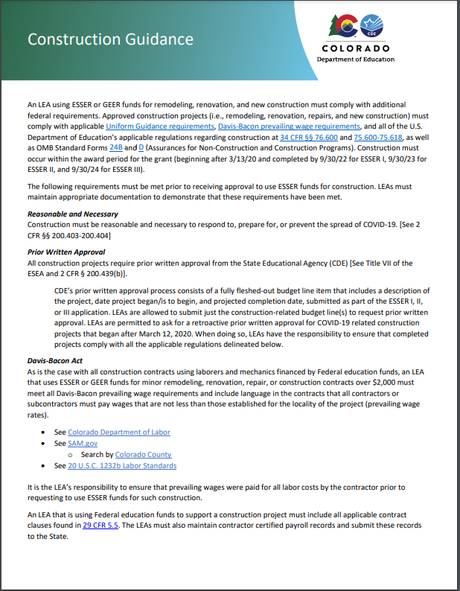
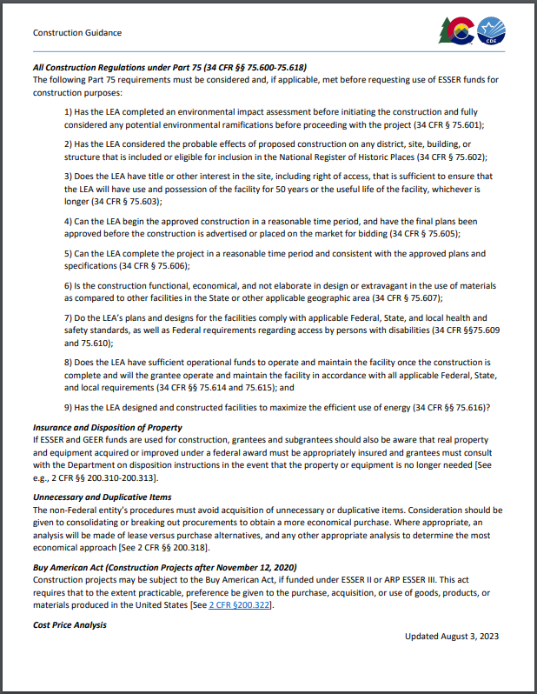
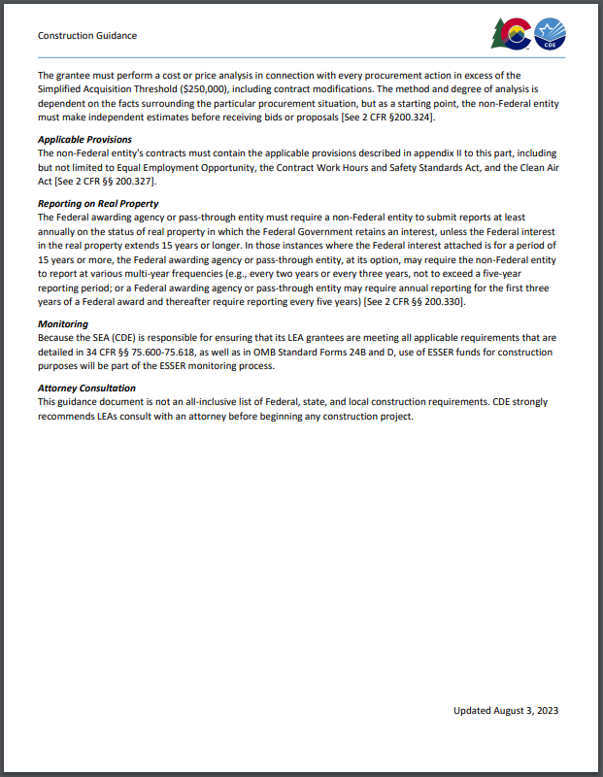
Construction Guidance
All construction projects must comply with applicable regulations, including Davis-Bacon prevailing wage requirements, as outlined in CDE’s Construction Guidance Document.
Notes:
Approval for construction line items follows the same capital expenditure process discussed in the previous slide. We encourage all LEAs with capital expenditures or construction projects to view the Construction Guidance Document, linked here.

Slide 11
Lessons Learned from Fiscal Monitoring
Davis-Bacon Compliance
LEAs must be periodically monitoring for this
Collect and review weekly certified payrolls - looking for assurance of prevailing wage being paid
May include on-site reviews for required wage notifications
Contract Clauses
Review contracts for any projects currently in progress and issue addendums
May even be required to amend contracts for projects already complete
Notice of Federal Interest
Have requested sample language from ED
County departments may have standard forms/language
Projects that have been completed are not “out of the woods”
CDE must contact the U.S. Department of Labor when contractors are unwilling to address Davis-Bacon violations

Slide 12
Helpful Links
Questions about construction requirements in general?
View CDE’s Construction Guidance (includes link to Construction Program Assurances form, 424D).
Questions about legal standpoints on some ESSER hot topics?
View the January 26, 2023 BruMan Training.
Questions about federally-funded equipment and requirements?
View the March 3, 2022 Office Hours on Federally-Funded Equipment.
Questions about Davis-Bacon requirements?
View the Davis-Bacon webinar provided by US DOL and hosted by ED and the Davis-Bacon Webinar 4.26.23 Attendee Questions and Answers.pdf.

Slide 13
Upcoming Meetings

Slide 14

Looking Ahead…
Any requests for topics or questions?
Upcoming Office Hours:
August 31
Sept 7
*Due to a scheduling conflict, the Sept 14 Office Hours has been rescheduled to Sept 7.

Slide 15
CDE Contacts!
Emails: Lastname_Firstinitial@cde.state.co.us (e.g., Smith_a@cde.state.co.us)
Federal Programs & Supports (ESEA/ESSER Program Supports) | School Finance & Operations (Fiscal and Systems Supports)
Nazie Mohajeri-Nelson, Executive Director of Federal Programs & Supports Unit Program Specialists Program Implementation Supervisor: Laura Meushaw Program Implementation Coordinator: Christina Adeboye Sullivan Program Monitoring Supervisor: Tammy Giessinger ESEA/ESSER Monitoring Coordinator: Kristin Crumley Program Effectiveness Supervisor: Tina Negley ESEA Programs Specialists and ESEA Regional Contacts (assigned by district) Title I: Laura Meushaw, Evita Byrd, Rachel Echsner Title II: Rachel Echsner Title III: Rachel Temple Title IV: Tammy Giessinger, Nathan Hickman Title V: Melissa Chaffin ESSER Program Specialists Jonathan Schelke Kim Boylan Kriselda Craven ESEA and ESSER Data and Reporting Specialists Tina Negley Mary Shen Mackenzie Owens Melissa Chaffin | Amy Carman, Executive Director of School District Operations Unit Fiscal Specialists Jennifer Austin, Director of Grants Fiscal Management ESEA Robert Hawkins, Grants Fiscal Analyst Steven Kaleda, Grants Fiscal Analyst ESSER Fiscal Specialist Steven Kaleda Grants Fiscal Analyst ESSER Monitoring Bill Parsley, ESSER Fiscal Monitoring Supervisor Hilery Morris, ESSER Fiscal Monitoring Kristina Jones, Federal Fiscal Monitoring and Reporting Specialist Werner Hagemann, ESSER Fiscal Monitoring Specialist Application Systems Specialists DeLilah Collins, Director of Grants Program Administration Online Applications Systems Technical Support Michelle Prael

