Slide 1
CDE ESEA and ESSER Office Hours
August 1, 2024

Slide 2
ESEA/ESSER Office Hours
Topics:
BruMan Training - August 6
2024-2025 Learning Cohorts
U.S. Department of Education Federal Student Aid Visits
ESEA Clarifications and Consolidated Application Reminders and Updates
ESSER Reminders and Updates
Contracted Project Monitoring Update

Slide 3
Reminder: BruMan Training next Tuesday!
CDE has contracted with the BruMan Group to provide training on the revised Uniform Grants Guidance (UGG) and proposed revisions on the Education Department General Administrative Regulations (EDGAR), as well as a few other hot topics!
Tuesday, August 6, from 8:30-4:00
Food/drinks cannot be provided
Registration
In-person registration
Virtual registration
Location: Adams County Government Building, 4430 South Adams County Parkway, conference room Apple A, Brighton, CO 80601
BruMan is offering 6.5 approved specialized knowledge-technical continuing professional education credits for the training!

Slide 4


Register Now!
Learning Cohort
2024-2025
Notes:
Adrienne, Victory
https://www.cde.state.co.us/cdeedserv/cdeleadershiplearningcohorts

Slide 5
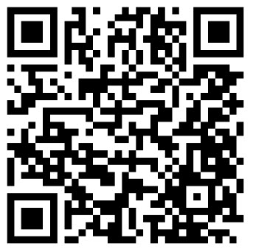
Rural Leadership Join Today!
Invest in your professional development
Connect with other change-makers
Engage in new leadership strategies
Notes:
https://www.cde.state.co.us/cdeedserv/lc_rural-leadership
Rural Principal Learning Cohort is for leaders who are doing it all. Join other rural principals and build camaraderie while learning new skills and information.

Slide 6
Empty Desks Join Today!
Invest in your professional development
Connect with other change-makers
Engage in new leadership strategies
Notes:
https://www.cde.state.co.us/cdeedserv/lc_chronic-absenteeism

Slide 7
Federal Student Aid - USDE Visits
Notes:
Nazie

Slide 8
U.S. Department of Education Office of Federal Student Aid
Hosting a week of student loan repayment and Free Application for Federal Student Aid (FAFSA) events in Colorado. Please share information with anyone in your organization and/or communities who might be interested.
Dates and Locations:
Tuesday, August 6, Colorado Springs
Wednesday, August 8, Pueblo
Thursday, August 8, Denver
Saturday, August 10, Fort Collins
See next few slides for details! For more information or questions, please email USDE representatives: Stephanie Sampedro (stephanie.sampedro@ed.gov) and Rachel Gittleman (rachel.gittleman@ed.gov).
If you would like the flyers to advertise these, please email Nazie to request a copy of the flyer.

Slide 9
USDE FAFSA Events: Navigating Federal Student Loan Repayment Event
Navigating Federal Student Loan Repayment Event in Colorado Springs
Tuesday, August 6, 3:00-5:00 PM MT
Old Colorado City Library, Meeting Room
2418 West Pikes Peak Avenue, Colorado Springs, CO 80904
Details: Learn how to navigate repayment, Public Service Loan Forgiveness, and disability discharge. Topics include: student loan repayment options, student loan forgiveness, income-driven repayments plans, disability discharge, and more! After a presentation, there will be an open clinic for borrowers with FSA to get support navigating their student loans and signing up for forgiveness and repayment programs.
Register here!

Slide 10
USDE FAFSA Events: Come Get Help with the FAFSA Event in Pueblo
Come Get Help with the FAFSA Event in Pueblo
Wednesday August 7, 11:00 AM-1:00 PM MT
Pueblo City County Library Rawlings Branch, Bret Kelly A Room
100 East Abriendo Avenue, Pueblo, CO 81004
Details: This session is for anyone looking to complete a FAFSA. There will be a presentation on the FAFSA, a question-and-answer session, and time for attendees to receive one-on-one assistance to complete their FAFSA application. This event is free to all attendees. This session will last about 2 hours. Attendees are encouraged to bring their personal computers for online FAFSA preparation.
Register here!

Slide 11
USDE FAFSA Events: Young Invincibles’ Student Debt Clinic in Pueblo
Young Invincibles' Student Debt Clinic in Pueblo
Wednesday, August 7, 4:00-6:30 PM MT
Pueblo City County Library Rawlings Branch, Brett Kelly A Room
100 East Abriendo Avenue, Pueblo, CO 81004
Details: The first hour of the event will include a training and Q&A session on student loan repayment and forgiveness options. The remainder of the event will serve as an open clinic for borrowers to get support navigating their student loans and signing up for income-driven repayment programs. We will have laptops available for folks to use during this session.
Register Here!

Slide 12
USDE FAFSA Events: Come Get Help with the FAFSA Event in Denver
Come Get Help with the FAFSA Event in Denver
Thursday, August 8, 1:00-3:00 PM MT
Blair-Caldwell African-American Research Library, Community Room
2401 Welton Street, Denver, CO 80205
Details: This session is for anyone looking to complete a FAFSA. There will be a presentation on the FAFSA, a question-and-answer session, and time for attendees to receive one-on-one assistance to complete their FAFSA application. This event is free to all attendees. This session will last about 2 hours. Attendees are encouraged to bring their personal computers for online FAFSA preparation.
Register here!

Slide 13
USDE FAFSA Events: Young Invincibles’ Student Debt Clinic in Denver
Young Invincibles' Student Debt Clinic in Denver
Thursday, August 8, 4:00-6:30 PM MT
Auraria Campus, CU Building, CU-1100
1250 14th Street, Denver, CO 80202
Details: The first hour of the event will include a training and Q&A session on student loan repayment and forgiveness options. The remainder of the event will serve as an open clinic for borrowers to get support navigating their student loans and signing up for income-driven repayment programs. We will have laptops available for folks to use during this session.
Register here!

Slide 14
USDE FAFSA Events: Young Invincibles Student Debt Clinic in Fort Collins
Young Invincibles Student Debt Clinic in Fort Collins
Saturday, August 10, 11:00 AM-1:30 PM MT
Colorado State University, Lory Student Center
Never No Summer Ballroom, 3rd Floor
1101 Center Avenue Mall, Fort Collins, CO 80521
Details: The first hour of the event will include a training and Q&A session on student loan repayment and forgiveness options. The remainder of the event will serve as an open clinic for borrowers to get support navigating their student loans and signing up for income-driven repayment programs. We will have laptops available for folks to use during this session.
Register here!

Slide 15
ESEA Clarifications and Cons App Updates and Reminders
Notes:
Nazie, Laura

Slide 16
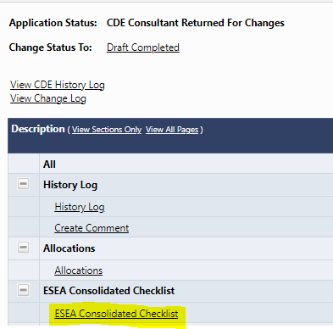
2024-25 Consolidated Application Updates
Thank you for submitting your 2024-2025 Consolidated Application! Many districts have already received preliminary feedback; please submit revisions as soon as possible!
Feedback can be found on the ESEA Consolidated Checklist.
When ready to submit revisions, select Draft Completed and move the application through the dual approval process (LEA Authorized Fiscal Representative and LEA Authorized Representative).
For LEAs that requested an extension, applications were due July 31st. Please submit the LEAs application as soon as possible so that the LEA may receive substantial approval and begin obligating funds.
If you need any support with submitting the LEA’s application, have any questions regarding the feedback provider, or would like to check the status of your application, contact your ESEA Regional Contact.
Notes:
Laura

Slide 17
ESEA Funds Requests - Clarifications
The funds request process is being migrated into GAINS.
In preparation, LEAs/BOCES should submit a Request for Funds (RFF) for as much of the expenditures that were approved in the 2023-2024 Consolidated Application in Formsite by close of business today - 8/1/2024.
Any remaining unrequested ESEA funds as of 8/2/2024 will be loaded into GAINS as carryover in the 2024-2025 application. Amounts entered as carryover must have associated budget lines in the 2024-2025 application and will be available for reimbursement after the application has final approval.
Grants Fiscal will be migrating the ESEA funds request process into the GAINS system during the month of August and requests for funds can be submitted in GAINS beginning in September.
Formsite will not be accessible after 8/1/2024 for requesting ESEA reimbursement.
Other grants that are not yet or will not be in GAINS will continue to have RFFs in Formsite (e.g., ESSER).

Slide 18
Unrequested ESEA Funds in the 2024-2025 Consolidated Application
The amount indicated as carryover in the application will be added after September 3, 2024.
In order to request reimbursement for those funds, budget lines must be entered.
Reminder that the application must have final approval in order to request funds.
BOCES/LEAs will receive approval for carryover activities during the 2024-2025 review process or Post-Award Revision process.
Please ensure that revisions are submitted as quickly as possible so that final approval can be granted as soon as possible.
BOCES/LEAs will have the option of accounting for carryover at the LEA level or at the school level. Note: accounting for carryover funds at the school level will impact rank order.
District Level
LEA Set Aside Page → Additional Year of Title Support
Budget → District Managed Activity and describe desired use of funds.
School Level
When carryover is uploaded by CDE, funds will be in the total allocation and will be available at school level unless set aside at the LEA level.

Slide 19
Clarifications Continued
The Annual Financial Report (AFR) process will be similar to prior years and should not be impacted by the funds request migration.
The Title I 15% carryover limit should also not be impacted.
CDE will continue using the same process, after AFRs are submitted, to determine which LEAs have carryover in excess of 15% and will need to submit a Waiver Request.
As in prior years, Grants Fiscal Management will contact any LEAs that will need to submit a Waiver Request.

Slide 20
ESSER Reminders and Updates
Notes:
Jonathan, Kriselda, Clint

Slide 21
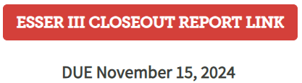
Reminders and Updates
Any updates to ESSER III PARs can be submitted right now!
Fiscal year 24-25 is now an option in the ESSER III budget
Reminder that CDE uses budgets to meet reporting on behalf of LEAs! Accuracy of the budgets representing how funds were spent is very important!
The Countdown to closeout website is a great resource.
The Closeout link is now live.
Scroll down to the red buttons
Notes:
Jonathan, Kriselda, Clint

Slide 22
ESSER Safe Return & Use of Funds Plans
Each recipient of an ARP ESSER III allocation, including supplemental awards, is required to develop, make publicly available, and submit to CDE a Safe Return to In-Person Instruction Plan and an ARP ESSER III Use of Funds Plan.
The plans should be reviewed every 6 months and revised, if needed.
In addition, each SEA must provide the U.S. Department of Education the URL(s) for LEA websites where the public can find the both LEA plans.
The Safe Return to In-Person Instruction and Use of Funds Plans are listed on CDE’s List of LEA Plans website.
Plans must remain posted on the LEA’s and CDE’s webpages through the end of the award period, September 30, 2024.
If your plans are not posted or up to date, please submit plans via the Safe In-Person Instruction and Use of Funds Plans form.

Slide 23
Liquidation Extensions
All ESSER III funds must be obligated by September 30th! No exceptions or extensions are allowed (statutory requirement).
Fully and properly obligated activities might be eligible for a liquidation extension.
Requests have to be submitted to the U.S. Department of Education for review and approval.
CDE has to submit one request on behalf of all subgrantees in the State for all ESSER programs!
CDE will have a process for submitting a request and will provide training at an upcoming Office Hours.

Slide 24
Contracted Project Monitoring Update
Notes:
Hilery

Slide 25
Contracted Project Monitoring Update - Missing Attestations of Completion and Construction Questionnaires (CQs)
All LEAs selected for contracted project monitoring were emailed in March 2024
A mandatory training was provided in March and LEAs/Subgrantees with contracted projects had to submit an attestation of attendance.
Missing Smartsheet Attestations of Completion for attendance at March 28 Office Hours
Missing Construction Questionnaire (CQs) - contact your ESSER Team Lead if you need a link
CQ applies to all types of projects, not just construction
All of an LEA’s project activity must be considered as they complete the CQ
Contact LEA’s ESSER Team Lead for listing of budget line items potentially subject to construction regulations and/or Davis-Bacon and Related Acts
May submit multiple CQs or an attachment (e.g., Excel spreadsheet)
Upload signed and completed CQ in Syncplicity per CQ Instructions
Please email Hilery Morris or Nadine Penn once the CQ is posted
Notes:
Hilery Morris

Slide 26
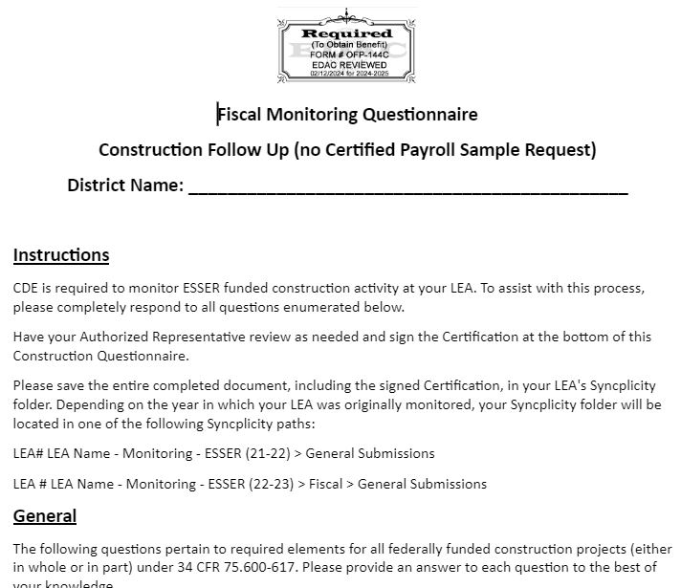
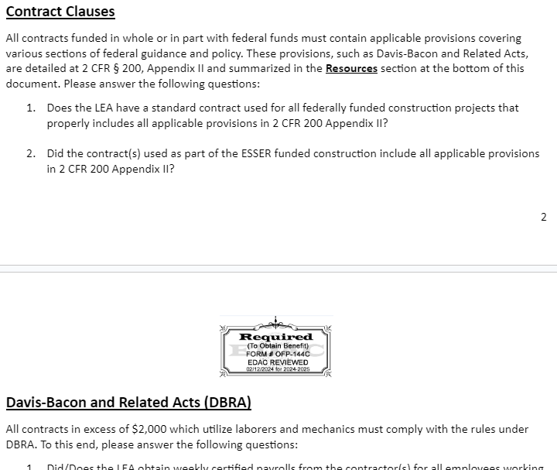
Contracted Project Monitoring Update - CQ Screenshots
Brief overview of CQ sections at the end of this Contracted Project Monitoring Update
Notes:
Hilery Morris

Slide 27
Contracted Project Monitoring Update -
Davis-Bacon and Related Acts (DBRA)
Federally funded (in whole or in part)
Exceed $2,000 (equipment cost PLUS installation cost even if split-funded)
For the construction, alteration, or repair (including painting and decorating) of public buildings and public works, and
Include employment of laborers or mechanics (work is manual or physical in nature as distinguished from mental or managerial duties)
Applies to services procured via contracts, POs, proposals, quotes, etc.
Exceptions to DBRA:
Work performed by LEA staff
Work performed by sole proprietor
Maintenance work

Slide 28
Contracted Project Monitoring Update - Good Faith Effort to Comply with Davis-Bacon and Related Acts Requirements
Prevailing wages (PWs) must be paid for projects that are ESSER-funded
Open projects must be brought into compliance with all DBRA requirements
A good faith effort must be made to ensure PWs were paid on closed projects
Good faith effort guidance document coming soon at GFMU’s Webinars, Trainings and Guidance page
Memo to file documenting good faith effort to contact:
Contractors and subcontractors to determine if PWs were paid
Laborers and mechanics to arrange payment of back wages where necessary
Use wage determination (WD) on sam.gov in place at time procurement completed
Obtain strongest supporting documentation possible from contractors and subs
Some LEAs opt to move noncompliant activity off of ESSER instead of taking steps to ensure compliance

Slide 29
Contracted Project Monitoring Update - Construction Examples
The following are examples of construction per the U.S. Department of Education
Outdoor classrooms and playgrounds, including:
New playgrounds (regardless of how the space was previously used)
Installation of fencing around a previously unsafe and unused space
Installation of a modular building, including site preparation
Structural repairs identified and completed during a minor remodeling HVAC project (only the repair portion would be construction)
Asbestos removal
Note, the list above is not all inclusive. LEAs should also consider projects that involved structural changes (e.g., moving load-bearing walls) or added square footage
Please remember that ESSER-funded construction will be subject to annual reporting for 15 years, beginning in 2024-2025 - collection form and training coming this Fall!
Construction projects of $1 million or more must also file a Notice of Federal Interest with local government.

Slide 30
Contracted Project Monitoring Update -
Construction on Property Not Owned by District
ESSER-funded construction at a leased property (title not held by district or charter)
Lease must include a 50-year right of access provision per 34 CFR 75.603
Lease must include real property disposition language referencing the requirements of 2 CFR 200.311(c)
ESSER-funded construction at a charter owned property (charter holds title)
Any future change in the nature of the entity (i.e., change from a public to private entity) will require a formal transfer of property per 2 CFR 200.311(c)

Slide 31
Contracted Project Monitoring Update - CQ Overview
Two different versions depending on whether LEA is required to submit a sample of certified payroll records required under DBRA. Contact your ESSER Team Lead if you need a link.
The CQ will open as a read only Google document. Download it in the format you prefer prior to completing it.
Reminder to consider all project activity as you complete the CQ.
Main sections include:
Instructions - includes where to submit the LEA’s CQ in Syncplicity
General - applies to construction projects (34 CFR 75.600-617 (601 and 605 exempted by ED), so if the section is not applicable to your LEA, please indicate why (e.g., N/A since all projects were only minor remodeling and did not involve structural changes)
Contract Clauses - applies to all federally funded projects (see 2 CFR 200, Appendix II)
Davis-Bacon and Related Acts (DBRA) - applies to all projects meeting the four previously mentioned DBRA criteria
Resources - helpful links
Certification - must be signed and dated prior to uploading in Syncplicity
Notes:
Hilery Morris

Slide 32
Upcoming Meetings

Slide 33

Looking Ahead…
Any requests for topics or questions?
Upcoming Office Hours
August 15
August 29

Slide 34
CDE Contacts!
Emails: Lastname_Firstinitial@cde.state.co.us (e.g., Smith_a@cde.state.co.us)
Federal Programs & Supports (ESEA/ESSER Program Supports) | School Finance & Operations (Fiscal and Systems Supports)
Nazie Mohajeri-Nelson, Executive Director of Federal Programs & Supports Unit Program Specialists Program Implementation Supervisor: Laura Meushaw Program Implementation Coordinator: Christina Adeboye Sullivan Program Monitoring Supervisor: Tammy Giessinger ESEA/ESSER Monitoring Coordinator: Kristin Crumley Program Effectiveness Supervisor: Tina Negley Program Evaluation & Research Coordinator: Anna Rowan ESEA Programs Specialists and ESEA Regional Contacts (assigned by district) Title I: Laura Meushaw, Evita Byrd, Rachel Echsner, Kim Boylan Title II: Rachel Echsner, Sue Miller-Curley Title III: Rachel Temple, Kim Boylan Title IV & Stronger Connections Grant: Nathan Hickman, Evita Byrd Title V: Christina Adeboye-Sullivan, Rachel Echsner ESSER Program Specialists Jonathan Schelke Kim Boylan Kriselda Craven Nadine Penn ESEA and ESSER Data and Reporting Specialists Melissa Chaffin (ESEA) Jerry Ring (ESEA) Ian Ray (ESSER) | Amy Carman, Executive Director of School District Operations Unit Fiscal Specialists Jennifer Austin, Director of Grants Fiscal Management ESEA Robert Hawkins, Grants Fiscal Analyst Steven Kaleda, Grants Fiscal Analyst ESSER Fiscal Specialist Steven Kaleda Grants Fiscal Analyst ESSER Monitoring Bill Parsley, ESSER Fiscal Monitoring Supervisor Hilery Morris, ESSER Fiscal Monitoring Kristina Jones, Federal Fiscal Monitoring and Reporting Specialist Werner Hagemann, ESSER Fiscal Monitoring Specialist Application Systems Specialists DeLilah Collins, Director of Grants Program Administration Online Applications Systems Technical Support Jessica Hollingshead

