Slide 1
CDE Office Hours
June 6, 2024

Slide 2
ESEA/ESSER Office Hours
Topics:
Consolidated Application Q&A

Slide 3
2024-25 Consolidated Application Updates
The 2024-2025 Consolidated Application and all applicable
documents are due July 1, 2024.
Reminder, an ARAC must be submitted by all LEAs. All LEAs that sign over to a BOCES or LEA must complete its ARAC prior to the BOCES or LEA application to open.
Extensions can be granted by submitting a request! *Please note, this will delay substantial approval.
For questions or assistance, please contact your ESEA Regional Contact.
Notes:
Laura

Slide 4
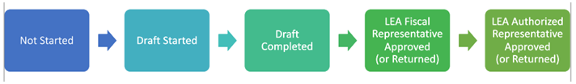
Common Questions – General Assurances
Question | Answer
Who needs to sign document? | LEAs can lean on local policies and practices to determine who has the authority to sign on behalf of the entity. “Local Educational Board or the Board’s Designee” “Authorized Representative”
How to upload? | During initial submission of the LEA ARAC, there is an upload option. If submitting once the LEA ARAC has received approval, the LEA will select “Revision Started” and upload a signed copy of the General Assurances form. Note, for the information to be submitted to CDE both the LEA Fiscal Representatives and LEA Authorized Representative need to approve the revision.

Slide 5
Common Questions - Carryover
Question | Answer
When will carryover be loaded into the GAINS System? | CDE uploaded estimated carryover into GAINS for any LEA that submitted that information to CDE by Friday, May 31st. For all LEAs, CDE will upload the actual calculated carryover amounts on September 4th. For LEAs that requested an upload of estimates, the carryover amount will be adjusted and will need to submit a budget revision to account for any differences, including any necessary revision to a school’s per pupil allocation.

Slide 6
Common Questions – School Ranking Page
Question | Answer
How do I edit a school’s grade span or add a school that is missing? | Please send the information that needs to be revised to gains@cde.state.co.us. Please cc: DeLilah Collins and your ESEA Regional Contact(s).

Slide 7
Common Questions – Budget Tips
Question | Answer
How do I budget indirect costs? | The application calculates the amount of indirect costs for each program based on the LEA’s indirect cost rate. The system does not automatically budget this amount. The LEA will need to add a budget line for the amount of indirect costs that will be taken.
What do I do with remaining cents? | If the LEA has any remaining funds (i.e., cents) on the School Ranking page, the LEA can add those remaining funds to a District Level Set Aside in order to balance the budget. Note, a warning on the School Ranking page does not prohibit submission. An LEA will have to have a $0 balance for all budgets in order to submit.

Slide 8
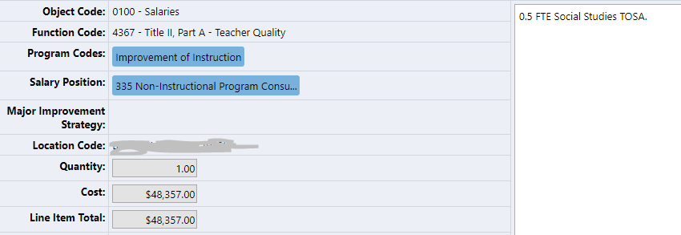
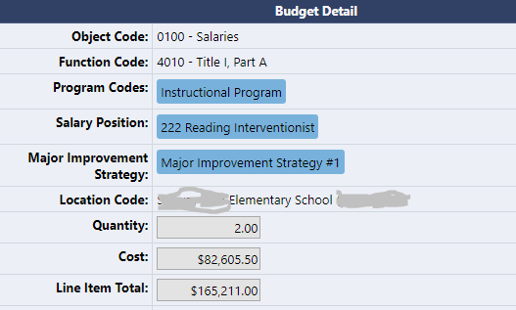
Budgeting FTE
Option 2: Put the actual FTE in the quantity and in the cost line put the number to be multiplied.
Quantity is a multiplier.
Option 1: Put in the total cost for the line into the “Cost” box and include the actual number of FTE in the narrative.

Slide 9

Common Questions
Question | Answer
What is the difference between a Warning and an Error? | Both indicate that there is an area to address however an error will prohibit submission while a warning will not.
How can I view all budget lines that have been added for a Title? | Select Modify All on the Budget Page.
Recommendation: Given the requirement for submission in GAINS, FPSU recommends that at least two staff members have the LEA Authorized Representative and LEA Fiscal Representative role.

Slide 10
Upcoming Meetings

Slide 11

Looking Ahead…
Any requests for topics or questions?
Upcoming Office Hours
  June 20
    Cons App Q&A and TA Sessions
  No Office Hours in July

Slide 12
CDE Contacts!
Emails: Lastname_Firstinitial@cde.state.co.us (e.g., Smith_a@cde.state.co.us)
Federal Programs & Supports (ESEA/ESSER Program Supports) | School Finance & Operations (Fiscal and Systems Supports)
Nazie Mohajeri-Nelson, Executive Director of Federal Programs & Supports Unit Program Specialists Program Implementation Supervisor: Laura Meushaw Program Implementation Coordinator: Christina Adeboye Sullivan Program Monitoring Supervisor: Tammy Giessinger ESEA/ESSER Monitoring Coordinator: Kristin Crumley Program Effectiveness Supervisor: Tina Negley Program Evaluation & Research Coordinator: Mary Shen ESEA Programs Specialists and ESEA Regional Contacts (assigned by district) Title I: Laura Meushaw, Evita Byrd, Rachel Echsner, Kim Boylan Title II: Rachel Echsner, Sue Miller-Curley Title III: Rachel Temple, Kim Boylan Title IV & Stronger Connections Grant: Nathan Hickman, Evita Byrd Title V: Christina Adeboye-Sullivan, Rachel Echsner ESSER Program Specialists Jonathan Schelke Kim Boylan Kriselda Craven Nadine Penn ESEA and ESSER Data and Reporting Specialists Melissa Chaffin (ESEA) Jerry Ring (ESEA) | Amy Carman, Executive Director of School District Operations Unit Fiscal Specialists Jennifer Austin, Director of Grants Fiscal Management ESEA Robert Hawkins, Grants Fiscal Analyst Steven Kaleda, Grants Fiscal Analyst ESSER Fiscal Specialist Steven Kaleda Grants Fiscal Analyst ESSER Monitoring Bill Parsley, ESSER Fiscal Monitoring Supervisor Hilery Morris, ESSER Fiscal Monitoring Kristina Jones, Federal Fiscal Monitoring and Reporting Specialist Werner Hagemann, ESSER Fiscal Monitoring Specialist Application Systems Specialists DeLilah Collins, Director of Grants Program Administration Online Applications Systems Technical Support Jessica Hollingshead

