Slide 1
CDE Office Hours
May 23, 2024
Notes:
Nazie

Slide 2
ESSER Office Hours
Topics
Updates and Reminders
  TIV Update
  24-25 Cons App Reminders
  Contracted Project Monitoring
  ESSER Safe Return and Use of Funds Plans
BOCES Consolidation Application in GAINS
Notes:
Nazie

Slide 3
Updates and Reminders
Notes:
Nazie

Slide 4
24-25 Consolidated Application Reminders
The deadline for a complete application and all applicable documents is July 1, 2024.
Submit the Assignment of Funds (Accept, Decline, Assign To)​, Certification and Agreement, and for applicable districts, the School Improvement Retention Form.
  The ARAC is located within the Grant Administration Implementation and Navigation System (GAINS) under Application Supplement. Please view this short recording on the ARAC.
  One Stop Shop of Consolidated Application information and trainings.
  For questions or assistance, please contact your ESEA Regional Contact.
Notes:
Laura

Slide 5
ESSA Reduction in Funds for FY 2024-2025
The State’s Title I allocation has gone down by $5 million!
ESSER funds are sunsetting!
How to strategize and which funding streams to consider:
Any remaining ARP ESSER III funds - PAR
ESSA Carryover Funds
Title I Reallocated
ARP ESSER III Rapid Request
If ESSA identified schools, EASI grants: Diagnostic Review or Targeted Grant for costs associated with an evidence-based interventions
Use above funding to free up general and/or ESSA funds for FY24-25
Which funding stream is going to best help meet your needs? None will make up for the full reductions!

Slide 6
Title I Reallocated Grant
Who? Any LEAs that have seen a significant reduction in their ESEA Allocations!
How Much? Total Available: $670,000
By when? Expiring ESEA Funds: Must be obligated by 9/30/24
For What? Allowable Uses of Funds: Title I allowable supplemental activities, aligned with CNA, reasonable and necessary to meet program intent.
Additional information available on CDE’s Title I website.
Contact Laura Meushaw, for questions about the Title I and EASI grants
Friday, May 31, 2024 | Applications due to CDE by 11:59 pm.
May 31 - June 13, 2024 | Review of Applications.
Friday, June 14, 2024 | Applicants will be notified of application status.
Monday, September 30, 2024 | All funds must be obligated (i.e., A contract with a provider must be executed).
Wednesday, October 30, 2024 | Funds must be requested for reimbursement from CDE.

Slide 7
ARP ESSER III Rapid Request
Who? Any LEAs that have spent their own ESSER III allocations but have remaining costs associated with the pandemic!
How much? Total Available to be determined!
By When? ARP ESSER III State Reserve Funds: Must be obligated 9/30/24
For what? Allowable Uses of Funds: Any activity that is allowable under ESSER, is reasonable in cost, and necessary to respond to, prepare for, prevent the spread of, or recover / emerge stronger from the pandemic.
Additional Information available on CDE’s ESSER III Rapid Request website.
Contact Matt Koziol for ESSER III Rapid Request
Thursday, June 13, 2024 | Applications due to CDE by 11:59 pm.
June 13 - July 1, 2024 | Review of Applications.
Friday, July 1, 2024 | Applicants will be notified of application status.
Monday, September 30, 2024 | All funds must be obligated
Wednesday, October 30, 2024 | Funds must be requested for reimbursement from CDE.

Slide 8
EASI Grant for ESSA Identified Schools
If an LEA has any ESSA Identified Schools (i.e., CS, TS, or ATS), there are 2 grant opportunities for this spring:
Diagnostic Reviews to be conducted in September or October of 2024
EASI Targeted - Costs associated with evidence-based interventions / strategies being implemented this summer
Additional information available on CDE’s EASI website.
Contact Laura Meushaw, for questions about the Title I and EASI grants
Wednesday, May 29, 2024 | Applications due to CDE by 5 p.m.
May 27 - June 6, 2024 | Review of Applications.
Friday, June 7, 2024 | Applicants will be notified of application status.
Monday, September 30, 2024 | All funds must be obligated (i.e., A contract with a provider must be executed).
Wednesday, October 30, 2024 | Funds must be requested for reimbursement from CDE.

Slide 9
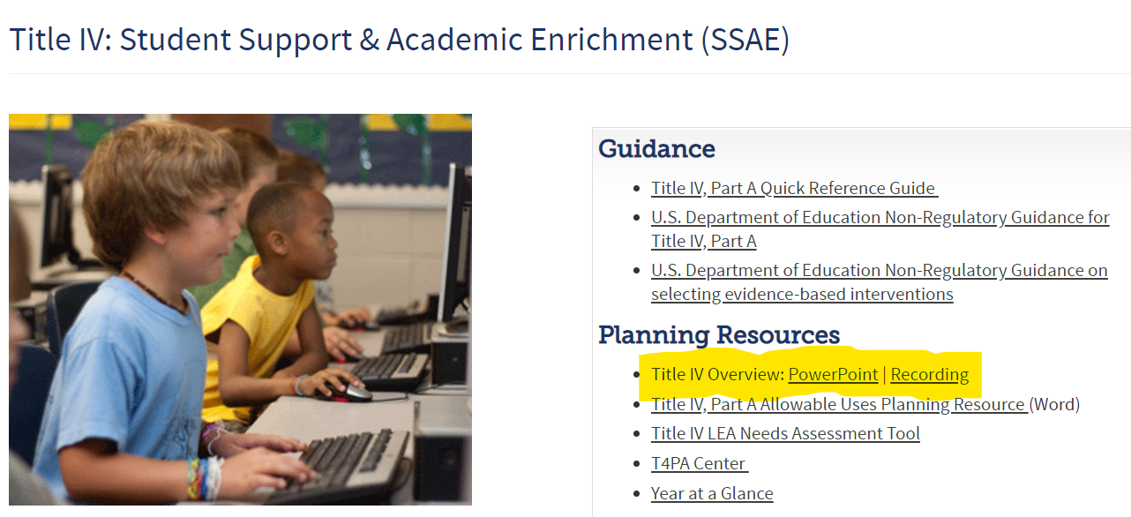
Title IV Update
New resource
See the Title IV overview webinar and PowerPoint slides on the Title IV webpage for guidance on:
Planning your Title IV funds,
Budget requirements in the Consolidated Application, and
Reporting requirements.
Notes:
Evita

Slide 10
Contracted Project Monitoring: Davis-Bacon and Related Acts (DBRA) Info and Resources
Four DBRA criteria
  Federally funded (in whole or in part)
  Exceeds the $2,000
  For construction, alteration, or repair of public buildings and public works
  Includes employment of laborers or mechanics
  DOL Wage and Hour Division DBRA Webpage
CDE Construction Guidance Document
March 28th, 2024 Office Hours (see slide links)
Contract Provisions for Non-Federal Entity Contracts Under Federal Awards (2 CFR §200, Appendix II)
OESE Davis-Bacon Overview Document
DOL DBA/DBRA Certified Payrolls training and related slides that provide guidance on how to review certified payrolls
Notes:
Hilery

Slide 11
Contracted Project Monitoring:
DBRA Reminders
DBRA does not apply to:
  LEA employees performing labor
  “Plug and play” deliveries (e.g., appliance delivery and hook up to existing utilities)
  Maintenance work
  Sole proprietors (confirm business type at Secretary of State website and ensure no employees or subcontractors were hired to assist with the LEA project)
Must combine the cost of equipment plus the cost of installation in considering the $2,000 DBRA threshold (regardless of how installation is funded)
Notes:
Hilery

Slide 12
Contracted Project Monitoring: Davis-Bacon and Related Acts (DRBA) Next Steps
Open project?
  Bring into full compliance (contract provisions, prevailing wages paid project inception to date, weekly certified payrolls, visible poster/wage determination)
Closed project?
  Were prevailing wages (PW) paid by contractors and subcontractors (LEA needs to obtain related payroll records and at least spot check against applicable wage determination)?
  If yes, and documentation shows PW were paid, contact Nazie Mohajeri-Nelson regarding optional waiver process, for extenuating circumstances, such as an audit finding
  If no, must make laborers whole (pay back wages) at the PW rate or find a non-federal funding source
  Contact CDE with questions
Notes:
Hilery

Slide 13
Contracted Project Monitoring:
“Construction Questionnaire”
“Construction” Questionnaire (CQ) is a misnomer - respond based on all ESSER and Rural Co-Action activity grant inception to date (not just construction and not just this fiscal year)
  LEAs may submit multiple CQs or group the projects on one CQ (e.g., project #1, project #2, etc.)
  CQ due date was April 5, 2024 - contact CDE for extensions or if a revised CQ needs to be submitted
General section only applies to construction (34 CFR 75.600-617 except 601 and 605)
  If the General section is not applicable to a project, please indicate why it is not applicable on the questionnaire (e.g., our HVAC project only replaced existing outdated equipment and did not involve moving load bearing walls)
Contract Clauses section applies to all federally funded projects (2 CFR 200 Appendix II)
DBRA section may ask for a certified payroll sample to be submitted in Syncplicity in which case CDE may include a sample request as part of any necessary corrective actions
Notes:
Hilery

Slide 14
Contracted Project Monitoring:
BEST Projects and Construction on Leased Property
Use of ESSER funding to meet a BEST award match triggers federal requirements for the entire BEST project
  This includes DBRA requirements and notice of federal interest ($1 million or more in federal funds)
Construction on property involved in a lease-to-own agreement is unallowable per 34 CFR 75.603
  A grantee must have or obtain a full title or other interest in the site, including right of access, that is sufficient to insure the grantee's undisturbed use and possession of the facilities for 50 years or the useful life of the facilities, whichever is longer.
  This includes property that is part of a lease-to-own arrangement between a charter school and the district
Notes:
Hilery

Slide 15
ESSER Safe Return & Use of Funds Plan
Each recipient of an ARP ESSER III allocation, including supplemental awards, is required to develop, make publicly available, and submit to CDE a Safe Return to In-Person Instruction Plan and an ARP ESSER III Use of Funds Plan.
The plans should be reviewed every 6 months and revised, if needed.
In addition, each SEA must provide the U.S. Department of Education the URL(s) for LEA websites where the public can find the both LEA plans.
Notes:
Kristin

Slide 16
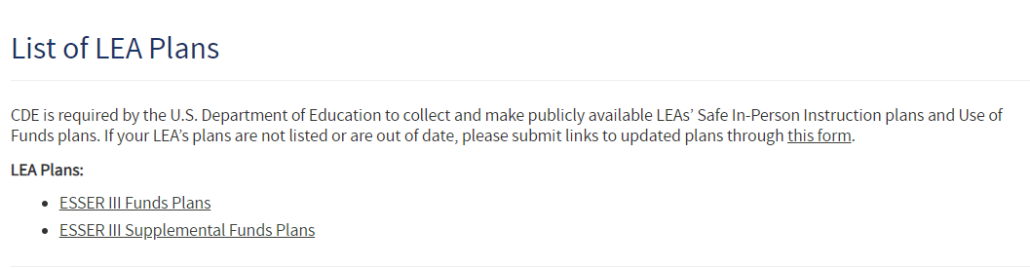
Is your plan posted?
The Safe Return to In-Person Instruction and Use of Funds Plans are listed on CDE’s List of LEA Plans website.
Please take a moment to check if the links to your LEA’s plans are posted.
  If yes, please check that the most recent plan is posted.
    As a reminder, the Safe Return to In-Person Instruction plan must be reviewed no less than every 6 months, and updated if needed. We recommend including the date of the most recent review or update directly on the plan to avoid any compliance issues.
  If no, please post the most recent version of your plan on your LEA’s website and ensure the link on CDE’s website is accurate.
    Use form on plan webpage to submit updated links.
Notes:
Kristin

Slide 17

Plans continued
Plans must remain posted on the LEA’s and CDE’s webpages through the end of the award period, September 30, 2024.
Please submit a link to the LEA’s Use of Funds plan by May 31, 2024.
For any LEAs without a use of funds plan linked on CDE’s website, a PDF copy of the approved ESSER III application will be posted.
Notes:
Kristin

Slide 18
Questions
Notes:
Nazie

Slide 19

Looking Ahead…
Any requests for topics or questions?
Upcoming Office Hours
  June 6 and 20
    Cons App Q&A and TA Sessions
Notes:
Nazie

Slide 20
CDE Contacts!
Emails: Lastname_Firstinitial@cde.state.co.us (e.g., Smith_a@cde.state.co.us)
Federal Programs & Supports (ESEA/ESSER Program Supports) | School Finance & Operations (Fiscal and Systems Supports)
Nazie Mohajeri-Nelson, Executive Director of Federal Programs & Supports Unit Program Specialists Program Implementation Supervisor: Laura Meushaw Program Implementation Coordinator: Christina Adeboye Sullivan Program Monitoring Supervisor: Tammy Giessinger ESEA/ESSER Monitoring Coordinator: Kristin Crumley Program Effectiveness Supervisor: Tina Negley Program Evaluation & Research Coordinator: Mary Shen ESEA Programs Specialists and ESEA Regional Contacts (assigned by district) Title I: Laura Meushaw, Evita Byrd, Rachel Echsner, Kim Boylan Title II: Rachel Echsner, Sue Miller-Curley Title III: Rachel Temple, Kim Boylan Title IV & Stronger Connections Grant: Nathan Hickman, Evita Byrd Title V: Christina Adeboye-Sullivan, Rachel Echsner ESSER Program Specialists Jonathan Schelke Kim Boylan Kriselda Craven Nadine Penn ESEA and ESSER Data and Reporting Specialists Melissa Chaffin (ESEA) Jerry Ring (ESEA) | Amy Carman, Executive Director of School District Operations Unit Fiscal Specialists Jennifer Austin, Director of Grants Fiscal Management ESEA Robert Hawkins, Grants Fiscal Analyst Steven Kaleda, Grants Fiscal Analyst ESSER Fiscal Specialist Steven Kaleda Grants Fiscal Analyst ESSER Monitoring Bill Parsley, ESSER Fiscal Monitoring Supervisor Hilery Morris, ESSER Fiscal Monitoring Kristina Jones, Federal Fiscal Monitoring and Reporting Specialist Werner Hagemann, ESSER Fiscal Monitoring Specialist Application Systems Specialists DeLilah Collins, Director of Grants Program Administration Online Applications Systems Technical Support Jessica Hollingshead
Notes:
Nazie

Slide 21
BOCES Supplemental Training
Notes:
DC

Slide 22

BOCES Agenda
BOCES Access to member district applications
Differences in BOCES versus LEA
  Allocations
  BOCES Narratives
  Title I, Part A
Walkthrough
Notes:
DC

Slide 23
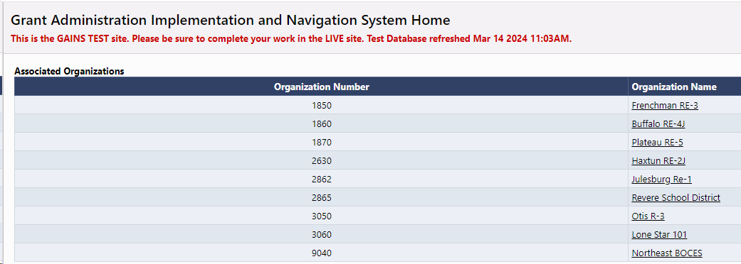
BOCES Application – Access
For BOCES that manage Title I, Part A - the BOCES users will need to be able to access the member district's application to complete various parts of Title I, Part A.
  However, the rest of the application will be completed in the BOCES application.
LEA User Access Administrators or LAMs can add/provide BOCES staff access to their Consolidated Application.
  LAM/User Access Administrator should provide BOCES staff the LEA ESEA Consolidated Director role.
Notes:
DC

Slide 24
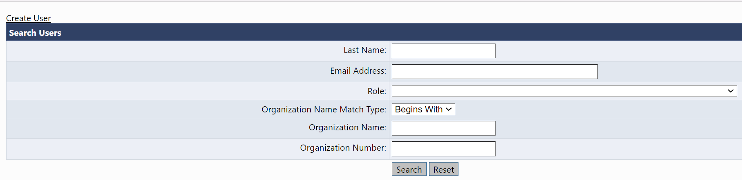
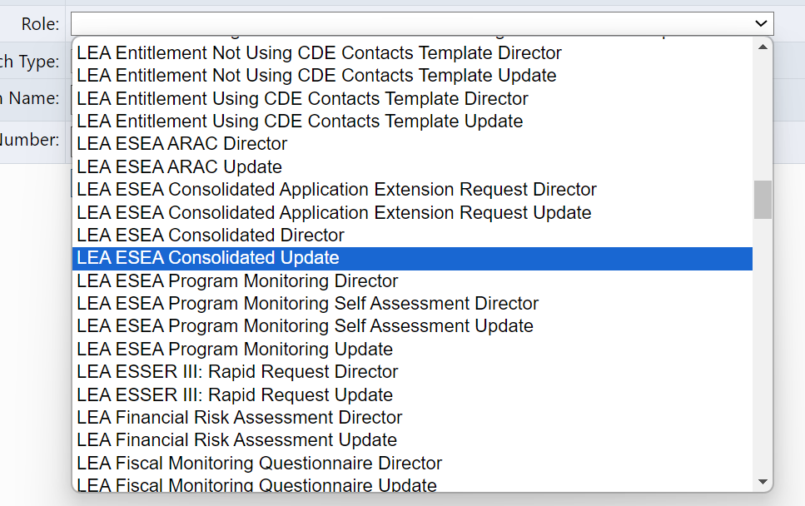
BOCES Application – Title III Access
If you are a BOCES that only manages Title III and would like your member districts to have access to the BOCES application the User Access Administrator/LAM at the BOCES can provide the member district the LEA ESEA Consolidated Update role.
Notes:
DC

Slide 25
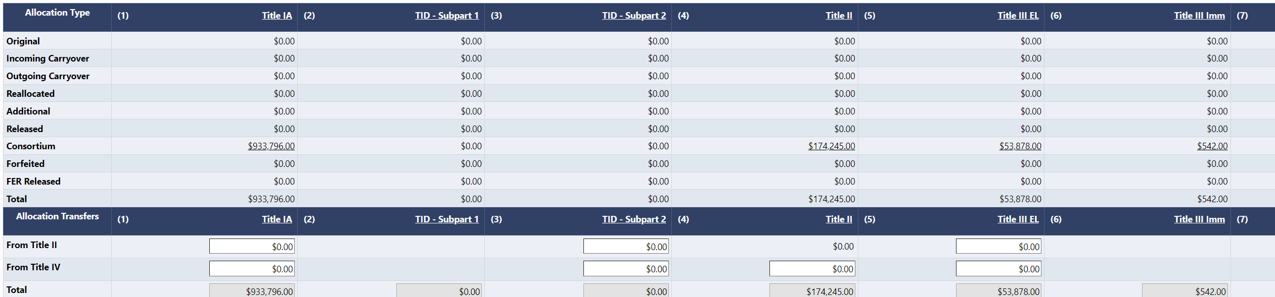
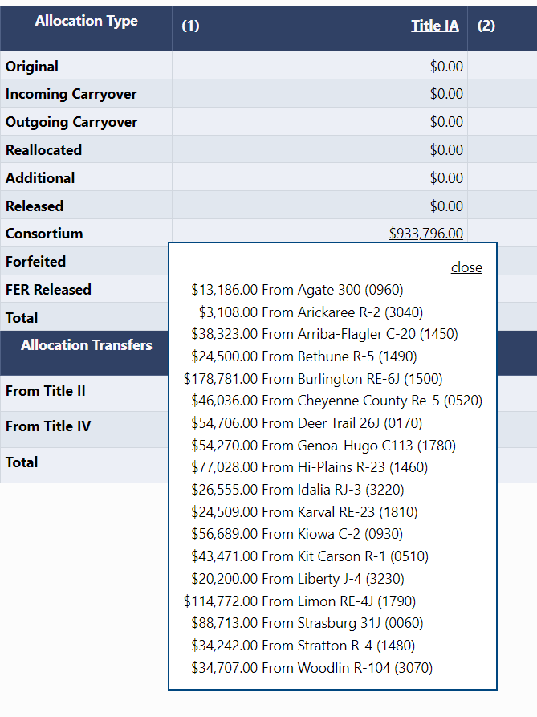
BOCES Allocations

Slide 26
BOCES Application – Differences from the LEA Application
BOCES will need to complete an additional section on the Contacts page to include a Title IX representative from each Member District. (Found on the Contact Page)
BOCES narratives are the same questions but structured differently to capture a response from every member district.
Title I, Part A requires that the BOCES goes into the member district application to complete certain pages:
  LEA Set-Asides
  LEA Data Profile
  School Ranking
  Preschool Table
Notes:
DC

Slide 27
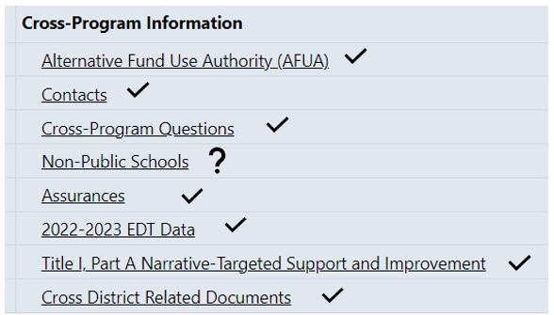
Section Differences – Cross Program
Items with a “check” are the pages that BOCES will complete
Item with the ? will be completed if there is a Nonpublic School pre-populated on the page.

Slide 28
BOCES Application - Contacts
BOCES must include the Title IX contact for each member district.
CWEL is a required contact, CDE recommends

Slide 29
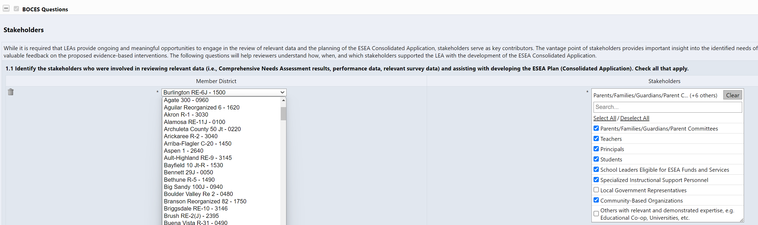
BOCES Application – Cross Program Questions
BOCES will use the drop down under each question and select their member district. This list contains all LEAs.

Slide 30
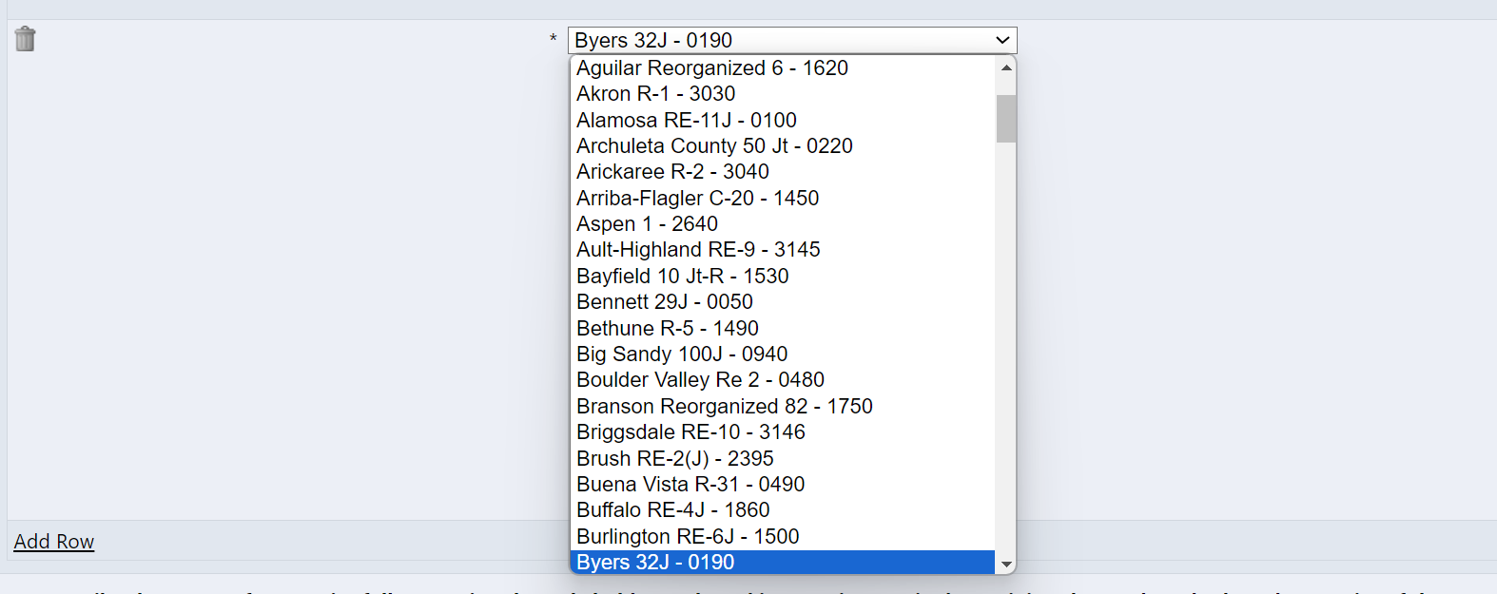

BOCES Application – Cross Program Questions, cont.
Use the “Add Row” link to add the next member district. Do this until all member districts have a response recorded.

Slide 31
BOCES Application – Title I, Part A Section
The BOCES user will go into each application and fill out the necessary pages under Title I, Part A.
  LEA Set-Asides
  LEA Data Profile
  School Ranking
  Preschool Table
Once these pages are complete and the School Allocation is known, the BOCES user will jump back into the BOCES application and complete the Title I, Part A narratives, as well as the budget.
The BOCES application won't be able to validate whether the schools are in rank order. CDE reviewers will be checking this once it is submitted.
Notes:
DC

Slide 32
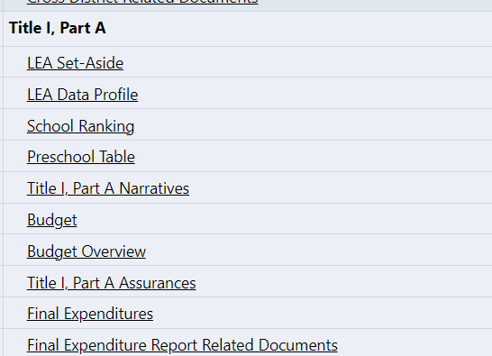


Section Differences - Title I BOCES vs. Title I Member District
BOCES | Member District
Preschool Table will need to be completed if there are preschools populated on this page.
The Budget Overview, Final Expenditures, and Final Expenditure Report Related Documents do not require any action at this time.

Slide 33
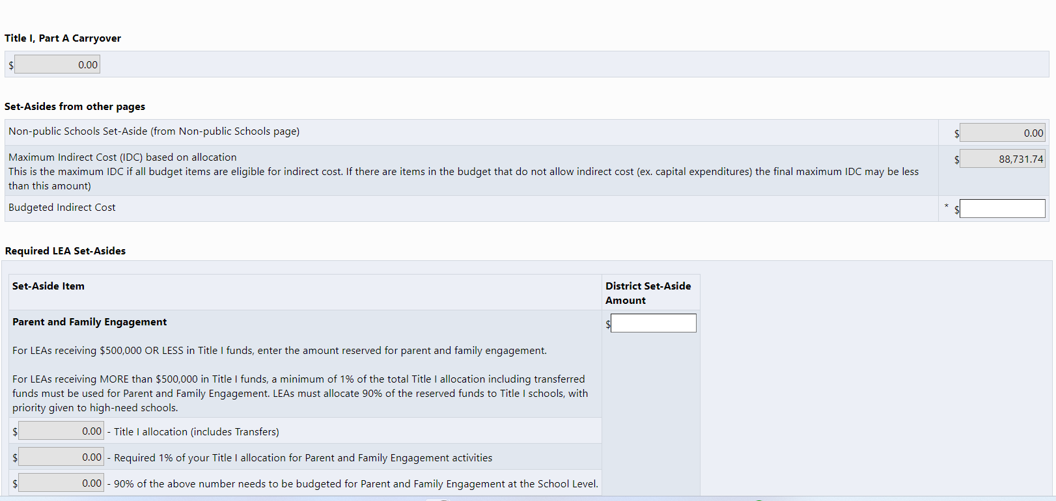
BOCES Set Aside
LEA Set-Aside page will remain blank. No action is needed.

Slide 34
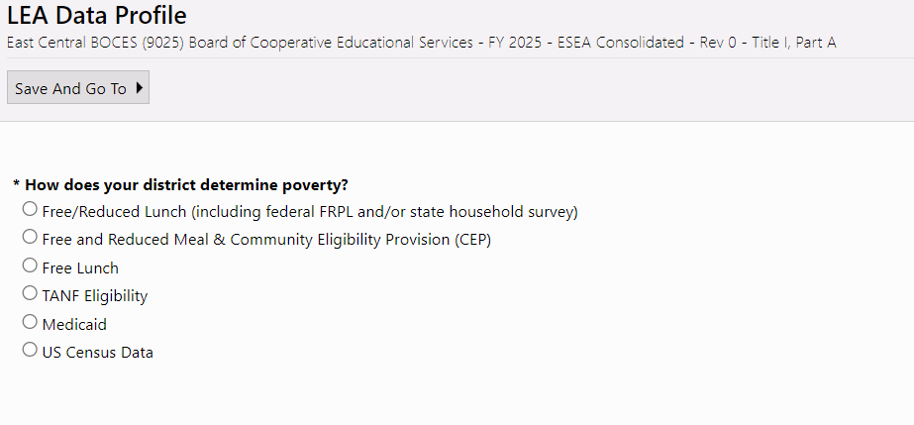
BOCES Data Profile
BOCES will leave this page blank. No action is needed.

Slide 35
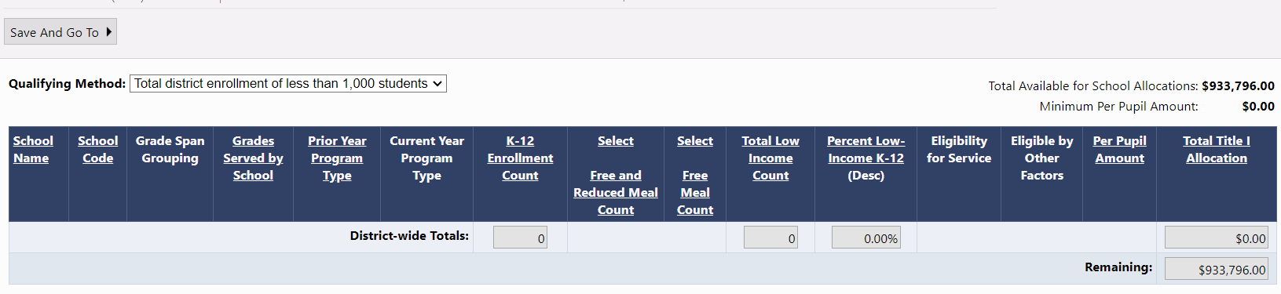
BOCES School Ranking Page
Again, BOCES does not complete this page. These cells are not editable and will remain greyed out.

Slide 36
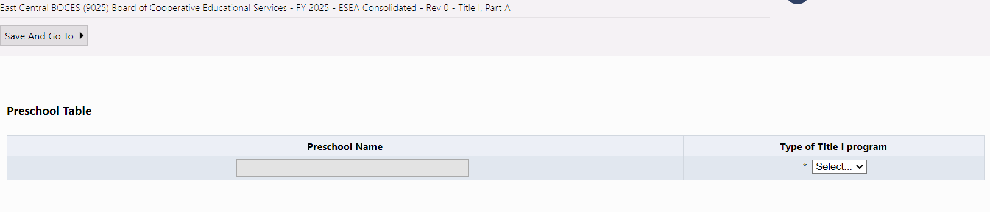
BOCES Preschool Table
No Action Required

Slide 37
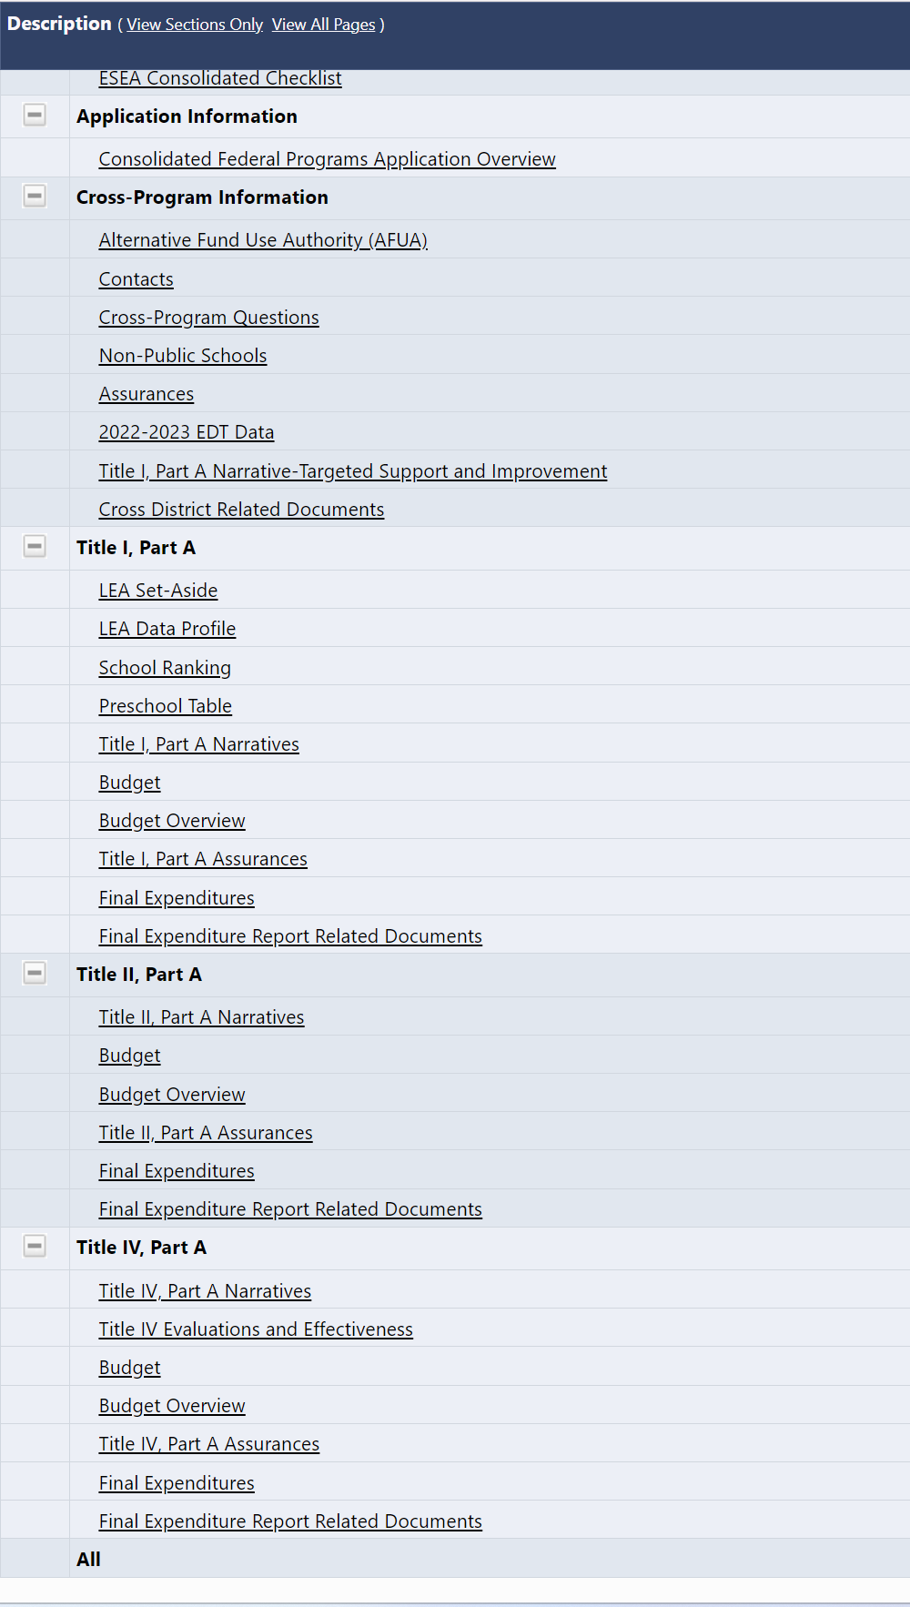
Titles II, III, IV and V (if applicable)
Member district application will not have Title II, III, IV, or V in their application.
Sections that have a budget will appear in the application except for Title I. The system is showing this section so the BOCES can complete the LEA Set Aside, LEA Data Profile, School Ranking and Preschool Table (if applicable).

Slide 38
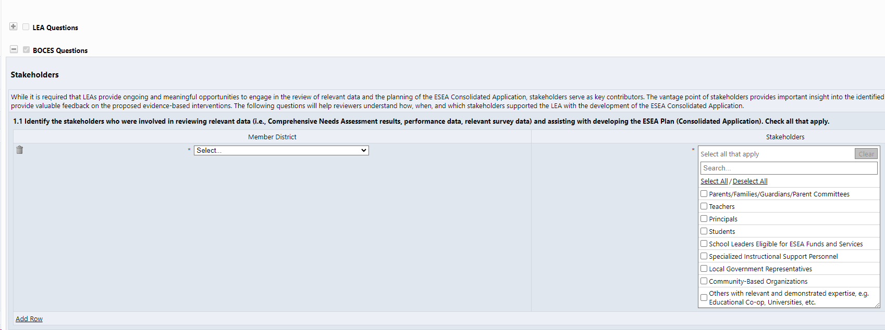
BOCES Application – Narratives
The application will only show the BOCES questions.
Each question will be in a chart where the BOCES can select the member district and provide the associated response.
The BOCES will have the option to "Add Row" and enter as many responses as necessary (one for each member district).
All narrative questions will be completed in the BOCES application.
Notes:
DC

Slide 39

2024-2025 BOCES Consolidated Application Walk Through
Notes:
DC

