Slide 1
Implementing Changes Using EDT Data Workshop
Training #3 in the EDT Series
Notes:
RUNTIME:
Niko leads speaking

Slide 2
Upcoming Training
Equitable Distribution of Teachers Series Training #3: Implementing Changes Using EDT Data Workshop
This training will provide LEAs with a range of strategies that can be implemented to positively impact an LEA’s equitable distribution of teachers.
Target Audience: LEAs with small, medium, or large EDT gaps (district leadership, HR, hiring managers, principals); LEAs without gaps also welcome.
Prep: LEAs will need access to their 20-21 EDT data from Syncplicity. Recommended to watch the recordings of trainings 1 & 2 of the EDT Training Series.
Date: March 29, 2022
Time: 10am-12pm
Register HERE
Agenda
Best Practices to Ensure Data Accuracy
Strategies to Improve EDT Data
Leveraging Funds
Contact Wilson_S@cde.state.co.us for any logistics questions or Kaloudis_N@cde.state.co.us with questions about the training.

Slide 3
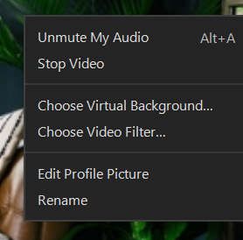
Introductions
Niko Kaloudis - ESEA Title I & II Specialist
Tina Negley - DARE Coordinator
Paige Moser - Educator Effectiveness Consultant
Jennifer Burgess - Educator Workforce Development Manager
Tanya Klein - Director, Educator Licensure
Annette Severson - Manager of Data Services
Please change your name to your preferred name by right clicking your image. Consider including your LEA and any preferred pronouns.
Notes:
We have experts from several CDE teams that can support you in the EDT work we are discussing today.
Would love if everyone on this list could come on camera and introduce themselves.

Slide 4
Prework
To get the most out of this training, you may:
Need to refer to knowledge reviewed in the previous two EDT Series trainings
  Recordings found on the EDT website.
Need access to your LEA’s 20-21 EDT Data file (from Syncplicity).
  Use the chat feature if you don’t have access to your LEA’s Syncplicity folder.
  Excel file found in Syncplicity.
  Access comes from an email from Syncplicity itself (check junk/spam)
Optionally,
Access to local HR data pertaining to the experience, in-field status, and effectiveness of employees in 20-21 and 21-22.
Notes:
This is training # 3 of 4.
[end] Other data may be useful in seeing the full picture of your EDT data. Historical data can help identify if a problem is persisting or lessening. Local data can ensure accuracy in reporting as well. Putting faces to the data is also beneficial.

Slide 5

Agenda
Training Norms
Grounding the Work
Quick Intro to EDT
Best Practices to Ensure Data Accuracy
Strategies to Improve EDT Data
Leveraging Funds
Next Steps

Slide 6

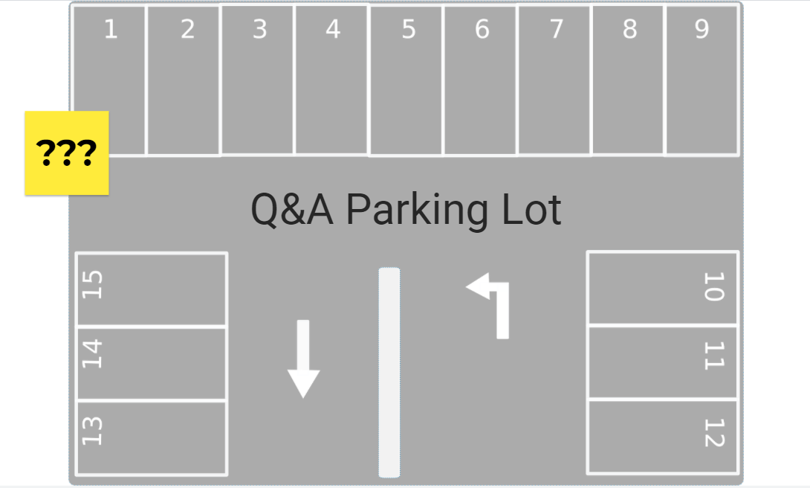
Training Norms
Participate fully.
Lean into discomfort; have a growth mindset.
Share the space with others in breakout rooms; invite people into the conversation.
Come on camera when speaking in large group and when in breakouts (whenever possible).
Enter questions into the chat at any time or come off mute during question pauses.
Use the Jamboard Parking Lot for one-off questions (answered later).
Notes:
[at end]
Niko screen shares for Jamboard demo
Explain jamboard and using a sticky

Slide 7

Objectives
LEA staff will be able to:
Analyze EDT data to inform decision making around choosing strategies.
Identify several strategies that may positively impact EDT data in their district.
Access resources to support in picking implementable strategies.
Better articulate strategies that may impact EDT data to stakeholders.
Identify potential funding streams to support EDT efforts.

Slide 8

Grounding the Work
Why talk about EDT now?
Annual requirement for LEAs with Title I schools, over 1,000 students, and more than 1 school per grade span to address disparities. (ESSA)
Pandemic has heavily impacted the teacher workforce; more so for minority students and students of poverty.
EDT can help LEAs quantify the impacts of COVID and help LEAs address them.
Notes:
[end] As we run EDT analyses during and after the COVID years, that data could be very useful and could be used in your comp needs assessments.

Slide 9
Poll Question
Q: How comfortable are you with discussing possible strategies that could be used in your LEA to positively impact the equitable distribution of teachers?
1: Not Comfortable - I don’t know how we can address any gaps in EDT data.
2: Slightly Comfortable
3: Somewhat Comfortable
4: Comfortable
5: Very Comfortable - I can interpret the data, select applicable strategies, and explain them to others.

Slide 10
Intro to EDT

Slide 11
Overview of EDT
The Every Student Succeeds Act (ESSA) requires state education agencies (SEAs) to evaluate annually whether low-income and minority students are taught disproportionately by ineffective, out-of-field, or inexperienced teachers.
LEAs with 1,000+ students and more than 1 school per grade span receive data.
  This includes public charter schools.
For more information on EDT:
  EDT Series Training #1: Using Data to Inform Comparability & EDT
    PowerPoint | Recorded Webinar
  EDT Series Training #2: Interpreting EDT Data Workshop
    PowerPoint | Recorded Webinar
Notes:
More information on the nuances with charter schools can be found in an EDT training geared specifically to charters, found later in the presentation.

Slide 12
Aligning Data Years
Data Year | 19-20 | 20-21 | 21-22 | 22-23
Planning Year | 20-21 | 21-22 | 22-23 | 23-24
EDT Plan Due Date | 6/30/21 | 6/30/22 | 6/30/23 | 6/30/24
Implementation Year (Also ConsApp Year) | 21-22 | 22-23 | 23-24 | 24-25
Example: Using 20-21 HR data that was finalized in March 2021, LEAs should spend 21-22 reviewing that data and planning with stakeholders to identify strategies to address gaps. Those plans are submitted (if med/large gaps) by June 30, 2022 to the 22-23 ConsApp and after approval, will be implemented over the course of that 22-23 school year.
Notes:
After example:
[Purple and Example - Point out where we are now in the process (using 20-21 data to plan for the 22-23 school year)]
[Orange - Also point out that in 21-22 there is something to do for 3 data years.]

Slide 13
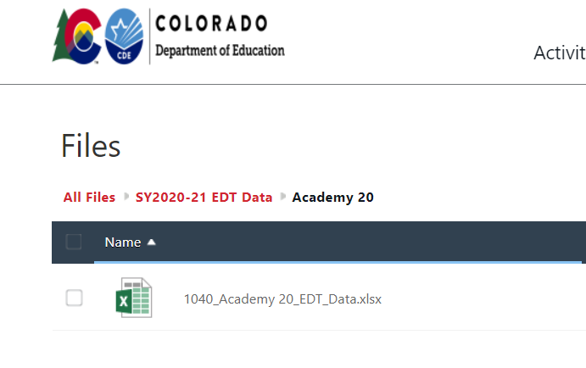

Accessing Your Data
Annual EDT files are sent out via Syncplicity to ConsApp Authorized Reps’ emails.
If you or your colleagues need access, please email kaloudis_n@cde.state.co.us.
The EDT Analysis excel data file is broken down into two tabs:
  District Level
  School Level
Notes:
Now would be a great time to pull up your EDT data file so you can follow along.
If you want to learn more about how to read the data on these tabs, watch training #2 in the series where Tina Negley describes the fields in detail.

Slide 14
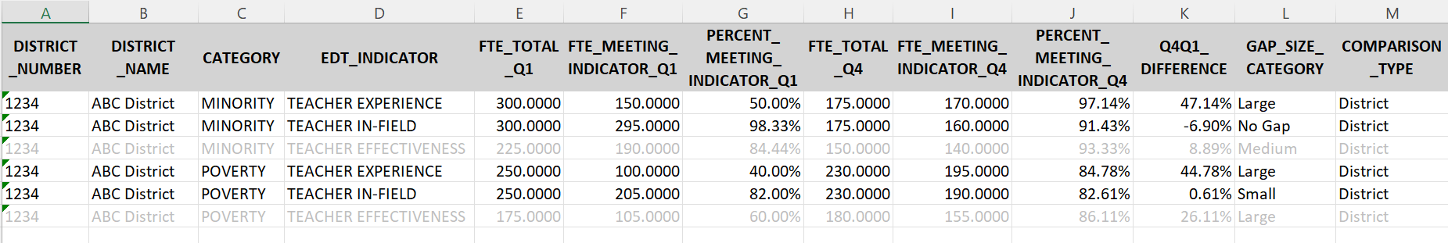
Establishing Your Baseline
No effectiveness analyses were provided on 20-21 data due to the accountability hold.
Open your 20-21 EDT Data File District tab.
  Does your district have any gaps?
  For which indicators?
  How large are the gaps?
Notes:
[Bubble at end] We will still talk about strategies to address EDT gaps in effectiveness since it will apply to future years and could help if you already know there will be gaps.

Slide 15
Poll Questions
Q1: Does your district have gaps?
Q2: Which indicator(s) does your district have gaps for?
Q3: What size gap(s) does your district have?
Notes:
From reading your EDT District Level Data…

Slide 16
Small vs Medium/Large Gap
Gap sizes are used to identify what next steps a district needs to take.
LEAs with small gaps must:
  Develop a plan to address the gaps.
  Maintain the plan locally for monitoring.
LEAs with medium or large gaps must:
  Develop a plan to address the gaps.
  Submit the plan to CDE by answering the 5 questions in the Consolidated Application.
Learn more about writing an EDT plan in the next training!
Notes:
[end] Today’s training should give you some strategies that you can include in your ConsApp EDT Plan.

Slide 17
Poll Questions
Q: Districts with identified _______ gaps must create an EDT Plan to address those disparities. (select all that apply)
A: Small, Medium, Large
Q: Districts with identified _______ gaps must submit their EDT Plan to CDE through the Consolidated Application. (select all that apply)
A: Medium, Large

Slide 18
Strategies to Address EDT Gaps
Notes:
Tina leads these slides

Slide 19

The Big Picture
Different gaps will require different strategies to address them and possibly a different level of urgency.
Local context can impact which strategies are reasonable/actionable.
Available resources can impact which strategies are possible to implement and to what scale.
Local data should supplement the EDT analyses from CDE to drive decision-making.
  HR Data, Future Retirements/Resignations/INRs, Student Population Shifts, etc.
Notes:
LEAs may want to prioritize larger gaps if there are limited resource. Some strategies will help with multiple indicators
Collective bargaining, proximity to colleges/universities
available $, your supply of applicants
Given the timeline of EDT data release and planning, use local HR and staffing data in planning process
If there is other local data you think would be useful, lets throw some ideas in the chat!

Slide 20

The Elephant in the Room
The Educator Shortage and COVID have greatly impacted how LEAs can serve students.
Increased focus on retaining & developing experienced, effective, and in-field teachers.
Decreased ability to attract already experienced, effective, and in-field teachers.
In this training, we will try to highlight strategies to leverage given the current hiring atmosphere.
Notes:
[at end] While it is harder, LEAs can and should still try to attract qualified staff to high-poverty or high-minority schools and can include those strategies into their EDT plans.

Slide 21
Best Practices for Ensuring Data Accuracy
Some strategies can be implemented as best practices and may positively impact the accuracy and gap size of multiple indicator categories.
Enter staff HR data into your HR system and Data Pipeline as part of the hiring process.
Work with hiring managers and HR to create paperwork that clearly identifies the experience and in-field status of new hires.
  Also use this paperwork when principals reassign/move staff to different positions or schools.
Frequently pull Data Pipeline & Cognos reports.
  Check for overall accuracy.
  Review the data throughout the year with building leaders.
Notes:
If you want to learn more about the various reports in Cognos, work with Annette Severson and her team.

Slide 22
Best Practices for Ensuring Data Accuracy
Create cyclical systems to ensure data accuracy throughout the year.
Ex) Staff Assignment File
  Appropriate number of Staff Assignment lines for each teacher.
  Demonstrates In-field Status
Take Action to Address the Data
Collect & Maintain Accurate Data
EDT HR Processes
Unsure what data is used for EDT calculations? Review this training:
EDT Series Training #1: Using Data to Inform Comparability & EDT
PowerPoint | Recorded Webinar
Pull & Analyze Related Cognos Reports
Upload Data into Data Pipeline Regularly

Slide 23
Available Data for Decision Making
CDE EDT Analyses
  Use historical data to identify trends. (Resources section)
  School Level Data tab to target supports/resources to schools with the lowest %s.
Local Data
  HR data pertaining to effectiveness, in-field status, and experience.
  Can help predict upcoming barriers to closing EDT gaps.

Slide 24
Strategies for Addressing Multiple EDT Gaps
Locally run EDT data throughout the year.
  Model your processes after the variables in the EDT school level tab.
Invest in increasing applicant pools.
  Job Fairs, HR Job Posting Software, Ads (incl. Social Media), Hiring Recruiters
Consider incentivizing effective, in-field, and experienced teachers to voluntarily serve your highest poverty and minority schools.
Supportive mentoring programs where all staff involved are compensated for extra time.
  Reduce burnout, encourage in-field attainment, increase effectiveness.
Adjusting staffing through reassignments.
Notes:
Speaks to attracting which is hard right now
Consider incentive pay for doing this
Work with local colleges/universities and BOCES
Unpopular, may be a last resort if gaps persist across several years.

Slide 25
Strategies for Addressing Multiple EDT Gaps
Retain, retain, retain.
  Increase staff compensation.
  Implement Retention Pay or Signing Bonuses.
  Hiring additional staff to manage workload
  Increase planning time.
  Offer compensated leadership opportunities.
  Strategies from USDE (supported by ESSER funds)
Use TLCC Survey data to identify what teachers need to feel supported and successful in their work.
Train and support principals.
  Often rated as the biggest impact on a teacher staying/leaving.
  Quality administrators can positively guide growth to address all 3 EDT indicator categories.
Notes:
Feds are urging prioritizing ESSER funds for this
Another great reason to make sure your TLCC completion rates are high.

Slide 26
Strategies for Addressing Multiple EDT Gaps
Collaborate with school, district, union, school board, and state stakeholders.
  District Accountability Committee
  1338 Council
Connect with the Educator Recruitment and Retention (ERR) Team at CDE:
  Support with all things Recruiting/Preparation/Development/Retention.
  Here to support small/large systems, BOCES, individual teaching candidates.
  Pathway to licensure/endorsement supports.
  educator_recruitment@cde.state.co.us
Complete the CDE Talent Self-Assessment Tool.
Notes:
Use stakeholder systems in place to discuss EDT rather than adding new processes. Embed EDT in the cyclical conversations you have.
More info later in the session

Slide 27

Turn & Talk (5 min)
Which strategies for addressing overall EDT gaps resonated with you given your LEA’s local context?
1 minute - Intros (include LEA and setting)
1 minute - Person #1
1 minute - Person #2
1 minute - Person #3
1 minute - Prepare to share out.
Were there any that CDE didn’t talk about?
Please turn your camera on when in small groups.
Notes:
Intro - include if you are a rural, suburban, or urban

Slide 28
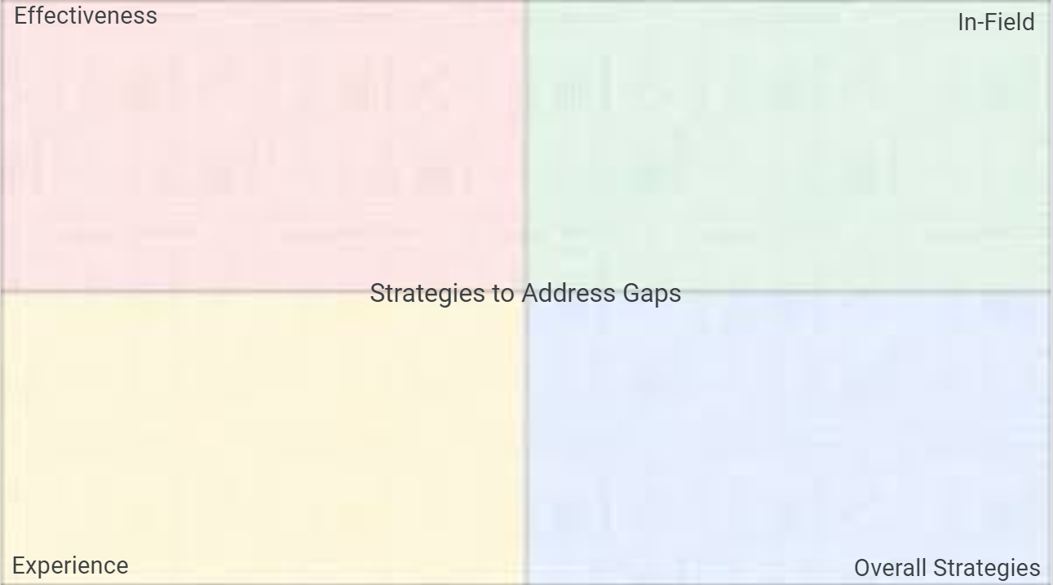
Strategy Jamboard
Please use the Jamboard (slide 2) to note any other creative ways to address gaps in the 3 EDT indicator categories that CDE did not call out.
Your experiences are valuable and could benefit other LEAs!
Notes:
[share out from groups]

Slide 29
Effectiveness Caveats
COVID impacted educator effectiveness data collection.
  20-21 EDT data does not contain educator effectiveness scores/ratings.
Districts have considerable flexibility when implementing education evaluations and can customize strategies to align with local systems and values related to educator effectiveness (Local Flexibility for Educator Evaluation).
This EDT indicator category has the greatest variability from district to district.
NOTE: Schools with applicable evaluation waivers in place are not included in EDT analyses for effectiveness.
Waivers 22-2-112(1)(q)(I) and 22-9-106, C.R.S.
Learn more about EDT for charter schools by viewing this training:
(Recording | PowerPoint)
Notes:
[Paige does left; Niko right]
[Niko at end of slide] talk about charters in EDT

Slide 30
Strategies for Gaps in Effectiveness
Work with district’s Advisory Personnel Performance Evaluation Council (1338 Council).
  Determine priorities and strategies that align with their district’s vision, mission, and values.
Enhance supports for educator evaluators, including bolstering effective observation and feedback skills for principals and evaluators.
  Provide Effective Observations and Feedback consistently throughout the year that includes follow-up conversations after observations.
  Improve inter-rater agreement.
  Analyze your Measure of Student Learning/Outcomes.
    MSL/O Training Webinars:
      Part 1: Thinking Through District and School Measures
      Part 2: Deepening Understanding and Creating Success Criteria around MSLs and MSOs
Notes:
[Paige]
[inter-rater & MSL/Os] improving the consistency and accuracy of evaluations and ratings between schools is a best practice but also could remove any discrepancies being drawn between high/low income/minority schools.

Slide 31
Strategies for Gaps in Effectiveness
Seek out additional information/support from your Educator Effectiveness Regional Specialist.
  Available for site visits, side-by-side coaching, and problem-solving aligned to district/BOCES values and decisions.
  Provides professional learning supports and ongoing dissemination of information and support resources.
Target supports for teachers rated as Partially Effective.
  Target specific Professional Practice Standards where a majority of teachers are struggling.
    Pull reports from RANDA or other evaluation platforms to narrow down the focus.
Notes:
[Paige]
If you have had gaps in effectiveness in the past and think that will continue, set up time with your Ed Effectiveness Regional Specialist.
This should be supplemental to supports that you are offering all teachers to improve their effectiveness.

Slide 32
Strategies for Gaps in Effectiveness
Substitute coverage for teachers to observe effective educators (at school or in other schools).
  Target these observations to skills that would benefit teachers in identified areas of improvement.
Hire qualified instructional coaches.
  Consider leveraging non-evaluative coaches.
  Focusing on the highest impact professional practice needs.
Notes:
[Paige]
Pulled from RANDA etc.
Have certificates and can be trainers in the buildings

Slide 33
Turn & Talk (5 min)
Which strategies for addressing gaps in effectiveness resonated with you given your LEA’s local context?
1 minute - Intros (include LEA and setting)
1 minute - Person #1
1 minute - Person #2
1 minute - Person #3
1 minute - Prepare to share out.
Were there any that CDE didn’t talk about?
Please turn your camera on when in small groups.
Notes:
[Niko resumes]
Pull up jamboard
EE Team adds a plant sticky note.

Slide 34
Strategy Jamboard
Please use the Jamboard (slide 2) to note any other creative ways to address gaps in the 3 EDT indicator categories that CDE did not call out.
Your experiences are valuable and could benefit other LEAs!
Notes:
[share out from groups]

Slide 35
Strategies for Gaps in In-Field Status
Check Cognos reports for expiring licenses regularly.
  Cognos > Human Resources folder > Teachers with License Information
  Cognos > Staff folder > Staff Licensing Status
  Check for expiring licenses and overall accuracy.
    Licenses may be renewed as earlier as six months prior to expiration
    Have systems in place to remind staff of credential needs.
    Ask staff to ensure their email address in COOL is correct.*
Partner with local institutions of higher education.
  To create a new staff pipeline.
  To support staff in becoming in-field.
  Professional development programs that confer continuing education credits for re-licensure and college credit.
*Expiration warnings are routinely sent from the COOL system.
Notes:
[start by reviewing the 4 ways to be in-field] license, BA in-field, 36+ credits in-field, passing exam.
To help get 36+ hours in their field

Slide 36
Strategies for Gaps in In-Field Status
Take current staff and offer to pay for their educational advancement.
  Paraprofessional to teacher program.
Providing loan forgiveness, grants, or service scholarship programs that significantly underwrite the cost of postsecondary education in exchange for a commitment to teach in a high-need field or school for a minimum number of years.
Cover the cost of PRAXIS testing and study materials.
Work with CDE Ed Talent to learn more about the variety of paths available to support getting teacher to be in-field.
  There are over 40 different pathways including alternative licensure.
Notes:
[at end have Tanya talk about last bullet–Jennifer can cover for Tanya….

Slide 37
Turn & Talk (5 min)
Which strategies for addressing gaps in in-field status resonated with you given your LEA’s local context?
1 minute - Intros (include LEA and setting)
1 minute - Person #1
1 minute - Person #2
1 minute - Person #3
1 minute - Prepare to share out.
Were there any that CDE didn’t talk about?
Please turn your camera on when in small groups.

Slide 38
Strategy Jamboard
Please use the Jamboard (slide 2) to note any other creative ways to address gaps in the 3 EDT indicator categories that CDE did not call out.
Your experiences are valuable and could benefit other LEAs!
Notes:
[share out from groups]

Slide 39
Strategies for Gaps in Experience
Retention is KEY!
Developing (and keeping) experienced teachers requires listening to them.
Effective Induction programming
  Developing mentorship programs.
  New to service teachers.
  Connect with other providers via regional PLCs through Educator Preparation and Development Office at CDE educator-development@cde.state.co.us
Use TLCC data to address the concerns of your staff, increasing job satisfaction and longevity.
Professional Development
  Support for staff at all levels.
  Leadership opportunities.
Notes:
[move quickly through this slide]
This indicator category is in the most control of an LEA.
[after second bullet] Use the strategies noted in the section for all EDT indicators.

Slide 40
Strategies for Gaps in Experience
Connect with CDE Educator Retention and Recruitment (ERR) team.
  Resources
  Connections
  Thought partnerships–pathways, licensure, etc…
  educator_recruitment@cde.state.co.us

Slide 41
Turn & Talk (5 min)
Which strategies for addressing gaps in experience resonated with you given your LEA’s local context?
1 minute - Intros (include LEA and setting)
1 minute - Person #1
1 minute - Person #2
1 minute - Person #3
1 minute - Prepare to share out.
Were there any that CDE didn’t talk about?
Please turn your camera on when in small groups.

Slide 42
Strategy Jamboard
Please use the Jamboard (slide 2) to note any other creative ways to address gaps in the 3 EDT indicator categories that CDE did not call out.
Your experiences are valuable and could benefit other LEAs!
Notes:
[share out from groups]

Slide 43
Leveraging Available Funds

Slide 44
Federal Funds
ESEA Title Funds through the Consolidated Application (esp. Title II)
  Title II can fund many if not most activities that are implemented to address EDT gaps.
ESSER
  Can be used if the activity/strategy being implemented is in response to the impacts of COVID or to help a district emerge stronger from the pandemic.

Slide 45
State Funds
CDE Educator Workforce Program Grant
CDE Principal Leadership Institute
CDE Retaining Teachers Grant Program
CDHE Rural School District Teaching Fellowship
Financial Incentives for Education in Rural Areas
Colorado Rural Student Teaching Stipend
Please reach out to the Educator Retention and Recruitment (ERR) Team if intending to apply for these grants.
educator_recruitment@cde.state.co.us
Notes:
[Jennifer] disclaimer: Educator Workforce Program Grant was funded with ESSER so it may not happen again in 22-23.

Slide 46
Panel of Experts

Slide 47
Next Steps

Slide 48
Next Steps
Reflect on internal systems/procedures for annually reviewing EDT data & implementing strategies.
Brainstorm ways to address your LEA’s 20-21 EDT data with appropriate staff in your district.
Begin having conversations with key stakeholder groups (superintendent/leadership, school board, DAC, union, etc.) about conclusions that can be drawn from the data and what possible strategies can be implemented.
  EDT Stakeholder PPT Template
Prepare for action planning based off EDT realizations.
  Attend training #4 of this EDT series. (April/May)
Med/Lg Gaps - Enter plan into ConsApp by June 30th, 2022.

Slide 49
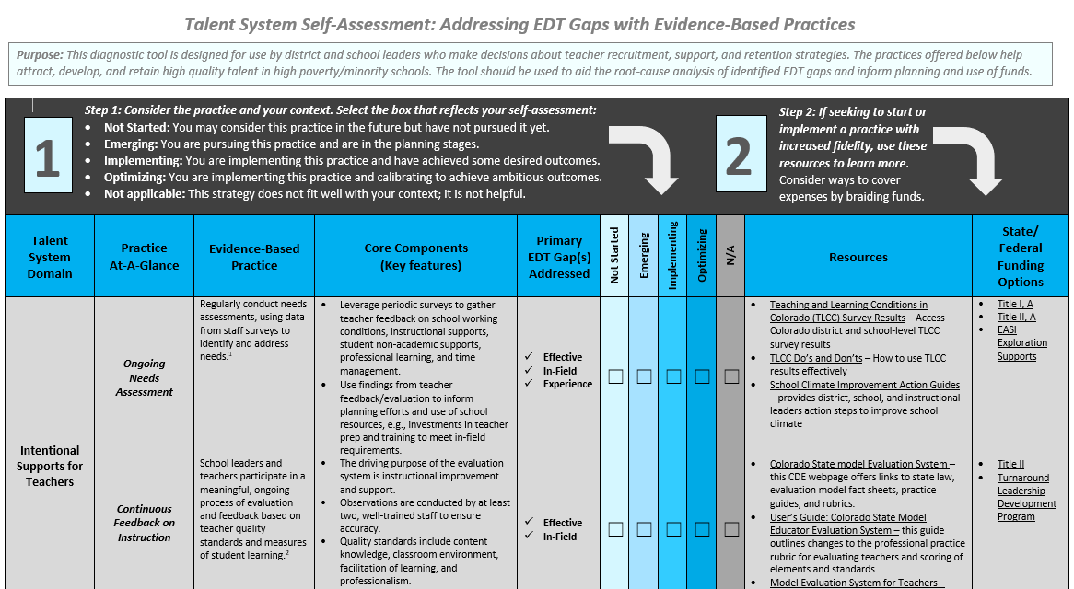
Talent System Self-Assessment
Help districts increase equitable access to quality teachers through the use of evidence-based practices – especially districts with identified gaps.
  Intentional Supports for Teachers
  Recruitment and Hiring
  Teacher Preparation and Costs to Entering the Classroom
  Compensation
  Induction for New Teachers
VERY useful tool with links to resources.
Can help with focusing efforts on high-need, high-impact areas.
Links to the Tool & Instructions

Slide 50
Questions and Parking Lot
Any unanswered questions will be collected and responded to via email.

Slide 51
Closing

Slide 52
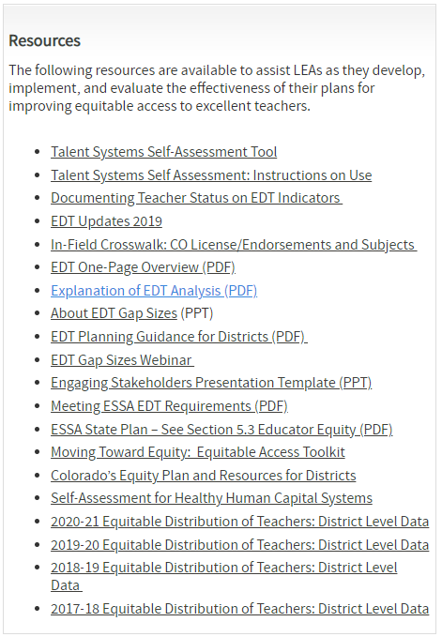
Resources
Visit the Equitable Distribution of Teachers (EDT) Webpage for more information regarding.
  Archive of Trainings
Notes:
Hopefully the example strategies we discussed have triggered some thoughts and drive some reflections of your LEA’s practices.
If you’d like to dig deeper into some next steps in analyzing and using EDT data, visit our website where you can find many tools on moving toward and sustaining an equitable distribution of your teachers.
Our archive of trainings has our tow previous trainings and is where we will post this recording and slidedeck.
Orange arrow identifies some the the resources that were linked or used in this presentation and may be a good place to start.

Slide 53

Upcoming Trainings
EDT Series Training #4: Building an EDT Plan
Date: TBD late April or early May
*more info will be in the Beeline and in Office Hours

Slide 54
Poll Question
Q: How comfortable are you with discussing possible strategies that could be used in your LEA to positively impact the equitable distribution of teachers?
1: Not Comfortable - I don’t know how we can address any gaps in EDT data.
2: Slightly Comfortable
3: Somewhat Comfortable
4: Comfortable
5: Very Comfortable - I can interpret the data, select applicable strategies, and explain them to others.

Slide 55

Survey
With the remaining time, please make sure you complete the training evaluation survey.
Your feedback is appreciated!

Slide 56
Contact Information
For questions about EDT programmatic requirements:
Niko Kaloudis
kaloudis_n@cde.state.co.us (720) 284-4356
For questions about EDT data calculations:
Tina Negley
negley_t@cde.state.co.us (303) 866-5243
If reviewing this slide deck after the live presentation, feel free to contact the above staff, visit our unit Contacts Page, or send questions to ESSAquestions@cde.state.co.us
Notes:
Thank people for participating

