Slide 1
Building an EDT Plan
Training #4 in the EDT Series
Notes:
RUNTIME:
Niko leads speaking

Slide 2
Upcoming Training
Equitable Distribution of Teachers Series Training #4: Building an EDT Plan
This training helps LEAs build an EDT plan that addresses gaps and adequately answers the EDT question of the Consolidated Application.
Target Audience: LEAs with medium or large EDT gaps (district leadership, HR, hiring managers, principals); LEAs with small gaps also welcome.
Prep: LEAs will need access to their 20-21 EDT data from Syncplicity. Recommended to watch the recording of at least training #3 of the EDT Training Series and come to the training with some possible strategies to address gaps ready.
Date: Tuesday, May 31, 2022
Time: 10am-12pm
Register HERE
Agenda
Small vs Med/Large Gaps
Alternative Calculator Assurance
Walkthrough of the EDT Plan Narrative Question
EDT Monitoring Indicators
Contact Wilson_S@cde.state.co.us for any logistics questions or Kaloudis_N@cde.state.co.us with questions about the training.

Slide 3
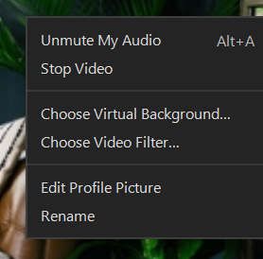
Introductions
Niko Kaloudis - ESEA Title I & II Specialist
Tina Negley - DARE Coordinator
Please change your name to your preferred name by right clicking your image. Consider including your LEA and any preferred pronouns.
Notes:
Would love if everyone on this list could come on camera and introduce themselves.
We have experts from several CDE teams that can support you in the EDT work we are discussing today.

Slide 4
Prework
To get the most out of this training, you may:
Need to refer to knowledge reviewed in the previous three EDT Series trainings
  Recordings found on the EDT website.
Need access to your LEA’s 20-21 EDT Data file (from Syncplicity).
  Use the chat feature if you don’t have access to your LEA’s Syncplicity folder.
  Excel file found in Syncplicity.
  Access comes from an email from Syncplicity itself (check junk/spam)
Optionally,
A list of strategies the LEA will leverage to address EDT gaps (See EDT Training #3 for ideas).
Access to local HR data pertaining to the experience, in-field status, and effectiveness of employees in 20-21 and 21-22.
Notes:
This is training # 4 of 4.
[“optionally”] I highly recommend watching training 3 to help give you ideas for strategies that you can include in your EDT Plan.
[end] Other data may be useful in seeing the full picture of your EDT data. Historical data can help identify if a problem is persisting or lessening. Local data can ensure accuracy in reporting as well. Putting faces to the data is also beneficial.

Slide 5

Agenda
Training Norms
Grounding the Work
Review EDT & Gap Sizes
Alternative Calculator Assurance
Walkthrough of the EDT Plan Narrative Question
EDT Monitoring Indicators
Next Steps

Slide 6

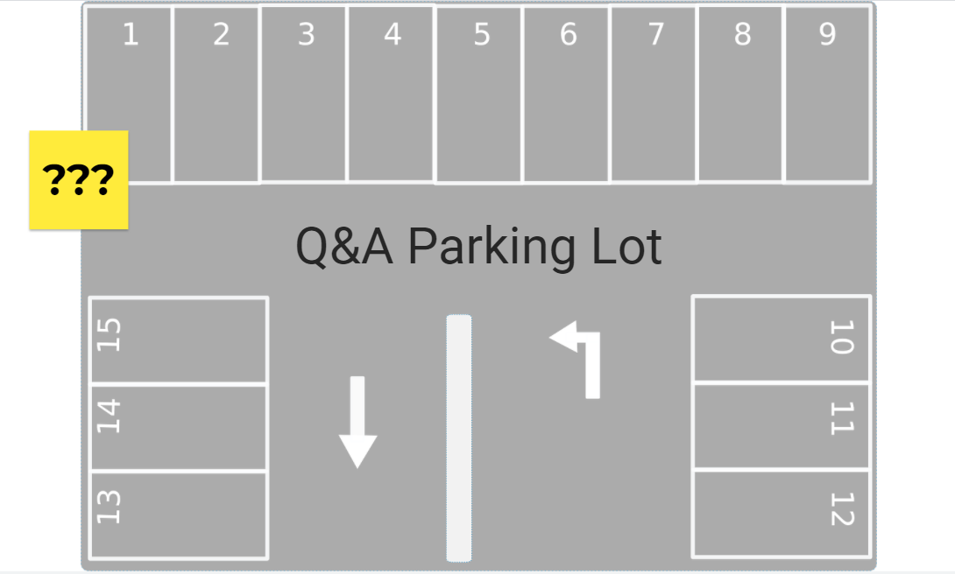
Training Norms
Participate fully.
Lean into discomfort; have a growth mindset.
Share the space with others in breakout rooms; invite people into the conversation.
Come on camera when speaking in large group and when in breakouts (whenever possible).
Enter questions into the chat at any time or come off mute during question pauses.
Use the Jamboard Parking Lot for one-off questions (answered later).
Notes:
[at end]
Niko screen shares for Jamboard demo
Explain jamboard and using a sticky

Slide 7

Objectives
LEA staff will be able to:
Determine if using the EDT Alternative Calculator is a viable option for the LEA.
Access and complete the EDT Alternative Calculator.
Build an EDT Plan in the Consolidated Application that meets requirements.
Prepare evidence for EDT Plan monitoring.

Slide 8

Grounding the Work
Why talk about EDT now?
Annual requirement for LEAs with Title I schools, over 1,000 students, and more than 1 school per grade span to address disparities. (ESSA)
22-23 Consolidated Application opens in mid-April and due by June 30th.
Pandemic has heavily impacted the teacher workforce; more so for minority students and students of poverty.
A strong EDT Plan can help LEAs address the impacts of COVID on their teaching force.

Slide 9
Poll Question
Q: How comfortable are you with building an EDT Plan that addresses identified EDT gaps?
1: Not Comfortable - I don’t know what needs to be in an EDT Plan.
2: Slightly Comfortable
3: Somewhat Comfortable
4: Comfortable
5: Very Comfortable - I’ve written EDT Plans to address EDT gaps before that meet monitoring requirements.
Notes:
Hopefully by the end of this training you will feel more comfortable with writing quality EDT Plans.
If you’re rating yourself 4 or 5, please add to the conversation or chat and pass some of your knowledge and ideas onto attendees that are newer to the process.

Slide 10
Review EDT and Gap Sizes

Slide 11
Overview of EDT
The Every Student Succeeds Act (ESSA) requires state education agencies (SEAs) to evaluate annually whether low-income and minority students are taught disproportionately by ineffective, out-of-field, or inexperienced teachers.
  Identify LEAs with gaps.
  LEAs with gaps must develop a plan to address the gaps.
LEAs with 1,000+ students and more than 1 school per grade span receive data.
  This includes public charter schools. (EDT & Charters Training found HERE)
For more information on EDT:
  EDT Series Training #1: Using Data to Inform Comparability & EDT
    PowerPoint | Recorded Webinar
  EDT Series Training #2: Interpreting EDT Data Workshop
    PowerPoint | Recorded Webinar
  EDT Series Training #3: Implementing Changes Using EDT Data Workshop
    PowerPoint | Recorded Webinar
Notes:
More information on the nuances with charter schools can be found in an EDT training geared specifically to charters, found on the Schools of Choice website.

Slide 12
Aligning Data Years
Data Year | 19-20 | 20-21 | 21-22 | 22-23
Planning Year | 20-21 | 21-22 | 22-23 | 23-24
EDT Plan Due Date | 6/30/21 | 6/30/22 | 6/30/23 | 6/30/24
Implementation Year (Also ConsApp Year) | 21-22 | 22-23 | 23-24 | 24-25
Example: Using 20-21 HR data that was finalized in March 2021, LEAs should spend 21-22 reviewing that data and planning with stakeholders to identify strategies to address gaps. Those plans are submitted (if med/large gaps) by June 30, 2022 to the 22-23 ConsApp and after approval, will be implemented over the course of that 22-23 school year.
Notes:
After example:
[Purple and Example - Point out where we are now in the process (using 20-21 data to plan for the 22-23 school year)]
[quickly Orange - Also point out that in 21-22 there is something to do for 3 data years.]

Slide 13
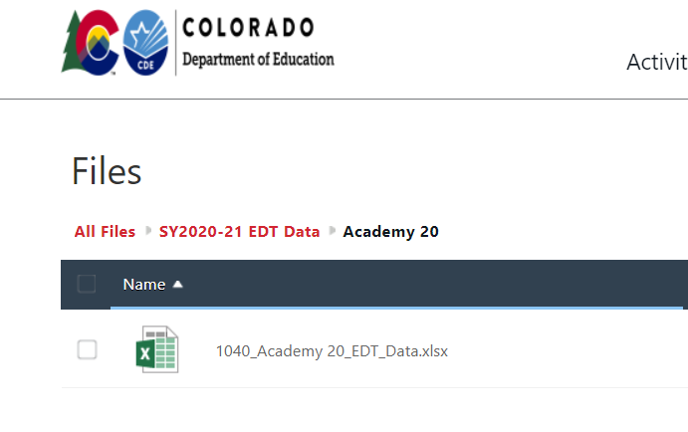

Accessing Your Data
Annual EDT files are sent out via Syncplicity to ConsApp Authorized Reps’ emails.
If you or your colleagues need access, please email kaloudis_n@cde.state.co.us.
The EDT Analysis excel data file is broken down into two tabs:
  District Level
  School Level
Notes:
Now would be a great time to pull up your EDT data file so you can follow along.
If you want to learn more about how to read the data on these tabs, watch training #2 in the series where Tina Negley describes the fields in detail.

Slide 14
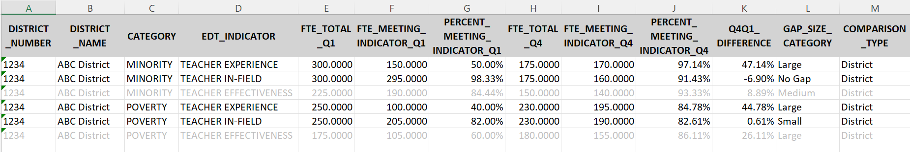
Establishing Your Baseline
No effectiveness analyses were provided on 20-21 data due to the accountability hold.
Open your 20-21 EDT Data File District tab.
  Does your district have any gaps?
  For which indicators?
  How large are the gaps?
Notes:
[Bubble at end]

Slide 15
Poll Questions
Q1: Does your district have gaps?
Q2: Which indicator(s) does your district have gaps for? (select all that apply)
Q3: What size gap(s) does your district have? (select all that apply)
Notes:
From reading your EDT District Level Data…

Slide 16
Small vs Medium/Large Gap
Gap sizes are used to identify what next steps a district needs to take.
LEAs with small gaps must:
  Develop a plan to address the gaps.
  Maintain the plan locally for monitoring.
LEAs with medium or large gaps must:
  Develop a plan to address the gaps.
  Submit the plan to CDE by answering the 5 questions in the Consolidated Application.
Notes:
[end with blue box] Today’s training will focus on the questions that LEAs with med/lg gaps must answer in the consapp but those questions can help LEAs with small gaps write their plans as well.

Slide 17
Poll Questions
Q: Districts with identified _______ gaps must create an EDT Plan to address those disparities. (select all that apply)
Q: Districts with identified _______ gaps must submit their EDT Plan to CDE through the Consolidated Application. (select all that apply)

Slide 18
Poll Questions
Q: Districts with identified _______ gaps must create an EDT Plan to address those disparities. (select all that apply)
A: Small, Medium, Large
Q: Districts with identified _______ gaps must submit their EDT Plan to CDE through the Consolidated Application. (select all that apply)
A: Medium, Large

Slide 19
Optional EDT Alternative Calculator
Notes:
[Tina Starts here]

Slide 20
Background
Statutory intent of EDT can be met through analyses conducted at many levels.
  The requirement to address identified gaps resides with the LEA, which can work with schools to develop plans.
CDE is able to calculate EDT at the school-level to create district-level aggregations.
Optionally, LEAs that have identified gaps can use local data and the EDT Alternative Calculator to demonstrate compliance at the student/teacher level if that data will demonstrate that there are no gaps.

Slide 21
Getting Started
Guidance around the calculator can be found on the EDT Website under the “Alternative Calculators for EDT Data Analyses” section.
Download the calculator and follow the directions on the Instructions tab.
  This will require a series of data extractions from your student information system, HR information system, and/or teacher evaluation system.
  Data will be copied into various tabs of the calculator.
Data quality checks will be performed on the data. Make corrections, as needed.
Run the EDT analysis and review the calculated results.
Use those results to take next steps (use flowchart on guidance website).
Reminder: Using the alternative calculator is optional!

Slide 22
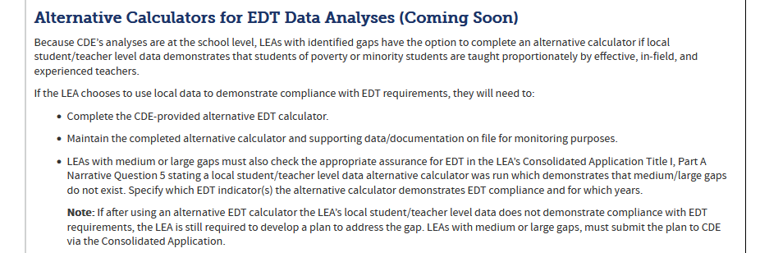
Downloading the Calculator
The calculator will be available on the EDT Website (about halfway down the page):

Slide 23
Data Needed for Calculator
Student Interchange Data
  SASID
  Grade
  Free/Reduced Meal Status
  Race/Ethnicity
Staff Interchange Data
  EDID
  Overall Performance Evaluation Rating (Effectiveness)
  Years of Prior Teaching Experience (Experience)
  Subject Area (In-Field)
  In-Field Status (In-Field)
Teacher-Student Data Link

Slide 24
Demonstration of EDT Alternative Calculator
Notes:
[Tina shares screen]

Slide 25
EDT Alternative Calculator Results
Understanding the results:
Make sure to review the results of each indicator (Effectiveness, Experience, In-Field), separately for students experiencing poverty and minority students.
  Compare these results with CDE’s analyses (results available in the “Resources” sidebar of the EDT Website or your Syncplicity folder).
If the LEA was previously identified with a medium or large gap based on CDE’s analyses, but is able to demonstrate no gap or a small gap based on local data evaluated using the EDT Alternative Calculator, the LEA can leverage the EDT Alternative Calculator Assurance in the Consolidated Application for that specific indicator.
  Any remaining medium or large gaps must be addressed in the Consolidated Application Narrative.

Slide 26
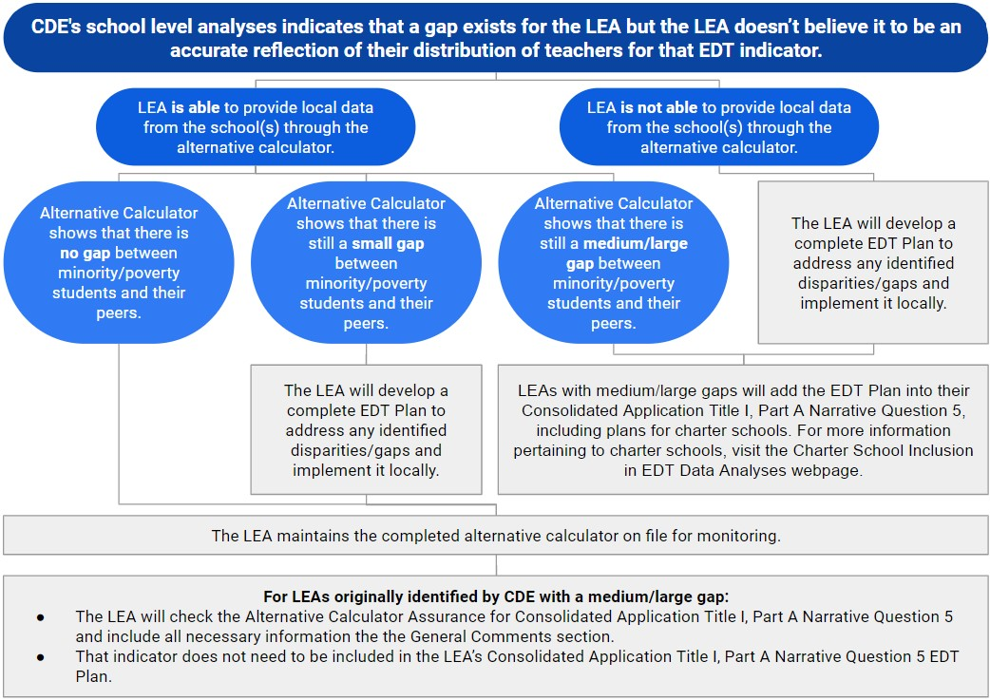
Demonstrating Compliance
View this chart in detail on our website.
Notes:
[Niko resumes]

Slide 27
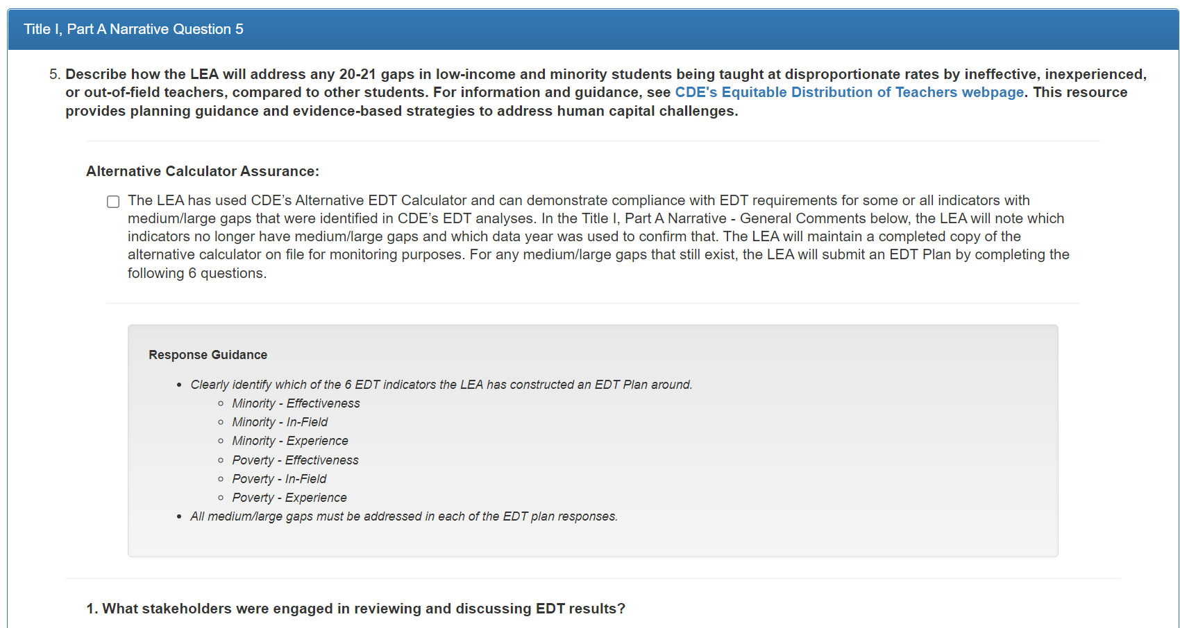
Optional EDT Alternative Calculator Assurance

Slide 28
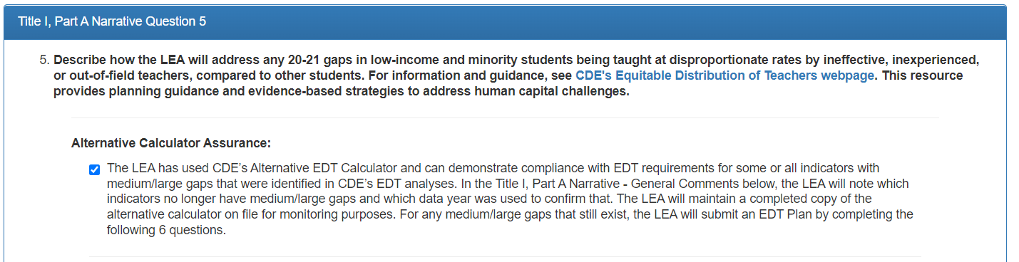
Alternative Calculator DOES Demonstrate Compliance
Select the assurance checkbox.
Add the following information in the General Comments box:
  Which identified indicator(s) were met through the Alternative Calculator data.
  The data year used in the Alternative Calculator.
Maintain a completed copy of the Alternative Calculator on file locally for monitoring purposes.

Slide 29
Alternative Calculator DOES NOT Demonstrate Compliance
Do not select the assurance checkbox.
An LEA with small gaps will create and implement an EDT Plan locally, and maintain on file for monitoring.
An LEA with medium/large gaps will develop an EDT plan, submit the plan by answering the 6 EDT questions, then implement the plan after approval.

Slide 30
EDT Planning in the Consolidated Application
Notes:
So if your LEA has been identified to have gaps and those gaps persist after running the alternative calculator, then you’ll need to build and implement an EDT plan.

Slide 31
EDT Planning
LEAs have one planning year to work with stakeholders, identify strategies, and develop an EDT Plan.
LEAs with medium/large gaps are required to submit their EDT Plan to CDE at the end of the planning year through the Consolidated Application for the implementation year.
  20-21 EDT data was used for planning in 21-22 and will be implemented in 22-23.
Plans should be reviewed annually and updated based off any changes in EDT data.
Notes:
Let’s start with what the planning process looks like.

Slide 32
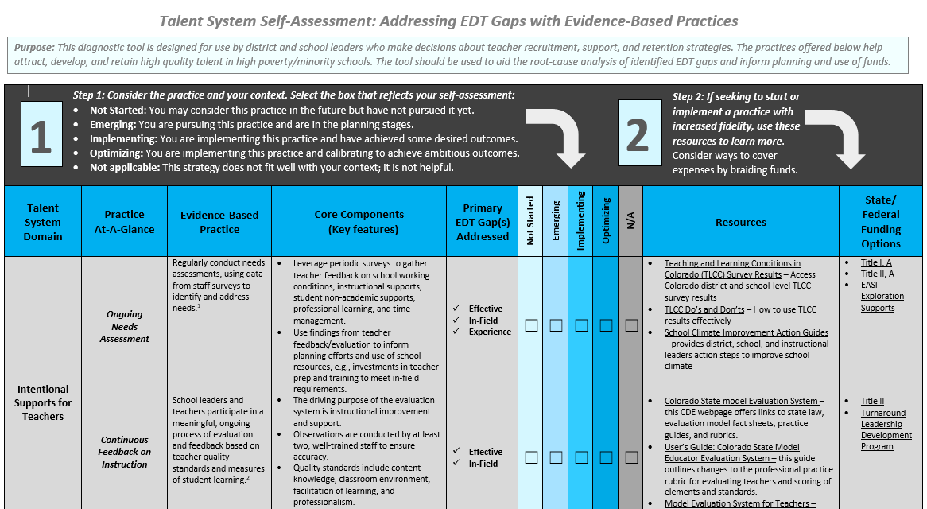
EDT Plan Resources: Talent System Self-Assessment
Help districts increase equitable access to quality teachers through the use of evidence-based practices – especially districts with identified gaps.
  Intentional Supports for Teachers
  Recruitment and Hiring
  Teacher Preparation and Costs to Entering the Classroom
  Compensation
  Induction for New Teachers
VERY useful tool with links to resources.
Can help with focusing efforts on high-need, high-impact areas.
Links to the Tool & Instructions
Notes:
When you’re trying to identify possible root causes of your EDT gaps, I highly recommend using the Talent System Self-Assessment to narrow down the areas where supports are the most needed.
[quickly review]

Slide 33
EDT Plan Resources
LEAs should leverage Title II, Part A and ESSER allocations to fund activities in their EDT Plans.
EDT Strategies List (pdf|excel)
EDT Series Training #3: Implementing Changes Using EDT Data Workshop
  PowerPoint | Recorded Webinar
Notes:
[quickly]
The Talent Self-Assessment has several evidence-based strategies that may benefit your district but there are many other steps you can take to address EDT gaps.
This slide has some tools that you could use when identifying possible strategies to address EDT gaps.
[review them]
If you haven’t already identified strategies with our stakeholders to build your EDT plan, I recommend watching the training but for now, keep open the Strategy List for reference.

Slide 34

Building Your EDT Plan in the Consolidated Application
Only LEAs with medium/large gap(s) must respond to Title I, Part A Narrative Question 5.
LEAs with small gaps can use these questions to build an EDT Plan to implement locally but are not required to submit their plans to CDE unless requested during monitoring (keep plans on file).
Title I, Part A Narrative Question 5 is broken down into 6 sections:
  5.1 Stakeholder Engagement
  5.2 Root Causes
  5.3 Key Strategies
  5.4 Goal(s)
  5.5 Timeline
  5.6 Funding Source(s)
Notes:
So now that we’ve reviewed the planning resources available, let’s start working on building responses to the EDT Plan questions in the ConsApp.
[review bullets]
Feel free to open up your 22-23 Consolidated Application and follow along as we discuss each of the sections.
If you’ve selected strategies with your stakeholders to implement this coming year, you’ll want to have those ideas accessible.

Slide 35
Response Guidance
Clearly identify which of the 6 EDT indicators the LEA has constructed an EDT Plan around.
  Minority - Effectiveness
  Minority - In-Field
  Minority - Experience
  Poverty - Effectiveness
  Poverty - In-Field
  Poverty - Experience
All medium/large gaps must be addressed in each of the EDT plan responses.
Small gaps do not need to be included in the EDT Plan you submit in the ConsApp. Please keep plans for small gaps on file to submit during monitoring.
Notes:
Pulled directly from the application.

Slide 36
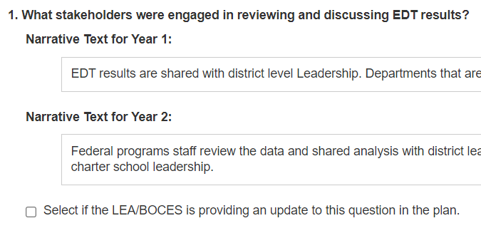
5.1 Stakeholder Engagement
What stakeholders were engaged in reviewing and discussing EDT results?
Response must include at least 3 stakeholder groups involved from the following:
  teachers, principals, instructional leaders, principal supervisors, instructional coaches, district administration, federal program coordinators, human resource staff, parents.
Copies of previous narrative responses may be in your application.
Check the box below the response to add or update a response.
Notes:
Bold is the question itself, bullets are the review checks that reviewers use to determine if the response meets compliance.

Slide 37
Sample Response
What stakeholders were engaged in reviewing and discussing EDT results?
After discussing the data at district leadership team meetings (principals, district-level administrators, and HR director), District ABC presented and discussed EDT data with parents, community members, and teachers at our September DAC meeting. They then identified strategies to address our medium EDT gap in Poverty - In-Field and our large gap in Poverty - Experience. Teachers and principals at schools with low % effective, in-field, and/or experienced measures also met with district leaders to engage in identifying strategies to address EDT gaps.
Notes:
Green highlights indicate crucial information that makes this a compliant response.

Slide 38
5.2 Root Causes
What root cause(s) of EDT disparities were identified?
Response must:
Identify root causes.
Describe how root causes
  were informed by stakeholder engagement.
  grounded in local evidence (e.g., TLCC survey data, turnover rates, evaluation data, other CNA data) or a strong rationale based on local evidence.

Slide 39
Sample Responses
What root cause(s) of EDT disparities were identified?
Through our needs assessment, we noted that District ABC’s medium EDT gap in Poverty - In-Field is being caused by systemic hiring issues. Hiring managers were unclear of the various ways to prove in-field status at some schools. Our HR forms also make it difficult to accurately collect data on the qualifications of applicants and hired staff.
Our large gap in Poverty - Experience can be largely attributed to many of our more experienced staff teaching more than 5 years leaving the district to work in neighboring districts that pay more for their experience as their career progresses. Additionally, at our Title I schools, most of the applicants in the past 3 years have been early career educators.
Notes:
Note that a response is included for both of this LEA’s gaps.

Slide 40

Turn & Talk (5 min)
Brainstorm key points that you will consider including in your responses to 5.1 and 5.2. Consider discussing your previous responses to these questions or what you may include for the coming year’s EDT Plan.
1 minute - Intros (include LEA and setting)
1 minute - Person #1
1 minute - Person #2
1 minute - Person #3
1 minute - Prepare to share out.
Please turn your camera on when in small groups.
Notes:
The hope is that during these turn and talks you can begin to formulate your narrative responses, run your thinking by colleagues, and get ideas from them as well.
[highlight stakeholder groups and root causes during this brainstorming]

Slide 41
5.3 Key Strategies
Describe key strategies the district will implement to address Equitable Distribution of Teachers disparities.
Strategies described must:
Address identified EDT gaps.
Address identified root causes of gaps.
Be informed by evidence, where possible.

Slide 42
Sample Responses
Describe key strategies the district will implement to address Equitable Distribution of Teachers disparities.
To address District ABC’s medium EDT gap in Poverty - In-Field we will adapt our application and hiring process to include clear language aligned to the 4 ways an applicant can be deemed “in-field” and create clear HR hiring paperwork for principals to increase our data accuracy. We will also more accurately track in-field status and support staff towards becoming “in-field” by offering to pay for additional college credits or PRAXIS exams.
To address our large gap in Poverty - Experience, our school board is increasing the annual step rate for our staff after reaching 5 years of experience. We will also be incentivizing our experienced teachers to transfer to our Title I schools by offering an annual incentive stipend of $3,000 to teach at our highest poverty Title I school in District ABC.

Slide 43
5.4 Goal(s)
Identify the goal(s) for addressing the EDT disparities.
Goals must be clearly defined and measurable.

Slide 44
Sample Response
Identify the goal(s) for addressing the EDT disparities.
District ABC‘s goal around Poverty - In-Field is to review the in-field status of all our our staff by October 202x to ensure 100% accuracy. We will then have plans built for at least 30% of out-of-field teachers that outline how the district will support them in becoming “in-field” by December 202x.
The district’s goal around Poverty - Experience is to retain 80% of our staff with 5+ years of teaching experience by the start of next school year. We are also aiming to have 1 teacher from each non-Title I school transfer into a vacant position at one of our highest poverty Title I schools each year until gaps no longer exist.

Slide 45
Turn & Talk (8 min)
Brainstorm key points that you will consider including in your responses to 5.3 and 5.4. Consider discussing your previous responses to these questions or what you may include for the coming year’s EDT Plan.
1 minute - Intros (include LEA and setting)
2 minutes - Person #1
2 minutes - Person #2
2 minutes - Person #3
1 minute - Prepare to share out.
Please turn your camera on when in small groups.
Notes:
[highlight strategies and goals]

Slide 46
5.5 Timeline
What is the timeline for implementing the strategies described?
Timeline must be clearly defined and, at minimum, outline initiatives for the upcoming school year.
Notes:
When setting your timeline, consider that most EDT data for the state comes from Student October and Staff Interchange HR reporting. These happen in the middle of the year.

Slide 47
Sample Response
What is the timeline for implementing the strategies described?
We will implement the strategies noted above in the coming 2x-2x school year, monitoring our progress towards reaching our goals in September, January, and May.

Slide 48
5.6 Funding Source(s)
Select the funding source(s) used to support these activities.
Title I, Part A; Title I, Part D; Title II, Part A; Title III, Part A; Title IV, Part A; Title V, Part B; State/Local Funds
At least one Title Program funding source is identified. If not, an explanation is provided.
  Reviewers will check that the budgets for any selected Title funds include activities described in the EDT Plan.

Slide 49
EDT Monitoring Indicators
Notes:
[Niko still]

Slide 50
Preparing for Monitoring
CDE’s vision for monitoring:
  Build awareness of the requirements associated with accepting federal funds.
  Build capacity to self-assess against the requirements of the grants.
  Enhance understanding of how to utilize grant funding to improve services for students.
Criteria for demonstrating compliance for the Equitable Distribution of Teachers:
  ID 1.8 Equitable Access to Effective, In-Field, and Experienced Teachers (EDT)
Notes:
[at end] The ESEA and ESSER program requirements have been divided into four main categories. The EDT indicator is within the Identification and Delivery category. The following slides will provide a review of the components of the indicator.

Slide 51
ID 1.8 Statutory Language
ESEA SEC. 1112. [20 U.S.C. 6312] LOCAL EDUCATIONAL AGENCY PLANS.
(b) PLAN PROVISIONS.—To ensure that all children receive a high-quality education, and to close the achievement gap between children meeting the challenging State academic standards and those children who are not meeting such standards, each local educational agency plan shall describe—
(2) how the local educational agency will identify and address, as required under State plans as described in section 1111(g)(1)(B), any disparities that result in low-income students and minority students being taught at higher rates than other students by ineffective, inexperienced, or out-of-field teachers;
Notes:
{don’t read, just note as this is statute that the indicator is based off of.]

Slide 52
ID 1.8 Demonstration of Compliance
If any disparities have been identified by the State, the LEA has a plan for addressing the disparity or the LEA can demonstrate that there are no gaps using an alternative calculator.
Strategies in plan are aligned to identified disparity.
Notes:
The DOCs are meant to be yes/no. An LEA must meet both DOCs through supporting evidence to be compliant.

Slide 53
ID 1.8 Examples of Evidence
Plan for addressing the disparity aligned to reasons for identification
  Professional development related to teacher effectiveness or in-field status
  Strategies related to the recruitment, retention, and professional growth of teachers
  Job fair materials
Alternative calculator(s) with student/teacher level data showing the equitable distribution of teachers for appropriate EDT indicator(s)
Local EDT analyses completed by the LEA
Hiring and staffing plans for upcoming years to address the equitable distribution of teachers across the district
Scheduled courses and assessments to support increasing the number of in-field staff
Notes:
We check compliance when an LEA is monitored. LEAs must submit evidence that demonstrates compliance to syncplicity during their monitoring year. CDE staff review the evidence during that process and request further documentation if needed.
Things you’ll want to consider collecting and maintaining locally to be prepared to meet this monitoring indicator are:... [bullets]

Slide 54
Monitoring Resources
Federal Programs Monitoring
ESEA & ESSER Monitoring Schedule
Monitoring Training Center
For questions regarding Monitoring, contact:
Tammy Giessinger
Federal Programs Monitoring Lead
(c)720-827-5291
giessinger_t@cde.state.co.us

Slide 55
Next Steps

Slide 56
Next Steps
Reflect on internal systems/procedures for annually reviewing EDT data, implementing strategies, and writing an EDT Plan.
Consider if your LEA may benefit from using the EDT Alternative Calculator.
Draft the LEA’s EDT Plan and have conversations with key stakeholder groups (superintendent/leadership, school board, DAC, union, etc.) about conclusions that can be drawn from the data and what strategies will be implemented.
  EDT Stakeholder PPT Template
Work with ESEA Team and your Regional Contact to build EDT Plan & narrative responses.
Med/Lg Gaps - Enter plan into ConsApp by June 30th.

Slide 57
Questions and Parking Lot
Any unanswered questions will be collected and responded to via email.

Slide 58
Closing

Slide 59
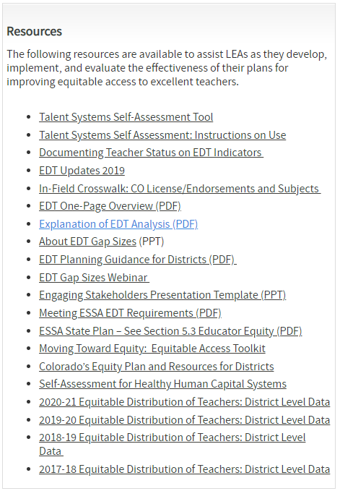
Resources
Visit the Equitable Distribution of Teachers (EDT) Webpage for more information regarding.
  Archive of Trainings
Notes:
Hopefully the example strategies we discussed have triggered some thoughts and drive some reflections of your LEA’s practices.
If you’d like to dig deeper into some next steps in analyzing and using EDT data, visit our website where you can find many tools on moving toward and sustaining an equitable distribution of your teachers.
Our archive of trainings has our previous trainings and is where we will post this recording and slidedeck.
Orange arrows identify some the the resources that were linked or used in this presentation and may be a good place to start.

Slide 60
Poll Question
Q: How comfortable are you with building an EDT Plan that addresses identified EDT gaps?
1: Not Comfortable - I don’t know what needs to be in an EDT Plan.
2: Slightly Comfortable
3: Somewhat Comfortable
4: Comfortable
5: Very Comfortable - I can write an EDT Plan to address EDT gaps that meet monitoring requirements.
Notes:
[After poll] I really encourage those of you that are self rating 1 and 2 to reach out to Tina Negley and I about your EDT data and to help you build your EDT Plan.

Slide 61

Survey
With the remaining time, please make sure you complete the training evaluation survey.
Your feedback is appreciated!

Slide 62
Contact Information
For questions about EDT programmatic requirements:
Niko Kaloudis
kaloudis_n@cde.state.co.us (720) 284-4356
For questions about EDT data calculations:
Tina Negley
negley_t@cde.state.co.us (303) 866-5243
If reviewing this slide deck after the live presentation, feel free to contact the above staff, visit our unit Contacts Page, or send questions to ESSAquestions@cde.state.co.us
Notes:
Thank people for participating.

