Slide 1
Comprehensive Support Plans
for Schools Identified for Low Graduation Rates
Federal Programs and Support Unit in Partnership with the School Improvement & Planning Team

Slide 2
The Who,What, Where, and Why (for this session)
Any school currently identified as comprehensive support and improvement must submit to both their district and the SEA an approvable plan
A plan that meets the statutory required elements to help LEAs ensure they are working towards rectifying the reasons for identification
In Colorado, the UIP can serve as the CS Improvement Plan and requires review and approval by the school, district, and CDE. CDE periodically reviews UIPs from CS schools to ensure they meet ESSA requirements.
  Schools that have been identified for Targeted Support and Improvement must also develop a plan that addresses the reasons for identification, which must be reviewed and approved by the school and district. CDE does not approve these plans; however, they are reviewed during monitoring. Most schools, identified as TS, utilize the UIP and add in the needed information to meet the ESSA requirements. However, you do not have to use this format, any plan that contains the required elements will suffice.
We will address the reasons for and the procedures of identification and how schools are exited.
The remainder of the time will be devoted to outlining the ESSA requirements that must be met in order for CDE to approve an improvement plan from a school identified for comprehensive support and improvement

Slide 3
ESSA Identification

Slide 4
Background
Every state that accepts funds under the Every Student Succeeds Act (ESSA) must have an approved methodology for meaningfully differentiating the performance of and identifying schools for support and improvement.
  Due to the COVID-19 pandemic, Colorado was approved to amend its State plan to account for short-term changes in the 2022-2023 school year (http://www.cde.state.co.us/fedprograms/essa).

Slide 5
Identification of Schools
Annual identification of schools for Support and Improvement under ESSA
Comprehensive Support and Improvement (CS)
  CS - Lowest 5%
  CS - Low Graduation Rate
  CS - Former ATS (first year of identification will be Fall 2022)
Targeted Support and Improvement (TS)
  TS - based on disaggregated group(s)
  Additional Targeted Support (ATS) - based on disaggregated group(s) that on their own meet the criteria for Lowest 5%
Possible to be identified due to participation only

Slide 6
Identification of Schools, cont.
Annual identification of schools for Support and Improvement under ESSA
You are participating in this meeting because your school or a school in your district has been identified as qualifying as Comprehensive support and Improvement for low graduation rates.

Slide 7
Overview of ESSA Indicators
K-2 School Identification
  Academic Achievement
    English Language Arts
      READ Act Percent with a Significant Reading Deficiency (SRD)
  Academic Progress
    English Language Arts
      Change in SRD
    English Language Proficiency
      Median Growth Percentile
      On-track to attain fluency
Academic Achievement
  English Language Arts
    CMAS (grades 3-8) and SAT (grade 11) mean scale scores (MSS)
  Math
    CMAS (grades 3-8) and SAT (grade 11) mean scale scores (MSS)
Academic Progress
  English Language Arts
    CMAS and SAT median growth percentiles (MGP)
  Math
    CMAS and SAT median growth percentiles (MGP)
Progress in Achieving English Language Proficiency
  Median growth percentiles
  On-track to attain fluency
School Quality or Student Success (SQSS)
  CMAS science (grades 5, 8, and 11) mean scale scores
  Reduction in chronic absenteeism (Elementary/Middle; beginning Fall 2022)
  Dropout rates (High)
Graduation Rates
  Four-year graduation rate
  Seven-year graduation rate
Alternative Education Campuses (AEC)
  When necessary, the following indicators are also used to differentiate among lowest performing AECs, in addition to other indicators (listed to left)
    Attendance rate
    Truancy rate

Slide 8
ESSA Student Groups
All students
English learners
Students with disabilities
Students experiencing poverty
Students from each racial/ethnic group, separately
  Aggregated Non-White group - Any non-White students from racial/ethnic groups that do not meet the minimum number of students to be reported on their own will be combined into one group for accountability purposes

Slide 9
Comprehensive Support and Improvement - Low Graduation Rate
Colorado identifies all public schools with 4-year and 7-year graduation rates below 67 percent for three consecutive years for CS - Low Graduation Rate
  If a school has both a 4-year and 7-year graduation rate, both must be below 67%

Slide 10
Additional Information
For more information, please visit Colorado’s ESSA Methods and Criteria for Identification of Schools for Support and Improvement Webpage (http://www.cde.state.co.us/fedprograms/essa_csi_tsi)
For additional information regarding the methodology, criteria, or data used to identify schools for support and improvement under ESSA, please contact:
Tina Negley
Supervisor, Program Effectiveness Office
720-766-2793
negley_t@cde.state.co.us
Mary Shen
ESEA Research Analyst
303-866-4571
Shen_M@cde.state.co.us

Slide 11
Planning Requirements

Slide 12
Improvement Planning Requirements for ESSA Identified Schools
CS plans must:
Be developed by the LEA in partnership with stakeholders, including the principal, other school leaders, teacher and parents of the school.
Be informed by student performance on accountability indicators. In Colorado, this currently refers to performance indicators on the School Performance Frameworks (i.e., English language arts and math achievement and growth, science achievement, and postsecondary workforce readiness).
Include evidence-based interventions.
Be based on a school-level needs assessment.
Address resource inequities.
Be approved by the school, LEA, and CDE.
CS Plan Submission and Approval Process and Monitoring:
CS plans should be documented within the school’s Unified Improvement Plan (UIP) and submitted through the Online UIP System.
The timeline for CS plan submission follows the typical UIP submission process.
CDE will use the ESSA CS plan requirements embedded within the Quality Criteria to approve plans.
Once plans are approved, CDE is required to monitor implementation of and periodically review CS plans.
Once identified, schools will remain CS for three years.
Schools may exit this category after the third year, if they no longer meet the identification criteria for the year in which the school was identified and they not re-identified in the fourth year.
CDE has been and will continue to work with stakeholders to determine what actions will be necessary for any schools that do not meet the exit criteria.

Slide 13
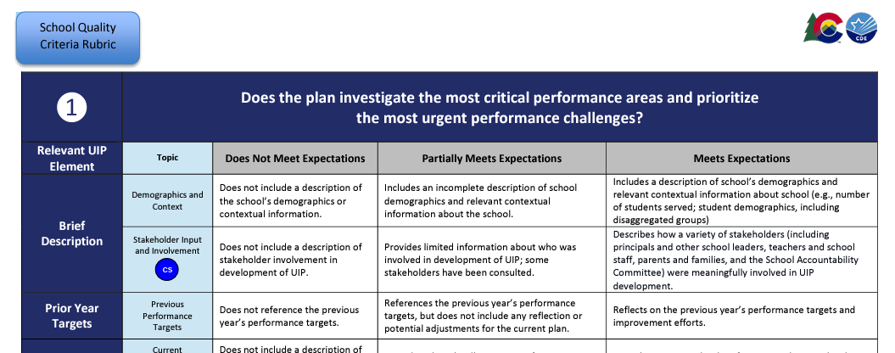
Where are requirements described?
https://www.cde.state.co.us/uip/school_qcrubric

Slide 14
Unified Improvement Planning - Typical Cycle
January- March
April-June
July-September
October-December
ACCESS Testing
State Assessment Window
State Assessment Initial Data Release
State Growth Data and Frameworks Released
Graduation Data Release
ESSA Identifications Released
Accountability and Assessment
MOY READ Assessment
EOY READ Assessment
October Count
SBE/Accountability Clock Hearings
BOY READ Assessment
Request to Reconsider
Improvement Plan Implementation
January - June
September - December
Implement UIP and Adjust Based on IB, Interim Measures
Implement UIP and Adjust Based on IB, Interim Measures
April
July/August
Current Year data analysis, adjust PPCs and targets
Adjust Data Analysis based on State Data
Submit UIP by October 17th
UIP Process
May
March
Solidify current year data analysis, PPCs, Root Causes, MIS
August/September
Reflect on current year, recent local data. Highlight potential Priority Performance Challenges
June
Confirm draft plan with rating and identification release, share with stakeholders. Build detailed action plan.
Draft Implementation Benchmarks and Interim Measures
March
May
June- August
September-December
Related School Leadership Moves
Refine budget and hiring vision to support improvement efforts
Make purchases related to improvement efforts (e.g. curriculum)
Plan teacher induction, including improvement efforts
Closely monitor implementation and keep stakeholders informed
Stakeholder Engagement
Progress Monitoring
Input on initial data, PPCs and targets
Input on Root Causes and MIS
Input on Finalized UIP
Progress Monitoring
Progress Monitoring
Notes:
Erin

Slide 15
Stakeholders and Planning
Section 1

Slide 16
Reason for Identification
The school acknowledges the reason for Identification, what led to the identification, and how the reason was communicated to your stakeholders and given an opportunity to provide input.
Lowest 5 % K-2 Title I Schools
  Is determined to be in the lowest-performing five percent of all schools, based on the state’s accountability system
Lowest 5% Title I Schools
  Is determined to be in the lowest-performing five percent of all schools, based on the state’s accountability system
Low Participation
  Less than 95% of qualifying students participate in state assessments
Low Graduation Rate
  A high school with a graduate rate of 67% or less
Chronically Low Performing Student Group [formerly ATS]
  Former ATS schools that have been identified for the same student group for four years
  Initiating 22-23 School Year

Slide 17
Reason for identification
This could look like :
We were identified for low graduation rate in 2021/2022 year. The key factor/s that led to this identification were graduation rate of 27% as compared to the state average 81%. It is also below the cut off of 67%. We communicated this information to our stakeholders by sending letters home with our students and communicating the reasons for our identification with our SAC.
We were identified for ________ in ______year. The key factor/s that led to this identification were __________ as compared to the state average/requirement of ________. We communicated this information to our stakeholders by______________________. Stakeholders were given opportunity to provide input through ______________.

Slide 18
Stakeholder Identification
Stakeholder groups that must be involved are:
Principals and other school leaders
Teachers
Parents and families
Other groups that are best practice but not required to add are:
Non-teaching staff
Community partners
Students
Plans must be approved by District Partners before submission to CDE. This is acknowledged through the submission process.

Slide 19
Stakeholder Identification, cont.
This could look like:
We strive to include our full school community but ensure we have representation of Principals and other school leaders, Teachers, and Parents. We will refer to this group as our SAC.
Another Example from a current school plan:
The Leadership Team consisted of the following positions within the building:
•Administrative Team (Principal, Assistant Principal)
•Instructional Coach
•Learning Specialist
•Classified Staff
•Parents
•Specialist
•One Teacher per Grade Level
•Gifted and Talented Coordinator

Slide 20
Stakeholder Involvement Throughout
Meaningful involvement throughout the process
  Review performance on ESSA indicators, including reason(s) for ESSA identification (See slide 21)
  Give input on strategies or interventions to be used in meeting identified needs related to CS-identification
  Continuing involvement

Slide 21
Stakeholder Involvement Throughout, cont.
This could look like:
Additionally, our SAC is involved in our review of the ESSA indicators especially the indicators that are related to our CS identification for low graduation rate. They provide input about our major improvement strategies and evidence based interventions during our school kick-off gathering. In addition, we have put a scheduled review of the CS plan during _______3.5.
Additionally, our ____________ is involved in our review of the ESSA indicators especially the indicators that are related to our identification. They gave input about our _________________ during ____________. In addition, we have put a scheduled review of the CS plan during __________meeting ________ times a year.

Slide 22
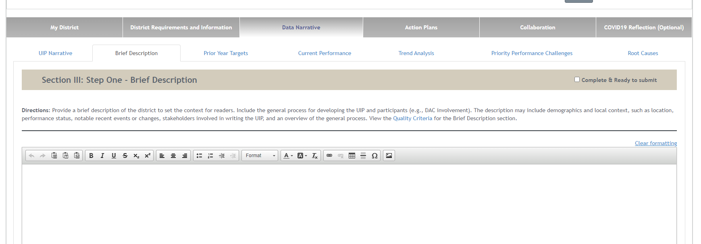
Where to Enter in the UIP-Brief Description Tab

Slide 23
Data Narrative
Section 2

Slide 24
Current Performance
Includes an explanation of the school’s current performance on each ESSA indicator within the school-level needs assessment based on the school’s ESSA identification
Each identification type has specific indicators that must be addressed (slide 25)
  If data on an indicator is unavailable then please provide an explanation as to why
Broken down by the major demographic groups (slide 26)
  If there is a group whose N group is too small for public reporting then please state that reason. Examples:
    Hispanic and two or more races groups numbers are too small to report CMAS math scores, OR
    Our district does not currently have any students in the Hawaiian or other Pacific Islander subgroups
    Our school does not have student counts or reportable numbers for the other disaggregated groups of students
  Data can be represented in a variety of ways such as narrative form or within a table.

Slide 25
Required Student Performance Data Based on Identification
CS Lowest 5%; K-2 School Only | CS Lowest 5%; Elementary and Middle Schools | CS Lowest 5%; High Schools | CS Low Graduation | CS Lowest 5%; Participation Only
Academic Achievement English Language Arts READ Act Percent with a Significant Reading Deficiency (SRD) Academic Progress English Language Arts Change in SRD English Language Proficiency Median Growth Percentile On-track to attain fluency | Academic achievement on English language arts and math Academic growth on English language arts and math English language proficiency for English learners School quality and student success indicator Science achievement Chronic absenteeism for elementary and middle schools | Academic achievement on English language arts and math Academic growth on English language arts and math English language proficiency for English learners Graduation rates for high schools School quality and student success indicator Science Achievement Dropout rate for high schools | Graduation rates for high schools | Participation rates for state assessments in English language arts and math

Slide 26
Major Demographic Groups
            All students
            English learners
            Economically disadvantaged students (FRL)
            Students with disabilities
            Students from major race and ethnic groups
              American Indian or Alaskan Native
              Asian
              Black or African American
              Hispanic or Latino
              White
              Native Hawaiian or Other Pacific Islander
              Two or More Races
              Aggregated Non-White

Slide 27
Priority Performance Challenge/s
Uses performance on all ESSA indicators to select at least one priority performance challenge that is clearly and explicitly contributed to the reason for identification under ESSA
You can see a list of priority challenges in the UIP handbook
This could look like:
One of our areas of highest need is retention of students.
Rationale:
Our priority challenge that addresses this need is to increase our CTE pathway choices . This is necessary to ensure that the curriculum is relevant to students’ interests and provides them with a firm connection between the classroom and their futures. Increased retention will lead to improved graduation rates.
Our priority challenge that addresses this need is _________________________________. This is necessary to ______________________. _________________(How this connects to your ESSA identification )

Slide 28
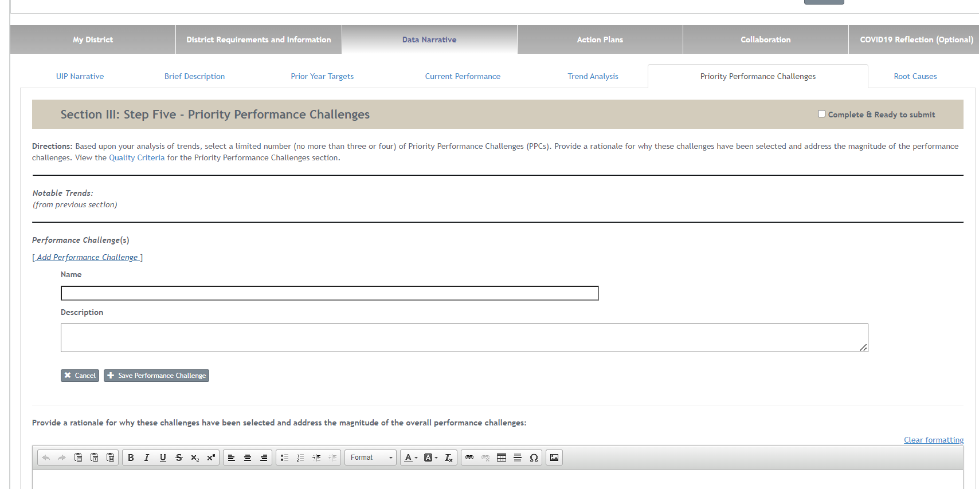
Where to Enter in the UIP

Slide 29
Major Improvement Strategies
Section 3

Slide 30
Major Improvement Strategies (MIS)
    At least one MIS must fulfill the following criteria. It is recommended that this is done with each MIS, but this is not required.
Includes at Includes at least one intervention and/or strategy that is clearly and explicitly aligned with the reason for ESSA identification.
Includes an evidence-based intervention (EBI). Provides a short description of what has been found in research regarding the success of the selected intervention and/or strategy as aligned to the school’s identification.
Describes the contextual fit for the implementation of the selected intervention and/or strategy aligned to the reason for identification
Notes:
Kathryn

Slide 31
Major Improvement Strategies Example
Based on our ESSA identification of Low Graduation Rate, our chosen priority improvement challenge it to increase our CTE pathway choices . Our major improvement strategy we have chosen that addresses this need is Increasing the CTE pathways that are available for our students including accessing those provided by local community colleges. This intervention has been shown to be effective in improving student outcomes including graduation rates within the research that can be found here: https://cepa.uconn.edu/wp-content/uploads/sites/399/2018/05/Career-and-Technical-Education-Current-Trends-and-Results.pdf. This strategy was chosen for this challenge because we struggle keeping students engaged in classes, many choose to work or need to work due to family dynamics. By offering classes that provide students with employable skills and a firm connection to their after school goals, the hope is more students will continue to pursue education.
Based on our ESSA identification of ________, our chosen priority improvement challenge is _________. Our major improvement strategy we have chosen that addresses this need is _________________________________. _____________________________(Program name) _____________________________( what it provides) . This intervention has been shown to be effective in improving /mitigating ____________________ by research that can be found here_______________________. This strategy was chosen for this challenge because _____________________________.

Slide 32
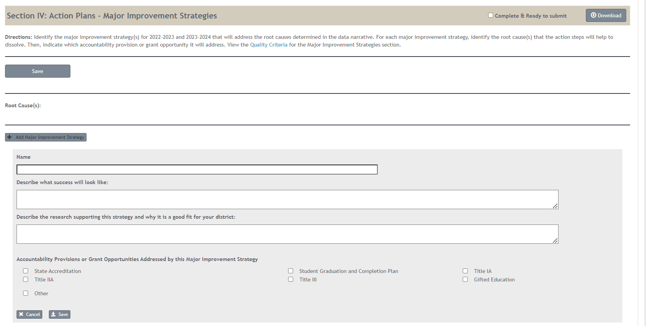
Where to Enter in the UIP
EBI screenshot

Slide 33
Monitoring and Action Steps
Section 4

Slide 34
Monitoring - Implementation Benchmarks
Shares a monitoring plan for tracking implementation and for determining if the selected intervention and/or strategy aligned to the reason for ESSA identification and is being implemented with fidelity.
We will monitor the implementation _____________ in our _________________.
We will monitor the implementation monthly in our PLC meetings.

Slide 35
Evaluation- Action Steps
Provides an evaluation plan for assessing the impact of the selected intervention and/or strategy. Includes a timeline and methods for determining if the school’s performance has increased on the ESSA indicator(s) that resulted in the school’s identification.
This may look like:
We will assess the impact of the intervention at our monthly meeting where we will look at student data to assess if the scores are reflecting student retainment. Additionally, we will assess if any specific classes are more popular than others and if there are holes in our offerings that would increase student engagement.
We will assess the impact of the intervention at our __________ meeting we will look ______________(what you will look at to see if the intervention is effective).

Slide 36
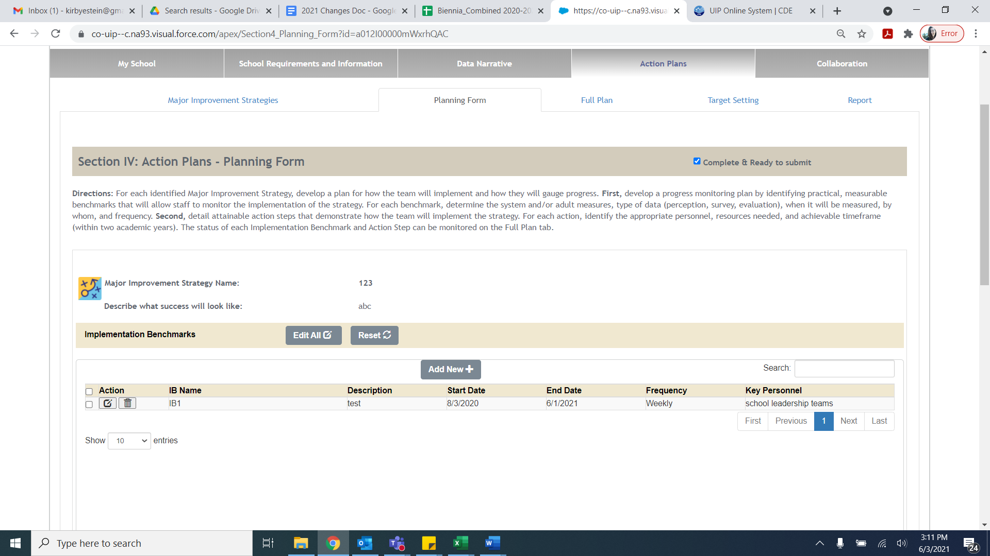
Where in the UIP – Planning Form

Slide 37
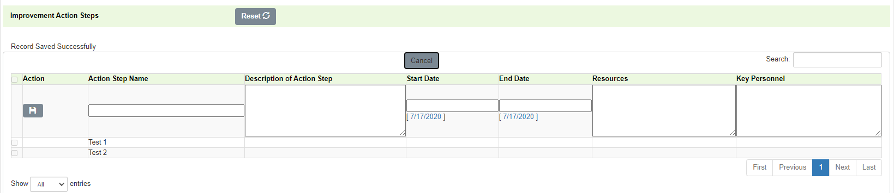
Where in the UIP – Improvement Action Steps

Slide 38
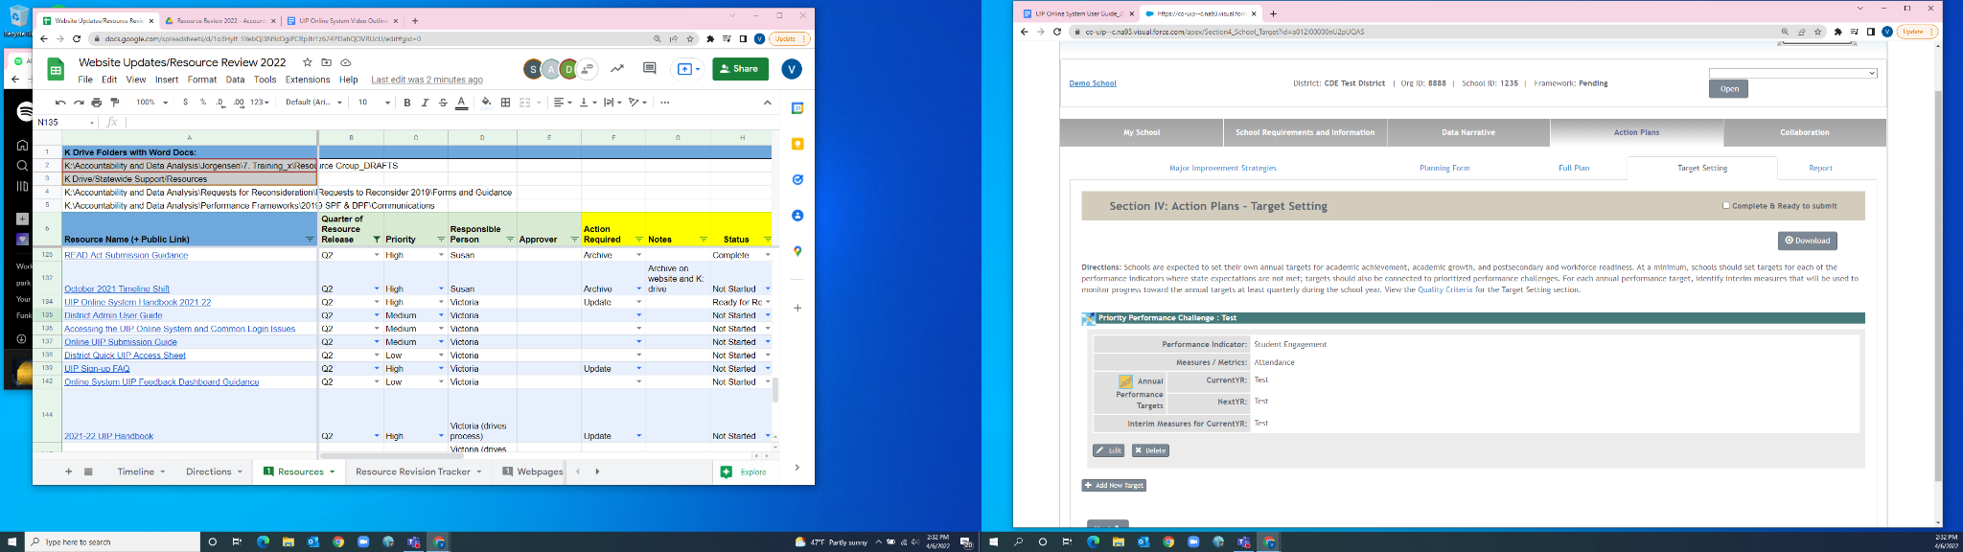
Where in the UIP – Target Setting

Slide 39
School Leader Upcoming Trainings -Focus on Identification Types
September CS UIP Specific Identification Workshop Sessions
Thursday, September 8, 2022 from 8:00-11:00 - Comprehensive Support Plan/UIP for CS Identified Schools: Lowest 5% Elementary/ Secondary Register HERE
Thursday, September 8, 2022 from 12:00- 3:00 - Comprehensive Support Plan/UIP for CS Identified Schools: Lowest 5% Elementary K-2 Register HERE
For newly identified schools this fall, another set of trainings will be coming soon.

Slide 40

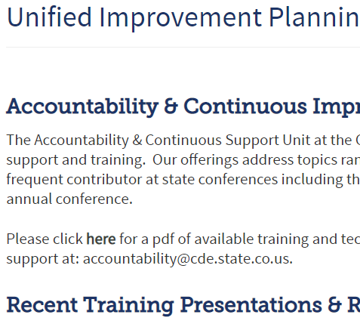
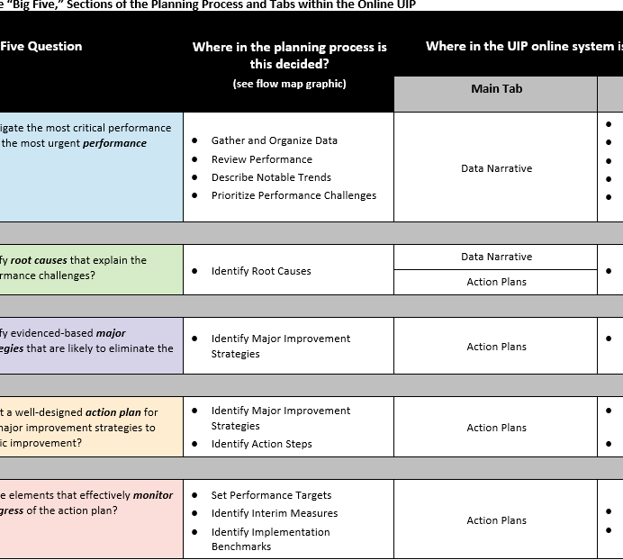
Resources
UIP 101
The UIP 101 video series provides an introduction to the elements of the school UIP and the UIP online system.
https://www.cde.state.co.us/uip/uip101
UIP Training Page
This page hosts a variety of training and technical assistance, both past and present.
https://www.cde.state.co.us/uip/uip_training
Other Resources
Implementation Benchmarks Guidance Document
Data Analysis for Small Student Populations
UIP School QC Rubric- (DOC)

Slide 41
Contacts
Identification
Tina Negley Negley_t@cde.state.co.us
Mary Shen Shen_m@cde.state.co.us
Programmatic
Karen Bixler Bixler_k@cde.state.co.us
Kathryn Wisner Wisner_k@cde.state.co.us
Tammy Giessinger Giessinger_t@cde.state.co.us
UIP General and Platform
Erin Loften Loften_e@cde.state.co.us
Victoria Rilett Rilett_@cde.state.co.us

Slide 42
Questions

