Slide 1







Title I Allocation Process & Funding and Fiscal Changes under ESSA
Office of Grants Fiscal Management
October 6, 2016

Slide 2

Title I-A Allocation Process NCLB/ESSA
Funding and Fiscal changes under ESSA
2

Slide 3







Title I-A Allocation Process

Slide 4
Acronyms & definitions
ESSA – Every Student Succeeds Act
NCLB – No Child Left Behind
CSDB – Colorado School for the Deaf and Blind
CSI – Charter School Institute
EFIG – Education Finance Incentive Grant
Formula children – 5-17 year olds from low-income families that are
determined through the U.S. Bureau Census and are the basis for allocations
LEA – Local Education Agency
SEA – State Education Agency
Special LEA – LEA that is not listed by the Census Bureau
USDE – United States Department of Education

Slide 5

Title I-Part A
Federal Program that provides financial assistance to local education agencies and schools with high numbers or high percentages of children from low-income families to help ensure that all children meet challenging state academic standards.
Allocated through four statutory formulas that are based primarily on population, census poverty estimates, and the cost of education in each state.

Slide 6
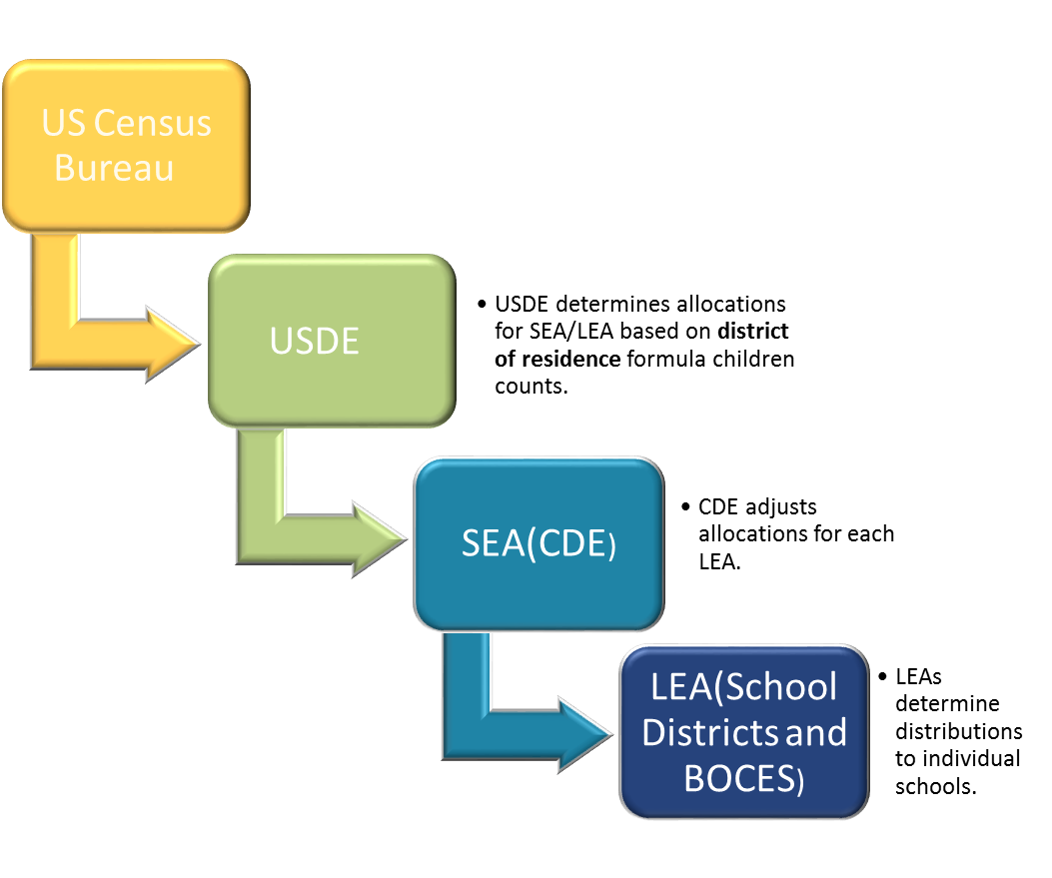
Allocations to States and Districts

Slide 7

USDE Allocations to CDE
Allocated through four statutory formulas, each with their own criteria, that are based primarily on population, census poverty estimates, and the cost of education in each state
  Basic, Concentration, Targeted and Education Finance Incentive Grant (EFIG)
  Each have individual criteria for eligibility
Allocated based on US Census Bureau poverty estimates
  2014 data used for 2017 allocations – data is 3 years in arrears
USDE applies the first Hold-Harmless Provision
USDE sends allocation figures by individual LEAs to CDE

Slide 8
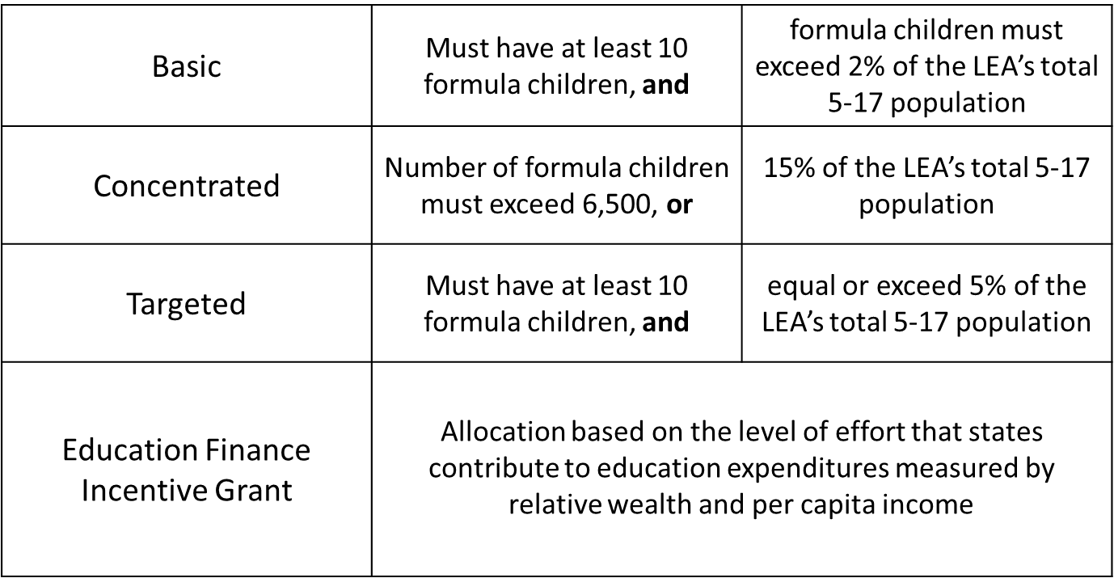
Title I, Part A

Slide 9



Title I, Part A Components FY16-17
Title I-A, 150.74m
$37.09
Incentive 25%
$68.01
Basic 45%
$33.68
Targeted 22%
*In Millions

Slide 10

Allocations to CDE
USDE sends source documentation to CDE on individual LEAs that include:
  Populations
    Total Formula children count which includes the total of:
      Poverty count from census data (3 years in arrears)
      Neglected
      Foster Care
      Temporary Assistance to Needy families (TANF)
    Total population ages 5-17
    Formula children as a percentage of the total 5-17 population
  Allocations
    Current year allocations broken out by each of the 4 components of Title I for each LEA
    Current year Total Allocation for each LEA
    Previous year allocations broken out by each of the 4 components of Title I for each LEA
    Previous year Total Allocation for each LEA

Slide 11

CDE Allocations to LEAs
Allocations from USDE are adjusted in CDEs allocation formula for:
  State administrative costs
  Special LEAs
    CSDB and CSI
  Multi District Online Pilot
  Required set asides
    Delinquent and School Improvement
  Hold Harmless provisions
CDE sends updated allocation figures to individual LEAs

Slide 12

State Administration
‘‘SEC. 1004. STATE ADMINISTRATION.
‘‘(a) IN GENERAL.—Except as provided in subsection (b), to carry out administrative duties assigned under parts A, C, and D of this title, each State may reserve the greater of—
‘‘(1) 1 percent of the amounts received under such parts;
or
‘‘(2) $400,000 ($50,000 in the case of each outlying area).
‘‘(b) EXCEPTION.—If the sum of the amounts appropriated for parts A, C, and D of this title is equal to or greater than
$14,000,000,000, then the reservation described in subsection (a)(1)
shall not exceed 1 percent of the amount the State would receive, if $14,000,000,000 were allocated among the States for parts A, C, and D of this title.
All entities (including States, Guam, Virgin Islands and others) receiving Title I grant funding use their proportional share of the $14B as a base to calculate their 1% administration set aside.
States proportional share of the $14B is proportionally shared by Title I-A, Title I-C and Title I-D.

Slide 13
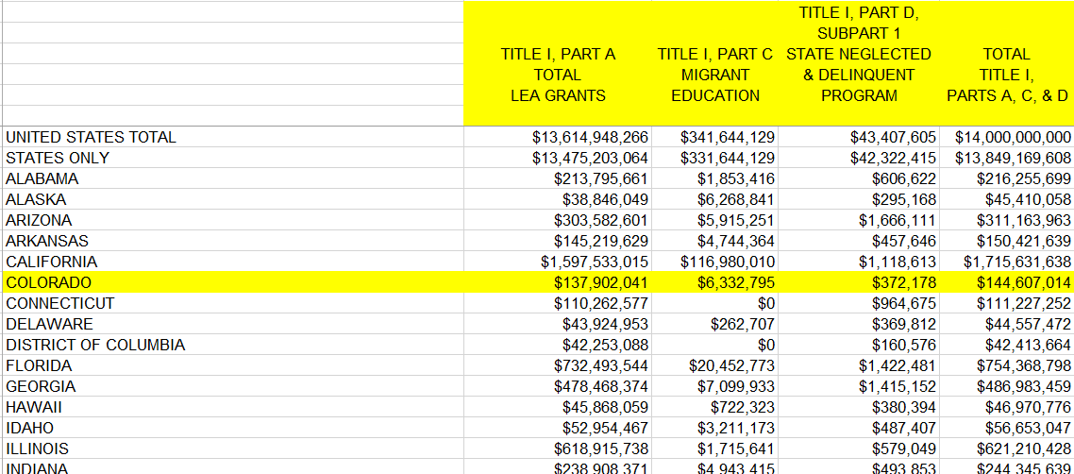
State Administration Cont’d

Slide 14

Special LEAs
A special LEA is one that is not listed by the Census Bureau
  CSI and CSDB are considered a special LEA
The USDE provides guidance that states must adhere to in
order to allocate funds to special LEAs
Manual adjustments are made to determine this funding
  District of residence, at-risk count, formula children
Iterations of allocations depend on district of residence and the CSI schools within geographic boundaries

Slide 15
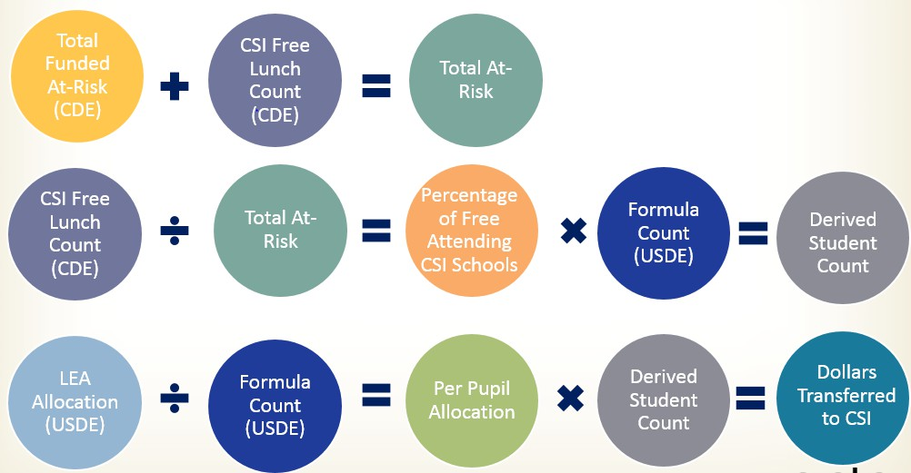
Reallocating Funding to Special LEAs

Slide 16



Multi-district online pilot
Allocations are adjusted for the State Board Approved Multi-District Online Pilot Program according to the following criteria:
  Must be a multi-district online school
  Must not have CSI as its authorizer
  Must have, at minimum, 10 free lunch students from outside the LEA’s boundaries
  Must have a significantly higher free lunch percentage compared to the
LEA’s percentage
  Must be currently served using FY 13-14 Title IA funds
  Must be participating in the United States Department of Agriculture
school meal program
Uses the same process as Special LEAs

Slide 17



Required Set-asides
Title I-A Allocations to districts are adjusted for state-level required set-asides:
  Title I-D Delinquent
  School Improvement

Slide 18


Title I-D Delinquent
Educational programs for neglected, delinquent and at-risk youth
Delinquent State allocation is sent to USDE and allocated to delinquent facilities based on prior year student counts

Slide 19



Title I-A School Improvement Set-aside
Grants for intensive and sustained support to schools designated as in need of improvement
School Improvement
  Set-Aside for School Improvement is 4% of the State Allocation
    Will be 7% for ESSA
Distributed based on a competitive grant process

Slide 20


Hold-Harmless and Set Asides
LEAs with an increase in funding over the previous year contribute to set-asides
However, LEA Allocations cannot fall below the hold-harmless
threshold
State may reduce 4% School Improvement Set-Aside if necessary to maintain appropriate hold-harmless percentages
  State may not reduce the 7% for year one of ESSA

Slide 21



Title I, Part A Hold-harmless
Statute guarantees that the LEA receive at least 85, 90, or 95 percent of the amount it was allocated in the preceding year.
Basic, Targeted, and Education Finance Incentive Grant
  If the district is no longer eligible for funding under these Title I, Part A components, hold-harmless provisions do not apply.
  The percentage guarantee varies according to the percentage of formula
children in each LEA.
Concentration Grant
  Guaranteed four consecutive year hold-harmless provision.
  No annual eligibility requirements during the hold-harmless period.

Slide 22


Allocating Title I-A to Schools
LEAs choose a poverty method to use in ranking their schools
LEAs assign funds to schools in Rank Order by poverty
percentage
  LEAs choose how much funding to provide to schools
LEAs budget these funds for school level programs
  Schoolwide
  Targeted Assistance

Slide 23
Allocating to Schools
LEAs choose a poverty measure to use in ranking their schools
  Free and Reduced Meal
  Free and Reduced Meal & Community Eligibility Provision (CEP)
  Free Lunch
  Temporary Assistance to Needy Families (TANF)
  Medicaid
  US Census Data

Slide 24
Allocating to Schools cont’d
LEAs assign funds to schools in Rank Order by poverty percentage using one of the following methods:
  Percentage District Wide
  35% Rule District Wide
  Grade Span Grouping + District Wide Percentage
  Grade Span Grouping + Group Wide Percentage
  Grade Span Grouping + 35% Rule
  LEAs with enrollment less than 1000
  One School Per Grade Span

Slide 25
Methods of Serving Schools
LEA may operate a Title I School utilizing one of two models:
  Schoolwide Program
    School must have at least 40% poverty
    All students benefit. No distinction between eligible and ineligible students
    School may budget by blending funds from Title I-A with Federal or
Local funding sources
    School must have a Schoolwide Plan
  Targeted Assistance Program
    No poverty threshold
    Services are provided only to eligible students who are low-achieving or at risk of low achievement

Slide 26

ESSA Overview

Slide 27

Title I-A
The State set-aside for Title I School Improvement has increased from 4% to 7%
School Improvement grants may now be awarded on either a competitive
or formula basis.
States may also now award 3% of Title I funds to “geographically diverse LEAs” for a Direct Student Services Grant.
Many Title I-A Set Aside requirements, such as SES, have been removed.
  Optional 5% set-aside for choice transportation
  Required set-aside for parental activities remains for allocations over $500,000.
Title I rank order now allows districts to lower the poverty threshold to
50% for High Schools, instead of the 75% requirement for all schools.
In a Title I secondary school with a schoolwide program, funds may now be used for concurrent enrollment programs.
27

Slide 28




7 % Must be set aside to support schools identified for ESEA School Improvement.
Eligibility for access to set aside
  Lowest 5% of Title I schools in the state
  High Schools with grad rate less than 67%
  Schools with underperforming Subgroups
Estimated ~ $10,500,000
95% of set-aside must go to LEAs with identified schools
SEA must
  Prioritize LEAs with large numbers of identified schools
  Take into account the geographic diversity of the LEAs in the state
Decision Points
  Award funds by formula?
  Award funds competitively (as under NCLB)?
  Hybrid (formula and competitive)?
  Should SEA retain a portion of the 7% to provide direct services to LEAs with identified schools?

Slide 29

SEAs may withhold an additional 3% for Direct Services to students.
Estimated ~ $4,500,000
99% must be distributed to LEAs with low performing schools
  HS student supports such as
    GED
    Concurrent enrollment
    Credit recovery
  After school tutoring
  Title I School Choice options
Decision Point
  Should CDE retain an additional 3% of Title I-A funds for LEAs to provide direct services to students in low performing schools?

Slide 30


NCLB Title I $150.74*
Administration
$1.68 1%
Title I-A
Distribution
$143.33 95%
School Improvement Distribution
$5.72 4%
30
* In millions

Slide 31




ESSA Title I $150.74*
Direct Services
$4.47
3%
Administration
$2.08 1%
Title I-A Distribution
$134.16 89%
School Improvement
Distribution
$10.02 7%
*Using 16-17 Allocations In millions
31

Slide 32


Title I-B
Two NEW grant programs for States to develop new assessment systems
  Grants for State Assessment and Related Activities
    Developing new assessments and report cards
    States receiving this grant may subgrant to LEA’s
  Innovative Assessment and Accountability Demonstration Authority
    Awarded to 7 states on a competitive basis

Slide 33


Title I-C
Funding allocated based on the current migratory children count.
  Previously based on a fixed student count from 2002
Colorado is anticipating a 10% reduction of the total award in FY2017-18.
Requires migratory programs and projects to provide for outreach activities for migratory children and their families.
Improved definition for migratory agricultural worker, migratory child, migratory fisher and qualifying move which will provide clear guidance on allowable expenditures

Slide 34



Title I-D
Included in this section is a requirement that States must establish provisions for, or timely re-enrollment of, youth placed in the juvenile justice system, including opportunities to participate in credit-bearing coursework.

Slide 35




Title I-E
This is a NEW Competitive program which allows consolidation of funds for LEAs into a system based on weighted per-pupil allocations for low-income and otherwise disadvantaged students.
  LEA applies directly to USDE for flexibility
  Agreements last for a period of 3 years
  Not more than 50 LEAs nationwide; this can be expanded in 2020
  Allows consolidation of Title I, Title II, Title III, Title IV-A, Title V-B
  Administrative costs limited by the amounts specified in each
program
  Annual report to the Secretary regarding progress

Slide 36

Title II-A
NEW Allocation Formula
  CDE to LEA Allocations
    20% of funds allocated based on total 5-17 year old population
    80% of funds based on formula student percentage
  USDE to CDE Allocations
    4 year phase in of new formula
      FY 2017-18 – 35% - 65%
      FY 2018-19– 30% - 70%
      FY 2019-20– 25% - 75%
      FY 2020-21– 20% - 80%

Slide 37
Title II-A NCLB v ESSA
NCLB | ESSA
Eisenhower $3,706,445 | 80% formula student population
Class Size Reduction $17,803,446 | 20% total 5-17 year old population
Additional Allocation above $21,509,911
80% formula student population
20% total 5-17 year old population

Slide 38

Title II-b
Several NEW competitive grant programs:
  Teacher and School Leader Incentive Fund
  Comprehensive Literacy State Development
  Subgrants to Eligible Entities in Support of Birth through Kindergarten Entry Literacy
  Subgrants to Eligible Entities in Support of Kindergarten through Grade 12
Literacy
  Innovative Approaches to Literacy
  Presidential and Congressional Academies for American History and Civics
  Supporting Effective Educator Development
  School Leader Recruitment and Support
  Technical Assistance and National Evaluation
  STEM Master Teacher Corps

Slide 39

Title III
Restriction of 2% administrative costs remains
Activities by Agencies Experiencing Substantial Increases in Immigrant Children and Youth (Formerly SAI) are still required
Supplement not supplant provision still remains
Reporting is now required every 2 years
NEW National Professional Development Project
  5 year competitive grant program
  Awarded to IHE’s or Private institutions, in consortia with SEAs or LEAs

Slide 40

Title IV-A
NEW Formula Grant
Proportional to Title I-A
No allocation may be less than $10,000, subject to ratable reduction
LEAs may form a consortium
2% direct administrative costs
Needs assessment shall be conducted every 3 years, however LEAs with an allocation less than
$30,000 do not need to conduct a needs assessment
Use of funds
  Partnership with Institutions of Higher Education
  Well-rounded education
  Effective use of technology
  Evaluation of effectiveness
  20% on Activities to Support Well-Rounded Educational Opportunities
  20% on Activities to Support Safe and Healthy Students
Supplement not Supplant non-Federal funds

Slide 41


Title IV-B
Competitive grant, formerly part of Title V
Grants will be awarded for a period of 3-5 years
Minimum award amount is $50,000
Match is allowed, but not required
Local activities have a direct connection to Workforce Centers

Slide 42

Title IV-C
Formerly part of Title V
This is a 3 year competitive grant that is awarded to new or expanding charter schools.

Slide 43

Title IV-E
This is a NEW grant
It creates Statewide Family Engagement Centers which provide training to SEAs and LEAs on effective parent and family engagement
Not less than 65% of funds to serve LEAs, schools and Community based organizations that serve high concentrations of disadvantaged students
Not less than 30% of funds to establish or expand technical assistance for evidence-based parent education programs

Slide 44


Title IV-F
Several NEW national competitive grant programs available
  Grants for Education Innovation and Research
  Community Support for School Success
  National Activities for School Safety
  Awards for Academic Enrichment
  Assistance for Arts Education
  Ready to Learn Programming
  Supporting High-Ability Learners and Learning

Slide 45

Title V
Formerly Title VI-B
Includes REAP-flex, and the Rural Education Initiative

Slide 46

Title VI
Formerly Title VII
Provides grants to LEAs and Indian Tribes; this grant is administered at the Federal level, CDE does not subgrant.

Slide 47


Title VIII
Formerly Title VIII
This program provides funding to districts that have been impacted by Federal land use, it is administered at the Federal level, CDE does not subgrant.

Slide 48

Title IX-A
This is a 3 year competitive grant program
There is an additional assurance required regarding MOE
Very little change in services to be offered and activities allowed
under the new legislation

Slide 49
Title IX-B
There will be a study on the Title I Formula, not later than 18 months from the passing of ESSA, which could lead to future changes in the formula.
Preschool Development Grants, formerly authorized under ARRA, are now a part of ESSA.
  This is a competitive Grant
  Assists states to develop a plan for coordination of preschool programs
  Requires a 30% match
  1 year grant that can be renewed for up to 3 years
  Allows for planning and transition of existing awards

Slide 50

NCLB Grants FY 16-17
NCLB Allocation 2016-17
$258.46*
Title I $150.74 58%
Impact Aid** $31.75 12%
Title II $24.88 10%
21st Century $11.58 4% Title III $8.95 3% Migrant $6.96 3% Charter School $6.70 3%
State Assessments $6.51 3%
Tiered Intervention 1003g $4.43 2% Title VI** $1.94 1%
Math and Science $1.72 0.67% Homeless $0.70 0.3%
Indian Education** $0.67 0.3% Title VIB $0.52 0.2%
* In millions
** Not administered by CDE
Neglected and Delinquent $0.41 0.2%

Slide 51
NCLB Formula Grants FY16-17
$184.47*
Title VIB
$0.52 0.3%
Title IIIA
$8.94 5%
Title IA
$150.74 82%
Title IIA
$24.26
13%
Total administration for all programs: $2.18, 1%
* In millions

Slide 52






State Education Funding (Revenue) FY2014-15
Local
$5,311.96 51%
NCLB
$220.15 2%
Federal
$513.72 5%
State
$4,467.41 42%
*In Millions

