Slide 1

2025-2026 Consolidated Application System Training
Title I, Part D Section
Notes:
DeLilah

Slide 2
Agenda
Consolidated Application System Training
Changes to the Consolidated Application Title I, Part D Section
Budget Reminders
Title I, Part D GAINS Walkthrough
Notes:
DeLilah

Slide 3
Consolidated Application: Title I, Part D Changes
Notes:
DC

Slide 4
Title I, Part D Changes
Consolidated Application System Training
Both State Agency application (Subpart 1) and LEA application (Subpart 2) will have a new budget tag for transition.
LEA Application (Subpart 2)
LEA application will contain a chart of Delinquent Facilites that will need to be completed.
Question 2 has changed to an upload function for the formal agreement.
Go to page 41 of the Consolidated Application Planning Resource for Response Guidance and Helpful Resources on Title I, Part D.

Slide 5
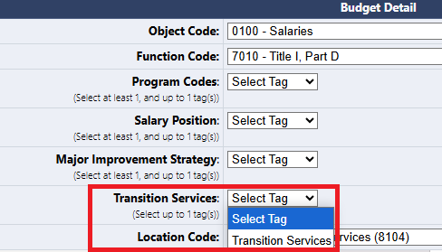
Title I, Part D – Budget Tag Change
Consolidated Application System Training
Division of Youth Services and LEAs with Title I, Part D now have the option to select "Transition Services" as a budget tag.
This tag is not required but should be utilized for any activities related to transition services.

Slide 6
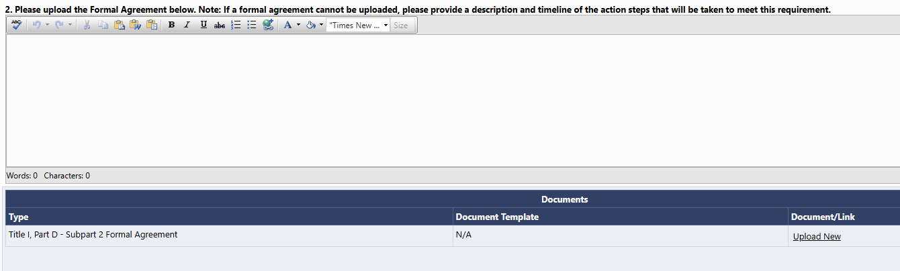
Title I, Part D – Subpart 2 Narrative Changes
Consolidated Application System Training
A new Delinquent Chart is at the top of the narrative page.
Question 2 of the narratives changed. The system allows the LEA to upload a formal agreement. If the formal agreement can't be uploaded, there is a space for the LEA to provide additional detail around the action steps to meet this requirement.

Slide 7
Consolidated Application: Budget Reminders
Notes:
JH

Slide 8
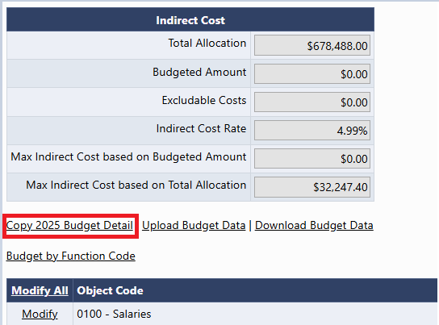
Copy 2025 Budget Detail
Consolidated Application System Training
A new link now appears in all budgets! Copy 2025 Budget Detail
This will copy last year's budget and place it in the 2026 budget.
Please be aware that you should consider using this feature before entering any line items. Once a line item is entered, this feature will disappear as an option!
Notes:
JH

Slide 9
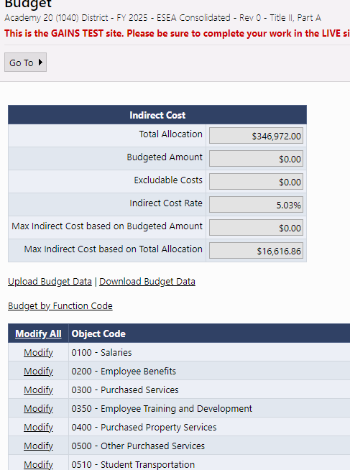
Budget Pages
Consolidated Application System Training
Budgets pages will appear in each Title program section, as applicable.
Indirect Cost table will show Total Allocation, ICR%, and Max Indirect based on Total Allocation
As budget line items are added, the table will calculate Max Indirect based on Budgeted Amount, Budgeted Amount, and any Excludable Costs.
To open any Budget to add line items, click "Modify All"
Notes:
JH

Slide 10
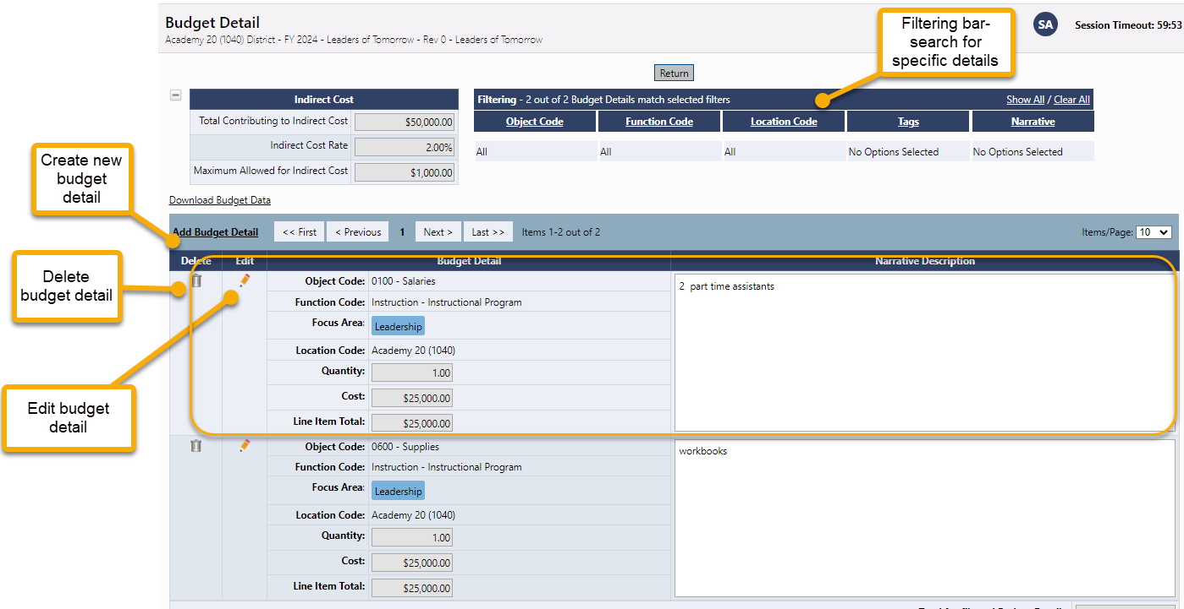
Budget Detail Page
Consolidated Application System Training
Click the Add Budget Detail link to create a new budget line entry.
On this screen, you can also edit or delete existing budget details line items.
Use the filtering bar at the top of the page to find a group of expenditures or a specific detail.
NEW! The budget will now allow users to filter by Item Key!
Notes:
JH

Slide 11
Budget Detail: Locations Dropdown
The Location Code is going to list all schools within the LEA as E, M, H but also as a general school (not broken out by gradespan).
Title I, Part D is unique as you will use the general school instead of the gradespan schools. This is different from the other programs!!
Notes:
JH

Slide 12
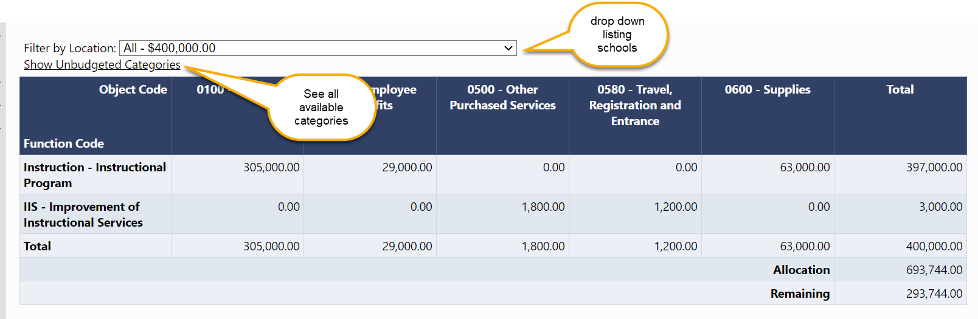
Budget Overview
Consolidated Application System Training
The Budget Overview page is a non-editable grid view of the budgeted subtotals.
The overview can be filtered by locations and can show all possible function/object code combinations by selecting Show Unbudgeted Categories.
Notes:
JH

Slide 13
Budget Upload Additional Instructions and Resources
Consolidated Application System Training
For step-by-step instructions on how to complete and upload an excel budget into GAINS and resolve commons upload errors, please see additional guidance:
Recorded Training
Text Instructions Resource
Slide Deck with Screenshots (ESEA Consolidated Application Specific)
Notes:
JH

Slide 14

2025-2026 Consolidated Application Walkthrough
Consolidated Application System Training

