Slide 1

2025-2026 Consolidated Application System Training
Title III, Part A

Slide 2
Agenda
Consolidated Application System Training
Changes to the Consolidated Application Title III, Part A
Budget Reminders
Title III GAINS Walkthrough

Slide 3
Consolidated Application: Title III, Part A Changes

Slide 4
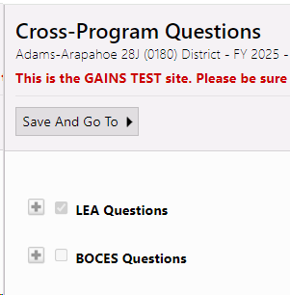
Narrative Question Layout
Consolidated Application System Training
Each narrative section has a set of questions for LEAs and a set of questions for BOCES.
These sections will be pre-selected based on your organization and expanded so questions can be seen, and responses can be entered.

Slide 5
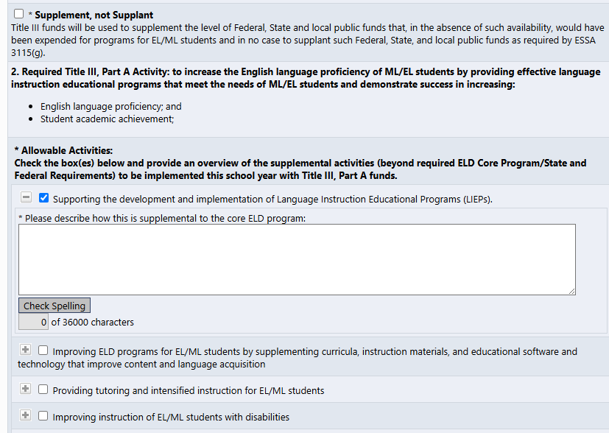
Title III, Part A Narrative Changes: LEA Questions
Consolidated Application System Training
Question 1: No major changes.
Question 2: Changes: Narrative text box replaced with:
(a) a required Supplement, Not Supplant checkbox assurance, and
(b) a required Allowable Activity check box(es) and narrative(s).
Must select at least one/all that apply
Questions 3 & 4: No major changes
Notes:
* Supplement, not Supplant Title III funds will be used to supplement the level of Federal, State and local public funds that, in the absence of such availability, would have been expended for programs for EL/ML students and in no case to supplant such Federal, State, and local public funds as required by ESSA 3115(g).
Allowable Activities: Check the box(es) below and provide an overview of the supplemental activities (beyond required ELD Core Program/State and Federal Requirements) to be implemented this school year with Title III, Part A funds.

Slide 6
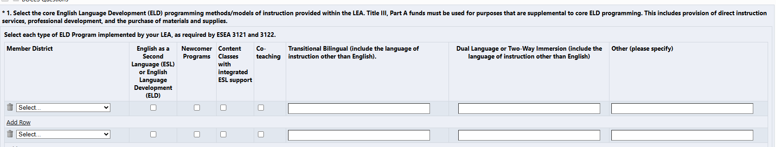
Title III, Part A Narrative Changes: BOCES Questions
Consolidated Application System Training
BOCES Questions
Question 1 Minor changes to BOCES Table organization, but the information requested is the largely the same.
Question 2: Changes: Narrative text box replaced with:
(a) a required Supplement, Not Supplant checkbox assurance, and
(b) a required Allowable Activity checkbox(es) and narrative(s).
Questions 3 & 4: No major changes
Notes:
* 1. Select the core English Language Development (ELD) programming methods/models of instruction provided within the LEA. Title III, Part A funds must be used for purposes that are supplemental to core ELD programming. This includes provision of direct instruction services, professional development, and the purchase of materials and supplies.
Select each type of ELD Program implemented by your LEA, as required by ESEA 3121 and 3122.Member District
English as a Second Language (ESL) or English Language Development (ELD)
Newcomer Programs
Content Classes with integrated ESL support
Co-teaching
Transitional Bilingual (include the language of instruction other than English).
Dual Language or Two-Way Immersion (include the language of instruction other than English
Other (please specify)

Slide 7
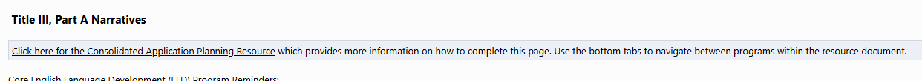
Title III, Part A - Consolidated Application Planning Resource
Consolidated Application System Training
New in this year’s application: Consolidated Application Planning Resource document link at the top of each narrative page
See pages: 47-52 for Title III, Narratives Response and Budget Guidance
See pages: 53-56 for Title III, Immigrant Set-Aside Narrative Response and Budget Guidance.
Note: There are no changes to Title III, Part A – Immigrant Set-Aside Narrative Questions.
Notes:
47-52 Title III Narratives and budget
53-56 – Title III, ISA narratives and budget

Slide 8
Consolidated Application: Budget Reminders

Slide 9
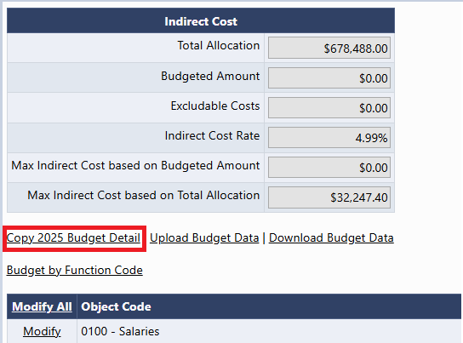
Copy 2025 Budget Detail
Consolidated Application System Training
A new link now appears in all budgets! Copy 2025 Budget Detail
This will copy last year's budget and place it in the 2026 budget.
Please be aware that you should consider using this feature before entering any line items. Once a line item is entered, this feature will disappear as an option!

Slide 10
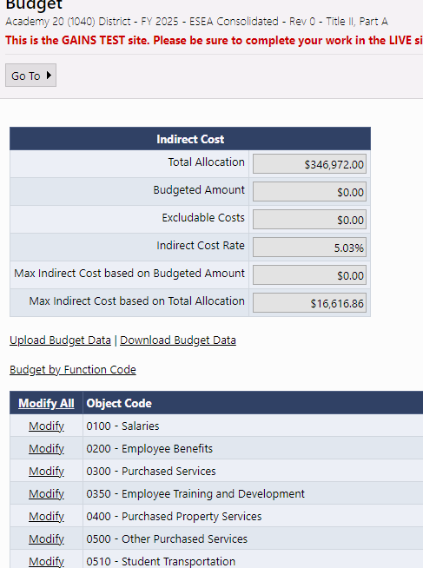
Budget Pages
Consolidated Application System Training
Budgets pages will appear in each Title program section, as applicable.
Indirect Cost table will show Total Allocation, ICR%, and Max Indirect based on Total Allocation
As budget line items are added, the table will calculate Max Indirect based on Budgeted Amount, Budgeted Amount, and any Excludable Costs.
To open any Budget to add line items, click "Modify All"
Notes:
JH

Slide 11
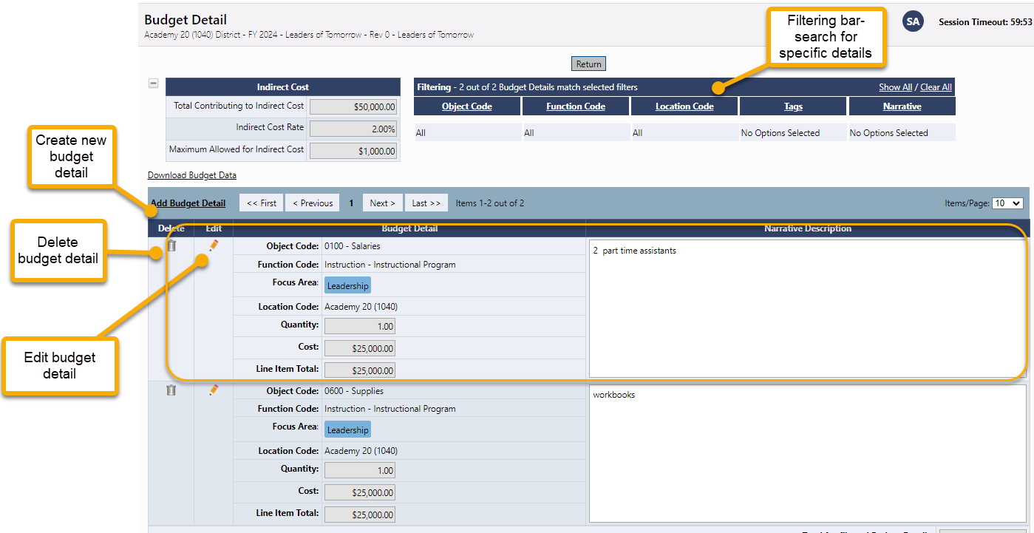
Budget Detail Page
Consolidated Application System Training
Click the Add Budget Detail link to create a new budget line entry.
On this screen, you can also edit or delete existing budget details line items.
Use the filtering bar at the top of the page to find a group of expenditures or a specific detail.
NEW! The budget will now allow users to filter by Item Key!
Notes:
JH

Slide 12
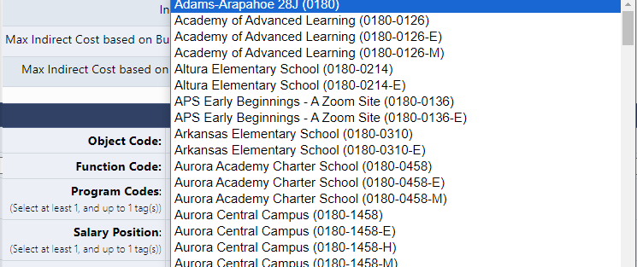
Budget Detail: Locations Dropdown
The Location Code is unique because it is going to list all schools within the LEA as E, M, H but also as a general school (not broken out by gradespan).
This is because the system is setup for grants across the department that do not breakout funding by gradespan.
It is imperative that Consolidated Application users select the gradespan for each school level activity. The School Ranking page is checking the allocation for that school based on the gradespan.
If a general school location is selected, you will get a validation error that the funds haven't been budgeted to the school correctly.
General School
Gradespan specific

Slide 13
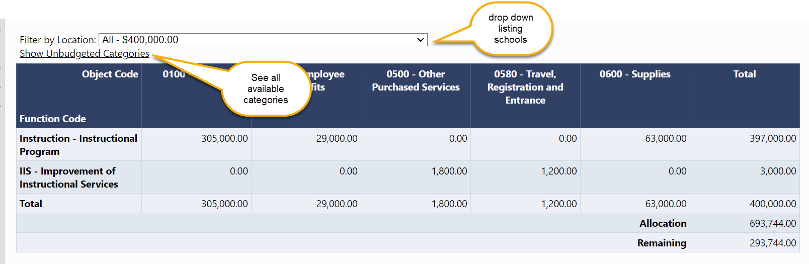
Budget Overview
Consolidated Application System Training
The Budget Overview page is a non-editable grid view of the budgeted subtotals.
The overview can be filtered by locations and can show all possible function/object code combinations by selecting Show Unbudgeted Categories.

Slide 14
Budget Upload Additional Instructions and Resources
Consolidated Application System Training
For step-by-step instructions on how to complete and upload an excel budget into GAINS and resolve commons upload errors, please see additional guidance:
Recorded Training
Text Instructions Resource
Slide Deck with Screenshots (ESEA Consolidated Application Specific)

Slide 15

2025-2026 Consolidated Application Walkthrough
Consolidated Application System Training

