Slide 1

2025-2026 Consolidated Application System Training
Cross Program Section
Notes:
DeLilah

Slide 2
Agenda
Consolidated Application System Training
Changes to the Consolidated Application Cross Program Section
Notes:
DeLilah

Slide 3
Consolidated Application: Cross Program Changes
Notes:
DC

Slide 4
Cross-Program Changes
Consolidated Application System Training
Title I, Part A contact is required
ESEA ARAC Forms moved to Cross Program
Non-Public Schools chart
NEW! ESSA School Improvement Narratives
Start on page 4 of the Consolidated Application Planning Resource for Response Guidance and Helpful Resources on the Cross-Program Information Section.

Slide 5
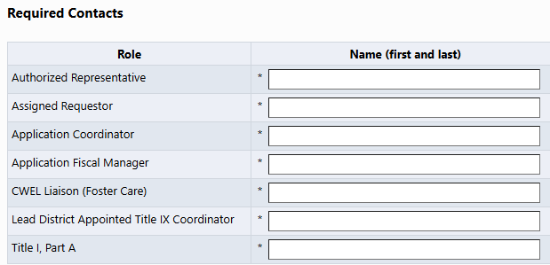
Cross-Program Changes - Contacts
Consolidated Application System Training
The Title I, Part A contact has been moved from the Additional Contacts section to the Required Contacts section.

Slide 6
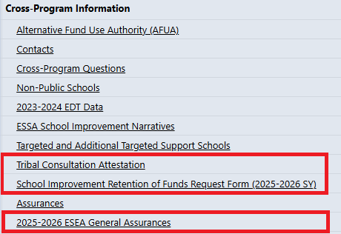
Cross-Program Changes - Forms
Consolidated Application System Training
With Cross Program open, you will now find the following forms:
Tribal Consultation Attestation (if applicable)
School Improvement Retention of Funds Form (if applicable)
2025-2026 ESEA General Assurances
These forms were in the ARAC last year.

Slide 7
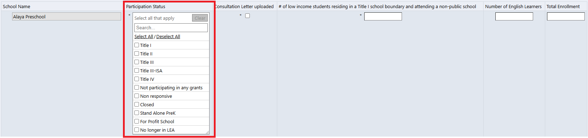
Non-Public School Changes
Consolidated Application System Training
All eligible non-public schools will need a Non-Public School Consultation form uploaded into the platform. This is regardless of whether the school decides to participate or not in funding.
If the school is not eligible for funding, the LEA will utilize the participation status to indicate the reason why such as a for-profit school, stand alone PreK, or closed.
LEAs will no longer remove the schools with a trashcan.
The participation status column will be a multi-select dropdown to identify the various programs the school wishes to participate in.
Notes:
DC

Slide 8
ESSA School Improvement Narratives
Consolidated Application System Training
This new page will only apply to those LEAs with schools identified for Comprehensive Support and Improvement, Targeted Support and Improvement, and Additional Targeted Support and Improvement.
The page will include a chart that lists all these schools and the associated identification.
Within that page, Question 2 will only appear for LEAs with schools identified for Comprehensive Support and Improvement and/or Additional Targeted Support and Improvement.

Slide 9

2025-2026 Consolidated Application Walkthrough
Consolidated Application System Training

