Slide 1
Family, School, and Community Partnerships:
Systemic, Scalable, and Sustainable Strategies
2022
Office of Family, School, and Community Partnerships

Slide 2
“…the purpose of implementing programs of family, school, and community partnerships should be to promote and help realize equity within our educational system, alongside attention to improving student outcomes.”
Epstein & Sheldon (2007)
Notes:
It was with this in mind that I entered into this work with the Colorado State Department of Education

Slide 3
The What
Inclusive
Linked to Learning
Intentional
Proactive vs
Reactive
Integrate and
Elevate
Sustainable
Realistically
Optimistic
Committed
School
Improvement
Strategy
Research-Based
Measurable
Beyond Random Acts
Context vs Content Expertise
Notes:
This slide represents the current trends in FSCP research and practice. This is not an exhaustive list.

Slide 4
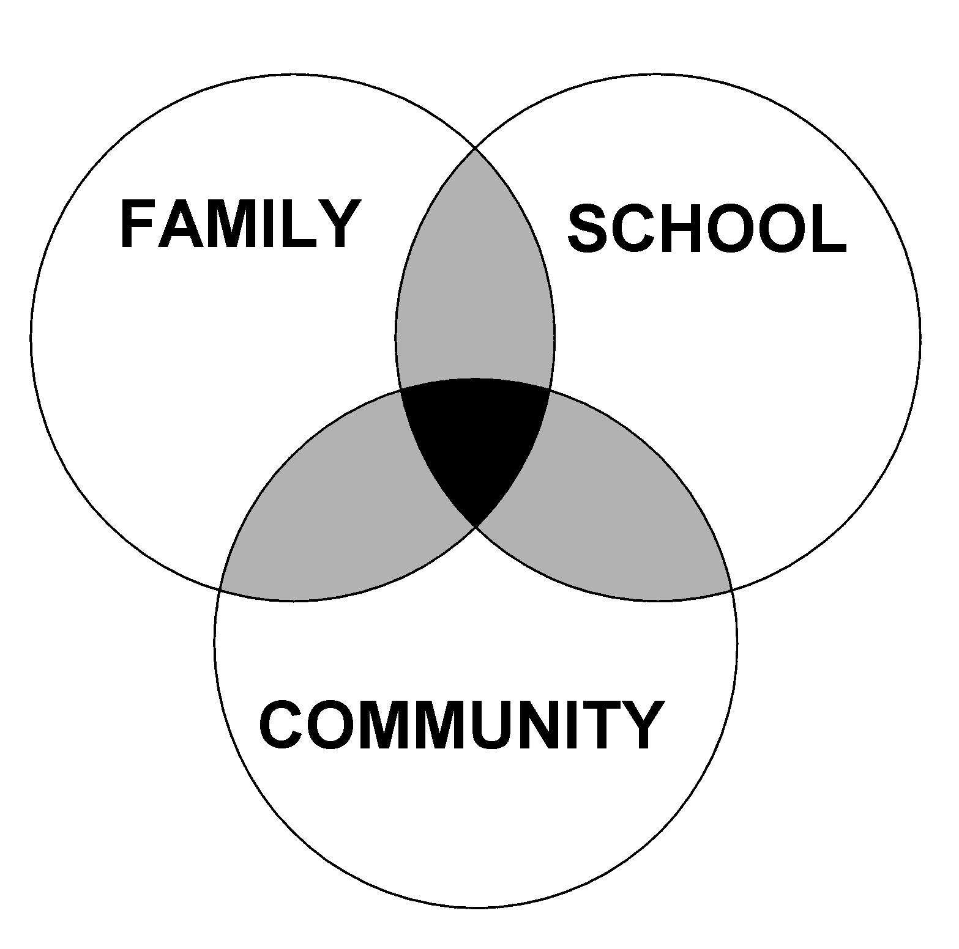
The Why
Factors Influencing
Effective Partnering
Experiences,
Beliefs,
Practices
Epstein, Joyce. "Caring for the children we share." Phi Delta Kappan 76.9 (1995): 701-712.
Notes:
This is a theoretical model for how school, family, and community interaction effects children’s learning. It was developed by Dr. Joyce Epstein based decades of research from schools primarily located in Baltimore City. You will see that three entities are represented: Family, School, and Community. Community can include businesses, school alumni, neighbors, parents with children not yet at school age. Each group does some things for students separately, and others together.
What are some sole responsibilities for families? Schools? The Community?
Depending on the extend of collaboration, the spheres either move closer together or farther apart. This model is NOT a Venn diagram. It is a dynamic model that is different for every student and school and can change over time. If the school’s beliefs and values differ greatly from those of the family, the circles will move away from each other. Likewise, if families, schools, and the community unite for a shared goal/vision, the circles will move closer together.
Just think about the answer to this question, you don’t need to vocalize it, but if you were to draw the Overlapping Spheres of Influence Model for you school, families, and community, how do you think it would look? Keep that question in mind as we move throughout the day.

Slide 5
Four Core Beliefs Are you ready to partner with families?
All parents have dreams for their children and want the best for them.
All parents have the capacity to support their children’s learning.
Parents and school staff should be equal partners.
The responsibility for building partnerships between school and home rests primarily with school staff, especially school leaders.
Henderson, A.T. et al. (2007) Beyond the bake sale: The essential guide to family-school partnerships.
Notes:
The third chapter of “Beyond the Bake Sale” is all about whether or not you are ready to partner with families. These four core beliefs set the foundation for readiness.

Slide 6
CO FSCP Framework for Districts and Schools and Early Childhood Programs
Definition
Families, early childhood programs, schools, and communities actively partnering to develop, implement, and evaluate effective and equitable practices to improve educational outcomes for children and youth.

Slide 7
Characteristics of Excelling FSCP Programs
Excelling Programs
Principal Leadership
Attending to Inequities
Giving Voice/ Sharing Power
Programmatic Approach
Teamwork/ Shared Leadership
Evaluation
Notes:
We drew upon these 6 components to help imagine what it is excelling partnership programs do.

Slide 8
Using the Rubrics
Step 1
Individuals rate the site’s partnership efforts
Step 2
Stakeholders discuss the ratings with one another
Step 3
The group establishes improvement goals and next steps to help meet those goals.
Notes:
Step 1: Individuals establish their own rating of the site’s partnership efforts
Use these prompts to provide details and descriptions of your site or school.
Compare your responses to the rubric and identify which rating most closely matches your description.
Record the rating in the Summary Worksheet provide in this this user’s guide.
Step 2: Bring together a group of stakeholders to participate in a discussion about their ratings.
This process should include a range of stakeholders including administrators, teachers, family members, and community partners.
As a group, members of the evaluation and accountability committee should share their ratings with one another, as well as the reasons why they felt that rating was most appropriate.
We encourage this group to come to a consensus about how the site is performing across each of the four Essential Elements. If one or two individuals have a rating that is very different from others, it is important to let those people speak openly and honestly about why they rated the site that way. Listen to their reasoning with empathy and do not try to shut down conversation. This conversation is not meant to change people’s minds, it is about hearing a diverse range of perspectives.
Step 3: The evaluation group should agree to partnership improvement goals and a set of next steps to help the site meet those goals.

Slide 9
Step 1: Individual Ratings

Slide 10
Step 1: Individual Ratings

Slide 11
Steps 2 and 3: Group Discussion

Slide 12
The How
Implementing the Framework of National Standards for Family-School Partnerships
Welcoming All Families into the School Community
Communicating Effectively
Supporting Student Success
Speaking Up for Every Child
Sharing Power
Collaborating with the Community
Sharing Leadership
Action Planning
Evaluating
Customized
Comprehensive
Continually Improved
Notes:
This slide represents the school-level research-base for comprehensive and sustainable partnerships. More information about the National Standards are in the handout “Goals and Indicators.”

Slide 13
Notes:
2 minutes
Key Messages:
Flamboyan has focused specifically on family engagement for more than 10 years…. Research and practice have taught us that important these five roles are…
The five roles that families play to accelerate student learning are communicate high expectations, monitor their child’s performance, support learning at home, guide their child’s education and advocate for their child.
These 5 roles that come from the literature and research on effective family engagement and provides a clear direction for what effective family engagement aims to achieve.
Effective family engagement is when educators share the information and resources that families need to play these roles well.
For example, it is important for parents to communicate to their children that they have high expectations and that they value education. One very simple but effective way parents do that is by asking children what they learned in school that day. Many of you are parents; when you ask your children what they learned at school today, what do they say? But…If your teacher sends home an email describing that they’re studying ancient Rome that week and suggests a list of three questions, like “ask your child who was his favorite emperor”, then you can have the conversation and do your job communicating the value of learning.
If you get info about how your son or daughter did on the last quiz or test – you can be monitoring and holding kids accountable, but if you don’t find out that they didn’t hand in any homework until the end of the grading period, then you can’t help
All parents play these five roles in some form or another. However, some parents have more access to resources, information, and relationships to play them well than others, and that’s where our focus on students most impacted by inequity is grounded.

Slide 14
CONTINUUM OF IMPACT
Parent training events
Goal-setting talks
Celebrations
Family help on administrative tasks
Relationship building
Regular, personalized communication
Fundraisers
Parent resource rooms
Back to school night
Academic partnering
Family support services
Interactive homework
Positive phone calls home
Home visits
Potlucks
Ongoing communications
Performances & showcases
Generic school newsletters
Data sharing
Modeling of learning support strategies
Notes:
5 minutes
There are no “right answers,” but here is how we look at these strategies in terms of impact on student success.
The family engagement activities that schools often engage in are school-wide, not learning-focused, and require families to come to the school.
“Numbers of participants” is what gets recognized – rather than the increase in a parent’s ability to play the five roles.
If families are being asked repeatedly to come to school but are not getting anything that will help them with what they most care about – educating their individual child, then schools often see the undesired effect of families choosing NOT to attend school events because they feel like their time is wasted.
Ask: What similarities do you notice between the schoolwide impact strategies? What do you notice about the activities on the higher impact side of the chart? What do they have in common? So what can we infer about high impact family engagement?
Emphasize: (Prompt if they don’t say: 1) teacher-led; 2) learning-focused; 3) individualized; 4) they either build relationships or support academic partnering; 5) most of them don’t require the family to come to the school

Slide 15
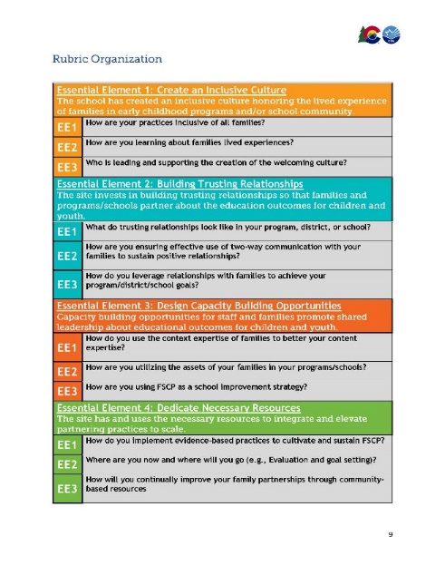
Strengthening FSCP on the UIP
Root Cause: Staff struggle to increase student attendance.
Staff believe building trusting relationships with families will lead to more opportunities to engage around attendance issues which will lead to more seat time. We know that increased attendance leads to improved learning outcomes.
Major Improvement Strategy: Increase student attendance by building strong relationships with families.
EOY Goal: 50% of families will receive a home visit
Implementation Benchmark: 10% of families will receive a “home visit” by the end of the first quarter.

