Slide 1
Implementing the Special Services Providers
State Model Evaluation System
for
Professional Practice
Legislative Overview and Professional Practice

Slide 2
Who are Special Services Providers?
School Audiologists
School Orientation and Mobility Specialists
School Psychologists
School Speech-Language Pathologists
School Counselors
School Nurses
School Occupational Therapists
Social Workers
School Physical Therapists

Slide 3

Training Objectives
By the end of this training, you will understand the Special Services Provider State Model Evaluation System, which includes:
      the evaluation process
      the Special Services Provider Quality Standards
      components of the rubric, and
      how to score the rubric

Slide 4

Agenda
Introductions and Icebreaker
Senate Bill 10-191 Information
  Purposes and Critical Effects
  Priorities of Implementation and Timeline
State Model Evaluation System Components and the Special Services Provider Quality Standards
  Evaluation Process
  Special Services Provider Quality Standards Gallery Walk
  Rubric Structure and Scoring
    Using this tool as a roadmap for improvement and coaching conversations

Slide 5
Introductions

Slide 6

How do you feel about Senate Bill 10-191?
There are four posters around the room with the titles of Beatles songs. Please go to the song title that best describes how you are feeling about S.B. 10-191 in relation to Special Services Providers.
Discuss with your group the prompts below:
  What made you choose the song title you did?
  What are your best hopes and worst fears about the evaluation system?

Slide 7
What’s on Your Mind?

Slide 8
Purposes of S.B. 10-191
A system to evaluate the effectiveness of licensed personnel and continually improve the quality of education and student outcomes.
Provide meaningful feedback for professional growth and continuous improvement.
Provide a basis for making decisions in the areas of hiring, compensation, promotion, assignment, professional development, earning and retaining non-probationary status, dismissal, and nonrenewal of contract.

Slide 9

Critical Effects of S.B. 10-191
Requires statewide minimum standards for what it means to be an _________ Special Services Provider
Requires ______ evaluation of all Special Services Providers
Requires that all Special Services Providers be evaluated at least ___% on the _________ of the students they support
“effective”
annual
50
outcomes

Slide 10
Priorities of Implementation
Human judgment
  Data should inform decisions, but human judgment will always be a part of the process
  Processes and techniques are recommended to improve individual judgment and minimize errors and bias
Embodiment of continuous improvement by monitoring
  Data from pilot and rollout intended to capture what works and what doesn’t
  Changes in practices and tools
  Emerging research and best practices

Slide 11
Priorities of Implementation
Providing credible and meaningful feedback with:
  Actionable information
  Opportunities for improvement
  Idea that this is a process and not an event
Involves all stakeholders in a collaborative process
  Families, teachers, Special Services Providers, administration, school board, etc.
  Special Services Providers involved throughout development process

Slide 12
Priorities of Implementation
Takes place within a larger, aligned and supportive system
  All components of the system must focus on increasing the number of Special Services Providers and students who are successful
Turn and Talk
  Which priority resonates with you and why?

Slide 13
Historical SSP Timeline of Implementation
2012-13
  Create 9 work groups comprised of experts from the field
  Work groups provide recommendations for definition, standards and elements (aligned with teacher) and measures of student outcomes to State Council for Educator Effectiveness
  SCEE presents recommendations to State Board of Education
  CDE facilitates work group creation of draft professional practice rubrics
  Release application for pilot districts/BOCES; Select pilot sites
    19 pilot sites including:
      4 BOCES
      Large suburban/urban districts
      Small rural districts
      Online school

Slide 14
Historical SSP Timeline of Implementation
2013-14
  All SSPs evaluated using current system employed in district/BOCES
  Pilot draft professional practice rubrics for Special Services Providers
    Collect feedback on professional practice rubrics and measures of student outcomes
    Refine rubrics and measures of student outcome based on feedback collected
  Provide training to districts and BOCES wanting to use the State Model System for SSPs

Slide 15
Historical SSP Timeline of Implementation
2014-15
  Statewide implementation of all SSP Standards and Elements, including measures of student outcomes
  Conduct a validation study for professional practice rubrics using pilot sites
  If able to earn non-probationary status, this year considered “hold harmless”
2015-16
  Continued statewide implementation of SSP Standards and Elements, including measures of student outcomes
  First year an ineffective or partially effective rating would count toward two consecutive years of ineffectiveness for those able to earn non-probationary status

Slide 16
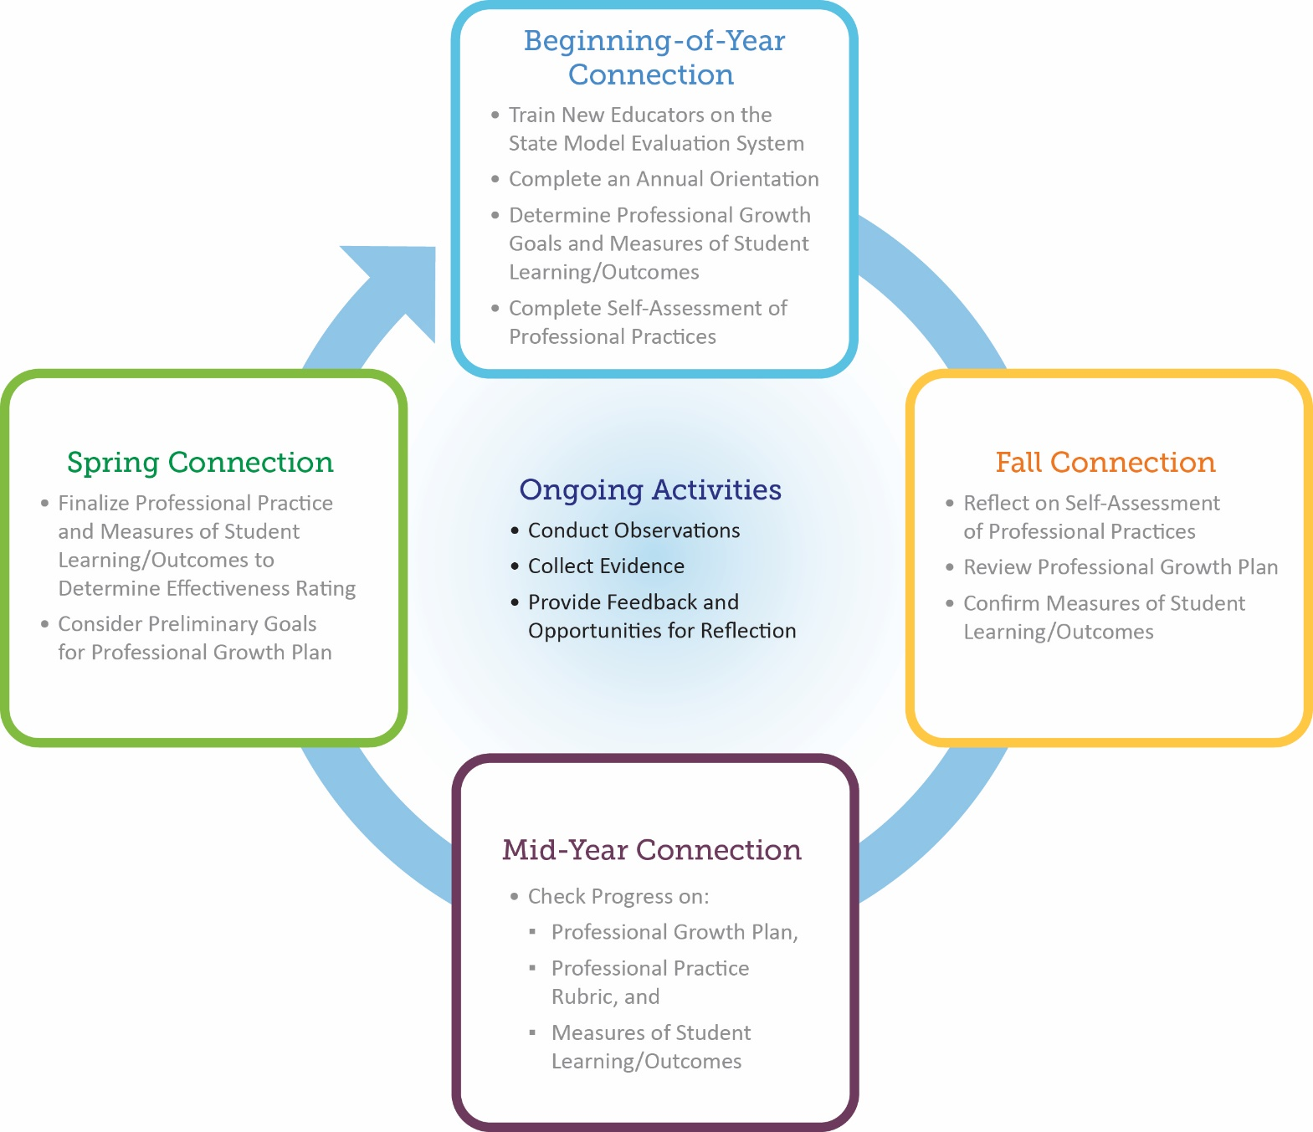
Evaluation Process Connections
Notes:
You see that there are 4 key times in the annual evaluation cycle for connecting evaluators with educators. We’ll break down the components of those key connection times as we review the evaluation process, which includes the 50% professional practices and the 50% measures of student learning/outcomes.

Slide 17
Building Your Evaluation System
Now that you are familiar with the evaluation process, think about how this will work in your setting.
  Who will serve as evaluators?
  Will you have more than one person contributing to the evaluation results?
  How many observations will you conduct?
  What will those observations look like?
  How will you handle observing itinerant staff?

Slide 18
Definition of Special Services Provider Effectiveness
Effective Special Services Providers in the state of Colorado are vital members of the education team and have the knowledge and skills necessary to ensure that diverse student populations have equitable access to academic instruction and participation in school-related activities. Effective Special Services Providers develop and/or implement evidence-based services or specially designed instruction to meet the unique needs of their students. They support growth and development to close achievement gaps and prepare students for postsecondary and workforce success. They have a deep understanding of the interconnectedness of the home, school and community and collaborate with all members of the education team to strengthen those connections. Through reflection, advocacy, and leadership, they enhance the outcomes and development of their students.

Slide 19
Colorado Department of Education
Framework for System to Evaluate
Special Services Providers
Definition of Special Services Provider Effectiveness
Quality Standards
I. Professional Expertise
II. Learning Environment
III. High Quality Delivery
IV. Professionalism
Measures of Student Outcomes
50% Professional Practice Standards 50% Measures of Student Outcomes
Observations of Professional Practice
Expert Input
Other Measures Aligned with CDE Guidance
Weighting: How Much Does Each Standard Count Towards Overall Performance?
Match of Measures of Student Outcomes to Assigned Duties
Weighting:
State Scoring Framework: How Do Measures of Quality Standards
Result in a Determination of Individual Performance?
Effectiveness Ratings
Ineffective Partially Effective Effective Highly Effective
Appeals Process*
Applies when professionals are not at-will employees

Slide 20

Definition of Teacher Effectiveness
Effective teachers in the state of Colorado have the knowledge, skills, and commitments needed to provide excellent and equitable learning opportunities and growth for all students. They strive to support growth and development, close achievement gaps and to prepare diverse student populations for postsecondary and workforce success. Effective teachers facilitate mastery of content and skill development, and employ and adjust evidence-based strategies and approaches for students who are not achieving mastery and students who need acceleration. They also develop in students the skills, interests and abilities necessary to be lifelong learners, as well as for democratic and civic participation. Effective teachers communicate high expectations to students and their families and utilize diverse strategies to engage them in a mutually supportive teaching and learning environment. Because effective teachers understand that the work of ensuring meaningful learning opportunities for all students cannot happen in isolation, they engage in collaboration, continuous reflection, on-going learning and leadership within the profession.
Notes:
Step Out: S.B. 191 required that Teacher Effectiveness be defined. The State Council members created this definition and the definition drove what was included in the rubric.

Slide 21
Colorado Department of Education
Framework for System to Evaluate Teachers
Definition of Teacher Effectiveness
Professional Practice Quality Standards
I. Know Content
II. Establish Environment
III. Facilitate Learning
IV. Professionalism
Measures of Student Learning
50% Professional Practice Standards 50% Measures of Student Learning
Observations of Other Measures Teaching Aligned with CDE Guidelines
Weighting: How Much Does Each Standard Count Towards Overall Performance?
State Other Assessments Other Measures
Summative for Non-tested Aligned with Assessments Areas CDE Guidelines
Match of test to teaching assignments
Weighting:
State Scoring Framework: How Do Measures of Quality Standards
Result in a Determination of Individual Performance?
Effectiveness Ratings
Ineffective Partially Effective Effective Highly Effective
Appeals Process

Slide 22
Special Services Provider and Teacher Quality Standards
Special Services Teacher Standards Provider Standards
What did you notice about the alignment between the Special Services Provider Standards and Teacher Standards?

Slide 23
Special Services Provider Quality Standards
Work with your professional group to complete the following:
  Read each standard and the corresponding elements under that standard.
  Select one element you would like to work with for that standard.
  Record, on your specifically assigned post-it note, a practice that brings your element to life in your educational setting.
  Record, using the same color post-it note, what students or other stakeholders would be doing to reflect that practice (Standards 1-3) or artifacts that would support the practice (Standard 4).
  Repeat this process with every standard.
Once you have created post-it notes for each standard (4 total), post your responses on the corresponding poster.

Slide 24
Gallery Walk Post-it Note Key
Audiologists – Bright Orange
Counselors – Light Green
Nurses – Lavender
Orientation and Mobility Specialists – Bright Purple
Occupation Therapists – Lime
Physical Therapists – Light Blue
School Psychologists – Bright Yellow
Speech Language Pathologists – Bright Pink
Social Workers – Light Pink

Slide 25
Quality Standards Gallery Walk
Read all responses posted
  Remember, each SSP group has their own post-it note color to differentiate expectations.
Be prepared to share out:
  What commonalities did you notice across the areas of expertise?
  What differences did you notice across the areas of expertise?
  What aha’s did you have?
  What questions do you have?

Slide 26
State Model Rubric Basics
Cumulative in content
Each level of the rubric represents an increase in the quality, intensity, consistency, breadth, depth, and complexity of practice
Effectiveness marked by the addition of practices that improve the overall performance of the Special Services Provider and drives to student/other stakeholder outcomes
Standards based
  Outlines the practices that you must meet to be at standard

Slide 27
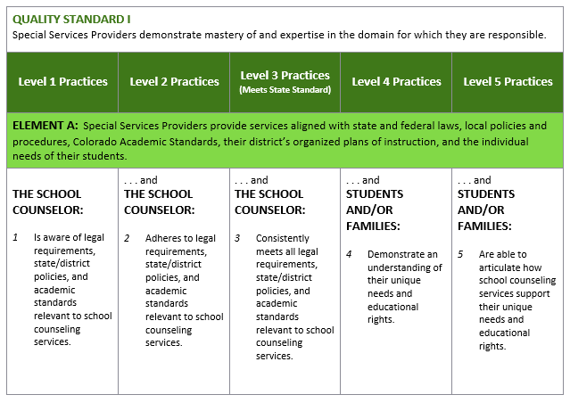
Rubric Structure and Rating Level Focus
The focus of Level 1 Practices is on the foundational elements of service delivery. Every SSP is expected to perform Level 1 Practices professional practices in their day-to-day work.
The focus of Levels 2 and 3 Practices is what SSPs do on a day-to-day basis to achieve state performance standards and assure that students are achieving at expected levels.
The focus of Levels 4 and 5 Practices shifts to the outcomes of the SSP’s practices, including expectations for staff, students, parents and community members, as a result of practices exhibited under Levels 1 through 3.

Slide 28
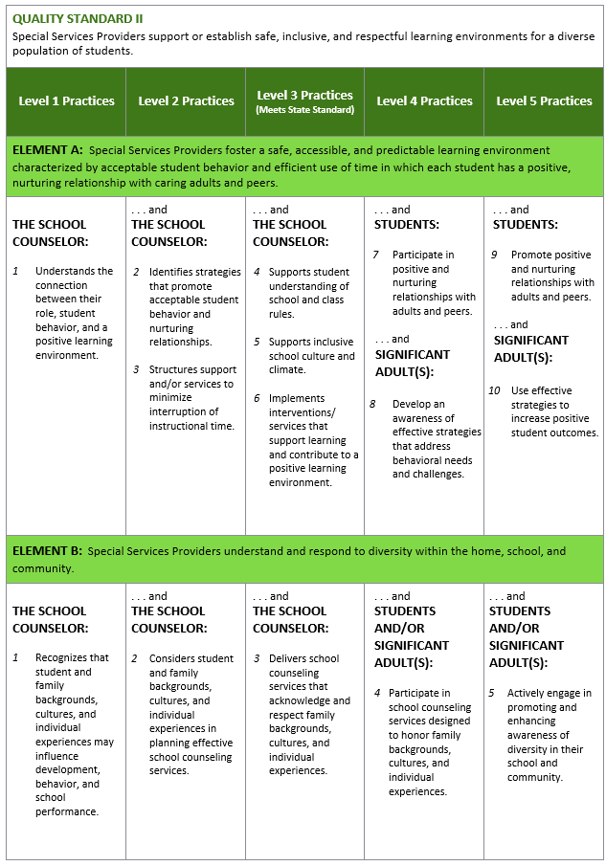
SSP Quality Standards
Performance
Rating Levels
Elements of the Standard
Professional Practices
Elements of the Standard

Slide 29
Scoring the Rubric
Determining the professional practices rating is a three-step process that involves rating the individual elements and standards and using those to determine the overall rating on professional practices.
  Rating the Elements
  Rating the Standards
  Determining the Overall Professional Practices Rating

Slide 30
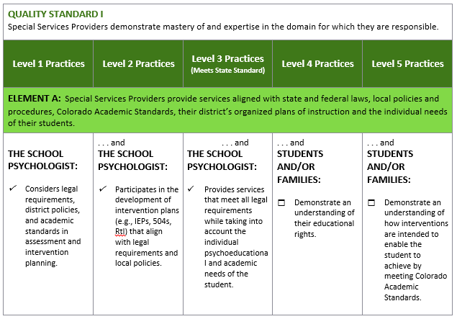
Understanding the Scoring “Business” Rule
Starting in the Level 1 Practices rating level and moving across, look for the first unchecked
professional practice. Move one column back to identify the rating for the element.

Slide 31
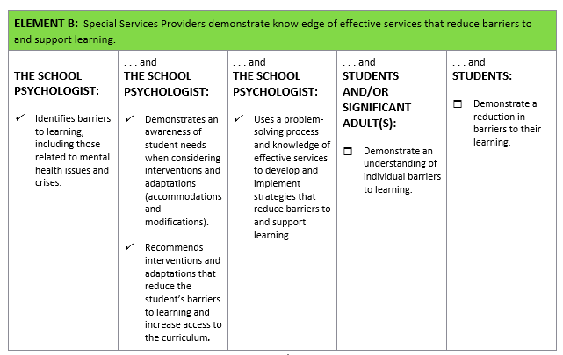
Determining the Element Rating
Starting in the Level 1 Practices rating level and moving across, look for the first unchecked
professional practice. Move one column back to identify the rating for the element.

Slide 32
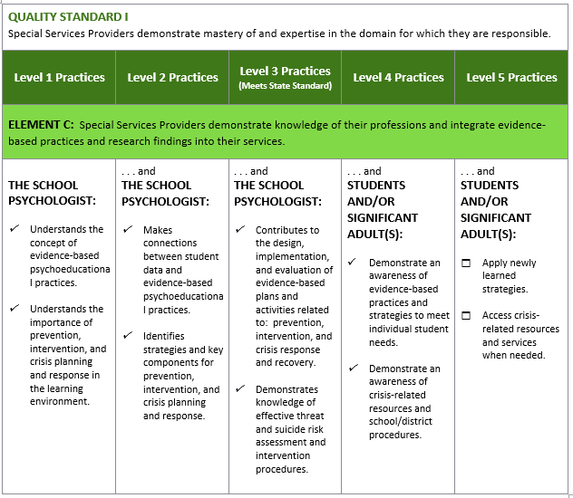
Determining the Element Rating
Starting in the Level 1 Practices rating level and moving across, look for the first unchecked
professional practice. Move one column back to identify the rating for the element.

Slide 33
Rubric Rating Level Points
Standard
Basic | Partially Proficient | Proficient | Accomplished | Exemplary
Element
Professional Practices | Professional Practices | Professional Practices | Professional Practices | Professional Practices
0
SSP’s performance on professional practices is significantly below the state quality standard.
1
SSP’s performance on professional practices is below the state quality standard.
2
SSP’s performance on professional practices meets state quality standard.
3
SSP’s performance on professional practices exceeds state quality standard.
4
SSP’s performance on professional practices significantly exceeds state quality standard.

Slide 34
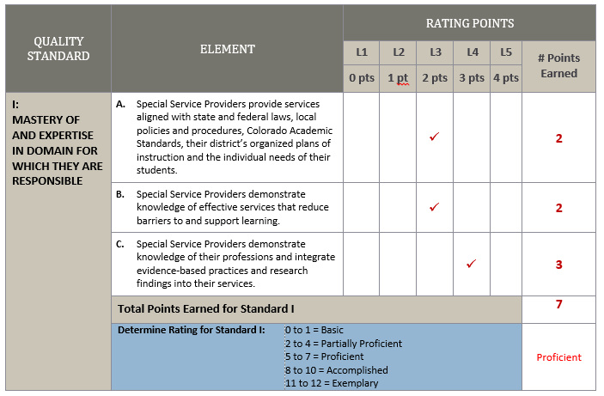

Slide 35
Rubric Simulation and Continuous Improvement
Group Activity
Score your entire rubric including:
    Elements
    Standards
Look for areas of focus for goal setting.
  Record a goal(s) for your scored rubric.
  What feedback would you give to support your claim?
  What type of professional development could you offer as support?
  Be prepared to share your thinking.

Slide 36
Focusing on Continuous Improvement
Find a partner from another professional group.
Together, discuss:
  Ratings of elements and standards in simulation
  Possible goals based on results
  Professional development support

Slide 37

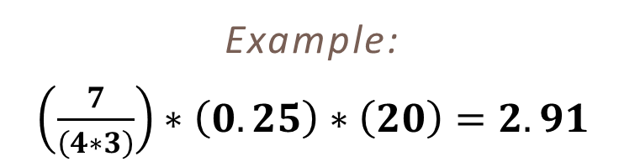
Determining Overall Professional Practice Rating
First, determine each Standard’s contribution to the overall professional practice rating by using the following formula:
$$\left(\frac{\left(Total number of points earned\right)}{\left(4∗Total number of elements\right)}\right)∗\left(weighted percent of standard\right)∗(20 point scale)$$
Example:
$\left(\frac{7}{\left(4∗3\right)}\right)∗\left(0.25\right)∗\left(20\right)=2.91$
Once you’ve completed this step for every Standard, you are then able to determine the overall professional practice rating.

Slide 38
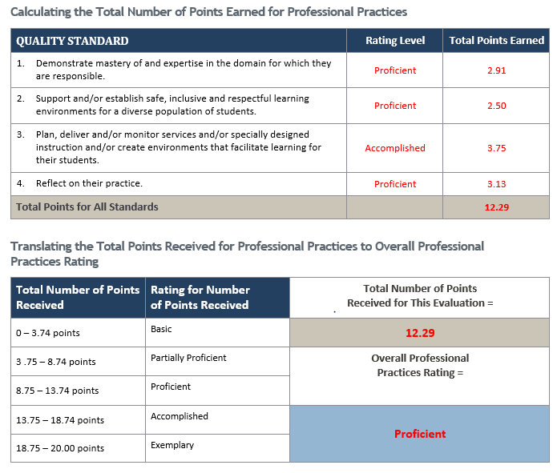
Determining Overall Professional Practice Rating

Slide 39
Building Your Evaluation System
Discuss the following:
  How can an evaluator provide a meaningful evaluation to an SSP who’s area of expertise they may not share?
  How can an SSP support an evaluator in gaining knowledge of their expertise in order to provide a meaningful evaluation?

Slide 40
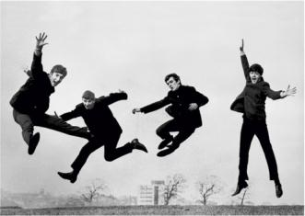

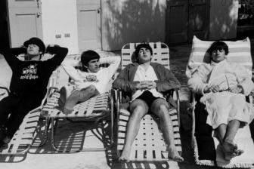

How Do You Feel About SB 10-191?
Choose a picture from below that best reflects your current feelings regarding SB 10-191. Why did you select the picture you did?

Slide 41
What’s on Your Mind?

Slide 42

Contact Us
  http://www.cde.state.co.us/educatoreffectiveness/contactus

