Slide 1
Orientation to the
Colorado State Model Evaluation System
2019-20 School Year
Educator Effectiveness Office

Slide 2
Friendly Reminders
All districts are required to evaluate all educators on all professional practice standards for teachers, special services providers, and principals.
Measures of Student Learning/Outcomes must account for 50% of an educator’s annual evaluation (Teacher, Principal, SSP).
  House Bill 15-1323, states that, “If a local board does not receive the results of state assessments in time to use them in the written evaluation report prepared for the school year in which the assessments are administered, the local board shall use the results of the state assessments as measures of student academic growth for educator evaluations and professional development in the school year following the school year in which the assessments are administered” (22-9-106).
All educators must be given a written evaluation report upon the completion of an evaluation.
  Teachers must receive the report no later than two weeks before the end of the school year.
Notes:
First, a few quick reminders - all professionals are to be evaluated on all standards to determine an overall effectiveness rating. This includes teachers, principals, and special services providers.
MSL/O’s must account for 50% of an educator’s evaluation. Districts should also be mindful of the requirements outlined in House Bill 15-1323, which states that, “If a local board does not receive the results of state assessments in time to use them in the written evaluation report prepared for the school year in which the assessments are administered, the local board shall use the results of the state assessments as measures of student academic growth for educator evaluations and professional development in the school year following the school year in which the assessments are administered” (22-9-106). When districts use prior year results, it means that state assessment results are the “first data point in” to an educator’s evaluation at the beginning of the year, rather than the “last data point in” at the end of the year.
Also, all educators must be given a written evaluation report no later than two weeks before the end of the school year.

Slide 3
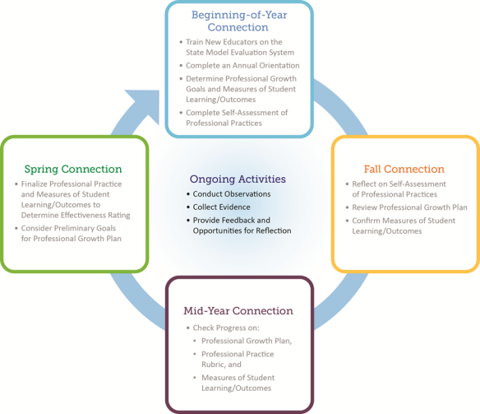
Evaluation Process Connections
Notes:
As a reminder, the evaluation process focuses on four key points of connection between evaluator and the person being evaluated. This includes the 50% professional practice and the 50% measures of student learning/outcomes. These connections will help in planning your evaluation cycle throughout the school year.

Slide 4

State Model Evaluation System for Teachers
Friendly Reminders of the Changes to the
Notes:
The following slide(s) offer a review of the changes that have occurred to the State Model Evaluation System for Teachers and were implemented in most school districts in 2018-19.

Slide 5
Changes to the Teacher State Model System
As a reminder, the State Model Evaluation System for teachers underwent significant changes that were implemented in most districts/BOCES during the 2018-19 school year. Those changes included:
  Significant revisions to rubric expectations, including a reduction in the number of Standards, Elements, and Professional Practices.
  Changes to category labels: Levels 1-5.
  Scoring at the Standard level for professional practice.
  Overall scoring when determining a final effectiveness rating.
Notes:
As a reminder, the State Model Evaluation System for Teachers underwent significant changes that were implemented in most districts during the 2018-19 school year. Those changes included:
Significant revisions to rubric expectations, including a reduction in the number of Standards, Elements, and Professional Practices.
Changes to category labels: Levels 1-5.
Scoring at the Standard level for professional practice.
Overall scoring when determining a final effectiveness rating.
There are multiple hidden slides in this power point should a district be transitioning to these changes this school year (2019-20) or have the desire to review these changes again with educators.

Slide 6
Rubric Revisions
 | Former Teacher Rubric | Revised Teacher Rubric
Number of Standards | 5 | 4
Number of Elements | 27 | 17
Number of Professional Practices | 309 (for an elementary teacher of literacy and mathematics) | 165
Notes:
This table highlights the major changes in the State Model Evaluation System teacher rubric. In attempting to reduce the length of the rubric, a primary goal of this revision was to maintain the rubric’s conceptual integrity. To do that, the Technical Working Group determined to reduce redundancies of similar practices by focusing on the high leverage practices identified in quantitative and qualitative data from the initial State Model Evaluation System teacher pilot and incorporating feedback from educators. In addition, the team focused on clarifying language, ensuring that practices appeared in the appropriate rating levels, and considered current research on best practices to modify, add, or delete professional practices. Thus similar elements were combined and rewritten to reflect changes made to professional practices. As a result, major shifts in the location of elements and professional practices occurred. In addition, Quality Standards IV and V were combined to expand the concept of professionalism and now includes elements of ethical conduct, reflection, and leadership.

Slide 7
Category Labels Change
Former Teacher Rubric | Revised Teacher Rubric
Basic | Level 1 Practices
Partially Proficient | Level 2 Practices
Proficient | Level 3 Practices
Accomplished | Level 4 Practices
Exemplary | Level 5 Practices
Notes:
In addition to reducing and changing rubric content, feedback from the field also indicated a negative impression of the label “Basic” on the rubric. With the help of focus group and Technical Working Group feedback, the five rubric categories that indicate the level of professional practices from the most foundational to the more complex have been changed to better reflect a focus on educator instructional practice and allow evaluators to better focus feedback conversations on instructional practices. The former teacher rubric rating levels of Basic, Partially Proficient, Proficient, Accomplished, and Exemplary, will still be utilized to determine standard and overall professional practice ratings, but within the professional practices the educator will move from Level One to Level Five as they move left to right.

Slide 8
Scoring at the Standard Level
Former Scoring System | Revised Scoring System | Justification
Half of the elements for any given standard must be scored at the higher of two ratings in order to earn the higher rating. | There must be a “preponderance of evidence” in order for an educator to receive the higher of two ratings within a standard. If there are 6 elements in a standard, then the educator must receive 4 out 6 elements at the higher rating in order to earn the higher rating. | In the former system, scores did not necessarily provide an accurate representation of an educator’s ability because educators only needed 50 percent (not a majority) of elements rated at the higher rating to earn the higher rating for the standard. Thus, the revised system requires a majority of elements be at the higher rating to earn the higher rating for the standard.
Notes:
In response to the feedback received from stakeholders in Colorado, there now must be a “preponderance of evidence” in order for an educator to receive the higher of two ratings within a standard. The scoring system requires a majority of elements to be at the higher rating to earn the higher rating for the Standard.

Slide 9
Scoring at the Standard Level
Rating Scenario of a 4-Element Standard Former/Revised | Standard Rating on the Former Teacher Rubric | Standard Rating on the Revised Teacher Rubric
Proficient/Level 3 | Accomplished | Proficient
Proficient/Level 3
Accomplished/Level 4
Accomplished/Level 4
Notes:
This graphic demonstrates the differences between the former teacher rubric and the revised teacher rubric for scoring at the standard level. If there are 4 elements in a standard, then the educator must receive 3 out of 4 elements at the higher rating in order to earn the higher rating for the standard. Previously only 2 of the 4 elements would have to be scored at the higher rating to earn that rating on the standard. This system better reflects actual classroom practice and better aligns to local and state values.

Slide 10
Overall Professional Practice Score
Former Scoring System | Revised Scoring System | Justification
The cut points were set based on the educator earning at least the minimum score for a rating in order to earn the rating. | The cut points were set based on the educator earning the midpoint or higher of the two consecutive ratings in each standard.* | The former scoring system did not accurately define proficient (according to stakeholder values) because an educator could score partially proficient on a majority of standards and still receive a score high enough to gain a proficient rating. The revised scoring system responds to this by making requirements to earn a proficient score more rigorous to better reflect stakeholders’ idea of proficient.
*The rating ranges were established based on the standards being weighted equally. LEAs may choose their own custom weights in order to emphasize specific standards based on local values and context.
Notes:
The preponderance of evidence approach will be used for scoring at the standard level. The educator will need to earn the higher rating on more than half of the elements to earn the higher rating on that standard. Note that the rating cut points were established based on the standards being weighted equally. Districts and BOCES may still choose their own custom weights in order to emphasize specific standards based on local values and context.

Slide 11
Changes in Rating Scale for Professional Practice
Former Professional Practices Rating | Rubric Scale 0-20 (Rounded to the nearest hundredth) | Scale Converted to 0-540 (Rounded to the nearest whole number)
Basic | 0 - 2 | 0 - 54
Partially Proficient | 2.01 - 7 | 55 - 189
Proficient | 7.01 - 12 | 190 - 324
Accomplished | 12.01 - 17 | 325 - 459
Exemplary | 17.01 - 20 | 460 - 540
Revised Professional Practices Rating | Rubric Scale 0-20 (Rounded to the nearest hundredth) | Scale Converted to 0-540 (Rounded to the nearest whole number)
Basic | 0 – 3.74 | 0 - 101
Partially Proficient | 3 .75 – 8.74 | 102 - 236
Proficient | 8.75 – 13.74 | 237 - 371
Accomplished | 13.75 – 18.74 | 372 - 506
Exemplary | 18.75 – 20.00 | 507 - 540
Notes:
The following tables demonstrate how the aforementioned changes have altered the cut scores for professional practice between the former and revised scales.

Slide 12
Measures of Student Learning
No changes have been made to the MSL scoring system. The table below details the measures of student learning ratings for the State Model Evaluation System.
Measures of Student Learning Rating | 0-3 Point Range per Rating (Rounded to the nearest hundredth) | Scale Converted to 0-540 (Rounded to the nearest whole number)
Much Less Than Expected | 0 - .49 | 0 - 134
Less Than Expected | .50 - 1.49 | 135 – 269
Expected | 1.50 - 2.49 | 270 – 404
More Than Expected | 2.50 - 3.00 | 405 – 540
Notes:
No changes have been made to the MSL scoring system. The table above details the measures of student learning ratings for the State Model Evaluation System.

Slide 13
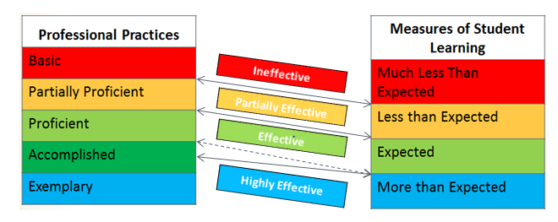
Final Effectiveness Rating Scoring Revisions
Notes:
The revised State Model Evaluation System also involves an adjustment of cut points at the Final Effectiveness Rating level in order to set a higher expectation to earn a Highly Effective rating. Previously, the minimum cut point for Highly Effective was determined by adding the minimum score for Accomplished (on Overall Professional Practice) to the minimum score for More than Expected (on Measures of Student Learning). The minimum cut point for Highly Effective is now determined by adding the midpoint score for Accomplished to the minimum score for More than Expected. The former cut point is represented with the dashed line in the image below. The solid lines represent the cut points that are now being used in the State Model Evaluation System.
In the former system, the highly effective category had the largest possible range of scores, making it easier to achieve. Additionally, school and district leaders found that it was more difficult to have effective feedback conversations around growth with teachers rated Highly Effective. Thus, the revised system sets a higher expectation for earning a Highly Effective rating in order to make the rating more accurate and to facilitate educator growth.

Slide 14
Final Effectiveness Score and Rating
The following table shows the changes in cut scores for the final effectiveness score and rating.
 | Former Scoring | Revised Scoring
Ineffective | 0 - 188 | 0 - 235
Partially Effective | 189 - 458 | 236 - 505
Effective | 459 - 728 | 506 - 843
Highly Effective | 729 - 1080 | 844 - 1080
Notes:
The changes to the cut points for the Professional Practice score affected the cut points for the combined Final Effectiveness Rating. A change was also made in determining the minimum cut point for Highly Effective. Previously, the minimum cut point for Highly Effective was determined by adding the minimum score for Accomplished to the minimum score for More than Expected. It is now determined by adding the midpoint score for Accomplished to the minimum score for More than Expected.

Slide 15
Changes to the Principal State Model Evaluation System

Slide 16
Revisions to the State Model Evaluation System for Principals/Assistant Principals
The following revision process was used to update the State Model Evaluation System Principal Rubric.
  A Technical Working Group was assembled over the summer of 2018 to create a working draft.
    Members of that working group included:
      1 teacher/literacy specialist, 1 assistant principal, 2 principals (1 elementary, 1 secondary), 2 human resource directors, 1 assistant superintendent, 1 superintendent, 2 higher education representatives
  The fall 2018-19 school year was a period of feedback statewide, including 15 focus groups and an online feedback form.
  State Board of Education voted to approve the Standards and Elements in April 2019.
  Statewide implementation of the revised principal rubric will take place in the 2019-20 school year.
Notes:
The following outline is provided to ensure stakeholders understand the revision process for the principal/assistant principal State Model Evaluation System, including those who informed the changes and participated in feedback opportunities.

Slide 17
So What Changed?
A primary goal for the revision of the State Model Evaluation System for principals included a philosophical shift in the way we evaluate leadership within schools. Specifically, the intentions were:
  to provide clear expectations for Colorado principals and assistant principals to continuously improve their practice and advance growth for all students.
  to offer a clear roadmap for professional growth for both the principal and those aspiring to the principalship.
  to ensure that the principal serves as the instructional and equity leader for both teachers and the community.
Notes:
This slide highlights the philosophical shifts that have occurred with the State Model Evaluation System for principals. This shift is incredibly important as users will notice a reduction in managerial expectations and an increase in high leverage leadership practices for principals and assistant principals. Understanding these shifts will aid users in understanding the expectations now outlined in the rubric.

Slide 18
So What Changed?
The revised principal rubric has undergone significant reductions in Standards, Elements, and Professional Practices. The chart below highlights the reductions at all levels.
 | Former Principal Rubric | Revised Principal Rubric
Number of Standards | 6 | 4
Number of Elements | 25 | 17
Number of Professional Practices | 255 | 215
Notes:
A primary goal for the revision of the State Model Evaluation System for principals included a philosophical shift in the way we evaluate leadership within schools. Specifically, the intentions were:
to provide clear expectations for Colorado principals and assistant principals to continuously improve their practice and advance growth for all students to offer a clear roadmap for professional growth for both the principal and those aspiring to the principalship to ensure that the principal serves as the instructional and equity leader for both teachers and the community.
The Technical Working Group, with a desire to align the teacher, principal, and SSP systems, focused on the high leverage practices identified in quantitative and qualitative data from the initial principal rubric pilot and incorporating feedback from educators. In addition, the team focused on clarifying language, ensuring that practices appeared in the appropriate rating levels and considered current research on best practices to modify, add or delete professional practices.

Slide 19
So What Changed?
The principal rubric category labels were also aligned to the changes in the teacher rubric and now read:
The rating levels of Basic, Partially Proficient, Proficient, Accomplished, and Exemplary, will still be utilized to determine standard and overall professional practice ratings.
Former Principal Rubric | Revised Principal Rubric
Basic | Level 1 Practices
Partially Proficient | Level 2 Practices
Proficient | Level 3 Practices
Accomplished | Level 4 Practices
Exemplary | Level 5 Practices
Notes:
In addition to reducing and changing rubric content, feedback from the field also indicated a negative impression of the label “Basic” on the lowest rating level. With the help of stakeholder groups, the five categories used to identify a rating were changed to better reflect a focus on educator instructional and leadership practices. This shift in labeling will allow evaluators to better focus feedback conversations rather than “labeling” an educator with a rating at the element level. The rating levels of Basic, Partially Proficient, Proficient, Accomplished, and Exemplary, will still be utilized to determine standard and overall professional practice ratings.

Slide 20
So What Changed?
The two major scoring shifts applied to the teacher State Model Evaluation System will also be applied to the principal system and include:
  Preponderance of Evidence scoring logic in most cases where a leader must receive 3 out of 4 elements within a standard at the higher rating in order to earn the higher rating.
Notes:
In the former professional practice rubric, the scoring reflects a “rounding up” approach in that half of the elements need to be of a certain rating in order to earn that rating. In the revised professional practice rubric there must be a “preponderance of evidence” in order for an educator to receive the higher of two ratings within a standard. If there are 4 elements in a standard, then the educator must receive 3 out of 4 elements at the higher rating in order to earn the higher rating. Previously only 2 of the 4 elements would have to be scored at the higher rating to earn that rating on the standard.
The preponderance of evidence approach will be used for scoring at the standard level. The educator will need to earn the higher rating on more than half of the elements to earn the higher rating on that standard. Note that the rating cut points were established based on the standards being weighted equally. Districts and BOCES may still choose their own custom weights in order to emphasize specific standards based on local values and context.

Slide 21
Changes in Rating Scale for Professional Practice for Principals
Former Professional Practices Rating | Rubric Scale 0-24 (Rounded to the nearest hundredth) | Scale Converted to 0-540 (Rounded to the nearest whole number)
Basic | 0 - 2 | 0 – 45
Partially Proficient | 2.01 - 8 | 46 – 180
Proficient | 8.01 – 14 | 181 – 315
Accomplished | 14.01 – 20 | 316 – 450
Exemplary | 20.01 - 24 | 451- 540
Revised Professional Practices Rating | Rubric Scale 0-20 (Rounded to the nearest hundredth) | Scale Converted to 0-540 (Rounded to the nearest whole number)
Basic | 0 – 3.74 | 0 - 101
Partially Proficient | 3 .75 – 8.74 | 102 - 236
Proficient | 8.75 – 13.74 | 237 - 371
Accomplished | 13.75 – 18.74 | 372 - 506
Exemplary | 18.75 – 20.00 | 507 - 540
Notes:
The following tables demonstrate how the aforementioned changes have altered the cut scores for professional practice between the former and revised scales.

Slide 22
Measures of Student Learning
No changes have been made to the MSL scoring system. The table below details the Measures of Student Learning ratings for the State Model Evaluation System.
Measures of Student Learning Rating | 0-3 Point Range per Rating (Rounded to the nearest hundredth) | Scale Converted to 0-540 (Rounded to the nearest whole number)
Much Less Than Expected | 0 - .49 | 0 - 134
Less Than Expected | .50 - 1.49 | 135 – 269
Expected | 1.50 - 2.49 | 270 – 404
More Than Expected | 2.50 - 3.00 | 405 – 540
Notes:
No changes have been made to the MSL scoring system. The table above details the measures of student learning ratings for the State Model Evaluation System.

Slide 23
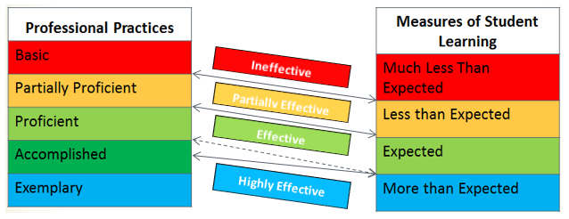
So What Changed?
The second major scoring shift applied to the principal State Model Evaluation System includes:
  Adjustment of the cut points at the Final Effectiveness Rating level in order to set a higher expectation to earn a Highly Effective rating.
Notes:
To align with the Teacher and Principal systems, the revised State Model Evaluation System for principals also involves an adjustment of cut points at the Final Effectiveness Rating level in order to set a higher expectation to earn a Highly Effective rating. Previously, the minimum cut point for Highly Effective was determined by adding the minimum score for Accomplished (on Overall Professional Practice) to the minimum score for More than Expected (on Measures of Student Learning). The minimum cut point for Highly Effective is now determined by adding the midpoint score for Accomplished to the minimum score for More than Expected. The former cut point is represented with the dashed line in the image below. The solid lines represent the cut points that are used in the revised State Model Evaluation System.

Slide 24
Final Effectiveness Score and Rating
The following table shows the changes in cut scores for the final effectiveness score and rating.
 | Former Scoring | Revised Scoring
Ineffective | 0 – 179 | 0 - 235
Partially Effective | 180 – 449 | 236 - 505
Effective | 450 – 719 | 506 - 843
Highly Effective | 720 – 1080 | 844 - 1080
Notes:
The changes to the cut points for the Professional Practice score affected the cut points for the combined Final Effectiveness Rating. A change was also made in determining the minimum cut point for Highly Effective. Previously, the minimum cut point for Highly Effective was determined by adding the minimum score for Accomplished to the minimum score for More than Expected. It is now determined by adding the midpoint score for Accomplished to the minimum score for More than Expected.

Slide 25
Changes to the SSP State Model Evaluation System

Slide 26
Revisions to the State Model Evaluation System for Special Services Providers
The following revision process was used to update all nine Special Services Providers State Model Evaluation System Rubrics.
  A Steering Committee was assembled during the fall of 2018 to create a common set of Standards and Elements aligned to the educator.
  Once a common set of Standards and Elements were created, Workgroups realigned or created professional practices under those Standards and Elements.
  The 2018-19 school year was a period of feedback statewide, including 11 focus groups which were conducted around the state and virtually as well as an online feedback form.
  State Board of Education voted to approve the Standards and Elements in April 2019.
  Statewide implementation of the revised SSP rubrics will take place in the 2019-20 school year.
Notes:
This outline is provided to ensure stakeholders understand the revision process for the SSP State Model Evaluation System, including the two groups who informed the changes and participated in feedback opportunities.
The Steering Committee convened to review and revise the SSP Quality Standards and Elements and included 15 participants, many of whom participated in the original creation of the SSP Quality Standards and Elements, and represented each of the nine SSP groups. Participants included practitioners, administrators, and stakeholders from school districts, BOCES, and institutes of higher education.
Workgroups (one for each of the nine SSP groups) convened to revise the professional practices within the corresponding rubrics. Participants represented practitioners and administrators; rural, urban, and suburban school districts; BOCES; as well as higher education and other statewide organizations.

Slide 27
So What Changed?
A goal of revising the State Model Evaluation System SSP rubrics was to align the standards and elements to the revised teacher rubric while maintaining each rubric’s conceptual integrity.
  The Workgroups, also determined to reduce redundancies of similar practices, focused on the high leverage practices identified in quantitative and qualitative data from the initial SSP rubric pilot and incorporated feedback from educators.
  In addition, the groups centered on clarifying language, focusing on ensuring the measurability of professional practices when possible.
Notes:
This slide highlights the changes that have occurred with the State Model Evaluation System for SSPs. This changes are incredibly important as users will notice an alignment to the Teacher Quality Standards as well as an attention to professional practices that are more concrete and measureable. Understanding these changes will aid users in understanding the expectations now outlined in the rubrics.

Slide 28
So What Changed?
The revised SSP rubrics have undergone significant reductions in Standards, Elements and Professional Practices. The chart below highlights the reductions at all levels.
*Each of the nine SSP groups have a unique set of professional practices. These numbers reflect the variation between rubrics.
 | Former SSP Rubrics | Revised SSP Rubrics
Number of Standards | 5 | 4
Number of Elements | 25 | 17
Number of Professional Practices | 135-177* | 99-146*
Notes:
A goal of revising the State Model Evaluation System SSP rubrics was to align the standards and elements to the revised teacher rubric while maintaining each rubric’s conceptual integrity. The Technical Working Groups, also determined to reduce redundancies of similar practices, focused on the high leverage practices identified in quantitative and qualitative data from the initial SSP rubric pilot and incorporated feedback from educators. In addition, the team focused on clarifying language, focusing on ensuring the measurability of professional practices when possible.

Slide 29
So What Changed?
The SSP rubric category labels were also aligned to the changes in the teacher rubric and now read:
The rating levels of Basic, Partially Proficient, Proficient, Accomplished, and Exemplary will still be utilized to determine standard and overall professional practice ratings.
Former SSP Rubrics | Revised SSP Rubrics
Basic | Level 1 Practices
Partially Proficient | Level 2 Practices
Proficient | Level 3 Practices
Accomplished | Level 4 Practices
Exemplary | Level 5 Practices
Notes:
In addition to reducing and changing rubric content, feedback from the field also indicated a negative impression of the label “Basic” on the lowest rating level. With the help of stakeholder groups, the five categories used to identify a rating were changed to better reflect a focus on SSP service delivery practices. This shift in labeling will allow evaluators to better focus feedback conversations on services provided rather than “labeling” an SSP with a rating at the element level. The rating levels of Basic, Partially Proficient, Proficient, Accomplished, and Exemplary, will still be utilized to determine standard and overall professional practice ratings.

Slide 30
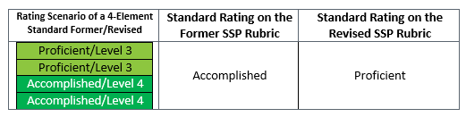
So What Changed?
The two major scoring shifts applied to the teacher State Model Evaluation System will also be applied to the SSP systems and include:
  Preponderance of Evidence scoring logic in most cases where an SSP must receive 3 out of 4 elements within a standard at the higher rating in order to earn the higher rating.
Notes:
In the former rubrics, the scoring reflects a “rounding up” approach in that half of the elements need to be of a certain rating in order to earn that rating. In the revised rubrics there must be a “preponderance of evidence” in order for an educator to receive the higher of two ratings within a standard. If there are 4 elements in a standard, then the educator must receive 3 out of 4 elements at the higher rating in order to earn the higher rating. Previously only 2 of the 4 elements would have to be scored at the higher rating to earn that rating on the standard.
The preponderance of evidence approach will be used for scoring at the standard level. The educator will need to earn the higher rating on more than half of the elements to earn the higher rating on that standard. Note that the rating cut points were established based on the standards being weighted equally. Districts and BOCES may still choose their own custom weights in order to emphasize specific standards based on local values and context.

Slide 31
Changes in Rating Scale for Professional Practice for SSPs
Former Professional Practices Rating | Rubric Scale 0-20 (Rounded to the nearest hundredth) | Scale Converted to 0-540 (Rounded to the nearest whole number)
Basic | 0 - 2 | 0 - 54
Partially Proficient | 2.01 - 7 | 55 - 189
Proficient | 7.01 - 12 | 190 - 324
Accomplished | 12.01 - 17 | 325 - 459
Exemplary | 17.01 - 20 | 460 - 540
Revised Professional Practices Rating | Rubric Scale 0-20 (Rounded to the nearest hundredth) | Scale Converted to 0-540 (Rounded to the nearest whole number)
Basic | 0 – 3.74 | 0 - 101
Partially Proficient | 3 .75 – 8.74 | 102 - 236
Proficient | 8.75 – 13.74 | 237 - 371
Accomplished | 13.75 – 18.74 | 372 - 506
Exemplary | 18.75 – 20.00 | 507 - 540
Notes:
These tables demonstrate how the aforementioned changes have altered the cut scores for professional practice between the former and revised scales.

Slide 32
Measures of Student Outcomes
No changes have been made to the MSO scoring system. The table below details the Measures of Student Outcomes ratings for the State Model Evaluation System.
Measures of Student Outcomes Rating | 0-3 Point Range per Rating (Rounded to the nearest hundredth) | Scale Converted to 0-540 (Rounded to the nearest whole number)
Much Less Than Expected | 0 - .49 | 0 - 134
Less Than Expected | .50 - 1.49 | 135 – 269
Expected | 1.50 - 2.49 | 270 – 404
More Than Expected | 2.50 - 3.00 | 405 – 540
Notes:
No changes have been made to the MSO scoring system. The table above details the Measures of Student Outcomes ratings for the State Model Evaluation System.

Slide 33
So What Changed?
The second major scoring shift applied to the SSP State Model Evaluation System includes:
  Adjustment of the cut points at the Final Effectiveness Rating level in order to set a higher expectation to earn a Highly Effective rating.
Notes:
To align with the Teacher and Principal systems, the revised State Model Evaluation System for SSPs also involves an adjustment of cut points at the Final Effectiveness Rating level in order to set a higher expectation to earn a Highly Effective rating. Previously, the minimum cut point for Highly Effective was determined by adding the minimum score for Accomplished (on Overall Professional Practice) to the minimum score for More than Expected (on Measures of Student Learning). The minimum cut point for Highly Effective is now determined by adding the midpoint score for Accomplished to the minimum score for More than Expected. The former cut point is represented with the dashed line in the image below. The solid lines represent the cut points that are used in the revised State Model Evaluation System.

Slide 34
Final Effectiveness Score and Rating
The following table shows the changes in cut scores for the final effectiveness score and rating.
 | Former Scoring | Revised Scoring
Ineffective | 0 - 188 | 0 - 235
Partially Effective | 189 - 458 | 236 - 505
Effective | 459 - 728 | 506 - 843
Highly Effective | 729 - 1080 | 844 - 1080
Notes:
The changes to the cut points for the Professional Practice score affected the cut points for the combined Final Effectiveness Rating. A change was also made in determining the minimum cut point for Highly Effective. Previously, the minimum cut point for Highly Effective was determined by adding the minimum score for Accomplished to the minimum score for More than Expected. It is now determined by adding the midpoint score for Accomplished to the minimum score for More than Expected.

Slide 35

Support Tools and Resources for Implementation of the Changes to the State Model Evaluation System for Principals and Special Services Providers
Notes:
We also wanted to share with you some other important resources and tools that will be available to you this year.

Slide 36
Principal Resources and Supports
The State Model Evaluation System for Principals webpage contains numerous resources and supporting documents to aid district/BOCES transition to the changes in the State Model.
  Access the revised State Model Evaluation System rubric for principals.
  View a high level overview of the changes to the State Model Evaluation System for Principals.
  View a detailed document that has also been created to further explain the changes in scoring for both the professional practice and overall effectiveness ratings.
  View a best practices in implementation of evaluation systems document.
Notes:
All of the resources above were specifically created to further explain the changes to the State Model Evaluation System. Districts/BOCES should determine how to best share these resources with all their stakeholders.

Slide 37
SSP Resources and Supports
The State Model Evaluation System for SSPs webpage contains numerous resources and supporting documents to aid district/BOCES transition to the changes in the State Model.
  Access the revised State Model Evaluation System rubrics for SSPs.
  View a high level overview of the changes to the State Model Evaluation System for SSPs.
  View a detailed document that has also been created to further explain the changes in scoring for both the professional practice and overall effectiveness ratings.
  View a best practices in implementation of evaluation systems document.
Notes:
All of the resources above were specifically created to further explain the changes to the State Model Evaluation System. Districts/BOCES should determine how to best share these resources with all their stakeholders.

Slide 38
Resources and Supports
A revised version of the User’s Guide for the Colorado State Model Evaluation System is now available and contains all updated tools and resources, including:
  The State Model Evaluation System Process and Components
  The State Model Evaluation System for Teachers
  The State Model Evaluation System for Principals
  The State Model Evaluation System for SSPs
  Measures of Student Learning/Outcomes
  Determining a Final Rating
  Forms and Resources
Notes:
CDE has conducted a significant revision to the User’s Guide for the Colorado State Model Evaluation System. This User’s Guide often serves as the “handbook” for the State Model System and provides a basis for implementing the evaluation system.

Slide 39
Resources and Supports
Practical Ideas for Evaluating Educators with the State Model System were revised during the 2018-19 school year and are currently available for the following teacher groups:
  Practical Ideas for Evaluating Teachers of the Arts-Visual Arts
  Practical Ideas for Evaluating Teachers of the Arts-Music
  Practical Ideas for Evaluating Teachers of the Arts-Drama & Theatre Arts
  Practical Ideas for Evaluating Teachers of the Arts-Dance
  Practical Ideas for Evaluating Comprehensive Health Education Teachers
  Practical Ideas for Evaluating Culturally and Linguistically Diverse Education Specialists
  Practical Ideas for Evaluating Early Childhood Educators
  Practical Ideas for Evaluating General Education Teachers of Bilingual Learners
  Practical Ideas for Evaluating Physical Education Teachers
  Practical Ideas for Evaluating Special Education Teachers
  Practical Ideas for Evaluating Teacher Librarians
  Practical Ideas for Evaluating Teachers of World Languages
Notes:
CDE has revised our set of “practical guides” for evaluating a variety of professionals in their specific positions within the requirements of the state model evaluation system. The practical ideas guides are heavily focused on what evaluators could look for during observations. They also provide other evidence related to these unique roles in order to support the ratings of the educators being evaluated.

Slide 40
Colorado State Model Performance Management System Reminders
Districts are able to enable the new school year as early as July 20th.
Professional Practice standard weights will need to be set no later than December 1st, 2019.
Mid-year review now ensures conversations around professional practice, Measures of Student Learning/Outcomes, and professional growth goals.
Notes:
Districts are able to enable the new school year as early as July 20th. To ensure your educators know and understand how they are being evaluated, COPMS will begin to require professional practice weights to be set no later than December 1st. This required weight setting will ensure rating calculations are correct and that all educators know and understand how they will be evaluated under the requirements specified in the State Board of Education Rules. Also, districts/BOCES should remember that the mid-year review now has an expectation for conversations around progress on the rubric, Measures of Student Learning/Outcomes, and professional growth goals.

Slide 41
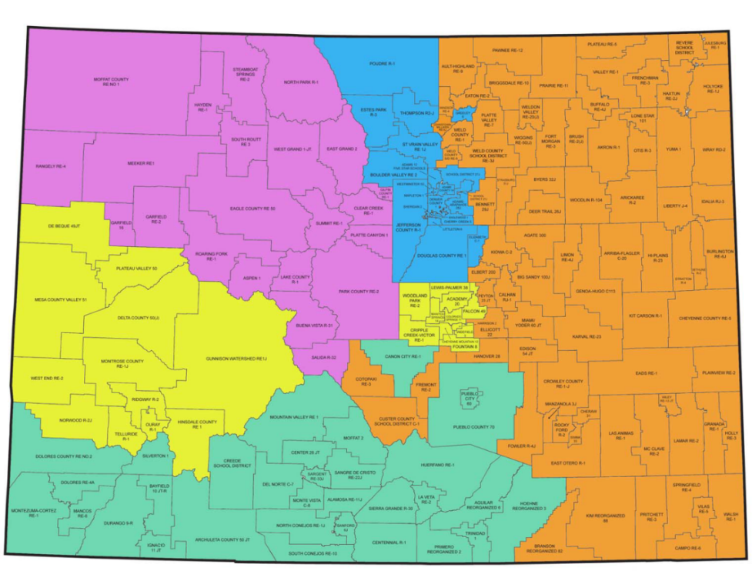
Regional Specialist Contacts
Ed Eff Regional Specialist | Assigned Region(s) | Email | Phone
Curtis Garcia | Southwest | garcia_c@cde.state.co.us | 303-981-8950
Lynn Kintz | West Central, Pikes Peak Region | kintz_l@cde.state.co.us | 303-913-7767
Sue Gill Joslyn Robich | Metro area, I-25 corridor, Weld RE-6 | gill_s@cde.state.co.us robich_j@cde.state.co.us | 720-454-6167 303-866-6221
Rachel Paul | Northeast, Southeast, Pikes Peak BOCES, North Central | paul_r@cde.state.co.us | 303-917-8410
Karin Reynolds | Northwest | reynolds_k@cde.state.co.us | 303-981-2804
http://www.cde.state.co.us/educatoreffectiveness/contactus
Notes:
The Educator Effectiveness (EE) Office will continue to offer differentiated support to districts through the use of Regional Specialists. The regional specialist model will continue to aid districts/BOCES as they support educator practice and build an integrated, systematic approach to educator evaluation.
As the 2019-20 school year begins, members of the team will be available to meet with districts/BOCES to discuss local needs. Please use the chart above to help identify your Educator Effectiveness Regional Specialist. Please note that there have been some district/BOCES shifts in Regional Specialists so be sure to refer to the contact us page which contains a detailed region map to ensure you are contacting the correct regional specialist. Feel free to contact your specialist with any questions you may have or support you may need!
Curtis Garcia
Southwest
garcia_c@cde.state.co.us
303-981-8950
Lynn Kintz
West Central and Pikes Peak Region
kintz_l@cde.state.co.us
303-913-7767
Sue Gill/Joslyn Robich
Metro
gill_s@cde.state.co.us
robich_j@cde.state.co.us
Sue – 720-454-6167
Joslyn - 303-866-6221
Rachel Paul
Eastern Rural
paul_r@cde.state.co.us
303-917-8410
Karin Reynolds
Northwest
reynolds_k@cde.state.co.us
303-981-2804
We hope this power point has provided you with valuable information when implementing the Colorado State Model Evaluation System pilot. Please contact any of the staff in the Educator Effectiveness Office if you have any questions.

