Slide 1
July 31, 2025
Data Pipeline Town Hall
The goal of the webinar is to provide updates on the Data Pipeline, current, and upcoming data collections. These webinars also provide a forum for districts, BOCES, and Administrative Units to have questions answered about Data Pipeline.

Slide 2
Colorado Department of Education
Identity Management (IdM)
Identity Management Site
Frequently Asked Questions
How do I add myself or others to the email listserv for town hall emails and/or a specific collection?
  Email lists are dependent on a person’s access rights in IdM. Contact your LAM to get an account or be assigned to a specific collection.
Where can I find the IdM role mappings for Data Pipeline and other applications?
  Role Mapping (XLS)
I am a LAM. How do I update the user permissions for someone in my district?
  Follow the steps outlined in the IdM Quick Guide for Access Management (DOCX)
Important: Users are not automatically removed from IdM when their email address is no longer active in your district. The LAM must deactivate their IdM account to ensure only designated staff can access CDE’s data reporting system.
Support:
  Michael Threlkeld
  Forgot Password
  Request LAM Assistance
Notes:
LAMs, please check the IdM roles for your district. Remove permissions for users who have retired, left your district, or are no longer assigned to a collection. Add roles for new hires and newly assigned respondents for specific collections.

Slide 3
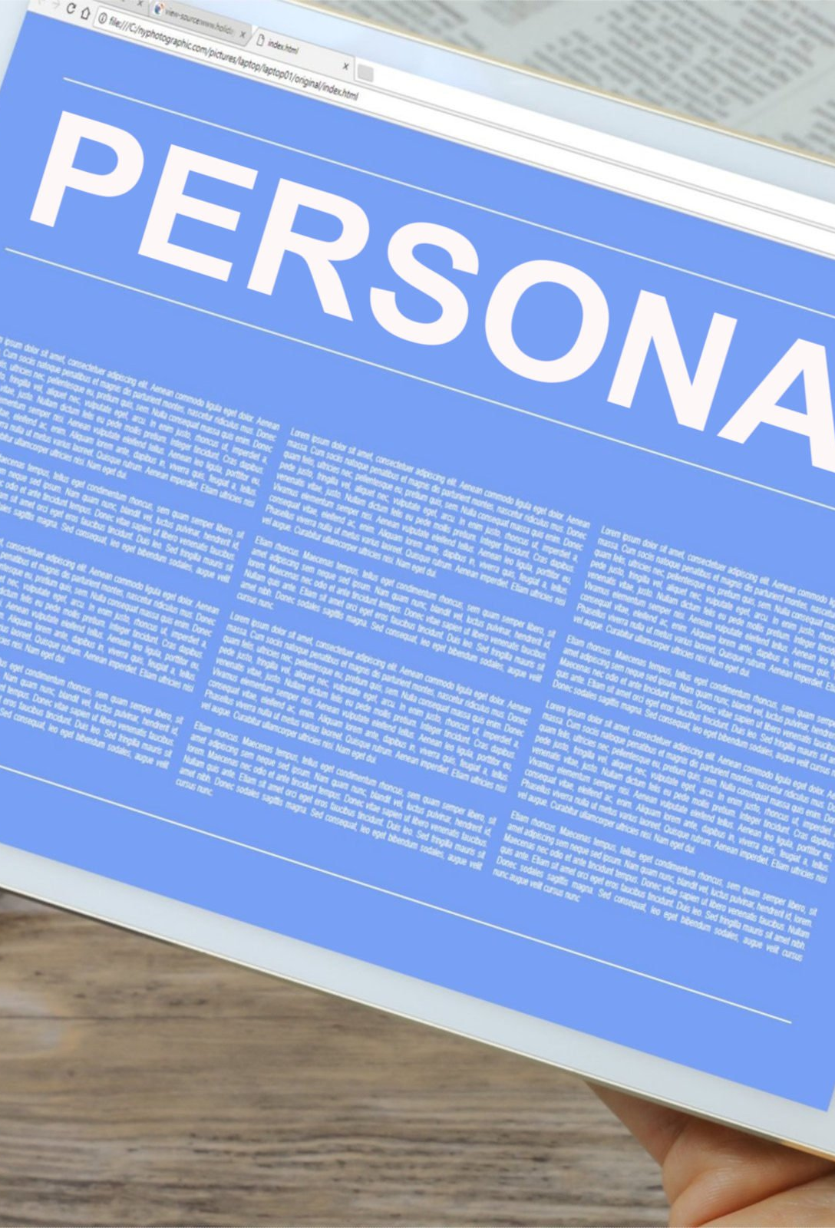
What is PII?
Student and Staff Personally Identifiable Information (PII) is defined by state and federal laws as information that, alone or in combination, personally identifies an individual
  This includes direct identifiers
  (i.e. student and staff names, SASID, EDID, etc.)
  Includes information that when combined is identifiable
Colorado’s Student Data Transparency and Security Act outlines requirements for how Student PII is collected, used and shared
See the Data Privacy and Security website for prepared guidance on how to comply with this and other privacy laws.

Slide 4

Sharing Data
Use secure methods to transfer any PII to CDE
  Contact Data Collection leads with questions about how to transmit PII securely
    Each Data Collection leads maintains their own Syncplicity folders for specific collections, reach out to the collection lead for access
  Use Syncplicity to encrypt emails to CDE
Avoid sending PII via unencrypted email or to unsecured faxes when sharing data between or within districts
  Use Syncplicity to encrypt emails to CDE
Check local policies for restrictions, requirements, etc. regarding PII
  Do not use PII in trainings, presentations, etc.
  Do not share PII with unauthorized individuals
  Do not share passwords
  Follow local policies when transmitting PII to any third party

Slide 5
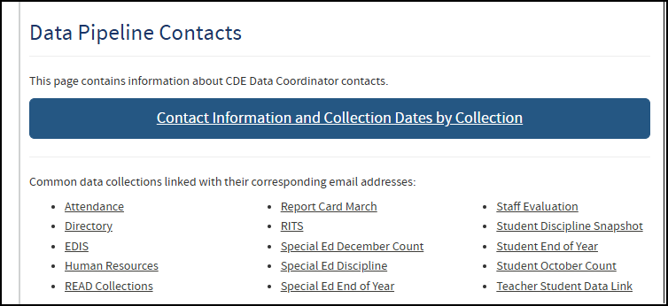
Need assistance with a collection?
Many data collections have a specific collection email address. Please use these email addresses when reaching out to CDE collection leads. Visit the Data Pipeline Contact Us page for a list of contacts or visit an individual collection webpage.
Please do not use the CDE helpdesk email for data collection questions as it may take significant time for the CDE helpdesk to determine the appropriate CDE department to respond to your inquiry, when the collection leads are actively monitoring the email address listed as the point of contact for a collection.

Slide 6
Today’s Agenda
Agenda Topic | Presenter
Open Data Collections and Upcoming Deadlines in Data Pipeline | Host: Dawna Gudka
Staff Evaluation | Dawna Gudka
Student Interchange | Reagan Ward
Student Discipline | Carrie Martin
Prevent Harassment or Discrimination | Carrie Martin
Special Education Discipline | Lindsey Heitman
READ Data Collections | Tara Rhodes

Slide 7
Open Collections and
Upcoming Deadlines in
Data Pipeline

Slide 8
Open Collections and Upcoming Dates:
Year-Round & Interchanges
Name | Category | Status | Key Dates
RITS | Year Round | Open | N/A
EDIS | Year Round | Open | N/A
Directory | Year Round | Open | District Calendars: Open, due 8/29/25
Student | Interchange | 2025 & 2026 Open | 2024-2025: Maintain error free files 2025-2026: Open, register for 8/5 training
At-Risk | Interchange | Open | 2025-2026: Opened 7/16/25
Title I | Interchange | Open | 2024-2025: Maintain error free file 2025-2026: Coming Soon! Scheduled to open in Aug
Special Education IEP | Interchange | Open | Maintain error free files
Staff | Interchange | Open | Staff Profile and Staff Evaluation interchange files are needed for the Staff Evaluation Snapshot
Discipline Action | Interchange | Open | This interchange file is needed for Student Discipline Snapshot and Special Education Discipline Snapshot
Teacher Student Data Link | Interchange | Open | Maintain error free file
Data Pipeline Resources: Data Pipeline Collection Dates (XLS)

Slide 9
Open Collections and Upcoming Dates:
Snapshots
Name | Category | Status | Final Deadline Date | Next Milestone | Looking Ahead
Teacher Student Data Link | Snapshot | Open | Aug. 29, 2025 | Interim Deadline: 8/22/25 error free interchange and snapshot | Report Review: 8/25 to 8/28 Final snapshot report review
Staff Evaluation | Snapshot | Open | Oct. 15, 2025 | Report Review: 7/15 to 8/15 Final snapshot report review | State Deadline: 10/15 Submitted snapshot and sign-off form
Student End of Year: Regular Phase | Snapshot | Open | Sept. 4, 2025 | Interim Deadline: 7/31/25 submit reporting exception requests *8/1 school level exceptions begin to be processed | Training Event: 8/12, 10:30-11:30am, SEY Office Hours—Reports and Data Validation
Student Attendance | Snapshot | Closed | July 25, 2025 | Deadline: 7/25/25 Collection closes; sign-off form due; data embargoed until Aug. release | Data Release: 8/21
Special Education Discipline | Snapshot | Closing Soon | Aug. 1, 2025 | Report Review: 7/25 to 8/1 Final snapshot report review | Deadline: 8/1 all snapshot errors resolved, final approval and report submission due to CDE
Student Discipline | Snapshot | Closing TODAY | July 31, 2025 | Deadline: 8/9/25 sign-off form due; data embargoed until release | Data Release: 8/31
Special Education EOY | Snapshot | Open | Oct. 3, 2025 | Interim Deadline: 9/4/25 all exception requests submitted to CDE for review | Interim Deadline: 9/11/25 error free snapshot
Data Pipeline Resources: Data Pipeline Collection Dates (XLS)

Slide 10
Open Collections and Upcoming Dates:
Periodic
Name | Category | Status | Final Deadline Date | Next Milestone | Looking Ahead
Summer EBT: Corrections Period | Periodic | Open | Sept. 3, 2025 | Corrections Period: 5/19/2025 to 9/3/2025
Prevent Harassment or Discrimination | Periodic | Closing Soon | August 1, 2025 | Deadline: 8/8/25 sign-off form due; data embargoed until October release | Data Release: October
READ Training | Periodic | Coming Soon | Aug. 30, 2025 | Training: 7/15/25, 1:00-2:00pm Join via Zoom | Collection Opens: 8/1/25; Teachers, Principals, and Administrators should have training completed by this date
Data Pipeline Resources: Data Pipeline Collection Dates (XLS)

Slide 11
Staff Evaluation
Dawna Gudka

Slide 12
Staff Evaluation Timeline 2024-2025
Date | Event | Event Description
09-01-2024 | Open | Staff Profile Interchange Open
04-22-2025 | Training Event | Collection Training 1-2pm Microsoft Teams Meeting
05-12-2025 | Interim Deadline | Update and upload Staff Profile Interchange file
05-21-2025 | Open | Staff Evaluation Interchange Open
06-05-2025 | Interim Deadline | Error free Staff Profile Interchange file
06-19-2025 | Interim Deadline | Error free Staff Evaluation Interchange file
06-26-2025 | Interim Deadline | Create at least one Staff Evaluation Snapshot in Data Pipeline
07-15-2025 | Interim Deadline | Error free Staff Evaluation Snapshot
07-15- 08-15-2025 | Report Review | Final Snapshot Review- This is your opportunity to review reports in detail and make any data corrections you deem necessary to make sure you are reporting valid and reliable data. All data corrections must be completed during this time. If you anticipate that you will not be able to meet this deadline, please contact Dawna Gudka by email: Staff Evaluation
10-15-2025 | State Deadline | Staff Evaluation Snapshot Final Deadline Required to have Staff Evaluation Snapshot data submitted and sign off page signed and emailed to Staff Evaluation
10-16-2025 | Closed | Collection is no longer available for LEAs to make changes
Staff Evaluation
StaffEvaluation@cde.state.co.us

Slide 13
Staff Evaluation Snapshot Status
Staff Evaluation
StaffEvaluation@cde.state.co.us

Slide 14
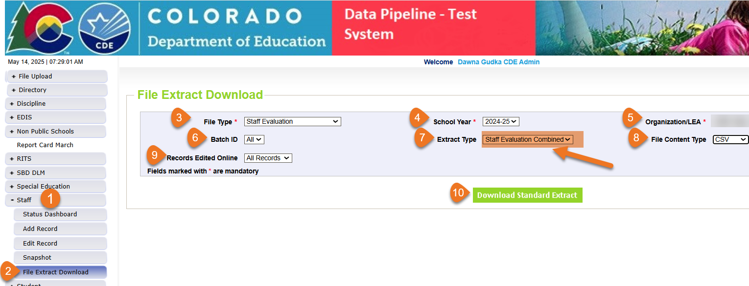
Staff Evaluation Interchange
Step that you should NOT SKIP if your LEA uses COPMS (RANDA)
Staff Evaluation Collection Manual
IMPORTANT STEP IF YOUR LEA USES COPMS (RANDA) do not skip this step. This step can be found on page 8 of the collection manual
Staff Evaluation
StaffEvaluation@cde.state.co.us

Slide 15

Staff Evaluation Snapshot Common Errors
EV030
EV004, EV005, EV006
This EDID was reported as a SSP, teacher or principal for the reported school year. Please add a record for this employee with their appropriate evaluation rating for the school year.
The EDID is listed in the more information section of the error.
The code 06 for teacher overall rating should be used minimally and only in extenuating circumstances (e.g., short-term disability). The percentage of records submitted exceeds 5%. To request an exception, visit cdeinfo.org/ses. For questions, contact EdTalentResearch@cde.state.co.us.
Copy and paste the URL address in a new browser window. There you will fill out EdTalents form to request the exception without providing any PII
Staff Evaluation
StaffEvaluation@cde.state.co.us

Slide 16
Questions & Resources:
Staff Evaluation
Staff Evaluation Snapshot Collection
Staff Interchange website
Staff Evaluation Snapshot website
Dawna Gudka
Collection Lead
(303) 598-7901
staffevaluation@cde.state.co.us

Slide 17
Student Interchange
Reagan Ward

Slide 18
Student Interchange 2024-2025
Date | Event | Event Description
6/11/2025 | Interim Deadline | Error Free interchange files: DEM, SSA, GG
6/12/2025 to 12/2/2025 | Other Date | Maintain error-free interchange files. Errors on DEM or SSA file prevent record from pulling into snapshots and/or may cause errors on student level data collections. Errors on GG file prevent record from connecting to student when validating graduates in SEY collection, causing SE301 SEY Errors Errors on Adj file prevent record from connecting to student to adjust final exit in SEY collection, which may cause Cross-LEA Errors
12/2/2025 | Closes | Student Interchange 2024-2025 Closes
Remaining Connected 2024-2025 Student Collection | Final Deadline
Student Attendance Snapshot | 7/25/2025
Student Discipline Snapshot | 7/31/2025
SPED Discipline Snapshot | 8/1/2025
Teacher Student Data Link Snapshot | 8/29/2025
SPED End of Year Snapshot | 10/3/2025
Student End of Year Snapshot Note: This is the only collection that utilizes GG and ADJ files | Regular Phase: 9/4/2025 Cross LEA Phase: 10/16/2025 Post-Cross LEA Phase: 11/18/2025 noon Superintendent Verification: 12/2/2025
Student Interchange
StudentOctober@cde.state.co.us
StudentEndOfYear@cde.state.co.us

Slide 19
Student Interchange 2025-2026
Date | Event | Event Description
7/14/2025 | Open | DEM, SSA, and GG files open
10/2/2025 | Interim Deadline | Student October: Upload initial DEM & SSA files
10/9/2025 | Interim Deadline | Student October: Error-free DEM & SSA files
12/17/2025 Tentative | Interim Deadline | SPED December: Error-Free DEM & SSA files
11/1/2025 | Other Date | Upload GG file to utilize CEDAR/COGNOS reports to monitor potential 2025-2026 graduates for GG completion, allowing ample time for LEAs to work with students to complete any missing measures during the year.
1/30/2026 | Other Date | Upload DEM, SSA, and GG files and address errors related to mid-year transfers.
4/1/2026 | Other Date | Prepare for Spring student level collections, uploading interchange files and addressing errors as needed.
4/30/2026 | Open | ADJ file opens
5/8/2026 | Interim Deadline | Upload the initial end of year interchange files. (DEM, SSA, GG) LEAs are expected to have an upload date 4/1/2026 or later to meet this interim deadline.
6/1/2026 | Other Date | Error free DEM and SSA records for K-3 students and 4-12 READ Cohort students to prevent errors in the READ Spring Assessments collection
6/10/2026 | Interim Deadline | Error free interchange files. (DEM, SSA, GG)
12/1/2026 | Closed | DEM, SSA, GG, and ADJ files close
Primary Point of Contact:
July 2025 to December 2025 – StudentOctober@cde.state.co.us
January 2026 to December 2026 – StudentEndofYear@cde.state.co.us
Student Interchange
StudentOctober@cde.state.co.us
StudentEndOfYear@cde.state.co.us

Slide 20

Upcoming Training
2025-2026
Student Interchange Overview
Collaborative Webinar:
ML Enrollment and Data Reports
This training session is being offered in two identical sessions.
  Topics include general data respondent information, student interchange files and process, 2025-2026 changes, timeline, business rules, and much more!
Option 1 of 2
  July 16, 9:00-10:00am
  Thanks to all who joined!
Option 2 of 2
  August 5, 9:00-10:00am
  Register for 8/5 Training
This collaborative webinar is designed for Data Staff and program staff who support Multilingual Learner identification and placement in LEAs.
  July 23, 9:00-10:00am
    Thanks to all who joined!
Missed the 7/23 date? Register for one of these additional opportunities to attend this webinar live
  August 8, 9:00-10:00am
  August 19, 1:30-2:30pm
  September 4, 10:30-11:30am
Student Interchange
StudentOctober@cde.state.co.us; StudentEndOfYear@cde.state.co.us

Slide 21
Updated DEM Business Rules for Multilingual Learner Coding
Prior Year: OCT Language Proficiency | Current DEM: Expected Language Proficiency (no error) | Current DEM: SP570 Error—Language Proficiency Out Of Sequence | Current DEM: Allowable Language Proficiency (warning)
1—NEP | 1, 2, 6 | 0, 7, 8, 9, 5, 4 | No other options available
2—LEP | 1, 2, 6 | 0, 7, 8, 9, 5, 4 | No other options available
6—FEP MY1 | 7 | 0, 6, 8, 9, 5, 4 | 1, 2 (SP566 warning)
7—FEP MY2 | 8 | 0, 6, 7, 9, 5, 4 | 1, 2 (SP566 warning)
8—FEP Exit 1 | 9 | 0, 6, 7, 8, 5, 4 | 1, 2 (SP566 warning)
9—FEP Exit 2 | 5 | 0, 6, 7, 8, 9, 4 | 1, 2 (SP566 warning)
5—Former ML | 5 | 0, 6, 7, 8, 9, 4 | 1, 2 (SP353 warning)
4—PHLOTE | 4 | 0, 6, 7, 8, 9, 4 | 1, 2 (SP352 warning)
0—N/A | 0 | 6, 7, 8, 9, 5 | 1, 2 (no warning) 4 (SP178 warning)
SP394 Error when student is grade PK or K and reported as FEP or FELL
  *Request an exception if student is repeating Kindergarten (Grade 006 or 007 in 2024-2025 and 2025-2026)
  and was NEP/LEP in 2024-2025
  and met redesignation criteria to be indicated as FEP MY1 in 2025-2026
Student Interchange
StudentOctober@cde.state.co.us; StudentEndOfYear@cde.state.co.us

Slide 22
COGNOS/CEDAR Report Changes
Multilingual Learner Historical Reporting: SASID Lookup
Multilingual Learner Historical Reporting: District List
Updated report published, old report removed
Former name English Learner Historical Reporting by SASID
Added additional prior year data
  SEY (current and prior year only)
  ACCESS (most recent assessment year, if student was Assessed)
    Alternate ACCESS Y/N
    Overall Composite
    Literacy Composite
Reordered report, most recent school year listed first then in descending order
Updated report published, old report removed
Former name English Learner Historical Reporting by District
Added additional prior year data
  ACCESS (most recent assessment year, if student was Assessed)
    Alternate ACCESS Y/N
    Overall Composite
    Literacy Composite
Include a record for every student on the DEM file, even if the student is indicated with language proficiency = 0 (n/a)
This report only reflects current student interchange files and the prior OCT year
Student Interchange
StudentOctober@cde.state.co.us; StudentEndOfYear@cde.state.co.us

Slide 23
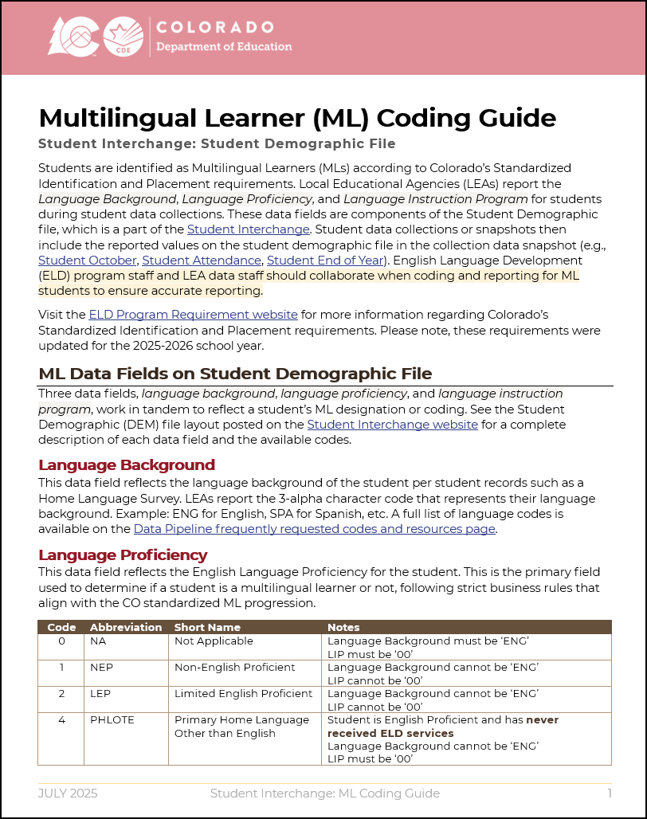
ML Coding Guide
Updated to reflect 2025-2026 updated business rules and updated ELD Program Requirements for standardized identification/placement a redesignation
Available on the Student Interchange website
Designed to support student data respondents with implementation of ML coding in alignment with ELD Team designations for students
Includes details regarding
  ML Data Fields
  Annual Data Cycle and ML Progression
  Determining Language Proficiency Coding
  Business Rules and Reporting Exceptions
  Data Best Practices
  COGNOS/CEDAR Reports
Student Interchange
StudentOctober@cde.state.co.us; StudentEndOfYear@cde.state.co.us

Slide 24
Questions & Resources:
Student Interchange
Student Interchange Website
2024-2025 Student Interchange StudentEndOfYear@cde.state.co.us
2025-2026 Student Interchange
July 2025-Dec 2025: StudentOctober@cde.state.co.us
Jan 2026-Dec 2026: StudentEndOfYear@cde.state.co.us

Slide 25
Student Discipline
Carrie Martin

Slide 26


Student Discipline Snapshot Status as of 7pm July 30
STATE DEADLINE-TODAY
To meet the deadline,
your Student Discipline Snapshot in Data
Pipeline by the end of business.
and return to
StudentDiscipline@cde.state.co.us by August 9, 2025
THANK YOU to all the districts that have completed the collection!
StudentDiscipline@cde.state.co.us
Student Discipline Snapshot Status

Slide 27
Questions & Resources:
Student Discipline
Student Discipline Snapshot Site
Student Discipline Snapshot Timeline
Discipline Interchange Website
Discipline Action File Layout
StudentDiscipline@cde.state.co.us
Carrie Martin-Collection lead
(720) 665-4456

Slide 28
Prevent Harassment or Discrimination
Carrie Martin

Slide 29
Prevent Harassment or Discrimination Status as of 8 pm July 30
STATE DEADLINE-AUGUST 1, 2025
To meet the deadline,
your PHD FILE in Data Pipeline by the end of business tomorrow.
and return to
PreventHD@cde.state.co.us by August 8, 2025
THANK YOU to all the districts that have completed the collection!
Prevent Harassment or Discrimination Collection
PreventHD@cde.state.co.us

Slide 30
Questions & Resources:
Prevent Harassment or Discrimination
Prevent Harassment or Discrimination Site
PHD Training Manual, Exception Request Template , Exception Request Instructions
PreventHD@cde.state.co.us
Carrie Martin-Collection lead
(720) 665-4456
Additional Resources and CDE contacts for Harassment, Discrimination, Title IX, and Bullying
Prevention of Harassment, Discrimination, and Bullying in Colorado Schools Site

Slide 31
Special Education Discipline
Lindsey Heitman

Slide 32
Special Education Discipline Snapshot:
Submission Status
August 1, 2025 - Final Submission Due to CDE
DUE TOMORROW!
To meet the deadline and not lose a point on your AU determination, you must complete both steps by the end of business Friday:
Approve and lock your final SPED Discipline Snapshot in the Data Pipeline
Upload signed reports to the DMS (2 reports in full, plus flag explanations doc if necessary)
    Huge THANK YOU to districts and AUs for your work on this collection!
SpedDiscipline@cde.state.co.us
Special Education Discipline – Lindsey Heitman

Slide 33
Questions & Resources:
Special Education Discipline
SpedDiscipline@cde.state.co.us
Lindsey Heitman
(720) 456-2033
Discipline Interchange Webpage
Special Education Discipline Snapshot Webpage

Slide 34
READ Data Collections
Tara Rhodes

Slide 35
Spring READ Assessment

Slide 36
READ Data Collections:
Spring READ Assessment
SRD confirmation emails will be sent to the district data respondent on Friday, 8/1. The purpose of this email is to confirm the SRD count from the 24-25 Spring READ Assessment data collection.
The numbers confirmed through this process will be used to calculate READ per-pupil funding for the 25-26 school year.
Districts will have until 8/8 to notify me if they need to make corrections to their 24-25 Spring submission. Corrections are also due by close of business on 8/8. Please do not delay in reviewing this email!
After this point, changes in identification or count will not be able to be accommodated for funding or warehouse purposes.
Spring READ Assessment
READActData@cde.state.co.us

Slide 37
READ Training

Slide 38
READ Training:
Background and Purpose
Any educator that is teaching kindergarten through 3rd grade, is a 4th-12th grade reading interventionist, or is a principal or administrator whose responsibility pertains to programs in kindergarten or any of grades one through three is required to take the READ Teacher training or the READ Principal/Administrator training, per 22-7-1208, C.R.S.
Though specific roles are defined in READ Act statute, the definitions are open ended as they relate to job function. This makes it difficult to provide standardized answers as to who is required to take the training from the state’s perspective. Determination of the job function must be made locally.
This means that districts should review job functions of their staff and determine if that meets the respective training requirements in statute regarding who is required to take the training.
Districts should report anyone who they deem required to take either the K-12 READ Teacher training or the K-3 READ Principal/Admin training per the definitions in the Colorado READ Act and functions of the jobs.
READ Training
READActData@cde.state.co.us

Slide 39
Collection Timeline
Date | Event | Event Description
7/15/2025 | Training Event | This training event will cover changes for the 25-26 READ Training collection. This is a live event from 1-2pm and will be recorded.
8/1/2025 | Open | The 25-26 READ Training collection opens in Data Pipeline.
8/15/2025 | Other Date | This is the date by which teachers, principals, and administrators should have their respective READ training designations added to their COOL accounts.
8/19/2025 | Other Date | This is the target upload date for the collection. Please complete an upload by this date.
8/26/2025 | Other Date | This is the target date for an error-free submission for the collection. Please resolve errors by this date.
8/30/2025 | Deadline | The 25-26 READ Training collection closes in Data Pipeline and sign-off forms are due.
9/8/2025 | Other Date | CDE prepares preliminary State Board of Education documents for any extension requests. Any districts requesting a good cause extension for their educators must have their submission locked by this date.
10/8/2025 | Other Date | State Board of Education hears extension requests and provides the final decision around the approval of any extension requests.
READ Training
READActData@cde.state.co.us

Slide 40
READ Training:
25-26 File Layout Changes
Removed the Staff’s Teacher Training Not Complete Status Code column and the Staff’s Administrator Training Not Complete Status column.
While these two columns were removed, the information was not. Additional codes were added to the Staff’s Teacher Training Status Code column and the Staff’s Administrator Training Status Code column to capture the reasons for non-completion.
Added a “No Report of Training” screen in Data Pipeline for districts that are either: 1. declining READ funds, or 2. have already reported all staff as having completed the appropriate training.
Updated the sign-off form to include non-completion counts for codes 14-17 as well as updated language if the district is declining READ funds.
READ Training
READActData@cde.state.co.us

Slide 41
READ Training:
Next Steps
CDE has provided the READ Training Export report in Cognos as a beginning point for the collection. You can pull this report and begin to review who CDE anticipates may need to complete the collection.
  CDE cannot provide a comprehensive list as the requirement is placed by the districts based on job function and not necessarily job class.
However, please note that this report will have to be updated. Please add, remove, or edit educators as needed before submission.
Please advise your educators to submit their documentation to COOL. The only exceptions to this are unlicensed teachers and individuals who took the administrator training but do not hold one of the four following licenses:
  Principal or Administrator license
  Principal Authorization
  Emergency Authorization with either a Principal or Administrator Endorsement
  Interim Authorization with either Principal or Administrator Endorsement
READ Training
READActData@cde.state.co.us

Slide 42
READ Training:
Upcoming Topics
Topics that will be covered during Data Pipeline Town Hall:
August 7: 25-26 Changes and Background
August 14: Manual Review Process
August 21: No Report of Training Screen
August 28: Any last reminders before collection close
READ Training
READActData@cde.state.co.us

Slide 43
Questions & Resources:
READ Data Collections
Tara Rhodes
Phone: 720.601.4125
READActData@cde.state.co.us
READ Data Collections Link
READ Training Data Collection Website

Slide 44
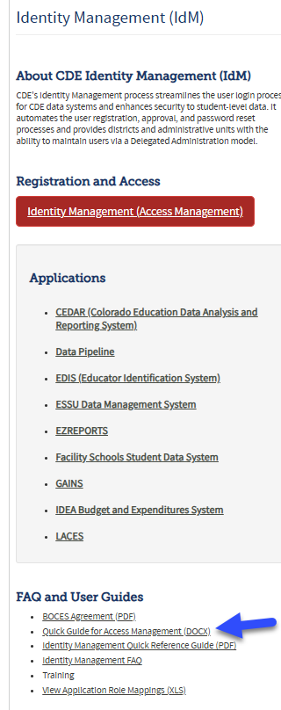
Thank you for Joining Today!
This weeks Reminder
Next Town Hall will be August 7th
Attention
Local Access Managers
(LAM’s)
Please log into IdM and update your staff changes.
The Colorado Department of Education Identity Management system (IDM) provides Local Education Agencies (LEAs) with a means of administering and maintaining user access to integrated CDE data systems. IDM also helps ensure adequate protection of student-level data that is received, collected, developed, and used by the Colorado Department of Education, in compliance with the Family Educational Rights and Privacy Act (FERPA).
Identity Management System (IdM) website

