Slide 1
Short Bytes
English Learners: Exceptions
October to June (Student End of Year)
Notes:
Welcome to this data pipeline short byte covering English learner exceptions from October to June, or the student end of year collection. Today's presentation is a joint presentation with the CLD E Office and the student end of your collection lead here at the Colorado Department of Education..

Slide 2


English Learner
State Proficiency Progression
Reminder: Districts should maintain copies of Screener & WIDA ACCESS scores
Site: CDE ELL Funding Factor Count &
Audit Resource Guide
Site: CDE Standardized Procedures for English Learner Identification
Redesignation: Annual ELP Assessment Scores & BOE
SCREENER & BOE
NEP/LEP
FEP Monitor Year 1
FEP Monitor Year 2
FEP Exited Year 1
FEP Exited Year 2
FELL
All identified NEPs & LEPs must take the annual ELP assessment, ACCESS/Alternate ACCESS
  Language Proficiency Code = ‘1’ or ‘2’
Language Instruction Program Code = 98
  Parents may decline for their child to be enrolled in a Language Instruction Program (LIP) but cannot decline the EL designation or the requirement for students to participate in the annual assessments (WIDA ACCESS).
  When parents opt out of LIP, this must be documented but does not release the district from its responsibility for providing access to a meaningful education. The district must support the academic learning of all identified English Learners (ELs). The Civil Rights Obligations remains the foundation of the legal rights of ELs.
Notes:
Hello everyone. Let's start off by reviewing the state proficiency progression. This is the visual that represents how English learners are identified through screening and a collection of evidence as well as how they are coded after meeting the state's redesignation criteria.
In the Gray box on the left, after screening, students are identified as non-english proficient NEP or limited English proficient LEP and would start to receive. English language development instruction students can be coded as NEP or LEP for multiple years until the district ELL coordinator or team makes a redesignation decision.
Redesignation includes a review of WIDA access scores and a collection of body of evidence that demonstrates the student is FEP or fluent English proficient students who transition successfully to classrooms with minimal language support or redesignated and will be coded as FEP monitor year one. And each year, the student will continue along the progression indicated in the green boxes before being coded as former English language learner or fell FL after two years of monitoring and two years as exited.
Very important here to note all identified NEPs and LEPs take annual tests to measure how language instruction and supports or helping them attain English.
The every Student Succeeds Act, or ESSA, ESSA states, parents and families can formally opt out of services instructions programming by not giving their consent for their child to participate in an LIP indicated as language instruction program code 98. But parents and families cannot formally opt out of the district's decision to designate or identify their child as an English learner. As such, if the district has identified students as an English learner through the following the state standardized identification procedures, students will retain their ELL designation and be coded with the language proficiency code of one or two. Opt out students are expected to take access or alternate access each year until a review of scores and a collection of evidence indicate that the student should be redesignated and coded as fluent English, proficient or FEP.
When parents opt out enrollment of their child into an LIP, districts must collect and store signed opt out documentation. Keep in mind, the district still has a responsibility for providing access to meaningful education. Civil rights obligation remains the foundation of legal rights for English learners, which means the district must support the academic and linguistic learning for all identified English learners, whether they are enrolled in language instruction programs or not.
And finally, as a friendly reminder, please make sure your district has clearly outlined how reports will be retained should an NEP or LEP student be audited for the ELL factor funding count, it's highly likely you will be asked to provide Screener score reports. Links to the ELL funding factor audit resource guide and standardized identification procedures are on this slide for your reference.

Slide 3
Home Language Survey (HLS)
The HLS should be created by districts with State guidance and meet Office for Civil Rights and Department of Justice minimum requirements. All students must have an HLS on file (questions and answers) and must be a standard part of the enrollment process. US Department of Education EL Toolkit, Chapter 1
Responses indicated on the HLS trigger an investigation into English Language Proficiency (ELP) but does not determine eligibility for language instruction / programming and annual ELP assessments.
Contact the Office of Culturally and Linguistically Diverse Education (CLDE) for more guidance.
Notes:
Let's pause for a minute to talk about the Home language survey. Its purpose and use.
There are multiple steps to take, and you shouldn't skip steps to make English language proficiency level decisions. Starting with student registration, the enrollment packet distributed to students enrolling your district and should include the Home Language Survey. All students must have a home language survey on file questions and answers, and this should be part of a standard part of the enrollment process. The Home Language Survey is a questionnaire used to help determine if the student is a potential English learner.
The Home Language survey should be created by districts with state guidance and meets office for Civil Rights and the Department of Justice minimum requirements found in the El Toolkit chapter one link on this slide. Responses indicated on the Home language Survey trigger an investigation into English language proficiency but does not determine eligibility for ELD instruction programming or annual English language proficiency assessments. A student cannot be identified as EL solely based on responses indicated on the Home Language survey. Please refer to the Colorado standardized procedures to collect Screener scores and a body of evidence to make data-driven decisions about English language proficiency.
After the district makes an English language proficiency determination, designate and code students according to their language, background, language proficiency, and language instruction program.

Slide 4
Language Proficiency
Annual Coding Cycle
End of Year
Summer
Coding remains same as October
October
Review WIDA ACCESS Scores and BOE
WIDA ACCESS administered
NEP/LEP students only
Plan for next year, follow Colorado’s Standardized Procedures when making EL redesignation decisions
Student moves along progression based on WIDA ACCESS scores and BOE
Parent opt-out students take WIDA ACCESS
Reminder: Districts should maintain copies of Screener & WIDA ACCESS scores
Site: CDE ELL Funding Factor Count & Audit Resource Guide
Site: CDE Standardized Procedures for English Learner Redesignation
Site: Student Interchange File Layout and Definitions-Student Demographic
Student End of Year
Is the summation of the current school year
Is not the status of the student for next year
Notes:
One way to better understand the coding requirements for English learners is by examining each part of this cycle.
The English Language Proficiency Act, or ELPA, requires districts to report students' language proficiency level each year during student October count, which is seen on the top left side of the cycle. Language proficiency codes indicated in the student interchange, file layout and definition. Student demographic provides codes to describe the student's ability to speak, listen, read, and write in English. English learners must have a proficiency code of 12678 or 9. On October Count day each year, use language proficiency codes to represent the student's proficiency levels.
Moving to the top right of the cycle, students coded as NEP or LEP, even those who are not enrolled in a language instruction program due to parent opt out discuss earlier are expected to take WIDA access during the assigned test window each year.
As we move to the lower right side of the cycle. The end of your coding will remain the same for continuously enrolled students. In other words, students who started the school year in your district and end the school year in your district should have identical codes for student October and student end of year. These two collections are a summation of the current year. Additionally, end of year should not indicate codes for the following school year, meaning ELD programming and instructional plans can change at anytime during the school year, but coding changes should only occur once during the following school year.
Typically, during the summer months or when your district receives WIDA access scores from CDE, EL coordinators and teens will evaluate scores and review a body of evidence to determine if the student has met the criteria for redesignation. So, for example, a student coded as an LEP during October 21 takes access during the testing window, which is usually January through February of 22. Scores are reviewed by the district may of 22 and shows the student is fully proficient in all four domains listening, speaking, reading and writing. So, by meeting CDE's minimum cut scores during maybe June or July of 22, the district would be determined to move the student from LEP to FEP monitor year one, as discussed on the previous slide. The reporting district would change the student's language proficiency code during student October count in 2022.
Please visit the links on this slide if you have questions about the ELL Funding factor audit, standardized redesignation procedures, or the student demographic definitions.

Slide 5
Common Scenario:
Students who Transfer Between Districts from OCT to SEY
Question 1: Was the student screened upon entry into your district?
  If the student was not screened upon entry, a Regular Exception Template & Mid-year Coding Change Form is required. Provide extensive detail regarding this unique circumstance with a detailed body of evidence.
Question 2: Did your district determine the student’s language proficiency is not in alignment with their coding in Student October at their prior district?
  Review EL coding history using CEDAR/COGNOS report “English Learner Historical Reporting”
  If your district agrees with the October coding in the prior district, code the student to match. A regular exception request is only need if errors still occur after coding student to match current year October.
If the answer is ‘Yes’ to both questions, complete a Regular Exception Template to request an exception for this error. Be sure to include a statement indicating student was screened upon entry into your district in the ‘reason for request’ portion of the exception request.
Reminder: Students should be screened upon entry into your district if their educational records indicate a language influence per the state’s standardized identification procedures. CEDAR/COGNOS is a great tool for reviewing a student’s EL History.
Notes:
Now let's talk about the common off cycle situations. So, what that means is, since we reviewed the language proficiency annual coding cycle and we reviewed the expected progression, we need to talk about what happens if a student has a situation with or not moving through the progression in the expected manner. This slide is showing one of the more common situations a student who has transferred between school districts between the student October data collection and the student end of year data collection.
When this happens, your district has followed the states identification procedures and during that process you may run into an issue because your coding may not align with the prior district. So, there's a couple of questions you need to ask yourself if you are receiving errors on your student demographic file that are showing the student is moving through the progression but not in alignment with what would have been expected. So, there's a change from the October collection to end of year as yourself two questions. The first one is, was this student screened upon entry into your district because that is a component of the identification procedures if the student was not screened upon entry, then you're going to need more information to request any kind of change. So, a regular exception template and a mid year coding change form will be required with extensive detail regarding the very unique circumstances with a detailed body of evidence, because it would be a very unique circumstance to have a student enter your district and not be following the standard identification procedures. So that would be that first question was the student screened?
The second question you're asking yourself is when the student was screened, did your district determine the student's language proficiency is not in alignment with the coding and student October at their prior school districts? So, you have screened the student and perhaps in the prior school district they were Limited English proficient in the 22-23 school year, so student October 2022, but now your district is saying actually their language progression shows that they should be FEP monitor year one or something else. A few things to remember. If your district is finding that their coding is not in alignment with the prior district, there is a report where you can review El coding history called the English Learner Historical reporting and we'll look at that here in a couple of slides. If your district agrees with the October coding in the prior district, then you'll just code the student to match, and you shouldn't run into any issues. It's when the district disagrees that you're going to run into errors, and we'll need to work through an exception process.
So, if your answer is yes to both questions. So yes, the student was screened, and yes, my district does not agree with the coding in student October this school year for the student based upon our body of evidence and the screen are reports, then your data respondent will complete a regular exception template to request an exception for this error. Be sure to include a statement indicating the student was screened upon entry into your district as the reason for request portion of this exception request, and we'll look at it at an example of this template in a couple slides. As a reminder, students should be screened upon entry into your district if their educational records indicate a language influence per the States standardized identification procedures. CEDAR or COGNOS is a great tool to review as students’ EL history, but it is not the only tool that you use because the standardized procedures include more components to determining if the student is an English learner.

Slide 6
Mid-Year EL Coding Changes within the same district (Clerical Error)
Student was mis-coded (clerical error) in Student October
  <2 years EL history in the same district
    Regular Exception Template
  >2 years EL history in the same district (3 October, 2 SEY)
    Regular Exception Template & Mid-year Coding Change Form required
Example: Student was redesignated over the summer per the standard coding cycle, but Student October did not show the updated status.
If approved, will require follow-up exception request in the subsequent Student October.
Notes:
There are instances where a district has a clerical error and needs to make a mid year El coding change O what has happened in this kind of situation and it is less common, but it does happen where a student was miscoded in student October and then in student end of year. The coding needs to change to what the coding should have been and student October. This is typically a situation like this example where your district was following the standardized redesignation procedures and over the summer, based on that standard coding cycle, the students educational team body of evidence we to access scores shows that the student was ready to move to the next step on that standardized progression. But for some reason, when you got to that student October collection, the code had not been updated in your information system. It hadn't been switched over as it should have been. So, the team has already made the decision and the correct portion of the cycle, but it just got missed for clerical reason, getting the code to align with the decision that had been made. When that happens, there is a process then to request that coding change be made during the middle of the school year.
Depending on the amount of English learner history for a student will direct the steps you need to take as a district to get this corrected. So if the student's English learner history within your same district is less than two years of history, it's just that regular exception template that we will look at in another slide. But if the students has more than two years of English learner history within your district, so we're looking at three student October collections and two student end of year collections O really because this is in the middle of the school year, you haven't gotten to that third student end of year collection yet. That's what you're asking the change to happen for, you're going to need a mid year coding change form with a more robust component of documentation to explain the situation and we'll look at that form here in a little bit.
It's important to note that if approved, so if this change is approved, there will be the need for a follow up exception request in the subsequent student October. So in next year's student October. So we make the mid year change for example in the 22-23 school year, you've got that exception request approved when you get to the 23-24 school year and you're doing that student October collection, you will need to request another exception to get the students coding completely back on track. So it does take 2 collections to get the student back on track.

Slide 7
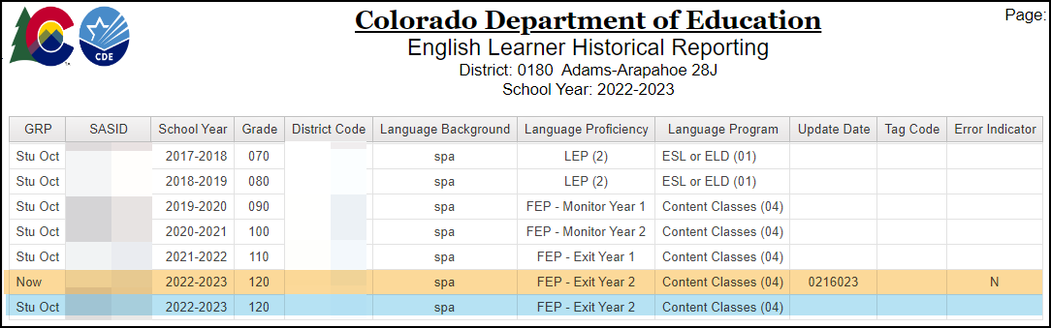
CEDAR/COGNOS: English Learner Historical Reporting
Reminder: This report is a tool to review EL coding, it does not determine a student’s current Language Proficiency. Follow the State’s standardized identification procedures and redesignation procedures.
Site: CDE Standardized Procedures for English Learner Identification
Site: CDE Standardized Procedures for English Learner Redesignation
Operational report to help districts check the English Learner history for a student by SASID
Reflects data from prior Student October Collections and Current Student Demographic (DEM) file
Available to data pipeline users with STD~LEAViewer or STD~LEAUser access
Notes:
The Colorado Education Data and Reporting Portal, CEDAR also known as COGNOS, contains many helpful reports to support district data respondents. One such report is called English Learner Historical Reporting which allows a data respondent to review the EL coding for a student in both their district and prior districts when researching EL errors. EL Program staff may wish to partner with data staff to review this report if they have questions about the past coding for an EL student or an incoming student who they believe may have EL history. It is important to note that this report is a tool to support districts when researching EL errors. It DOES NOT determine the appropriate Language Proficiency identification for a student. Follow the state’s standardized identification and redesignation procedures.
You’ll notice the report shows the Student October coding for a student and the current coding. It does not show coding from prior Student End of Year collections, so it is important for districts who’ve received an approved mid-year EL coding change to track this information and request the follow-up Student October exception.
___
As mentioned before, there is a tool in the Colorado education data and Reporting system which is something called Cedar, (but many of us often call it Cognos so those two terms are synonymous), called the English Learner Historical Reporting report. What this tool does is it's an operational report that allows a district to check the English learner history for a student by SASID. It will reflect data from all the prior student October collections, so it'll say on the left, Stu Oct to say this is the student October coding and it will reflect, where it says now, the current student demographic file. It shows the different districts that the student has been in with their coding as well. Very helpful if the student has transferred to you and you are curious what their prior student October coding was and their prior district.
This is a report available to data pipeline users with the student interchange LEA Viewer role or the student interchange LEA user role. So, if you have that user role in data pipeline, you'd be able to access this report, which is why data staff and EL program staff really need to work together if they want to do some research to a prior year's report or to a specific students EL history.
You'll notice that this is focusing on student October and the current coding for a student. It does not reflect coding from a prior student end of year. If your district has received an approved mid year El coding exception, it will not reflect on this report and it will be up to your district to keep an eye on that component because of that follow up request that would need to be made the next do not October to finalize the change in progression.
As a reminder, this report is a tool to review El coding. It does not determine a student's current language proficiency to determine a student's current language proficiency, your district must follow the state standardized identification procedures and redesignation procedures.

Slide 8

Personally Identifiable Information (PII)
Personally Identifiable Information (PII) is defined by state and federal laws as information that alone, or in combination, personally identifies an individual
  Includes direct identifiers (i.e. SASID, student names)
  Includes information when combined is identifiable
Colorado’s Student Data Transparency and Security Act outlines requirements for how Student PII is collected, used and shared
See CDE’s data security and privacy site for more information
Syncplicity
  Secure file transfer site used to communicate PII with CDE collection leads
  Each collection lead maintains their own Syncplicity folder and can assign rights to that folder
    Student End of Year, Student October, and Attendance all utilize the same primary folder with subfolders to organize the collections
    Primary Syncplicity Folder: District Code – DISTRICT NAME – Student
Notes:
Before we can look at example exception request forms, we need to talk about personally identifiable information which is defined by state and federal laws as information that alone or in combination personally identifies an individual. So, in this instance we're talking about students. It would be direct identifiers such as SASID, student names, date of births or other information that when you combine it together would identify a student. Because of Colorado's student data transparency and Security Act we really need to think about the requirements for how we communicate student PII and how it is used and shared. So, this is data that we do need to keep secure and we do need to keep private. That means that when communicating with CDE staff or communicating amongst one another, it's important to know that e-mail is not considered secure. I will say that again, e-mail is not considered a secure method to transfer personally identifiable information.
But what we are talking about now with exception requests are situations where we do need to communicate personally identifiable information. To do that we use a tool here at CDE called syncplicity. This is a secure file transfer site that allows us to communicate between CDE collection leads and the data respondents within a school district so they can securely send this information back and forth. Each data collection lead maintains their own syncplicity folders with the access rights to that folder. The Student End of Year, Student October, and Attendance collections all use the same primary folder and then organize the collections with subfolders. The primary syncplicity folder when working with English learner exceptions, because this is a student level, data is going to be your district code, your district name and then dash student at the end. When communicating personally identifiable information, what the data respondent would do is they would tell the Student End of Year collection lead “Hey, I've put a document in Syncplicity, will you please review it?” That allows the collection lead to then securely go and look at that student information without it being sent via e-mail.

Slide 9
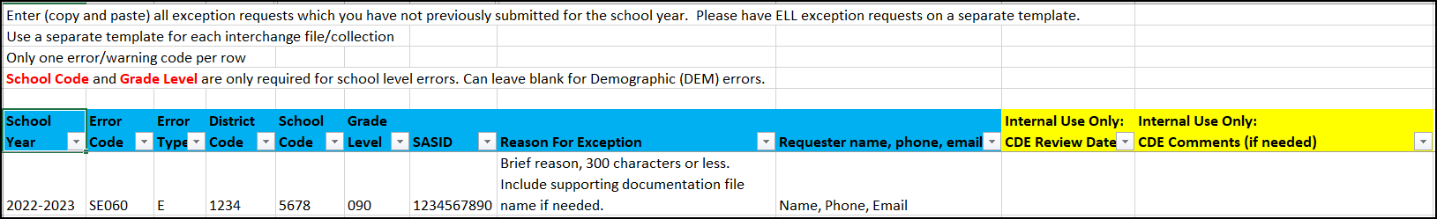
Regular Exception Template
Required for all reporting exceptions, even when additional documentation is also being provided
Uploaded to Syncplicity for Review
Create a new exception request form when additional exceptions are needed, not a running list
Available on Student End of Year and Student Interchange Websites
Notes:
Let's look at the regular exception collection template. The regular exception template is the template used for the majority of exceptions in the student data collections, not just English learner exceptions, but any other situation that may require a reporting exception. It's imperative that the information on this form is accurate. The error code, error type, District code, school code, grade level, and safe and must be accurate. Otherwise, the exception does not process correctly. Data respondents are encouraged to copy this information directly from the corresponding error detail report. Once you have copied that, that's how you know you'll have it accurate. The most common issues are that grade level is a 3-digit code, not a 2-digit code and the district code and school code are always 4-digit codes. Leading zeros are what typically get lost, so remembering that those need to be exactly as you would see on the error report and the error code needs to be the specific error code on the error report. That's what you're putting into this exception template.
Once you have completed it exception template and it is one row of information per student that needs an exception. It would get saved and uploaded to syncplicity to that student folder we are just talking about. And then you're going to e-mail the data collection lead. So, in this case, the student end of year data collection lead and say please review the exception request that in Syncplicity.
This template is available on the student end of your website and on the student interchange website. So the template is there for you with instructions on both of those sites, with more details for filling out the form and getting it into syncplicity.

Slide 10
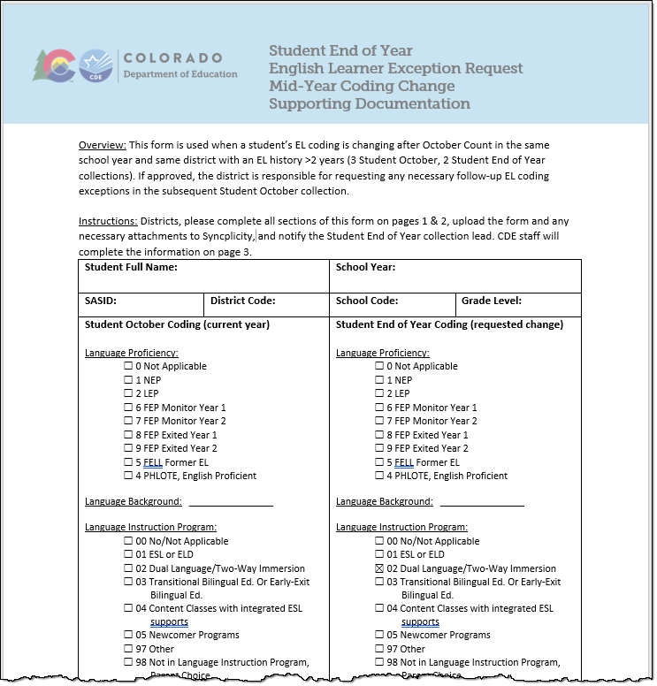
Mid-year Coding Change Form Components
Student October coding vs. requested coding change
Most Recent WIDA Screener Scores
Most Recent WIDA ACCESS Scores
Required Information – explain district’s decision-making process and supporting body of evidence for this change
Future Planning
  How will you district prevent this scenario in the future?
Form available on the Student End of Year website
Notes:
The Mid-Year EL Coding Change Form can be found in the Templates section of the Student End of Year website. This form is completed for each student with a mid-year change and uploaded to syncplicity alongside the regular exception request template. It provides space for the additional information needed when reviewing a mid-year coding change for a student with significant EL history in a district since the regular exception form is limited to 300 characters or less for an exception reason.
--
If you have one of these situations where you do need that mid year coding change form, that form is also available in the template section of the student end of year website and it would be completed for each student with a mid year change and uploaded to syncplicity alongside that regular exception request template. So, you'll have the regular template and then you would have a file that is this form for each student that would need this request. It provides space for all of the additional information that is needed when reviewing these mid year coding changes for students with a significant English learner history in a district (since the regular exception request form where it has a place for you to write a reason is limit to a very small number of characters). So, this form will have a place for you to show what their current student October coding is and what the request to change is. So that's how it starts off. Then, it’s got a place to add the most recent WIDA Screener scores and most recent WIDA access scores. There's a required information section where districts explain their decision-making process, and the supporting body of evidence for requesting this change. And does have a place for future planning. How will your district prevent this scenario in the future? Because as we talked before, many of these would be, the example given was a clerical error, so how are you going to prevent a clerical error in the future? Would be what you would explain or how are you going to prevent (however we got to the need for this form) in the future. Because, ideally, we shouldn't have too many of these scenarios.
This form is available on that student end of year website and like said would get uploaded In Sync plus city alongside the other exception requests.

Slide 11
Additional Support:
CLDE Office
Student End of Year Collection Lead
Notes:
If you would like additional support or would need more information, please contact the CLDE office or the student end of year collection lead here at CDE and we would be happy to talk to you about mid year changes for English learners. Thank you so much for joining us for this short bite.

