Slide 1
Short Bytes
Adequate Documentation of Transfer

Slide 2
Adequate Documentation Overview
Adequate documentation is the documentation maintained by districts/schools when students transfer out of their district
Necessary to avoid incorrectly coding students in 7th-12th grade as dropouts
Adequate documentation is maintained year-round and should be readily available upon request by SEY collection lead
Reviewed by SEY collection lead on a case-by-case basis
Typically used when addressing SE903 errors in the Post-Cross LEA Phase
Requirements are further outlined in state rule, as seen here: 1 CCR 301-1 Rules for the Administration of the Accreditation of School Districts

Slide 3
1-CCR-301 Highlights/Reminders
When a student withdraws, districts are authorized to request information from the parent or guardian about the specific type of educational enviornment that a student is transferring to in order to monitor compliance with the School Attendance Law. [section 22-33-104 (1), C.R.S.]
Colorado Public Schools and local education agencies are required to send transcripts or to confirm attendance when requested from another Colorado Public School or local education agency within two weeks of receiving the request with the exception of students in out of-home placements whose records must be transferred within five (5) days pursuant to sections 22-32-138(2)(a)(II) and (3)(a), C.R.S

Slide 4
Types of Documentation
School Exit Type(s) | Documentation Needed
13 | Confirmation of Enrollment/Attendance RITS is not considered adequate documentation because a student may enroll and not attend
14, 15, 18, 19, 21, 26, 70 | Written Records Request Confirmation of Enrollment/Attendance
05 | Written Records Request Confirmation of Enrollment/Attendance Parent/guardian signature on written intent to emigrate and attend school in another country Written confirmation by school administrator based on a conversation with parent/guardian
16 | Confirmation of intent to homeschool signed by parent/guardian
30 | Doctor’s Note
02 | Obituary Notification from parent/guardian Written confirmation from school administrator
Note: All documentation should include the student’s full name and SASID if assigned

Slide 5
Adequate Documentation Site
Sample Forms/Templates:
Records Request
Receiving district
Confirmation of Enrollment and Attendance/Records Request
Receiving district
Request for Confirmation of Enrollment and Attendance
Sending district
Notification of Withdrawal
Completed by parent/guardian when withdrawing student
Student Transfer Follow-up
Used by district when parent/guardian unable to complete notification of withdrawal

Slide 6
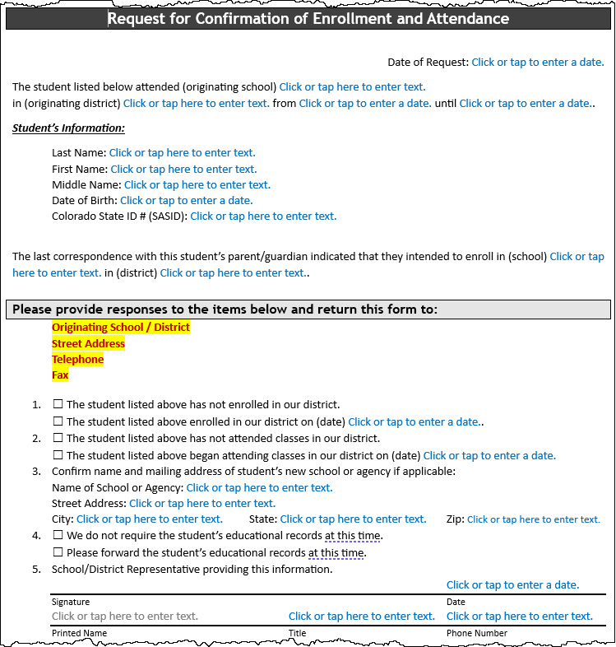
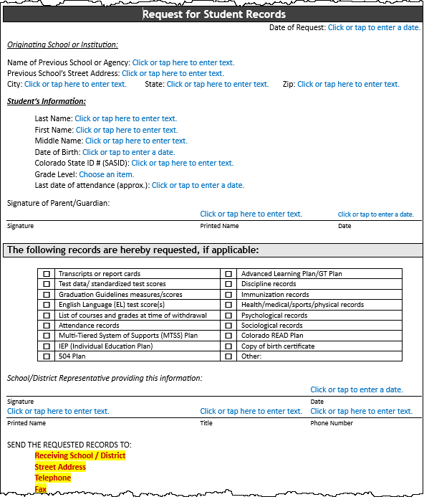
Sample Forms

Slide 7
More Information: Student End of Year Website Adequate Documentation Website

