Slide 1
School Discipline Data Reporting Review
2019-2020

Slide 2
Agenda
SDA Data Collection Process
SDA Data File Review
Determining Most Serious Incident to Report
Other Resources

Slide 3
School Discipline (SDA)
Discipline Interchange/
Discipline Snapshot
Interchange
Student Level Data
ONLY Students with disabilities are included
Districts submit data in pipeline; AU’s create and finalize Discipline Snapshot data
Periodic Collection
School Level Data
  count of incidents
  count of students
ALL Students disciplined counted and reported
Districts Submit data and finalize data

Slide 4
SDA Data Collection Process

Slide 5
SDA data is Required by Statute:
22-11-503 (3)(c): The information shall be consistent for each type of report and, at a minimum, shall include the occurrence of each of the following types of incidents, expressed as a number and as a percentage of the total occurrences of all of the incidents:
    Substance abuse-drugs; Substance abuse- alcohol; Substance abuse- tobacco; Felony assaults; Fights; Possession of dangerous weapons; and Other violations of the code of conduct at the public school
22-32-109.1(2)(b)(IV): The number of conduct and discipline code violations…only in the most serious category that is applicable to that violation including to specific information on the number of and the action taken with respect to the following types of incidents:
    Dangerous Weapon; Destruction of Property; Alcohol; Tobacco; Drug; Robbery; Disobedient/Defiant; Detrimental Behavior; 1st, 2nd or Vehicular Assault; 3rd degree Assault/Disorderly Conduct

Slide 6


Data is Reported to CDE via Data Pipeline Process
Schools
Track data throughout school year
Districts
Combine data from schools
Report data to CDE
Data Pipeline
Provide data to district
Verify accuracy of reports
Determines the appropriate category for every incident
Correct and Approve data
Checks data for accuracy
Collects data from districts
Rejects data if not accurate-districts must resubmit
Verify accuracy with schools
CDE
Reports data as required
Aligns data with law
Reviews Data

Slide 7
What must be Reported?
All (includes special education) students disciplined during the school year
Include the incidents that are either state reportable or resulted in a suspension, expulsion or referral to law enforcement
Include all of the students that were involved in the reported incidents

Slide 8
CDE Uses of Data
School View Data Center –
  all data is published by school for the public to review
Provided to the U.S. Department of Education
Provided for various data requests – media, researchers, legislatures and advocates

Slide 9
Public Uses of Data
Advocacy groups:
  Campaigning to end the “school-to-prison pipeline” rely on accurate discipline numbers to define the problem
  Data helps as school discipline policies become more of a focal point for education reform advocates who say punitive discipline erodes students’ motivation and negatively impacts their attitudes toward their school.
Media: Reporting and analysis for the public review of the safety and attendance of their local schools. Quote from a recent report:
  “These aren’t just numbers. These are students’ lives. These are the conditions they walk into every day at school. This is the environment of their school. That’s what these numbers reflect.”

Slide 10
Discipline by Action File: Behaviors/Allegations Reported
Code | Behavior /Allegation Type
01 | Drug Violation
02 | Alcohol Violation
03 | Tobacco Violation
04 | 1st, 2nd Degree or Vehicular Assault
05 | Dangerous Weapons
06 | Robbery
07 | Other Felony
08 | Disobedience/Defiant or Repeated Interference
09 | Detrimental Behavior
10 | Destruction of School Property
12 | Other Violation of Code of Conduct
13 | 3rd Degree Assault/Disorderly Conduct
14 | Marijuana Violation
15 | Sexual Violence/Battery (other than Rape)
16 | Rape or Attempted Rape
Discipline by Action

Slide 11
Civil Rights Data Collection Behavior/Allegation Types
Code | Behavior /Allegation Type
17 | Threats of Physical Attack
18 | Allegations of harassment or bullying on the basis of sex**
19 | Allegations of harassment or bullying on the basis of race, color or national origin**
20 | Allegations of harassment or bullying on the basis of disability**
21 | Allegations of harassment or bullying on the basis of sexual orientation**
22 | Allegations of harassment or bullying on the basis of religion**
These codes are for CRDC reporting purposes only and are optional to be reported
2019-2020 is a CRDC reporting year – so report if you want included in the pre-populated CRDC file
Discipline by Action

Slide 12
Other Violations of Code of Conduct Clarification
Only include incidents with behavior code 12- Other Violations of Code of Conduct IF the resulting action was one of the following:
  Classroom Suspension
  In-School Suspension
  Out-of-School Suspension
  Expulsion
  Referral to Law Enforcement
Otherwise, these incidents are not state reportable
Discipline by Action

Slide 13
Discipline by Action file: Weapon Description
New field “Weapon Description”
  Provide additional information for the reported behavior and whether a weapon was used or not during the incident.
Required for CRDC reporting only for the following behavior types: Robbery, 3rd Degree Assault/Disorder Conduct, and Threats of Physical Attack incidents
Code | Type | Description
0 | No Weapon | No weapon was used for reported behavior.
1 | With Weapon | A weapon is any instrument or object used with the intent to threaten, injure, or kill. This includes look-alikes if they are used to threaten others. Using words that refer to a weapon would not be considered with a weapon.
2 | With Firearm or Explosive Device | A firearm or explosive device refers to any weapon that is designed to (or may readily be converted to) expel a projectile by the action of an explosive. This includes guns, bombs, grenades, mines, rockets, missiles, pipe bombs, or similar devices designed to explode and capable of causing bodily harm or property damage.
Discipline by Action

Slide 14
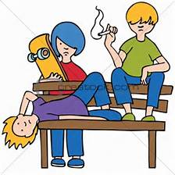
Reporting Incident Example 1
Discipline by Action File
1 Incident of tobacco violation
1 In-School Suspension
1 Referral to Law Enforcement
3 students receive in-school suspensions and are referred to law enforcement for tobacco use (1 incident)
Discipline by Student Demographic File
School | Ethnicity/Race | Gender | Grade | IDEA/ Special Ed | Section 504 | ELL | Undup # | Class Removal | In-School Susp | Only 1 OSS | More than 1 OSS | Total OSS | Expul With Services | Expul Without Services | Law Referral | Arrest | Other Action
1234 | 05 | 02 | 070 | 0 | 0 | 0 | 1 | 0 | 1 | 0 | 0 | 0 | 0 | 0 | 1 | 0 | 0
1234 | 02 | 01 | 070 | 0 | 0 | 0 | 1 | 0 | 1 | 0 | 0 | 0 | 0 | 0 | 1 | 0 | 0
1234 | 05 | 02 | 080 | 0 | 0 | 0 | 1 | 0 | 1 | 0 | 0 | 0 | 0 | 0 | 1 | 0 | 0
Discipline by Action
Discipline by Student Demographics

Slide 15
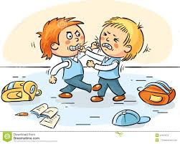
Reporting Incident Example 2
Discipline by Action File
1 Incident of 3rd Degree Assault
1 Out-of-School Suspension
2 students fight and are suspended (1 out of school and the other in school) Most Severe Action Taken is the Out of School Suspension
Discipline by Student Demographic File
Ethnicity/Race | Gender | Grade | IDEA/ Special Ed | Section 504 | ELL | Undup # | Class Removal | In-School Susp | Only 1 OSS | More than 1 OSS | Total OSS | Expul With Services | Expul Without Services | Law Referral | Arrest | Other Action
05 | 02 | 090 | 0 | 0 | 0 | 2 | 0 | 1 | 1 | 0 | 1 | 0 | 0 | 0 | 0 | 0
Discipline by Action
Discipline by Student Demographics

Slide 16

Important Note to Remember
Discipline by Student Demographic
>
or
=
Discipline by Action
Count of Students Disciplined
Count of Incidents
Multiple Students may be disciplined for 1 incident
2 students
disciplined
>
1 fight

Slide 17
Firearm (GFSA) Discipline File
One record per school and firearm weapon with counts of actions taken.
If there are no firearms to report for a school, no record will be needed in file (based on No Reportable Incidents screen)
4 types of Firearms reported
  - Handgun - Rifle/Shotgun - Other Firearm - Multiple Firearms
Expulsions reported are a subset of Dangerous Weapon Expulsions reported
Firearm (GFSA) Discipline

Slide 18
Firearm (GFSA) Discipline File Flowchart
(A) Brought or Possessed at School
(B1) Expelled
(B2) Other Discipline Action
(B3) Remove Other
(B4) No Action Taken
(C1) Less Than Mandatory One Calendar Year
(C2) Full Mandatory One Calendar Year
(D2) Referred to Alternative School/Program
(D1) Referred to Alternative School/Program
Action Taken
Length
Alt Program
Firearm (GFSA) Discipline

Slide 19
Determining Most Serious Incident to Report

Slide 20
Guide for Determining “Most Serious” Incident
The Safe School Act; 22-32-109.1( 2) ( b) , C.R.S. requires …to report…. The number of conduct and discipline code violations, each of which violations shall be reported only in the most serious category that is applicable to that violation
Therefore, if a situation includes more than one violation, school officials must determine which among the violations they deem to be “most serious” for the purposes of reporting the incident only once

Slide 21
Additional Information
At times it may be difficult to conclude which among two or more serious incidents and/or behaviors within one incident should be considered the most serious of all.
Although CDE offers the following guidance for a school’s consideration, it must be understood that the discretion for determining seriousness rests with the local school and school district.
Important: The guidance applies only to when a situation includes more than one violation. Incidents considered to be only one violation will be reported as that particular violation.

Slide 22
Guidance – in general
In general; Behaviors that rise to the level of violating the criminal code are considered more serious than those that do not, and:
  crimes against persons are considered by law to be more serious than crimes against property,
  crimes classified as felonies are considered to be more serious than misdemeanors

Slide 23
Guidance – Other Felony
Incidents given its own reporting category that may be a felony are to be reported per the incident ’ s category . “Other Felonies” refer only to those felonies that don’t have their own separate category. For example, the “willful destruction or defacement of school property” may be a felony if the cost of the damage is quite high. It would be reported under the defacement -related category and not the “other felony” category.

Slide 24
Example 1
Fights and Assaults:
  According to state statues, 1st and 2nd degree assaults and vehicular assault are felonies. 3rd degree assault and disorderly conduct are misdemeanors. Disorderly conduct for SDA purposes is defined as “fights with another in a public place except in an amateur or professional contest of athletic skill”. If a fight resulted in the commission of a 1st or 2nd degree assault, then it would be reported as an assault instead of a 3rd degree assault/disorderly conduct.

Slide 25
Example 2
Dangerous Weapons:
  A dangerous weapon in and of itself should be reported as a dangerous weapon. If the weapon was used to inflict death or serious bodily injury it would be reported in the 1st and 2nd degree/vehicular assault category.

Slide 26
Example 3
Alcohol, Fights, Weapons:
  If a student scuffled with another student in the parking lot which was considered to be a fight, then pulled out a knife (measuring longer than 3”)and threatened but did not harm the other student, and was found to have a six-pack of beer in his car, the student has committed three violations. The school official would weigh the harm and potential harm caused by the student and determines the appropriate action for one or more of the violations. The potential for the knife to cause death would most likely be considered the most dangerous of the behaviors so it would be reported in the dangerous weapons category. (This may also be considered a felony menacing crime reportable as “Other Felony”.)

Slide 27
Example 4
Tobacco, Defiance:
  A student becomes confrontational with a teacher during class, frightens other students in the meantime and walks out. The student has a pack of cigarettes in his/her shirt pocket. He/she is suspended for defiance and possession of tobacco because they had been caught and warned several times before about the tobacco. The school considered the “willful disobedience and openly defiant” the more serious of the violations because it involved a person-to-person confrontation as well as involving other students by disrupting the entire class.

Slide 28
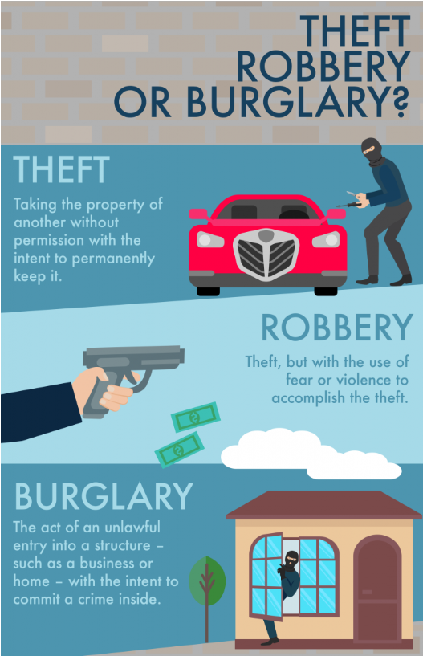
06 - Robbery
Commission of an act on school grounds that, if committed by an adult, would be considered robbery. Robbery is a class four felony.

Slide 29
Ranking – Guidance Only
This ranking is intended as guidance only. Incidents can vary in seriousness on a case-by-case bas is that would deviate from the order listed.
    1.1st, 2nd Degree or Vehicular Assaults
    2.Rape or Attempted Rape
    3.Dangerous Weapons -Unless used to inflict death or serious bodily injury
    4.Sexual Violence/Battery (other than Rape)
    5.3rd Degree Assaults /Disorderly Conduct
    6.Robbery
    7.Other Felony (not reported in another descriptive category)
    8.Detrimental Behavior
    9.Drug Violations
    10.Marijuana Violations
    11.Alcohol Violations
    12.Destruction of School Property
    13.Disobedient/Defiant or Repeated Interference
    14.Tobacco Violations
    15.Other Violations of Code of Conduct

Slide 30
Resources

Slide 31
Resources
http://www.cde.state.co.us/datapipeline/schooldisciplineattendance
  Behavior Statutes and Clarifications document
  Previous trainings
  File layouts
  Guide for Determining Most Serious Incident
  FAQs
Please contact me with questions and/or if you would like any other documentation: severson_a@cde.state.co.us

Slide 32
Drugs & Alcohol
Drug Violation - Use, possession, or sale of a drug or controlled substance, other than marijuana, on school grounds, in a school vehicle, or at a school activity or sanctioned event.
Alcohol Violation - Use or possession of alcohol on school grounds, in a school vehicle, or at a school activity or sanctioned event.
Tobacco Violation - Use or possession of a tobacco product on school grounds, in a school vehicle, or at a school activity or sanctioned event.
“Tobacco Product” means:
Any product that contains nicotine or tobacco or is derived from tobacco and is intended to be ingested or inhaled by or applied to the skin of an individual; or
Any device that can be used to deliver tobacco or nicotine to the person inhaling from the device, including an electronic cigarette, cigar, cigarillo, or pipe.

Slide 33
Tobacco
Tobacco Violation - Use or possession of a tobacco product on school grounds, in a school vehicle, or at a school activity or sanctioned event.
“Tobacco Product” means:
  Any product that contains nicotine or tobacco or is derived from tobacco and is intended to be ingested or inhaled by or applied to the skin of an individual; or
  Any device that can be used to deliver tobacco or nicotine to the person inhaling from the device, including an electronic cigarette, cigar, cigarillo, or pipe.

Slide 34
Marijuana
Marijuana Violation - The unlawful use, possession, or sale of marijuana on school grounds, in a school vehicle, or at a school activity or sanctioned event.

