Slide 1
2024 SAT SBD Review Process Training Webinar
Tara Rhodes, Assessment Division
Aislinn Wales, Accountability & Continuous Improvement Unit

Slide 2
Welcome!
As we are getting started:
  Please mute your microphones.
  Cameras have been turned off for participants for privacy reasons.
  This session will be recorded and posted to the SBD collection webpages as soon as possible after the session ends.

Slide 3
Outline
Presentation Outline:
General Information
  Purpose
  Collection Timeline
  Role Assignments in Identity Management (IdM)
SBD Step-by-Step Guide
Additional Resources
Deeper Dive into PSAT and SAT
Accountability Implications
Time for Questions

Slide 4
SBD: Purpose
The Student Biographical Data (SBD) Review Process provides districts with an opportunity to verify the accuracy of student data after testing but prior to reporting and accountability calculations.
This process is completed for the following four assessments:
  WIDA ACCESS for ELLs Assessment
  CMAS Assessments
    -ELA/Math (including CSLA) and Science
    -CoAlt Science
  CO PSAT/SAT
  CoAlt ELA/Math via Dynamic Learning Maps (DLM)

Slide 5
SBD: General Process
Vendors provide portals for district use prior to and during testing.
Test Administration
Data used in SBD windows comes from vendors post-test administration.
Notes:
For each collection:
1. Data used in the SBD review process comes from the vendor system after testing.
2. Most vendors provide portals for districts to use to validate data prior to testing.
2a.The exception is College Board (CO PSAT/SAT). College Board does not have a data portal. The SBD review process is the ONLY opportunity for a district to verify the accuracy of PSAT/SAT student data before or after testing.
3. The SBD review process can be used to validate/update student information that is not in the vendor portal. One example is SASID validation.
4. The SBD review process is not required BUT is highly recommended because inaccurate data can impact accountability.

Slide 6
SBD: Collection Timelines
 | Assessment | Dates | Data Pipeline Group
1 | ACCESS for ELLs | 3/11/24-3/20/24 | ACC
2 | CO PSAT/SAT | 5/15/24-5/22/24 | SAT
3 | CMAS ELA/Math (including CLSA) and Science CoAlt Science | 5/16/24-5/29/24 | CMS
4 | CoAlt: ELA/Math (DLM) | 5/29/24-6/5/24 | DLM

Slide 7
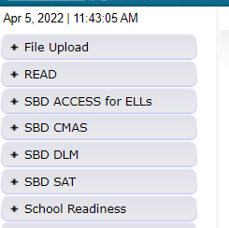
SBD: Group Role Assignments
You can learn whether you have access to the collections by logging into Data Pipeline and reviewing the gray boxes on the left-hand side.
If you do not have access to the collections, please reach out to your district’s local access manager (LAM). Please ensure that the APPROVER role is assigned.
CDE cannot provide access for district users.
Collection | Data Pipeline Group
WIDA ACCESS for ELLs | ACC
CO PSAT/SAT | SAT
CMAS: ELA/Math CoAlt: Science | CMS
CoAlt: ELA/Math (DLM) | DLM
The table to the left shows the group code for each SBD collection (also provided on Slide 6).
Notes:
If you are unsure of who your LAM is, please reach out to me, either through my email or to the SBDSupport inbox and I can help you locate that person.

Slide 8
SBD: Support Email/Phone
SBD support is available by phone or email
  CDE has a team that responds to emails and to phone calls. Please use the SBD Support phone number and email address. Do not contact a specific person at CDE or the general CDE Helpdesk.
  This provides a single point of contact for all collections.
  Emails create support tickets that can be tracked to ensure that questions are answered quickly. Remember: DO NOT send student personally identifiable information (PII) by email!
  Members of multiple CDE units are available to answer different questions (Assessment, Accountability, and Information Management Systems).
Phone Number: 720-696-0185
Email address: sbdsupport@cde.state.co.us

Slide 9
SBD Review: Step-by-Step Guide

Slide 10
Overview of SBD Steps
1. Review SBD Manual
2. Log into Data Pipeline
3. Download a Vendor SBD Extract
4. Upload Vendor SBD Extract
5. Review Data Errors and Warnings
6. Correct Data Errors and Warnings*
7. Complete Data Validation
8. Submit Final SBD Data
Step 6 could include multiple uploads into Data Pipeline, although the primary amount of this work is done in the downloaded document in your chosen program (Excel, etc).
Step 7 could include pulling reports out of Data Pipeline.

Slide 11
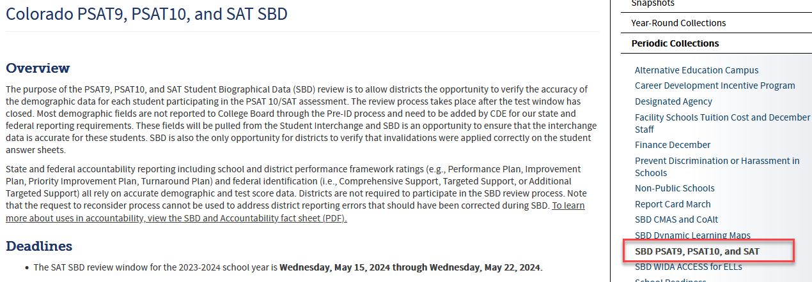
Step 1: Download the SBD Manual and Collection Specific Information
Please download the SBD Manual and collection specific information.
  Link for Manual: SBD Manual 2023-24
    The manual provides a detailed, step-by-step process with screenshots on how to complete the four SBD collections.
  Link for collection specific information: Data Pipeline Collections Website
    Please download and review:
      SBD File Layout (includes specific instructions for each field)
      Business Rules (includes how to resolve errors)
      Training materials (including the SBD Manual)

Slide 12
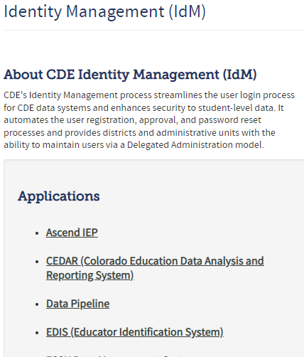
Step 2: Log in to Data Pipeline
On the Identity Management website, select “Data Pipeline” under Applications on the left side of the screen.
Enter your username and password
Check to ensure:
  There is no red banner at the top of the screen
  Your user role is correct
  The collection you are working on appears on the left side of the screen
Most log-in issues must be handled by your LAM.

Slide 13
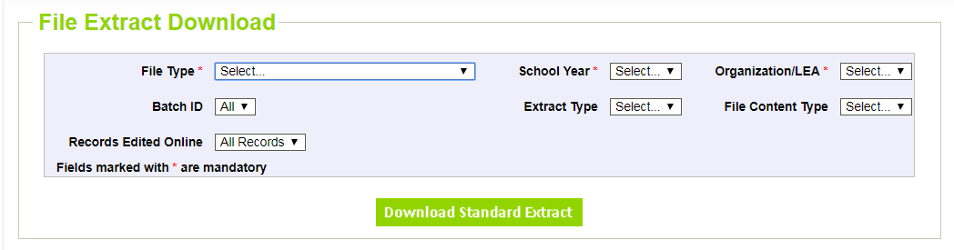
Step 3: Download a Vendor SBD Extract
Navigate to the collection tab along the left-hand side.
Select “File Extract Download” for the appropriate assessment.
Make the following selections:
  File Type: Vendor File
  Extract Type:
    SBD Extract using Student Profile – Student Interchange demographics
  File Content Type:
    Excel: If you are using Excel for data review, use this option and not the .csv format
    CSV: Comma delimited
    Text: Fixed format

Slide 14
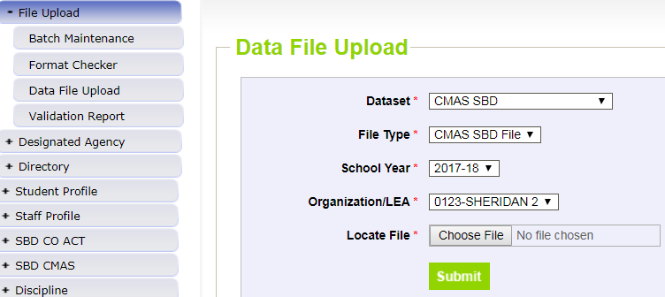
Step 4: Upload Vendor SBD Data Extract
Upload back into Data Pipeline prior to editing the file
  Allows access to COGNOS reports
    Error Summary
    Error Detail
  The number of errors found can help guide data clean up and give a sense of how much work needs to be done on the file
  Activates the Edit Records screen
This is done by:
  Select “File Upload” tab -> Data File Upload
  Choose file and submit
  Emails:
    Submission Notification
    File Upload Summary

Slide 15
Step 5: Review Errors and Warnings
The number of errors and warnings are available in two places:
  Error Report under “Pipeline Reports” along the left-hand side
  COGNOS Error Summary Report under “Cognos Reports”
Identifying specific records with errors can be done in three places:
  COGNOS Error Detail Report
    Download as an Excel file to review
  Pipeline Report – View Details
    Same layout as the Error Detail Report
  Edit Records Page
    Choose records with errors and warnings
    Fields with errors will be red; warnings will be yellow

Slide 16
Step 6: Correct Data Errors
Method 1: Correcting errors using the Vendor SBD Extract File
  Open the vendor file in your chosen program
  Update data in records with errors
    Start with SASID errors
    Use the Data File Layout with field definitions and the Business Rules documents to figure out how to correct the data
      Business rules will explain errors. For example, “Date First Enrolled US cannot be blank”.
  Upload the file periodically and re-run COGNOS reports to check your progress
    Once you are down to just a few errors, it may be faster to use the Edit Records screen

Slide 17
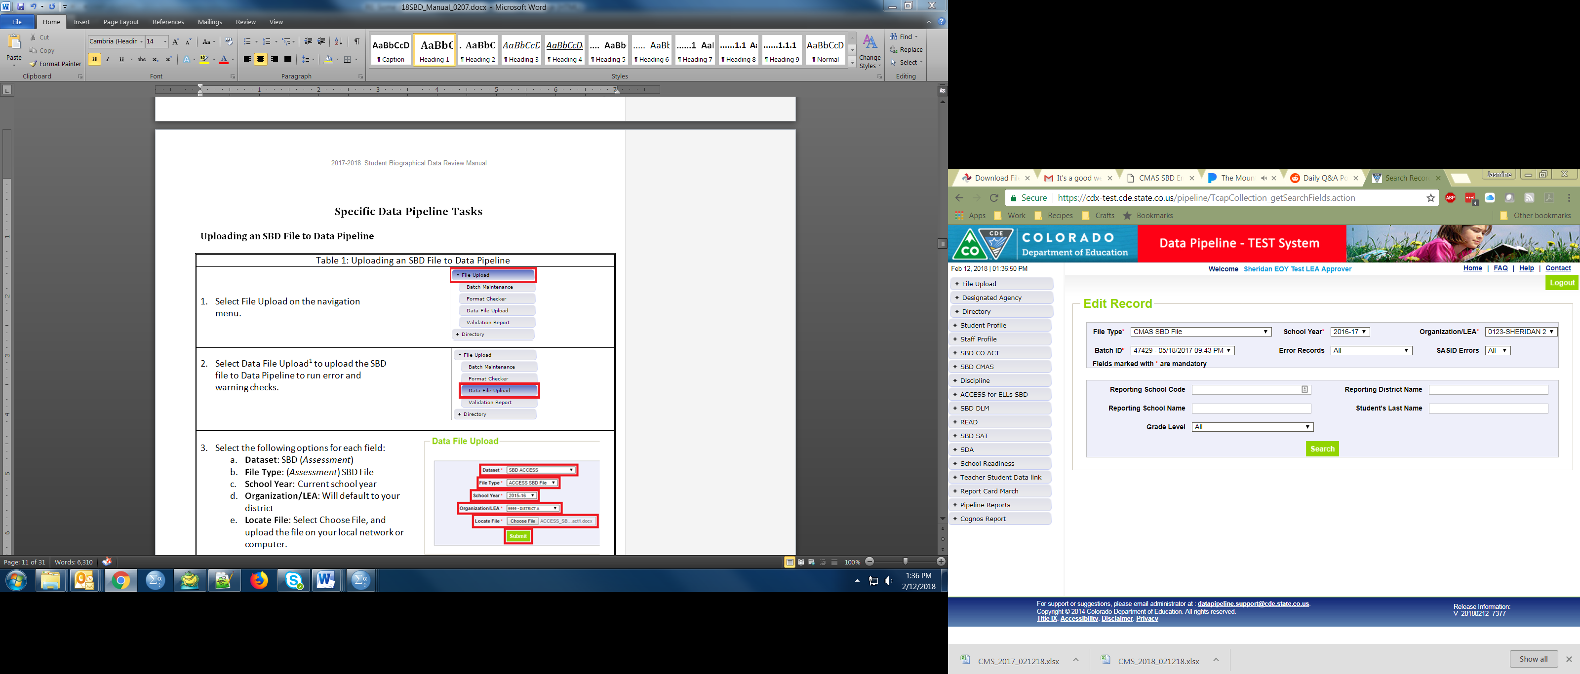
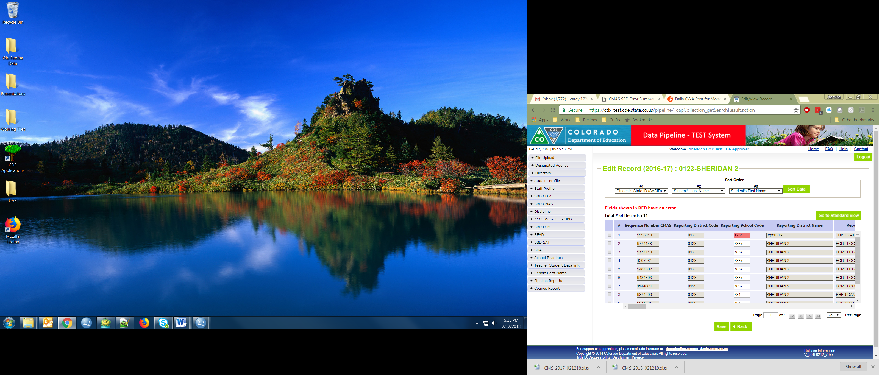
Step 6: Correct Data Errors (Continued)
Method 2: Correcting errors using the Edit Records page
  On the Edit Records page, select the appropriate drop downs
  Check the box next to record you would like to edit
  Correct the data in the fields highlighted in red
  Make sure that the box along the left-hand side is checked, and then click “Save” to save the edits

Slide 18
Step 7: Data Validation
Data Pipeline can only check for certain types of errors
  It cannot check that your demographic data are accurate (i.e., a student is actually Hispanic or not)
  It cannot validate that students have the correct invalidation
    The Data File Layout will have instructions for how to select the appropriate invalidation
Do not change/make up data just to clear errors!
  If you have a lot of missing data, check a different extract
    Maybe the interchange data or vendor data are better
  Making up data can cause issues with reporting and accountability
  If you have an error that cannot be cleared but the data are correct, contact SBD Support.
Warnings
  Warnings are used to inform users of situations that may indicate, but not necessarily are, issues with the data (such as an unusually low or high percent of the student population classified in a particular category)
  Warnings do not prevent data submission, but Errors do

Slide 19
Step 7: Data Validation (Continued)
Download the COGNOS SBD Summary Report
  Compare your district summary numbers to last year’s final data
    Large changes in the number of students in a category could indicate a coding error or incorrect data submitted to the Interchange or vendor system
  Review Invalidations
    Check for students who were invalidated who may have scores
    Check that Parent Excuses are correctly applied
      College Board assessments have invalidations added by the schools, so it is important to double check that they have been correctly applied.

Slide 20
Step 8: Submit SBD Data
Download your final SBD extract for your records through the File Extract Download option
  This is especially important if you use the Edit Records screen
Select “Status Dashboard” under the appropriate assessment collection
Review the data on the Status Dashboard to make sure you are ready to submit
  Validation Errors and RITS Errors must be zero unless you have contacted SBD Support specifically to ignore errors
  If errors are ignored, you must submit without making any additional changes or uploading a new file or it will reset the ignore errors status
Click “Submit to CDE” and “Yes” in the pop-up window
If you need to make additional changes after submission, please contact SBD Support to unlock your data. This can be done until the end of the window.

Slide 21
Troubleshooting
See the SBD Manual for common issues and trouble shooting techniques
Users generally have issues at three different points in the SBD process:
  Logging in to Data Pipeline
    Generally these issues must be resolved by the district LAM.
    CDE cannot change or grant user permissions.
  Uploading a Data file
    This is usually an issue with the file format. See the manual for common issues and how to identify them.
  Clearing Errors
    Usually the Data File Layout and Definitions and Business Rules documents are enough to identify why an error is occurring.
    If you think an error is triggering incorrectly, contact SBD Support.

Slide 22
Moving Students
All SBD collections allow a district to move students between schools within their district
Moving between districts is a collection specific process
  CO PSAT/SAT - Do not send a Failsafe document
    The SBD layout will include the Pre-ID, Testing, and Responsible District and School fields
    If the Pre-ID and Testing fields do not match, the Responsible District and School fields will be filled in with your district to properly calculate the continuous fields
    If the discrepancy is in the district set of fields, both districts will see the student records and have a chance to review the data and agree on the appropriate Responsible District and School (CDE will monitor students submitted with conflicting Responsible Districts and will contact the data respondents)

Slide 23
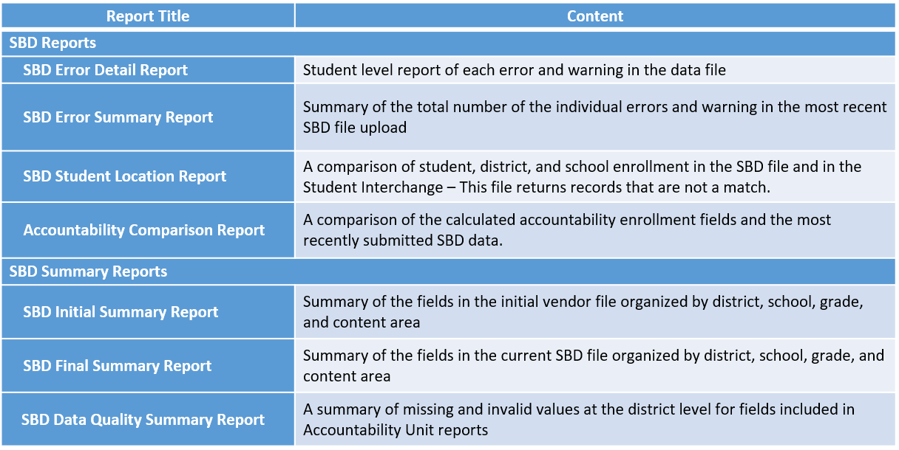
COGNOS Reports

Slide 24
Additional Resources

Slide 25
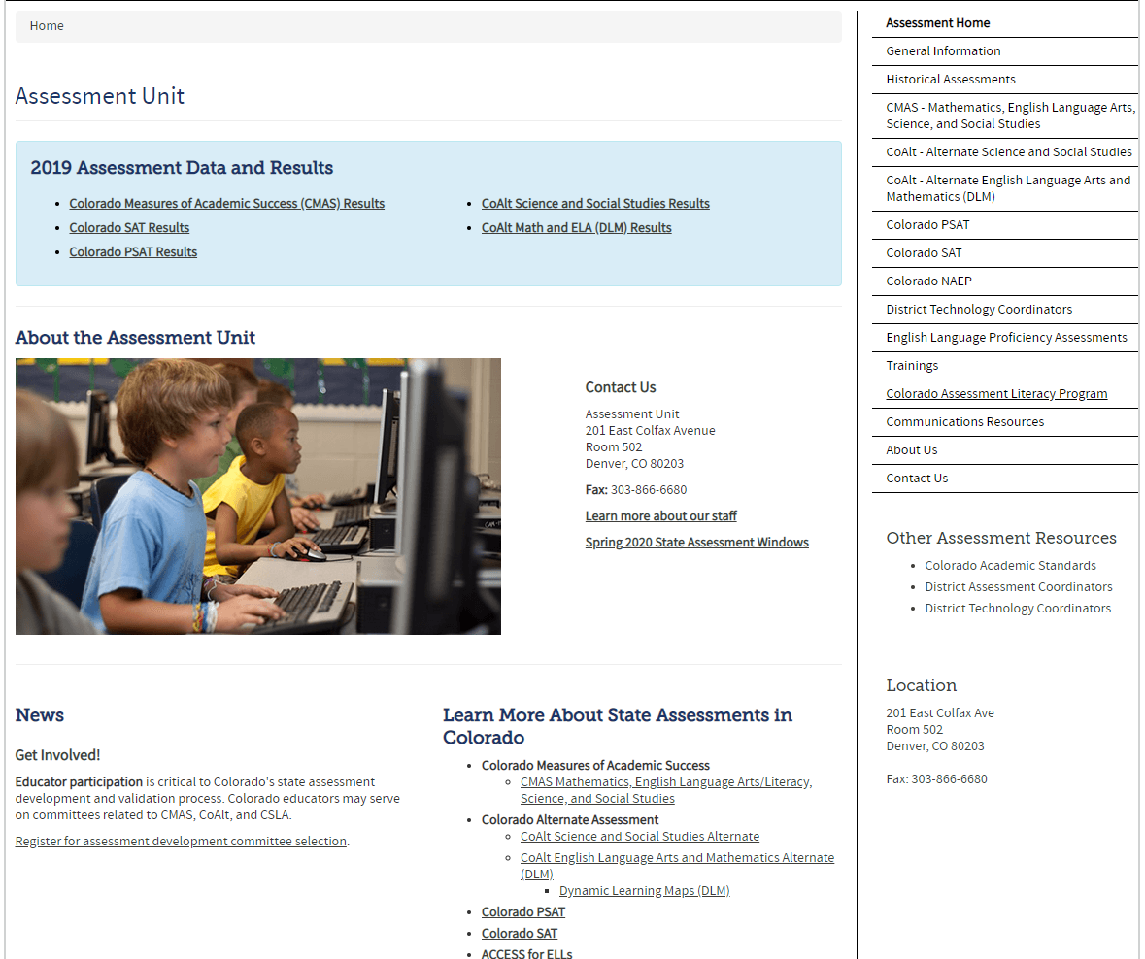
Assessment Division Homepage
https://www.cde.state.co.us/assessment

Slide 26
Invalidation Instructions
Instructions for applying invalidations during SBD are in the File Layout and Definitions documents.
There are also instructions for applying invalidations in the assessment materials with details on the appropriate uses of each code:
  CO SAT/PSAT – School Day Supervisor Manual
    https://satsuite.collegeboard.org/media/pdf/sat-school-day-coordinator-manual.pdf

Slide 27
Deeper Dive:
PSAT and SAT SBD
Specific Fields
Notes:
Colorado High Schoolers in Grades 9-11 take the PSAT9, PSAT10, and SAT as their state assessment
Alternate assessment takers in these grades will take the Dynamic Learning Maps assessment (DLM)
PSAT and SAT are taken on paper and there is no vendor data system
Students who were not in Pre-ID will have only hand bubbled information
SBD is the only opportunity to verify student data, enrollment, and invalidations

Slide 28
Changes for 23-24 Collection
File Layout:
  There were two changes to the file layout for the 23-24 collection year. A “Preferred First Name” field was added and the “Valid Answer Sheet” field was removed.
Coding Adjustments:
  The gender field was updated to include a third category of “03” (Nonbinary).
  A code of “11-Extenuating Circumstances” was added to the Invalidation Code field.
Business rules have been updated to account for these changes.
Notes:
I also wanted to provide some more information about the new 11-Extentuating Circumstances code. This is for students who are new to the United States after the October Count date and are a NEP/LEP Student with Limited
or Interrupted Formal Education. The definition we are using for students with limited or interrupted formal education means that the student either did not have formal schooling (or very limited formal schooling) in their prior country or had an interruption in their formal education due to war, civil unrest, migration to the U.S., or limited access to school resulting in less time spent in formal schooling in their prior country compared to similarly-aged peers in the United States. The file layout has more detail around this code as well as specific examples to help guide and inform the use of this code.

Slide 29
Responsible District and School
There are three sets of district and school fields
  Pre-ID: attending institution AI code on the student’s registration at the time of testing.
  Testing: the school where the test was administered
  Responsible: the district and school where the student should be counted for accountability
If Pre-ID and Testing district do not match, the record will be duplicated and both districts will see a copy
  These records will have a ‘CO SAT Record ID Number’ starting with ‘P’ or ‘T’
  Responsible district and school will default to your district so that the accountability variables are calculated correctly if you are keeping the record
  If you are not the responsible district, simply update responsible district and school to the district and school that you believe is correct for the student
    We will only use data submitted in the record coming from the responsible district, so you do not need to update any other data for that record. Contact SBD Support to ignore errors on this record.

Slide 30
Responsible District and School (Cont’d)
After SBD closes, the duplicated records will be compared
  If both districts agree on the responsible district for that record, it will be automatically associated with that district and only the data they submitted will be used for the final data, including invalidations
  If the two records do not have matching responsible districts, then CDE will use interchange enrollment data or contact the districts to determine who should receive the record
    CDE will try to start this before the end of SBD, but be prepared to receive phone calls on 5/23 after the window closes

Slide 31
Test and Grade Fields
Students may only take the test for the grade in which they are enrolled on the day of testing
  If a student is promoted after testing, you should not change the grade on the record
  If a student was promoted between October Count and test day, they should have taken the test for the grade to which they were promoted
    Students who were promoted to 12th grade after October Count may be included due to being in the Pre-ID. These students should be invalidated with ’03 – Withdrew Before Testing’ to remove them from your participation counts.
  If a student was given the wrong test for their grade at the time of testing, they will be invalidated as a “Misadministration” in CDE records, but they will still receive their scores from College Board. Please submit these students through the Failsafe or contact SBD Support to document the record.

Slide 32
Continuous in District and School
Continuous in District and School are important fields for CDE’s Accountability Unit
  Students coded as 0 will not be included in accountability calculations
  This field is calculated during SBD based on the student’s enrollment at October Count, based on the initial Responsible District and School
  If you change the Responsible School during SBD, please double check that the continuous fields are accurate
If you get an error when trying to update these fields for records that are staying in your district, contact SBD Support for assistance.

Slide 33
Invalidation Codes
Invalidation codes may have been entered into the student’s record by the school or district
  There may be errors/multiple invalidations, and these must be corrected during SBD to a single valid code
Invalidations can also be added during SBD
  Please review these during SBD
Invalidations are only used by CDE Assessment and Accountability teams
  Students will still receive scores through the College Board system if they completed the test
If you have a record for a student who left your district for another district in Colorado before testing, update the Responsible District and School fields. If Testing District is blank and you don’t know where they moved, invalidate the record with ‘Withdrew Before/During Testing’

Slide 34
Invalidation Codes (Continued)
Invalidation Codes that Can Be Added During SBD:
Took other assessment/Duplicate Attempt
  If the student was supposed to take DLM, verify that they were loaded to the DLM vendor system before applying the invalidation
Withdrew Before or During Testing
  Should only be used for students who left your district, but do not have a testing district and school on the record or no other enrollment in RITS
Medical Exemption
  Students receiving district services or who are medically fragile and cannot test
Part-time Public and Part-time Home School
  Student who attends the school part-time but are primarily home schooled and do not count for accountability purposes
Parent Excuse
  Should be indicated by the school, but some districts may collect this information for reporting during SBD
Extenuating Circumstances
  Students who were new to country after the Fall October Count date; NEP/LEP Student with Limited or Interrupted Formal Education (SLIFE)

Slide 35
Invalidation Codes (Continued)
Invalidation Codes that Should Not Be Added During SBD:
Misadministrations
  Testing administration or accommodation issues should be handled through College Board according to the coordinator manual. If College Board deems that a misadministration took place, the invalidation will be added to the record by CDE, and College Board will invalidate the score as well.
  Misadministrations due to off-grade testing are a CDE only issue and we will apply the appropriate code after discussion with the district. These students will still receive a score through the College Board system.
Newcomer to US
  English learners who are new to the US may choose not to take the Reading and Writing section. This requires special administration directions and registration with College Board. Do not apply this code during SBD unless you can confirm with the school that the student was given a newcomer administration and forgot to indicate it using the invalidation.
Student Test Refusal
  Should only be added if the school has informed the district of an incident but forgot to code the student.
Absent
  Should be added by the school if the student is absent for initial test day and all make up opportunities. This code counts as a non-participant so should not be added as a default without cause.
Notes:
Absent:

Slide 36
Questions and Discussion
Questions?
Please feel free to unmute or use the chat box.

Slide 37
Accountability Implications

Slide 38
Why should districts participate in the SBD review?
Districts are highly encouraged to participate in SBD because:
Student test records are used to calculate school plan types (e.g., Performance, Turnaround) and district accreditation ratings (e.g., Accredited with Distinction, Accredited with Turnaround Plan)
Student test records are used to identify schools under Every Student Succeeds Act (ESSA) as Comprehensive Support (CS), Targeted Support (TS), and Additional Targeted Support (ATS)
The request to reconsider (R2R) process cannot be used to address district reporting errors that should have been corrected during SBD (i.e., miscoded parent excusals cannot be appealed).

Slide 39
Major Impacts on Accountability
Students may be excluded from achievement, growth, & participation calculations
State accountability ratings can be decreased due to participation
Schools may be identified due to participation under the federal accountability process
For federal accountability, a school that is not already identified as CS, TS, or ATS can be identified “Due to Participation” based on non-participants in excess of 5 percent.
Low total participation rates are added as a descriptor in performance frameworks
Test administration and student demographic codes impact which students are included in accountability calculations. Assessment student data fields used for accountability exclusion rules include ‘Continuous in District’, ‘Continuous in School’, ‘Language Proficiency’ combined with ‘Date First Enrolled in US’, ‘Expelled’, and ‘Not Tested Reason.’
A school/district’s rating can be decreased due to participation. This occurs when the accountability participation rate (parent excusals are excluded) is below 95% in English language arts and math*.
Schools/districts below 95% total participation in English language arts and math are noted on the performance framework to indicate that the results may not be representative of the entire student population. The plan type is not impacted by this participation descriptor.
* For the official 2024 plan types, science results are not included or factored into participation calculations.

Slide 40
Lessons Learned
Complete SBD to ensure your district’s student test records are error free and accurate.
Collect, document, and report all parent excusals and student accommodations.
Reconcile any student transfers (between schools or out of district) that occur after October Count.
Do not make up data or give all students the same value to clear errors.
If there are persistent errors, make sure your district’s data respondents, assessment coordinators, and accountability contacts communicate to address any issues.
Contact CDE with any questions or concerns.

Slide 41
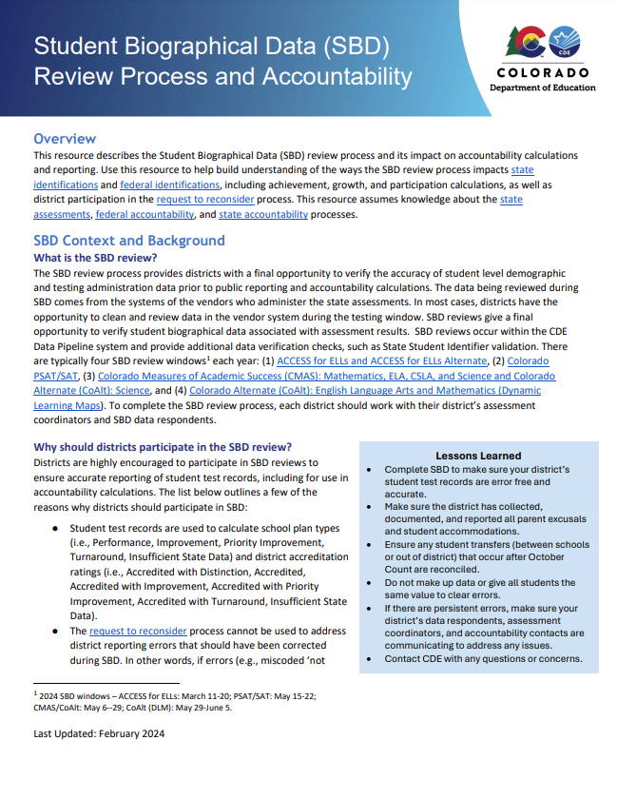
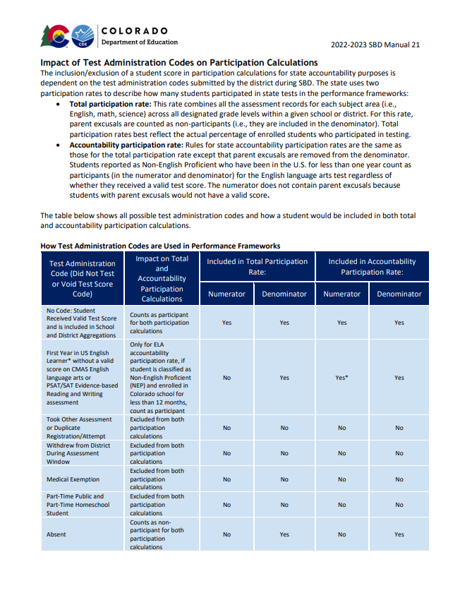
Resources
SBD and Accountability Fact Sheet
SBD Manual – beginning on pg. 19
Other 2024 Accountability Resources:
https://www.cde.state.co.us/accountability/accountability-resources

Slide 42
Questions and Discussion
Questions?
Please feel free to unmute or use the chat box.

Slide 43
Contact Information and Resources
Please contact SBD Support with any technical SBD questions:
Email: sbdsupport@cde.state.co.us
Phone: 720.696.0185
For state accountability questions, Email: accountability@cde.state.co.us
For federal accountability questions, Email: ESSAquestions@cde.state.co.us
Data Collection Webpages:
PSAT/SAT: https://www.cde.state.co.us/datapipeline/per_sat
CMAS: https://www.cde.state.co.us/datapipeline/sbd-cmas
DLM: https://www.cde.state.co.us/datapipeline/dynamiclearningmapssbd
SBD Manual Link:
https://www.cde.state.co.us/datapipeline/2024_sbdmanual

