Slide 1
Spring READ Assessment Data Collection
Tara Rhodes
READActData@cde.state.co.us
April 1, 2025

Slide 2

Topics in Today’s Webinar
Part 1: Background Information and Updates for 24-25
Data Privacy & Security
Purpose of the Spring READ Assessment Collection
Timeline
2024-25 File Layout and Definitions
Website Updates
Q&A
Part 2: Step-by-Step Process in Pipeline
Pipeline Walkthrough
Cognos Reports
Resolving Errors
Common Problems
Q&A

Slide 3
Data Privacy and Security

Slide 4
PII Definitions and Requirements
Student Personally Identifiable Information (PII) is defined by state and federal laws as information that, alone or in combination, personally identifies an individual
  This includes direct identifiers (i.e. name, SASID, etc.)
  Includes information that when combined is identifiable
Colorado’s Student Data Transparency and Security Act introduces several new requirements for how Student PII is collected, used and shared
CDE has prepared guidance on how to comply with this and other privacy laws which can be found here: http://www.cde.state.co.us/dataprivacyandsecurity

Slide 5
Data Sharing Processes
Check local policies for restrictions, requirements, etc.
Ensure that you are following local policies when transmitting PII to any third party
Use secure methods to transfer any PII to CDE
  Contact Data Collection lead with questions about how to transmit PII securely
  Use Syncplicity to encrypt emails to CDE
Avoid sending PII via unencrypted emails or to unsecured faxes when sharing data between or within districts
Do not use PII in trainings, presentations, etc.
Do not share PII with unauthorized individuals
Do not share passwords

Slide 6
Purpose of the Spring READ Assessment Data Collection

Slide 7
Background: The READ Act
The Colorado Reading to Ensure Academic Development Act (READ Act) focuses on early literacy development for all students and especially for students at risk to not read at grade level by the end of third grade. Students are assessed for reading skills, and those who are identified as reading significantly below grade level are given individual READ plans.
In order to support students with significant reading deficiencies (SRDs), the READ Act provides per-pupil intervention funds to assist districts with providing intervention support.

Slide 8
READ Act Reporting Requirements for Districts
Districts must annually report the information necessary to determine the prevalence of SRDs among students in grades K-3. This data determines the per-pupil funding for districts by dividing the amount of money available by the total number of K-3 students identified as having an SRD in the preceding budget year. Districts must also report whether students in grades 4-12 remain on a READ plan. The data provided in this report will be publicly reported and will enable the department to calculate district funding.

Slide 9
Data Components of the READ Act
Data Components of the READ Act
Components Collected through Data Pipeline
Spring READ Assessment
(Spring)
READ Literacy Programs and Assessment
(Spring)
Components Collected through GAINS
READ Budgets
(Spring)
READ Training
(Fall)

Slide 10
Reminders to Ensure Data Accuracy
Reporting accurate data is the primary goal of the collection
  CDE wants to make sure that districts receive the correct amount funding for SRD students
How to ensure your data is accurate?
  Complete the basics of the collection early!
    Get files error free by early June
    An error free file does not guarantee accurately reported data
    Thoroughly review your data
    Ask district READ leads or other content area experts to assist in verifying data
    Use Cognos reports available through Data Pipeline to assist in data verification
Do not report inaccurate data to avoid errors
  If a student is generating errors, please call the data collection lead to find out how to properly code the student

Slide 11
Spring READ Assessment Data Collection Timeline

Slide 12
Spring READ Assessment Data Collection Timeline
(Data Collection Phase)
There are two phases:
Data Collection Phase: 4/15/25 – 6/13/2025
Duplicate Phase: 6/16/25 – 6/20/25
Sign-off forms are due by the end of the duplicate phase.
Date | Event | Event Description
4/1/2025 | Training Event | This training event will cover changes for the 24-25 READ Spring Assessment Reporting collection. This is a live event from 1-2pm and will be recorded.
4/15/2025 | Open | The 24-25 READ Spring Assessment Reporting collection opens in Data Pipeline.
5/15/2025 | Other Date | This is the target upload date for the collection. Please complete an upload by this date.
6/6/2025 | Other Date | This is the target date for an error-free submission for the collection. Please resolve errors by this date.
6/6/2025 | Report Review | Assuming the district has uploaded a file and is error-free, this report review window allows districts to review Cognos reports about their data, verifying accuracy.
6/13/2025 | Deadline | The 24-25 READ Spring Assessment Reporting collection closes in Data Pipeline.

Slide 13
Spring READ Assessment Data Collection Timeline
(Duplicate Phase)
This phase of the collection occurs after all districts have uploaded and locked their submission. This phase allows for duplicate SASID resolution between districts. If a district does need to remove a SASID from their file due to having a duplicate with another district, they are required to reupload and relock their data submission in Data Pipeline by the posted deadline.
Date | Event | Event Description
6/16/2025 | Open | Assuming all districts are locked, the duplicate phase will open to resolve duplicate SASIDs between districts.
6/20/2025 | Deadline | Assuming all duplicate SASIDs are resolved, the duplicate phase will close. If it is determined that a district has duplicate SASIDs that need to be removed, then a new Spring READ Assessment file must be uploaded and locked in Data Pipeline. *Note: Only districts who remove duplicate SASIDS from their ile are required to re-submit data.
6/20/2025 | Other Date | District signature pages due to CDE. Please email these to READActData@cde.state.co.us.

Slide 14
24-25 File Layout and Defintions

Slide 15
Changes for the 24-25 Spring READ Assessment File Layout
Some assessments were removed. These are ones that are no longer approved.
Tried to clean up language and standardize field names.
  For example, the SRD Status field is now labeled as such.
Made the file layout accessible.
Altered the sign-off form to include the count of SRD as well as the SRD percentage for the district.
  Please have the appropriate staff review this at your district before submitting your data!

Slide 16
Spring READ Assessment Data Collection Elements (1 of 2)
Name of Field | Field Length | Text Start Position | Text End Position | CSV Order | Excel Column | Example(s) | Remarks
School District/BOCES Code* | 4 | 1 | 4 | 1 | A2 | 1111 | A unique four-digit number assigned by CDE to each school district or BOCES
School Code* | 4 | 5 | 8 | 2 | B2 | 2222 | A unique four-digit number assigned by CDE to each school
Student SASID* | 10 | 9 | 18 | 3 | C2 | 1234567890 | A unique ten-digit number assigned to each student by CDE
Student Last Name* | 30 | 19 | 48 | 4 | D2 | Doe | Student’s last name as recorded in RITS
Student First Name* | 30 | 49 | 78 | 5 | E2 | John | Student’s first name as recorded in RITS
Student Gender* | 2 | 79 | 80 | 6 | F2 | 01 | Student’s sex as recorded in RITS; 01=Female; 02=Male; 03=Nonbinary
Student Date of Birth * | 8 | 81 | 88 | 7 | G2 | 01312016 | Format = MMDDYYYY
Student READ Plan Status* | 1 | 89 | 89 | 8 | H2 | 1 | Field indicates whether a READ plan is in place for the student: No=0; Yes=1; 2=N/A
Student READ Status (SRD Status)* | 1 | 90 | 90 | 9 | I2 | 1 | Indicates whether a student has a significant reading deficiency: No=1; Yes=2
Student READ Assessment* | 2 | 92 | 93 | 10 | J2 | 03 | District-selected READ assessment administered to student

Slide 17
Spring READ Assessment Data Collection Elements (2 of 2)
Name of Field | Field Length | Text Start Position | Text End Position | CSV Order | Excel Column | Example(s) | Remarks
Student Assessment Score* | 4 | 94 | 97 | 11 | K2 | 0123 | Score range dependent on assessment taken
Student Test Date* | 8 | 98 | 106 | 12 | L2 | 04152022 | Format = MMDDYYYY
Student Recommended Retention* | 1 | 107 | 107 | 13 | M2 | No = 0 Yes = 1 2 = N/A
Student Retained* | 1 | 108 | 108 | 14 | N2 | No = 0 Yes = 1 2 = N/A
Summer School* | 1 | 109 | 109 | 15 | O2 | No = 0 Yes = 1
Tutor READ* | 1 | 110 | 110 | 16 | P2 | No = 0 Yes = 1
Intervention Services | 1 | 111 | 111 | 17 | Q2 | No = 0 Yes = 1

Slide 18
Additional Information on Data Elements
Points of Clarification:
  Student READ Status (SRD Status):
    This is the field that captures whether the student has a significant reading deficiency (SRD). This is the field that I use to calculate the funding amount for the district.
  Student READ Plan Status:
    This field identifies if a student has a READ plan (which is separate from a significant reading deficiency). If a student has an SRD, though, they are required to have a READ plan, but a student can have a READ plan without an SRD (for example, in the case where they are not yet reading at grade level, but have not been identified with an SRD through one of the approved READ assessments).
  Student READ Assessment:
    This field identifies the assessment on which the student was assessed during the Spring assessment window. It is important that this is correctly marked, as the cutscores for identifying an SRD are programmed into Pipeline based on the assessment.

Slide 19
READ Plan Field Coding
Scenarios | Coding
1. K-3 student identified with an SRD | 1 – Yes (student has a READ plan)
2. K-3 student identified with an SRD at any time throughout the year and is no longer SRD in the spring but remains on READ plan | 1 – Yes (student has a READ plan)
3. K-3 student identified with an SRD in the prior year and no longer SRD in the spring but remains on a READ plan | 1 -Yes (student has a READ plan)
4. K-3 student was previously identified with an SRD but has reached grade level competency and no longer has a READ plan in place | 0 - No (student no longer has READ plan)
5. K-3 student has never been identified as having an SRD and has never been on a READ plan | 2 – N/A (student never identified as having an SRD and has never had a READ plan)

Slide 20
4th-12th Grade Cohort Students
Why do we report 4-12th grade cohort students?
  Once a student has been identified as having an SRD, they are put on an individual READ plan. Their READ plan remains in place until that student reaches grade level proficiency in reading, regardless of the student’s grade level.
Who is included in the 4-12th grade cohort?
  Students who exited 3rd grade identified as having an SRD in the spring of 2013 collection became the first group of cohort students.
  The cohort will continue to increase each year until students reach 12th grade.
  Students who exit 3rd grade with a SRD (READ Status = 2) and/or remain on a READ plan at the end of the 3rd grade are calculated into the READ cohort group.
When does a student exit the cohort?
  Once a student has reached reading competency (determined locally), they are removed from their READ plan and will be coded as READ plan = 0 (no) which will remove them from the cohort group.

Slide 21
How to Identify the 4th-12th Grade Cohort Students
Step 1
Run the “Student Extract of 4-12th Graders with a Significant Reading Deficiency in the Prior Year” Report in Cognos
Step 2
Run this report for the current school year (2024-25). Districts will be able to download an excel file pre-loaded with all READ fields for the 4-12th graders except for the READ plan field.
Step 3
Districts must add the value of READ plan (0 or 1) to indicate if the cohort student remains in the cohort or if they have exited from the cohort based on READ plan (0 – No or 1 – Yes)
Step 4
Districts will then remove the entry_grade_level column and copy and paste this information into their READ file before submitting data.

Slide 22
Website Review and Updates

Slide 23
Website Updates
If you’re the data respondent for more than just the Spring READ Assessment data collection, you’ll notice that all of the READ data collection websites have been updated to follow the standard Data Pipeline website layout.
On the website, you can find:
  The file layout
  The collection manual (coming soon)
  The business rules
  Recordings of trainings and other resources
Here’s the link to the Spring READ Assessment Data Collection webpage.

Slide 24
Questions on Background?

Slide 25
Step-by-Step Guide in Data Pipeline

Slide 26
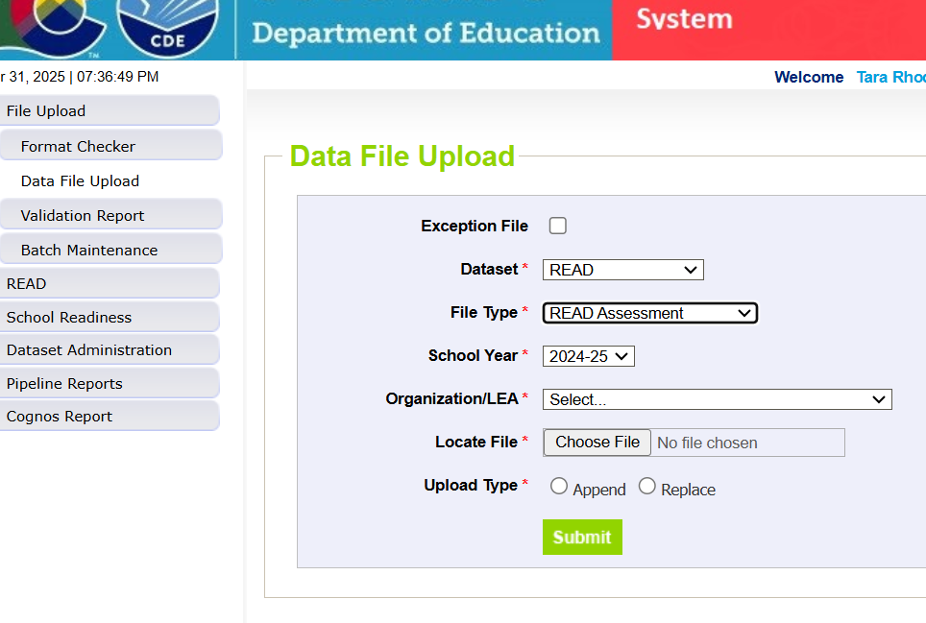
Step 1: Upload Data
Please ensure that your student interchange files, student profile or demographics file and student school association file are updated prior to uploading data.

Slide 27
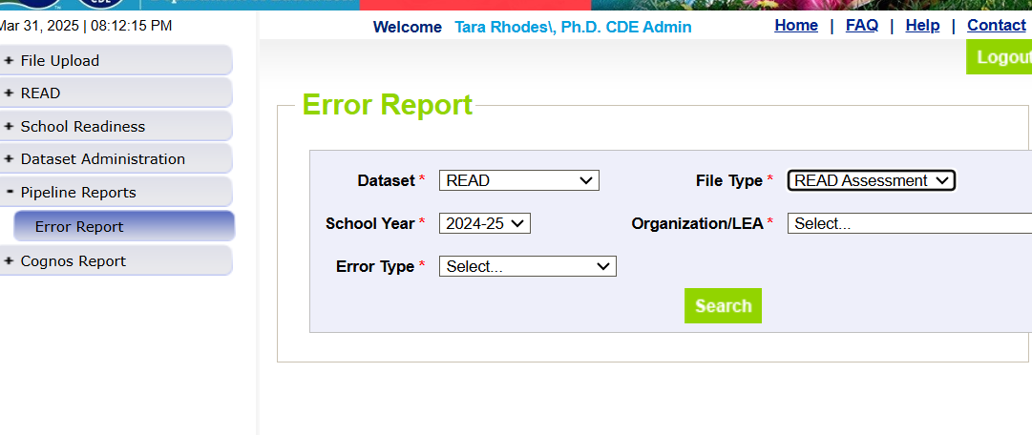
Step 2: Check Pipeline Error Report
After uploading, Pipeline will send an automated email that will tell you how many errors exist in your file.
After receiving this email, you can check your error report in Pipeline through using the options shown in the screenshot.

Slide 28
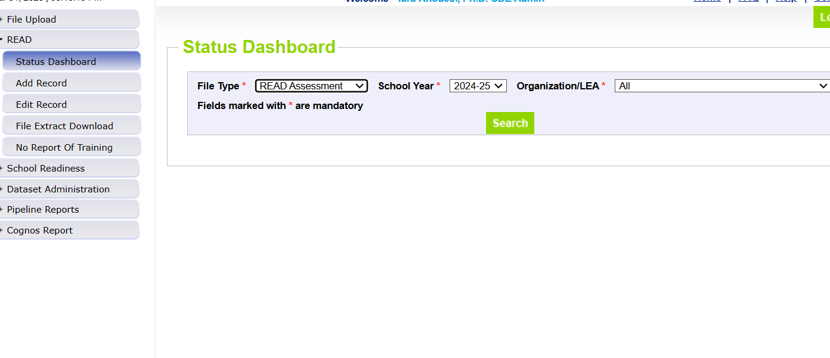
Step 3: Correct Errors and Reupload
Please continue this process of uploading and checking your error report until you reach zero errors. To confirm that you have zero errors, please use the Status Dashboard, as shown to the right.

Slide 29
Resolving Errors
Why do we get errors? Errors are edits that are in place to assist with providing most accurate information to CDE which is published, analyzed and reviewed by legislators, stakeholders, researchers, etc
Errors must be corrected in the file before finalizing the data
Error message should provide adequate information to assist you with determining the corrections needed
Each error message will list the data field(s) that is an issue
Find the data field(s) in the data file upload and make appropriate adjustment
Upload fixed data file again into data pipeline and run error reports

Slide 30
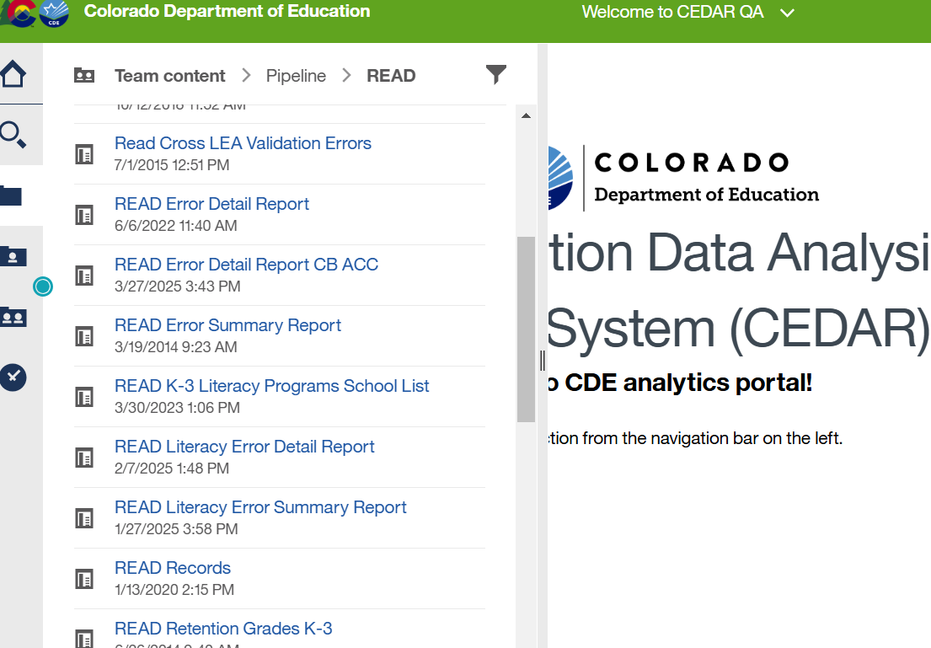
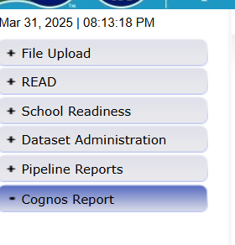
Step 4: Review Reports for Accuracy
Once you have cleared all errors, please ensure the accuracy of your data through the available Cognos reports.
Please reach out if you have any questions on the reports.

Slide 31
Cognos Reports
Report Name | Report Function
READ Error Detail Report | Report that will list errors record by record similar to Data Pipeline.
READ Records | Report that shows all records submitted in your file and includes grade level.
READ Status Grades K-3 | Report that shows the number of students identified with SRDs by school and grade level.
Student Extract of 4th-12th Graders with an SRD in the Prior Year | Pre-populated report that identifies your 4th-12th grade cohort students
Students Reported by Another District | Report that shows students you’ve reported that are also reported by another district (this is what is used during the duplicate phase).

Slide 32
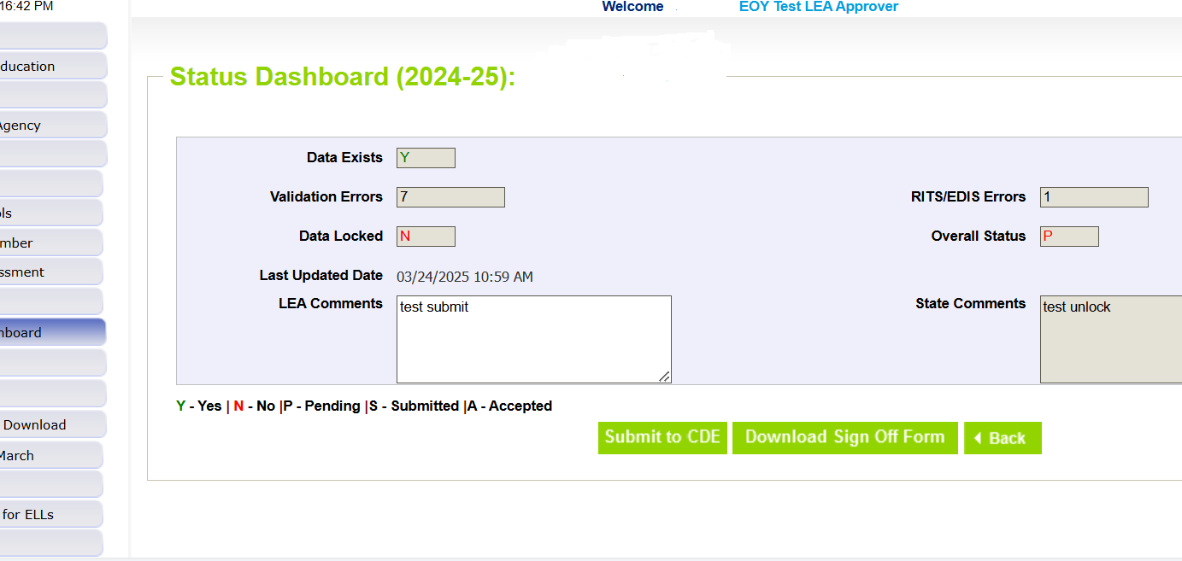
Step 5: Lock Your Submission
After you have reached zero errors and have reviewed your data for accuracy, please lock your submission in Data Pipeline. This will ensure that no further changes are made to your file.

Slide 33
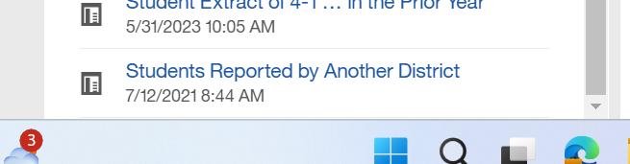
Step 6: Check for Duplicates During the Duplicate Phase
Once you have locked your data, you have completed the first phase of the collection! Thank you!
However, as a state, we have to check for duplicate SASIDs. This phase will begin on 6/16/2025. Please pull the “Students Reported by Another District” Report in Cognos to see if you have any SASIDs shared with other districts. If you do, you will need to repeat Steps 1-5. Please reach out with any questions.

Slide 34
Step 7: Download and Submit Sign-Off Form
Once you have checked in Cognos and have either resolved your duplicate SASIDs or do not share any with other districts, please verify the count and rate on the sign-off form and then submit that to the READ Act Data email at READActData@cde.state.co.us by 6/20/2025.

Slide 35
Questions on Data Pipeline?

Slide 36
Coding Scenarios

Slide 37
Coding Scenario 1: Multilingual Students
A multilingual student in our district was tested because she has some English proficiency and is beyond her first year in a US school. She received a score low enough on the assessment to qualify as having an SRD, but we don’t believe the score accurately reflects an SRD because we have a body of evidence that supports that she can read fluently in her first language.
Student READ Status (SRD Status) = 4
Student READ Plan Status = 2 (NA because student was not identified with SRD)
Student READ Assessment = the code for the assessment that was used
Student READ Score = the score the student received on the assessment
Recommended Retention = 2
Retained = 2
READ Plan Support = 0 for each

Slide 38
Coding Scenario 2: Excessive Absences
A student in our district was unable to be tested due to excessive absences, but the child was enrolled during the period for testing and has a READ plan currently in place.
Student READ Status (SRD Status) = 0 (exemption)
Student READ Plan Status = 1 (yes)
Student READ Assessment = 06 (exemption)
Student READ Score = 9999 (place holder score)
Recommended Retention = 2
Retained = 2
READ Plan Support = Indicate supports the student received

Slide 39
Coding Scenario 3: Multilingual Students New to US School
A multilingual student in our district wasn’t tested because he is Non-English Proficient (NEP) and in his first year in a US school.
Student READ Status (SRD Status) = 0 (exemption)
Student READ Plan Status = 2 (NA)
Student READ Assessment = 04 (exemption)
Student READ Score = 9999 (placeholder score)
Recommended Retention = 2
Retained = 2
READ Plan Support = 0 for each

Slide 40
Coding Scenario 4: Student only on a READ Plan
A 1st grade student in our district was placed on a READ plan earlier this year. The Spring DIBELS score is above the cut score so she is no longer identified as having a significant reading deficiency. However, the body of evidence doesn’t demonstrate she is at grade level yet. We will keep her on a READ plan.
Student READ Status (SRD Status) = 1 (not SRD)
Student READ Plan Status = 1 (yes)
Student READ Assessment = the code for the assessment that was used
Student READ Score = the student’s score from the assessment
Recommended Retention = 2
Retained = 2
READ Plan Support = 0 for each

Slide 41
READ Collection Resources
READ Collection resources can be found at:
https://www.cde.state.co.us/coloradoliteracy/readdatapipeline
Webinar recordings
Timeline
Additional resources such as assessment cut scores and guidance documents
Questions?
Contact Tara Rhodes, READ Data Collection Lead
Email: READActData@cde.state.co.us
Cell: 720-601-4125

