Slide 1
October 9, 2025 Data Pipeline Town Hall
The goal of the webinar is to provide updates on the Data Pipeline, current, and upcoming data collections. These webinars also provide a forum for districts, BOCES, and Administrative Units to have questions answered about Data Pipeline.

Slide 2
Colorado Department of Education Identity Management (IdM)
Identity Management Site
Frequently Asked Questions
How do I add myself or others to the email listserv for town hall emails and/or a specific collection?
Email lists are dependent on a person’s access rights in IdM. Contact your LAM to get an account or be assigned to a specific collection.
Where can I find the IdM role mappings for Data Pipeline and other applications?
Role Mapping (XLS)
I am a LAM. How do I update the user permissions for someone in my district?
Follow the steps outlined in the IdM Quick Guide for Access Management (DOCX)
Important: Users are not automatically removed from IdM when their email address is no longer active in your district. The LAM must deactivate their IdM account to ensure only designated staff can access CDE’s data reporting system.
Support:
Michael Threlkeld
Forgot Password
Request LAM Assistance
Notes:
LAMs, please check the IdM roles for your district. Remove permissions for users who have retired, left your district, or are no longer assigned to a collection. Add roles for new hires and newly assigned respondents for specific collections.

Slide 3

What is PII?
Student and Staff Personally Identifiable Information (PII) is defined by state and federal laws as information that, alone or in combination, personally identifies an individual
This includes direct identifiers (i.e. student and staff names, SASID, EDID, etc.)
Includes information that when combined is identifiable
Colorado’s Student Data Transparency and Security Act outlines requirements for how Student PII is collected, used and shared
See the Data Privacy and Security website for prepared guidance on how to comply with this and other privacy laws.

Slide 4

Sharing Data
Use secure methods to transfer any PII to CDE
Contact Data Collection leads with questions about how to transmit PII securely
Each Data Collection leads maintains their own Syncplicity folders for specific collections, reach out to the collection lead for access
Use Syncplicity to encrypt emails to CDE
Avoid sending PII via unencrypted email or to unsecured faxes when sharing data between or within districts
Use Syncplicity to encrypt emails to CDE
Check local policies for restrictions, requirements, etc. regarding PII
Do not use PII in trainings, presentations, etc.
Do not share PII with unauthorized individuals
Do not share passwords
Follow local policies when transmitting PII to any third party

Slide 5
Today’s Agenda
Agenda Topic | Presenter
Open Data Collections and Upcoming Deadlines in Data Pipeline | Host: Reagan Ward
Abbreviated School Day Training | Peter Hoffman
Student Interchange: Date First Enrolled in US | Reagan Ward
Student End of Year | Reagan Ward
Student October | Collin Slutzky
Staff Evaluation | Dawna Gudka
Non-Public Enrollment Count | Jessica Tribbett

Slide 6
Open Collections and Upcoming Deadlines in Data Pipeline

Slide 7
Open Collections and Upcoming Dates: Year-Round & Interchanges
Name | Category | Status | Key Dates
RITS | Year Round | Open | N/A
EDIS | Year Round | Open | N/A
Directory | Year Round | Open | N/A
Student | Interchange | 2025 & 2026 Open | 2024-2025: Maintain error free files 2025-2026: Interim Deadline 10/9, error free DEM and SSA file Register for 10/15 Abbreviated School Day Webinar
At-Risk | Interchange | Open | Interim Deadline 10/9, error free file Register for 10/9, 1pm, Questions from the Field & Live Q&A webinar
Title I | Interchange | 2025 & 2026 Open | 2024-2025: Maintain error free file 2025-2026: Interim Deadline 10/9, error free file
Special Education IEP | Interchange | Open | Maintain error free files
Staff | Interchange | 2025 & 2026 Open | 2024-2025: Maintain error free files 2025-2026: Interim Deadlines for initial uploads 10/24 staff profile initial file upload 10/31 staff assignment initial file upload
Teacher Student Data Link | Interchange | Open | Maintain error free file
Data Pipeline Resources: Data Pipeline Collection Dates (XLS)

Slide 8
Open Collections and Upcoming Dates: Snapshots
Name | Category | Status | Final Deadline Date | Next Milestone | Looking Ahead
Teacher Student Data Link | Snapshot | Past Due | Aug. 29, 2025 | Submit TSDL Snapshot to CDE
Staff Evaluation | Snapshot | Open | Oct. 15, 2025 | State Deadline: All LEAs must meet this deadline | State Deadline: 10/15/25
Student End of Year: Cross LEA Phase | Snapshot | Open | Oct. 16, 2024 | Report Review: 10/6/25 to 10/16/25 | Deadline: 10/16/25
Special Education EOY | Snapshot | Closed | Oct. 3, 2025 | Resolve duplicates and data validity Issues by 9/26 | Final review and submission due by 10/3/2025
Student October | Snapshot | Open | Nov. 10, 2025 | Interim Deadline: 10/9/25 Error-free interchange files | Interim Deadline: 10/14/25 Create an initial Student October Snapshot​
Data Pipeline Resources: Data Pipeline Collection Dates (XLS)

Slide 9
Open Collections and Upcoming Dates: Periodic
Name | Category | Status | Final Deadline Date | Next Milestone | Looking Ahead
Instructional Days and Hours | Periodic | Open | Dec. 19, 2025 | Collection Opens: 9/17/25 | Collection Closes: 12/19/25
Kindergarten School Readiness | Periodic | Open | Dec. 12, 2025 | Interim Deadline: 11/14/25 | Deadline: 12/12/25
Non-Public Schools Fall Enrollment Count | Periodic | Coming Soon | Jan. 12, 2025 | Opens 10/13/2025
Data Pipeline Resources: Data Pipeline Collection Dates (XLS)

Slide 10
Abbreviated School Day Training
Peter Hoffman

Slide 11
Abbreviated School Day Collaborative Training Webinar
Will include representatives from CDE's DSU and Exceptions Student Services (ESSU) Units
Covering programmatic and data expectations for the 2 new fields in the 2025-26 Student Interchange SSA file: 'Abbreviated School Day Schedule Status' and 'Total Days on Abbreviated Schedule'.
Event Date: Wednesday October 15, 2025
Event Time: 10:00 a.m. - 11:00 a.m.
Registration Link: 10/15/25 Webinar Registration
Student Interchange
Attendance@cde.state.co.us

Slide 12
Questions & Resources: Abbreviated School Day SSA Data Fields
Student Interchange Website
Attendance@cde.state.co.us

Slide 13
Student Interchange: Date First Enrolled in US
Reagan Ward

Slide 14
Date First Enrolled in US SSA Data Field
Resource: Date First Enrolled in US Field Overview
Short Definition: Date a student first enrolled* in any public or non-public US school (Grades K-12)
Note: Schools on US military bases count as US schools
*This is the date a student first enrolled in a US school, not the date of entry into the US
Methods Date first enrolled in US is Determined:
Parent/Guardian indicates the date on enrollment paperwork
Earliest reported school entry date in a Colorado public school (Grade Kinder or above)
District calculated or CDE auto calculated
Expected Parameters:
All PK students should have this value zero filled (00000000)
Homeschool does not count as a “public or non-public school”
Students entering from a school outside of CO (entry type 05 and 14) must have a reported value from the district
If a district inputs a specific date, CDE does not fill in the CDE calculated date, but business rules will still check the district reported date across historical data
Treat this as demographic information with every SSA record for a student reflecting the same date first enrolled in US value
Exception: Student has both a PK and a K record in the same year. The PK record must have ‘00000000’ but the K record may require a specific value.
Student Interchange
StudentOctober@cde.state.co.us or StudentEndOfYear@cde.state.co.us

Slide 15
Date First Enrolled in US CDE Calculated Date
Resource: Date First Enrolled in US Field Overview
When a district zero fills (00000000) the date first enrolled in US data field for a student in Grade K-12, CDE calculates this field based upon prior reporting history in Colorado, using the SEY collection as the primary source for historical data
Calculated Outcomes:
Historical records indicate a date first enrolled in US: Use the earliest reported date across all CO public school data
No available historical data: Use the earliest school entry date in the current year
School entry type 05 or 14 prohibits use of 00000000: LEA must input a specific date. This will be later be cross referenced in business rules, triggering an error if that student has an earlier reported date in CO historical and current year data
Contact StudentEndOfYear@cde.state.co.us if LEA has evidence that the CDE calculated date is incorrect
Please provide information via Syncplicity regarding the SASID, CDE Calculated Date, LEA Date First Enrolled, note explaining why LEA believes the CDE Calculated Date is incorrect
Student Interchange
StudentOctober@cde.state.co.us or StudentEndOfYear@cde.state.co.us

Slide 16
Related Business Rules
File | Type | Code | Scenario | Next Steps
SSA | E | SP449 | Date first enrolled in US is before the date of birth | Check the date first enrolled in US and date of birth fields are accurate for this SASID within the LEA CDE Calculated Date: Check the history for this SASID in RITS, ensuring there isn’t an issue where this SASID was used in the past for a different student with a different date of birth – Consult with RITS@cde.state.co.us if believe a new SASID is needed for this student
SSA | E | SP552 | PK Students must have a date first enrolled in US that is zero-filled | Update the date first enrolled in US data field to show ‘00000000’ for any student with grade level 004 or 002
SSA | E | SP461 | CDE was unable to calculate the date first enrolled in US for this student | Enter a specific value for this data field instead of zero-filling
SSA | E | SP448 | K-12 student with school entry type 05 or 14 cannot have a zero-filled date first enrolled in US | Enter a specific value for this data field instead of zero-filling
SSA | E | SP553 | LEA provided date first enrolled in US is later than the value calculated by CDE | The conflicting date is listed in the error details for each record Option 1: Zero fill this field to accept CDE’s calculated value Option 2: Enter an earlier date first enrolled based upon the LEA’s local records
SBDs | E | CM130, DL051, CB063, CS119 | Date first enrolled is later than the value calculated by CDE through historical resources | Option 1: Zero fill this field to accept CDE’s calculated value Option 2: Enter an earlier date first enrolled based upon the LEA’s local records
Student Interchange
StudentEndOfYear@cde.state.co.us

Slide 17
Related Business Rules cont.
File | Type | Code | Scenario | Next Steps
SSA | W | SP534 | Confirm date first enrolled in US for students with entry type 05 or 16 | This warning will not clear if the school entry type remains 05 or 16 Once the date has been double checked, choosing to use CDE’s calculated date or providing a date based on LEA records, can ignore this warning
SSA | W | SP551 | Student with a LEA reported date first enrolled in US that is earlier that the school entry date of the current year when the student’s school entry type is 01, 05, 06, or 14 | These school entry types indicate a student who is likely new to the Colorado public school system Ignore the warning if LEA records show student attended a CO public school (grades K-12) in a prior year and happen to be returning to a CO public school in the current year
SEY | W | SE725 | Date first enrolled in US reported by your district is more recent than the date first enrolled in US reported by another CO LEA during the current year | These warnings in SEY 2024-2025 indicate potential issues the next school year (2025-2026) because the SSA error SP553 will trigger based on prior year data where CO historical reporting shows an earlier date first enrolled in US than the LEA has in their files
Contact StudentEndOfYear@cde.state.co.us if LEA has evidence that the CDE calculated date is incorrect
Please provide information via Syncplicity regarding the SASID, CDE Calculated Date, LEA Date First Enrolled, note explaining why LEA believes the CDE Calculated Date is incorrect
Student Interchange
StudentEndOfYear@cde.state.co.us

Slide 18
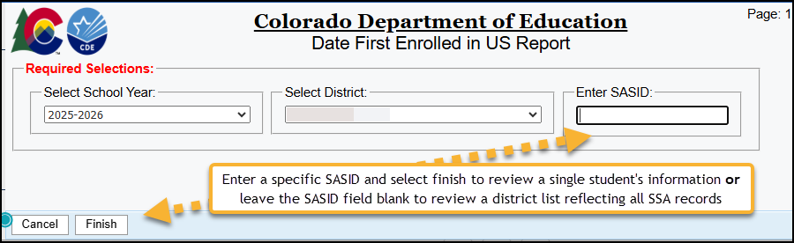
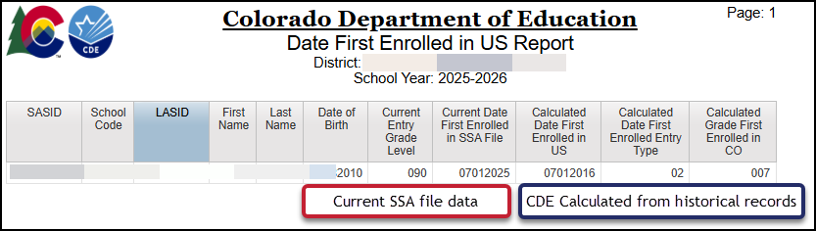
Student Interchange COGNOS/CEDAR Report: Date First Enrolled in US
Enter a specific SASID or leave the SASID field blank to review a district list reflecting all SSA records
Compare current date first enrolled in SSA file to the Calculated Date First Enrolled in US
CDE calculated date based upon prior year finalized SEY collections
At this time, it does not show the conflicting date first enrolled in US in the current year across two different LEAs, which could cause the calculated date to be earlier once the most recent SEY collection is closed
Student Interchange
StudentEndOfYear@cde.state.co.us

Slide 19
SB25-276 Protected Civil Rights Immigration Status FAQs
Federal Programs Unit Responses to frequent questions about this new piece of legislation
Data Impacts
Place of Birth
Immigrant Status
Date Of Entry to Us or Date Enrolled
Other FAQs
Is collection of birth certificates prohibited as part of the enrollment process?
Should we delete data pertaining to place of birth previously collected as part of enrollment process?
Resource: SB-276 FAQ (PDF)
Available on Student Interchange, RITS, and Pipeline Frequently Requested Code and Resources Pages
Student Interchange
StudentOctober@cde.state.co.us or StudentEndOfYear@cde.state.co.us

Slide 20
Questions & Resources: Student Interchange
Student Interchange Website
Data Pipeline Collections Support Page: Request a meeting for Student Interchange support with Collin or Reagan
2024-2025 Student Interchange StudentEndOfYear@cde.state.co.us
2025-2026 Student Interchange
July 2025-Dec 2025: StudentOctober@cde.state.co.us
Jan 2026-Dec 2026: StudentEndOfYear@cde.state.co.us

Slide 21
Student End of Year
Reagan Ward

Slide 22
SEY Collection Timeline: Cross LEA Phase
Date | Event | Event Description
10/6/2025 to 10/16/2025 | Report Review | • Validate Student End of Year data using CEDAR/COGNOS reports. • Submit snapshot as soon as review is complete
10/16/2025 | Cross LEA Deadline | Resubmit error-free SEY Snapshot
10/17/2025 to 10/22/2025 | Closed | Snapshot closed in preparation for the Post-Cross LEA Phase
10/23/2025 to 11/18/2025 | Post-Cross LEA Phase | See the SEY Website for the detailed timeline
12/2/2025 | Deadline | Superintendent Verification (Sign-Off) form due. Collection Closes.
Student End of Year
StudentEndOfYear@cde.state.co.us

Slide 23
SEY Status as of 7am on 10/9
Submission Checklist: *LEA Approvers*
Error free interchange files
Validate Data
Review SE700 series warnings
Review CEDAR/COGNOS reports (rates and lists)
Error free SEY Snapshot
Reminder: The Cross LEA Phase allows LEAs to update any data field. The Post-Cross Phase is very restricted in possible updates, requiring extra steps to make changes to records that aren’t triggering SE900 series errors.
Student End of Year
StudentEndOfYear@cde.state.co.us

Slide 24
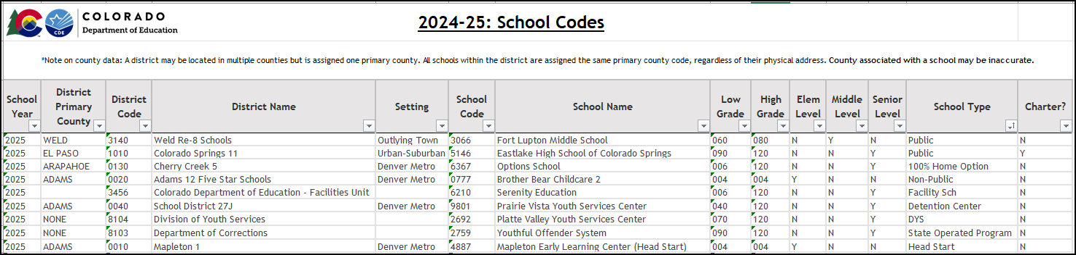
School Code List
Available on Frequently Requested Codes & Resources Page
“School Type” column dictates the school exit type used if a student transfers to one of these locations (COE/A)
Out of State Lookup Tool
NCES Public School Search
NCES Private School Search
Transfer to → School Type | School Exit Type
Public | 13
100% Home Options | 13
Non-Public | 15
Facility Sch | 19
Detention Center | 26 (out of LEA) or 12 (within LEA)
DYS | 21
State Operated Program (DYS or Dept of Corrections) | 21
Head Start (PK only) | 13
Student End of Year
StudentEndOfYear@cde.state.co.us

Slide 25
Questions & Resources: Student End of Year
StudentEndOfYear@cde.state.co.us
720-484-9057
Data Pipeline Collection Support Page: Request a SEY meeting
Student End of Year Collection Website
Student Interchange Website
Graduation Guidelines (Program) Website

Slide 26
Student October
Collin Slutzky

Slide 27
October Count Timeline
Date​ | Event​ | Event Description​
10/01/2025 | Other Date​ | Official Count Day for 2025
10/09/2025 | Interim Deadline​ | Error-free Student Interchange File Uploads (DEM and SSA)
10/14/2025 | Training Event​ | Mid-Collection Office Hours 1-2 p.m. Registration Link
10/14/2025 | Interim Deadline​ | Create an initial Student October Snapshot​
10/27/2025 | Interim Deadline​ | Submit any necessary reporting exceptions for review.
10/27/2025 | Interim Deadline​ | Error free Student October Snapshot​
10/28/2025 | Training Event​ | Data Validation, Transfer Enrollment Exceptions and Cognos Reports 1-2 p.m.​ Registration Link
10/30/2025 | Training Event​ | Data Pipeline Duplicate Process and Submission 11-12 pm Registration Link
11/03/2025 | Report Review​ | Review Student October Cognos Reports for data validation. Submit Student October Snapshot data as soon as review is complete.​
11/10/2025, 12:00 p.m.​ | State Deadline​ | Submit Student October Snapshot data​
Student October
StudentOctober@cde.state.co.us

Slide 28
October Count Timeline: Duplicate Phase
Date​ | Event​ | Event Description​
11/13/2025 | Deadline | Duplicate count funding documentation due to School Auditing Office​
11/19/2025 | Other Date | School Auditing makes decisions on funding duplicates
11/26/2025 | Deadline​ | Resubmit Student October Snapshot data to CDE based on decisions from School Auditing
12/05/2025 | Deadline​ | Collection Closes Secretary of the Board of Education Verification (sign-off) form due Data remains embargoed until the official release in January
01/21/2026 | Data Release​ | Official data release
Student October
StudentOctober@cde.state.co.us

Slide 29
Student October Training Schedule
Mid-Collection Office Hours
Date/Time: 10/14/2025 1-2 p.m
Click here to register for the Mid-Collection Office Hours
Data Validation and Cognos Reports Training
Date/Time: 10/24/2025 1-2 p.m.
Click here to register for the Data Validation and Cognos Training
Data Pipeline Duplicate Process and Submission Training
Date/Time: 10/28/2025 9-10 a.m.
Click here to register for the Duplicate Process and Submission Training
Student October
StudentOctober@cde.state.co.us

Slide 30
Student October: Changes and Updates
97 LEAs have attempted Student October snapshots
155 LEAs have submitted an SSA file, and 171 have submitted a DEM file
High-risk students who are 21 years old and attending an AEC may be eligible for funding if they have sufficient credits to graduate by the end of the current school year
These students will be pulled into your snapshot, but will flag an error (OC210) and require an exception
Business Rules will be posted as soon as possible
Student October
StudentOctober@cde.state.co.us

Slide 31
Student October: New Business Rules
OC210: Students over age 21 as of 10/1 may receive funding if they attend an AEC program and have enough credits to graduate within the current school year.
Must be cleared with an exception request
OC212: K-12 student who was indicated as gifted and talented yes (9) in the prior Student End of Year whose current October status indicates gifted and talented no (0) within the same LEA. Student must be indicated gifted and talented in at least one of the 14 gifted and talented domains in the current year.
During the SEY Cross-LEA Phase: Update prior year SEY snapshot and recreate OCT snapshot to clear this error. Request an exception if prior year SEY snapshot can no longer be updated (SEY Post-Cross LEA Phase).
OC213 (Warning): K-12 student who was indicated as gifted and talented yes (9) in the prior Student End of Year in another LEA whose current October status indicates gifted and talented no (0) in your LEA. Student must be indicated gifted and talented in at least one of the 14 gifted and talented domains in the current year.
Student October
StudentOctober@cde.state.co.us

Slide 32
Student October: SSA File Layout Issues
Some districts have had the following issues with their SIS extracts:
Innovative Learning Opportunity Pilot (ILOP) field still present
Abbreviated School Day Schedule Status and Total Days on an Abbreviated School Day Schedule fields not included
If ILOP field is still present but Abbreviated School Day fields are included, you can delete the ILOP field
If Abbreviated School Day fields are missing, you must contact your SIS vendor and notify them of changes in the 2025-26 SSA file layout
When editing your file, please follow these steps to ensure Excel doesn’t break your file’s formatting
Student October
StudentOctober@cde.state.co.us

Slide 33
Questions & Resources: October Count
Collin Slutzky
studentoctober@cde.state.co.us
(720) 760-3569
Student October Website
Student Interchange Website
School Auditing Office Website

Slide 34
Staff Evaluation
Dawna Gudka

Slide 35

Staff Evaluation Snapshot Collection Status
Staff Evaluation Snapshot Collection
staffevaluation@cde.state.co.us

Slide 36
Staff Evaluation Snapshot State Deadline is October 15th
Common Errors
EV004, EV005, EV006 errors trigger when you go over the 5% threshold of staff not evaluated, in the error message you will find a URL address to request an exception
EV030 triggers when a teacher, special service provider or principal was reported in Human Resources or Special Education December count and is missing from your staff evaluation file. Please add a record for this staff member in your staff evaluation file.
If this person was not fully evaluated due to the fact they left your LEA prior to the evaluations being completed, use 06 in their overall rating, and 00 in the other ratings. This will indicate they were not fully evaluated.
Staff Evaluation Snapshot Collection
staffevaluation@cde.state.co.us

Slide 37
Questions & Resources: Staff Evaluation
Staff Interchange website
Staff Evaluation Snapshot website
Dawna Gudka
(303) 598-7901
staffevaluation@cde.state.co.us

Slide 38
Non-Public Schools Fall Enrollment Count
Jessica Tribbett

Slide 39
Non-public Enrollment Count Overview
Opens: Monday, October 13th, 2025
Closes: Monday, January 12th, 2026
Section 22-1-114 of the Colorado Revised Statutes allows Colorado’s public-school districts to collect, not more than once per month, certain information from non-public schools within their districts to meet their responsibilities for the compulsory attendance of eligible children.
The pupil membership counts reported below become a significant component in computing allocations for ESEA, CPP, Special Education, Nutrition Programs, etc.
LAMS will need to assign a PIPELINE-xxx-NPS~LEAUSER
DirectoryData@cde.state.co.us
Non-Public Enrollment Fall Count

Slide 40
Non-public Enrollment Count: Steps for non-public schools
Districts and CDE will contact non-public schools with a link to the Non-Public Fall Enrollment Count form.
Non-public schools will complete the information requested in the form and email the counts to the district NPS respondent, as designated by your districts LAM.
Non-public schools will need a CDE assigned Non-public School Code, which they may apply for before or after completing the non-public fall enrollment count form. Non-Public School Code Request Form.
DirectoryData@cde.state.co.us
Non-Public Enrollment Fall Count

Slide 41
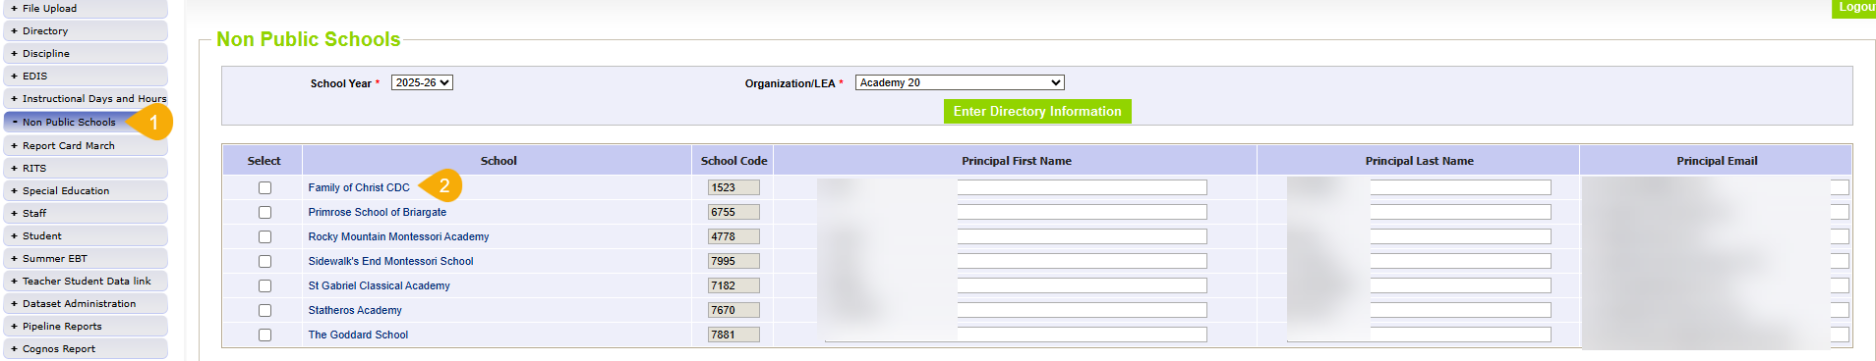
Non-public Enrollment Count: Steps for district respondents
3. Non-public district respondents will log-in to the Data Pipeline and enter the non-public enrollment numbers, checking that all other information is correct and updated.
DirectoryData@cde.state.co.us
Non-Public Enrollment Fall Count

Slide 42
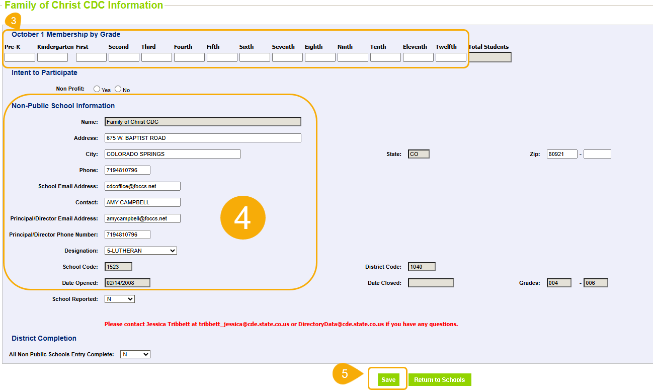
Non-public Enrollment Count: Steps for district respondents cont.
DirectoryData@cde.state.co.us
Non-Public Enrollment Fall Count

Slide 43
Questions & Resources: Non-Public Schools Enrollment
Jessica Tribbett
Non-Public Enrollment Fall Count
Non-Public School Code Request Form

Slide 44
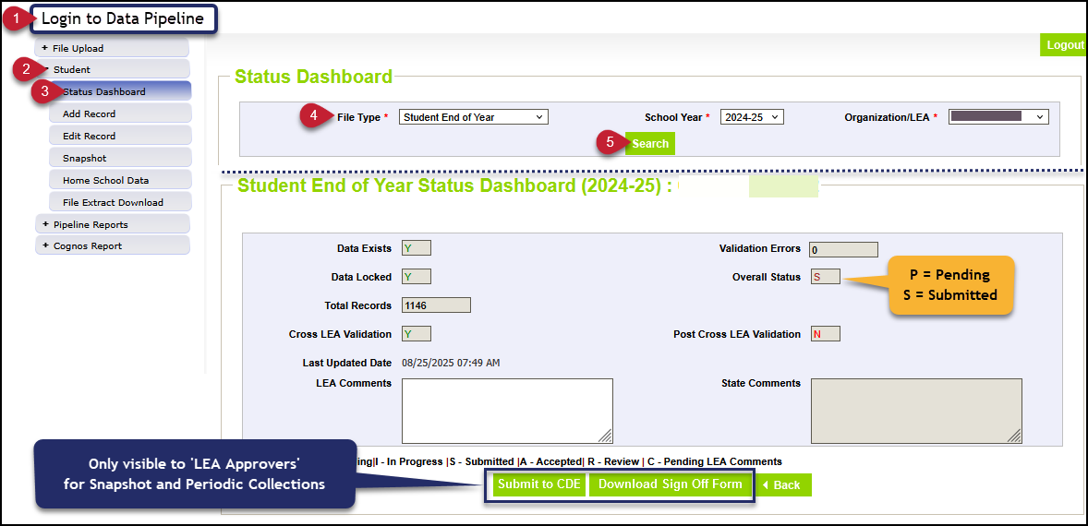
Thank you for joining us today!
Next Town Hall will be October 16th
Reminder/Tip of the week:
Use the Status Dashboard screen for collections/snapshots to review the number of records, errors, and status of your file/snapshot. This is also the screen that indicates a file/snapshot has been submitted to CDE.

