Slide 1
Kindergarten School Readiness (KSR)
Data Collection
Overview for First Time Data Respondents
Tara Rhodes, READ Data Collection Lead
October 2, 2024

Slide 2
KSR: Roadmap
Background Information
  Historical Timeline
  Assessment Domains
Overview of Data Pipeline
  General Steps for Completing the Collection
  Access Management (IdM)
  Communications
  Upload, Errors, and Submission Process
Vendor Information
  Options available
Resources
  File Template, File Layout, Business Rules
  Contacts for Vendor Support
Questions

Slide 3
Background Information

Slide 4
KSR: Background Information
Timeline
Passed in 2008, Colorado Achievement Plan for Kids (CAP4K) requires districts to report school readiness data to the Colorado Department of Education.
In March 2016, the State Board of Education voted to adopt a system for reporting school readiness data, which consisted of only the number of domains in which students demonstrated school readiness.
In March 2020, the State Board of Education voted to change the reporting system to include named domains.
In June 2023, the State Board of Education voted to expand the assessment menu to include single-domain assessment tools.
Consequently, the system calls for districts to submit aggregate readiness information by named domains in which students demonstrate readiness.
Historically, the State Board of Education has set the file layout.

Slide 5
KSR: Background Information
Assessment Domains
As required by Colorado law (Section 22-7-1004 (1)(b) C.R.S.), school readiness includes the following domains:
  physical well-being and motor development
  social and emotional development
  language and comprehension
  cognition
  math
  literacy
The assessment tools linked here have been approved by the State Board of Education for use.
Data reported to CDE is from the initial fall assessment window for school readiness, which is the first 60 calendar days of the school year, as required by HB 15-1323.

Slide 6
Overview of Data Pipeline

Slide 7
KSR: Overview of Data Pipeline
General Steps to Complete the Collection
General Steps to Complete the Collection:
Step 1: Students are assessed and data recorded within the first 60 calendar days of the school year, per HB15-1323.
Step 2: Data are aggregated or extracted from certain vendor systems to meet the file layout. (Note: Make sure the new Assessment Used column is added to your file template.)
Step 3: Data is uploaded in the correct file layout to Data Pipeline.
Step 4: Any errors are resolved within Data Pipeline.
Step 5: Once error-free, data are locked within Data Pipeline.
Step 6: Superintendent sign-off form is downloaded, signed, and emailed back to KSRData@cde.state.co.us.

Slide 8
KSR: Overview of Data Pipeline
Access Management/Identity Management (IdM)
Access Management/Identity Management (IdM) is the system through which districts assign Pipeline roles to individuals.
This is important because if you do not have a role assigned in IdM, then you will not be able to access the collection in Pipeline. Please work with your local access manager (LAM) to determine the correct role assignment for your district:
  There are three roles that can be assigned: KSR-LEA VIEWER, KSR-LEA USER, KSR-LEA APPROVER.
This is also important because I create the contact lists from the role assignments. If you want to be on the listserv for KSR, then please make sure you have a role assigned in IdM.
Notes:
The LEA VIEWER can only view the collection and cannot upload or officially submit/lock the data submission. The LEA USER can upload to the collection but still cannot lock the submission, and the LEA APPROVER is only the role that can upload and lock the submission for the district. Each district must have an LEA APPROVER role assigned.

Slide 9
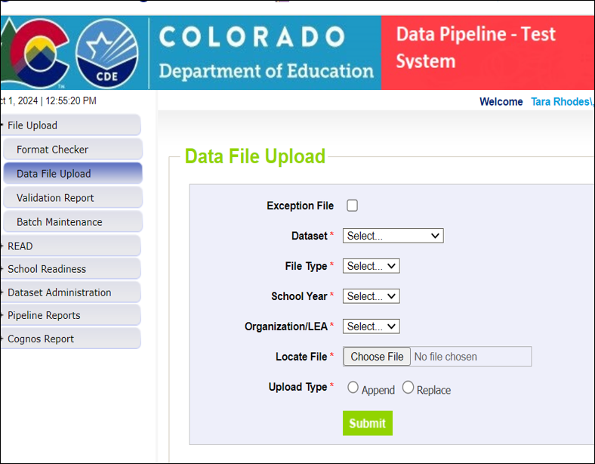
KSR: Overview of Data Pipeline
Upload Process
To Complete an Upload:
Log into Data Pipeline.
Click on “File Upload” in the gray boxes along the left-hand side.
Click on “Data File Upload”.
Select “Dataset: School Readiness”
Select “File Type: School Readiness Collection”
The menus for School Year and Organization/LEA should prepopulate to your LEA.
Select the “Choose File” button to open the dialog box to navigate to your prepared data file.
For most districts, select “Replace” for “Upload Type”.
Click on “Submit”.
Notes:
A few things to remember:
I generally instruct districts to work in their prepared data file, which is generally an Excel file. Making all edits here ensures that you have a copy of what was uploaded into Data Pipeline, and setting a naming convention like “_v1, _v2, etc” helps with version control.
This allows you to use the “Replace” option for the Upload Type because your upload file contains all records that you are intending to submit for the collection. This is because the “Replace” option replaces any data stored from any previous uploads with the information that you are currently uploading. This is in comparison to the “Append” option, where you could submit half of your schools, for example, and then append the second half of your schools at a later date.
I don’t generally recommend doing this unless you are very familiar and comfortable with Pipeline and have amazing organizational skills. It’s too easy to lose where you are in files and then you haven’t submitted all of your information.
You also run the risk of creating duplicate records, which is not as fun to sort through.

Slide 10
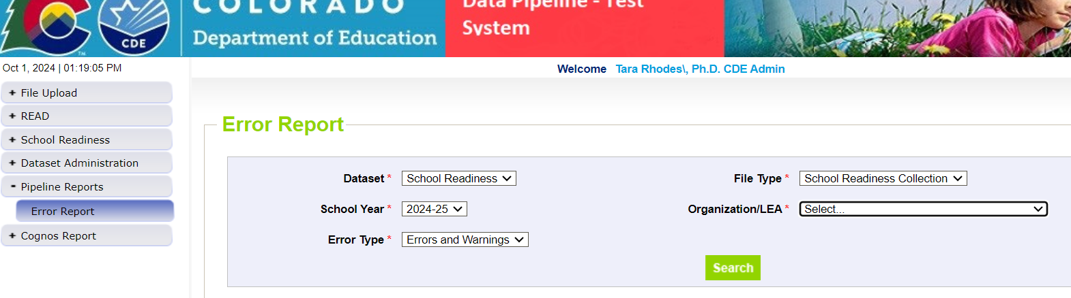
KSR: Overview of Data Pipeline
Error Resolution Process – Main Screen
After you’ve completed an upload, two things will happen:
  1. You will receive either a green message or a red message in Data Pipeline under the “Data File Upload” header.
  2. You (and me) will receive a CDE PROD email. This email will state how many errors you have.
You can also check errors by going to Pipeline Reports > Error Reports in Data Pipeline and making the following selections:

Slide 11
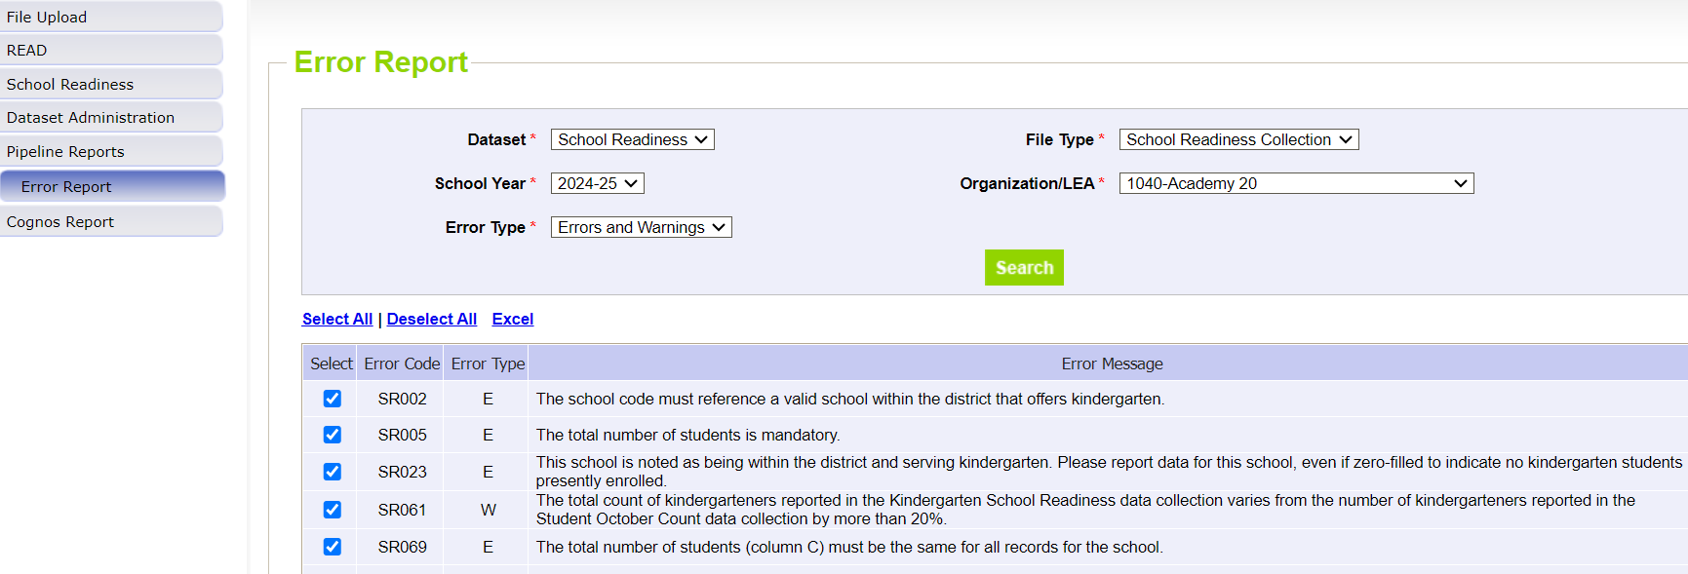
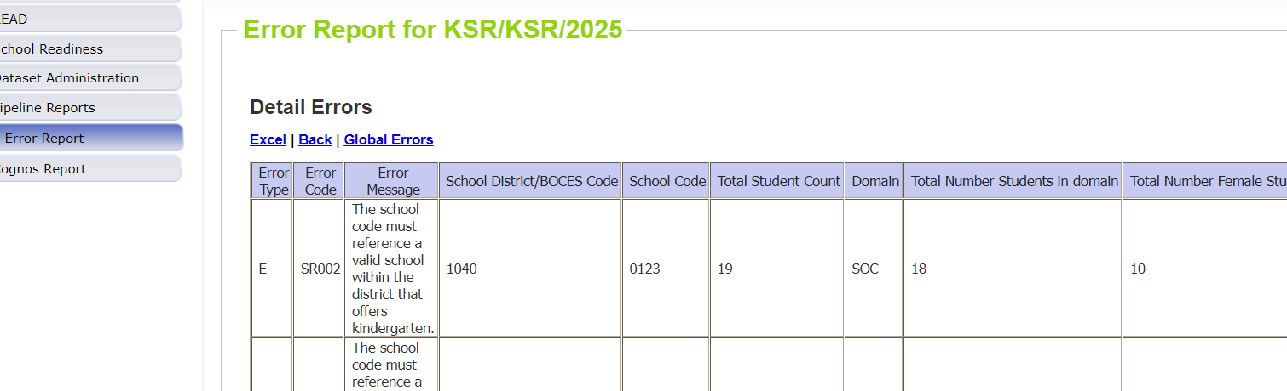
KSR: Overview of Data Pipeline
Error Resolution Process – Error Report
Once you hit “Search”, you will see a screen similar to this:
This screen will reference each of errors and warning that you have in your current file. You can also click on “View Details” at the bottom of the screen to look at the specific records causing these errors.
Notes:
At this point, you will want to work in your data file to correct these errors.

Slide 12
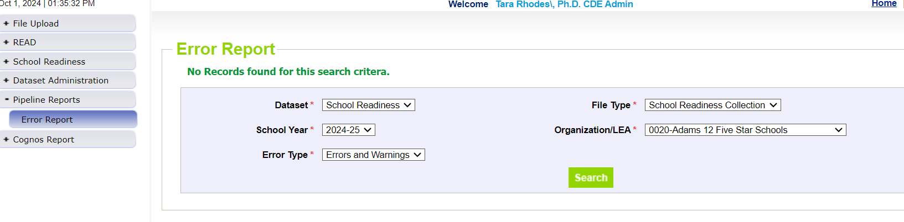
KSR: Overview of Data Pipeline
Error Resolution Process – No Further Errors
At this point, you will want to work in your data file to correct these errors. Once you believe you have corrected all of your errors, you’ll continue this process of uploading and checking errors until you have no further errors to address. The error screen at that point will look like this:

Slide 13
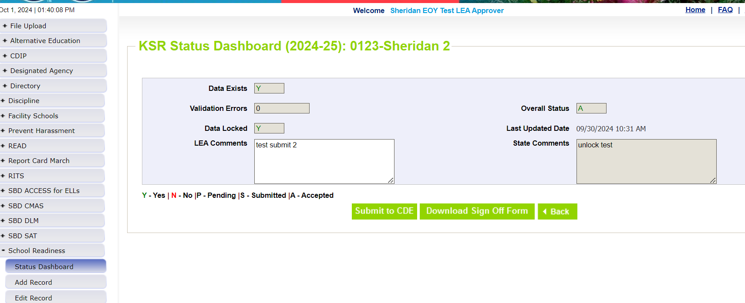
KSR: Overview of Data Pipeline
Submission Process
How to Officially Submit/Lock Your Data:
Once you have reached zero errors, you still need to lock your submission. This ensures that no further changes can be made to your submission and officially sends your data over to CDE.
This is done in Data Pipeline > School Readiness > Status Dashboard through hitting the “Submit to CDE” button. Please note you will only see this button if you have the LEA APPROVER role.
Notes:
Because the collection is not considered complete until this step is taken, I will bug you to officially submit or lock your data until this is done.

Slide 14
Vendor Information

Slide 15
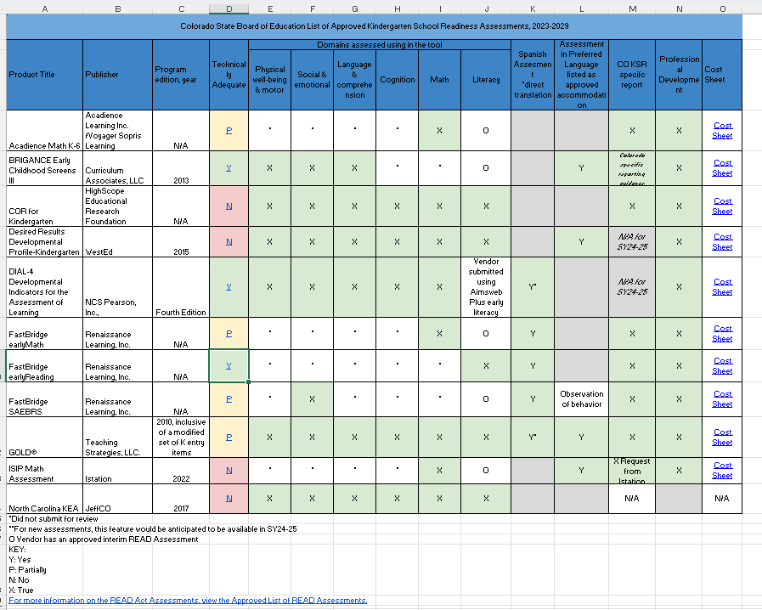
KSR: Vendor Information
Notes:
Please see Column M for which vendors have reports available for whatever domains.

Slide 16
KSR: Vendor Information
Reports Available
The previous slide, which you can download from this link, displays which vendors have Colorado specific reports that can be used for reporting purposes.
Please note that data may need to be manipulated some to meet the file layout requirements. Additionally, the new additional column, which denotes what assessment tool was used, will also need to be added.
Please also consider attending one of the next two trainings, which will cover how to manipulate data from different platforms.

Slide 17
Resources

Slide 18
KSR: Important Dates and Links
Important Dates:
  Collection Open: 10/23/24
  Collection Close: 12/11/24
Important Links:
  Kindergarten School Readiness Data Collection Website
    Questions around Data Pipeline
    Questions around file template, file layout, business rules
    Questions on trainings
  Kindergarten School Readiness Website
    Questions around assessment in kindergarten
    Questions around implementation

Slide 19
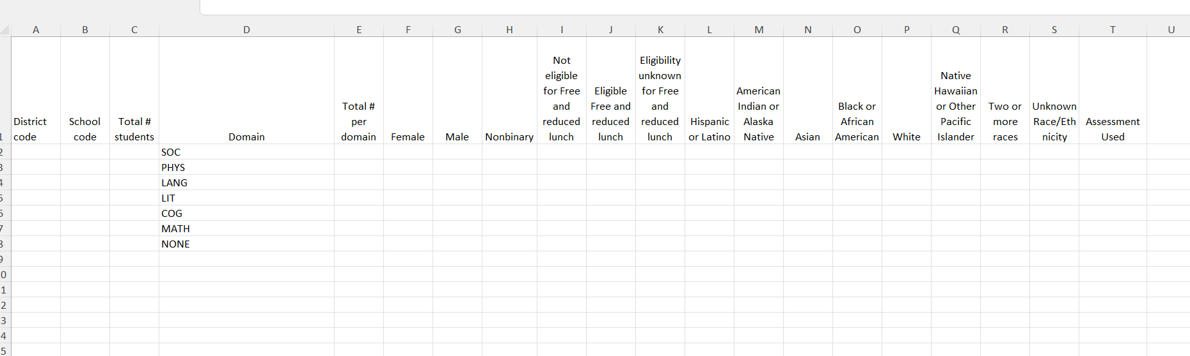
KSR: File Template for 24-25

Slide 20
KSR: 24-25 Changes to Collection
New Column Added
24-25 Changes to the Collection:
With the State Board of Education voting to add single-domain assessment tools to the school readiness assessment tool menu, this necessitated adding an additional column to the file layout to capture that information.
Business rules have been updated to reflect this change. However, vendors have not implemented this change and so this will need to be done manually after extracting your data from the vendor system or by adding this piece of information if you are already manually aggregating your data.
Notes:
If you are a previous data respondent for KSR, you will note that the Assessment Used Menu screen has been disabled and is no longer required.

Slide 21
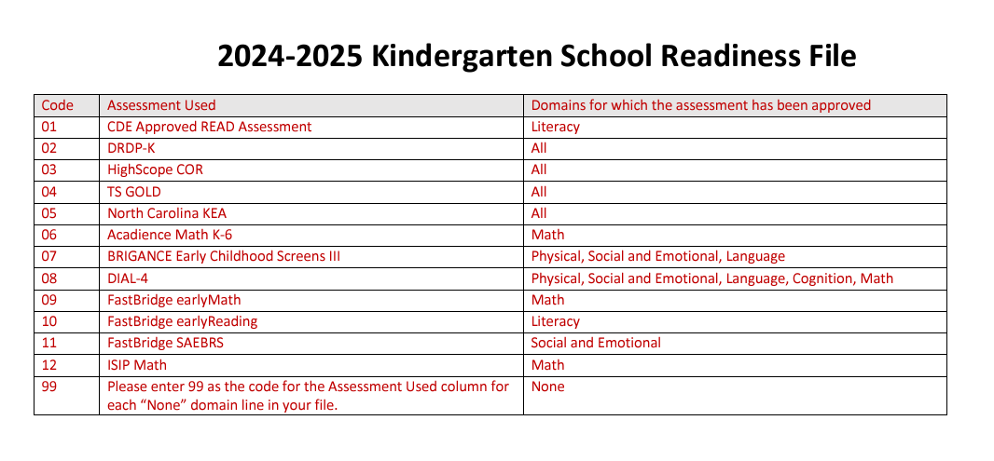
KSR: 24-25 Changes to Collection
Assessment Used Codes
Below is a screenshot of the codes for the different assessment tools. These are entered into your data file to denote which assessment was used. (Note: The NONE domain must have a code of 99.)

Slide 22
KSR: Reminders for the 24-25 Collection
Reminders for the 2024-2025 Collection
  Statute requires the use of an approved assessment tool
  All data must go through the district data respondent, including data from charter schools
    Please connect with your charter schools early!
Waivers
  Districts/schools requesting waivers must go before the State Board and those waivers must be approved prior to using them in the collection window.
    Need to work with the Schools of Choice and Innovation Office at CDE
  Please also note that so far, the State Board of Education has only approved waivers that waive the use of an approved assessment tool. So far, no waivers have been approved that waive the entire collection. Therefore, data collection is still required even with a waiver.
  The school readiness waiver does not fall under the general charter school waiver.

Slide 23
KSR: Steps to Take
Add the collection dates to your calendar.
  It is imperative that this collection is completed on-time because this information is used in the CAP4K Legislative Report in January.
Understand which assessment tool your district is using, including your charter schools.
Work with your School Readiness contact to ensure that the assessment is being completed and information is being entered in the vendor platform, if applicable.
Reach out with any questions!

Slide 24
Questions

Slide 25
Contact Information:
Tara Rhodes
KSRData@cde.state.co.us
Phone: 720.601.4125

