Slide 1
June 6, 2024 Data Pipeline Town Hall
The goal of the webinar is to provide updates on the Data Pipeline, current, and upcoming data collections. These webinars also provide a forum for districts, BOCES, and Administrative Units to have questions answered about Data Pipeline.

Slide 2
Colorado Department of Education Identity Management (IdM)
Identity Management Site
Frequently Asked Questions
How do I add myself or others to the email listserv for town hall emails and/or a specific collection?
Email lists are dependent on a person’s access rights in IdM. Contact your LAM to get an account or be assigned to a specific collection.
Where can I find the IdM role mappings for Data Pipeline and other applications?
Role Mapping (XLS)
I am a LAM. How do I update the user permissions for someone in my district?
Follow the steps outlined in the IdM Quick Guide for Access Management (DOCX)
Important: Users are not automatically removed from IdM when their email address is no longer active in your district. The LAM must deactivate their IdM account to ensure only designated staff can access CDE’s data reporting system.
Notes:
LAMs, please check the IdM roles for your district. Remove permissions for users who have retired, left your district, or are no longer assigned to a collection. Add roles for new hires and newly assigned respondents for specific collections.

Slide 3
What is PII?
Student Personally Identifiable Information (PII) is defined by state and federal laws as information that, alone or in combination, personally identifies an individual
This includes direct identifiers (i.e. student and staff names, SASID, EDID, etc.)
Includes information that when combined is identifiable
Colorado’s Student Data Transparency and Security Act outlines requirements for how Student PII is collected, used and shared
See the Data Privacy and Security website for prepared guidance on how to comply with this and other privacy laws.

Slide 4
Sharing Data
Use secure methods to transfer any PII to CDE
Contact Data Collection leads with questions about how to transmit PII securely
Each Data Collection leads maintains their own Syncplicity folders for specific collections, reach out to the collection lead for access
Use Syncplicity to encrypt emails to CDE
Avoid sending PII via unencrypted email or to unsecured faxes when sharing data between or within districts
Use Syncplicity to encrypt emails to CDE
Check local policies for restrictions, requirements, etc. regarding PII
Do not use PII in trainings, presentations, etc.
Do not share PII with unauthorized individuals
Do not share passwords
Follow local policies when transmitting PII to any third party

Slide 5
Today’s Agenda
Agenda Topic | Presenter
Open Data Collections and Upcoming Deadlines in Data Pipeline
READ Spring Assessment Reporting | Tara Rhodes
K-3 Literacy Programs & Assessment Reporting | Tara Rhodes
SAT, CMAS, and DLM SBDs | Tara Rhodes
Teacher Student Data Link | Peter Hoffman
Directory | Jessica Tribbett
RITS | Jessica Tribbett
Attendance | Brooke Wenzel
Special Education End of Year | Lindsey Heitman
Special Education Discipline | Lindsey Heitman

Slide 6
Open Collections and Upcoming Deadlines in Data Pipeline

Slide 7
Open Collections and Upcoming Dates: Year-Round & Interchanges
Name | Category | Status | Key Dates
RITS | Year Round | Open
EDIS | Year Round | Open
Directory | Year Round | Open | School Code Change Requests: 2/5/2024 to 6/28/2024
Student | Interchange | Open | Interim Deadline: 6/12/2024 error free files
Title I | Interchange | Open | Interim Deadline: 6/12/2024 error free file
Special Education IEP | Interchange | Open
Staff | Interchange | Open | Staff Evaluation Interchange opened 5/29
TSDL | Interchange | Open
Discipline | Interchange | Open
Data Pipeline Resources: Data Pipeline Collection Dates (XLS)

Slide 8
Open Collections and Upcoming Dates: Snapshots
Name | Category | Status | Final Deadline Date | Next Milestone | Looking Ahead
TSDL | Snapshot | Open | Aug. 30, 2024
Attendance | Snapshot | Open | July 12, 2024 | Interim Deadline: 6/12/2024 error free interchange files | Interim Deadline: 6/26/2024 Error free attendance snapshot
Staff Evaluation | Snapshot | Open | October 15, 2024 | Interim Deadline: 6/12/2024 To upload staff evaluation file | Interim Deadline: 6/26/2024 Error free staff profile
Student Discipline | Snapshot | Open | July 31, 2024 | Interim Deadline: 6/14/2024 Student interchange files error free | Interim Deadline: 6/21/2024 Discipline action file error free
Student End of Year | Snapshot | Open | Nov. 19, 2024 | Interim Deadline: 6/12/2024 error free interchange files | Training Event: June SEY Office Hours 6/12/2024 2:30-3:30pm
Special Education Discipline | Snapshot | Open | Aug. 29, 2024 | Interim Deadline: 6/27/2024 Interchange files error- free | Timeline Reminder: 6/30/2024 Reporting period ends
Special Education End of Year | Snapshot | Open | Sept. 27, 2024 |  | Interim Deadline: 6/27/2024 Interchange errors resolved
Data Pipeline Resources: Data Pipeline Collection Dates (XLS)

Slide 9
Open Collections and Upcoming Dates: Periodic
Name | Category | Status | Final Deadline Date | Looking Ahead
AEC Collections | Periodic | Open | Jun. 28, 2024 | Planned Measures and Actual Measures
CDIP | Periodic | Open | Jun. 30, 2024
Designated Agency | Periodic | Open | Aug. 30, 2024
CMAS & CoAlt SBD | Periodic | Closed | May 29, 2024 | Opens 5/16/2024
DLM SBD | Periodic | Closed | Jun. 5, 2025 | Opens 5/29/2024
P/SAT SBD | Periodic | Closed | May 22, 2024 | Opens 5/15/2024
READ Spring Assessment | Snapshot | Open | Jun. 14, 2024 | Interim Deadline: 6/10/2024 error free
READ Literacy Programs | Periodic | Open | Jun. 28, 2024 | Interim Deadline: 6/10/2024 error free
Data Pipeline Resources: Data Pipeline Collection Dates (XLS)

Slide 10
READ Spring Assessment Reporting
Tara Rhodes

Slide 11
READ Data Collections Status Update
Status Update
~59.9% of districts have done an upload
~31.3% of districts have officially submitted
As a reminder, files are due next Friday, 6/14.
Link to updates to cut scores as well as approved programs:
Please review the updates on the READ Act Approved Assessments webpage.
Known Bugs:
The READ export out of Infinite Campus is not correctly configured for Dibels 8.
A fix is supposed to be deployed sometime this week (week of 6/3).
READ Act Data Collections – Spring Assessment Data
Readactdata@cde.state.co.us

Slide 12
READ Data Collections Purpose and Criteria Cont.
Spring READ Assessment reporting window is scheduled to open April 10, 2024 and is scheduled to close June 14, 2024.
Timeline:
April 10, 2024: Data collection opens, and files may be uploaded in Data Pipeline
May 13, 2024: Target: First Upload of Spring READ Assessment file in Data Pipeline
June 10, 2024: Target: Spring READ Assessment file is error free in Data Pipeline
• June 14, 2024: Date by which district must have error free and locked file in the Status Dashboard
• June 21, 2024: CDE conducts cross LEA validation process and districts will work with each other to remove duplicate SASIDS
• June 28, 2024: Date by which district must have file resubmitted with duplicate SASIDs removed
• July 25, 2024: CDE sends emails to data respondents with final SRD numbers through Data Pipeline for district confirmation
• July 29, 2024: CDE sends emails to superintendents with final SRD numbers
READ Act Data Collections – Spring Assessment Data
Readactdata@cde.state.co.us

Slide 13
Questions & Resources: READ Spring Assessments
Email: ReadActData@cde.state.co.us
READ Collections Website

Slide 14
K-3 Literacy Programs & Assessment Reporting
Tara Rhodes

Slide 15
Literacy Programs & Assessment Reporting Changes for 24-25 Collection and Status Update
Status Update
~41.8% of districts have done an upload
~23.6% of districts have submitted
As a reminder, there are about 3 weeks left in the collection window.
Updates have been made to the advisory list for the instructional programming.
Please review the updates on the Advisory List of Instructional Programming Webpage.
READ Act Data Collections – Literacy Programs
ReadActData@cde.state.co.us

Slide 16
Literacy Programs & Assessment Reporting Timeline
Literacy Programs & Assessment reporting window is scheduled to open on April 24, 2024 and close June 28, 2024.
Timeline:
• April 24, 2024: Data collection opens, and files may be uploaded in Data Pipeline
May 20, 2024: Target: Literacy Programs and Assessment file upload in Data Pipeline
June 10, 2024: Literacy Programs and Assessment file is error free in Data Pipeline
• June 28, 2024: Date by which district must have error free and locked file in the Status Dashboard
READ Act Data Collections – Literacy Programs
ReadActData@cde.state.co.us

Slide 17
Questions & Resources: K-3 Literacy Programs & Assessments
Email: ReadActData@cde.state.co.us
READ Collections Website

Slide 18
SAT, CMAS, and DLM SBDs
Tara Rhodes

Slide 19
SAT, CMAS, and DLM SBDs Important Dates
Assessment | SBD Name | Dates | User Role Group Name
CO PSAT/SAT | SAT SBD | 5/15/24 - 5/22/24 | SAT
CMAS English Language Arts (ELA), Math, Science CoAlt Science CSLA (Spanish English Language Arts) | CMAS SBD | 5/16/24 - 5/29/24 | CMS
CoAlt English and Math | DLM SBD | 5/29/24 - 6/5/24 | DLM
Assessment SBDs
SBDSupport@cde.state.co.us

Slide 20
SAT, CMAS, and DLM SBDs Status Update
Submissions:
SAT SBD: We had 75.7% (140/185) of districts participate.
CMAS SBD: We had 73.7% (137/186) of districts participate.
DLM SBD: We had 73.1% (95/130) of districts participate.
Assessment SBDs
SBDSupport@cde.state.co.us

Slide 21
CMAS, SAT, and DLM SBDs Anticipated Release of Results
Find out the full release calendar here.
Student Level Data Files:
CMAS (ELA/Math): Anticipated 6/17 via PearsonAccess^{Next}
CoAlt Science: Anticipated 6/17 via PearsonAccess^{Next}
CoAlt ELA and Math: Anticipated 6/17 via Syncplicity
PSAT/SAT: Anticipated 6/28 via Syncplicity
District and School Summary Data Files:
CMAS: Anticipated 6/27 via PearsonAccess^{Next}
CoAlt Science: Anticipated 6/27 via PearsonAccess^{Next}
Assessment SBDs
Sbdsupport@cde.state.co.us

Slide 22
Questions and Resources: SBD Collections
Email: SBDSupport@cde.state.co.us
SAT SBD Webpage
CMAS SBD Webpage
DLM SBD Webpage

Slide 23
Teacher Student Data Link (TSDL)
Peter Hoffman

Slide 24
Teacher Student Data Link Timeline
Date | Event | Event Description
Friday June 14, 2024 | Interim Deadline | TARGET: Date by which the TSDL Upload interchange should be uploaded and error free.
Friday June 28, 2024 | Interim Deadline | TARGET: Date by which the TSDL snapshot should be created at least once.
Friday August 23, 2024 | Interim Deadline | TARGET: Date by which you should have a complete Teacher Student Data Link Snapshot. Complete Teacher Student Data Link Snapshot means: ◻ All TSDL interchange errors are resolved ◻ All TSDL snapshot errors are resolved If you anticipate that you will not be able to meet this deadline, please contact CDE at TeacherStudentDataLink@cde.state.co.us
Monday August 26, 2024 – Thursday August 29, 2024 | Report Review | Final Snapshot Report Review – This is your opportunity to review reports in detail and make any data corrections you deem necessary to make sure you are reporting valid and reliable data. All data corrections must be completed during this time.
Friday August 30, 2024 | Deadline | Required to have TSDL snapshot error free and finalized before or on this date. TSDL closed and final report is signed and provided to CDE via email TeacherStudentDataLink@cde.state.co.us
Teacher Student Data Link
TeacherStudentDataLink@cde.state.co.us

Slide 25
Teacher Student Data Link
We are still working through getting the TSDL Snapshot Error report to show the detail report, this should be fixed soon.
If you cannot see the Status Dashboard or Snapshot options, make sure you have both IDM Roles:
TSL~LEAUSER
and
TLS~LEAAPPROVER
Record expectations: One record for each student and core course enrolled for 6 weeks or more along with the educator of record and contributing professional if applicable for grades 6-12. “Core course" means a course in English, mathematics, science, social studies. For 8th-12th grade Migrant Students, all courses must be reported.
It is recommended to also include AP and Computer sciences courses as these are required during CRDC reporting years.
CDE uses NCES SCED codes for State course codes. The latest file can be found here either on the TSDL Interchange or the NCES SCED websites.
Teacher Student Data Link
TeacherStudentDataLink@cde.state.co.us

Slide 26
Questions & Resources: TSDL
Peter Hoffman
TeacherStudentDataLink@cde.state.co.us
TSDL Interchange Webpage

Slide 27
Directory
Jessica Tribbett

Slide 28
Directory: Principal Contact Information
For CDE internal use only - TLCC survey
Will not be made public but can be requested via CORA.
Directory Data
DirectoryData@cde.state.co.us

Slide 29
Questions & Resources: Directory
Jessica Tribbett
DirectoryData@cde.state.co.us
Directory Collection Webpage

Slide 30
RITS Updates SASID Merges
Jessica Tribbett

Slide 31
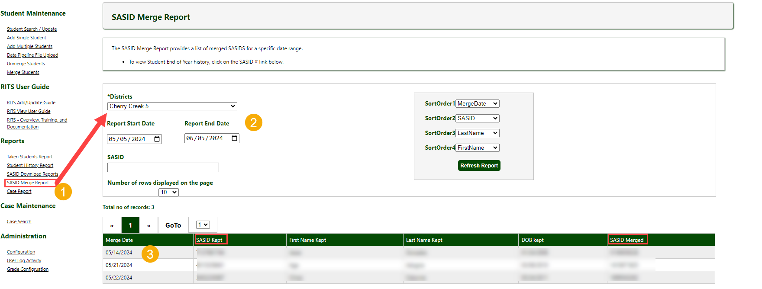
RITS: SASID Merges
SASID Merges
RITS@cde.state.co.us

Slide 32
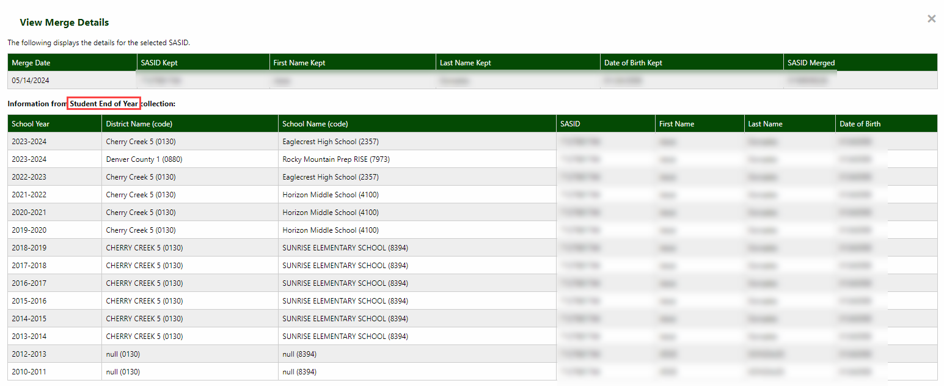
RITS: SASID Merges
SASID Merges
RITS@cde.state.co.us

Slide 33
Questions & Resources: Directory
Jessica Tribbett
RITS@cde.state.co.us
RITS Information Webpage
RITS Web

Slide 34
Title I Interchange
Melissa Chaffin

Slide 35
2023-2024 Important Dates
Date | Event | Event Description
5/9/2024 | Interim Deadline | Upload end of year Title 1 Interchange File. Districts should have an upload date of 4/1/2024 or later to meet this deadline.
6/12/2024 | Interim Deadline | Error free end of year Title 1 Interchange File.
9/05/2024 | Deadline | Student End of Year snapshot submission date. 2023-2024 Title 1 Interchange data is incorporated into this snapshot.
9/19/2024 | Open | Student End of Year Cross LEA phase begins. Final opportunity to correct 2023-2024 Title 1 Interchange data.
10/17/2024 | Deadline | Student End of Year Cross LEA submission date. 2023-2024 Title 1 Interchange data can no longer be corrected.
Title 1 Interchange – Melissa Chaffin
chaffin_m@cde.state.co.us

Slide 36
Title I Targeted Assistance
Most LEAs have already uploaded a Title I file in the Data Pipeline for the October Count collection during the Fall of 2023.
This same file will be used to feed into the EOY collection that is currently happening.
If your LEA hasn't already during the past few months, check that file and make sure it doesn't need to be updated.
If it doesn't need to be updated, email me at chaffin_m@cde.state.co.us to let me know that the file does not need to be updated (if you haven't already), so I don't keep sending you reminders.
If it does need to be updated, or if you are not sure, please refer to the following 2 slides to check and make changes if necessary.
Title 1 Interchange – Melissa Chaffin
chaffin_m@cde.state.co.us

Slide 37
Data Submission Expectations
SEY 2023-24 School Year
Only Schools and grade spans listed as TA need to be uploaded, not SW or NS (SW is Schoolwide Title I and is automatically uploaded into the EOY collection).
If needed, check your schools and grade spans at: http://www.cde.state.co.us/fedprograms/dper/tiaschlst
Review that same file that was uploaded in Fall 2023 (for Oct Count) and determine if any students need to be added or resource boxes changed.
Make sure resource boxes where T1 services were used indicate 0 for no or 1 for yes. All students in the file should have at least one box checked with a 1. Do not leave blanks.
Include students in TA grade spans/schools who received Title I services/resources any time during the year, even if student left school/district or services were stopped.
The only reason a student would be removed from the file is if they never received any Title I services throughout the school year.
Indicate resource(s) they received (reading, math, etc.).
If the file is needs to be updated, LEAs can either append (add on to) or replace the old file with the updated file.
Title 1 Interchange – Melissa Chaffin
chaffin_m@cde.state.co.us

Slide 38
Common Errors
Two main error codes: TI003 and TI004
TI003 error message: “The school is not a Targeted Assistance school for the grade of the students’ enrollment in the Student Profile”.
Double check that the school and grade the student is in is approved for Targeted Assistance.
If K-8 school only funded at E (K-5) level, 6th-8th graders cannot be entered.
TI004 error message: “There must be a School Association record for this student in the Student Profile at this school for the current School Year”.
Make sure the Student School Association file is uploaded first and the student data matches in the Title ! File.
May have to refresh EOY file for system to re-read the files.
Wrong formats
Missing leading zeros: Gender (01,02) must have zeros.
In Excel, right-click cell and format as ‘text’ to include leading zeros.
Birthdate format is mmddyyyy. June 5, 1992 is 06051992.
General data errors
Invalid SASID, first and last name swapped, missing letters
Services not marked 0 or 1 in template; blanks=errors.
Title 1 Interchange – Melissa Chaffin
chaffin_m@cde.state.co.us

Slide 39
Questions & Resources: Title I Interchange
Melissa Chaffin
chaffin_m@cde.state.co.us
Title I Interchange Webpage
Student End of Year Webpage

Slide 40
Attendance
Brooke Wenzel

Slide 41
Attendance Timeline
Date | Event | Event Description
04/17/2024 | Open | Districts may begin creating snapshots. Attendance Snapshot dependencies are the Student Demographic File and Student School Association File.
05/08/2024 10:30-12:00 p.m. | Training Event | Collection Overview Training
05/09/2024 | Interim Deadline | Upload Student Demographic and Student School Association Files
05/28/2024 | Interim Deadline | Create an initial Attendance Snapshot
06/12/2024 | Interim Deadline | Error free Student Interchange file uploads
06/26/2024 | Interim Deadline | Error free Attendance Snapshot
07/05/2024 | Report Review | Review Attendance Cognos Reports for data validation. Submit Attendance Snapshot data as soon as review is complete.
07/12/2024 | Deadline | Submit Attendance Snapshot data.
07/26/2024 | Deadline | Collection closes Superintendent Verification (sign-off) form due. Data remains embargoed until the official release in August.
08/16/2024 | Data Release | Official data release
See the Attendance website for collection timeline
Attendance – Brooke Wenzel
Attendance@cde.state.co.us

Slide 42
Attendance Snapshot Status (4:00 pm, 6/5)
Attendance – Brooke Wenzel
Attendance@cde.state.co.us

Slide 43
AS020 Error
Student must be in DEM and SSA file (error free!)
Check your Attendance Fields (Student School Association File)
Attendance Fields must be formatted correctly and not NULL
Zero-fill will automatically exclude the student from the snapshot (do not meet Total Days Possible >= 10.0)
Attendance Snapshot Layout contains criteria to be included in snapshot
Exception Needed?
Misreported in OCT
Total Possible Attendance Days is less than 10.0
Etc..
Attendance – Brooke Wenzel
Attendance@cde.state.co.us

Slide 44
Attendance Signoff Form Errors
Snapshot Created Date is incorrect
Use Status Dashboard for up-to-date information on creation timestamp
Signature of Superintendent instead of the Secretary of the Board of Ed.
Please continue to use the form! Update if you would like!
Attendance – Brooke Wenzel
Attendance@cde.state.co.us

Slide 45
Questions & Resources: Attendance
Brooke Wenzel
Attendance@cde.state.co.us
720-441-7963
Attendance Webpage
Student Interchange Webpage

Slide 46
Special Education End of Year
Lindsey Heitman

Slide 47
Special Education End of Year: Timeline and Office Hours
2023-2024 Special Education EOY Snapshot Timeline
Important to get Participation file up to date and mostly error free before looking into Sped EOY and Sped Discipline Snapshot errors.
May 1, 2024 - SPED EOY Snapshot official open
June 27, 2024 – IEP Interchange files error-free
August 29, 2024 - All Exception requests submitted to CDE
September 5, 2024 – All errors resolved at snapshot/interchange
September 5 -13, 2024 -Initial Report Review
September 16 - 20, 2024 – Resolving duplicates
September 20 - 27, 2024 – Final Report Review
September 27, 2024 - Final approval in Data Pipeline and reports uploaded to DMS
Sped EOY Office Hours:
Monday June 24th 11:00 – 12:00
Join the meeting now
Special Education EOY – Lindsey Heitman
SpedEndofYear@cde.state.co.us

Slide 48
Special Education End of Year - Initial referral record -parents request to wait and start services in the fall
Remember:
Path 2 or 3 referral records should be reported in the school year in which the IEP was implemented.
Implemented means the services have begun and that date should match the Start Date of Services/Date of Entry to Sped.
If you are reporting a ‘Date IEP Implemented’ on an initial referral record, that would indicate services are already being received by the student
How to report an initial evaluation that wrapped up in the spring, student was found eligible, and parents request to wait and start services in the fall when child begins preschool?
Please report the initial referral record next year, school year – 24-25 - if you expect student to start services in the fall.
Nothing should be reported for this student in the 23-24 Sped EOY – they should not have a record in your Child/Participation files this year
The 24-25 record will contain the initial referral code of 02 or 03 and all the evaluation dates that occurred in the spring of 2024, as well as any applicable delay codes.
In Enrich under student’s Program History tab:
Do an Admin Edit and populate ‘Actual Start Date of Services’ with the expected first day of school for the 24-25 school year. Ex: 08/19/2024
If record is a C to B, you will likely be prompted for a delay code (45, 41, or 49 are all codes that might fit= all valid delay reasons)
Next you must recollect the data
After recollecting, the system should automatically withhold the record from the 23-24 EOY files and hold it for the 24-25 EOY files instead.
Once evaluation process has completed and you are certain the parent has decided to not enroll their child or start services, please go ahead and report that record in 23-24 with the delay code ’01’, which indicates child never enrolled
Special Education EOY – Lindsey Heitman
SpedEndofYear@cde.state.co.us

Slide 49
New Business Rules in 23-24: Errors or Warnings
SY311: Delay Code 41 -Parents chose to extend Part C Services - may only be used on students with third birth dates between May 1st and the start of the following school year.
SY312: Delay Code 41 - Parents chose to extend Part C services - may only be used on students beginning services at the start of the school year
SY313: Delay Code 49 -Child's third birthday occurred over the summer - may only be used on students with birth dates between May 15th of the prior school year and the start of the following school year.
SY314: Delay Code 49 - Child's third birthday occurred over the summer - may only be used on students beginning services at the start of the school year
SY310: Duplicate, this student is also reported as in attendance at another AU/SOP and has the same date of exit. Please verify your records for this student and contact the other AU to determine how to resolve on both ends.
SY315: Student is reported as completing transition in the Student EOY Snapshot with a School Exit Type of 28, indicating they met graduation requirements in a prior year. Please report a 90 in the Sped Basis of Exit field.
Special Education EOY – Lindsey Heitman
SpedEndofYear@cde.state.co.us

Slide 50
Questions & Resources: Special Education End of Year
Lindsey Heitman
SpedEndofYear@cde.state.co.us
(303) 866-5759
Special Education IEP Interchange Webpage Special Education End of Year Snapshot Webpage

Slide 51
Special Education Discipline
Lindsey Heitman

Slide 52
Special Education Discipline Snapshot
Timeline:
May 1, 2024 - SPED Discipline Snapshot official open
May 23, 2024 - All Interchange files that feed into snapshot uploaded or updated at least once
June 27, 2024 - Interchange errors resolved – Discipline Action File, Child File, Participation File
August 15, 2024 - All Exception requests submitted to CDE processing
August 22, 2024 - Snapshot error-free
Aug. 22 – Aug. 29, 2024 - Report Review
August 29, 2024 - Final Submission approval in Data Pipeline and reports uploaded to DMS.
SpedDiscipline@cde.state.co.us
Special Education Discipline – Lindsey Heitman

Slide 53
Special Education Discipline Snapshot: Breakdown of records that will pull into this snapshot from the Discipline Action file
Discipline Action
Suspensions:
In-school (11)
Out of School (12)
Expulsion: (with or without services)
(13)
Sped Removal
Unilateral Removal to an *IAES by school personnel for up to 45 days
(01)
Removal by a hearing officer to an *IAES for up to 45 days
(02)
OR
Special Education Removal Reason required-
Incident involving drugs (01), weapons (03), or serious bodily injury (02)
Received Services During Expulsion (0- No, 1- Yes)
*IAES – Interim Alternative Educational Setting
Each record should contain a Discipline OR a Sped Removal Type
Special Education Discipline – Lindsey Heitman
SpedDiscipline@cde.state.co.us

Slide 54
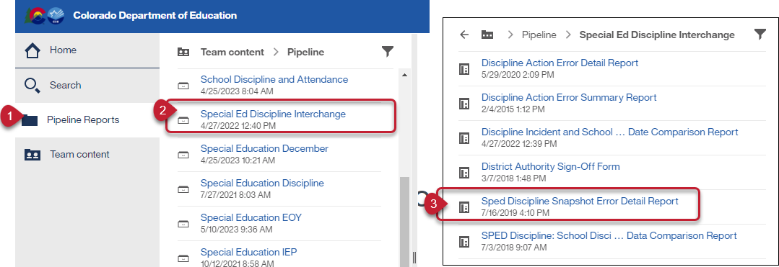
Special Education Discipline: District Report For Viewing Snapshot Level Errors (DIS role)
This report allows the district respondent to see the Sped Discipline Snapshot errors.
SpedDiscipline@cde.state.co.us
Special Education Discipline – Lindsey Heitman

Slide 55
Questions & Resources: Special Education Discipline
Lindsey Heitman
SpedDiscipline@cde.state.co.us
Discipline Interchange Webpage Special Education Discipline Snapshot Webpage

Slide 56
Thank you for joining today!
Next Town Hall will be June 13th
Town Hall will continue to meet weekly throughout the summer.
We will not meet on Thursday, July 4th.

