Slide 1
May 1, 2025
Data Pipeline Town Hall
The goal of the webinar is to provide updates on the Data Pipeline, current, and upcoming data collections. These webinars also provide a forum for districts, BOCES, and Administrative Units to have questions answered about Data Pipeline.

Slide 2
Colorado Department of Education
Identity Management (IdM)
Identity Management Site
Frequently Asked Questions
How do I add myself or others to the email listserv for town hall emails and/or a specific collection?
  Email lists are dependent on a person’s access rights in IdM. Contact your LAM to get an account or be assigned to a specific collection.
Where can I find the IdM role mappings for Data Pipeline and other applications?
  Role Mapping (XLS)
I am a LAM. How do I update the user permissions for someone in my district?
  Follow the steps outlined in the IdM Quick Guide for Access Management (DOCX)
Important: Users are not automatically removed from IdM when their email address is no longer active in your district. The LAM must deactivate their IdM account to ensure only designated staff can access CDE’s data reporting system.
Notes:
LAMs, please check the IdM roles for your district. Remove permissions for users who have retired, left your district, or are no longer assigned to a collection. Add roles for new hires and newly assigned respondents for specific collections.

Slide 3

What is PII?
Student and Staff Personally Identifiable Information (PII) is defined by state and federal laws as information that, alone or in combination, personally identifies an individual
  This includes direct identifiers
  (i.e. student and staff names, SASID, EDID, etc.)
  Includes information that when combined is identifiable
Colorado’s Student Data Transparency and Security Act outlines requirements for how Student PII is collected, used and shared
See the Data Privacy and Security website for prepared guidance on how to comply with this and other privacy laws.

Slide 4

Sharing Data
Use secure methods to transfer any PII to CDE
  Contact Data Collection leads with questions about how to transmit PII securely
    Each Data Collection leads maintains their own Syncplicity folders for specific collections, reach out to the collection lead for access
  Use Syncplicity to encrypt emails to CDE
Avoid sending PII via unencrypted email or to unsecured faxes when sharing data between or within districts
  Use Syncplicity to encrypt emails to CDE
Check local policies for restrictions, requirements, etc. regarding PII
  Do not use PII in trainings, presentations, etc.
  Do not share PII with unauthorized individuals
  Do not share passwords
  Follow local policies when transmitting PII to any third party

Slide 5
Today’s Agenda
Agenda Topic | Presenter
Open Data Collections and Upcoming Deadlines in Data Pipeline | Host: Jessica Tribbett
Reduced Academic Calendar Requests | Jessica Tribbett
Student Attendance | Peter Hoffman
Teacher Student Data Link | Peter Hoffman
Student Interchange | Reagan Ward
Student End of Year | Reagan Ward
SBD Collections | Leon Merker
Special Education Discipline | Lindsey Heitman
Special Education End of Year | Lindsey Heitman
Student Discipline | Carrie Martin
Prevent Harassment or Discrimination | Carrie Martin

Slide 6
Open Collections and
Upcoming Deadlines in
Data Pipeline

Slide 7
Open Collections and Upcoming Dates:
Year-Round & Interchanges
Name | Category | Status | Key Dates
RITS | Year Round | Open | N/A
EDIS | Year Round | Open | N/A
Directory | Year Round | Open | Reduced Academic Calendar: 2/5/2025 to 5/9/2025 School Code Change Requests: 2/5/2025 to 6/30/2025
Student | Interchange | Open | 5/9/2025 Interim Deadline: Upload initial end of year DEM, SSA, GG file in preparation for Spring student collections
At-Risk | Interchange | Closed | N/A
Title I | Interchange | Open | 5/9/2025 Interim Deadline: Upload initial end of year file in preparation for Attendance and SEY collections
Special Education IEP | Interchange | Open | Special Education EOY Snapshot open now
Staff | Interchange | Open | Staff Evaluation Interchange opens 5/21/25
Discipline Action | Interchange | Open | This interchange file is needed for Student Discipline Snapshot and Special Education Discipline Snapshot Collections
Teacher Student Data Link | Interchange | Open | Upload an interchange file at least once by 5/16/2025
Data Pipeline Resources: Data Pipeline Collection Dates (XLS)

Slide 8
Open Collections and Upcoming Dates:
Snapshots
Name | Category | Status | Final Deadline Date | Next Milestone | Looking Ahead
Teacher Student Data Link | Snapshot | Open | Aug. 29, 2025 | Interim Deadline: 5/16/2025, upload TSDL interchange at least once | Interim Deadline: 6/13/2025, error free TSDL interchange
Student End of Year | Snapshot | Open | Dec. 2, 2025 | Interim Deadline: Upload SSA/DEM/GG/TT1 files by 5/09 | Training: May SEY Office Hours 5/13/2025, 10:30-11:30am
Student Attendance | Snapshot | Open | July 25, 2025 | Interim Deadline: Upload SSA/DEM files by 5/09 | Collection Training 5/7/2025
Special Education Discipline | Snapshot | Open | Aug. 1, 2025 | Interim Deadline: upload or update at Disc Action and Sped Participation files at least once by 5/9/25 | Snapshot Opens: 5/1/2025
Student Discipline | Snapshot | Coming Soon | July 31, 2025 | Office Hours 5/12/25 10AM | Snapshot Opens: 5/6/2025
Special Education EOY | Snapshot | Open | Oct. 3, 2025 | Interim Deadline: 6/26/25 IEP Interchange files error free | Snapshot Opens: 5/1/2025
Data Pipeline Resources: Data Pipeline Collection Dates (XLS)

Slide 9
Open Collections and Upcoming Dates:
Periodic
Name | Category | Status | Final Deadline Date | Next Milestone | Looking Ahead
Summer EBT | Periodic | Corrections Period Coming Soon | Feb. 28, 2025 | Corrections Period: 5/19/2025 to 9/3/2025
Alternative Education Campus | Periodic | Open | Jun. 27, 2025 | Planned Measures File: 3/19/2025 to 6/27/2025 Actual Measures File: 5/19/25 to 6/27/25
Prevent Harassment or Discrimination | Periodic | Open | August 1, 2025 | Collection Officially Opens 5/1/25
READ Spring Assessments | Periodic | Open | June 13, 2025 | Other Date: 5/15/2025 target initial upload date | Other Date: 6/6/25 error free submission target
READ Literacy Programs & Assessments | Periodic | Open | June 13, 2025 | Other Date: 5/15/2025 target initial upload date | Other Date: 6/6/25 error free submission target
Data Pipeline Resources: Data Pipeline Collection Dates (XLS)

Slide 10
Reduced Academic Calendar formally 4 Day School Week
Jessica Tribbett

Slide 11
Reduced Academic Calendar
Reduced Academic Calendar Requests*
*formally 4 Day School Week
Fewer than 160 contact days
2/6/2025 – 5/9/2025
Complete Reduced Academic Calendar Request form in Data Pipeline.
If your district is on a district wide improvement plan, you will need to extra documentation to field services via this webform.
Field services and the commissioner will approve by 6/30/2025 and districts will be notified.
Reduced Academic Calendar
DirectoryData@cde.state.co.us

Slide 12
Questions & Resources:
Reduced Academic Calendar
DirectoryData@cde.state.co.us
Reduced Academic Calendar Website

Slide 13
Student Attendance
Peter Hoffman

Slide 14
Student Attendance Collection Timeline
Date | Event | Event Description
04/16/2025 | Open | Districts may begin creating snapshots. Attendance Snapshot dependencies are the Student Demographic File and Student School Association File.
05/07/2025 10:30-12:00 p.m. | Training Event | Collection Overview Training. Registration link here. Can also be found on the Attendance Website.
05/09/2025 | Interim Deadline | Upload Student Demographic and Student School Association Files
05/23/2025 | Interim Deadline | Create an initial Attendance Snapshot
06/11/2025 | Interim Deadline | Error free Student Interchange file uploads
06/20/2025 | Interim Deadline | Submit any necessary reporting exceptions for review.
06/27/2025 | Interim Deadline | Error free Attendance Snapshot
07/03/2025 | Report Review | Review Attendance Cognos Reports for data validation. Submit Attendance Snapshot data as soon as review is complete.
07/11/2025 | Deadline | Submit Attendance Snapshot data.
07/25/2025 | Deadline | Collection closes Superintendent Verification (sign-off) form due. Data remains embargoed until the official release in August.
08/21/2025 | Data Release | Official data release
Student Attendance – Peter Hoffman
Attendance@cde.state.co.us

Slide 15
Quick Guide for Attendance Reporting
All attendance student-level data will be reported in the Student Interchange: Student School Association File
  You need the STD~LEA User role to make any updates to the Student files OR
  You will need to work with the Student Interchange respondent to make updates during the Attendance snapshot process
IDM Roles – Can be assigned by your LAM (Local Access Manager)*
You will need at least 1 person in your district assigned to LEAPPROVER
Application | Collection | Role | Internal Name
Pipeline | Student Interchange | LEA USER | -STD~LEAUSER
Pipeline | Attendance | LEA USER or APPROVER | -ATS~LEAUSER -ATS~LEAAPPROVER
Student Attendance – Peter Hoffman
Attendance@cde.state.co.us

Slide 16
Student Interchange SSA file Attendance Fields
Please remember to start including data in the Attendance fields in your SSA file:
  Total Days Attended – The aggregate number of days the student attended school
  Total Days Excused – The aggregate number of days the student had excused absences(out of school). Absence due to a suspension is excused. (A student who is tardy is not considered to be absent).
  Total Days Unexcused - The aggregate number of days the student was absent (out of school), without being excused by a parent/guardian. (A student who is tardy is not considered to be absent).
Total Possible Attendance Days -The aggregate number of days the student would have attended school if there had been no absences. Expelled students are included until date of expulsion. This number must equal the sum of Total Days Attended, Total Days Excused by Students and Total Days Unexcused by Students combined.
Habitually Truant Status - Indicate if the student met any of the habitually truant criteria for the record with the corresponding code. Students must be at least 6 years old on or before August 1st of the school year and under the age of 17 to be considered habitually truant.
Total Days Missed Due to Out of School Suspensions - The total number of school days that were missed by the student due to out-of-school suspensions. Optional for CRDC Reporting Purposes Only.
Student Attendance – Peter Hoffman
Attendance@cde.state.co.us

Slide 17
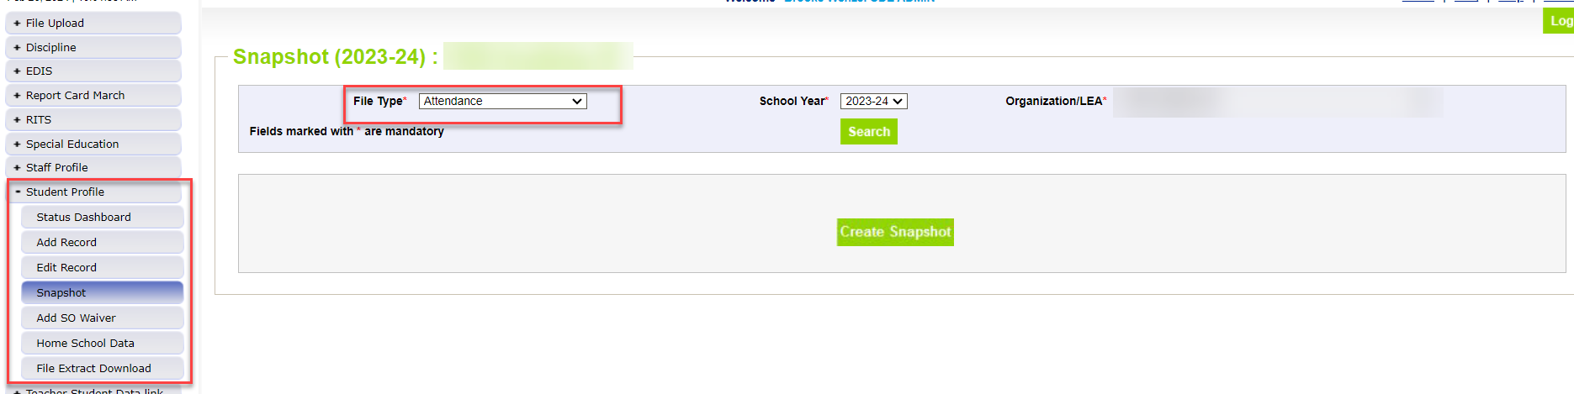
Creating Attendance Snapshot
Attendance Snapshot is located under Student Profile
  Select Student Profile then Snapshot
  Fill out prompts for Attendance (File Type: Attendance, School Year: 2024-25, Organization/LEA should auto-fill)
Student Attendance – Peter Hoffman
Attendance@cde.state.co.us

Slide 18
Attendance Training
2024-2025 Collection Overview
May 7th, 2025
10:30a.m.-12:00p.m.
Registration can be found on the Attendance Website or click here to register.
Student Attendance – Peter Hoffman
Attendance@cde.state.co.us

Slide 19
Questions & Resources:
Student Attendance
Peter Hoffman
Attendance@cde.state.co.us
720-925-8611
Attendance Webpage
Student Interchange Webpage

Slide 20
Teacher Student Data Link
Peter Hoffman

Slide 21
2024-2025 TSDL Timeline
Date | Event | Event Description
Friday, May 16, 2025 | Interim Deadline | TARGET: Date by which you should have uploaded the TSDL Upload interchange file at least once
Friday, June 13, 2025 | Interim Deadline | TARGET: Date by which the TSDL Upload interchange should be uploaded and error free.
Friday, June 27, 2025 | Interim Deadline | TARGET: Date by which the TSDL snapshot should be created at least once.
Friday, August 22, 2025 | Interim Deadline | TARGET: Date by which you should have a complete Teacher Student Data Link Snapshot. Complete Teacher Student Data Link Snapshot means: All TSDL interchange errors are resolved All TSDL snapshot errors are resolved If you anticipate that you will not be able to meet this deadline, please contact CDE at TeacherStudentDataLink@cde.state.co.us
Monday, August 25, 2025 – Thursday, August 28, 2025 | Report Review | Final Snapshot Report Review – This is your opportunity to review reports in detail and make any data corrections you deem necessary to make sure you are reporting valid and reliable data. All data corrections must be completed during this time.
Friday, August 29, 2025 | Deadline | Required to have TSDL snapshot error free and finalized before or on this date. TSDL closed and final report is signed and provided to CDE via email TeacherStudentDataLink@cde.state.co.us
Teacher Student Data Link
TeacherStudentDataLink@cde.state.co.us

Slide 22
TSDL Tips / Common Questions
What should I do for classes where the Educator is out of state or a college professor?
  If the school has an educator who is "responsible" for the class (ie a concurrent enrollment class) please use their information. Otherwise leave the Educator of Records field blank.
  For the SCED code, find the one that best matches your local course description or utilize the "general" code that each subject area has.
Please make sure that the Local Course Title field does not contain any commas as this will cause columns to shift and prevent upload into data pipeline.
Please ensure that all expected classes are being included in your extract (all core, computer science, and AP courses for students grades 6-12, all courses for migrant students grades 8-12). If not, either ensure that the courses are selected to be included in state reporting or reach out to your SIS vendor to update your TSDL extract logic.
Teacher Student Data Link – Peter Hoffman
TeacherStudentDataLink@cde.state.co.us

Slide 23
TSDL Training Now Posted
PowerPoint and Recording from Training on 4/23 can be found on the Teacher Student Data Link Website.
Teacher Student Data Link – Peter Hoffman
TeacherStudentDataLink@cde.state.co.us

Slide 24
Questions & Resources:
TSDL
Peter Hoffman
720-925-8611
TeacherStudentDataLink@cde.state.co.us

Slide 25
Student Interchange
Reagan Ward

Slide 26
2024-2025 Remaining Key Dates
Date | Event | Event Description
05/01/2025 | Adjustment File | Adjustment File opens (supports Student End of Year collection)
05/09/2025 | Interim Deadline | Upload initial end of year interchange files (DEM, SSA, GG) *Upload date of 04/01/2025 or later expected to meet this interim deadline
06/11/2025 | Interim Deadline | Error free interchange files (DEM, SSA, GG)
05/21/2025 | Connected Collection | Assessment SBD: PSAT/SAT Collection Deadline
05/28/2025 | Connected Collection | Assessment SBD: CMAS/COAlt Collection Deadline
06/04/2025 | Connected Collection | Assessment SBD: Dynamic Learning Maps Collection Deadline
06/13/2025 | Connected Collection | READ Spring Assessments: Submission Deadline
07/11/2025 | Connected Collection | Student Attendance: Snapshot Submission Deadline
07/31/2025 | Connected Collection | Student Discipline: Snapshot Submission Deadline
08/01/2025 | Connected Collection | Special Education Discipline: Submission Deadline
08/29/2025 | Connected Collection | Teacher/Student Data Link: Snapshot Submission Deadline
09/04/2025 | Connected Collection | Student End of Year: Snapshot Submission Deadline (Regular Phase)
10/03/2025 | Connected Collection | Special Education End of Year: Submission Deadline
10/16/2025 | Connected Collection | Student End of Year: Snapshot Submission Deadline (Cross LEA Phase)
12/02/2025 | Connected Collection | Student End of Year: Final Deadline (Post-Cross LEA Phase end 11/18, sign-off due 12/02)
12/02/2025 | Closed | Student Interchange 2024-2025 Closes with the end of the Student End of Year collection
Student Interchange
StudentEndOfYear@cde.state.co.us

Slide 27
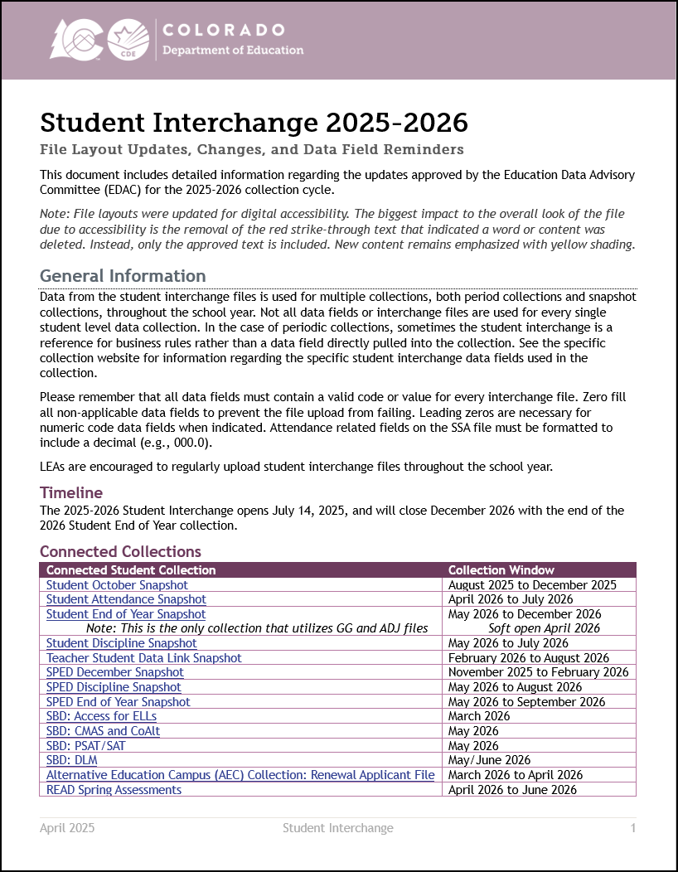
2025-2026 Changes Overview
Student Interchange 2025-2026 Updates and Changes (PDF)
  Additional Resource (All Collections): 2025-2026 Data Pipeline Collection Updates Overview (PDF)
Includes expanded information for LEAs regarding 2025-2026 Student Interchange updates
  New/Removed data fields
  Coding pattern examples for new school entry/exit type codes
  Planned business rule updates
  Reminders for existing data fields based on frequently asked questions
Student Interchange
StudentEndOfYear@cde.state.co.us

Slide 28
Questions & Resources:
Student Interchange
Student Interchange Website
2024-2025 Exception Requests: StudentEndOfYear@cde.state.co.us
2025-2026 General Questions: StudentEndOfYear@cde.state.co.us
Additional Support:
Attendance@cde.state.co.us and StudentOctober@cde.state.co.us

Slide 29
Student End of Year
Reagan Ward

Slide 30
SEY Collection Timeline
Date | Event | Event Description
5/1/2025 | Open | Collection officially opens. Districts may create snapshots Adjustment (ADJ) interchange file opens.
5/9/2025 | Interim Deadline | Upload the initial end of year interchange files – DEM, SSA, GG, TT1 (targeted assistance schools only) Districts are expected to have an upload date 04/01/2025 or later for each file to meet this interim deadline
5/13/2025, 10:30-11:30am | Training Event | May SEY Office Hours: May SEY Office Hours Registration
5/29/2025 | Interim Deadline | Create initial SEY snapshot
6/10/2025,10:30-11:30am | Training Event | June SEY Office Hours: June SEY Office Hours Registration
6/11/2025 | Interim Deadline | Error free interchange files – DEM, SSA, GG, TT1
7/15/2025,10:30-11:30am | Training Event | July SEY Office Hours: July SEY Office Hours Registration
7/31/2025 | Interim Deadline | Submit any necessary reporting exceptions for review School level errors will be processed beginning on this date (SE181, SE182, SE183, etc.)
8/12/2025, 10:30-11:30am | Training Event | August SEY Office Hours: August SEY Office Hours Registration Topic—Reviewing Reports and Data Validation
8/14/2025 | Interim Deadline | Error free SEY snapshot
8/14/2025 to 9/4/2025 | Report Review | Validate SEY data using CEDAR/COGNOS reports.
9/4/2025 | State Deadline | Submit SEY snapshot
9/5/2025 to 9/17/2025 | Closed | SEY Snapshot is closed until the start of the Cross LEA phase
9/18/2025 to 10/16/2025 | Cross LEA Phase | See the SEY Website for the detailed timeline
10/23/2025 to 11/18/2025 | Post-Cross LEA Phase | See the SEY Website for the detailed timeline
12/2/2025 | Deadline | Superintendent Verification (Sign-Off) form due. Collection Closes.
Student End of Year
StudentEndOfYear@cde.state.co.us

Slide 31
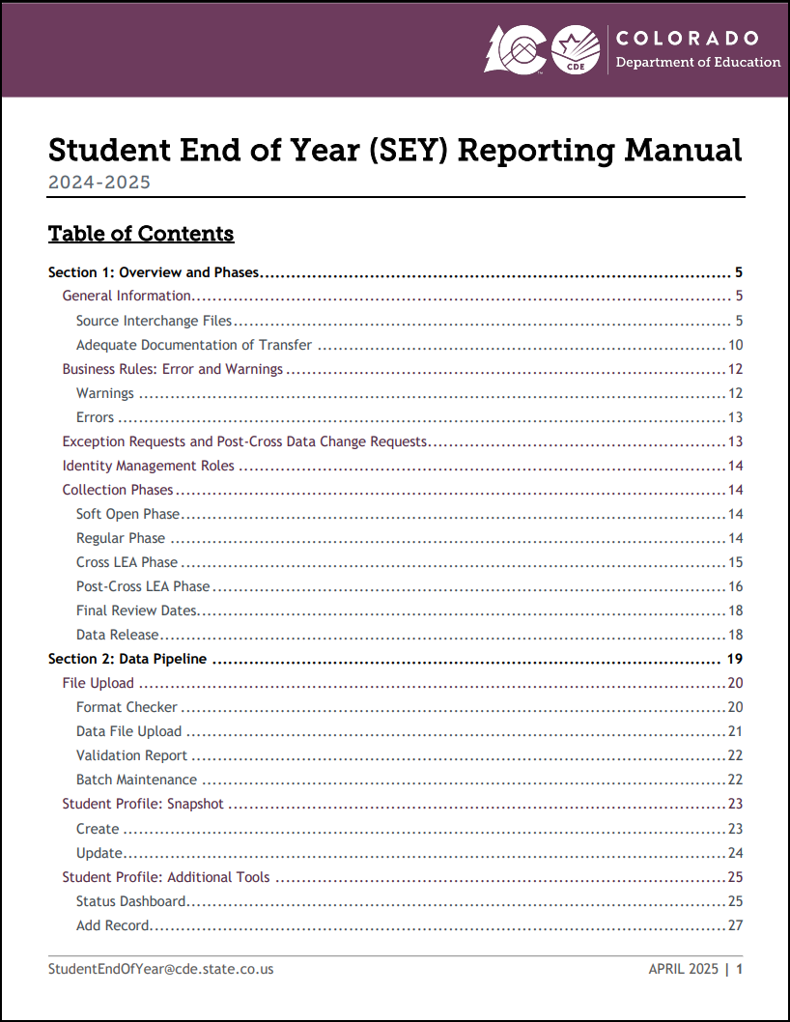
Critical Training Resources
SEY Collection Manual (PDF)
  Section 1: Overview and Phases
  Section 2: Data Pipeline
  Section 3: CEDAR/COGNOS Basics
    See SEY CEDAR/COGNOS Guide for detailed information
  Section 4: Syncplicity and PII
  Section 5: Common Coding Patterns
  Section 6: Frequently Asked Questions
  Section 7: SEY Data Use and Privacy Guidelines
Collection Overview Training
  Collection Overview Recording
  Collection Overview Slides (PPT)
Collaborative Webinar: SPED Transition
  Secondary Transition Recording
  Secondary Transition Slides (PPT)
Registration for monthly SEY Office Hours is available on the SEY Website
Student End of Year
StudentEndOfYear@cde.state.co.us

Slide 32
Questions & Resources:
Student End of Year
StudentEndOfYear@cde.state.co.us
720-484-9057
  Student End of Year Collection Website
  Student Interchange Website
  Graduation Guidelines (Program) Website

Slide 33
Assessment SBD Reviews
Leon Merker

Slide 34
Introductions
Leon Merker
  SBD Collection Lead, Primary SBD support
  Merker_l@cde.state.co.us
Jasmine Carey
  Back up SBD Collection Lead, SBD support
  Carey_j@cde.state.co.us
Assessment SBDs
sbdsupport@cde.state.co.us

Slide 35
Student Biographical Data (SBD) Timeline
SBD Collections
  There are four collections, one for each assessment vendor
    ACCESS for ELLs is complete!
  Details are in the Periodic Collections on the Data Pipeline page
    Timelines are subject to change; please make sure you have users in each collection group to receive emails about the specific collection
Assessment and Collection Page Link | Data Pipeline Group | SBD Review Window
Colorado PSAT/SAT | SAT | May 13 – 21, 2025
Colorado Measures of Academic Success (CMAS): Mathematics, ELA, CSLA, Science and Social Studies Colorado Alternate (CoAlt): Science and Social Studies | CMS | May 15 – 28, 2025
Colorado Alternate (CoAlt): English Language Arts and Mathematics (Dynamic Learning Maps) | DLM | May 28 – June 4, 2025
Assessment SBDs
sbdsupport@cde.state.co.us

Slide 36
SBD Training Webinar
SBD Training Webinar
May 6th at 2
The Teams link was provided in an email sent to all current Data Users for each collection. If there were no registered users in a district, then emails were sent to the District Assessment Coordinator.
The training slides and recorded webinar will be posted on the periodic collection website after the training.
Assessment SBDs
sbdsupport@cde.state.co.us

Slide 37
Preparing for SBD
  Download and review the documentation on the Data Pipeline Collection Pages
    File Layout – describes the data collected and gives directions on how they should be filled out
      SBD Manual – if you have never done an SBD review, please review the step by step section of the manual before you start working on the collection
      Business Rules
      Failsafe Template (if needed to move a student to another district)
  Attend the training webinar, review the training powerpoint, or watch the training webinar once posted
  Make sure you have the appropriate groups in IDM and have at least one district data respondent with the LEA Approver role for each collection
    Remove users who are no longer with your district
Assessment SBDs
sbdsupport@cde.state.co.us

Slide 38
Changes to the collections for 2025
Change details are in the layouts
  CMAS and DLM changes are only in valid values for Invalidation Codes
  SAT layout has been changed
    No Pre-ID District and School
    Responsible District and School reflect the student’s registration during testing and cannot be changed in SBD
      It will never be blank going forward and any student moves will need to be done using a failsafe process like CMAS
Assessment SBDs
sbdsupport@cde.state.co.us

Slide 39
Questions & Resources:
Assessment SBDs
Contact SBD Support with any questions:
Email: sbdsupport@cde.state.co.us
Phone: 720.696.0185
Please do not use the general CDE Help Desk!
Remember not to send PII by email or on voicemail because an email will be autogenerated.

Slide 40
Special Education Discipline
Lindsey Heitman

Slide 41

Special Education Discipline Snapshot
Timeline and Annual Training
March 15th – Discipline Interchange opened
May 1, 2025 - SPED Discipline Snapshot opens
May 9, 2025 - All Interchange files that feed into snapshot uploaded or updated at least once
June 26, 2025 - Interchange errors resolved – Discipline Action File, Child File, Participation File and at least one snapshot taken
July 24, 2025 - All Exception requests submitted to CDE processing
July 25, 2025 - Snapshot error-free
July 25 – Aug. 1, 2025 - Report Review and final submission
Friday Aug. 1, 2025 - Final Submission due to CDE
  Upcoming Training
  Special Education Discipline Annual Snapshot Training
    Tuesday May 6th 10:00 – 11:30
      Overview of the snapshot data required and process in Data Pipeline
      Join the meeting now
  Student Discipline Office Hours
    Monday May 12th 10:00 – 10:45
    Monday June 9th 10:00 – 10:45
      Student or Sped Discipline reporting questions
      Join the meeting now
Special Education Discipline – Lindsey Heitman
SpedDiscipline@cde.state.co.us

Slide 42
Special Education Discipline Snapshot
2024–2025 Changes
Discipline Interchange – Discipline Action file
January 2025 – adjusted file layout to include restraint and seclusion records that had no discipline
  These records are now included in the Discipline Action file with:
      Behavior Type = 00
      Discipline Action = 00
      Sped Removal Type = 00
  Please report a separate record if a Discipline Action was associated with an incident that also involved restraint or seclusion
Special Education Discipline Snapshot
2024-2025 change - added an existing field from the Discipline Action File to this snapshot
  The ‘Behavior Type’ field has been added to the Special Education Discipline Snapshot for analyzation purposes
  This is a change made on the CDE programming side; no changes are needed by your vendor for this change
Special Education Discipline – Lindsey Heitman
SpedDiscipline@cde.state.co.us

Slide 43
Special Education Discipline
Collection Process Review
Discipline Interchange Note:
  The data in the Discipline Action File will be used in both the Student Discipline Snapshot (District responsibility) and the Special Education Discipline Snapshot (AU responsibility).
District Respondents (DIS User Role) – upload and validate Discipline Action file for their district
  Updated 24-25 file layout is found on the Discipline Interchange webpage under the File Layout and Definitions section.
  file should include all students who were disciplined, restrained, or placed in seclusion between 7/01/2024 – 6/30/2025.
AU Respondents (SPI Role) – create Special Education Discipline Snapshots
  Communicate with District (DIS role) respondent on file upload/errors status
    Use cognos District Activity Report to confirm status
  Clear SPED Discipline Snapshot errors
    changes to clear these errors will be needed in either the Discipline Action, Student SSA or DEM, or Sped Participation Files
  Approve and submit final SPED Discipline Snapshot to CDE
Special Education Discipline – Lindsey Heitman
SpedDiscipline@cde.state.co.us

Slide 44
Questions & Resources:
Special Education Discipline
Lindsey Heitman
SpedDiscipline@cde.state.co.us
Discipline Interchange Webpage
Special Education Discipline Snapshot Webpage

Slide 45
Special Education End of Year
Lindsey Heitman

Slide 46

Special Education End of Year:
Timeline and Training
2024-2025 Special Education EOY Snapshot Timeline
  Upcoming Training
  Sped EOY Annual Training Webinar
  Tuesday May 13th - 1:00 – 2:30
  Join the meeting now
  Office Hours TBD
May 1, 2025 - SPED EOY Snapshot official open
June 26, 2025 – IEP Interchange files error-free
September 4, 2025 - Exception requests submitted to CDE
September 11, 2025 – All errors resolved at snapshot/interchange
September 12 -19, 2025 -Initial Report Review
September 22 - 26, 2025 – Resolving duplicates
September 29 – October 1, 2025 – Final Report Review
October 3, 2025 - Final submission due to CDE
Special Education EOY – Lindsey Heitman
SpedEndofYear@cde.state.co.us

Slide 47
Special Education EOY
Reporting Period
The Special Education End of Year reporting period is July 1,2024 through June 30, 2025.
  The purpose of this snapshot is to obtain data on students who were referred, evaluated, and/or received special education services in your AU at any point during the reporting period.
All Users:
Please update your Child and Participation files with a SPED EOY reporting focus now
Enrich Users:
Be sure you are selecting the EOY 24-25 option for your Child and Participation files.
Check collection parameters under collection settings to be sure it shows the full collection period of 07/01/24 – 06/30/2025.
Special Education EOY – Lindsey Heitman
SpedEndofYear@cde.state.co.us

Slide 48
Special Education EOY:
Please Report All Students Who:
Received services in your Administrative Unit (or a detention center within your AU) at any point during this reporting period (July 1-June 30)
Had an initial evaluation for Part B services:
  were 2.5 but not 4 years old when they were referred from Part C (early intervention services) to Part B (path 2)
  were referred for a Part B special education Initial Evaluation (path 3)
Were placed in an Allowed Eligible Facility and you are the Administrative Unit of residence
Were detained at a Detention Center located within your AU boundaries
Were on an IEP and received services at a private school on a tuition basis or parentally placed in a private school, have an ISP and receive Sped services from the AU
*more specific details on who should be reported can be found on the Special Education EOY Data Content Guide pages 1 and 2. Posted here under Additional Resources: http://www.cde.state.co.us/datapipeline/snap_sped-eoy

Slide 49
Questions & Resources:
SPED End of Year
Lindsey Heitman
SpedEndofYear@cde.state.co.us
Special Education IEP Interchange Webpage
Special Education End of Year Snapshot Webpage

Slide 50
Student Discipline
Carrie Martin

Slide 51
Student Discipline
Collection Timeline
Date | Event | Event Description
3/01/2025 | Open | Discipline Action Interchange Open
5/06/2025 | Open | Student Discipline Snapshot Open
5/06/2025 | Interim Deadline | Upload Student Discipline Interchange file at least once
5/09/2025 | Interim Deadline | Update and upload Student Interchange files: Student Demographics and Student School Association Districts are expected to have an upload date of 4/1/25 or later to meet this interim deadline
5/09/2025 | Interim Deadline | Upload Student Discipline Interchange file at least once
6/11/2025 | Interim Deadline | Error free Student Demographics and Student School Association Interchange files
6/21/2025 | Interim Deadline | Create at least one student discipline snapshot
7/08/2025 | Interim Deadline | Student Discipline Snapshot records error free
7/08-7/26/2025 | Report Review | LEAs should use this time to review reports prior to the deadline. Typically, one week prior to the deadline.
7/31/2025 | State Deadline | All LEAs must have a Student Discipline Snapshot submitted in Data Pipeline
8/9/2025 | State Deadline | Signature page emailed to Student Discipline Snapshot
8/31/2025 | Data Release | Data published
StudentDiscipline@cde.state.co.us

Slide 52
Business Rule Updates
Discipline Action File
  Error DA019-Discipline Start Date must be between July 1st and June 30th of the current school year. If Discipline Start Date is accurate, please refer to the Exception Request Instructions.
  Error DA043-Date of Incident must be between July 1st and June 30th of the current school year. If Date of Incident is accurate, please refer to the Exception Request Instructions.
    Exception Request Template and Exception Request Instructions will be added to website
  Error DA076 is now a Warning-If Behavior Type is 00 or 17-43, Discipline Action Type should be 00. The Discipline Action for this incident should be reported in a separate record with a corresponding state reportable Behavior Type 01-16.
    NOTE: In 2025-2026 the Discipline Action Type must be 00 for Behavior Types 17-43
Student Discipline Snapshot Collection
StudentDiscipline@cde.state.co.us

Slide 53

Office Hours
  Student Discipline Office Hours
    Monday May 12th 10:00 – 10:45
    Monday June 9th 10:00 – 10:45
      Student Discipline reporting questions
Student Discipline Snapshot Collection
StudentDiscipline@cde.state.co.us

Slide 54
Questions & Resources:
Student Discipline
Student Discipline Snapshot Site
Student Discipline Snapshot Timeline
Discipline Interchange Website
Discipline Action File Layout
StudentDiscipline@cde.state.co.us
Carrie Martin-Collection lead
(720) 665-4456

Slide 55
Prevent Harassment or Discrimination Collection
(PHD Collection)
Carrie Martin

Slide 56
Prevent Harassment or Discrimination
Collection Timeline
Date | Event | Event Description
4/30/2025 | Interim Deadline | LAMs ensure PHD respondent is assigned
5/1/2025 | Official Open | PHD Collection Open
5/12/2025 | Training | Prevent Harassment or Discrimination Training, Register
6/5/2025 | Interim Deadline | Upload Prevent Harassment or Discrimination File at least once
7/3/2025 | Interim Deadline | Error free Prevent Harassment or Discrimination File
7/7-7/25/2025 | Report Review | LEAs should use this time to review reports prior to the deadline. Typically, one week prior to the deadline.
8/1/2025 | State Deadline | PHD Collection Closes- All LEAs must have Prevent Harassment or Discrimination submitted in Data Pipeline.
8/8/2025 | State Deadline | Signature page emailed to Prevent Harassment or Discrimination
PHD Collection
PreventHD@cde.state.co.us

Slide 57
Prevent Harassment or Discrimination User Roles
LAMS – Please ensure someone in your district has one of these roles assigned in Identity Management (IdM)
PHD~LEAVIEWER
PHD~LEAUSER - Recommended
PHD~LEAAPPROVER - Recommended
Each user is assigned only one role, or they will encounter errors when trying to login to Data Pipeline.
We will be communicating periodically throughout the collection with the data respondents.
Prevent Harassment or Discrimination Collection
PreventHD@cde.state.co.us

Slide 58
Business Rule Update
Prevent Harassment or Discrimination File
  Error PH024-No incidents have been reported for this school. If this is accurate, please refer to the Exception Request Instructions.
    Exception Request Template and Exception Request Instructions will be added to website
  Error PH028-Bias type no bias cannot be zero when all other biases are zero. Must select a bias for the record.
    In other words, if the investigation determined a bias was found, at least one bias type must be selected
Prevent Harassment or Discrimination Collection
PreventHD@cde.state.co.us

Slide 59
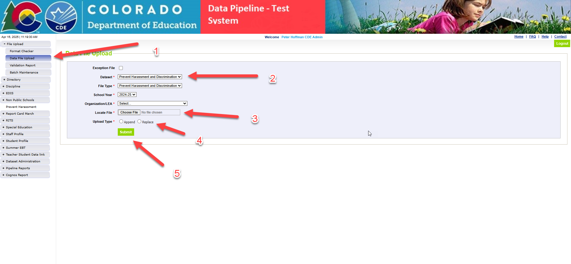
Prevent Harassment or Discrimination
Quick Reference
Steps
1. Login to Data Pipeline
2. Select File Upload
3. Select Data File Upload
4. Complete the Dropdown menus, indicating the specific file you are uploading.
  Dataset: Prevent Harassment and Discrimination
  File Type: Prevent Harassment and Discrimination
  School Year: Current School Year
  Organization/LEA: Your district
  File Name: Choose File → Select file from your computer
    .csv, .xls, .xlsx (.xlsx is preferred)
    Spaces are not allowed in the file name
  Upload Type = Append or Replace
    Relace is recommended
5. Select Submit
Prevent Harassment or Discrimination Collection
PreventHD@cde.state.co.us

Slide 60
Prevent Harassment or Discrimination
Collection Training
  PHD Collection Training
    Monday May 12th 1:00 – 2:00
      Register
Prevent Harassment or Discrimination Collection
PreventHD@cde.state.co.us

Slide 61
Prevent Harassment or Discrimination
Questions & Resources
Prevent Harassment or Discrimination Site
PHD File Layout, PHD Business Rules, PHD Training Manual,
Prevent Harassment or Discrimination Fact Sheet
PreventHD@cde.state.co.us
Carrie Martin-Collection lead
(720) 665-4456
Additional Resources and CDE contacts for Harassment, Discrimination, Title IX, and Bullying
Prevention of Harassment, Discrimination, and Bullying in Colorado Schools Site

Slide 62

Thank you for Joining Today!
Next Town Hall will be May 8th
Reminder:
LAMs, please review your IdM users to ensure accurate permissions for data respondents in your district. Deactivate users who no longer oversee a data collection in your district.

